Slide 1
Statistical Framework for Semantic Similarity
Searching on Biological Data
Authors: Dr. Prashanti Manda, Assistent Professor UNCG

Slide 2
Purpose of the research
What is the main idea of the project
Semantic similarity introduction

Slide 3
Semantic similarity intro

Slide 4
Data description
~12,000,000 rows
Taxon profiles along with their sizes
Gene profiles along with their sizes
For each pair Taxon profile size-Gene profile size, their Overall Similarity
We used Random Simulated data and Real data

Slide 5
Data description

Slide 6
Data manipulation
-average similarity scores-
For each pair (gene size, taxon size) we computed the average score
Why? - in order to manipulate data easily and have clearer view of how the data looks; multiple pairs genes and taxons with same profile sizes have same similarity scores.

Slide 7
Data manipulation
-log & box cox transformation-
On all 3 fields, we applied:
Log transformations.
Why? - get all values into certain intervals
Box Cox - power transformation.
Why? - useful data transformation technique used to stabilize variance, make the data more normal distribution-like.

Slide 8
Methods to analyze data
Multiple linear regression
Dependent fields: Average similarity score
Independent field: Taxon profile size, Gene profile size
2 approaches:
OLS (ordinary least squares)
WLS (weighted least squares)

Slide 9
Methods to analyze data
Gene size, Taxon size, avg sem similarity
(5 versions)
OLS
Log Gene size, Log Taxon size, avg sem similarity
WLS
WLS
Log Gene size, Log Taxon size, Log avg sem similarity
box cox Gene size, box cox Taxon size, avg sem similarity
box cox Gene size, box cox Taxon size, box cox avg sem similarity

Slide 10
Multiple linear regression-Results
OLS results
Data | R squared
gene, taxon, avg score
loggene&taxon, avg score
log all 3
Boxcox gene&taxon, avg
boxcox all 3
WLS results
Data | R squared
gene, taxon, avg score
loggene&taxon, avg score
log all 3
Boxcox gene&taxon, avg
boxcox all 3

Slide 11
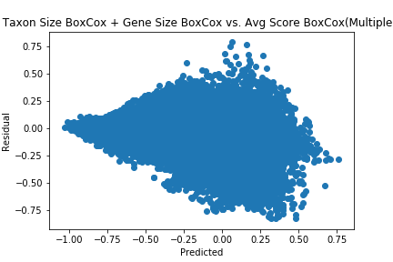
Results
-WLS boxcox all-

Slide 12
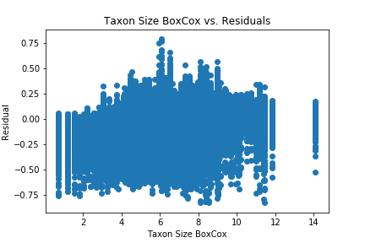
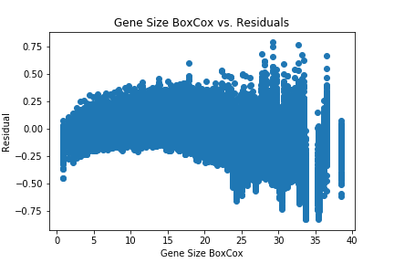
Results
-WLS boxcox all-

Slide 13
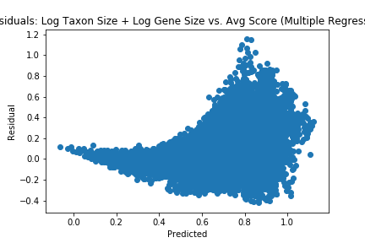
Results
-WLS log gene size, taxon size-

Slide 14
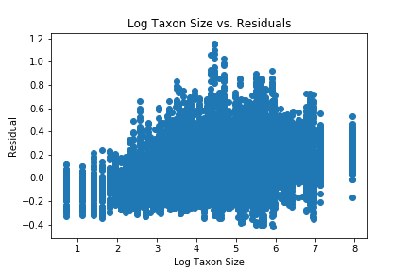
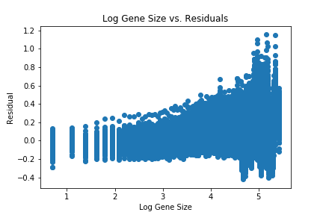
Results
-WLS log gene size, taxon size-

Slide 15
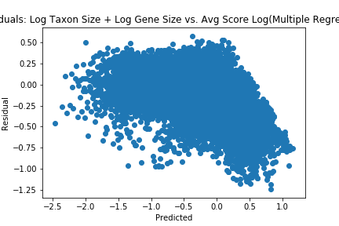
Best Results
-WLS log all-

Slide 16
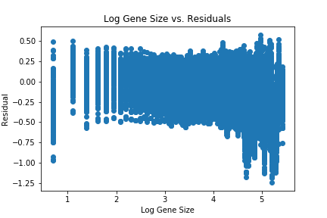
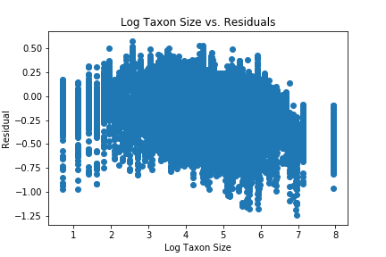
Best Results
-WLS log all-

Slide 17
Methods to analyze data
-computing z value and p value-
Formula used for z value
z = (observed value – predicted value)/standard deviation
const = -2.903170
coefficient taxonLog = 0.252263
coefficient geneLog = 0.378430
Formula used for p value
p = 1 – exp(-e…….)

