Slide 1

Upgrade to Java SE 8 Programmer (Oracle Beta Exam #1Z1-810)
2015 Olivier Dupuy with some
invaluable help from

Slide 2
List of topics
Lambda Expressions (JSR 335)
Using Built in Lambda Types
Filtering Collections with Lambdas
Collection Operations with Lambda
Parallel Streams
Lambda Cookbook
Method Enhancements
Use Java SE 8 Date/Time API
JavaScript on Java with Nashorn

Slide 3
Recommended reads (web)
Java 8 in action (book *****) [J8IA]
Java 8 API
java.util.function API and Javadoc [JUFAPI], Java 8 java.util.stream API [JUSAPI]
Java 8 Stream Javadoc [JDStream], of Spliterator [JDSpliterator]…
Java 8 launch videos
Brian Goetz (Java Language Architect, Oracle, lambda spec lead) expert group summaries and drafts (*****)
State of the Lambda: Libraries Edition (04/2012) [historical] [BGSLLE1]
State of the Lambda: Libraries Edition (11/2012) [historical] [BGSLLE2]
Translation of Lambda Expressions (04/2012)
State of the Lambda (11/2013) [final] [BGSL] (good summary)
State of the Lambda: Libraries Edition (09/2013) [final] [BGSLLE3] (good summary)
State of the Specialization Proto Edition (12/2014) (Java 9?)
One final stab at improving lambda serialization (08/2013) [BGLS]
ClassDynamic (06/2014) (Java 9?)
Java 8 certification books (Amazon)
Java 8 language and VM specifications
Java 8 Programmer II beta upgrade exam 1Z1-810 (from Java 7 programmer)
Java 8 Programmer II final upgrade exam 1Z0-810 (from Java 7 programmer) (no topic change)
Java 8 Programmer II beta exam 1Z0-809 (from Java 8 associate)
Upgrade to Java SE 8 OCP ( Java SE 6 and all prior versions) beta exam 1Z0-813
Java SE 7 new features (Oracle course)
Java SE 8 new features (Oracle course)
Java Programming Language Enhancements (history from 1.0 to 1.8)
Sun Certified Java Programmer X (McGraw-Hill) (book) [SCJP7]
Java lambda FAQ (Mastering lambdas book available from the same author)
Sample questions for the certification from Oracle (some paragraphs in the slides are copied from the API and from B.Goetz)

Slide 4
Approximate breakdown of the 126 questions in the beta exam
Anonymous classes: 10%
Optional<T> 10%
Collection enhancements (computeIf(), forEach(), replaceAll(), merge()…): 15%
Files methods (walk(), find()…): 5%
Functional interfaces, lambdas (may include capturing questions?): 10%
Streams: 40% (75% sequential, 25% parallel)
Date/Time API including daylight savings time changes: 5%
JavaScript on Java with Nashorn (Java to/from JS): 5%
Advanced stream questions (Spliterator, ordered streams, exception in a stream, Stream and Collector characteristics…): None!!!
Questions with code sample (they never fit the screen!!!) vs theoretical: 90-95% to 5-10%
Questions with an “exhibit” button to see the code in a window: 0%
Multiple choices (2 or 3) vs single choice: 20% to 80%
Write your own code: 0%
Drag and drop code blocks questions: 0%
Poorly written questions (would not even compile…): 0%
Many questions have a few ellipsis lines (getters and setters go here…)

Slide 5
Exam preparation and experience
Jeanne Boyarsky (CodeRanch marshal and co author of OCA 8 book)
How do you manage your time during the exam?
How do you block out distractions during the exam?
What do you write down during exams?
Java 8 upgrade experience
Code ranch: Java 8 Certification - Oracle Java SE 8 Upgrade 1Z1-810 Experience
Code ranch: Upgrade to Java SE 8 Programmer (1Z1-810) reports

Slide 6
Topic 0 : Java 7
Before leaving Java 7, do not forget what it brings and put it in action in your code:
fork/join framework and Concurrency utilities (JSR 166)
NIO2
Java XML - JAXP, JAXB, and JAX-WS
Java Programming Language Enhancements (Coin / JSR 334)
Binary Literals
Strings in switch Statements
The try-with-resources Statement
Catching Multiple Exception Types and Rethrowing Exceptions with Improved Type Checking
Underscores in Numeric Literals
Type Inference for Generic Instance Creation

Slide 7
Topic 1 : Lambda Expression
Describe Java inner classes and develop the code that uses Java inner classes (such as: nested class, static class, local class and anonymous classes)
Define and write functional interfaces
Describe a Lambda expression; refactor the code that use anonymous inner class to use Lambda expression; including type inference, target typing

Slide 8
Topic 1-1 : Describe and develop Java inner classes
Describe Java inner classes and develop the code that uses Java inner classes (such as: nested class, static class, local class and anonymous classes)
Read http://docs.oracle.com/javase/tutorial/java/javaOO/nested.html
Read [J8IA] chapter 2.3 and [SCJP7] chapter 12
Watch the video and read the text on this link. TODO do it
Why to use them: encapsulation, grouping, organization, readability.
From the outer class, initialize the instance with InnerClass inner = new InnerClass(); and from the outside with OuterClass.InnerClass inner = outer.new InnerClass();
The inner class has access to the methods and fields of the outer class even if private.
The static inner class has only access to static methods and fields of the outer class. A static class can only be below the outer class, never below an inner class. It can contain itself inner and static classes.
Inner methods and fields of the same name as outer ones “shadow” the outer ones.
“Anonymous class instances” are created where needed w/o declaring a new class name just the class extended or the unique interface implemented. The instance is typically passed in as a parameter of a method requiring it, extending another class or implementing some interface (Runnable, Listener…).
Serialization of inner classes is strongly discouraged due to the use of “synthetic constructs” for the methods (e.g. inner class modified constructor, enum magical methods… try >javap –p org.java8.topic1.subject1.OuterClass$1) not guaranteed to be compatible between compilers.
Inner classes do not support static blocks and methods. Only static final fields are OK. Interfaces are considered like a “static” class for this purpose.
It is impossible to define a local interface, only a local class as the interfaces are like “static classes”.
All the inner classes are compiled as separate class files with the name of the outer class in it e.g. Outer$StaticInner.class, OuterClass$1 (anonymous class), OuterClass$1LocalClass.class…

Slide 9
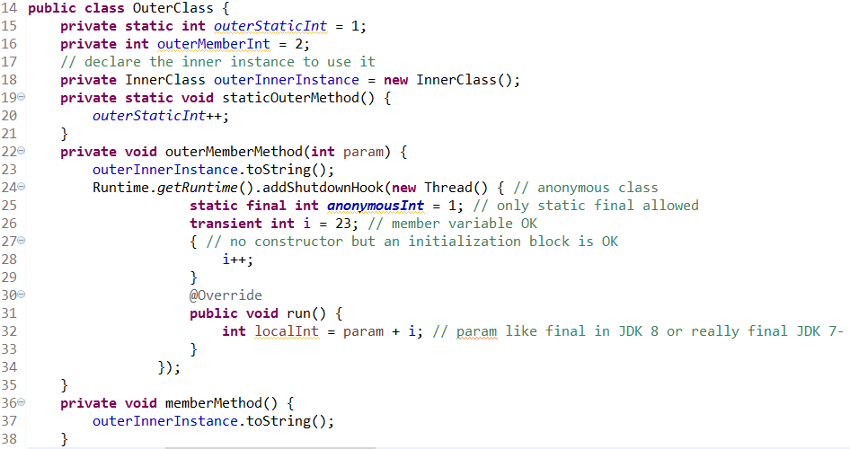
Topic 1-1 : Example 1/3
The ‘thread ‘constructor below is synthetic. Notice how the outer class instance and parameter are passed to the constructor to be saved as member fields. C:\workspace_luna\Java8OCPUpgradeBeta\target\classes>javap -p org.java8.topic1.subject1.OuterClass$1
Compiled from "OuterClass.java"
class org.java8.topic1.subject1.OuterClass$1 extends java.lang.Thread {
static final int anonymousInt;
transient int i;
final org.java8.topic1.subject1.OuterClass this$0;
private final int val$param;
org.java8.topic1.subject1.OuterClass$1(org.java8.topic1.subject1.OuterClass, int);
public void run();

Slide 10
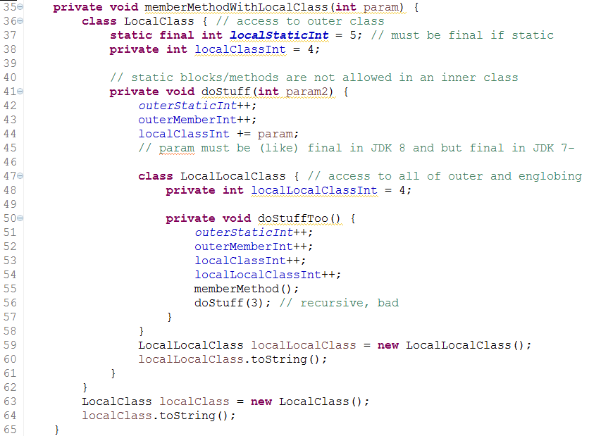
Topic 1-1 : Example 2/3 (continued)

Slide 11
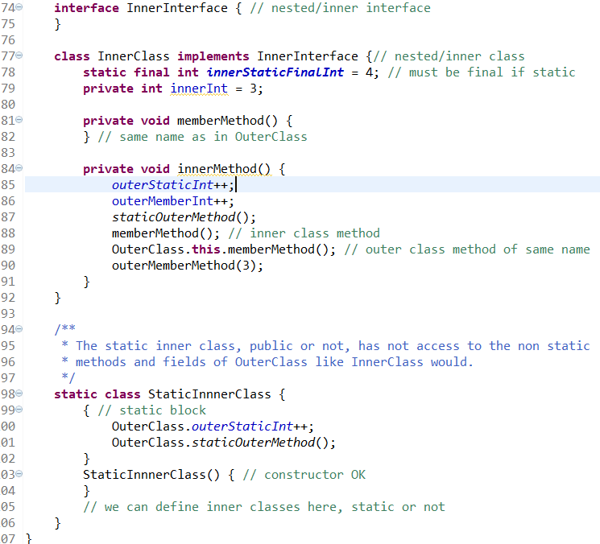
Topic 1-1 : Example 3/3 (continued)

Slide 12
Topic 1-1 : Summary
Class type | Defined inside | Can have static methods or blocks | Can have static fields | Can define its constructors | Can be serializable | Can use outer class member fields and methods | Can use englobing method parameters and local variables | Goal in life or reasons to use one
Outer class | package | yes | yes | 0-* | yes | N/A | N/A | N/A
(member) inner class | outer | no | final only | optional, default w/ the outer instance as a synth parameter | better not | yes | N/A | Grouping, partitioning, adapter, helper, access to outer members while extending another class than outer. Need a constructor or multiple instances or multiple extensions
Inner interface | outer and never in inner | N/A | final only | N/A | N/A | N/A | N/A | Interface used by the inner classes
Static (nested) class | outer and never in inner | yes and even static interf. and classes | final only | optional | yes | No, only static fields and methods | N/A | Like inner but w/o the need to access member fields and methods of outer
Local (inner) class | method or block of any | no | final only | Can choose but not define, default w/ the outer instance and method parameters as synth parameters | better not | yes | Outside of constructor, yes if declared final (JDK7-) and effectively final (JDK8) | Used from a single place. Like the inner class otherwise. Need to access englobing method parameters
Anonymous (inner) class | outer or method of any | no | final only | Can choose but not define, member variables and initialization blocks OK. Default constructor w/ the outer instance and method parameters as synth parameters | better not | yes | Outside of constructor, yes if declared final (JDK7-) and effectively final (JDK8) | Need a single interface. No need for constructor. Not reused in other places. Usually passed in as a parameter of some method call

Slide 13
Topic 1-1 : Q&A
Q: What is a local class?
Q: What is different for nested classes in Java 8 compared to before?
Q: If I do not reuse a nested class what are my choices?
Q: I need to define my own constructor in the nested class, what are my choices?
Q: What is the difference between a nested class and an inner class?

Slide 14
Topic 1-1 : Q&A
Q: What is a local class? A class defined inside a method
Q: What is different for nested classes in Java 8 compared to before? They can access effectively final method parameters and local variables while before they had to be declared as final.
Q: If I do not reuse a nested class what are my choices? An anonymous class or a local class can do. You may prefer an inner class for readability purpose or for unit testing purpose though.
Q: I need to define my own constructor in the nested class, what are my choices? This cannot be an anonymous class (but member variables and initialization blocks are OK!) so a local class or an inner class will do. If there is no need to access the member fields and methods of the outer class, a static inner class is a better choice.
Q: What is the difference between a nested class and an inner class? A nested class (or interface) is defined inside another class (static, inner, anonymous, local). An inner class is below an enclosing class and can access to the outer class member fields and methods. Inner classes are a subset of nested classes. Local classes and anonymous classes are two special kinds of inner classes, the local class being inside a method or block and the anonymous class anywhere. The static class is nested but it cannot access member fields and methods of the outer class. This is the only nested class which include another static class or an interface. Any interface in considered like a “static” class.

Slide 15
Topic 1-2 : Define and write functional interfaces (FI)
New with Java 8, a functional interface (FI) is an interface tagged with @FunctionalInterface [java.lang] and made of a mandatory single abstract (non default, non Object) method called the functional method (FM).
Object methods (toString(), hashCode()…) can be added to it (as abstract for the purpose of documenting some contract but NEVER as default (“A default method cannot override a method from java.lang.Object”)) as well as static methods with their body or default methods with their body. The above methods have no impact on the number of abstract methods of the FI.
The compiler will test any FI (compile check) to respect the above contract, looking up the chain of extended interfaces.
The compiler will treat any interface meeting the definition of a FI as a FI regardless of whether or not a FI annotation is present on the interface declaration.
Note that instances of FIs (tagged or effective) can be created with lambda expressions (topic 1-3) including for these ones method references or constructor references. For an effective one, the compiler will also check for the constraints.
Tagging an interface as @FunctionalInterface shows a design intent versus being a FI by accident and makes it available for lambda substitution. By using the tag, breaking the contract will explicitly create a compilation error.
The FI interface can extend other interfaces as long as the above contract is respected. If it extends multiple interfaces being in practice FIs but all defining the same method (signature) then the interface is still functional.
See JLS 1.8 4.3.2. The Class Object, 9.8 Functional Interfaces, 9.4.3 Interface Method Body
A few existing JDK 8 interfaces below are now a FI. Some other could but were not promoted. Why in your opinion?
java.awt.KeyEventDispatcher java.awt.KeyEventPostProcessor
java.io.FileFilter java.io.FilenameFilter
java.lang.Runnable java.lang.Thread.UncaughtExceptionHandler
java.nio.file.DirectoryStream.Filter java.nio.file.PathMatcher
java.time.temporal.TemporalAdjuster java.time.temporal.TemporalQuery
java.util.Comparator java.util.concurrent.Callable
java.util.function xxxConsumer / xxxFunction / xxxOperator / xxxPredicate / xxxSupplier (java 8)
java.util.logging.Filter java.util.prefs.PreferenceChangeListener

Slide 16
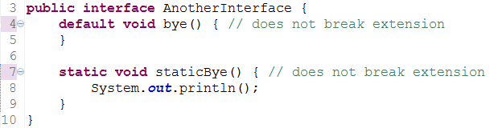
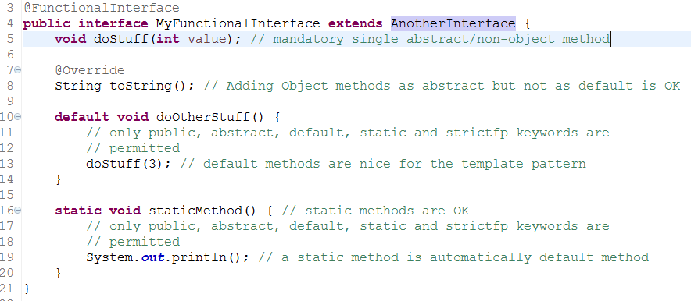
Topic 1-2 : Example

Slide 17
Topic 1-2 : Q&A
What is the official name of the single abstract method of a FI?
Give the names of a few Java 8 interfaces old and new which are now a FI.
Give the name of a few Java 8 interfaces old or new which are a FI in practice.
Give the name of a few existing Java interfaces which cannot be a FI. Explain why.
Give the name of an existing Java interface which cannot be a FI for the opposite reason. Explain why.
If my interface A extends interface B and if A is a FI, how can I break A by modifying B?
What is the impact of default methods and static methods present in the interface on the capacity at being a FI?
My interface A extends the FI B and A is also an effective FI. How come?
In a FI, can you override a method of Object creating a default method for it?

Slide 18
Topic 1-2 : Q&A
What is the official name of the single abstract method of a FI? The functional method (FM)
Give the names of a few Java 8 interfaces old and new which are now a FI. Function, Supplier, Runnable, Comparator
Give the names of a few Java 8 interfaces old or new which are a FI in practice. Observer, Formattable
Give the names of a few existing Java interfaces which cannot be a FI. Explain why. Serializable, EventListener (no method)
Give the name of an existing Java interface which cannot be a FI for the opposite reason. Explain why. List, Iterator, Enumerator (too many abstract methods)
If my interface A extends interface B and if A is a FI, how can I break A by modifying B? By adding an abstract method in B, making 2 abstract methods to implement for any A instance
What is the impact of default methods and static methods present in the interface on the capacity at being a FI? None, you can add tons of them w/o changing the FI aspect.
My interface A extends interface B which is a FI and A is also an effective FI. How come? I have added no abstract method in A or defined a method with the same signature. Adding static or default makes no change. I may have also implemented the abstract method from B making it a default method but added another abstract method keeping the count of abstract methods at one.
In a FI, can you override a method of Object creating a default method for it? No but you can mark it as abstract to highlight a specific contract for this FI or a need to override it in a given way. This also includes finalize(). classFinalize() can be used as a static method of the FI. If you extend an interface and you override a default method (non object) of it, marking is as abstract then you have to implement it in the concrete class.

Slide 19
Topic 1-3 : Lambda expression
Describe a Lambda expression; refactor the code that use anonymous inner class to use Lambda expression; including type inference, target typing
Lambdas: JLS 15.27, J8IA Ch.2, http://docs.oracle.com/javase/tutorial/java/javaOO/lambdaexpressions.html
Target typing: J8IA A2, http://docs.oracle.com/javase/tutorial/java/javaOO/lambdaexpressions.html#target-typing and section 4 http://cr.openjdk.java.net/~briangoetz/lambda/lambda-state-final.html
A lambda is close to an anonymous class/interface instance as it can be used as an parameter of a method call. It can access static and member fields and methods of the outer class the same way. It can also access “constant” method parameters or “constant” local variables. You can consider the lambda code as an anonymous method (w/o a name). We use the arrow notation “->” used in other languages too e.g. (String a) -> a.length();
A lambda is a valid replacement for any FI (declared or implicit) value, this because the lambda code provides one and only one missing abstract method implementation.
Neither the anonymous class nor the lambda can define a constructor but the anonymous class can have initialization blocks (not static). The anonymous class can have member fields, the lambda (method) just local variables. Both can have static final fields (but coming from the interface for the lambda).
A difference is that an anonymous class instance can have static final fields and can implement or override multiple methods while the lambda instance can/must implement a single method (w/o naming it), the functional one defined in the FI, defined or implicit. It can however have multiple statements.
A lambda expression returning a value is a valid substitute for a FI w/ a void return type. If you use the return keyword with an expression, the type must match the single abstract method return type.
You can serialize a lambda expression if its target type and its captured arguments are serializable. However, like inner classes, the (persistent) serialization of lambda expressions is strongly discouraged. [BGLS]
Depending on what the lambda expression uses from the outside, if the line creating it is called again, the same lambda instance will be reused or a new one created.
The lambda code implementing the abstract method of the FI has no access to the default and static methods of the FI. The returned interface has access to all the methods as expected.

Slide 20

Topic 1-3 : A case for lambdas
Often, some very similar code in used in multiple spaces. As an example, the same collections could be sorted, filtered and displayed using different sorts and filters.
To palliate this redundancy, one can be tempted to reuse the common code (iterating the collection, calling a sort, calling a filter) and delegating to custom part to some external code. We talk about either the template mechanism, where a subclass of the abstract one implements the abstract methods (sort, filter) or about delegating sorting and filtering to new classes.
Composition being better (more flexible) than specialization, the delegation is a better choice. For this, we typically extract sorting and filtering to new interfaces, each of them typically doing only one of these operations. TODO example
Then the first move is to create an inner class doing this specialized work.
A better approach if the code is not reused is to use an anonymous class.
In any case, even w/ an anonymous class there is still a lot of boiler plate. (“Well, inner classes suck!”, Brian Goetz, Oracle Java Language Architect)
With lambdas, providing a simple implementation such as a predicate to filter or a sorting/comparing mechanism becomes short and sweet going to the essential.
Moreover, the collection frameworks and the new Stream classes provide a new or better support for such operations (filtering, sorting, doing work on the iterated values…) as seen later.
Name of lambdas and “desugaring”, two types of lambdas:
Not using member variables or this/super: non-instance-capturing lambdas aka non-capturing lambdas (the lambda code becomes a static private method)
Using member variables or this/super: instance-capturing lambdas (the lambda code becomes a member private method)

Slide 21
Topic 1-3 : Comparison anonymous class vs. lambda
Class type | Anonymous class | Lambda (JDK 8)
Inside | any | any
Extends or implements | A single class or a single interface | A single FI
Static methods or blocks | no | no
Static fields | final only | If final ones defined in the interface
Constructors (the capture order matters) | no, default synthetic constructor w/ captured outer and method parameters and local variables as synthetic parameters. Possible non static initialization blocks. Possible static and member variables. | no, default synthetic constructor w/ captured outer and method parameters and local variables as synthetic parameters. No possible initialization blocks. No possible static or member variables but local variables are OK.
Serializable | better not (see Brian Goetz document) | better not
Can use outer class member fields and methods | Yes | Yes. “this” can be used for a “member” lambda but not for a “static” one and only to access the outer object.
Can use englobing method parameters and local variables | Yes if declared final (JDK7-) and effectively final (JDK8) | Yes if declared final or effectively final (called variable capture)
Can have member fields | Yes | No but local variables
Can implement or override multiple methods | Yes | No just implement the single abstract method
Can have its own nested classes | Yes but not static | Yes but not static
Can call the default and static methods of the interface | Yes | No, in the lambda code only the static methods and prefixing them with the interface name. In practice the lambda is like a single method. Outside of the lambda code, the complete interface is available. Static methods of an interface cannot be prefixed w/ the instance name.
Goal in life or reasons to use one | Need a single interface with multiple abstract/overridden methods. No need for constructor. Not reused in other places. Usually passed in as a parameter of some method call | Getting rid of verbose anonymous classes used for FIs. Avoid the proliferation of “classes” with their file. Base for functional programming by encouraging the extraction of the custom behavior. No need reusing the code.
This represents | The anonymous class instance. | The outer class if used inside the lambda expression.

Slide 22
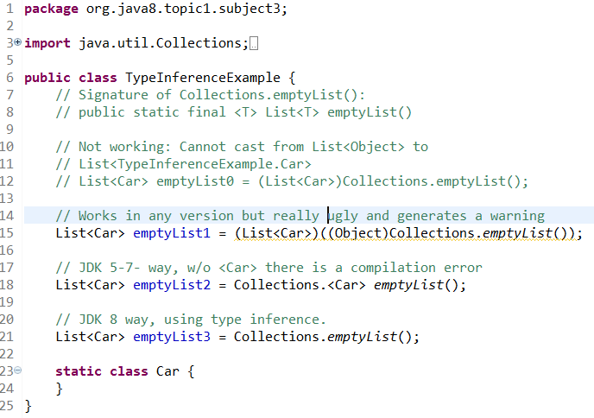
Topic 1-3 : Example of type inference (new in JDK 8)

Slide 23
Topic 1-3 : More on target typing and type inference
From http://cr.openjdk.java.net/~briangoetz/lambda/lambda-state-final.html 4 and 5
Target typing
Of course, no lambda expression will be compatible with every possible target type. The compiler checks that the types used by the lambda expression are consistent with the target type's method signature. That is, a lambda expression can be assigned to a target type T if all of the following conditions hold:
T is a FI type (in practice) as only the code for a single method is provided
The lambda expression has the same number of parameters as T's method, and those parameters' types are the same (or are boxing/unboxing/widening compatible w/o ambiguity)
Each expression returned by the lambda body is compatible with T's method's return type (boxing…) or optionally any value can be returned while the FI functional method is void TODO test strictfp
Each exception thrown by the lambda body is allowed by T's method's throws clause
Context for target typing
The following contexts have target types:
Variable declarations TODO examples
Assignments
Return statements
Array initializers
Method or constructor arguments
Lambda expression bodies
Conditional expressions (?:)
Cast expressions

Slide 24
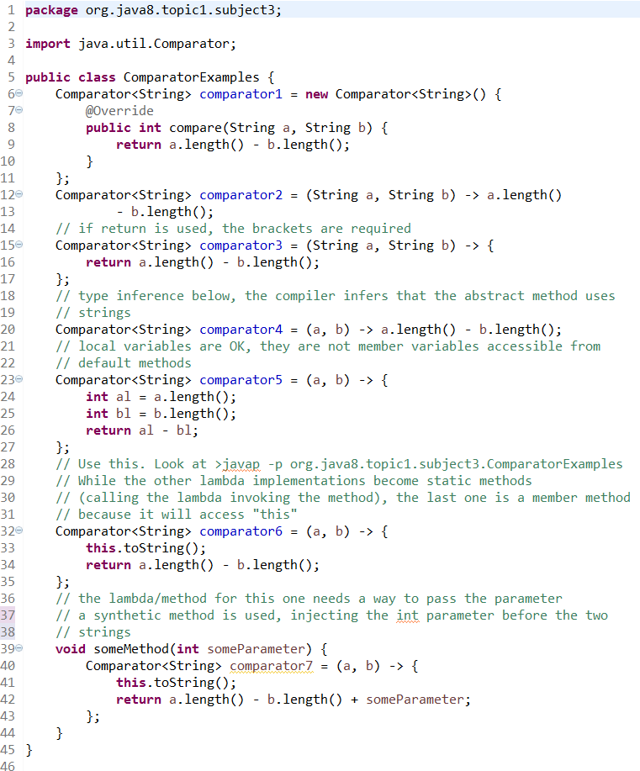
Topic 1-3 : Example from anonymous class to lambda
C:\workspace_luna\Java8OCPUpgradeBeta\target\classes>javap -p
org.java8.topic1.subject3.ComparatorExamples
Compiled from "ComparatorExamples.java"
public class org.java8.topic1.subject3.ComparatorExamples {
java.util.Comparator<java.lang.String> comparator1;
java.util.Comparator<java.lang.String> comparator2;
java.util.Comparator<java.lang.String> comparator3;
java.util.Comparator<java.lang.String> comparator4;
java.util.Comparator<java.lang.String> comparator5;
java.util.Comparator<java.lang.String> comparator6;
// default constructor created for us
public org.java8.topic1.subject3.ComparatorExamples();
void someMethod(int);
// for comparator 2/3/4/5
// notice that it is static as the lambda uses nothing from outside it
private static int lambda$0(java.lang.String, java.lang.String);
private static int lambda$1(java.lang.String, java.lang.String);
private static int lambda$2(java.lang.String, java.lang.String);
private static int lambda$3(java.lang.String, java.lang.String);
// for comparator 6
// notice that it is not static but member as comparator6 uses "this"
private int lambda$4(java.lang.String, java.lang.String);
// for comparator 7
// notice that the method receives an int in addition of the two strings
// this is because comparator7 accesses to the (effectively) final method
// parameter someParameter
private int lambda$5(int, java.lang.String, java.lang.String);

Slide 25
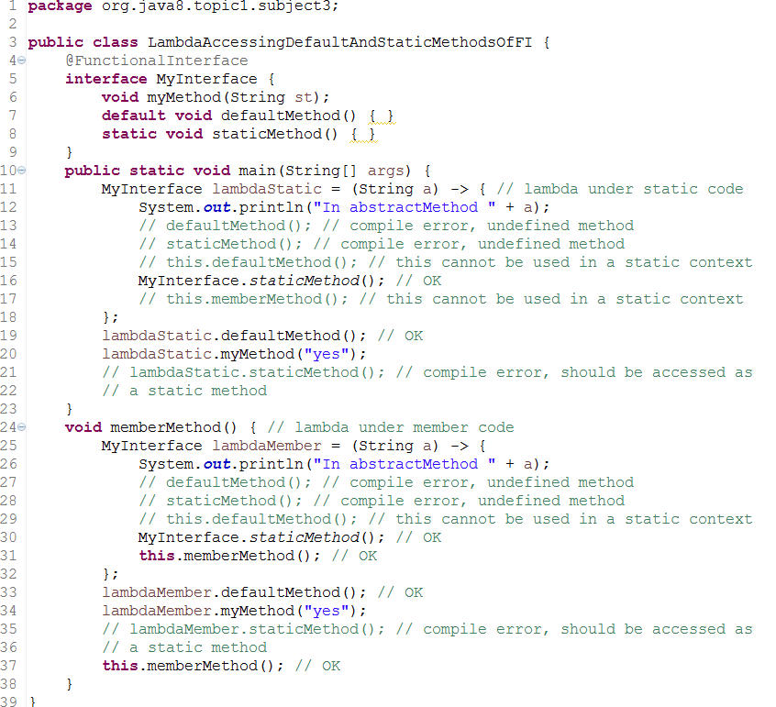
Topic 1-3 : Example of what the lambda code can call

Slide 26
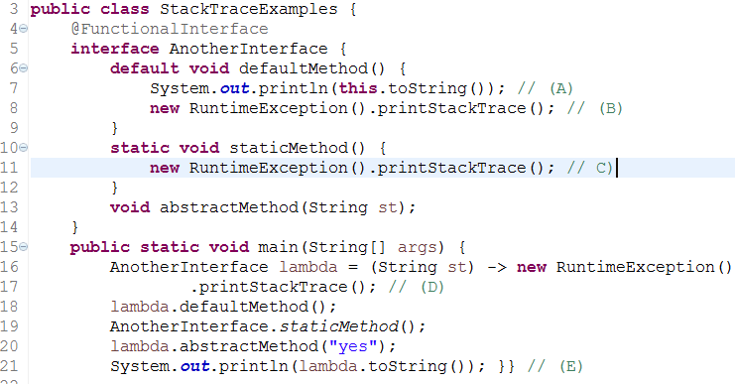
Topic 1-3 : Stack trace in the lambda
Questions: What happens if I add System.out.println(this.toString()); in the code of this lambda? What corresponds to “this”?
Exercise: What can I do to access to the default method from inside the lambda code?
org.java8.topic1.subject3.StackTraceExamples$$Lambda$1/1175962212@24d46ca6 // (A)
java.lang.RuntimeException // (B)
at org.java8.topic1.subject3.StackTraceExamples$AnotherInterface.defaultMethod(StackTraceExamples.java:8)
at org.java8.topic1.subject3.StackTraceExamples.main(StackTraceExamples.java:18)
java.lang.RuntimeException // (C)
at org.java8.topic1.subject3.StackTraceExamples$AnotherInterface.staticMethod(StackTraceExamples.java:11)
at org.java8.topic1.subject3.StackTraceExamples.main(StackTraceExamples.java:19)
java.lang.RuntimeException // (D)
at org.java8.topic1.subject3.StackTraceExamples.lambda$0(StackTraceExamples.java:16) // what is lambda$0?
at org.java8.topic1.subject3.StackTraceExamples$$Lambda$1/1175962212.abstractMethod(Unknown Source) // what is Lambda1$$...?
at org.java8.topic1.subject3.StackTraceExamples.main(StackTraceExamples.java:20)
org.java8.topic1.subject3.StackTraceExamples$$Lambda$1/1175962212@24d46ca6 // (E)

Slide 27
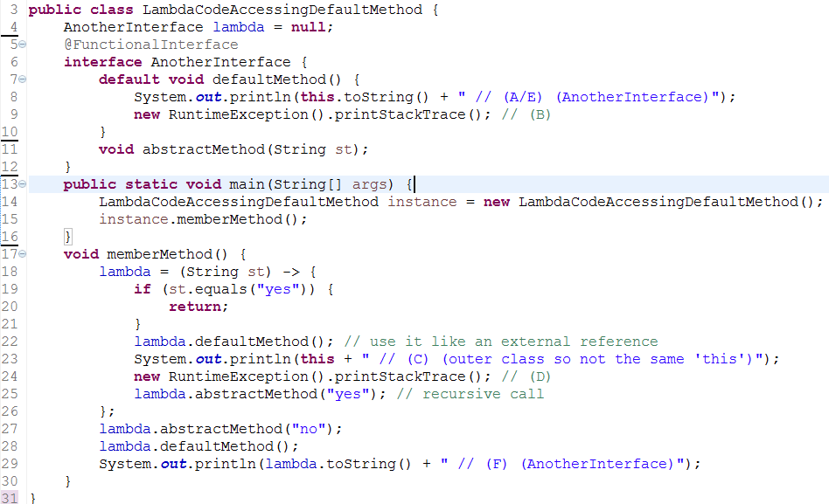
Topic 1-3 : Meaning of “this” in a lambda
The meaning of “this” is different in the default methods and in the lambda code
“this” is the interface instance in the default methods.
“this” is the outer class in the lambda code if this is a “member” lambda. If the lambda is defined in a static context then “this” is forbidden for use.
org.java8.topic1.subject3.LambdaCodeAccessingDefaultMethod$$Lambda$1/918221580@5ca881b5 // (A/E) (AnotherInterface)
java.lang.RuntimeException
org.java8.topic1.subject3.LambdaCodeAccessingDefaultMethod@4517d9a3 // (C) (outer class so not the same 'this')
at org.java8.topic1.subject3.LambdaCodeAccessingDefaultMethod$AnotherInterface.defaultMethod(LambdaCodeAccessingDefaultMethod.java:9)
at org.java8.topic1.subject3.LambdaCodeAccessingDefaultMethod.lambda$0(LambdaCodeAccessingDefaultMethod.java:22)
at org.java8.topic1.subject3.LambdaCodeAccessingDefaultMethod$$Lambda$1/918221580.abstractMethod(Unknown Source)
at org.java8.topic1.subject3.LambdaCodeAccessingDefaultMethod.memberMethod(LambdaCodeAccessingDefaultMethod.java:27)
at org.java8.topic1.subject3.LambdaCodeAccessingDefaultMethod.main(LambdaCodeAccessingDefaultMethod.java:15)
java.lang.RuntimeException
at org.java8.topic1.subject3.LambdaCodeAccessingDefaultMethod.lambda$0(LambdaCodeAccessingDefaultMethod.java:24)
at org.java8.topic1.subject3.LambdaCodeAccessingDefaultMethod$$Lambda$1/918221580.abstractMethod(Unknown Source)
at org.java8.topic1.subject3.LambdaCodeAccessingDefaultMethod.memberMethod(LambdaCodeAccessingDefaultMethod.java:27)
at org.java8.topic1.subject3.LambdaCodeAccessingDefaultMethod.main(LambdaCodeAccessingDefaultMethod.java:15)
org.java8.topic1.subject3.LambdaCodeAccessingDefaultMethod$$Lambda$1/918221580@5ca881b5 // (A/E) (AnotherInterface)
java.lang.RuntimeException
at org.java8.topic1.subject3.LambdaCodeAccessingDefaultMethod$AnotherInterface.defaultMethod(LambdaCodeAccessingDefaultMethod.java:9)
at org.java8.topic1.subject3.LambdaCodeAccessingDefaultMethod.memberMethod(LambdaCodeAccessingDefaultMethod.java:28)
at org.java8.topic1.subject3.LambdaCodeAccessingDefaultMethod.main(LambdaCodeAccessingDefaultMethod.java:15)
org.java8.topic1.subject3.LambdaCodeAccessingDefaultMethod$$Lambda$1/918221580@5ca881b5 // (F) (AnotherInterface)

Slide 28
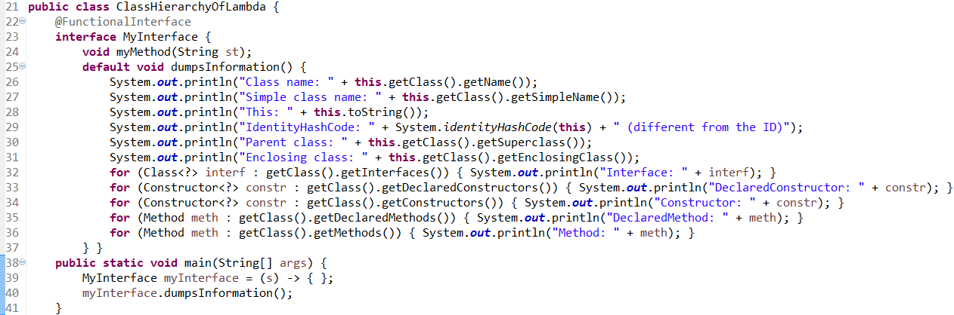
Topic 1-3 : The inside of a lambda
Class name: org.java8.topic1.subject3.ClassHierarchyOfLambda$$Lambda$1/2055281021
Simple class name: ClassHierarchyOfLambda$$Lambda$1/2055281021 << number not changing if you recompile, even adding a method
This: org.java8.topic1.subject3.ClassHierarchyOfLambda$$Lambda$1/2055281021@372f7a8d
IdentityHashCode: 925858445 (different from the ID)
Parent class: class java.lang.Object
Enclosing class: null
Interface: interface org.java8.topic1.subject3.ClassHierarchyOfLambda$MyInterface
DeclaredConstructor: private org.java8.topic1.subject3.ClassHierarchyOfLambda$$Lambda$1/2055281021()
Constructor: (none)
DeclaredMethod: public void org.java8.topic1.subject3.ClassHierarchyOfLambda$$Lambda$1/2055281021.myMethod(java.lang.String)
Method: public void org.java8.topic1.subject3.ClassHierarchyOfLambda$$Lambda$1/2055281021.myMethod(java.lang.String)
Method: public final void java.lang.Object.wait() throws java.lang.InterruptedException
Method: public final void java.lang.Object.wait(long,int) throws java.lang.InterruptedException
Method: public final native void java.lang.Object.wait(long) throws java.lang.InterruptedException
Method: public boolean java.lang.Object.equals(java.lang.Object)
Method: public java.lang.String java.lang.Object.toString()
Method: public native int java.lang.Object.hashCode()
Method: public final native java.lang.Class java.lang.Object.getClass()
Method: public final native void java.lang.Object.notify()
Method: public final native void java.lang.Object.notifyAll()
Method: public default void org.java8.topic1.subject3.ClassHierarchyOfLambda$MyInterface.defaultMethod()

Slide 29
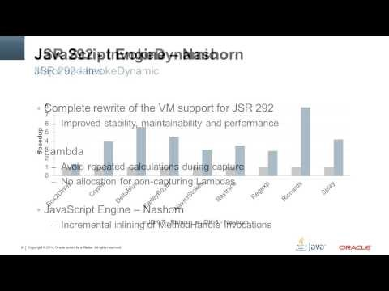
Topic 1-3 : (off topic) Lambda, performance and good usage
For performance reasons (simpler initialization) and to avoid memory leaks (no reference kept to the outer class), each anonymous class which can should be converted to a static class, to an external class or to a lambda (only if FI).
Lambda code is however more readable than static or inner classes so it should be preferred if code reuse is not a problem.
The lambda performance should be better at linking time and at instance creation time than an anonymous class.
Lambdas are harder to debug (bigger stack trace). If you can, create a function and unit test it before calling it.
Use the following video at 3:40 for the performance improvements for JSR 292 – InvokeDynamic used for lambdas.
TODO flow choice diagram and rephrase

Slide 30
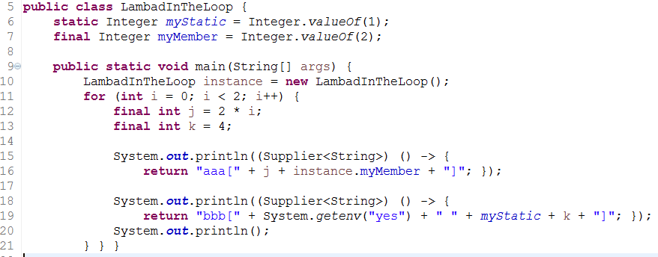
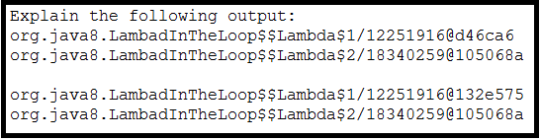
Topic 1-3 : Q&A
Which kind of return types are OK for a lambda?
What could it be a value for () -> () -> { System.gc(); }; ?
How can I simplify this lambda and why? Comparator<String> comp = (String a, String b) -> a.length() – b.length();
Is (String a, String b) -> return a + b; a valid lambda?
What is the simplest lambda code matching a Runnable?
Given the code below, what will be the output of >javap for this class? class JavapQuestion { void MyMethod(String a) { Comparator<Integer> comp = (Integer b, Integer c) -> (a.length() + b - c); } }
Explain the difference in the output of the two lambdas. Explain what causes it.
Ultimately and technically, what is a lambda? UML diagram please.

Slide 31
Topic 1-3 : Q&A
What are the benefits and drawbacks of a lambda expression vs. an anonymous class?
If you can squeeze “this” in the lambda code, what does it mean for the lambda and what represents “this”?
Can you access to the default methods of the FI from the lambda code?
Can you access to the outer class instance from the default methods of the FI?
What happens if I create two lambda instances of the same FI with the exact same code and compare their corresponding class for identity or equality?
What are the rules for the presence of () at the left of the lambda arrow?
Can you chain functional interfaces and lambdas?
Exercise: Serialize and unserialize an inner class and a lambda to understand how this is unsafe. What can go wrong? [See BGLS for the explanations]
Exercise: Create a lambda with a state which can be shared by the FM and the inherited default methods w/o passing the values as method parameters. This lambda will be potentially be called multiple times. The impact of previous calls must be visible. For this exercise use the following FI. @FunctionalInterface interface Accumulator { // adds the value to the existing sum and return the new sum long addAndReturnSum(long value); } Likely, a lambda may be not the best choice here for this behavior but this is not the point of the exercise.
Exercise: More generally create a generic FI with a distinct state for each instance (including lambdas) and easy to use.

Slide 32
Topic 1-3 : Q&A
Which kind of return types are OK for a lambda? void or any primitive type or class/interface type. If you cannot use “return” for void.
What could it be a value for () -> () -> { System.gc(); }; ? Supplier<Runnable> (FI to be seen later, also called an high order function)
How can I simplify this lambda and why? Comparator<String> comp = (String a, String b) -> a.length() – b.length(); Comparator<String> comp = (a, b) -> a.length() – b.length(); // using type inference
Is (String a, String b) -> return a + b; a valid lambda? No. If you use return, you need the brackets around the set of statements
What is the simplest lambda code matching a Runnable? () -> {};
Given the code below, what will be the output of >javap for this class? class JavapQuestion { void myMethod(String a) { Comparator<Integer> comp = (Integer b, Integer c) -> (a.length() + b - c); } } C:\workspaces\luna\Java8OCPUpgradeBeta\target\classes>javap -p org.java8.topic1.subject3.JavapQuestion
Compiled from "JavapQuestion.java"
class org.java8.topic1.subject3.JavapQuestion {
org.java8.topic1.subject3.JavapQuestion();
void myMethod(java.lang.String);
// lambda desugared to a static method as we do not use the outer class (this)
// myMethod is member so in theory it could be static too
private static int lambda$0(java.lang.String, java.lang.Integer, java.lang.Integer);
}

Slide 33
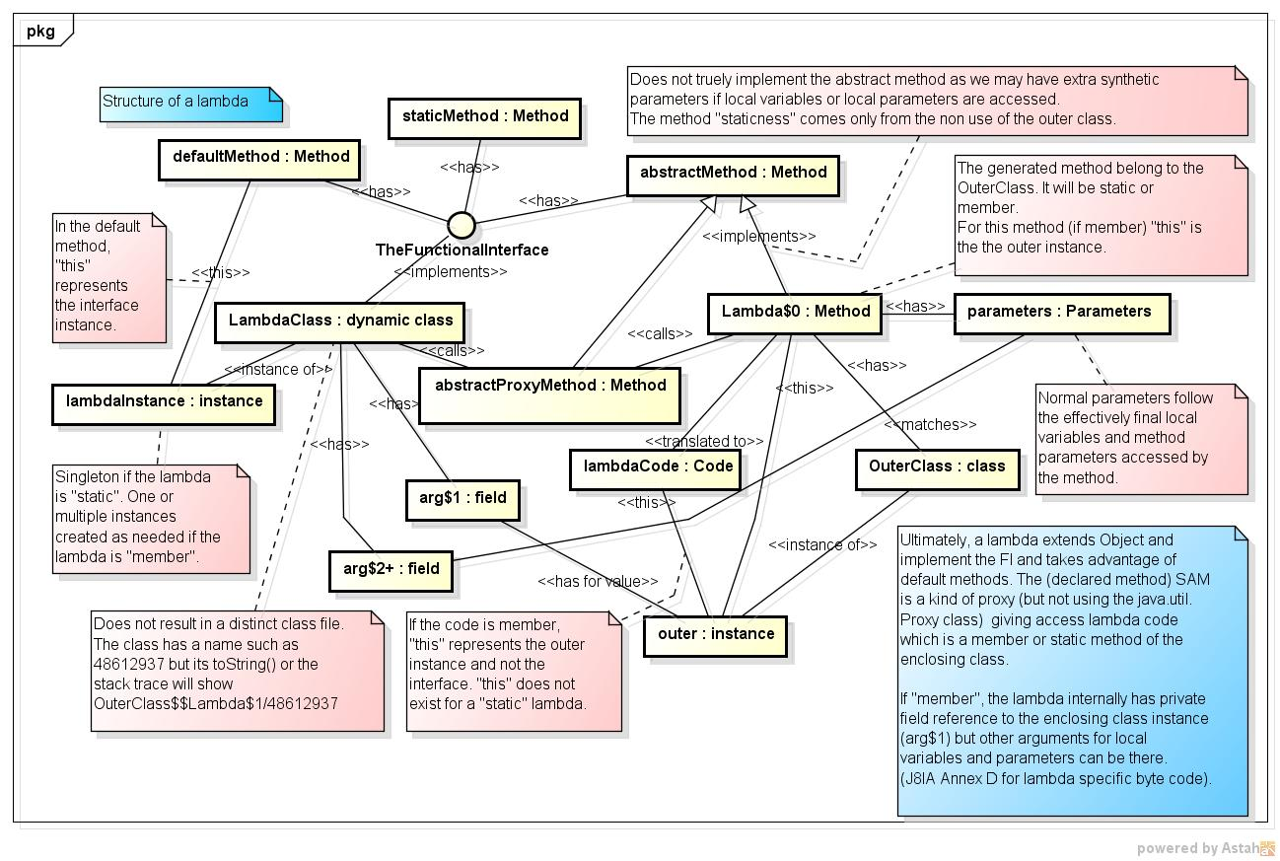
Topic 1-3 : Q&A
Ultimately and technically, what is a lambda? UML diagram please.

Slide 34
Topic 1-3 : Q&A
Explain the difference in the output of the two lambdas. Explain what causes it. The first lambda uses non static values from the outside so a new instance is recreated at each loop. The second uses only static values so the instance is reused at each loop Exercise: dig to know the exact rules
What are the benefits and drawbacks of a lambda expression vs. an anonymous class? You get a more concise code with a lambda, saving boiler plate code and encouraging functional programming. However your lambda cannot really access the default methods while the anonymous class can. Duplicated code means duplicated classes for both. Lambdas save extra class files. Lambdas allow JVM code optimization (J8IA Annex D).
When method references are used, the method name does not matter, only the signature. (later topic)
If you can squeeze “this” in the lambda code, what does it mean for the lambda and what represents “this”? This means that your lambda is a member one and “this” represents the instance of the outer class.
Can you access to the default methods of the FI from the lambda code? No but if you save the created lambda as a member field of the outer class (or any other solution making it visible) then the lambda code should be able to access to the instance of the interface. However it will not access it as “this” but as an external object.
Can you access to the outer class instance from the default methods of the FI? No except if you use the reflection API to find the private final field arg$1. You can the same way find the outer class instance from the inner class looking for the package-scoped final field named this$0.
What happens if I create two lambda instances of the same FI with the exact same code and compare their corresponding class for identity or equality? They will be different, the JVM does not optimize. However if created in a loop you deal with the same class but the instances are of course different.
What are the rules for the presence of () at the left of the arrow? They are required for no parameter or for multiple parameters but optional f there is a single parameter
Can you chain functional interfaces and lambdas? Yes. The supplier and runnable are lambdas Supplier<Runnable> s = () -> () -> {System.out.println();};

Slide 35
Topic 1 : More reading
Brian Goetz is the chief java architect and author of these papers
State of the Collections Laziness (April 2012)
http://cr.openjdk.java.net/~briangoetz/lambda/collections-overview.html
State of the Lambda Libraries Edition (September 2013)
http://cr.openjdk.java.net/~briangoetz/lambda/lambda-libraries-final.html
State of the Lambda (September 2013)
http://cr.openjdk.java.net/~briangoetz/lambda/lambda-state-final.html
Translation of Lambda Expressions (April 2012)
http://cr.openjdk.java.net/~briangoetz/lambda/lambda-translation.html
State of the specialization (December 2014)
http://cr.openjdk.java.net/~briangoetz/valhalla/specialization.html

Slide 36
Topic 2 : Using Built in Lambda Types
Describe the built in interfaces included in Java 8 – java.util.function package
Develop code that uses the Function interface
Develop code that uses the Consumer interface
Develop code that uses the Supplier interface
Develop code that uses the UnaryOperator interface
Develop code that uses the Predicate interface
Develop the code that use primitive and binary variations of base interfaces of java.util.function package
Develop the code that use method reference; including refactor the code that use Lambda expression to use method references
Note: Google Guava and collections like Apache Commons have some similar FIs potentially applicable to collections

Slide 37
Topic 2-1 : Interfaces of java.util.function
New package full of new FI
FIs provide target types for lambda expressions and method references. Each FI has a single abstract method ((SAM) old wording), called the functional method (FM) for that FI, to which the lambda expression's parameter and return types are matched or adapted. FIs can provide a target type in multiple contexts, such as assignment context, method invocation, or cast context:
The FIs in this package follow an extensible naming convention, as follows:
There are several basic function shapes, including Function (unary function from T to R), Consumer (unary function from T to void), Predicate (unary function from T to boolean), and Supplier (nilary function to R).
Function shapes have a natural arity based on how they are most commonly used. The basic shapes can be modified by an arity prefix to indicate a different arity, such as BiFunction (binary function from T and U to R).
There are additional derived function shapes which extend the basic function shapes, including UnaryOperator (extends Function) and BinaryOperator (extends BiFunction).
Type parameters of functional interfaces can be specialized to primitives with additional type prefixes. To specialize the return type for a type that has both generic return type and generic arguments, we prefix ToXxx, as in ToIntFunction. Otherwise, type arguments are specialized left-to-right, as in DoubleConsumer or ObjIntConsumer. (The type prefix Obj is used to indicate that we don't want to specialize this parameter, but want to move on to the next parameter, as in ObjIntConsumer.) These schemes can be combined, as in IntToDoubleFunction.
If there are specialization prefixes for all arguments, the arity prefix may be left out (as in ObjIntConsumer).
No TriXXXX FI is provided.
No FI is provided for a method taking no argument and returning nothing. Use Runnable.
Some of these FIs already existed in Guava, Apache Collections or in both.

Slide 38
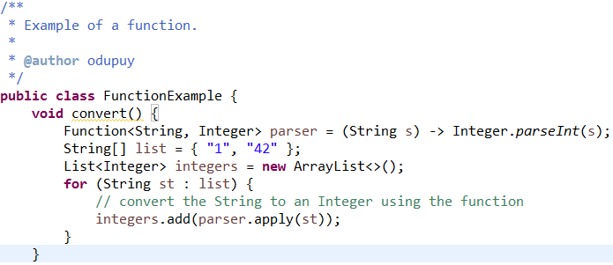
Topic 2-2 : Code that uses the Function interface
Goal: Converting an element to something else
@FunctionalInterface public interface Function<T,R> represents a function that accepts one argument and produces a result. This is a functional interface whose FM is R apply(T). They are used to transform values, map a value... Functions can be composed giving a new function (e.g. g(f(t)) giving f.andThen(g).apply(t) which is equivalent to g.compose(f).apply(t). The output type R of f() must match the input type of g().
E.g. Function<String, Integer> size = (String s) -> s.length();
BiFunction<T,U,R> takes 2 parameters.

Slide 39
Topic 2-3 : Code that uses the Consumer interface
Goal: Processing an element and return nothing with Consumer
@FunctionalInterface public interface Consumer<T> represents an operation that accepts a single input argument and returns no result. Unlike most other functional interfaces, Consumer is expected to operate via side-effects. void accept(T) Performs this operation on the given argument.
E.g. Consumer<String> printer = (String s) -> System.out.println(s);
Java 1.8 API example: ConcurrentHashMap.forEach() processing each key/value
public void forEach(BiConsumer<? super K,? super V> action)
Performs the given action for each entry in this map until all entries have been processed or the action throws an exception. Unless otherwise specified by the implementing class, actions are performed in the order of entry set iteration (if an iteration order is specified.) Exceptions thrown by the action are relayed to the caller.
myMap.forEach(new ByConsumer(K,V) = (k,v) -> System.out.println(k + “:” v));
Stream.peek(Consumer<T>) does the same (later topic) being given the current value passing through the stream.

Slide 40
Topic 2-4 : Code that uses the Supplier interface
Goal: Provides or creates a value given nothing
@FunctionalInterface public interface Supplier<T> represents a supplier of results. There is no requirement that a new or distinct result be returned each time the supplier is invoked. T get() gets a result.
E.g. Supplier<String> supplier = () -> "hello world";
Java 1.8 API example: java.util.Logger
public void fine(Supplier<String> msgSupplier) Logs a FINE message, which is only to be constructed if the logging level is such that the message will actually be logged. If the logger is currently enabled for the FINE message level then the message is constructed by invoking the provided supplier function and forwarded to all the registered output Handler objects.
Example of passed in value
Complex c = …
Supplier<String> supplied = () -> c.doesSomethingTakingLongAndReturningAString ();
Logger myLogger = …
myLogger.fine(supplied); // benefit: get() is not called if not FINE
Exercise: try to do provide the same functionality in Log4j 2.0

Slide 41
Topic 2-5 : Code that uses the UnaryOperator interface
Goal: Processing an argument and return an object of the same type
public interface UnaryOperator<T> extends Function<T,T> represents an operation on a single operand that produces a result of the same type as its operand. This is a specialization of Function for the case where the operand and result are of the same type. T apply(T).
E.g. UnaryOperator<String> superSizeMe = (String s) -> s + s;
Java 1.8 API example: List.replaceAll(UnaryOperator<E> operator)
Example of use: a calculator, each key is an “operator”. The change sign key/operation can be modeled as UnaryOperator as it works on a single value and returns a value of the same type.
Some keys become a UnaryOperator and some a BinaryOperator.
UnaryOperator<T extends number> changeSignKey = (t) -> -t;
BinaryOperator<T extends number> additionKey = (t1,t2) -> t1+t2;
additionKey.apply(1,4);
Exercise: write the complete calculator and use a Stack to save the values

Slide 42
Topic 2-6 : Code that uses the Predicate interface
Goal: Tells if a condition is true on the argument
public interface Predicate<T> represents a predicate (boolean-valued function) of one argument.
boolean test(T t) evaluates this predicate on the given argument.
E.g Predicate<String> plural = (String s) -> s.endsWith("s");
Java 1.8 API example: Filtering a list based on some criterion
public String[] File.list(FilenameFilter filter)
FilenameFilter is “like” a Predicate<File> but was not refactored.
public Stream<T> Stream.filter(Predicate<T>)
e.g. myStream.filter((t) -> t.value > 10)….

Slide 43
Topic 2-7 : Code that use primitive and binary variations
For 4 of the 5 defined FIs of java.util.function, there is a binary version of it taking two parameters instead of one.
As UnaryOperator<T> extends Function<T,T> the same way BinaryOperator<T> extends BinaryFunction<T,T,T>.
Example:
BinaryOperator<Integer> addition = (t,u) -> new Integer(t.intValue() + u.intValue();
Interface | Functional method | Binary variant | Functional method
Function<T,R> | R apply(T) | BiFunction<T,U,R> | R apply(T,U)
Supplier<T> | R get() | N/A | N/A
Consumer<T> | void accept(T) | BiConsumer<T,U> | void accept(T,U)
UnaryOperator<T> | T apply(T) | BinaryOperator<T> | T apply(T,T)
Predicate<T> | boolean test(T) | BiPredicate<T,U> | boolean test(T,U)

Slide 44
Topic 2-7 : Code that use primitive and binary variations
For 4 of the 5 defined FIs of java.util.function and their binary variations, there are a few extra methods, either default methods or static methods.
Interface | Functional method | Extra methods
Function<T,R> | R apply(T) | default <V> Function<V, R> compose(Function<? super V, ? extends T> before) default <V> Function<T, V> andThen(Function<? super R, ? extends V> after) static <T> Function<T, T> identity()
BiFunction<T,R> | R apply(T,U) | default <V> BiFunction<T, U, V> andThen(Function<? super R, ? extends V> after)
Supplier<T> | R get() | N/A
Consumer<T> | void accept(T) | default Consumer<T> andThen(Consumer<? super T> after)
BiConsumer<T,U> | void accept(T,U) | default BiConsumer<T, U> andThen(BiConsumer<? super T, ? super U> after)
UnaryOperator<T> | T apply(T) | static <T> UnaryOperator<T> identity()
BinaryOperator<T> | T apply(T,T) | static <T> BinaryOperator<T> maxBy(Comparator<? super T> comparator) static <T> BinaryOperator<T> minBy(Comparator<? super T> comparator)
Predicate<T> | boolean test(T) | default Predicate<T> and(Predicate<? super T> other) default Predicate<T> negate() default Predicate<T> or(Predicate<? super T> other) static <T> Predicate<T> isEqual(Object targetRef)

Slide 45
Topic 2-7 : Code that use primitive and binary variations
Goal: to save on boxing and unboxing a few selected primitive variations of the 5 FIs have been introduced. The FM name may change to reflect the return type XXX like XXX applyAsXXX() (function) or XXX getAsXXX() (supplier). Example:
ToDoubleBiFunction<Number, Number> tangent = (x,y) -> y.doubleValue() / x.doubleValue();
final double result = tangent.applyAsDouble(0.5, Math.sqrt(3) / 2);
The primitive variants of the FI may miss the composition methods or other default/static methods.
Interface | Functional method | Primitive variants
Function<T,R> | R apply(T) | IntFunction<R> ToIntFunction<T> IntToDoubleFunction IntToLongFunction LongFunction<R> ToLongFunction<T> LongToDoubleFunction LongToIntFunction DoubleFunction<R> ToDoubleFunction<T>
BiFunction<T,U,R> | R apply(T,U) | ToIntBiFunction<T, U> ToLongBiFunction<T, U> ToDoubleBiFunction<T, U>
Supplier<T> | R get() | BooleanSupplier IntSupplier LongSupplier DoubleSupplier
Consumer<T> | void accept(T) | IntConsumer LongConsumer DoubleConsumer
BiConsumer<T,U> | void accept(T,U) | ObjIntConsumer<T> ObjLongConsumer<T> ObjDoubleConsumer<T>
UnaryOperator<T> | T apply(T) | IntUnaryOperator LongUnaryOperator DoubleUnaryOperator
BinaryOperator<T> | T apply(T,T) | IntBinaryOperator LongBinaryOperator DoubleBinaryOperator
Predicate<T> | boolean test(T) | IntPredicate LongPredicate DoublePredicate
BiPredicate<T,U> | boolean test(T,U)

Slide 46
Topic 2-8 : Code that uses method reference 1/5
Goal: Shorter code especially useful in streams, collections and FIs.
Read State of Lambda by Brian Goetz (9/2013) [BGSL]
A (concrete) method reference is a full replacement for the lambda code [(…) -> …]. A different name (FI vs. method) or the choice of a static or member method does not count. Only counts the signature/arity. An amibiguity translates to a compilation error.
Examples of syntax:
Class::memberMethod
BiFunction<String,Integer,String> bf1 = String::substring; // matched to String.substring(int beginIndex)
bf1.apply("qwerty",3); // returns the substring.
the 1st parameter is casted to an instance of the class, the 2nd parameter is the method first argument…
Class::staticMethod
Function<Boolean,String> bf1 = String::valueOf; // matched to String.valueOf(boolean b)
bf1.apply(true); // returns “true”
the 1st parameter is the method first argument…
Instance::memberMethod
String myString = …
BiFunction<Integer, Integer,String> bf1 = myString::substring; // matched to String.substring(int beginIndex, int endIndex)
bf1.apply(3.5); returns the substring.
the 1st parameter is the method first argument…
The instance can be a static field, the member field of another class, the value returned by some static method
Runnable runnable = Thread.currentThread()::checkAccess; // calling member method of a value returned by a static method
runnable.run();
Consumer<String> cons = System.out::println; // calling member method of a static value
cons.accept("hello");

Slide 47
Topic 2-8 : Code that uses method reference 2/5
Constructor reference
Just use new for the method name and prefix it with the class name as the constructor is a “static” method.
Function<String,String> bf1 = String::new; // matched to String.new(String st)
bf1.apply(”stringtoduplicate”); // returns the string
the 1st parameter is the method first argument…
Exercise: Using method references and Supplier, create a factory which given the string name of a type from a know list returns a new instance of it.
Inner class method reference
You can refer easily to an inner method of the inner class
// using a reference to an inner class method through the instance
BiFunction<String, Integer, String> bf8 = otherClass.innerClass::applyPublicInner;
System.out.println(bf8.apply("yes", 1));
// using a reference to an inner class method w/o the instance
BiFunction<OtherClass.InnerClass, Integer, Integer> bf9 = OtherClass.InnerClass::applyPublicInnerInteger;
System.out.println(bf9.apply(otherClass.innerClass, 1));
However accessing the inner class constructor is impossible due to the synthetic constructor. You can compile but the execution fails to find a match.

Slide 48
Topic 2-8 : Code that uses method reference 3/5
Super class method reference
You can use super in member code to refer to a super method of the current object (this). super can only be used if the construction would be valid with this. Like for this, super must be used within a member method.
public class SuperRef {
public void runBody() { for(int i = 0; i < 10; i++) {
System.out.println("square of i is " + (i*i)); }
}}
public class MetRefSuper extends SuperRef{
public static void main(String[] args) { MetRefSuper mrs = new MetRefSuper(); mrs.createThread(); }
private void createThread() { new Thread(super::runBody).start(); } // super::runBody is a valid Runnable
}
Array constructor reference
// reference to an array constructor and create a single dimension array of length 3
Function<Integer, int[]> arrayCreator1 = int[]::new;
int[] myIntArray1 = arrayCreator1.apply(3);
// for more dimensions you have to use the Array class as a factory
BiFunction<Class<Integer>, int[],Object> arrayCreatorMany = Array::newInstance;
Integer[][][] myIntegerArray3 = (Integer[][][])arrayCreatorMany.apply(Integer.class, new int[] {3, 4, 5});
// for a primitive use the Class instance representing the corresponding primitive type
int[][][] myIntArray3 = (int [][][])arrayCreatorMany.apply(Integer.TYPE, new int[] {3, 4, 5});
Exercise: If you need more than 2 parameters, you will have to define your own TriFunction, QuadFunction… and use it. Define yours.

Slide 49
Topic 2-8 : Code that uses method reference 4/5
Checked exceptions declared thrown by the method reference
If a checked exception is declared then the FM must have declared it, e.g. this one does not compile as is
BiFunction<byte[],String,String> bf2 = String::new;
// matched to String(byte[] bytes, String charsetName) throws UnsupportedEncodingException
// you need to create your “BiFunction throwing exceptions” to use this method
Auto-boxing and unboxing using a method reference
For the declaration of the FI you can only use Object types as usual and never primitives, e.g. Function<Integer,String> is OK while Function<int,String> is not. Primitive variants of the FIs can help.
For the corresponding method reference, if this is not an exact match then boxing and unboxing apply for both the referred method parameters and to its return type
e.g. BiFunction<String,Integer,String> matches with the method reference String::substring(int pos) with the first type (String) matching to the class, the second (Integer) being unboxed to the pos parameter. Finally the third type (String) is the return type of substring().
On use of the FI instance (e.g. f.apply(x,y)) boxing and unboxing work as usual
BiFunction<String,Integer,String> bf2 = String::substring;
String bit = bf2.apply("theanswer",4);
Access to the referred method
The usual rules apply, e.g. you cannot make a reference to AnotherClass::somePrivateMethod.
Referring to an abstract, default or static method of an interface
This is not different from referring to an abstract, concrete or static method of a class.

Slide 50
Topic 2-8 : Code that uses method reference 5/5
Choice of the matching method and ambiguous method references
As discussed earlier boxing and unboxing apply for both accepting a method reference and calling the FI using it e.g. given
static class AmbiguousReference {
static void ambig(Integer in, boolean bo) { }
static void ambig(int in, Boolean bo) { } // would it be the same with the method in a parent class?
}
BiConsumer<Integer, Boolean> bia = AmbiguousReference::ambig can be equal to the reference of one or the other.
However if both methods are present, an error is reported until one of the two methods is renamed or until its signature is changed.
// Error reported: The type MethodReferenceExamples.AmbiguousReference
// does not define ambig(Integer, Boolean) that is applicable here
The message is different from what you get for a direct method call
static {
// Error reported: The method ambig(Integer, boolean) is ambiguous
// for the type MethodReferenceExamples.AmbiguousReference
ambig(Integer.valueOf(1), Boolean.TRUE);
}

Slide 51
Topic 2 : Q&A
What are the five new FIs?
In which package are they?
What are the method names, the signatures and the goals of these FIs?
Anyone of them extending another one?
Which ones of these FIs have a Bixx equivalent? What are their names?
What is the class relation between Supplier and IntSupplier?
Which ones of these FIs and Bixx have a primitive variation? What are their names?
What are the primitive used? Why this choice?
What is the impact of the primitive variation on the name of FI? Give an example.
What is the impact of the primitive variation on the name of FM? Give an example.
What are the different kinds of method references?
Where can you use a method reference? What is the syntax?
What are the rules regarding the mapping for the input parameters of the FM to the referred method parameters?
What are the rules for a matching method reference?
What are the access restrictions for the use of a method reference?
Can I use a method reference ignoring the returned value?
Can I use a method reference to an abstract method?

Slide 52
Topic 2 : Q&A
Exercise: Give the most exact type (no warning) or general (max flexibility) corresponding to the lambdas below and give some examples of call to them and “assert” the returned value if any:
() -> () -> () -> 42;
(a) -> a + a;
(a, b) -> {};
(a, b) -> return b.apply(a);
(int a, String b) -> () -> b + a;
[StringBuffer stringBuffer = new StringBuffer();] (int a, String b) -> (a, b) -> ();
a -> () -> a.hashCode();
Exercise: Give a possible implementation for the corresponding types and using method references if doable, give an example of call and assert the result
UnaryOperator<String>
BinaryOperator<Function<String, Vector<String>>>
BiSupplier<Integer, Supplier<String>>
BiPredicate<int, CharSequence>
Consumer<Supplier<Vector<String>>>
IntPredicate<String>
UnaryOperator<DoublePredicate>
Exercise: What happens at execution time if the FI code compiles using a lambda while at runtime the FI is not one anymore? Write some code showing that… it still works.

Slide 53
Topic 2 : Q&A
What are the five new FIs? Supplier, Consumer, Predicate, Function, UnaryOperator
In which package are they? java.util.function
What are the method names, the signatures and the goals of these FIs? Supplier<T> T get() provide something Consumer<T> void accept(T t) use something Predicate<T> boolean test(T t) test something Function<T,R> R apply(T t) create an R from a T UnaryOperator<T> T apply(T t) create a T from a T
Anyone of them extending another one? UnaryOperator<T> extends Function<T,T>
Which ones of these FIs have a Bixxxxx equivalent? What are their names? Consumer<T> gives BiConsumer<T,R> with void accept(T t,R r) Predicate<T> gives BiPredicate<T,R> with boolean test(T t,R r) Function<T,R> gives BiFunction<T,U,R> with R apply(T t,U u) UnaryOperator<T> gives BinaryOperator<T> with T apply(T t1, T t2)
What is the class relation between Supplier and IntSupplier? They present similarities but they are siblings.

Slide 54
Topic 2 : Q&A
Which ones of these FIs have a primitive variation? What are their names? All. The names but Supplier e.g.
What are the primitive used? Why this choice? int, long, double. Because byte, short, float and boolean are not likely being used or can be casted or widened to the other ones. The exceptions are BooleanSupplier and ObjIntConsumer, ObjLongConsumer and ObjDoubleConsumer.
What is the impact of the primitive variation on the name of FI? Give an example. It can be used to specify the source, the destination or both e.g. IntFunction (applies on an int), ToIntFunction (returns an int) IntToDoubleFunction (applies on an int and returns a double)
What is the impact of the primitive variation on the name of FM? Give an example. If the primitive is used for the return type then the method name is changed e.g. for an IntSupplier it will be int getAsInt(). This allows to have a class being at the same time a DoubleSupplier (getAsDouble()) and an IntSupplier (getAsInt()) w/o a name clash.

Slide 55
Topic 2 : Q&A
What are the different kinds of method references? There are several different kinds of method references, each with slightly different syntax: A static method (ClassName::methName) An instance method of a particular object (instanceRef::methName) A super method of a particular object (super::methName) An instance method of an arbitrary object of a particular type (ClassName::methName) A class constructor reference (ClassName::new) An array constructor reference (TypeName[]::new)
Where can you use a method reference? What is the syntax? Anywhere a lambda could be used instead. The syntax is ClassName/expression(field or method call)/this/super/type[] followed by :: and then by the unambiguous method name e.g. thisString::length for an IntSupplier. Using a method reference for a Method is illegal e.g. Method met = String::codePointAt; triggers a compilation error (The target type of this expression must be a FI).
What are the rules regarding the mapping for the input parameters of the FM to the referred method parameters? Static method (a constructor is ‘static’), the input parameters of the FM must match the method parameters. Member method, if a class is at left of ::, the first FM input parameter must match the class, 2nd+ input parameters must match the method parameters. Member method, if an instance/expression is at left of ::, the FM input parameters must match the method parameters.

Slide 56
Topic 2 : Q&A
What are the rules for a matching method reference? The arity must be the same, w/ or w/o (un)boxing. The call must not be ambiguous. The declared exceptions must be compatible. The access (public…) must be compliant. The context (static vs. member) must be compliant. If the FI is void, the value returned by the referenced method is ignored.
What are the access restrictions for the use of a method reference? Same rules as usual (and like lambdas) for the access to private… methods.
Can I use a method reference ignoring the returned value? Totally. static class IgnoredReturnValue { String getString(Integer integer) { return null; }
// the return value is ignored BiConsumer<IgnoredReturnValue, Integer> bic = IgnoredReturnValue::getString; // same method reference, the return value is used BiFunction<IgnoredReturnValue, Integer, String> bif = IgnoredReturnValue::getString; }
Can I use a method reference to an abstract method? Yes.

Slide 57
Topic 3 : Filtering Collections with Lambdas
Develop the code that iterates a collection by using forEach(); including method chaining
Describe the Stream interface and pipelines
Filter a collection using lambda expressions
Identify lambda operations that are lazy

Slide 58
Topic 3-1 : Collections iteration, forEach() and method chaining 1/5
Develop the code that iterates a collection by using forEach(); including method chaining
forEach() comes from java.lang.Iterable<T> (1.5)
Being Iterable is required to be the target of the for loop (Java 5) [for (Item item : items) {…}]
Iterable is implemented by many interfaces: BeanContext, BeanContextServices, BlockingDeque<E>, BlockingQueue<E>, Collection<E>, Deque<E>, DirectoryStream<T>, List<E>, NavigableSet<E>, Path, Queue<E>, SecureDirectoryStream<T>, Set<E>, SortedSet<E>, TransferQueue<E>
forEach() is also available in the interfaces java.util.Map (1.8) and java.util.stream.Stream (1.8) but w/o the interface while keeping the same behavior (parameters are BiConsumer<T,U> and Consumer<T>)
public void exampleMap() {
Map<String,Integer> map = new HashMap<>();
map.put("one", 1);
map.put("two", 2);
map.forEach((a,b) -> System.out.println(a + " -> " + b)); // displays each pair
}
void Iterator.forEachRemaining(Consumer<T>) (1.8) is similar and iterates on what is left of the elements.
Modifier and Type | Method and Description
default void | (1.8) forEach(Consumer<? super T> action) Performs the given action for each element of the Iterable until all elements have been processed or the action throws an exception.
Iterator<T> | (1.5) iterator() Returns an iterator over elements of type T.
default Spliterator<T> | (1.8) spliterator() Creates a Spliterator over the elements described by this Iterable.

Slide 59
Topic 3-1 : Collections iteration, forEach() and method chaining 2/5
Source: [BGSLLE3]
Internal vs external iteration
The Collections framework relies on the concept of external iteration, where a Collection provides a way for its client to enumerate its elements (Collection extends Iterable), and clients use this to step sequentially through the elements of a collection. External iteration is straightforward enough, but it has several problems:
It is inherently serial
It deprives the library method of the opportunity to manage the control flow
Sometimes the tight specification of the for-each loop is an impediment to performance.
The alternative to external iteration is internal iteration, where instead of controlling the iteration, the client delegates that to the library and passes in snippets of code to execute at various points in the computation.
This approach moves the control flow management from the client code to the library code, allowing the libraries not only to abstract over common control flow operations, but also enabling them to potentially use laziness, parallelism, and out-of-order execution to improve performance. (Whether the implementation of forEach() actually does any of these things is a matter for the library implementor forEach() to decide, but with internal iteration they are at least possible, whereas with external iteration, they are not.)
Internal iteration lends itself to a programming style where operations can be "pipelined" together

Slide 60
Topic 3-1 : Collections iteration, forEach() and method chaining 3/5
forEach() does not return the original collection so there is no way to write myCollection.forEach(…).forEach…). forEach() is to be set as the last operation.
The Stream interface provides for debugging purpose peek(…) which is similar to forEach() and which allows chaining myStream.peek(…).peek(…).
The way to understand the question is that dealing with a collection we usually do the following:
Iterate on the collection and in any order
Filter it
Sort it
Transform the values
Collect the elements filtered or not somewhere in a new collection or creating some statistics (e.g. count).
Another collection can be involved in nested loops.
Let’s try to do it with a collection of Cars that we will sort, filter, transform and then make a count.
/**
* An enumeration is some kind of R/O ordered collection
*/
enum Car {
FORESTER("Subaru", "Forester", 1998), //
ACCORD("Honda", "Accord", 1997), //
ECHO("Toyota", "Echo", 2000), //
RAV4("Toyota", "Rav4", 2000), //
Escort("Ford", "Escort", 1984), //
ModelT("Ford", "Model-T", 1920);//
final String brand;
final String model;
final int year;
Car(String brand, String model, int year) {
this.brand = brand;
this.model = model;
this.year = year;
} … // getters there

Slide 61
Topic 3-1 : Collections iteration, forEach() and method chaining 4/5
static void oldWay() {
// select the first 3 different brands
// TreeSet automatically sorts by natural order
Set<String> brands = new TreeSet<>();
for (Car car : Car.values()) {
if (car.getYear() > 1930) {// filter by year
// extract the brand and transformation then store it
brands.add(car.getBrand().toUpperCase());
}
// test if we have the 3 first brands
if (brands.size() == 3) {
break;
}
}
// display the different brands sorted
for (String brand : brands) {
System.out.println(brand); // here we print sorted values
}
}
We “chain” different operations but the code is bulky. You can also use default void Collection.forEach(Consumer<T>) [1.8] to do chaining using composition of the consumer but the code is still bulky and limited in what it can do. The same way Iterator and Spliterator can iterate on the “remaining” elements. myList.forEach(consumer1.andThen(consumer2).andThen(consumer3)); myList.forEach(t -> f1.andThen(f2).andThen(f3).apply(t)); default void [Spl]iterator.forEachRemaining(Consumer<? super E> action)

Slide 62
Topic 3-1 : Collections iteration, forEach() and method chaining 5/5
With the streams the code is more natural and the operations are really chained w/o intermediate values, collections or if/then logic. Null/empty logic is not demoed here. Optional<T> seen later could be used for this purpose.
Streams allow you to switch from imperative programming (you control the flow and say what happens) to functional programming (you only say what happens).
static void newWay() {
// select the first 3 different brands
Set<String> brands =
Stream.of(Car.values()).// getting a stream source
filter(a -> a.getYear() > 1930).// filtering
map(a -> a.getBrand().toUpperCase()).// extraction/transformation
distinct().// we need distinct values
limit(3).// no more than 3
sorted(). // sort before display
peek(System.out::println). // print them
collect(Collectors.toCollection(TreeSet::new)); // save in a TreeSet (sorted)
}

Slide 63
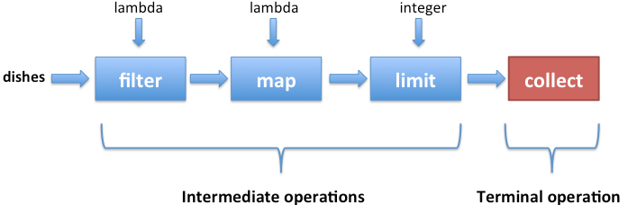
Topic 3-2 : Describe the Stream interface and pipelines 1/6
To perform a computation, stream operations are composed into a stream pipeline. A stream pipeline consists of a source (which might be an array, a collection, a generator function, an I/O channel, etc), zero or more intermediate operations (which transform a stream into another stream, such as filter(Predicate)), and a terminal operation (which produces a result or side-effect, such as count() or forEach(Consumer)). Streams are lazy; computation on the source data is only performed when the terminal operation is initiated, and source elements are consumed only as needed. [JDStream].
Without a terminal (also called collector) operation the pipeline is not set in action. This is similar to the builder pattern where build() marks the end of the construction operations.
Collections and streams, while bearing some superficial similarities, have different goals. Collections are primarily concerned with the efficient management of, and access to, their elements. By contrast, streams do not provide a means to directly access or manipulate their elements, and are instead concerned with declaratively describing their source and the computational operations which will be performed in aggregate on that source. However, if the provided stream operations do not offer the desired functionality, the BaseStream.iterator() and BaseStream.spliterator() operations can be used to perform a controlled traversal.
A stream pipeline can be viewed as a query on the stream source. Unless the source was explicitly designed for concurrent modification (such as a ConcurrentHashMap), unpredictable or erroneous behavior may result from modifying the stream source while it is being queried.

Slide 64
Topic 3-2 : Describe the Stream interface and pipelines 2/6
Most stream operations accept parameters that describe user-specified behavior, such as the lambda expression w -> w.getWeight(). To preserve correct behavior, these behavioral parameters:
must be non-interfering (they do not modify the stream source); and
in most cases must be stateless (their result should not depend on any state that might change during execution of the stream pipeline).
Such parameters are always instances of a functional interface such as Function, and are often lambda expressions or method references. Unless otherwise specified these parameters must be non-null.
A stream should be operated on (invoking an intermediate or terminal stream operation) only once. This rules out, for example, "forked" streams, where the same source feeds two or more pipelines, or multiple traversals of the same stream. A stream implementation may throw IllegalStateException if it detects that the stream is being reused. However, since some stream operations may return their receiver rather than a new stream object, it may not be possible to detect reuse in all cases.
Streams have a BaseStream.close() method and implement AutoCloseable, but nearly all stream instances do not actually need to be closed after use. Generally, only streams whose source is an IO channel (such as those returned by Files.lines(Path, Charset)) will require closing. Most streams are backed by collections, arrays, or generating functions, which require no special resource management. (If a stream does require closing, it SHOULD be declared as a resource in a try-with-resources statement or close() should be called explicitely.) [JDStream]

Slide 65
Topic 3-2 : Describe the Stream interface and pipelines 3/6
Stream pipelines may execute either sequentially or in parallel. This execution mode is a property of the stream. Streams are created with an initial choice of sequential or parallel execution (parallel = topic 5). For example, Collection.stream() creates a sequential stream, and Collection.parallelStream() creates a parallel one. This choice of execution mode may be modified by the BaseStream.sequential() or BaseStream.parallel() methods, and may be queried with the BaseStream.isParallel() method. (source [JDStream])
There is no interface declaring that a given class can return a Stream like Iterable does with Iterator.
The subclasses dealing with primitives are IntStream, LongStream, DoubleStream. They have their own builders DoubleStream.Builder, IntStream.Builder, LongStream.Builder. The API is slightly different
For a Map or an Hashtable, use keySet(), entrySet() or values() to get a collection to stream.
The different ways to build a Stream<T> are … using a generic constructor or with specialized constructors.

Slide 66
Topic 3-2 : Describe the Stream interface and pipelines 4/6
Generic Stream constructors. Specialized collection classes provide optimized [parallel]stream() and spliterator() methods based on the source characteristics. Primitive streams have their own constructors.
Signature | Description
default Stream<T> Collection<T>.stream() | Returns a sequential Stream with this collection as its source.
default Stream<E> Collection<T>.parallelStream() | Returns a possibly parallel Stream with this collection as its source.
static <T> Stream<T> Stream.generate(Supplier<T> s) | Returns an infinite sequential unordered stream where each element is generated by the provided Supplier.
static <T> Stream<T> Stream.iterate(T seed, UnaryOperator<T> f) | Returns an infinite sequential ordered Stream produced by iterative application of a function f to an initial element seed, producing a Stream consisting of seed, f(seed), f(f(seed)), etc.
static <T> Stream<T> Stream.of(T... values) | Returns a sequential ordered stream whose elements are the specified values.
static <T> Stream<T> Stream.of(T t) | Returns a sequential Stream containing a single element.
static <T> Stream<T> Arrays.stream(T[] array[, int startInclusive, int endExclusive]) | Returns a sequential Stream [with the specified range of the specified array as its source.]
static <T> Stream<T> Stream.concat(Stream<? extends T> a, Stream<? extends T> b) | Creates a lazily concatenated stream whose elements are all the elements of the first stream followed by all the elements of the second stream. // if any is //. Splits on a/b. Characteristics are “anded” before the split, come from b after.
static <T> Stream<T> Stream.empty() | Returns an empty sequential Stream.
static <T> Stream<T> StreamSupport.stream(Spliterator<T> spliterator, boolean parallel) | Creates a new sequential or parallel Stream from a Spliterator.
static <T> Stream<T> StreamSupport.stream(Supplier<? extends Spliterator<T>> supplier, int characteristics, boolean parallel) | Creates a new sequential or parallel Stream from a Supplier of Spliterator.

Slide 67
Topic 3-2 : Describe the Stream interface and pipelines 5/6
Specialized Stream constructors (incomplete)
Signature | Description
Stream<String> BufferedReader.lines() | Returns a Stream, the elements of which are lines read from this BufferedReader.
static Stream<Path> Files.find(Path start, int maxDepth, BiPredicate<Path,BasicFileAttributes> matcher, FileVisitOption... options) | Return a Stream that is lazily populated with Path by searching for files in a file tree rooted at a given starting file.
static Stream<String> Files.lines(Path path) | Read all lines from a file as a Stream.
static Stream<String> Files.lines(Path path, Charset cs) | Read all lines from a file as a Stream.
static Stream<Path> Files.list(Path dir) | Return a lazily populated Stream, the elements of which are the entries in the directory.
static Stream<Path> Files.walk(Path start, FileVisitOption... options) | Return a Stream that is lazily populated with Path by walking the file tree rooted at a given starting file.
static Stream<Path> Files.walk(Path start, int maxDepth, FileVisitOption... options) | Return a Stream that is lazily populated with Path by walking the file tree rooted at a given starting file.
Stream<JarEntry> JarFile.stream() | Return an ordered Stream over the ZIP file entries.
Stream<String> Pattern.splitAsStream(CharSequence input) | Creates a stream from the given input sequence around matches of this pattern.
Stream<? extends ZipEntry> ZipFile.stream() | Return an ordered Stream over the ZIP file entries.
Double/Int/LongStream Random.doubles/ints/longs(…) | Returns an effectively unlimited stream of pseudorandom double/int/long values.
IntStream BitSet.stream() | Returns a stream of indices for which this BitSet contains a bit in the set state.

Slide 68
Topic 3-2 : Describe the Stream interface and pipelines 6/6
To these constructors and converters we need adding public static interface Stream.Builder<T> extends Consumer<T>.
A mutable builder for a Stream. This allows the creation of a Stream by generating elements individually and adding them to the Builder (without the copying overhead that comes from using an ArrayList as a temporary buffer.)
Created by Stream<T>.builder() a stream builder has a lifecycle, which starts in a building phase, during which elements can be added, and then transitions to a built phase, after which elements may not be added. The built phase begins when the build() method is called, which creates an ordered Stream whose elements are the elements that were added to the stream builder, in the order they were added.
Signature | Description
void Stream<T>.Builder.accept(T t) | Adds an element to the stream being built.
default Stream.Builder<T> Stream<T>.Builder.add(T t) | Adds an element to the stream being built.
Stream<T> Stream<T>.Builder.build() | Builds the stream, transitioning this builder to the built state.
default Consumer<T> Stream<T>.Builder.andThen(Consumer<? super T> after) | Method inherited from interface java.util.function.Consumer but not really useful

Slide 69
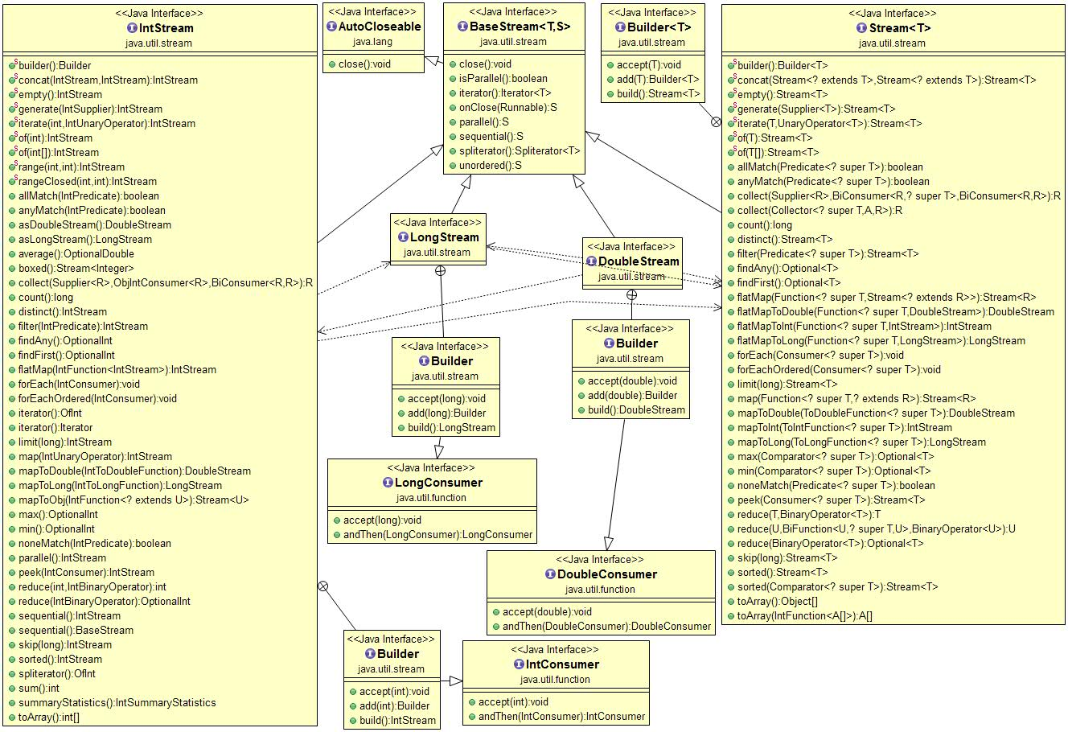
Topic 3-2 : Stream, builder and variations

Slide 70
Topic 3-3 : Filter a collection using lambda expressions
Example of a filter from above:
Set<String> brands =
Stream.of(Car.values()).// getting a stream source from the factory
filter(a -> a.getYear() > 1930).// filtering
More code here to collect the values
In a similar manner on a good old collection: Collection<T> myCollection = … myCollection.removeIf(a -> …); // there is no similar method for Map
For simplicity, filtering (with a Predicate<T>) can take advantage of:
method references if the method returns a boolean (e.g. filter(Car::isRecent))
composition with Predicate<T> Predicate.and/or(Predicate<? super T> other) No XOR!
static boolean methods of Objects (1.7): equals(a,b), deepEquals(a,b), isNull(a), nonNull(a)
static boolean methods of Arrays: equals(a,b), deepEquals(a,b)
Collection.equals(Object), Set.equals(Object), List.equals(Object)
Other built-in equals() methods
Q: What does this predicate?
Predicate<Car> predicate = ((Predicate<Car>)(Car::isRecent)).or(c -> c.getLastYear() != null).negate();

Slide 71
Topic 3-3 : Filter a collection using lambda expressions
In a similar way, mapping (with a Function<T,R>) can take advantage of:
method references
Function composition with default <V> Function<T,V> andThen(Function<? super R,? extends V> after) or default <V> Function<V,R> compose(Function<? super V,? extends T> before)
In a similar way, sorting (with a Comparator<T>) can take advantage of:
method references: static <T,U extends Comparable<? super U>> Comparator<T> Comparator.comparing(Function<? super T,? extends U> keyExtractor) : Accepts a function that extracts a Comparable sort key from a type T, and returns a Comparator<T> that compares by that sort key.
base and reversed Comparator instances: static Comparator<T> naturalOrder(), default Comparator<T> reversed(), static Comparator<T> reverseOrder()
null friendly Comparator instances: static <T> Comparator<T> nullsFirst/Last(Comparator<? super T> comparator)
Comparator composition: default Comparator<T> thenComparing(...) Q: What does this comparator?
Comparator<Car> comparator = Comparator.nullsFirst(Comparator.comparing(Car::getYear)). thenComparing(Comparator.naturalOrder());

Slide 72
Topic 3-3 : Filter a collection using lambda expressions
Exercise copied from [BGSLLE3]
Below is an fragment from the JDK Class.getEnclosingMethod(), which loops over all declared methods, matching method name, return type, and number and type of parameters. Rewrite the original code with streams. Tip: look at simple equals() and at the methods of Optional.
for (Method m : enclosingInfo.getEnclosingClass().getDeclaredMethods()) {
if (m.getName().equals(enclosingInfo.getName()) ) {
Class<?>[] candidateParamClasses = m.getParameterTypes();
if (candidateParamClasses.length == parameterClasses.length) {
boolean matches = true;
for(int i = 0; i < candidateParamClasses.length; i++) {
if (!candidateParamClasses[i].equals(parameterClasses[i])) {
matches = false;
break;
}
}
if (matches) { // finally, check return type
if (m.getReturnType().equals(returnType) )
return m;
}
}
}
}
throw new InternalError("Enclosing method not found");

Slide 73
Topic 3-3 : Filter a collection using lambda expressions
Exercise solution
Using streams, we can eliminate all the temporary variables and move the control logic into the library. We fetch the list of methods via reflection, turn it into a Stream with Arrays.stream(), and then use a series of filters to reject the ones that don't match name, parameter types, or return type. The result of findFirst() is an Optional<Method> (both seen in Topic 4), and we then either fetch and return the resulting method or throw an exception.
return Arrays.stream(enclosingInfo.getEnclosingClass().getDeclaredMethods())
.filter(m -> Objects.equals(m.getName(), enclosingInfo.getName())
.filter(m -> Arrays.equals(m.getParameterTypes(), parameterClasses))
.filter(m -> Objects.equals(m.getReturnType(), returnType))
.findFirst()
.orElseThrow(() -> new InternalError("Enclosing method not found");
This version of the code is more compact, more readable, and less error-prone.

Slide 74
Topic 3-4 : Identify lambda operations that are lazy
Operations such as filtering and mapping can be thought of as naturally lazy, whether or not they are implemented as such. On the other hand, value-producing operations such as sum() [IntStream] or side-effect-producing operations such as Stream.orEach(), are "naturally eager", because they must produce a concrete result.
In a pipeline such as: int sum = shapes.stream() .filter(s -> s.getColor() == BLUE) .mapToInt(s -> s.getWeight()) .sum(); the filtering and mapping operations are lazy. This means that we don't start drawing elements from the source until we start the sum operation, and when we do perform the sum operation, we fuse filtering, mapping, and addition into a single pass on the data. This minimizes the bookkeeping costs required to manage intermediate elements.
Terminal methods like anyMatch(Predicate) or findFirst(), while eager, can use short-circuiting to stop processing once they can determine the/a final result. Short-circuiting applies to intermediate methods but the meaning is different. It means that an infinite stream is converted to a finite one. As an example first(3) will select the three first values. W/o a short-circuit intermediate and/or terminal operation, an infinite stream (e.g. built with Stream.generate(Supplier<T> supplier)) is an INFINITE LOOP.
Given a pipeline like: Optional<Shape> firstBlue = shapes.stream() .filter(s -> s.getColor() == BLUE) .findFirst(); Because the filter step is lazy, the findFirst() implementation will only draw from upstream until it gets an element, which means we need only apply the predicate to input elements until we find one for which the predicate is true, rather than all of them. The findFirst() method returns an Optional, since there might not be any elements matching the desired criteria. Optional (topic 4) provides a means to describe a value that might or might not be present.
Note that the user didn't have to ask for laziness, or even think about it very much; the right thing happened, with the library arranging for as little computation as it could.
Basically all the intermediate operations are lazy. (Refer to Brian Goetz [BGSLLE3] document about the lambda library edition, some excerpts copied here)

Slide 75
Topic 3-4 : Identify lambda operations that are lazy
Here is a list of member intermediate (and lazy) operations (returning a stream). Without the intermediate operations being lazy (thanks to lambdas), there would be no stream
Signature | Description
Stream<T> BaseStream.onClose(Runnable closeHandler) | Returns an equivalent stream with an additional close handler.
Stream<T> BaseStream.parallel() | Returns an equivalent stream that is parallel.
Stream<T> BaseStream.sequential() | Returns an equivalent stream that is sequential.
Stream<T> BaseStream.unordered() | Returns an equivalent stream that is unordered.
Stream<T> Stream.distinct() | Returns a stream consisting of the distinct elements (according to Object.equals(Object)) of this stream.
Stream<T> Stream.filter(Predicate<? super T> predicate) | Returns a stream consisting of the elements of this stream that match the given predicate.
Stream<R> Stream.flatMap(Function<? super T,? extends Stream<? extends R>> mapper) | Returns a stream consisting of the results of replacing each element of this stream with the contents of a mapped stream produced by applying the provided mapping function to each element.
Stream<T> Stream.limit(int maxSize) | Returns a stream consisting of the elements of this stream, truncated to be no longer than maxSize in length.
Stream<R> Stream.map(Function<? super T,? extends R> mapper) | Returns a stream consisting of the results of applying the given function to the elements of this stream.
Stream<T> Stream.peek(Consumer<? super T> action) | Returns a stream consisting of the elements of this stream, additionally performing the provided action on each element as elements are consumed from the resulting stream.
Stream<T> Stream.skip(long n) | Returns a stream consisting of the remaining elements of this stream after discarding the first n elements of the stream.
Stream<T> Stream.sorted() | Returns a stream consisting of the elements of this stream, sorted according to natural order.
Stream<T> Stream.sorted(Comparator<? super T> comparator) | Returns a stream consisting of the elements of this stream, sorted according to the provided Comparator.
<U> Stream<U> Double/Int/LongStream.mapToObj(Double/Int/LongFunction<? extends U> mapper) | Returns an object-valued Stream consisting of the results of applying the given function to the elements of this stream.
<U> Stream<U> Double/Int/LongStream.mapToInt/Long/Double (Double/Int/LongFunction<? extends U> mapper) | Returns an int/long/double-valued Stream consisting of the results of applying the given function to the elements of this stream.
<U> Stream<U> Double/Int/LongStream.flatMapToInt/Long/Double (Double/Int/LongFunction<? extends U> mapper) | Returns an int/long/double-valued Stream consisting of the results of applying the given function to the elements of this stream.

Slide 76
Topic 3-4 : Stream<T> versus IntStream intermediate operations
Stream<T> Signature | Description (Stream<T>) | IntStream
Stream<T> BaseStream.onClose(Runnable closeHandler) | Returns an equivalent stream with an additional close handler. They are all called at the end even if one throws an exception. | same
Stream<T> BaseStream.parallel() | Returns an equivalent stream that is parallel. [OVERRIDE] | same
Stream<T> BaseStream.sequential() | Returns an equivalent stream that is sequential. [OVERRIDE] | same
Stream<T> BaseStream.unordered() | Returns an equivalent stream that is unordered. | same
N/A | Returns a Double/LongStream consisting of the elements of this stream, converted to double/long. | Double/LongStream asDouble/LongStream()
N/A | Returns a Stream consisting of the elements of this stream, each boxed to an Integer. | Stream<Integer> boxed()
Stream<T> Stream.distinct() | Returns a stream consisting of the distinct elements (according to Object.equals(Object)) of this stream. | same
Stream<T> Stream.filter(Predicate<? super T> predicate) | Returns a stream consisting of the elements of this stream that match the given predicate. | same (IntPredicate)
Stream<R> Stream.flatMap(Function<? super T,? extends Stream<? extends R>> mapper) | Returns a stream consisting of the results of replacing each element of this stream with the contents of a mapped stream produced by applying the provided mapping function to each element. | same (IntFunction)
Stream<T> Stream.limit(int maxSize) | Returns a stream consisting of the elements of this stream, truncated to be no longer than maxSize in length. | same
Stream<R> Stream.map(Function<? super T,? extends R> mapper) | Returns a stream consisting of the results of applying the given function to the elements of this stream. | same (UnaryIntOperator)
Stream<T> Stream.peek(Consumer<? super T> action) | Returns a stream consisting of the elements of this stream, additionally performing the provided action on each element as elements are consumed from the resulting stream. | same (IntConsumer)
Stream<T> Stream.skip(long n) | Returns a stream consisting of the remaining elements of this stream after discarding the first n elements of the stream. | same
Stream<T> Stream.sorted() | Returns a stream consisting of the elements of this stream, sorted according to natural order. | same
Stream<T> Stream.sorted(Comparator<? super T> comparator) | Returns a stream consisting of the elements of this stream, sorted according to the provided Comparator. | N/A
<U> Stream<U> Double/Int/LongStream.mapToInt/Long/Double (Double/Int/LongFunction<? extends U> mapper) | Returns an int/long/double-valued Stream consisting of the results of applying the given function to the elements of this stream. | mapToLong/Double/Obj()
<U> Stream<U> Double/Int/LongStream.flatMapToInt/Long/Double (Double/Int/LongFunction<? extends U> mapper) | Returns an int/long/double-valued Stream consisting of the results of applying the given function to the elements of this stream. | N/A

Slide 77
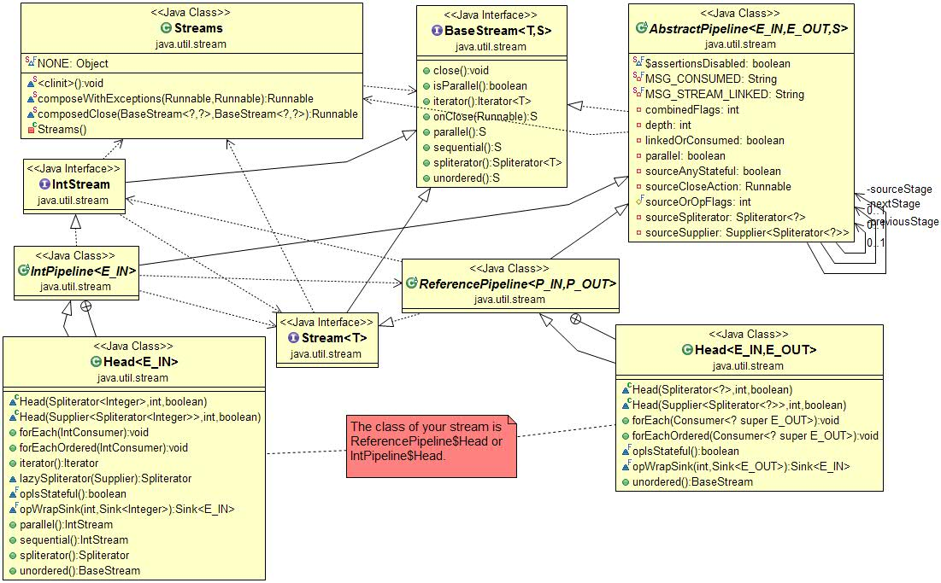
Topic 3 : Stream class hierarchy (NEW)

Slide 78
Topic 3-4 : Characteristics of the intermediate operations
Stream<T> Signature | Impact of sorted, ordered, distinct, sized | Stateful | FI stateless and non interfering | Short-circ.
Stream<T> BaseStream.onClose(Runnable closeHandler)
Stream<T> BaseStream.parallel() | The last call to sequential() or parallel() determines the nature of the stream.
Stream<T> BaseStream.sequential() | The last call to sequential() or parallel() determines the nature of the stream.
Stream<T> BaseStream.unordered()
Double/LongStream asDouble/LongStream()
Stream<Integer> boxed()
Stream<T> Stream.distinct() | For ordered streams, the selection of distinct elements is stable (for duplicated elements, the element appearing first in the encounter order is preserved.) For unordered streams, no stability guarantees are made. API Note: Full barrier for a // ordered stream. | YES
Stream<T> Stream.filter(Predicate<? super T> predicate) |  |  | YES
Stream<R> Stream.flatMap(Function<? super T,? extends Stream<? extends R>> mapper) | Each mapped stream is closed after its contents have been placed into this stream. (If a mapped stream is null, an empty stream is used, instead.) |  | YES
Stream<T> Stream.limit(int maxSize) | API Note: While limit() is generally a cheap operation on sequential stream pipelines, it can be quite expensive on ordered // pipelines, especially for large values of maxSize, since limit(n) is constrained to return not just any n elements, but the first n elements in the encounter order. | YES |  | YES
Stream<R> Stream.map(Function<? super T,? extends R> mapper) |  |  | YES
Stream<T> Stream.peek(Consumer<? super T> action) | For // stream pipelines, the action may be called at whatever time and in whatever thread the element is made available by the upstream operation. If the action modifies shared state, it is responsible for providing the required synchronization. API Note: This method exists mainly to support debugging, where you want to see the elements as they flow past a certain point in a pipeline. |  | YES
Stream<T> Stream.skip(long n) | API Note: While skip() is generally a cheap operation on sequential stream pipelines, it can be quite expensive on ordered // pipelines, especially for large values of n, since skip(n) is constrained to skip not just any n elements, but the first n elements in the encounter order. | YES
Stream<T> Stream.sorted() |  | YES
Stream<T> Stream.sorted(Comparator<? super T> comparator) |  | YES | YES
<U> Stream<U> Double/Int/LongStream.mapToInt/Long/Double (Double/Int/LongFunction<? extends U> mapper) |  |  | YES
<U> Stream<U> Double/Int/LongStream.flatMapToInt/Long/Double (Double/Int/LongFunction<? extends U> mapper) | Each mapped stream is closed after its contents have been placed into this stream. (If a mapped stream is null an empty stream is used, instead.) |  | YES

Slide 79
Topic 3 : Q&A
What is an intermediate operation?
How can you create a new intermediate operation?
What are the names of the different parts of the pipeline?
What are the benefits of streams over collections?
How do you create a Stream from a Collection, an array, an individual object, multiple individual objects, from an enum?
Give examples of specialized streams?
What is the difference between an IntStream and a Stream<Integer>?
What is laziness?
How could you prove the laziness in a pipeline?
How do you convert a stream of object to a stream of other objects?
How do you convert an object[] or Collection<Object> obtained from an object of the stream to another stream?
Give an example of filtering in a stream, a list and a set
Which intermediate operations use short-circuiting?
Can you write a stateless filter letting pass the elements 5 to 15?
How many times can you traverse a stream using a terminal operation?
Exercise: Read an Integer using the Console class then write the number added with 1 to 10 (use a method reference) then multiplied by 1 to 10. TODO
Exercise: Write the multiplication table (10x10) using streams. TODO
Exercise: How could you check if composition is used to simplify the pipeline processing?
Exercise: Unzip the Java 8 source code to see if java.util.stream.Stream is used in some API.

Slide 80
Topic 3 : Q&A
What is an intermediate operation? It takes a stream and return one, not automatically of the same type. It will filter, sort… It is lazy. If it was not then each intermediate operation would have to be fully executed cutting on the benefits of the streams (no fusion of the operations).
How can you create a new intermediate operation? You cannot really do that. Intermediate operations are locked. Or… create something taking a stream/spliterator in an returning a new stream but this is no more a single pipeline.
What are the names of the different parts of the pipeline? There is a source, typically a collection, one or many intermediate operations and a terminal operation.
What are the benefits of streams over collections? You give up the flow control but benefit from laziness, potential parallelism and simpler code. But the debug stack grows.
How do you create a Stream from a Collection, an array, an individual object, multiple individual objects, from an enum? Collection.stream(), Arrays.stream(), Stream.of(), Stream.of(…) (or using Stream.builder().add(), Arrays.stream(enum.values()), etc.
Give examples of specialized streams? BufferedReader.lines(), Files.lines(), Jar.stream(), Files.find(…)
What is the difference between an IntStream and a Stream<Integer>? The first deals with the int primitive, the second with the Integer wrapper. Due to unboxing the first one can be a better choice.

Slide 81
Topic 3 : Q&A
What is laziness? A capital sin! Intermediate operations do nothing of their own initiative until asked by the pipeline operation at right and then they just do the minimum required.
How could you prove the laziness in a pipeline? You could add a few peek() calls between the operations to see the returned values and the order. Look at LazinessDemonstrated.java.
How do you convert a stream of object to a stream of other objects? Using Stream<R> Stream.map(Function<T,R>).
How do you convert an object[] or Collection<Object> obtained from an object of the stream to another stream? Using Stream<R> flatMap(Function<? super T,? extends Stream<? extends R>> mapper) the function creating the new stream being Arrays.stream(T[]), Collection.stream() or other.
Give an example of filtering in a stream, a list, a map and a set int number = Cars.stream.filter(a -> a.getYear() > 1930).count(); myCarList.removeIf(a -> a.getYear() > 1930); // removing from the original list!!! myCarSet.removeIf(a -> a.getYear() > 1930); // removing from the original set!!!
Which intermediate operations use short-circuiting? limit() and this is the only one.
Can you write a stateless filter letting pass the elements 5 to 15? limit(15).skip5)

Slide 82
Topic 3 : Q&A
How many times can you traverse a stream using a terminal operation?
Only once or you will get an IllegalStateException.
Exercise: Read an Integer using the Console class then write the number added with 1 to 10 (use a method reference) then multiplied by 1 to 10.
Exercise: Write the multiplication table (10x10) using streams.
Exercise: How could you check if composition is used to simplify the pipeline processing?
Intermediate operations do nothing of their own initiative until asked by the pipeline operation at right and then they just do the minimum required.
Look at CompositionInAction.java Is composition used to merge the two filter() as a single one? Is composition used to compose two map() as a single one?
Put a breakpoint in the code of Predicate.andThen(), Function.andThen() , Function.compose() and debug the code.
Do you really think that full blown intermediate streams are created after each intermediate operation?
Search for “fuse” in [BGSLLE3]. What does it mean?

Slide 83

Topic 4 : Collection Operations with Lambda
Develop the code to extract data from an object using map()
Search for data using search methods including: findFirst(), findAny(), anyMatch(), allMatch(), noneMatch().
Describe the unique characteristics of the Optional class
Perform calculations using methods: count(), max(), min(), average(), sum()
Sort a collection using lambda expressions
Save results to a collection by using the collect() method and Collector class; including methods such as averagingDouble(), groupingBy(), joining(), partitioningBy()
No more intermediate operations.
Let’s talk terminal operations!

Slide 84
Topic 4 : Stream terminal operations
Here is a list of terminal (usually eager) operations:
Signature | Description
void BaseStream.close() | Closes this stream, causing all close handlers for this stream pipeline to be called. Called only in a try-with-resources or by an explicit call or by flatMap(). Class.finalize() does not call it.
boolean BaseStream.isParallel() | Returns whether this stream, if a terminal operation were to be executed, would execute in parallel.
Iterator<T> BaseStream.iterator() | Returns an iterator for the elements of this stream.
Spliterator<T> BaseStream.spliterator() | Returns a spliterator for the elements of this stream.
<R,A> R Stream.collect(Collector<? super T,A,R> collector) <R> R collect(Supplier<R> supplier, BiConsumer<R,? super T> accumulator, BiConsumer<R,R> combiner) | Performs a mutable reduction operation on the elements of this stream using a Collector. Performs a mutable reduction operation on the elements of this stream.
long Stream.count() | Returns the number of elements in a stream. The operation returns a long.
Optional<T> Stream.findAny() Optional<T> Stream.findFirst() | Returns an Optional describing some/the-first element of the stream, or an empty Optional if the stream is empty. (short circuit evaluation on these) findAny() is (should be) equivalent to findFirst() for an ordered stream. Makes more sense if a filter() is used.
boolean Stream.noneMatch(Predicate<T>) boolean Stream.anyMatch(Predicate<T>) boolean Stream.allMatch(Predicate<T>) | Returns whether none/any/all element(s) of this stream match(es) the provided predicate. (short circuit evaluation on these)
Optional<T> Stream.max(Comparator<? super T> comparator) Optional<T> Stream.min(Comparator<? super T> comparator) | Returns the maximum/minimum element of this stream according to the provided Comparator.
Optional<T> Stream.reduce(BinaryOperator<T> accumulator) T Stream.reduce(T identity, BinaryOperator<T> accumulator) <U> U Stream.reduce(U identity, BiFunction<U,? super T,U> accumulator, BinaryOperator<U> combiner) | Performs a reduction on the elements of this stream, using an associative accumulation function, and returns an Optional describing the reduced value, if any. Performs a reduction on the elements of this stream, using the provided identity value and an associative accumulation function, and returns the reduced value. Performs a reduction on the elements of this stream, using the provided identity, accumulation and combining functions.
Object[] Stream.toArray() <A> A[] Stream.toArray(IntFunction<A[]> generator) | Returns an array containing the elements of this stream. [using the provided generator function to allocate the returned array, as well as any additional arrays that might be required for a partitioned execution or for resizing.]
void Stream.forEach(Consumer<T>) void Stream.forEachOrdered(Consumer<? super T> action) | Performs an action for each element of this stream [, in the encounter order of the stream if the stream has a defined encounter order (Note: be it ORDERED or not!!!).]

Slide 85
Topic 4-1 : Develop the code to extract data from an object using map()
Example mapping Car to String:
static void usingMap() {
Stream.of(Car.values()).// Getting a stream source from the enum values map(a -> a.getBrand().toUpperCase()).// extraction/transformation forEach(System.out::println); // print the brands
Stream.of(Car.values()).// Getting a stream source from the enum values mapToInt(a -> a.getYear()).// could be shorter with Car::getYear forEach(System.out::println); // print the years
}
More generally we use a Function to convert/extract. The resulting Stream has generally a different type than the original one.
Implementation Note: If the boolean system property org.openjdk.java.util.stream.tripwire is set to true then diagnostic warnings are reported if boxing of primitive values occur when operating on primitive subtype specializations. This can be a clue to use mapToDouble/Int/Long() instead of map().
Signature | Description
<R> Stream<R> map(Function<? super T,? extends R> mapper) | Returns a stream consisting of the results of applying the given function to the elements of this stream.
Double/Int/LongStream mapToDouble/Int/Long(ToDouble/Int/LongFunction<? super T> mapper) | Returns a Double/Int/LongStream consisting of the results of applying the given function to the elements of this stream.

Slide 86
Topic 4-1 : Develop the code to extract data from an object using flatMap()
Example flat mapping some cars to something else:
Stream.of(Car.values()).//collection to stream flatMap(a -> a.getPossibleColors().stream()).// Stream<Color> forEach(System.out::println); // print colors
Stream.of(Car.values()).// array to stream flatMap(a -> Arrays.stream((a.getBrand().toUpperCase().split("")))).// // transformation to a Stream<String> …"F","O","R","D"... forEach(System.out::println); // print
Stream.of(Car.values()).// custom stream flatMapToInt(a -> a.getLastYear() != null ? IntStream.of(a.getYear(), a.getLastYear()) : IntStream.of(a.getYear())).// we get an IntStream forEach(System.out::println); // print first [and last year]
More generally, we use a Function to convert/extract an array, collection.. That we have to convert to a stream. The resulting Stream has generally a different type than the original one.
flatMap() automatically converts a null returned stream to an empty stream.
flatMap() automatically calls close() on the returned streams.
Signature | Description
<R> Stream<R> flatMap(Function<? super T,? extends Stream<? extends R>> mapper) | Returns a stream consisting of the results of replacing each element of this stream with the contents of a mapped stream produced by applying the provided mapping function to each element.
Double/Int/LongStream flatMapToDouble/Int/Long(Function<? super T,? extends Double/Int/LongStream> mapper) | Returns an Double/Int/LongStream consisting of the results of replacing each element of this stream with the contents of a mapped stream produced by applying the provided mapping function to each element.

Slide 87
Topic 4-2 : Search for data using search methods including: findFirst(), findAny(), anyMatch(), allMatch(), noneMatch()
Example of finding a Car:
static void findExample() {
Optional<Car> carFound = Stream.of(Car.values()).
filter(a -> a.getYear() > 1930).// filtering
findFirst();
// findAny() if sorted stream;
}
Example of testing a Predicate on the Stream:
static void matchExample() {
boolean predicateTrue = Stream.of(Car.values()).
anyMatch(a -> a.getYear() > 1930);
//allMatch();
//noneMatch();
}
Signature | Description
Optional<T> findAny() Optional<T> findFirst() | Returns an Optional describing some/the-first element of the stream, or an empty Optional if the stream is empty. (short circuit evaluation on these) findAny() is equivalent to findFirst() for a sequential stream. (should be) Makes more sense to use it if a filter() is used or if the map can be empty.
boolean noneMatch(Predicate<T>) boolean anyMatch(Predicate<T>) boolean allMatch(Predicate<T>) | Returns whether none/any/all element(s) of this stream match(es) the provided predicate. (short circuit evaluation on these). allMatch() and noneMatch() return true for an empty stream while anyMatch() returns false.

Slide 88
Topic 4-3 : Describe the unique characteristics of the Optional class
A null returned by map() (or emptiness) does not forbid to continue the pipeline but introduces some if/else logic.
The Optional<T> extends Object class allows (typically) to collect a single element from a Stream and possibly none if it is empty or if in the Stream filter() or skip() deny any element. (Javadoc below)
Optional<T>: A container object which may or may not contain a non-null value. If a value is present, isPresent() will return true and get() will return the value. Optional<T> is immutable.
Additional methods that depend on the presence or absence of a contained value are provided, such as orElse() (return a default value if value not present) and ifPresent() (execute a block of code if the value is present).
This is a value-based class; use of identity-sensitive operations (including reference equality (==), identity hash code, or synchronization) on instances of Optional may have unpredictable results and should be avoided.
Example displaying the brand of the first car of each owner:
enum Owner {
Olivier("Olivier", Car.FORESTER, CAR.ACCORD), Bruce("Bruce", Car.RAV4), Bob("Bob");
final String name; final Car[] cars;
Owner(String name, Car... cars) { this.name = name; this.cars = cars; } }
Arrays.stream(Owner.values()).//
map(o -> { return o.cars.length > 0 ? Optional.of(o.cars[0]) : Optional.empty(); }).// Stream<Optional<Car>>
forEach(System.out::println); // prints Optional[Forester] Optional[RAV4] Optional.empty
Arrays.stream(Owner.values()).//
map(o -> { return o.cars.length > 0 ? Optional.<Car> of(o.cars[0]) : Optional.<Car> empty(); }).// Stream<Optional<Car>>
map(oc -> oc.map(Car::getBrand)).// Stream<Optional<String>>
forEach(System.out::println); // prints Optional[Subaru] Optional[Honda] Optional.empty
Arrays.stream(Owner.values()).//
flatMap(o -> Arrays.stream(o.cars)).// Stream<Optional<Car>> shorter code with flatMap() but different behavior!!!
forEach(System.out::println); // prints Optional[Forester] Optional[Accord] Optional[RAV4]
Arrays.stream(Owner.values()).//
map(o -> Arrays.stream(o.cars).findFirst()).// cleanest, returns Optional[Forester] Optional[RAV4] Optional.empty
forEach(oc -> System.out.println(oc.map(Car::getBrand).orElse("zilch"))); // prints Optional[Subaru] Optional[Subaru] zilch

Slide 89
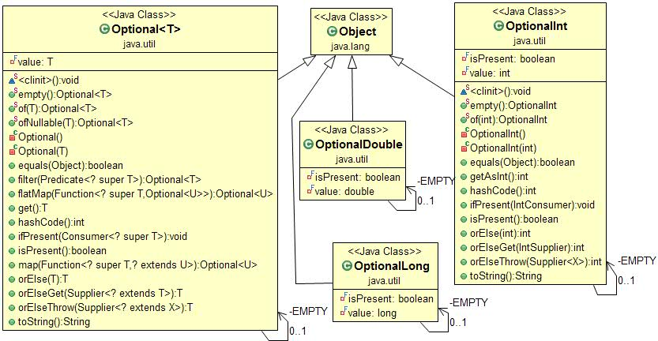
Topic 4-3 : Optional class and variations
OptionalInt, OptionalLong, OptionalDouble exist to support the primitive versions of the streams (IntStream…). The API is slightly different from the generic version.

Slide 90
Topic 4-3 : Optional<T> class API
Signature | Description
static <T> Optional<T> empty() | Returns an empty Optional instance.
boolean equals(Object obj) | Indicates whether some other object is "equal to" this Optional.
Optional<T> filter(Predicate<? super T> predicate) | If a value is present, and the value matches the given predicate, return an Optional describing the value, otherwise return an empty Optional.
<U> Optional<U> flatMap(Function<? super T,Optional<U>> mapper) | If a value is present, apply the provided Optional-bearing mapping function to it, return that result, otherwise return an empty Optional.
T get() | If a value is present in this Optional, returns the value, otherwise throws NoSuchElementException.
int hashCode() | Returns the hash code value of the present value, if any, or 0 (zero) if no value is present.
void ifPresent(Consumer<? super T> consumer) | If a value is present, invoke the specified consumer with the value, otherwise do nothing.
boolean isPresent() | Return true if there is a value present, otherwise false.
<U> Optional<U> map(Function<? super T,? extends U> mapper) | If a value is present, apply the provided mapping function to it, and if the result is non-null, return an Optional describing the result.
static <T> Optional<T> of(T value) | Returns an Optional with the specified present non-null value.
static <T> Optional<T> ofNullable(T value) | Returns an Optional describing the specified value, if non-null, otherwise returns an empty Optional.
T orElse(T other) | Return the value if present, otherwise return other.
T orElseGet(Supplier<? extends T> other) | Return the value if present, otherwise invoke other and return the result of that invocation.
<X extends Throwable> T orElseThrow(Supplier<? extends X> exceptionSupplier) | Return the contained value, if present, otherwise throw an exception to be created by the provided supplier.
String toString() | Returns a non-empty string representation of this Optional suitable for debugging.

Slide 91
Topic 4-3 : Optional<T> map() versus flatMap()
Optional<String> emptyString = Optional.empty();
Optional<String> notEmptyString = Optional.of("notempty");
// map(), wrapping the result with an Optional is done by the call
Optional<Integer> mapEmptyStringLength = emptyString.map(String::length);
Assert.assertTrue(!mapEmptyStringLength.isPresent());
Optional<Integer> mapNotEmptyStringLength = notEmptyString.map(String::length);
Assert.assertTrue(mapNotEmptyStringLength.isPresent());
Assert.assertEquals(Integer.valueOf(8),mapNotEmptyStringLength.get());
// flatMap(), you are in charge of returning the Optional
Optional<Integer> flatMapEmptyStringLength = emptyString.flatMap(s -> Optional.of(s.length()));
Assert.assertTrue(!flatMapEmptyStringLength.isPresent());
Optional<Integer> flatMapNotEmptyStringLength = notEmptyString.flatMap(s -> Optional.of(s.length()));
Assert.assertTrue(flatMapNotEmptyStringLength.isPresent());
Assert.assertEquals(Integer.valueOf(8),flatMapNotEmptyStringLength.get());
Map() and flatMap() do not exist for the primitive flavors of Optional.
Signature | Description
<U> Optional<U> flatMap(Function<? super T,Optional<U>> mapper) | If a value is present, apply the provided Optional-bearing mapping function to it, return that result, otherwise return an empty Optional.
<U> Optional<U> map(Function<? super T,? extends U> mapper) | If a value is present, apply the provided mapping function to it, and if the result is non-null, return an Optional describing the result.

Slide 92
Topic 4-4 : Perform calculations using methods: count(), max(), min(), average(), sum()
Example: [Note: average(), min(), max() and sum() exist only in Int/Long/DoubleStream]
static void calculation() {
long count1 = Stream.of(Car.values()).count();
long count2 = Stream.of(Car.values()).mapToInt(Car::getYear).count();
long count3 = Stream.of(Car.values()).collect(Collectors.counting());
Optional<Integer> max = Stream.of(Car.values()).map(a -> a.getYear()).max(Comparator.naturalOrder()); // stream of Comparable, same for min()
Optional<Integer> max2 = Stream.of(Car.values()).map(a -> a.getYear()).collect(Collectors.maxBy(Comparator.naturalOrder()));
Optional<Car> max3 = Stream.of(Car.values()).collect(Collectors.maxBy(Comparator.comparing(Car::getYear)));
OptionalInt max4 = Stream.of(Car.values()).mapToInt(Car::getYear).max();
intsum1 = Stream.of(Car.values()).collect(Collectors.summingInt(a -> a.getYear())); // ToIntFunction
int sum2 = Stream.of(Car.values()).mapToInt(Car::getYear).sum();
double average1 = Stream.of(Car.values()).collect(Collectors.averagingInt(a -> a.getYear())); // ToIntFunction
OptionalDouble average2 = Stream.of(Car.values()).mapToInt(Car::getYear).average();
}
Signature | Description
long Stream.count() | Returns the number of elements in a stream. The operation returns a long.
Optional<T> Stream.max/min(Comparator<? super T> comparator) | Returns the maximum/minimum element of this stream according to the provided Comparator. You can also use collect() using the approriate Collector: static <T> Collector<T,?,Optional<T>> Collectors.maxBy(Comparator<? super T> comparator)
static <T> Collector<T,?,Long/Int/Double> Collectors.summingLong/Int/Double(ToLong/Int/DoubleFunction<? super T> mapper) | Returns a Collector that produces the sum of a long/int/value-valued function applied to the input elements.
static <T> Collector<T,?,Double> Collectors.averagingLong/Int/Double(ToLong/Int/DoubleFunction<? super T> mapper) | Returns a Collector that produces the arithmetic mean of a long/int/double-valued function applied to the input elements.

Slide 93
Topic 4-5 : Sort a collection using lambda expressions
Example static void sortExample() { // with streams Stream.of(Car.values()).sorted(). forEach(System.out::println); // a -> {System.out.println(a);}
Stream.of(Car.values()).sorted((a, b) -> a.getYear() - b.getYear()).forEach(System.out::println);
// sorted collection, also PriorityQueue([Comparable<T>]), ConcurrentSkipListSet([Comparable<T>]) // Collectors.to[Concurrent]Map(…,Suplier<Map<>>) could do the trick // CollectorscollectingAndThen(Collector<T,A,R> downstream, Function<R,RR> finisher) too using a sort finisher Stream.of(Car.values()).collect(Collectors.toCollection(() -> new TreeSet<>())); // TreeSet::new
// with arrays and collections (cannot chain)
Arrays.sort(Car.values(), 1, 4, Comparator.comparing(Car::getYear));
Arrays.asList(Car.values()).sort((a, b) -> a.getYear() - b.getYear()); }
Below, this is not exactly sorting but doing an operation in the encounter order which implies some kind of preserved order.
Signature | Description | Side effect
Stream<T> Stream.sorted() | Returns a stream consisting of the elements of this stream, sorted according to natural order. | Blocks all outputs until there is no more input.
Stream<T> Stream.sorted(Comparator<? super T> comparator) | Returns a stream consisting of the elements of this stream, sorted according to the provided Comparator. | Blocks all outputs until there is no more input.
static void Arrays.sort(T[] [,int fromIndex, int toIndex] [,Comparator<? super T> c]) | Sorts the full array (or part of it if indices are provided) using the natural order of the elements (or the comparator if provided) | Modifies the original array!
default void List.sort(Comparator<? super T> c); | Sorts this list according to the order induced by the specified Comparator. | Modifies the original list!
Signature | Description
void Stream.forEach(Consumer<T>) void Sream.forEachOrdered(Consumer<? super T> action) | Performs an action for each element of this stream [, in the encounter order of the stream if the stream has a defined encounter order (Note: be it ORDERED or not!!!).]

Slide 94
Topic 4-6 : Using Stream.collect() method for various purpose
You can collect the elements of a Stream using either collect() or toArray(). (Javadoc below)
The class Collectors provides implementations of many common mutable reductions.
interface Collector<T,A,R>
Type Parameters:
T - the type of input elements to the reduction operation
A - the mutable accumulation type of the reduction operation (often hidden as an implementation detail)
R - the result type of the reduction operation (e.g. a Set, List, Optional, a scalar (count)…
A mutable reduction operation that accumulates input elements into a mutable result container, optionally transforming the accumulated result into a final representation after all input elements have been processed. Reduction operations can be performed either sequentially or in parallel.
A Collector is specified by four functions that work together to accumulate entries into a mutable result container, and optionally perform a final transform on the result. They are:
creation of a new result container (supplier())
incorporating a new data element into a result container (accumulator())
combining two result containers into one (combiner())
performing an optional final transform on the container (finisher())
Signature | Description
<R,A> R Stream.collect(Collector<? super T,A,R> collector) <R> R Stream.collect(Supplier<R> supplier, BiConsumer<R,? super T> accumulator, BiConsumer<R,R> combiner) | Performs a mutable reduction operation on the elements of this stream using a Collector. Performs a mutable reduction operation on the elements of this stream.

Slide 95
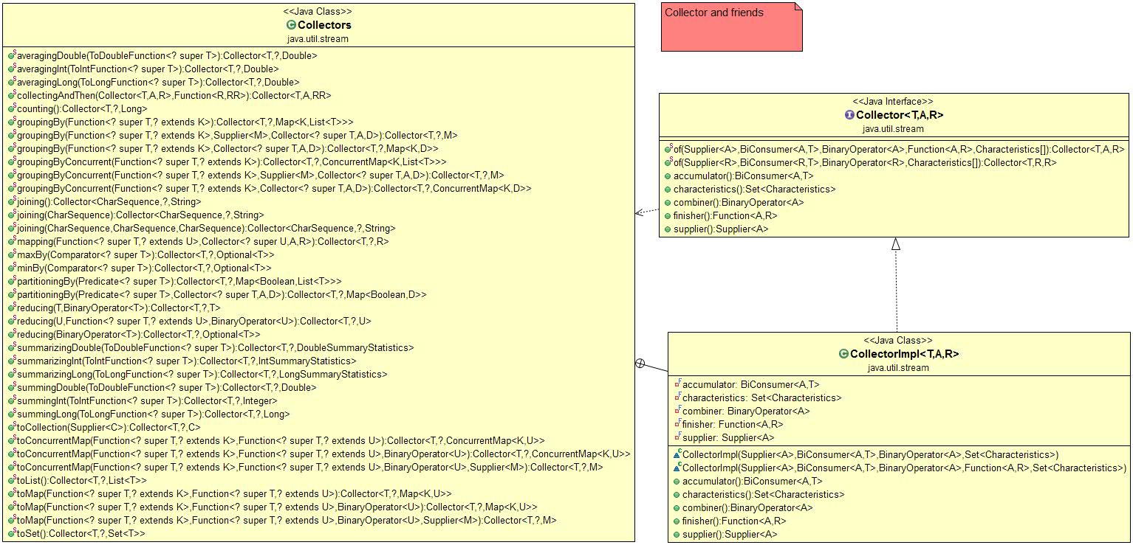
Topic 4 : Stream.collect() using a Collector (new)

Slide 96
Topic 4-6 : Collectors API: collecting the results 1/2
You can also “collect” the elements of a Stream using Stream.toArray() (Javadoc below)
You can obtain an iterator() or spliterator() from the stream or use forEach() to save the values. (Beware of managing a possible race condition when executed in parallel).
More generally, the different Collector implementations return among other choices different types of collections. The Collector used is passed in to Stream.collect().
Signature | Description
Object[] Stream.toArray() <A> A[] Stream.toArray(IntFunction<A[]> generator) | Returns an array containing the elements of this stream. [using the provided generator function to allocate the returned array, as well as any additional arrays that might be required for a partitioned execution or for resizing.]
Iterator<T> Stream.iterator() Spliterator<T> Stream.spliterator() | Returns a iterator for the elements of this stream. Returns a spliterator for the elements of this stream.
static <T,C extends Collection<T>> Collector<T,?,C>Collectors.toCollection(Supplier<C> collectionFactory) | Returns a Collector that accumulates the input elements into a new Collection, in encounter order.
static <T,K,U> Collector<T,?,[Concurrent]Map<K,U>> Collectors.to[Concurrent]Map(Function<? super T,? extends K> keyMapper, Function<? super T,? extends U> valueMapper) | Returns a [concurrent] Collector that accumulates elements into a [Concurrent]Map whose keys and values are the result of applying the provided mapping functions to the input elements.
static <T,K,U> Collector<T,?,[Concurrent]Map<K,U>> Collectors.to[Concurrent]Map(Function<? super T,? extends K> keyMapper, Function<? super T,? extends U> valueMapper, BinaryOperator<U> mergeFunction) | Returns a [concurrent] Collector that accumulates elements into a [Concurrent]Map whose keys and values are the result of applying the provided mapping functions to the input elements.
static <T,K,U,M extends [Concurrent]Map<K,U>> Collector<T,?,M> Collectors.to[Concurrent]Map(Function<? super T,? extends K> keyMapper, Function<? super T,? extends U> valueMapper, BinaryOperator<U> mergeFunction, Supplier<M> mapSupplier) | Returns a [concurrent] Collector that accumulates elements into a [Concurrent]Map whose keys and values are the result of applying the provided mapping functions to the input elements.
static <T> Collector<T,?,List<T>> Collectors.toList() | Returns a Collector that accumulates the input elements into a new List.
static <T> Collector<T,?,Set<T>> Collectors.toSet() | Returns a Collector that accumulates the input elements into a new Set.

Slide 97
Topic 4-6 : Collectors API: collecting the results 2/2
// Stream method
Car[] array = (Car[]) Stream.of(Car.values()).toArray();
// Stream method but no need to cast to a Car[]
Car[] array2 = Stream.of(Car.values()).toArray(Car[]::new);
// set
Set<Car> set = Stream.of(Car.values()).collect(Collectors.toSet());
// list
List<Car> list = Stream.of(Car.values()).collect(Collectors.toList());
// provide your own collection
Vector<Car> vector = Stream.of(Car.values()).collect(Collectors.toCollection(Vector::new));
// map using two mapping functions (also possible with your merger for similar results and Supplier<Map>
Map<String, String> map = Stream.of(Car.values()).collect(
Collectors.toMap(Car::getModel, Car::getBrand,
(u, v) -> {throw new IllegalStateException(String.format("Duplicate key %s", u));}, HashMap::new));
// there is no reduction here as this is a concurrent collector if this is a // stream, the same ConcurrentMap is used
Map<String, String> concurrentMap = Stream.of(Car.values()).collect(Collectors.toConcurrentMap(Car::getModel, Car::getBrand));
// equivalent to Collectors.toList()
List<Car> asList = Stream.of(Car.values()).collect(ArrayList::new, ArrayList::add, ArrayList::addAll);

Slide 98
Topic 4-6 : Collectors API: post-processing the results
You can post-process the results (off topic ?) to map the result of the collect() operation to anything of your choice.
// e.g. the collected list is converted to an immutable one
List<Car> list = Stream.of(Car.values()).//
collect(Collectors.collectingAndThen(
Collectors.toList(), // downstream
Collections::unmodifiableList)); // finisher
BaseStream.onClose(Runnable closeHandler) allows also some kind of work being done on close(). Remember that side effects are strongly discouraged.
The closing handlers added with onClose(…) are called in the reverse order (even if throwing an exception, all of them being collected to be rethrown)) by an explicit call to close. close() is also called if the stream is called in a try-with-resources. close() is not called by finalize(). [See OnCloseTest.java]
For a concatenated stream, close() of the main stream (not called automatically) closes first the tributaries. (see OnCloseTest.java).
For a flat-mapped stream close() is automatically called on the flattened streams (see OnCloseTest.java).
Signature | Description
Stream<T> Stream.onClose(Runnable closeHandler) | Returns an equivalent stream with an additional close handler.
static <T,A,R,RR> Collector<T,A,RR> Collectors.collectingAndThen(Collector<T,A,R> downstream, Function<R,RR> finisher) | Adapts a Collector to perform an additional finishing transformation.

Slide 99
Topic 4-6 : Collectors API: averagingXXX(), summingXXX () and summarizingXXX()
// for the average, the end result is a double whatever the parameters
double average1 = Stream.of(Car.values()).collect(Collectors.averagingInt (a -> a.getYear())); // ToIntFunction double average2 = Stream.of(Car.values()).collect(Collectors.averagingLong(a -> a.getYear())); // ToLongFunction (widening)
double average3 = Stream.of(Car.values()).collect(Collectors.averagingDouble(a -> a.getYear())); // ToDoubleFunction (w…)
// you can as well get the sum with summingXXX() int sum1 = Stream.of(Car.values()). collect(Collectors.summingInt(a -> a.getYear())); // ToIntFunction
long sum2 = Stream.of(Car.values()).collect(Collectors.summingLong(a -> a.getYear())); // ToLongFunction (widening)
double sum3 = Stream.of(Car.values()).collect(Collectors.summingDouble(a -> a.getYear())); // ToDoubleFunction (w...) // if you want minimum, maximum, count, average and sum together... use summarizingXXX()
IntSummaryStatistics stats1 = Stream.of(Car.values()).collect(Collectors.summarizingInt(a -> a.getYear())); // ToIntFunction
LongSummaryStatistics stats2 = Stream.of(Car.values()).collect(Collectors.summarizingLong(a -> a.getYear())); // ToLongFunction (widening)
DoubleSummaryStatistics stats3 = Stream.of(Car.values()).collect(Collectors.summarizingDouble(a -> a.getYear())); // ToDoubleFunction (w...)
System.out.println("Min: " + stats1.getMin());
System.out.println("Max: " + stats1.getMax());
System.out.println("Average: " + stats1.getAverage());
System.out.println("Count: " + stats1.getCount());
System.out.println("Sum: " + stats1.getSum());
Signature | Description
static <T> Collector<T,?,Double> Collectors.averagingInt/Long/Double(ToInt/Long/DoubleFunction<? super T> mapper) | Returns a Collector that produces the arithmetic mean of a int/lng/double-valued function applied to the input elements.
static <T> Collector<T,?,Integer/Long/Double> Collectors.summingInt/Long/Double(ToInt/Long/DoubleFunction<? super T> mapper) | Returns a Collector that produces the sum of a int/long/double-valued function applied to the input elements.
static <T> Collector<T,?,Int/Long/DoubleSummaryStatistics> Collectors.summarizingInt/Long/Double(ToInt/Long/DoubleFunction<? super T> mapper) | Returns a Collector which applies an int/long/double-producing mapping function to each input element, and returns summary statistics for the resulting values.

Slide 100
Topic 4-6 : Collectors API: groupingBy()
// we get a Map<Car.brand,List<Car>> as a result, the cars are grouped by brand
Map<String, List<Car>> map1 = Stream.of(Car.values()).collect(Collectors.groupingBy(Car::getBrand));
System.out.println(map1);
// {Toyota=[ECHO, RAV4], Subaru=[FORESTER, IMPREZA], Ford=[Escort, ModelT], Honda=[ACCORD]}
// provide your downstream collector (toList() by default)
Map<String, List<Car>> map2 = Stream.of(Car.values()).collect(Collectors.groupingBy(Car::getBrand,Collectors.toList()));
// provide your supplier too (HashMap by default)
Map<String, List<Car>> map3 = Stream.of(Car.values()).collect(Collectors.groupingBy(Car::getBrand,HashMap::new,
Collectors.toList())); Using groupingByConcurrentMap() the same ConcurrentMap is reused by all the threads if this is a parallel stream hence there is no reduction. The reduction on a Collector applies only when using a parallel stream.
Signature | Description
static <T,K> Collector<T,?,[Concurrent]Map<K,List<T>>> Collectors.groupingBy[Concurrent](Function<? super T,? extends K> classifier) | Returns a [concurrent] Collector implementing a "group by" operation on input elements of type T, grouping elements according to a classification function.
static <T,K,A,D> Collector<T,?,[Concurrent]Map<K,D>> Collectors.groupingBy[Concurrent](Function<? super T,? extends K> classifier, Collector<? super T,A,D> downstream) | Returns a [concurrent] Collector implementing a cascaded "group by" operation on input elements of type T, grouping elements according to a classification function, and then performing a reduction operation on the values associated with a given key using the specified downstream Collector.
static <T,K,A,D,M extends [Concurrent]Map<K,D>> Collector<T,?,M> Collectors.groupingBy[Concurrent](Function<? super T,? extends K> classifier, Supplier<M> mapFactory, Collector<? super T,A,D> downstream) | Returns a [concurrent] Collector implementing a cascaded "group by" operation on input elements of type T, grouping elements according to a classification function, and then performing a reduction operation on the values associated with a given key using the specified downstream Collector.

Slide 101
Topic 4-6 : Collectors API: joining()
// you need having a Stream<CharSequence> or you have to map() it before the method
// we get a concatenated list of car names
String joined1 = Stream.of(Car.values()).map(Car::toString).collect(Collectors.joining());
System.out.println(joined1);
// FORESTERIMPREZAACCORDECHORAV4EscortModelT
// we get a concatenated list of car names with a separator
String joined2 = Stream.of(Car.values()).map(Car::toString).collect(Collectors.joining(","));
System.out.println(joined2);
// FORESTER,IMPREZA,ACCORD,ECHO,RAV4,Escort,ModelT
// we get a concatenated list of car names with a separator, a prefix, a suffix
String joined3 = Stream.of(Car.values()).map(Car::toString).collect(Collectors.joining(",", "<", ">"));
System.out.println(joined3);
// <FORESTER,IMPREZA,ACCORD,ECHO,RAV4,Escort,ModelT>
Signature | Description
static Collector<CharSequence,?,String> Collectors.joining() | Returns a Collector that concatenates the input elements into a String, in encounter order.
static Collector<CharSequence,?,String> Collectors.joining(CharSequence delimiter) | Returns a Collector that concatenates the input elements, separated by the specified delimiter, in encounter order.
static Collector<CharSequence,?,String> Collectors.joining(CharSequence delimiter, CharSequence prefix, CharSequence suffix) | Returns a Collector that concatenates the input elements, separated by the specified delimiter, with the specified prefix and suffix, in encounter order.

Slide 102
Topic 4-6 : Collectors API: partitioningBy()
// This is a specialized version of groupingBy()
// we get a Map<Boolean,List<Car>> as a result, the cars are grouped by the predicate result
Map<Boolean, List<Car>> map1 = Stream.of(Car.values()).collect(
Collectors.partitioningBy(Car::isRecent));
System.out.println(map1);
// {false=[ModelT], true=[FORESTER, IMPREZA, ACCORD, ECHO, RAV4, Escort]}
// provide your downstream collector (toList() by default)
Map<Boolean, List<Car>> map2 = Stream.of(Car.values()).collect(
Collectors.partitioningBy(Car::isRecent, Collectors.toList())); // same output
Signature | Description
static <T> Collector<T,?,Map<Boolean,List<T>>> Collectors.partitioningBy(Predicate<? super T> predicate) | Returns a Collector which partitions the input elements according to a Predicate, and organizes them into a Map<Boolean, List<T>>.
static <T,D,A> Collector<T,?,Map<Boolean,D>> Collectors.partitioningBy(Predicate<? super T> predicate, Collector<? super T,A,D> downstream) | Returns a Collector which partitions the input elements according to a Predicate, reduces the values in each partition according to another Collector, and organizes them into a Map<Boolean, D> whose values are the result of the downstream reduction.

Slide 103
Topic 4 : Stream<T> versus IntStream terminal operations
Stream <T> Signature | Stream<T> Description | IntStream
void BaseStream.close() | Closes this stream, causing all close handlers for this stream pipeline to be called. | same
boolean BaseStream.isParallel() | Returns whether this stream, if a terminal operation were to be executed, would execute in parallel. | same
Iterator<T> BaseStream.iterator() | Returns an iterator for the elements of this stream. | same
Spliterator<T> BaseStream.spliterator() | Returns a spliterator for the elements of this stream. | same
<R,A> R Stream.collect(Collector<? super T,A,R> collector) <R> R collect(Supplier<R> supplier, BiConsumer<R,? super T> accumulator, BiConsumer<R,R> combiner) | Performs a mutable reduction operation on the elements of this stream using a Collector. Performs a mutable reduction operation on the elements of this stream. | N/A same (Supplier<R> supplier, ObjIntConsumer<R> accumulator, BiConsumer<R,R> combiner))
long Stream.count() | Returns the number of elements in a stream. The operation returns a long. | same
Optional<T> Stream.findAny() Optional<T> Stream.findFirst() | Returns an Optional describing some/the-first element of the stream, or an empty Optional if the stream is empty. (short circuit evaluation on these) findAny() is equivalent to findFirst() for an ordered stream. Makes more sense if a filter() is used. | same (OptionalInt)
Equivalent can be done with a Collector. | Returns an OptionalDouble describing the arithmetic mean of elements of this stream, or an empty optional if this stream is empty. For the sum, an empty stream gives 0. | sum(), average()
boolean Stream.noneMatch(Predicate<T>) boolean Stream.anyMatch(Predicate<T>) boolean Stream.allMatch(Predicate<T>) | Returns whether none/any/all element(s) of this stream match(es) the provided predicate. (short circuit evaluation on these) | same (IntPredicate)
Optional<T> Stream.max(Comparator<? super T> comparator) Optional<T> Stream.min(Comparator<? super T> comparator) | Returns the maximum/minimum element of this stream according to the provided Comparator. An empty optional is returned if this stream is empty. | same (no Comparator)
Optional<T> Stream.reduce(BinaryOperator<T> accumulator) T Stream.reduce(T identity, BinaryOperator<T> accumulator) <U> U Stream.reduce(U identity, BiFunction<U,? super T,U> accumulator, BinaryOperator<U> combiner) | Performs a reduction on the elements of this stream, using an associative accumulation function, and returns an Optional describing the reduced value, if any. Performs a reduction on the elements of this stream, using the provided identity value and an associative accumulation function, and returns the reduced value. Performs a reduction on the elements of this stream, using the provided identity, accumulation and combining functions. | same (int identity, IntBinaryOperator op)
Object[] Stream.toArray() <A> A[] Stream.toArray(IntFunction<A[]> generator) | Returns an array containing the elements of this stream. [using the provided generator function to allocate the returned array, as well as any additional arrays that might be required for a partitioned execution or for resizing.] | Same (toArray() only)
void Stream.forEach(Consumer<T>) void Stream.forEachOrdered(Consumer<? super T> action) | Performs an action for each element of this stream [, in the encounter order of the stream if the stream has a defined encounter order (Note: be it ORDERED or not!!!).] | same (IntConsumer)

Slide 104
Topic 4 : Characteristics of the non intermediate operations
Stream <T> Signature | Impact of sorted, ordered, distinct, sized | Eager | Short circ. | FI (associat., )non interfering, (stateless) | Perf. // Impact for an ordered stream
void BaseStream.close()
boolean BaseStream.isParallel()
Iterator<T> BaseStream.iterator()
Spliterator<T> BaseStream.spliterator() | Lazy methods. See SpliteratorMethodsAreLazy.java.
<R,A> R Stream.collect(Collector<? super T,A,R> collector) <R> R collect(Supplier<R> supplier, BiConsumer<R,? super T> accumulator, BiConsumer<R,R> combiner) | If the stream is parallel, and the Collector is concurrent, and either the stream is unordered or the collector is unordered, then a concurrent reduction will be performed (see Collector for details on concurrent reduction.) When executed in parallel, multiple intermediate results may be instantiated, populated, and merged so as to maintain isolation of mutable data structures. Therefore, even when executed in parallel with non-thread-safe data structures (such as ArrayList), no additional synchronization is needed for a parallel reduction. | YES |  |  | YES
long Stream.count() |  | YES
Optional<T> Stream.findAny() Optional<T> Stream.findFirst() |  | YES | YES |  | NO YES
IntStream.sum(), IntStream.average() |  | YES
boolean Stream.noneMatch(Predicate<T>) boolean Stream.anyMatch(Predicate<T>) boolean Stream.allMatch(Predicate<T>) |  | YES | YES | YES
Optional<T> Stream.max(Comparator<? super T> comparator) Optional<T> Stream.min(Comparator<? super T> comparator) | sum(), min(), max(), average(), and joining() are all special cases of reduce(). reduce() operation parallelize gracefully. | YES |  | YES
Optional<T> Stream.reduce(BinaryOperator<T> accumulator) T Stream.reduce(T identity, BinaryOperator<T> accumulator) <U> U Stream.reduce(U identity, BiFunction<U,? super T,U> accumulator, BinaryOperator<U> combiner) | Is not constrained to execute sequentially! (???) Thread-safe code. | YES |  | YES (assoc) | ??
Object[] Stream.toArray() <A> A[] Stream.toArray(IntFunction<A[]> generator) |  | YES |  |  | ???
void Stream.forEach(Consumer<T>) void Stream.forEachOrdered(Consumer<? super T> action) | forEach() is nondeterministic. For parallel stream pipelines, this operation does not guarantee to respect the encounter order of the stream. Use forEachOrdered() if the order matters. The operations can be done by different threads but there is an happens-before between operations. | YES |  | YES (assoc) | NO YES

Slide 105
Topic 4 : Q&A
In a Stream, can you deal with nulls returned by the Stream source? If returned by map()? If returned by flatMap().
Which terminal operations are lazy and which ones are eager?
Can you write your own terminal operation?
Can you write your own short-circuit collector or reduction?
Stream being an interface, what is the concreate class implementing Stream<Car>?
What are the benefits of Optional<T>? Where is it used in the API and potentially by you?
How would you write a Stream returning the first filtered element or throwing an exception of your choice if none is found? What about returning a default value if not found?
What are the terminal functions returning a boolean? Any special property? Which signature?
What are the terminal functions returning an Optional<T>? Which signature?
What are the terminal functions returning a long? Which signature?
What are the terminal functions returning an int? Which signature?
What are the terminal functions returning a double? Which signature?
How can I get statistics on my Stream scalar values? Which signature?
Describe the class relationship between OptionalInt and Optional?
How can I convert my Stream<T> to an IntStream? And my IntStream to a Stream<Car>?
What is the difference between Collectors.groupingBy(), joining() and partitioningBy()? What are the return types?
What happens if I call distinct(), sorted(), unordered()… on a stream having already this characteristic?
What happens to the Spliterator estimate for the size if there is a filter upstream?
Generally for a() being any intermediate operation, is myStream.a() the same instance as myStream or a new stream? And for map()?
Other questions from the 2 days course

Slide 106
Topic 4 : Q&A
Exercise: Show how the characteristics of the stream can be changing before/after some intermediate operations.
Exercise: Write your max() collector taking an Optional<Comparator<T>> parameter.
Exercise: Write a findLast() Collector? (w/o using special intermediate operations)
Exercise: Create a Collector returning an EnumSet populated from the Enum values of the stream.
Exercise: Create a Collector returning a sorted map populated from the values of the stream mapped to keys and values.
Exercise: Return a sorted list using Collectors.collectingAndThen().
Exercise: Write your collector adding standard deviation…, slope… to the base statistical values.
Exercise: Using peek() with thread names, show that the parallel steam executes in parallel.
Exercise: Create a “shuffle” Collector returning a fully shuffled stream from the input stream.
Exercise: Create you collector for toList(), toSet(), toMap(), toConcurrentMap(), joining(), groupBy(), partitioningBy()
Exercise: Write a factorial function using a stream and a reduction?

Slide 107
Topic 5 : Parallel Streams
Develop the code that use parallel streams
Implement decomposition, reduction in streams

Slide 108
Topic 5 : Examples of creating parallel streams (1/2)
A stream can be created parallel from the start or can become parallel.
// the easiest solution is to get a sequential or parallel stream from a stream source but there is no parallel flag available
List<Car> list = Stream.of(Car.values()).collect(Collectors.toList());
Stream<Car> sequentialStream = list.stream();
Stream<Car> parallelStream = list.parallelStream();
// you can simply change your mind and call sequential() or parallel() to change the nature of the stream
sequentialStream = parallelStream.sequential();
// the last call to sequential() or parallel is the choice for the whole operation
Stream<Car> stream = Arrays.stream(Car.values())
.parallel()
.peek(c -> { System.out.println(Thread.currentThread().getName() + ": " + c + “/” + c.getYear());})
.count());
System.out.println(Thread.currentThread().getName() + ": " + stream.count());
********** count() test ********* (peek() unordered)
main: RAV4
ForkJoinPool.commonPool-worker-6: ECHO
ForkJoinPool.commonPool-worker-4: Escort
ForkJoinPool.commonPool-worker-3: FORESTER
ForkJoinPool.commonPool-worker-5: ACCORD
ForkJoinPool.commonPool-worker-1: IMPREZA
ForkJoinPool.commonPool-worker-2: ModelT
Main: 7
A Spliterator is the parallel analogue of an Iterator; it describes a (possibly infinite) collection of elements, with support for sequentially advancing, bulk traversal, and splitting off some portion of the input into another spliterator which can be processed in parallel. At the lowest level, all streams are driven by a spliterator. (source [JDstream]).
Operations using a Spliterator that cannot split, or does so in a highly imbalanced or inefficient manner, are unlikely to benefit from parallelism. Traversal and splitting exhaust elements; each Spliterator is useful for only a single bulk computation. (source [JDSpliterator]).

Slide 109
Topic 5 : Examples of creating parallel streams (2/2)
// Using the generic StreamSupport factory and a Spliterator
// use instead StreamSupport to create the stream from a Spliterator
// boolean parallel = true;
// OfInt is a "subset" of the methods of the IntSream Spliterator (same for long and double)
OfInt ofInt = …;
// Create the stream from a (simpler) Spliterator or a supplier of it, optional Spliterator characteristics and your choice
IntStream intStream1 = StreamSupport.intStream(() -> ofInt, Spliterator.CONCURRENT, parallel);
IntStream intStream2 = StreamSupport.intStream(ofInt, parallel);
// Create the stream from a (simpler) Spliterator or a supplier of it, optional Spliterator characteristics and your choice
Spliterator<Car> spliteratorCar = …; // you can create an unoptimized Spliterator from an Iterator using the Spliterators class
Stream<Car> carStream1 = StreamSupport.stream(() -> spliteratorCar, Spliterator.CONCURRENT + Spliterator.NONNULL, parallel);
Stream<Car> carStream2 = StreamSupport.stream(spliteratorCar, parallel);
// you can get an Iterator and a Spliterator from a Stream
Spliterator<Car> mySpliterator = parallelStream.spliterator();
Iterator<Car> myIterator = parallelStream.iterator();
// you can convert Iterator and Spliterator to each other with the class Spliterators (10 is the estimated size)
Spliterator<Car> mySpliterator2 = Spliterators.spliterator(Spliterators.iterator(mySpliterator), 10, Spliterator.CONCURRENT);

Slide 110
Topic 5 : Differences of behavior between parallel and sequential streams (new)
Using a parallel stream, the syntax is identical for the intermediate and terminal operations involved.
Some operations will have an identical result (e.g. count()) while other may have it potentially different (findAny()).
Except if specified otherwise, the results should be the same for a parallel stream and for a sequential stream.
It’s up to you to use stateless, associative and thread-safe functions and code in your parallel streams. Now your code is concurrent.
TODO same table for the intermediate operations TODO same table for the collectors
Stream <T> Signature | Parallel stream vs sequential stream (ordered) | Parallel stream versus sequential stream (unordered)
void BaseStream.close() | Same | Same
boolean BaseStream.isParallel() | true vs false | true vs false
Iterator<T> BaseStream.iterator() | Same order of the elements (?) | Random order of the elements (?)
Spliterator<T> BaseStream.spliterator() | Same characteristics (?) Same order of the elements (?) | Same characteristics (?) Random order of the elements (?)
<R,A> R Stream.collect(Collector<? super T,A,R> collector) <R> R collect(Supplier<R> supplier, BiConsumer<R,? super T> accumulator, BiConsumer<R,R> combiner) | Depends on the collector and its characteristics | Depends on the collector and its characteristics
long Stream.count() | Same | Same
Optional<T> Stream.findAny() Optional<T> Stream.findFirst() | Any element versus first (first in practice?) Same | Any element versus first Same ? (JD say that any value can be returned)
IntStream.sum(), IntStream.average() | Same | Same
boolean Stream.noneMatch(Predicate<T>) boolean Stream.anyMatch(Predicate<T>) boolean Stream.allMatch(Predicate<T>) | Same | Same
Optional<T> Stream.max(Comparator<? super T> comparator) Optional<T> Stream.min(Comparator<? super T> comparator) | Same | Same
Optional<T> Stream.reduce(BinaryOperator<T> accumulator) T Stream.reduce(T identity, BinaryOperator<T> accumulator) <U> U Stream.reduce(U identity, BiFunction<U,? super T,U> accumulator, BinaryOperator<U> combiner) | ??? TODO | ???
Object[] Stream.toArray() <A> A[] Stream.toArray(IntFunction<A[]> generator) | Same (?) stream | Random vs. stream order (?)
void Stream.forEach(Consumer<T>) void Stream.forEachOrdered(Consumer<? super T> action) | Random order Same (happens-before) | Random order Same (happens-before) (Note: be it ORDERED or not!!!)

Slide 111
Topic 5 : Examples of difference of behavior (new)
stream.forEach(c -> {
System.out.println( Thread.currentThread().getName() + ": forEach " + c);
});
** (peek() and forEach() unordered)
ForkJoinPool.commonPool-worker-5: peek IMPREZA/1992
ForkJoinPool.commonPool-worker-3: peek ACCORD/1989
main: peek RAV4/2000
main: forEach RAV4
ForkJoinPool.commonPool-worker-2: peek ECHO/1999
ForkJoinPool.commonPool-worker-6: peek FORESTER/1998
ForkJoinPool.commonPool-worker-7: peek Escort/1968
ForkJoinPool.commonPool-worker-1: peek ModelT/1908
ForkJoinPool.commonPool-worker-7: forEach Escort
ForkJoinPool.commonPool-worker-6: forEach FORESTER
ForkJoinPool.commonPool-worker-2: forEach ECHO
ForkJoinPool.commonPool-worker-3: forEach ACCORD
ForkJoinPool.commonPool-worker-5: forEach IMPREZA
ForkJoinPool.commonPool-worker-1: forEach ModelT
stream.forEachOrdered(c -> {
System.out.println( Thread.currentThread().getName() + ": forEachOrdered " + c);
});
** (peek() unordered, forEachOrdered() ordered)
ForkJoinPool.commonPool-worker-3: peek FORESTER/1998
ForkJoinPool.commonPool-worker-3: forEachOrdered FORESTER
ForkJoinPool.commonPool-worker-2: peek Escort/1968
ForkJoinPool.commonPool-worker-5: peek ModelT/1908
main: peek RAV4/2000
ForkJoinPool.commonPool-worker-6: peek ACCORD/1989
ForkJoinPool.commonPool-worker-1: peek IMPREZA/1992
ForkJoinPool.commonPool-worker-7: peek ECHO/1999
ForkJoinPool.commonPool-worker-1: forEachOrdered IMPREZA << previous line in order but different thread than before (1 vs. 3)
<< the only requirement is an happens-before between calls
<< Having an unordered stream makes no difference!!!
ForkJoinPool.commonPool-worker-1: forEachOrdered ACCORD
ForkJoinPool.commonPool-worker-1: forEachOrdered ECHO
ForkJoinPool.commonPool-worker-1: forEachOrdered RAV4
ForkJoinPool.commonPool-worker-1: forEachOrdered Escort
ForkJoinPool.commonPool-worker-1: forEachOrdered ModelT
The order as defined in the enum and as well in the stream is:
FORESTER("Subaru", "Forester", 1998), //
IMPREZA("Subaru", "Impreza", 1992), //
ACCORD("Honda", "Accord", 1989), //
ECHO("Toyota", "Echo", 1999, 2005), //
RAV4("Toyota", "Rav4", 2000), //
Escort("Ford", "Escort", 1968, 2002), //
ModelT("Ford", "Model-T", 1908, 1927);//

Slide 112
Topic 5 : Parallel streams are driven by Spliterators
A Spliterator is like an Iterator but it allows decomposing a stream in two for each call to trySplit(). A Spliterator is not mandated to be thread safe. Typically you do not deal with a Spliterator, just with the Stream. If you extend the Collection framework or want to expose a value as a Stream then you may need to provide your own Spliterator.
You can get an Iterator and a Spliterator from an existing Stream (iterator() and spliterator()).
With StreamSupport, you can, at your choice, build a sequential or parallel stream from a Spliterator.
Spliterators contains multiple factories made from an Iterator, an array or other.
With Spliterators, you can get an Iterator from a Spliterator and vice versa.
Specialized classed have specialized iterators and spliterators which are more source aware and more efficient than the default ones coming with the interfaces or with their parent class.
Stream <T> Signature | Stream<T> Description
int characteristics() | int characteristics()
long estimateSize() | Returns an estimate of the number of elements that would be encountered by a forEachRemaining(java.util.function.Consumer<? super T>) traversal, or returns Long.MAX_VALUE if infinite, unknown, or too expensive to compute.
default void forEachRemaining(Consumer<? super T> action) | Performs the given action for each remaining element, sequentially in the current thread, until all elements have been processed or the action throws an exception.
default Comparator<? super T> getComparator() | If this Spliterator's source is SORTED by a Comparator, returns that Comparator.
default long getExactSizeIfKnown() | Convenience method that returns estimateSize() if this Spliterator is SIZED, else -1.
default boolean hasCharacteristics(int characteristics) | Returns true if this Spliterator's characteristics() contain all of the given characteristics.
boolean tryAdvance(Consumer<? super T> action) | If a remaining element exists, performs the given action on it, returning true; else returns false.
Spliterator<T> trySplit() | If this spliterator can be partitioned, returns a Spliterator covering elements, that will, upon return from this method, not be covered by this Spliterator.

Slide 113
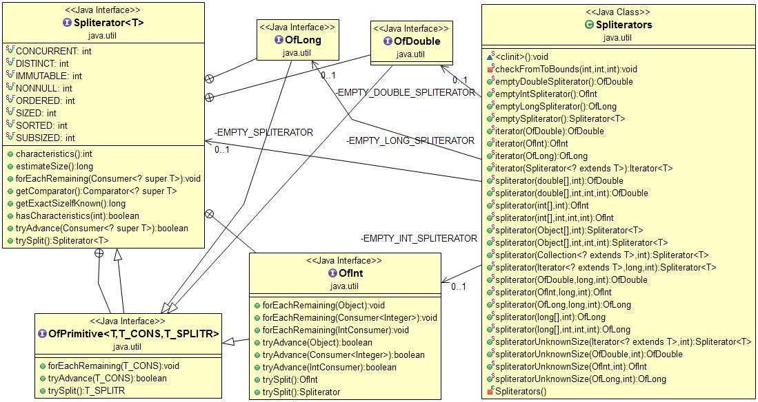
Topic 5 : Spliterator hierarchy

Slide 114
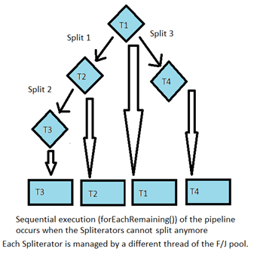
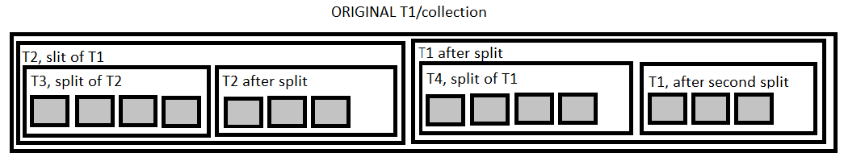
Topic 5 : Spliterator in action and decomposition process
If the stream is sequential, the stream framework basically calls Spliterator.forEachRemaining(consumerCorrespondingToThePipeLineSteps) to process the pipeline for each element of the stream.
If the stream is parallel, the framework calls Spliterator.trySplit() to divide the work to be done in two, the halves not being automatically equal in size, everything depending on the quality of the characteristics of the spliterator and the nature of the stream (e.g. infinite stream).
The new Spliterator and the old one are called recursively on trySplit(). When they cannot split anymore, forEachRemaining(…) is called instead to process what is left.
Each split is passed in to a new Fork/Join task put in the Java 7 F/J pool to be processed.
This is the “decomposition process” (divide to conquer).
For most of the stream operations, the work will not be complete without a “reduction process”, building a single result from the various individual results: summing the results, looking for the maximum value, putting the values in some collection, reordering them if needed…
Note: In 1.8, the Iterator class has a new default method void forEachRemaining(Consumer<? super T> action) similar to the one of Spliterator. E.g. myIterator.forEachRemaining(System.out::println);

Slide 115
Topic 5 : Streams and Spliterators characteristics [JDSpliterator]
Charact. | Description | Example Counter-example | Added with | Removed with
IMMUTABLE | Characteristic value signifying that the element source cannot be structurally modified; that is, elements cannot be added, replaced, or removed, so such changes cannot occur during traversal. | + array - ArrayList | None. Looks like coming from the source. | Stream.concat() with a non… immutable stream TODO confirm each for split.
CONCURRENT | Characteristic value signifying that the element source may be safely concurrently modified (allowing additions, replacements, and/or removals) by multiple threads without external synchronization. | + ConcurrentHashMap - ArrayList | None. Looks like coming from the source. | Stream.concat() with a non…
DISTINCT | Characteristic value signifying that, for each pair of encountered elements x, y, !x.equals(y). | + HashSet - ArrayList | distinct() | Stream.concat() with a non… map(), mapToXXX() , flatMap(), flatMapToXXX()
NONNULL | Characteristic value signifying that the source guarantees that encountered elements will not be null. | + HashSet (not IntStream as expected ! TODO BUG?) | TODO should it be added by mapToXXX () | Stream.concat() with a non… TODO map methods too
ORDERED | Characteristic value signifying that an encounter order is defined for elements. | + ArrayList - HashSet | sorted() | Stream.concat() with a non… unordered()
SORTED | Characteristic value signifying that encounter order follows a defined sort order. | + TreeMap, TreeSet - HashSet, ArrayList | sorted() | Stream.concat() with a non… Should be with unordered() but is not. BUG! map(), mapToXXX(), flatMap() , flatMapToXXX()
SIZED | Characteristic value signifying that the value returned from estimateSize() prior to traversal or splitting represents a finite size that, in the absence of structural source modification, represents an exact count of the number of elements that would be encountered by a complete traversal. | + HashSet -Stream.generate<Supplier<>) -ConcurrentSkipListSet | limit() should but does not. BUG? It is a max but… | Stream.concat() with a non… filter(), flatMap(), flatMapToXXX(), distinct()
SUBSIZED | Characteristic value signifying that all Spliterators resulting from trySplit() will be both SIZED and SUBSIZED. | + HashSet - Stream.generate(Supplier<T>) | limit() should but does not. BUG? | Stream.concat() with a non… TODO test filter() and flatMap()
Invariants: A source is IMMUTABLE, CONCURRENT or none of them and in this case must document its policy for the detection of structural interference. A SORTED source is also ORDERED. A SUBSIZED source is also SIZED or is inconsistent. A source should be CONCURRENT, SIZED or none of them but not both. An infinite stream cannot be SIZED.
The characteristics of the source (may) have an impact on the performance of the Stream operation or of the Collector (which as its own characteristics) as well as on the parallelization. Giving up on the ordering can help. Possibly, sorting can help if we are looking for a minimum.
The characteristics can change after a split or depending on some intermediate operations. Generally the new Spliterator and the original one have the same characteristics as before.
Some operations depend on the ordering and this can hinder their performance. In some case you can choose ordered or not e.g. forEach() and forEachOrdered() have the same behavior for a sequential stream but not for a parallel steam.
For a concatenated Stream (Stream.concat(a,b)), the split happens between a and b. The characteristics are potentially different before and after the split w/o an intermediate operation! This can likely happen to other spliterators but you would have to apply an intermediate operation!

Slide 116
Topic 5 : Ideal characteristics of a stream source [JDSpliterator]
By decreasing order of preference
AN IMMUTABLE source.
A CONCURRENT source.
A mutable source with a late-binding and fail-fast Spliterator.
A mutable source provides a non-late-binding but fail-fast Spliterator.
A mutable source provides a late-binding and non-fail-fast Spliterator.
A mutable source provides a non-late-binding and non-fail-fast Spliterator.
Late binding means that the terminal operation links the Spliterator to the elements of its source not on creation but on first use (estimateSize(), trySplit() …).
Fail-fast means that a concurrent modification will result ASAP in a ConcurrentModificationException. The bulk traversal method forEachRemaining() may test for the modification after its works rather than for each element.
A Spliterator neither IMMUTABLE nor CONCURRENT must document its policy regarding late-binding and fail-fast.
The Spliterator Javadoc is a great read like the BaseStream Javadoc, the Stream Javadoc, the Collector Javadoc and the Collectors Javadoc as well as the documentation of the stream package itself.

Slide 117
Topic 5 : Characteristics of some streams and of the resulting split (new)
Collection | IMM. | CONC. | DIST. | NON NULL | ORDER. | SORT. | SIZED | SUB SIZED | Exct Sz. If Kn. | Est. Sz. | Rem. ESIK | Rem. ES | Split. ESIK | Split. ES | Rem. char. | Split. Char.
ArrayList | F | F | F | F | T | F | T | T | 7 | 7 | 4 | 4 | 3 | 3 | same | same
ArrayList (sorted) | F | F | F | F | T | T | T | T | 7 | 7 | N/A | N/A | N/A | N/A | N/A | N/A
ArrayList (unordered) | F | F | F | F | F | F | T | T | 7 | 7 | N/A | N/A | N/A | N/A | N/A | N/A
Car[] | T | F | F | F | T | F | T | T | 7 | 7 | 4 | 4 | 3 | 3 | same | same
ConcurrentHashMap | F | T | T | T | F | F | F | F | -1 | 7 | -1 | 3 | -1 | 3 | same | same
ConcurrentSkipListSet | F | T | T | T | T | T | F | F | -1 | 2^31 | -1 | 2^30 | -1 | 2^30 | same | same
EmptyList | F | F | F | F | F | F | T | T | 0 | 0 | N/A | N/A | N/A | N/A | N/A | N/A
HashMap | F | F | T | F | F | F | T | F | 7 | 7 | -1 | 3 | -1 | 3 | -SI | -SI
HashSet | F | F | T | F | F | F | T | F | 7 | 7 | -1 | 3 | -1 | 3 | -SI | -SI
Hashtable | F | F | T | F | F | F | T | T | 7 | 7 | 0 | 0 | 7 | 7 | same | same
Head (IntStream of) | T | F | F | F | T | F | T | T | 7 | 7 | 4 | 4 | 3 | 3 | same | same
Head (IntStream iterate) | T | F | F | T | T | F | F | F | -1 | 2^63 | -1 | 2^63 | 1024 | 1024 | same | +SI+SS
Head (IntStream range) | T | F | T | T | T | T | T | T | 7 | 7 | 4 | 4 | 3 | 3 | same | same
Head (empty Stream) | F | F | F | F | F | F | T | T | 0 | 0 | N/A | N/A | N/A | N/A | N/A | N/A
Head (singleton st.) | T | F | F | F | T | F | T | T | 1 | 1 | N/A | N/A | N/A | N/A | N/A | N/A
PriorityQueue | F | F | F | T | F | F | T | T | 7 | 7 | 4 | 4 | 3 | 3 | same | same
Supplier | T | F | F | F | F | F | F | F | -1 | 2^63 | -1 | 2^62 | -1 | 2^62 | same | same
SynchronizedRandomAccessList | F | F | F | F | T | F | T | T | 7 | 7 | 4 | 4 | 3 | 3 | same | same
TreeMap | F | F | T | F | T | T | T | F | 7 | 7 | -1 | 3 | -1 | 3 | -SI | -SI
TreeSet | F | F | T | F | T | T | T | F | 7 | 7 | -1 | 3 | -1 | 3 | -SI | -SI
UnmodifiableRandomAccessList | F | F | F | F | T | F | T | T | 7 | 7 | 4 | 4 | 3 | 3 | same | same
Vector | F | F | F | F | T | F | T | T | 7 | 7 | 4 | 4 | 3 | 3 | same | same
In RED, some interesting characteristics or potential bugs. TODO investigate TODO for supplier see how much you can pull from both and if the same supplier is used
Except the empty Stream<Car>, the Stream<Car> of a single instance and the Stream<Car> made with a Supplier, the other streams are composed of 7 values from the enum Car (implementing Comparable<Car> as being an enum). The IntStream is made of 7 ints. The “maps” are in fact their entry set. The estimated size for the ConcurrentSkipListSet comes from the fact that the maximum size of a Set is represented as an int.
Some of the streams are splittable. The last column shows if they are not or what is the estimated size of the Spliterator returned by trySplit(). The ESIK and ES of the split and of the remaining not always make the previous total. ES does if sub-sized. In one case, the split got all. Question: why?
Question: TODO bug why is the IntStream not always NONNULL? Why is UnmodifiableRandomAccessList not immutable?
Advanced exercise: Create this CSV matrix starting from StreamSourcesAndCharacteristicsCommon.java. Trick, use an enum to represent the operation returning the cell value for a given collection/Spliterator (row) and operation (column), Use only streams if you can. Can you do it in a single stream traversal? This CSV matrix was obtained from StreamSourcesAndCharacteristicsCSVSingleLoop.java which is a possible solution.

Slide 118
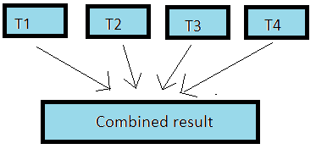
Topic 5 : Reduction process (1/3) : combining
The “reduction process” is the reverse of the “decomposition process” shown below at left. From individual results (and multiple threads for a parallel stream) a single result is returned. There are two parts, accumulating and combining.
The end result can be a scalar such as the long value returned by count(), an object of the stream such as an Optional<T> returned by max(), a collection returned by groupingBy() or anything else such as a for joining().
In some cases, nothing is returned like with forEach() or an Iterator or a Spliterator, etc.
Executing in parallel, the combining process takes the results produced by two different threads and merges them. The combining continues until a single result exist. The stream framework takes care of threading and concurrency in the reduction like it does for the decomposition. If the terminal operation is short-circuit, the reduction can stop early.
If the stream is ORDERED and if the collector is described as preserving an existing order (being not UNORDERED) then the reduction process must happen in a precise order. Otherwise, any order is good. This is why unordered streams, having less constraints, are normally better for parallel execution.
For a sequential stream, there is nothing to combine, a single thread is involved.
For a parallel stream, we have many possible choices to combine the results returned by the different threads.
(T1 + T2) + (T3 + T4)…
T1 + ((T2 + T3) + T4)
etc. (TODO W instead of T?)
72 different choices!!!
…but only one if the stream is ordered and if it matters to the reduction operation:
(((T3 + T2) + T4) + T1)
(if we assume that the "split" gets the start of the stream)
Because the splits occur in any order, the combining operation must be associative. (A + B) + C must be equivalent to A + (B + C). For a similar reason, the identity constraint (neutral/empty operand/collection) must be satisfied.
(A + empty) must be equivalent to A. If the order really does not matter, e.g. count() vs Collectors.toList() then it is commutative. (A + B) must be equivalent to (B + A).

Slide 119
Topic 5 : Reduction process (2/3) : accumulating
Before we combine the results of different threads for our parallel stream, each thread needs accumulating all the values first.
For a sequential stream, the unique thread involved also needs accumulating the values.
This step is called the accumulation and is done with an accumulator object and/or an accumulating function, e.g. sum().
Like the intermediate operations, the terminal operation (here the reduction) should not mutate the elements of the stream.
The reduction can return a T or an Optional<T> or it can return something else like a collection, a scalar, a boolean, etc.
If it returns a T from two T’s (the accumulated one and a new one coming from the stream), there is no other choice than creating a new T each time (A + B => C) to not modify the original value. There is however the special case where one of the values would be returned as is. E.g. if we search the biggest of the values, returning the biggest value of the pair is fine as nothing is modified.
To return a T or an Optional<T> the reduce() method can be called but it has its limits. You can add two numbers but can you add two cars or crash two cars? If your T is some kind of collection you can however merge or intersect tow instances.
If you want to return a T created from existing ones, use reduce(). You could do the job with collect() storing the result to a collection and using a finisher to convert the result to a T.
Sum, min, max, average, and string concatenation are all special cases of reduction. Summing a stream of numbers can be expressed as:
Integer sum = myIntStream.reduce(0, (a, b) -> a+b);
or:
Integer sum = myIntStream.reduce(0, Integer::sum);
While this may seem a more roundabout way to perform an aggregation compared to simply mutating a running total in a loop, reduction operations parallelize more gracefully, without needing additional synchronization and with greatly reduced risk of data races.
If you want to return an Optional<T> use reduce(). You could do the job with collect() storing the result to a collection and using a finisher to convert the result to an Optional<T>.
If you want to return something else than a T or an Optional<T> (or these ones too) the collect() method is the best solution. The 3rd version of reduce using a combine could potentially do it.
Stream <T> Signature | Stream<T> Description | IntStream
<R,A> R Stream.collect(Collector<? super T,A,R> collector) | Performs a mutable reduction operation on the elements of this stream using a Collector. | N/A
<R> R collect(Supplier<R> supplier, BiConsumer<R,? super T> accumulator, BiConsumer<R,R> combiner) | Performs a mutable reduction operation on the elements of this stream. | Same (int flavors)
Optional<T> Stream.reduce(BinaryOperator<T> accumulator) | Performs a reduction on the elements of this stream, using an associative accumulation function, and returns an Optional describing the reduced value, if any. | same (IntBinaryOperator op)
T Stream.reduce(T identity, BinaryOperator<T> accumulator) | Performs a reduction on the elements of this stream, using the provided identity value and an associative accumulation function, and returns the reduced value. | same (int identity, IntBinaryOperator op)
<U> U Stream.reduce(U identity, BiFunction<U,? super T,U> accumulator, BinaryOperator<U> combiner) | Performs a reduction on the elements of this stream, using the provided identity, accumulation and combining functions. | N/A

Slide 120
Topic 5 : Reduction process (3/3) : together
Here is an example of different ways to reduce a Stream<Car> to a given value. TODO complete
Method | sum(year) Int map(Car::getYear) then | count(car) long | max(year) OptionalInt | Max(car/year) Optional<Car>
simplest | sum() | count() “equivalent to” mapToLong(e -> 1L).sum()) | max() | max(Comparator.comparingInt(Car::getYear))
<R,A> R Stream.collect(Collector<? super T,A,R> collector) |  | collect(Collectors.counting())
<R> R collect(Supplier<R> supplier, BiConsumer<R,? super T> accumulator, BiConsumer<R,R> combiner) | // we need a mutable value collect(AtomicInteger::new, AtomicInteger::addAndGet, (ai1, ai2) -> { ai1.addAndGet(ai2.get()); }) or collect(LongAdder::new, LongAdder::add, (la1, ai2) -> { la1.add(la2.get()); }) This collector could be declared CONCURRENT
Optional<T> Stream.reduce(BinaryOperator<T> accumulator) | N/A really? | N/A
T Stream.reduce(T identity, BinaryOperator<T> accumulator) | reduce(0, Integer::sum) |  | N/A | N/A
<U> U Stream.reduce(U identity, BiFunction<U,? super T,U> accumulator, BinaryOperator<U> combiner)

Slide 121
Topic 5 : Reduction class hierarchy of Collector (new)
As an example
Implement sum() traditionally, with reduce() with collect() (for collect concurrent or not)
Implement max() traditionally, with reduce() with collect() (for collect concurrent or not)
Compare empty stream and reduce(T identity, BinaryOperator<T> accumulator) and reduce(BinaryOperator<T> accumulator) and collect()
Introduced with Java 8, LongAdder and DoubleAdder, specilazed versions of LongAdder and DoubleAdder. Close to an AtomicLong and AtomicDouble at low contention but significantly better at high contention
Question: is it possible that reduce() is never called by more than one thread for a parallel stream?
Tell what is called and how many times including for an empty thread, parallel and sequential

Slide 122
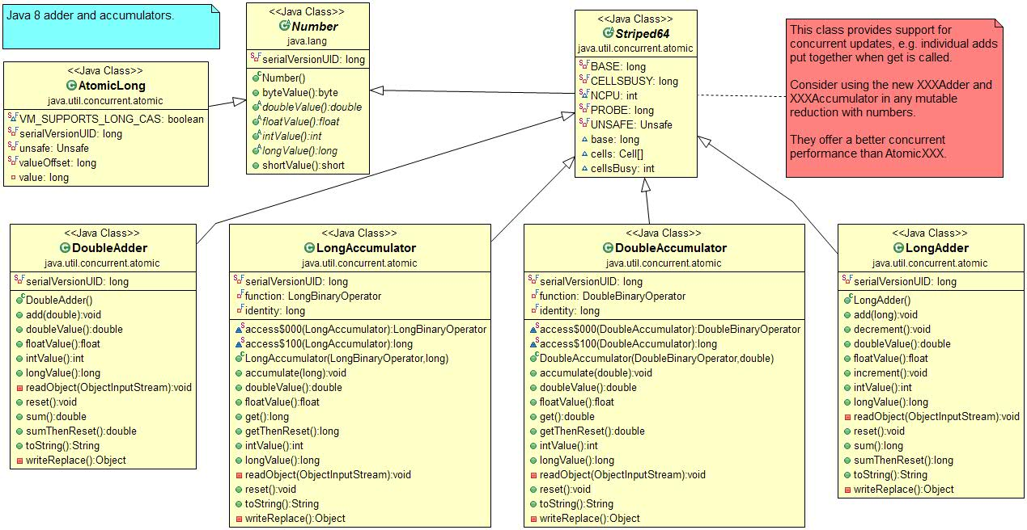
Topic 5 : Reduction adders and accumulators (new)
TODO invert LongAccumulator and double
Gove an example of using adder (+) and accumulator (x)

Slide 123
Topic 5 : Characteristics of some collectors (collect() call)
The collectors have their own characteristics which have an impact on the performance.
Characteristic | Description
CONCURRENT | Indicates that this collector is concurrent, meaning that the result container can support the accumulator function being called concurrently with the same result container from multiple threads. If a CONCURRENT collector is not also UNORDERED, then it should only be evaluated concurrently if applied to an unordered data source.
IDENTITY_FINISH | Indicates that the finisher function is the identity function and can be elided. If set, it must be the case that an unchecked cast from A to R will succeed.
UNORDERED | Indicates that the collection operation does not commit to preserving the encounter order of input elements. (This might be true if the result container has no intrinsic order, such as a Set.)
Non UNORDERED means that the collector cares about the order or that the order does not apply (e.g. count()). TODO confirm
On the right, here are some Collector instances created by the Collectors utility. More of them could be CONCURRENT but are not. Q: Would it be beneficial if they were?
Below you can see how the reduction proceeds based on the stream and on the collector. If the stream is sequential then the reduction is sequential too whatever the collector.
Collector | CONCURRENT | IDENTITY_FINISH | UNORDERED
averagingInt() | F | F | F
counting() | F | F | F
groupingBy() | F | T | F
groupingByConcurrent() | T | T | T
joining() | F | F | F
mapping() | F | F | F
maxBy() | F | F | F
partitioningBy() | F | T | F
reducing() | F | F | F
summarizingInt() | F | T | F
summingInt() | F | F | F
toConcurrentMap() | T | T | T
toList() | F | T | F
toMap() | F | T | F
toSet() | F | T | T
Characteristics | // ordered stream | // unordered stream
CONCURRENT | Sequential collection | Concurrent collection
CONCURRENT + UNORDERED | Concurrent collection | Concurrent collection
UNORDERED | Sequential collection | Sequential collection
NONE | Sequential collection | Sequential collection
Questions:
Should not we have more unordered collectors such as counting(), summing(), maxBy()…?
Does UNORDERED apply only to “collections”?
Why UNORDERED and not ORDERED?

Slide 124
Topic 5 : How much parallel is parallel?
The Fork/Join pool (Java 7) is used to run a stream in parallel. It is shared with all the Fork/Join other tasks. Beware of singletons and using ThreadLocal!!!
The default size of the pool is Runtime.getRuntime().availableProcessors() (e.g. 8 on a quad core Intel i7 with hyper threading enabled).
You can force its size setting the global system property java.util.concurrent.ForkJoinPool.common.parallelism to a different int value but this is likely not advisable.
Question: How many splits can we have on a finite and on an infinite stream? Do we stop splitting when the F/J pool is fully used? TODO
Question: Do we have any guarantee that the same thread is in charge of the execution, start to end, of each of the parallel branches? Look at the documentation of forEach(), forEachOrdered() [happens-before] and peek().
Question: For the code below, on which stream (the cars or the years) do you have the split?
Arrays.stream(Car.values()).// filter(Car::isRecent).// parallel().// mapToInt(Car::getYear).// forEach(System.out::println);
Exercise: Can you write a custom Spliterator (or decorate one) to control the minimum size to try a split?
Exercise: Can you write a custom Spliterator (or decorate one) to control the maximum number of a threads or chunks created for a parallel stream?

Slide 125
Topic 5 : Parallel versus sequential execution
Question: What happens to the stream if an exception is thrown processing a sequential stream? Or a parallel stream?
For a parallel stream the execution continues in the other individual threads. The (runtime) exception is thrown by the F/J task is rethrown by the main thread. See ExceptionInParallelStream.java.
Question: Can a parallel execution be no better than a sequential execution?
Yes: myStream.parallel().forEachOrdered() will not go faster than sequentially. Roughly the same for myStream.parallel().sorted(…).forEach ().
Question: Memory and/or CPU wise, can a parallel execution be worse than a sequential execution?
http://blog.jooq.org/2014/06/13/java-8-friday-10-subtle-mistakes-when-using-the-streams-api/

Slide 126
Topic 5 : Q&A
Describe the stream characteristics IMMUTABLE, CONCURRENT, DISTINCT, NONNULL, ORDERED, SORTED, SIZED and SUBSIZED.
Which characteristics are mutually exclusive or are implied by another one?
How to create a parallel stream?
What is the design goal of a Spliterator? What are its methods? What is their contract?
How do I test if a Stream is parallel?
How can access to my stream in the intermediate or terminal operation?
What is the difference between a regular reduction versus a mutable reduction? Which stream methods do you use for that?
Give examples of gaining a characteristic for a stream or losing one.
How else could I change the characteristics of a stream?
Explain collect() versus reduce() for a sequential stream and for a parallel stream.
When does the size of the source as reported by the spliterator become firm?
Can you recreate a stream for a spliterator or iterator obtained from a stream?
Which API in the stream package allows to post-process a call to collect()? How is called the post-processing function?
What are the names of the different functions of a Collector and their role?
How can you obtain the characteristics of a collector? What can you do create your own collector specifying the values of your choice?

Slide 127
Topic 5 : Q&A
Which sequential intermediate and terminal operations could benefit from an IMMUTABLE Spliterator? For which ones could it be an issue?
And for CONCURRENT? And for DISTINCT? And for NONNULL? And for ORDERED? And for SORTED? And for SIZED? And for SUBSIZED?
Describe the Collector characteristics CONCURRENT, IDENTITY_FINISH and UNORDERED. Give examples of Collector instances having or not having these characteristics.
Which Collector characteristics are mutually exclusive or are implied by each other?
How do you optimize the stream processing to do parts sequentially and parts in parallel?
Which intermediate operations add/remove characteristics to the stream and which ones?
If I use a parallel ORDERED stream with a CONCURRENT collector, is the reduction concurrent or sequential?
How can you possibly speed-up a parallel stream pipeline?
What is the impact of an exception in an intermediate or terminal operation for a parallel stream?
How can you render your reduction process short-circuit?
What are the different characteristics of a Collector and their impact?
What is the possible impact of ordering on parallel streams? How can you alleviate it?
To keep the same results/output ordered for some operations (distinct(), limit(), skip()) as in a sequential stream, buffering is required and the operation can be a full barrier. Using unordered will change the behavior.

Slide 128
Topic 5 : Q&A
Exercise: Does a sorted Stream help to get the min()? Prove it.
Exercise: Prove that reduce() operates in parallel?
Exercise: Write some code showing the characteristics of the Spliterator for different sources as well as the sizes real and estimated as well as its splitability.
Exercise: Write your own Spliterator backed up by an array and not splitting below a remaining size of 5.
Exercise: Decorate a Spliterator to split only if the remaining size is larger than X elements.
Exercise: Write a “skipOdd()” intermediate operation. If it could, would it change the characteristics of the stream?
Exercise: Write a reduction summing the elements of an IntStream with reduce() then collect(). What is the difference. How can you modify collect() to be mutable?
Exercise: rewrite the reduction for min, max, count, sum. Can you write it being CONCURRENT?
Exercise: Write a Collector extending the summarizing one and providing the standard deviation.
Exercise: Write a utility creating a sequential or parallel stream based on the size of the source bigger than XXX
Exercise: Stream natural integers (1+) to calculate the sum of the inverse of their square (1/1^2 + 1/ 2^2 + 1/3^2..). Multiply the sum by 6 then get the square root. Optimize the calculation to limit the operations. Does it converge? Make it run in parallel. What could you do to have the maximum precision but not running more than XXX seconds w/o setting a limit on the number of ints?

Slide 129
Topic 6 : Lambda Cookbook
Develop the code that use Java SE 8 collection improvements: Collection.removeIf(), List.replaceAll(), Map.compute(), computeIfAbsent(), computeIfPresent(), Map.forEach(), Map.replaceAll()
Read files using lambda improvements: Files.find(), lines(), walk()
Use merge(), flatMap() methods on a collection
Describe other stream sources: Arrays.stream(), IntStream.range()

Slide 130
Topic 6-1 : Collection improvements, compute…()
compute(), for example, to either create or append a String msg to a value mapping:
map.compute(key, (k, v) -> (v == null) ? msg : v.concat(msg));
computeIfAbsent(), for example the memoizer pattern
map.computeIfAbsent(key, k -> new Value(f(k)));
or to implement a multi-value map, Map<K,Collection<V>>, supporting multiple values per key:
map.computeIfAbsent(key, k -> new HashSet<V>()).add(v);
computeIfPresent(), for example to double the bet
bets.computeIfPresent("bob", (k, v) -> new Double(v.intValue() * 2));
Signature | Description | Equivalent code
default V Map.compute(K key, BiFunction<? super K,? super V,? extends V> remappingFunction) | Attempts to compute a mapping for the specified key and its current mapped value (or null if there is no current mapping). Returns: the new value associated with the specified key, or null if none | The default implementation is equivalent to performing the following steps for this map, then returning the current value or null if absent: V oldValue = map.get(key); V newValue = remappingFunction.apply(key, oldValue); if (oldValue != null ) { if (newValue != null) map.put(key, newValue); else map.remove(key); } else { if (newValue != null) map.put(key, newValue); } return newValue;
default V Map.computeIfAbsent(K key, Function<? super K,? extends V> mappingFunction) | If the specified key is not already associated with a value (or is mapped to null), attempts to compute its value using the given mapping function and enters it into this map unless null. Returns: the current (existing or computed) value associated with the specified key, or null if the computed value is null | The default implementation is equivalent to the following steps for this map, then returning the current value or null if now absent: if (map.get(key) == null) { V newValue = mappingFunction.apply(key); if (newValue != null) map.put(key, newValue); }
default V Map.computeIfPresent(K key, BiFunction<? super K,? super V,? extends V> remappingFunction) | If the value for the specified key is present and non-null, attempts to compute a new mapping given the key and its current mapped value. Returns: the new value associated with the specified key, or null if none | The default implementation is equivalent to performing the following steps for this map, then returning the current value or null if now absent: if (map.get(key) != null) { V oldValue = map.get(key); V newValue = remappingFunction.apply(key, oldValue); if (newValue != null) map.put(key, newValue); else map.remove(key); }

Slide 131
Topic 6-1 : Collection improvements, other
Removing new cars from the existing collection: myCollection.removeIf(Car::isRecent);
Replacing Boolean values from the list by their opposite: myList.replaceAll(b -> Boolean.valueOf(!b.booleanValue()));
Changing each password: myMap.replaceAll((user, pass) -> (pass + "changed"));
Listing the content of the map: myMap.forEach((k, v) -> { System.out.println("Key: " + k + ", value: " + v);});
Signature | Description
default boolean Collection.removeIf(Predicate<? super E> filter) | Removes all of the elements of this collection that satisfy the given predicate.
default void List.replaceAll(UnaryOperator<E> operator) | Replaces each element of this list with the result of applying the operator to that element.
default void Map.replaceAll(BiFunction<? super K,? super V,? extends V> function) | Replaces each entry's value with the result of invoking the given function on that entry until all entries have been processed or the function throws an exception.
default void Map.forEach(BiConsumer<? super K,? super V> action) | Performs the given action for each entry in this map until all entries have been processed or the action throws an exception.
Out of scope | Out of scope
default boolean Map.remove(Object key, Object value) | Removes the entry for the specified key only if it is currently mapped to the specified value.
default V Map.replace(K key, V value) | Replaces the entry for the specified key only if it is currently mapped to some value.
default boolean Map.replace(K key, V oldValue, V newValue) | Replaces the entry for the specified key only if currently mapped to the specified value.
default V Map.putIfAbsent(K key, V value) | If the specified key is not already associated with a value (or is mapped to null) associates it with the given value and returns null, else returns the current value.

Slide 132
Topic 6-2 : Read files using lambda improvements
Misleading question! Only Files.find() uses a function.
// finds and display all the folders whatever their path up to 2 levels below c:\WINDOWS Files.find(new File("C:/WINDOWS").toPath(), 2, (path, basicFileAttributes) -> basicFileAttributes.isDirectory(), FileVisitOption.FOLLOW_LINKS).forEachOrdered(System.out::println);
// displays the content of the file Files.lines(new File("C:/workspaces/dictionnary.txt").toPath(),Charset.defaultCharset()).forEachOrdered(System.out::println);
// finds and display all the files and folders up to 2 levels below c:\WINDOWS w/o filtering Files.walk(new File("C:/WINDOWS").toPath(), 2,FileVisitOption.FOLLOW_LINKS).forEachOrdered(System.out::println);
Signature | Description
static Stream<Path> Files.find(Path start, int maxDepth, BiPredicate<Path,BasicFileAttributes> matcher, FileVisitOption... options) | Return a Stream that is lazily populated with Path by searching for files in a file tree rooted at a given starting file. The file tree is traversed depth-first like in walk() which is called.
static Stream<String> Files.lines(Path path) | Read all lines from a file as a Stream.
static Stream<String> Files.lines(Path path, Charset cs) | Read all lines from a file as a Stream.
static Stream<Path> Files.walk(Path start, FileVisitOption... options) | Return a Stream that is lazily populated with Path by walking the file tree rooted at a given starting file. The file tree is traversed depth-first.
static Stream<Path> Files.walk(Path start, int maxDepth, FileVisitOption... options) | Return a Stream that is lazily populated with Path by walking the file tree rooted at a given starting file. The file tree is traversed depth-first.
Out of scope | Out of scope
static Stream<Path> Files.list(Path dir) | Return a lazily populated Stream, the elements of which are the entries in the directory.
public static BufferedReader Files.newBufferedReader(Path path) | Opens a file for reading, returning a BufferedReader to read text from the file in an efficient manner.
public static BufferedWriter Files.newBufferedWriter(Path path, OpenOption... options) | Opens or creates a file for writing, returning a BufferedWriter to write text to the file in an efficient manner.
public static List<String> Files.readAllLines(Path path) | Read all lines from a file.
public static Path Files.write(Path path, Iterable<? extends CharSequence> lines, OpenOption... options) | Write lines of text to a file.

Slide 133
Topic 6-3 : merge() and flatMap() on a collection
merge() applies only to Map. flatMap() applies only to Optional and Stream, not to Collection!
// (merge()) // If the specified key is not already associated with a value or is associated with null, associates it with the given non-null value.
// Otherwise, replaces the associated value with the results of the given remapping function, or removes if the result is null. This method may be of use when combining multiple mapped values for a key.
// For example, to either create or append a String someValue to a value mapping:
Map<String, String> accumulatedValues = new HashMap<>();
String someKey = "key";
String someValue = "value";
accumulatedValues.merge(someKey, someValue, String::concat);
// For example, to pick randomly the old value or the new one
Random random = new Random(System.currentTimeMillis());
accumulatedValues.merge(someKey, someValue,
(oldValue, newValue) -> (random.nextBoolean() ? oldValue : newValue));
Signature | Description
default V Map.merge(K key, V value, BiFunction<? super V,? super V,? extends V> remappingFunction) | If the specified key is not already associated with a value or is associated with null, associates it with the given non-null value. Otherwise, replaces the associated value with the results of the given remapping function, or removes if the result is null.
Already covered | Already covered
<R> Stream<R> Stream<T>.flatMap(Function<? super T,? extends Stream<? extends R>> mapper) | Returns a stream consisting of the results of replacing each element of this stream with the contents of a mapped stream produced by applying the provided mapping function to each element.
public <U> Optional<U> Optional<T>.flatMap(Function<? super T,Optional<U>> mapper) | If a value is present, apply the provided Optional-bearing mapping function to it, return that result, otherwise return an empty Optional. This method is similar to map(Function), but the provided mapper is one whose result is already an Optional, and if invoked, flatMap does not wrap it with an additional Optional.

Slide 134
Topic 6-4 : Other stream sources
Describe other stream sources: Arrays.stream(), IntStream.range()

Slide 135
Topic 6-4 : Other stream sources (copied from 3.2)
Specialized Stream constructors (incomplete)
Signature | Description
Stream<String> BufferedReader.lines() | Returns a Stream, the elements of which are lines read from this BufferedReader.
static Stream<Path> Files.find(Path start, int maxDepth, BiPredicate<Path,BasicFileAttributes> matcher, FileVisitOption... options) | Return a Stream that is lazily populated with Path by searching for files in a file tree rooted at a given starting file.
static Stream<String> Files.lines(Path path) | Read all lines from a file as a Stream.
static Stream<String> Files.lines(Path path, Charset cs) | Read all lines from a file as a Stream.
static Stream<Path> Files.list(Path dir) | Return a lazily populated Stream, the elements of which are the entries in the directory.
static Stream<Path> Files.walk(Path start, FileVisitOption... options) | Return a Stream that is lazily populated with Path by walking the file tree rooted at a given starting file.
static Stream<Path> Files.walk(Path start, int maxDepth, FileVisitOption... options) | Return a Stream that is lazily populated with Path by walking the file tree rooted at a given starting file.
Stream<JarEntry> JarFile.stream() | Return an ordered Stream over the ZIP file entries.
Stream<String> Pattern.splitAsStream(CharSequence input) | Creates a stream from the given input sequence around matches of this pattern.
Stream<? extends ZipEntry> ZipFile.stream() | Return an ordered Stream over the ZIP file entries.
Double/Int/LongStream Random.doubles/ints/longs(…) | Returns an effectively unlimited stream of pseudorandom double/int/long values.
IntStream BitSet.stream() | Returns a stream of indices for which this BitSet contains a bit in the set state.

Slide 136
Topic 6 : Q&A
Question: Which are the new stream classes?
Question: Which existing classes now expose a stream?
Question: What are the differences between Map.compute(), computeIfPresent() and computeIfAbsent()? TODO
Exercise: Remove from a Collection<Integer> the odd numbers.
Exercise: Remove from a Collection<Car> the recent cars.
Exercise: Replace in List<Integer> the numbers by their double.
Exercise: Having a Vector<String>, reverse it bottom-up and reverse as well the strings inside.
Exercise: In your Map<String(brand),Car> substitute the car by another car of the same brand.
TODO Add something about the performance of streams. Bench the Java getEnclosingMethod()

Slide 137
Topic 7 : Method Enhancements
Adding static methods to interfaces
Define and use a default method of a interface; Describe the inheritance rules for a default method

Slide 138
Topic 7-1 : Method Enhancements : static methods
Previously all the methods of an interface were abstract. Like before, an interface can contain static final fields which does not mean that they are immutable!!! Now static methods can be added and are prefixed as is. The public keyword is optional, the method cannot be private, protected or package.
Contrary to a class method it cannot be synchronized. strictfp is a valid modifier.
You can even execute an interface these days!!!
public interface MyInterfaceWithStaticMain {
public static void main(String[] params) {
System.out.println("main running in an interface");
// .. not working in Eclipse but working on the command line, which one is right?
}
While the Java compiler accepts (with a warning) to call a static method prefixing it with an instance name this is not supported for an interface. The interface name must be used instead.
myClass.staticMethod() generates a warning vs. MyClass.staticMethod() being good.
myInterface.staticMethod() is bad vs. MyInterface.staticMethod() being good.

Slide 139
Topic 7-1 : Method Enhancements : static methods
The static methods can have their own local classes, call other static methods…
public interface MoreComplexInterface {
public static void someStaticMethod() {
// no need to use the class name internally
anotherStaticMethod();
}
public static void anotherStaticMethod() {
// an inner interface declaration is not accepted!!!
List<String> things = new ArrayList<>();
class MyLocalClass extends Vector<String> {
private void bla() {
someStaticMethod(); // need to prefix
class MyEvenMoreLocalClass extends Vector<String> {
private void blabla() {
someStaticMethod(); // no need to prefix
things.clear();
}
}
}
}
MyLocalClass myLocalClass = new MyLocalClass();
myLocalClass.bla();
}
}

Slide 140
Topic 7-1 : New static methods
Interface | Methods
Collector | <T,A,R> Collector<T,A,R> of(Supplier<A> supplier, BiConsumer<A,T> accumulator, BinaryOperator<A> combiner, Function<A,R> finisher, Collector.Characteristics... characteristics) <T,R> Collector<T,R,R> of(Supplier<R> supplier, BiConsumer<R,T> accumulator, BinaryOperator<R> combiner, Collector.Characteristics... characteristics)
Stream | <T> Stream.Builder<T>builder() <T> Stream<T> concat(Stream<? extends T> a, Stream<? extends T> b) <T> Stream<T> empty() <T> Stream<T> generate(Supplier<T> s) <T> Stream<T> iterate(T seed, UnaryOperator<T> f) <T> Stream<T> of(T... values) <T> Stream<T> of(T t)
Predicate | <T> Predicate<T> isEqual(Object targetRef)
Function | <T> Function<T,T> identity()
UnaryOperator | <T> UnaryOperator<T> identity()
Comparator | <T,U extends Comparable<? super U>> Comparator<T>comparing(Function<? super T,? extends U> keyExtractor) <T,U> Comparator<T> comparing(Function<? super T,? extends U> keyExtractor, Comparator<? super U> keyComparator) <T> Comparator<T> comparingDouble(ToDoubleFunction<? super T> keyExtractor) <T> Comparator<T> comparingInt(ToIntFunction<? super T> keyExtractor) <T> Comparator<T> comparingLong(ToLongFunction<? super T> keyExtractor) <T extends Comparable<? super T>> Comparator<T> naturalOrder() <T> Comparator<T> nullsFirst(Comparator<? super T> comparator) <T> Comparator<T> nullsLast(Comparator<? super T> comparator) <T extends Comparable<? super T>> Comparator<T> reverseOrder()
java.time.* | New interfaces

Slide 141
Topic 7-1 : Method Enhancements : static methods
They will have static code, they can have their own inner classes (local + anonymous), call other static methods.
Example of static methods
Examples of new static methods in interfaces: Collection, List, Set, Map, Iterator, Comparator
Overriding classFinalize()…
What is the typical use of a static method in an interface?
Question: Can you break the existing code adding a static method to an existing interface?
Question: How do you call a static method of an Interface?
Question: Which modifiers can you use on an interface static method?
Question: Which kind of classes, interfaces, lambdas… can you use in an interface static method? Can they capture member fields and local variables?
Question: Can you use classFinalize() as a static method? Is it called?
Question: What are the inheritance rules for a static method, especially if a class implements two interfaces having the same static method?

Slide 142
Topic 7-2 : Method Enhancements : default methods
What is the typical use of a default method? Composition, go beyond the functional method
Examples of new default methods in interfaces: Collection, List, Set, Map, Iterator, Iterable, Comparator
You can override finalize() but…
What is the impact of the new Stream support in the Collection framework for Guava or Commons Collection classes?
New static and other methods in classes Object, Objects, Arrays, Integer…

Slide 143
Topic 7-2 : New default methods
Interface | Methods | Methods (continued)
Collector | <T,A,R> Collector<T,A,R> of(Supplier<A> supplier, BiConsumer<A,T> accumulator, BinaryOperator<A> combiner, Function<A,R> finisher, Collector.Characteristics... characteristics) | <T,R> Collector<T,R,R> of(Supplier<R> supplier, BiConsumer<R,T> accumulator, BinaryOperator<R> combiner, Collector.Characteristics... characteristics)
Stream | <T> Stream.Builder<T> builder() <T> Stream<T> concat(Stream<? extends T> a, Stream<? extends T> b) <T> Stream<T> empty() <T> Stream<T> generate(Supplier<T> s) | <T> Stream<T> iterate(T seed, UnaryOperator<T> f) <T> Stream<T> of(T... values) <T> Stream<T> of(T t)
Predicate | Predicate<T> and(Predicate<? super T> other) Predicate<T> negate() | Predicate<T> or(Predicate<? super T> other)
Function | <V> Function<T,V> andThen(Function<? super R,? extends V> after) | <V> Function<V,R> compose(Function<? super V,? extends T> before)
Consumer | Consumer<T> andThen(Consumer<? super T> after)
Comparator | Comparator<T> reversed() Comparator<T> thenComparing(Comparator<? super T> other) <U extends Comparable<? super U>> Comparator<T> thenComparing(Function<? super T,? extends U> keyExtractor) | <U> Comparator<T> thenComparing(Function<? super T,? extends U> keyExtractor, Comparator<? super U> keyComparator) Comparator<T> thenComparingDouble(ToDoubleFunction<? super T> keyExtractor) Comparator<T> thenComparingInt(ToIntFunction<? super T> keyExtractor) Comparator<T> thenComparingLong(ToLongFunction<? super T> keyExtractor)
Collection | Stream<E> parallelStream() boolean removeIf(Predicate<? super E> filter) | Spliterator<E> spliterator() Stream<E> stream()
List | void replaceAll(UnaryOperator<E> operator) void sort(Comparator<? super E> c) | Spliterator<E> spliterator()
Set | Spliterator<E> spliterator()
Map | V compute(K key, BiFunction<? super K,? super V,? extends V> remappingFunction) V computeIfAbsent(K key, Function<? super K,? extends V> mappingFunction) V computeIfPresent(K key, BiFunction<? super K,? super V,? extends V> remappingFunction) void forEach(BiConsumer<? super K,? super V> action) V getOrDefault(Object key, V defaultValue) | V merge(K key, V value, BiFunction<? super V,? super V,? extends V> remappingFunction) V putIfAbsent(K key, V value) boolean remove(Object key, Object value) V replace(K key, V value) boolean replace(K key, V oldValue, V newValue) void replaceAll(BiFunction<? super K,? super V,? extends V> function)
Iterator | void forEachRemaining(Consumer<? super E> action) | void remove()
Statement | long[] executeLargeBatch() long executeLargeUpdate(String sql) long executeLargeUpdate(String sql, int autoGeneratedKeys) long executeLargeUpdate(String sql, int[] columnIndexes) | long executeLargeUpdate(String sql, String[] columnNames) long getLargeMaxRows() long getLargeUpdateCount() void setLargeMaxRows(long max)
CallableStatement | void registerOutParameter(int parameterIndex, SQLType sqlType) void registerOutParameter(int parameterIndex, SQLType sqlType, int scale) void registerOutParameter(int parameterIndex, SQLType sqlType, String typeName) void registerOutParameter(String parameterName, SQLType sqlType) | void registerOutParameter(String parameterName, SQLType sqlType, int scale) void registerOutParameter(String parameterName, SQLType sqlType, String typeName) void setObject(String parameterName, Object x, SQLType targetSqlType) void setObject(String parameterName, Object x, SQLType targetSqlType, int scaleOrLength)
ResultSet | void updateObject(int columnIndex, Object x, SQLType targetSqlType) void updateObject(int columnIndex, Object x, SQLType targetSqlType, int scaleOrLength) | void updateObject(String columnLabel, Object x, SQLType targetSqlType) void updateObject(String columnLabel, Object x, SQLType targetSqlType, int scaleOrLength)
java.time.* | New interfaces

Slide 144
Topic 7-1 : Method Enhancements : default methods
They will have static code, they can have their own inner classes (local + anaonymous), call other default methods (e.g. template pattern).
Example of static methods
Examples of new static methods in interfaces: Collection, List, Set, Map, Iterator, ComparatorOverriding classFinalize()…
What is the typical use of a default in an interface?
Multiple inheritance of behaviour but not of the state.
Question: Can you break the existing code adding a default method to an existing interface? If this default method already existed in an interface extending this one or in a class implementing the interface?
Question: Which modifiers can you use on an interface default method?
Question: Which methods can you set as a default in an interface? Which ones cannot you define? Why?
Question: Which kind of classes, interfaces, lambdas… can you use in an interface default method? Can they capture member fields and local variables?
Question: Can you use finalize() as a default method? Is it called?
Question: What are the inheritance rules for a default method, especially if a class implements two interfaces having the same static method?
Question: Can you add a state to default methods?

Slide 145
Topic 7-2 : Method Enhancements : inheritance rules
fffffffffffffff

Slide 146
Topic 7-2 : Noticeable API changes
fffffffffffffff

Slide 147
Topic 8 : Date/Time API
Create and manage date-based and time-based events; including combination of date and time into a single object using LocalDate, LocalTime, LocalDateTime, Instant, Period, Duration
Work with dates and times across time-zones and manage changes resulting from daylight savings
Define and create timestamps, periods and durations; apply formatting to local and zoned dates and times

Slide 148
Topic 8 : LocalDate, LocalTime, LocalDateTime
The old Date and Calendar classes are complex to use. The indexes start at 0 or 1 for the first day of the week or the month, many methods are deprecated, the class is not thread safe, the formatters are not.

Slide 149
Topic 8 : Date/Time API - UML
Create

Slide 150

Topic 9 : JavaScript on Java with Nashorn
Develop JavaScript code that creates and uses Java members such as Java objects, methods, JavaBeans, Arrays, Collections, Interfaces.
Develop code that evaluates JavaScript in java, passes Java object to JavaScript, invokes JavaScript function and calls methods on JavaScript objects.

Slide 151
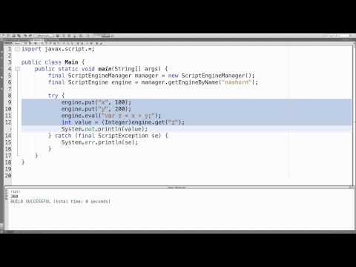
Topic 9 : Nashorn resources
Nashorn (Java 8) is the replacement of Rhino (Java 7). Nashorn is fully Ecma compliant!
Oracle “Nashorn: JavaScript on the JVM” 10’ video, Java 8 performance (Nashorn vs Rhino video).
Oracle Nashorn blog,
Oracle Nashorn documentation
Oracle Nashorn users’s guide and API
\orsacl

Slide 152
Bonus : Miscellanea
Other PAI changes… J8IA annexes
CallableFuture
Faster ConcurrentHashMap (and HashMap?)
Don’t forget try with resources from Java 7

Slide 153
Java 8: Have more fun
Father’s day is coming. Put Java 8 in action, Manning 2014 in your basket.
As a certified OCP 7, for a limited time pass the beta exam for the upgrade to Java 8 programmer for 50 USD vs. 250 usually.
.

