Slide 1
Java 8 on AWS Lambda
Olivier DUPUY, Senior Software Developer, Qlik, 2017

Slide 2
The Java application
Monitors an AWS RDS Postgres instance for a few key metrics (CPU, disk, memory), and statuses (availability and pending maintenance) and sends alerts to PagerDuty
Copies the Postgres log files from AWS RDS (not searchable at all) to AWS CloudWatch (searchable for words, case sensitive, no special characters)
Creates extra snapshots in addition to the daily snapshots of RDS (Postgres RDS also provides Point In Time Recovery)
Why the choice Java versus Node.js, Python and C# (or more)?
Java pros and cons versus other languages

Slide 3
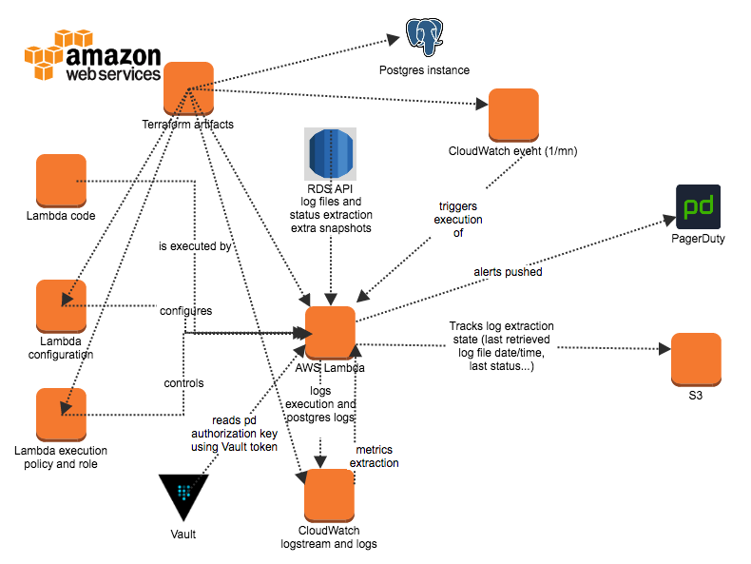
Interaction diagram

Slide 4
Building a Java application for AWS
Use Maven or Gradle
Follow the AWS tutorial for Java
Creating a single JAR for upload (maven-shade-plugin)
Minimum dependencies
Putting your dependency .jar files in a separate /lib directory (untested)
Clean dependencies (mvn dependency:tree, (show) mvn dependency:analyze)

Slide 5
Code structure and infrastructure
Top level handler, regular class
→ event handler method with a context giving access to the time left, the log group name, the HTTP request…
→ Managers (Backups, Alerts, Logs…)
→ Connectors for each API (RDS, CloudWatch, Vault, PagerDuty, S3, KMS…)
→AWS API
→ Utilities
Reading configuration from environment variables and system properties to override them in the tests
Handling AWS exceptions, transient or not
CloudWatch timer (rule) firing every minute and invoking the handler
CloudWatch log group and streams automatically created for you
A new stream is created when you redeploy, usually when the lambda is restarted or if the stream become too big (set a retention limit e.g. 30 days)
IAM role for the lambda
Basic policy granted (execution, logging)
Add a policy giving access to selected S3, RDS… resources
/** * @inheritDoc} <BR> * Receives an event. This handler is called for the CloudWatch scheduled events with the event being a LinkedHashMap<String,String>. */ public Void handleRequest(Object event, com.amazonaws.services.lambda.runtime.Context context) {

Slide 6
Build and testing
Junit and EasyMock
Unit tests mostly (*Test.java) and some integrations tests (*IT.java)
Total code coverage around 92%
On each Git commit (show circle.yml from CircleCI), we have
A build
The unit tests running
A dry run of the Serverless deployment
The integration tests run only on my Mac for now

Slide 7
Deploying to AWS
Use the console
Use a scripts like Terraform, AWS Cloud Formation or Serverless
Serverless example (show)
The lambda starts
The log group is created if it does not exist
A new log stream is created (UTC time vs local!)
Search capabilities in the log group

Slide 8
The Lambda execution environment
Java version in AWS is Open JDK 1.8.0_41 64 bits server VM
Hardware
256 MB, 2 CPUs
Libraries available by default
aws-lambda-java-core
Default and error outputs going to a CloudWatch log group
Logging of the invocations
21:03:42 START RequestId: 825df1e3-a490-11e7-876e-472aaaccb808 Version: $LATEST
21:03:42 INFO Handler:296 - LAMBDA_OUTPUT Processing an event on the lambda started at 2017-09-28 17:59:45 Z on ip-10-14-159-193.ec2.internal/10.14.159.193. Current time: Thu Sep 28 21:03:42 UTC 2017
21:03:45 END RequestId: 825df1e3-a490-11e7-876e-472aaaccb808
21:03:45 REPORT RequestId: 825df1e3-a490-11e7-876e-472aaaccb808 Duration: 2965.23 ms Billed Duration: 3000 ms Memory Size: 256 MB Max Memory Used: 130 MB
AWS specific environment variables (region, keys, TZ (UTC)…)

Slide 9
The Lambda configuration
Your code uploaded as a JAR or as a ZIP with version management
Execution T/O up to 5 minutes
Allocated memory 128-1536 MB. You pay for (memory x execution time rounded up to the closest 100 ms). ROI for more memory.
Your function is allocated CPU proportional to the memory configured
Any increase in memory size triggers an equivalent increase in CPU available to your function
Configuration through environment variables
Optional KMS encryption of selected variables (custom or default key)
Optional dead letter queue (DLQ)
Optional HTTP(S) calls using the Web API Gateway
Optional attachment to an existing VPC defined in Serverless
Optional IAM role (AWSLambdaBasicExecutionRole or more evolved)
Optional triggers (e.g. a scheduler)

Slide 10
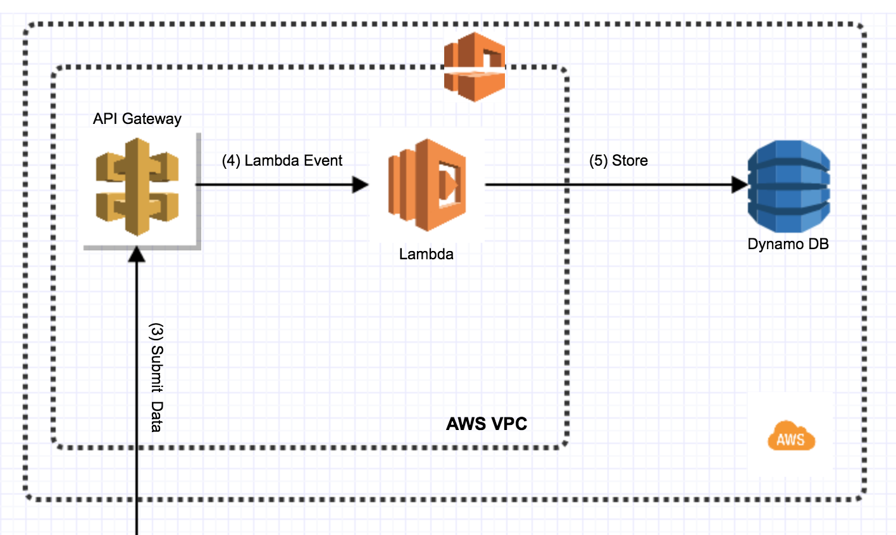
Lambda in VPC with an HTTP(S) endpoint

Slide 11
Specifics of the AWS execution environment (1)
Environment variables and system properties
Dump them at the start and compare to your PC or build system (UTC, locale…) (show)
Execution environment:
It looks like being in a Docker container, PID = 1
AWS Lambda was announced at the same time as the AWS EC2 Container Services for Docker
System.exit()
Not tested but likely a new instance is started and an invocation error is logged
Shutdown hooks are not called
Runtime.getRuntime().addShutdownHook(new Thread() { public void run() {
// System exiting. Do something, quickly
}});

Slide 12
Specifics of the AWS execution environment (2)
Limited number of CPUs and impact
java.util.concurrent.ForkJoinPool.common.parallelism
ForkJoinPool.commonPool().getParallelism()
ForkJoin common pool users: Collection.parallelStream(), CompletableFuture.supplyAsync(), Arrays.parallelSort() and 3rd party libraries
Change the parallelism!
State management and stateless execution environment
Externalize your state in S3 or other
When will the GC happen? Your control on the GC
No initial control on the system properties but you can set them if this is not too late
No details available on the invocation errors! (screen)
UTC vs non UTC

Slide 13
More specifics and trouble (1)
All the AWS calls can fail
Temporary exceptions, rate exceptions (your fault or not), first AWS API call, other
Add exception processing, retries, some tolerance…
Work in parallel to not have a T/O blocking a different processing
Beware of parallel streams and failures
Some outages are across all your accounts
E.g. RDS or S3 is down in us-east-1 in all the accounts

Slide 14
More specifics and trouble (2)
Long initialization
An initialization (constructor) taking longer than 10 s is at risk of being interrupted
No message in the logs about the start cancelled (no end + report)
No invocation error logged
Another lambda instance is started, often on the same host (beware if you use files). Sometimes this happens even if the initialization succeeded and if we are in the event handler within the T/O limits
Make the initialization really short
Let it continue in the event handler if needed
Log the initialization of XXX starting and finished or failed

Slide 15
More specifics and trouble (3)
Multiple instances running
With a timer ticking every minute and a 50 s T/O you would expect a single instance
AWS lambda can start 2+ instances (likely on the same host) for any reason because scaling up?). No visual indication of it in the console.
Interleaved execution
Add logging such as the host name and start time in each request
Detect an interleaved execution
Protect the state
There is an option to control the concurrency in the lambda settings (to test)

Slide 16
More specifics and trouble (4)
Keep track of the T/O limit
Know how much time is allocated and left
Cut short if needed
Create an health check endpoint?
Use the AWS 2.0 API

Slide 17
Conclusion
Main lessons learned…
Parallelize the execution
State in S3 (fails sometimes)
Transient errors, tolerance, retries
Interleaved executions! Concurrent executions!
Trust no one!
Java longer for the initialization but still powerful and supposedly faster than other runtimes once optimized (untested). You could set the VM flags to optimize fast (untested).
AWS X-Ray for performance analysis (untested)

Slide 18
Thanks
Questions?

Slide 19
References
Lambda announcement
Comparing Java and Node.js on AWS lambda

