Slide 1
Database systems: Assignment Project
Lecturers: Prof. Dr. A. Voisard, M.-U. Karagülle
Tutor: Alexander Stage
Students: Ivan Timofeev, Konstantinos Kokkalis, Meri Sukiasyan, Dea Karam
https://github.com/oduwancheekee/DBS_project

Slide 2
Task 1: Project Idea
With given tables we decided that most informative visual output would be connected to counts of stolen bikes and damages depending on the time and place of a theft. Specifically, we’ll look into:
1. total damage per borough, which could be nicely plotted into pie chart
2. quantity of stolen bikes per area per borough, to be presented in bar chart
3. quantity of bikes stolen per day in Berlin, which is the best visualizable with line plot, as timeline spans for one and a half year
4. quantity of bikes stolen in each planning area, plotted to the map. In order to do this, we’ll enrich our lor_planungsraeume table with geo coordinates of according planning areas.

Slide 3
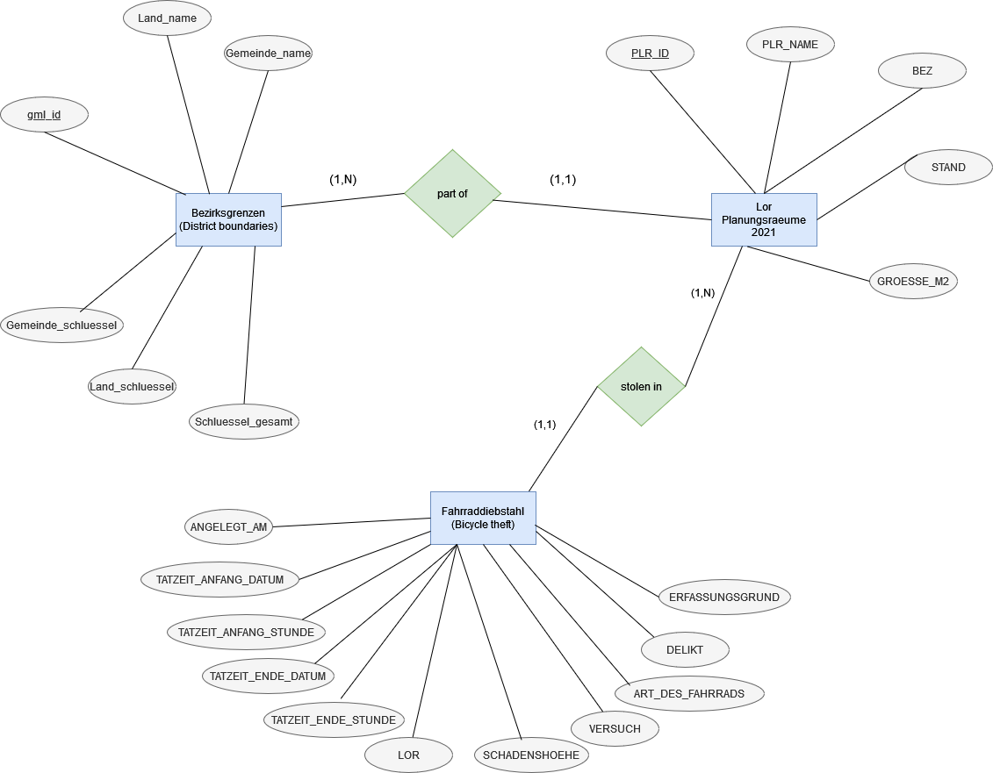
Task 2: ERM

Slide 4
Task 2: Relational model
Bezirksgrenzen (gml_id, Land_name, Gemeinde_name, Gemeinde_schluessel, Land_schluessel, Schluessel_gesamt)
Lor_Planungsraeume (PLR_ID, PLR_NAME, BEZ, STAND, GROESSE_M2)
Fahrraddiebstahl (ANGELEGT_AM, TATZEIT_ANFANG_DATUM, TATZEIT_ANFANG_STUNDE, TATZEIT_ENDE_DATUM, TATZEIT_ENDE_STUNDE, LOR, SCHADENSHOEHE, VERSUCH, ART_DES_FAHRRADS, DELIKT, ERFASSUNGSGRUND)
Part_of (gml_id, PLR_ID)
Stolen_in (LOR)

Slide 5
Task 2: database set up
To set up a database we employed Postgresql DBS. Here are the Ubuntu specific instructions, based on our approach:
install postgresql: sudo apt-get install postgresql
ensure its running: sudo service postgresql restart
create db: createdb fahrraddiebstahl

Slide 6
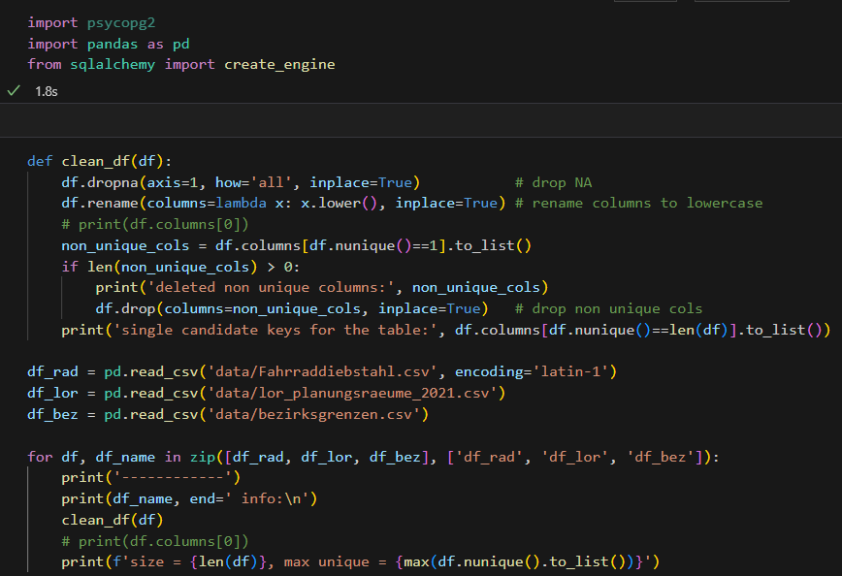
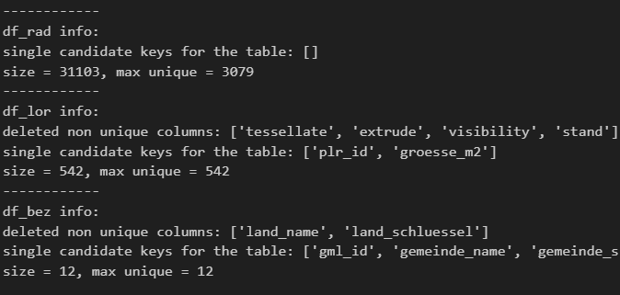
Task 3: Pre-processing and import data

Slide 7
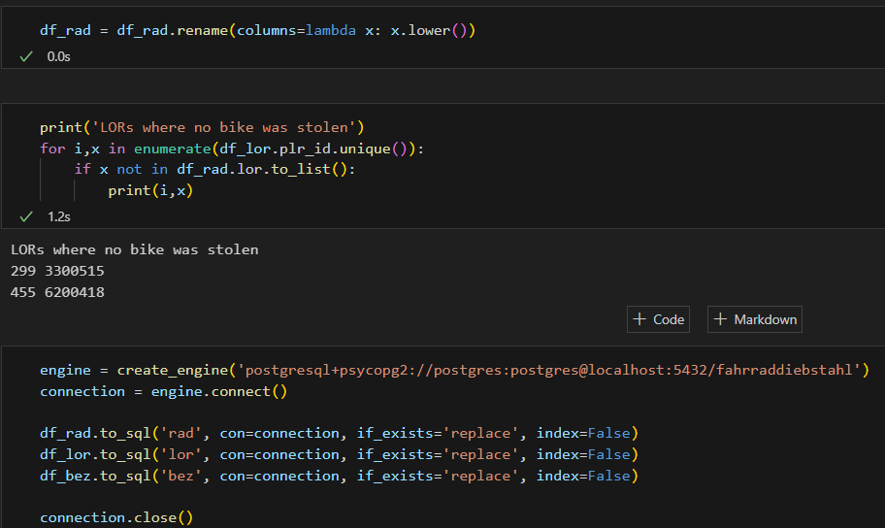
Task 3: Pre-processing and import data

Slide 8
Task 3: Pre-processing and import data
The obtained database could be reached for SQL querying by the command:
> psql -U postgres -d fahrraddiebstahl
The obtained database could be dumped to file by the command:
> pg_dump -U postgres -d fahrraddiebstahl > fahrraddiebstahl_dump.sql
The obtained database could be restored locally using dump file by the command:
> psql -U postgres -d fahrraddiebstahl < fahrraddiebstahl_dump.sql

Slide 9
Task 4: plots and SQL queries
1. pie chart: total damage per borough
SELECT bez.gemeinde_name AS bezirk, SUM(rad.schadenshoehe) AS damage_per_borough
FROM bez
JOIN lor ON bez.gemeinde_schluessel = lor.bez
JOIN rad ON lor.plr_id = rad.lor
GROUP BY bez.gemeinde_name
ORDER BY damage_per_borough DESC;
2. bar chart: quantity of stolen bikes per area per borough
SELECT bez.gemeinde_name AS bezirk, COUNT(*)/SUM(lor.groesse_m2)*1000000 AS quantity_per_area_per_borough
FROM bez
JOIN lor ON bez.gemeinde_schluessel = lor.bez
JOIN rad ON lor.plr_id = rad.lor
GROUP BY bez.gemeinde_name
ORDER BY quantity_per_area_per_borough DESC;

Slide 10
Task 4: plots and SQL queries
3. line plot: bikes stolen per day
SELECT TO_DATE(angelegt_am,'DD.MM.YYYY') AS day COUNT(*) AS bikes_per_day
FROM rad
GROUP BY day
ORDER BY day;
4. map plot
SELECT lor.plr_name AS planning_area, count(*)
FROM lor
JOIN rad ON lor.plr_id = rad.lor
GROUP BY lor.plr_name
ORDER BY count(*) DESC
LIMIT 10;

Slide 11
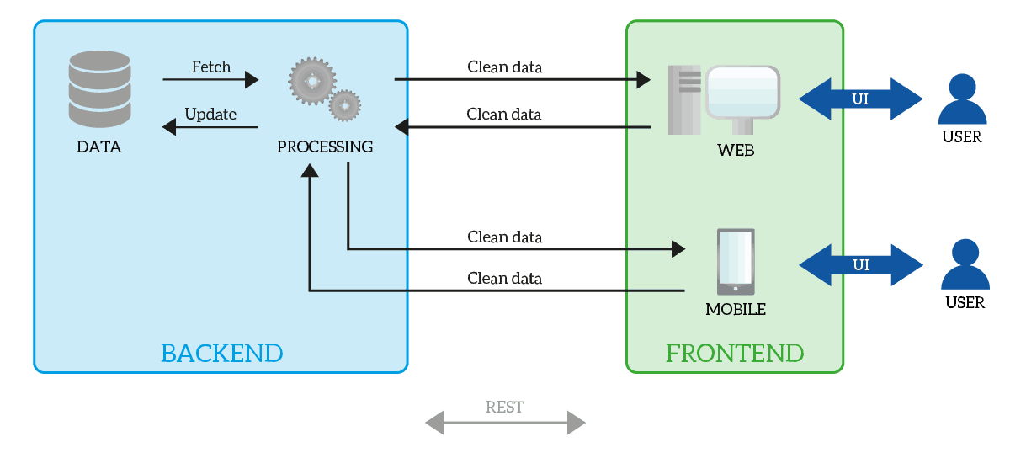
Task 4: Development of a Web application

Slide 12



Technologies

Slide 13
APIs
Communication APIs with our server
Google APIS

Slide 14
THANK YOU

