Slide 1

NETWORK COMMUNICATION PRESENTATION / TEAM 06
TCP/IP Communication in Action
Following the data when a user opens a secure website, from the browser to the web server and back
Speakers and responsibilities
01
Mariam Blessing Ajao
Introduction + Application layer
Team Lead, 1st speaker
02
Wisdom Binichiuku Odili
Transport layer + TCP/UDP: how the connection is established
2nd speaker
03
Beverlyn Ewuradwoa Amanfu
Internet layer, addressing and network devices
3rd speaker
04
Richard Inyang
Encapsulation, decapsulation and the OSI mapping
4th speaker
05
Fokemg-yalie Brisco Elias
Troubleshooting process
5th speaker
01
Notes:
Mariam Blessing Ajao (Team Lead, 1st speaker) opens the presentation. Scenario: opening a secure website. Decorative artwork reused from the Module 2 model deck.

Slide 2
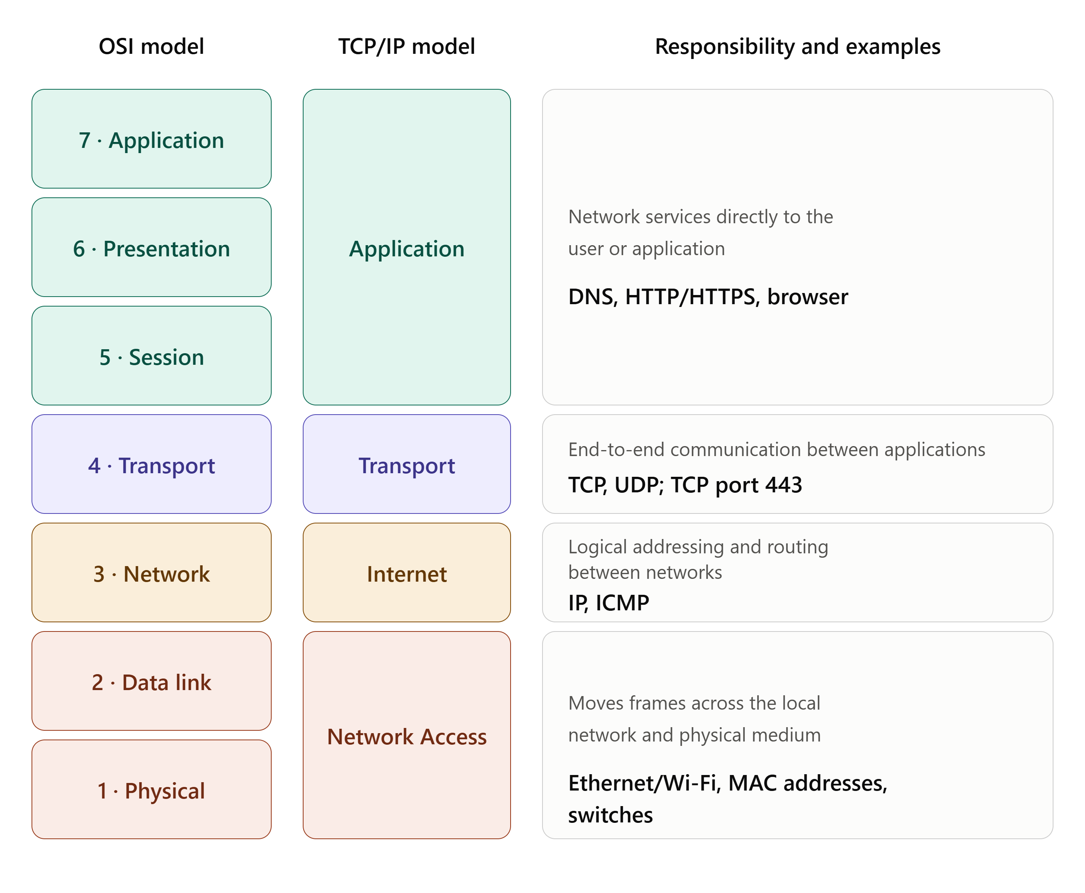
TEAM 06 / TCP/IP IN ACTION
The TCP/IP model and its four layers
A layered framework that explains how data moves between devices. Each layer has one job.
TCP/IP has four layers; the OSI model has seven.
02
Notes:
Introduction: TCP handles reliable delivery between applications; IP handles addressing and routing. Source: RFC 9293, RFC 791, Cisco Networking Academy.

Slide 3
TEAM 06 / TCP/IP IN ACTION
Scenario: opening a secure website
A user types https://www.icdfa.edu.ng in the browser and presses Enter.
01
02
03
04
05
06
Enter URL
Read URL
DNS lookup
TCP connect
HTTPS request
Response
User types the address in the browser
Browser interprets the address
Domain name becomes an IP address
Three-way handshake to port 443
TLS-protected HTTP request is sent
Server replies along the reverse path
Data is encapsulated as it moves down the layers on the client, and decapsulated as it moves up the layers at the web server.
03
Notes:
Mariam: the scenario and the basic journey User, Browser, Network, Web Server, Response.

Slide 4
TEAM 06 / TCP/IP IN ACTION
Application layer: how the communication starts
DNS: finding the IP address
HTTPS: HTTP protected by TLS
1
Client checks its local DNS cache
HTTP carries web content between browser and server. TLS protects the channel.
2
If needed, a query goes to a DNS resolver
Confidentiality
Helps stop others simply reading the traffic
3
Resolver returns the IP address
Integrity
4
Browser uses it to contact the web server
Helps detect unauthorised changes to data
Like phone contacts: select a name and the phone finds the number. DNS does this for website names.
Authentication
Helps the browser verify the server’s identity
DNS, HTTP and HTTPS belong to the TCP/IP Application layer.
04
Notes:
Mariam. Sources: RFC 1034, RFC 1035, RFC 9110, RFC 8446.

Slide 5
TEAM 06 / TCP/IP IN ACTION
Application layer: protocols and the OSI model
Protocol | Meaning | Purpose
DNS | Domain Name System | Finds the IP address of a domain
HTTP | Hypertext Transfer Protocol | Transfers web content
HTTPS | Hypertext Transfer Protocol Secure | Protects web communication using TLS
TCP/IP
OSI
OSI
OSI
Application
Application
Presentation
Session
Network services to applications
Data representation, encryption, compression
Establishes, manages and ends sessions
TLS functions sit near OSI Presentation/Session, though modern stacks do not map one-to-one.
05
Notes:
Mariam. The TCP/IP Application layer corresponds mainly to the OSI Application, Presentation and Session layers.

Slide 6
TEAM 06 / TCP/IP IN ACTION
Transport layer: the TCP three-way handshake
Client / browser
Web server
Destination port: TCP 443
SYN
Identifies the HTTPS service on the server
Client asks to connect
SYN-ACK
Source port: ephemeral
Server acknowledges, sends its own SYN
A temporary port chosen by the client’s operating system
ACK
Client acknowledges: connection established
Reliability
Sequence numbers, acknowledgements and retransmission keep data complete and in order
After the handshake, HTTPS/TLS communication can begin.
06
Notes:
Wisdom. Source: RFC 9293. Port numbers plus IP addresses identify the communication endpoint.

Slide 7
TEAM 06 / TCP/IP IN ACTION
TCP compared with UDP
Feature | TCP | UDP
Connection | Connection-oriented; uses a handshake | Connectionless; no TCP-style handshake
Reliability | Acknowledgements, retransmission and ordered delivery | No TCP-style guaranteed delivery or ordering
Speed / overhead | More overhead from connection and reliability mechanisms | Lower overhead; suits small or time-sensitive traffic
Example uses | Traditional HTTPS over TCP, file transfer, email protocols | DNS queries, streaming, real-time apps, HTTP/3 via QUIC
UDP is not simply a faster TCP. It is a different service model.
07
Notes:
Wisdom. HTTPS normally uses TCP port 443; HTTP/3 uses QUIC over UDP (RFC 9000).

Slide 8
TEAM 06 / TCP/IP IN ACTION
Internet layer: addressing, routing and devices
IP addressing
Network devices
IPv4
Router
Switch
Four decimal numbers, e.g. 192.168.1.50
Reads the destination IP and forwards packets between networks
Connects devices inside a local network
IPv6
Hexadecimal with colons, e.g. 2002:db8::1
Private / public
Wi-Fi access point
ISP
Private inside local networks; public is routable online
Gives wireless access to the local network
Carries traffic from the local network to the wider Internet
Source → destination
Sender’s IP to the web server’s IP, found through DNS
08
Notes:
Beverlyn. Source: RFC 791. 192.168.1.50 is an example private address.

Slide 9
TEAM 06 / TCP/IP IN ACTION
Packet journey: client to web server
REQUEST
User device
Wi-Fi AP / switch
Router
ISP
Internet routers
Web server
Browser
Local network
Forwards by IP
Provider network
IP routing
HTTPS : 443
RESPONSE
Web server
Internet routers
ISP
Router
Wi-Fi AP / switch
User device
HTTPS : 443
IP routing
Provider network
Forwards by IP
Local network
Browser
The router reads the destination IP and forwards the packet. The response follows the same path back and is decapsulated at the user’s device.
The packet may pass through several routers before reaching the web server.
09
Notes:
Beverlyn. Request: user computer, router, ISP, Internet, web server. Response: the reverse path.

Slide 10
TEAM 06 / TCP/IP IN ACTION
IP address vs MAC address
Feature | IP address | MAC address
Other name | Logical address | Physical address
Layer | Internet layer | Network Access layer
Purpose | Identifies the network location of a host | Identifies a network interface on the local link
Example | 192.168.1.50 | A1:B4:C5:DD:C1:3E
Used for | Routing between networks | Local network / frame delivery
IP address = where the device is on the network. MAC address = which interface is addressed on the local link.
10
Notes:
Beverlyn. IP addressing matters for the end-to-end journey; MAC addressing is used for local-link delivery.

Slide 11
TEAM 06 / TCP/IP IN ACTION
Complete view: encapsulation and decapsulation
Sending device
Web server
Application
HTTPS data
Application
HTTPS data
Transport
TCP segment
Transport
TCP segment
Encapsulation
Decapsulation
Headers added
Headers removed
Internet
IP packet
Internet
IP packet
Each layer adds the information needed to deliver the data.
Each layer removes and processes its information, until the web server gets the HTTPS request.
Network Access
Frame
Network Access
Frame
Network
Sending device | Down the layers
Receiving device | Up the layers
11
Notes:
Richard. Sending device: data moves down the layers, each adding information. Receiving device: each layer removes and processes its information on the way up.

Slide 12
TEAM 06 / TCP/IP IN ACTION
Troubleshooting: the website does not load
1
Check IP configuration
6
Check TCP port 443
Reading the handshake
ipconfig or ip addr
Blocked, refused or dropped?
Repeated SYNs, no SYN-ACK
2
Test the default gateway
7
Check firewall rules
Possible connectivity, firewall, routing or server issue. Needs further investigation.
ping gateway IP
Client, network, router, server
3
Test external connectivity
8
Capture packets
Immediate RST
ping 8.8.8.8
Wireshark, if still unclear
The destination may be refusing the connection.
4
Check DNS resolution
9
Interpret the TCP handshake
nslookup or dig
SYN, SYN-ACK, ACK or RST
SYN, SYN-ACK, ACK
Handshake completes, HTTPS/TLS starts and the page loads.
5
Check destination and routing
10
Test the website again
Route and router reachability
Confirm the fix
12
Notes:
Fokemg-yalie. Repeated SYNs alone do not identify the exact cause; further investigation is required.

Slide 13
TEAM 06 / TCP/IP IN ACTION
Reference
Internet Engineering Task Force (IETF). (2022). RFC 9110: HTTP Semantics.
Cisco Networking Academy. Introduction to Networking / TCP/IP Networking Model. Cisco Press
Rescorla, E. (2018). RFC 8446: The Transport Layer Security (TLS) Protocol Version 1.3. IETF.
Mockapetris, P. (1987). RFC 1034: Domain Names – Concepts and Facilities.
Internet Engineering Task Force (IETF), RFC 9293 – Transmission Control Protocol (TCP).
NIST, Computer Security Resource Center – networking and cybersecurity reference materials.
Thank you.
13
Notes:
Sources: RFC 9110 (HTTP), RFC 8446 (TLS 1.3), RFC 1034/1035 (DNS), RFC 9293 (TCP), RFC 791 (IP), RFC 9000 (QUIC); Cisco Networking Academy, Introduction to Networking; NIST CSRC.

