Slide 1
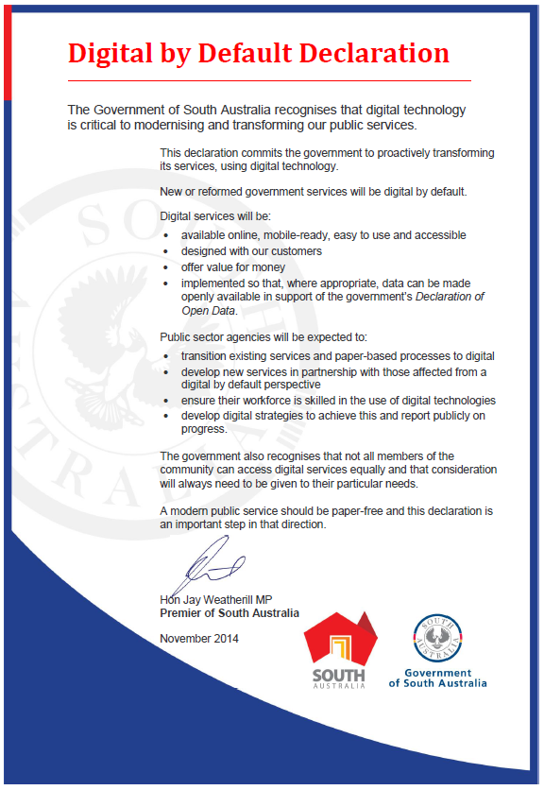
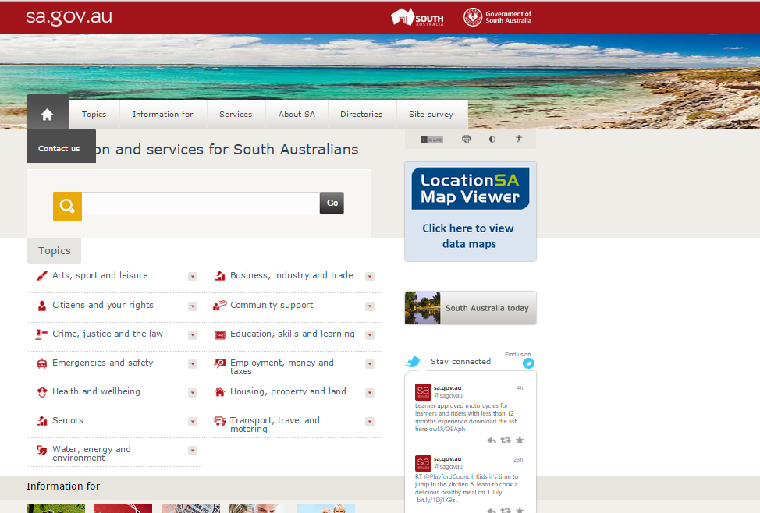
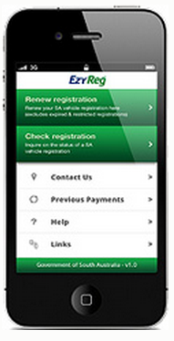
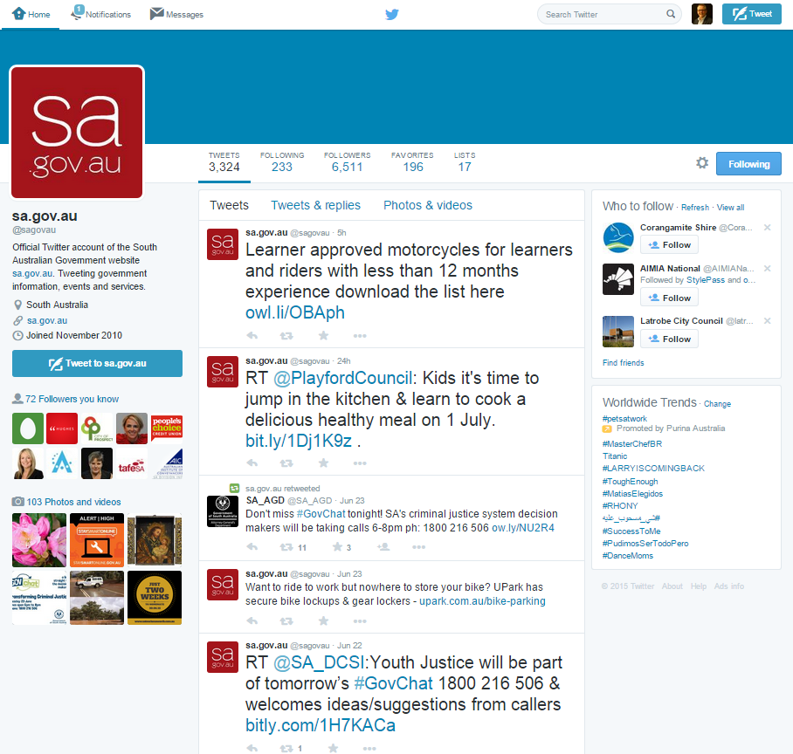



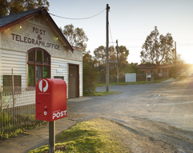


‘Organisation Name’ - Digital Strategy
WHY
How
Premier’s Digital by Default Declaration
Agency mission and vision
Insert here your mission statement, strategic intent, service charter etc
Digital transformation
How and what will be transformed
Customer service
Customer service promise
Innovation
What are your aspirations for innovation?
All service channels are digitally enabled and aligned
WHAT
Website
Channels to Customers
mobile/apps
What is the Strategy
Insert here the
purpose of the DS
guiding principles
defining characteristics
Capability and change management
What policies, procedures, staff training and change management are required.
social media
Call Centres
walk-in
post
site visits
publications
Governance
What management structure and resourcing is required.
Enabling technologies
What hardware and software do you need e.g. new CRM,
etc.
Better… eg
customer experience
education and advice that is easy to find, understand and act on
understanding of customers and the changing workplace
consistency of service delivery
More… eg
customers self-serving
time for Agency staff to provide quality service due to less time doing admin
customers acting as our advocates
services tailored to customer needs
collaboration across Agency in devising and delivering services to customers
Shorter… eg
time finding the right answers and responding to customer queries
Face-to-face time with customers because they are assisted by digital technologies
time to determine a customer’s issue
Reduced… eg
red-tape and barriers to customers doing business with us
cost to serve
number of customers visiting us
time spent by our staff on administrative tasks
Benefits

