Slide 1
Explainable Antibiotics Prescriptions in NLP with Transformer Models
Omar Emilio Contreras Zaragoza

Slide 2
Agenda
Problem description
Background
Research questions
Methodology
Results
Conclusions

Slide 3
Problem description
The treatment for bacterial infections is usually antibiotics.
Nevertheless, bacteria can become resistant to antibiotics, which is considered a threat to global health [1].
Dental care accounts for 7% of the prescribed antibiotics in outpatients care in Sweden [2].
In a recent paper from FTV [3], the prescription of antibiotics was evaluated, following the criteria for correctly prescribing antibiotics.
Predicting if a patient should be prescribed antibiotics from individual visits of dental records can be considered a text classification task.
Predictions in medical tasks are hard to approve [4].
Explanations are needed to build trust [5].

Slide 4
Background
Data
Transformer models
Transformer architecture
BERT models
XLM-R
mT5
Explainability methods
Integrated Gradients
SHAP

Slide 5
Data
Four columns: Clinic, Patient number (pseudo anonymized), Date and Notes.
Information from one visit was spread along multiple rows.
Notes column contains information about the patient, what was found by dentist, examinations performed, etc.
Dataset for predictions consisted of the Notes column and a label column.
It contained all information needed to decide if antibiotics should be prescribed.
Almost balanced (56% class 1)
Dataset showed the decision taken by the dentist, not the ground truth
Not ready for machine learning.
Data leakage.
Html tags.
Nan cells.
Automatically generated messages.
 | 2012 | 2015 | 2018
Correct | 87.6 | 85.1 | 89.3
Inaccurate | 12.4 | 14.9 | 10.7
Evaluation of antibiotics prescription in the dataset used [3].

Slide 6
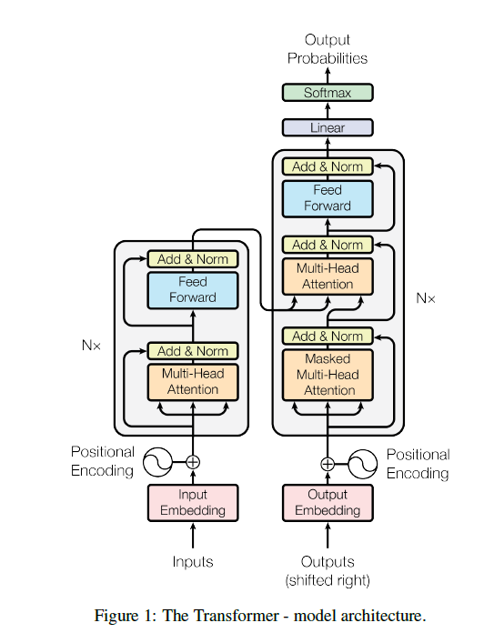
Attention is all you need [6]
Model based on attention mechanism instead of RNNs or CNNs.
Better parallelization.
Improved performance of Neural Machine Translation.
Encoder-decoder architecture.
Architecture of Transformer model [6].

Slide 7
BERT [7]
Model based on the encoder of Transformers [6]
Two phases:
Pre-training
Fine-tuning
Pre-training. Trained on unlabeled data:
Masked language model (MLM)
Next sentence prediction (NSP)
Fine-tuning. Trained on task specific labeled data.
BERT’s pre­training and fine­tuning phases [7].

Slide 8
BERT based models
ELECTRA [8]. Different pre-training.
Generator. Performs MLM like BERT
Discriminator. Predicts if word was original or replaced by generator
ALBERT [9]. Shares parameters for feed-forward network (FFN) and attention mechanism.
Different size of hidden layers and vocabulary embeddings.
mBERT [10]. Multilingual version of BERT.
Trained on 104 languages from Wikipedia dataset
Sampling of languages tries to avoid overfitting low resource languages and underfitting of high resource languages
XLM-R [11]. Multilingual model based on RoBERTa [12]
Modifies hyperparameters, removes NSP and trained in larger mini-batches and learning rates.
Trained on 100 languages from CommonCrawl Corpus.
Sentence Transformers XLM-R was also used.
Swedish version of monlingual models [15].
KB-BERT
KB-ELECTRA
KB-ALBERT

Slide 9
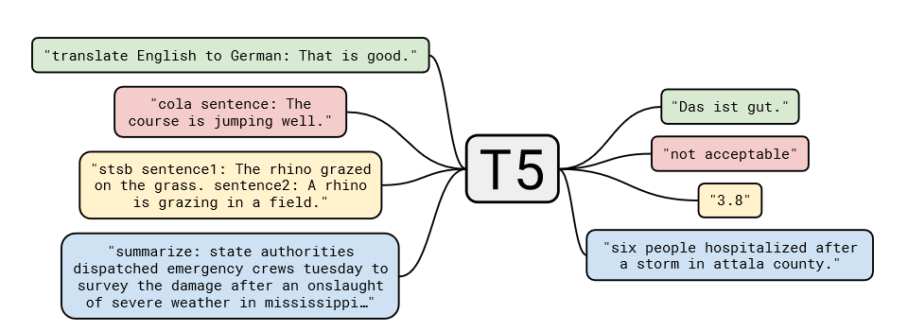
mT5 [14]
Multilingual version of T5 (Text-to-Text Transfer Transformer) [8]
Sequence to sequence model based on the full Transformer architecture [6].
T5 is pre-trained on the MLM task.
Sampling of language is similar to mBERT’s.
Pre-trained with 101 languages from mC4 dataset.
Diagram of text to text framework [14].

Slide 10
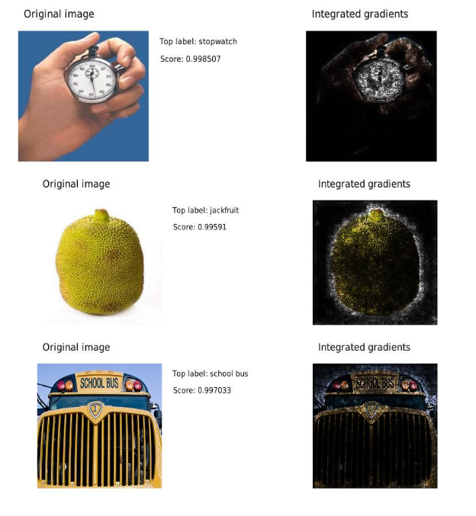
Explainability methods
Integrated Gradients [16].
Feature attribution method.
Post-hoc method.
Considers a straight line path from baseline x’ to input x.
Computes the gradients at small steps along the path.
Integrates all the gradients.
Example of Integrated gradients used in an image classification task [18].

Slide 11
Explainability methods
SHapley Additive exPlanations (SHAP) [17].
Feature attribution method.
Post-hoc method.
Kernel SHAP:
Samples feature vectors and sets some features randomly to absent.
Obtains predictions with the features vectors as input.
Computes the weight for each feature vector.
Fits a weighted linear model.
Approximate SHAP values.

Slide 12
Research questions
Text classification in the medical domain
How can an NLP model predict if a patient should be prescribed antibiotics or not from individual visits of patients' dental records using a low-resource language, such as Swedish?
1.How do multilingual and monolingual models’ performance compare in predicting if antibiotics should be prescribed?
Explainable predictions for text classification
How can a post-hoc method provide high-quality explanations of an NLP model?
2.What attribution method is better for medical classification tasks?
How can local explanations be used to obtain global explanations?

Slide 13
Methodology
Data cleaning
Transformer models
Explainability methods

Slide 14
Data cleaning
Train Transformer models
Remove data leakage
Obtain Explanations from SHAP/IG
Transformer models trained with raw dataset
Obtained explanations from feature attribution methods
Remove sources of data leakage
Re-train Transformer models

Slide 15
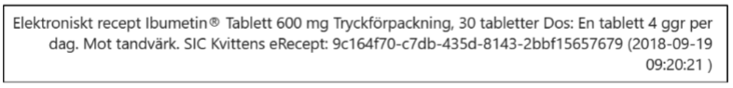
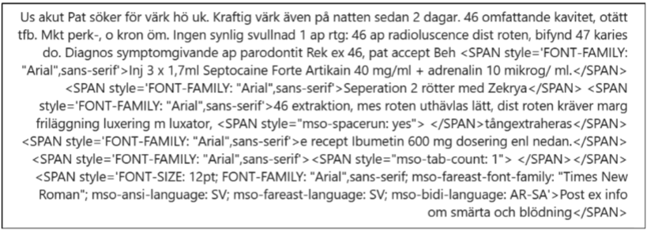

Modifications
Removed:
Electronic recipe ~%6
Html tags
Replacing:
Antibiotics ~3%
Years ~2%
Names ~2%

Slide 16
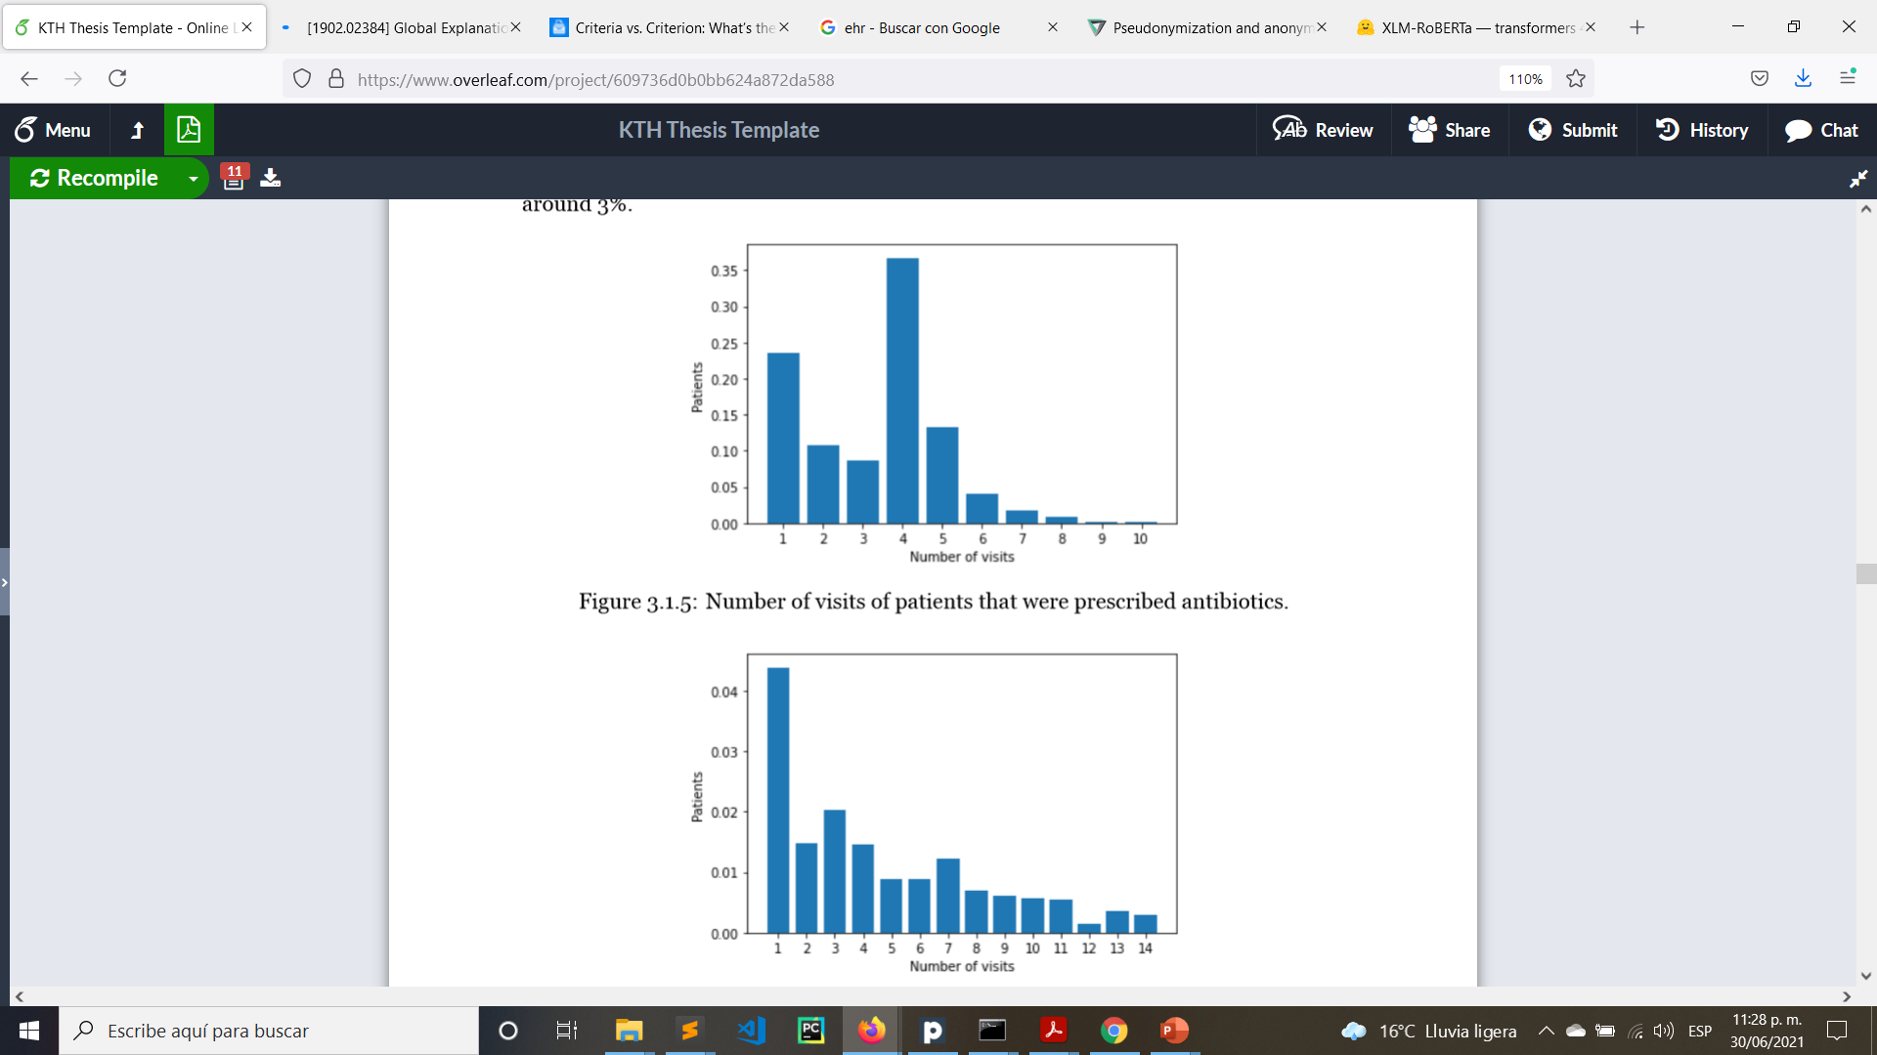
Visits
23.55% of the patients that were prescribed antibiotics visited the dentist just once.
15.58% of all patients that were prescribed antibiotics had their second visit within the next 14 days after the first visit.

Slide 17
Methodology
Transformer models.
Fine tuned with individual visits from the patients’ medical records.
Each model used the tokenization proposed in its publication.
80% of dataset was used for training.
Coarse hyperparameter search.
Metrics used: Accuracy and F1 score.

Slide 18
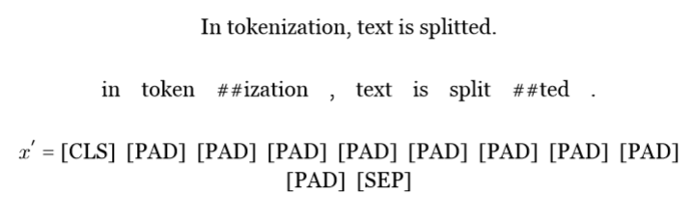
Methodology
Local explanations. Explanations of an individual prediction (one patient’s visit).
Text input is not padded.
Variable baseline.
Explainability methods assign weight to each feature not word.

Slide 19
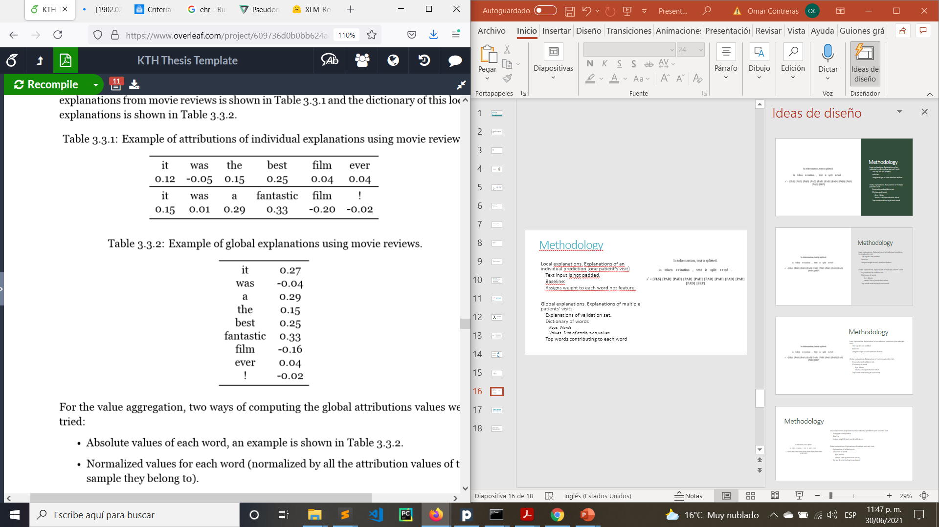
Methodology
Global explanations. Explanations of multiple patients’ visits.
Explanations of validation set.
Dictionary of words
Keys. Words
Values. Sum of attribution values.
Top words contributing to each class

Slide 20
Top models
Model | Accuracy (%) | F1 score (%)
KB-BERT | 91.35 ± 0.27 | 92.05 ± 0.19
KB-ELECTRA | 90.30 ± 1.54 | 90.82 ± 1.17
KB-ALBERT | 88.09 ± 0.68 | 88.49 ± 1.10
mBERT | 90.72 ± 0.43 | 91.35 ± 0.79
XLM-R | 90.52 ± 0.57 | 91.61 ± 0.51
st/XLMR | 89.89 ± 0.47 | 91.08 ± 0.48
mT5 | 88.75 ± 0.80 | 89.93 ± 0.70

Slide 21
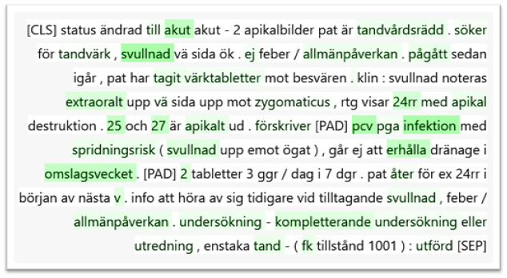
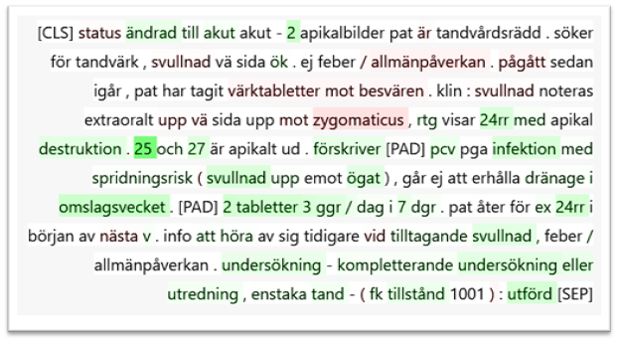
Local explanations: SHAP vs IG
KB-BERT and SHAP
KB-BERT and IG
Akut (Acute), Svullnad (Swelling), Pcv (Phnoxymethylpenicillin), Infektion (Infection)
25
Ej allmänpacerkan (Not general impact)

Slide 22
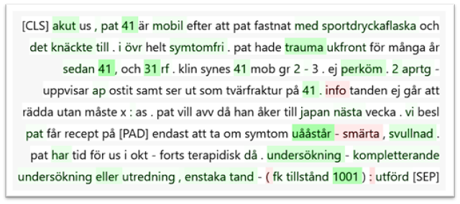
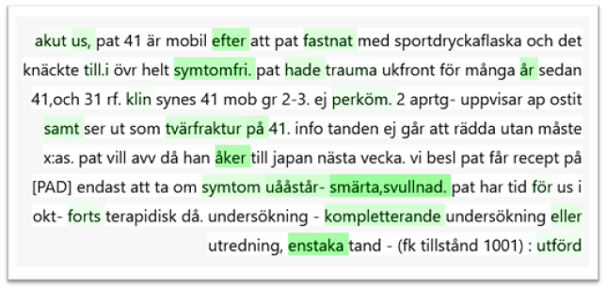
Local explanations: Models comparison using SHAP
mBERT
XLM-R
Akut (Acute), trauma, svullnad (swelling), 41, 31 and 1001
Efter (after), symptomfri (symptom free), åker (goes), smärta (pain), svullnad (swelling) and enstaka (single)
Common words: acute, symptom free, swelling, kompletterande (complementary), eller (or), single

Slide 23
Criteria for prescribing antibiotics [3]
Subgroups | Criteria
Affected general condition | General impact with feeling sick
 | Fever
Increased risk of spreading | Trismus
 | Extensive swelling submandibular up towards the eye or backwards in the pharynx
 | Swollen, sore local lymph nodes
Other | Acute Necrotizing Ulcerative Gingivitis (ANUG)
 | Prescription after specialist consultation
 | Extensive trauma
 | Dental sinusitis

Slide 24
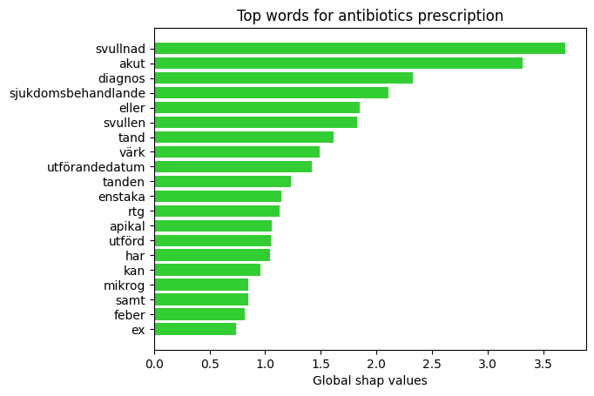
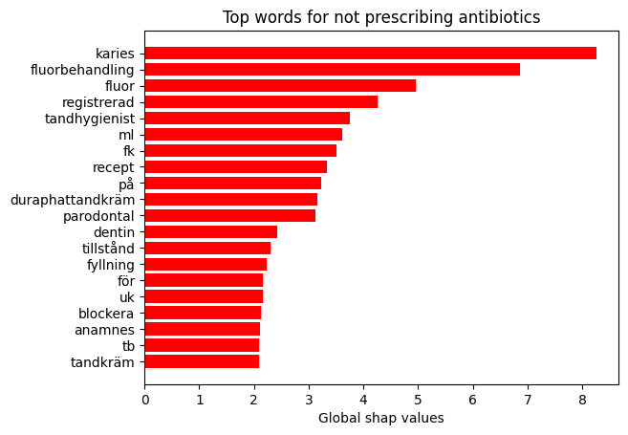
Global explanations: KB-BERT and SHAP
Svullnad (Swelling), Svullen (Swollen), Akut (Acute), Värk (Pain), feber (fever)
Karies (Caries), Fluorbehandling (Fluoride treatment), Fluor (Fluorine), Tandhygienist (Dental hygienist), Tandkräm (Toothpaste)

Slide 25
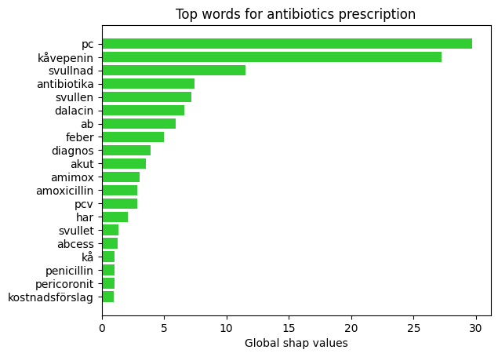
Global explanations: KB-BERT and SHAP for data cleaning
Top words with data cleaned
Top words without data cleaned
Pc. (Penicillin), amimox, Kåvepenin, Antibiotika. Antibiotics, Dalacin, Ab. (antibiotics), Amimox, Amimoxicillin, Penicillin, Pcv (Phenoxymethylpenicillin)

Slide 26
Conclusions
NLP models are capable of medical classification task with Swedish data.
IG and SHAP produce similar explanations.
SHAP is easier to interpret.
Global explanations can be obtained from local explanations.
Some of the correct criteria for prescribing antibiotics are learned from patients’ medical records.
Explanations can be used to understand what each model is focusing on but also to guide data cleaning.

Slide 27
References
[1] World Health Organization. Antibiotics Resistance.2020.URL: https://www.who.int/news-room/fact-sheets/detail/antibiotic-resistance
[2] Lund, Bodil, Cederlund, Andreas, Hultin, Margareta, and Lundgren, Frida. “Effect of governmental strategies on antibiotic prescription in dentistry”. In:Acta Odontologica Scandinavica 78.7 (2020). PMID: 32293215, pp. 529–534. DOI: 10.1080/00016357.2020.1751273. eprint: https://doi.org/10.1080/00016357.2020.1751273. URL: https://doi.org/10.1080/00016357.2020.1751273.
[3] Blomgren, Johan. “Förskrivning av antibiotika”. In:Tandläkartidningen5(2020), pp. 52–57. URL: https://www.tandlakartidningen.se/wp-content/uploads/2020/04/Blomgren-Jacobsen.pdf.
[4] He, Jianxing, Baxter, Sally, Xu, Jie, Xu, Jiming, Zhou, Xingtao, and Zhang,Kang. “The practical implementation of artificial intelligence technologies inmedicine”. In:Nature Medicine25 (Jan. 2019). DOI:10.1038/s41591-018-0307-0.
[5] Dzindolet, Mary T., Peterson, Scott A., Pomranky, Regina A., Pierce, Linda G.,and Beck, Hall P. “The role of trust in automation reliance”. In: International Journal of Human ­Computer Studies58.6 (2003). Trust and Technology, pp. 697–718. ISSN: 1071­5819. DOI: https://doi.org/10.1016/S1071-5819(03)00038-7. URL:https://www.sciencedirect.com/science/article/pii/S1071581903000387.
[6] Vaswani, Ashish, Shazeer, Noam, Parmar, Niki, Uszkoreit, Jakob, Jones, Llion, Gomez, Aidan N., Kaiser, Lukasz, and Polosukhin, Illia. “Attention Is All You Need”. In: CoRRabs/1706.03762 (2017). arXiv:1706.03762. URL:http://arxiv.org/abs/1706.03762

Slide 28
References
[7] Devlin, Jacob, Chang, Ming­ Wei, Lee, Kenton, and Toutanova, Kristina. “BERT: Pre­training of Deep Bidirectional Transformers for Language Understanding”. In:CoRRabs/1810.04805 (2018). arXiv:1810.04805. URL:http://arxiv.org/abs/1810.04805
[8] Clark, Kevin, Luong, Minh ­Thang, Le, Quoc V., and Manning, Christopher D. “Pre­ Training Transformers as Energy ­Based Cloze Models”.In:EMNLP.2020.URL:https://www.aclweb.org/anthology/2020.emnlp-main.20.pdf
[9] Lan, Zhenzhong, Chen, Mingda, Goodman, Sebastian, Gimpel, Kevin, Sharma, and Soricut, Radu. “ALBERT: A Lite BERT for Self­supervised Learning of Language Representations”. In:CoRRabs/1909.11942 (2019). arXiv:1909.11942. URL:http://arxiv.org/abs/1909.11942
[10] Devlin, Jacob, Chang, Ming ­Wei, Lee, Kenton, and Toutanova, Kristina. “BERT: Pretraining of Deep Bidirectional Transformers for Language Understanding”. In:CoRRabs/1810.04805 (2018). arXiv:1810.04805. URL:https://github.com/google-research/bert/blob/master/multilingual.md.[8
[11] Conneau, Alexis, Khandelwal, Kartikay, Goyal, Naman, Chaudhary, Vishrav, Wenzek, Guillaume, Guzmán, Francisco, Grave, Edouard, Ott, Myle, Zettlemoyer, Luke,and Stoyanov, Veselin. “Unsupervised Cross­lingual Representation Learningat Scale”. In:CoRRabs/1911.02116 (2019). arXiv:1911.02116. URL:http://arxiv.org/abs/1911.02116
[12] Liu, Yinhan, Ott, Myle, Goyal, Naman, Du, Jingfei, Joshi, Mandar, Chen, Danqi, Levy, Omer, Lewis, Mike, Zettlemoyer, Luke, and Stoyanov, Veselin. “RoBERTa: A Robustly Optimized BERT Pretraining Approach”. In:CoRRabs/1907.11692(2019). arXiv:1907.11692. URL:http://arxiv.org/abs/1907.11692.

Slide 29
References
[13] Reimers, Nils and Gurevych, Iryna. “Making Monolingual Sentence Embeddings Multilingual using Knowledge Distillation”. In:CoRRabs/2004.09813 (2020). arXiv:2004.09813. URL:https://arxiv.org/abs/2004.09813
[14] Xue, Linting, Constant, Noah, Roberts, Adam, Kale, Mihir, Al­Rfou, Rami, Siddhant, Aditya, Barua, Aditya, and Raffel, Colin. “mT5: A massively multilingual pre­trained text ­to ­text transformer”. In:CoRRabs/2010.11934(2020). arXiv:2010.11934. URL:https://arxiv.org/abs/2010.11934.
[15] Malmsten, Martin, Börjeson, Love, and Haffenden, Chris. “Playing with Wordsat the National Library of Sweden ­ Making a Swedish BERT”. In:CoRRabs/2007.01658 (2020). arXiv:2007.01658. URL:https://arxiv.org/abs/2007.01658.
[16] Sundararajan, Mukund, Taly, Ankur, and Yan, Qiqi. “Axiomatic Attribution forDeep Networks”. In:CoRRabs/1703.01365 (2017). arXiv:1703.01365. URL:http://arxiv.org/abs/1703.01365.
[17] Lundberg, Scott and Lee, Su­In. “A unified approach to interpreting modelpredictions”. In:CoRRabs/1705.07874 (2017). arXiv:1705.07874. URL:http://arxiv.org/abs/1705.07874
[18] Kedar Dhamdhere, Pramode Kaushik Mudrakarta, Mukund Sundararajan, Ankur Taly, Jinhua Xu. “Integrated Gradients”. https://github.com/ankurtaly/Integrated-Gradients/blob/master/icml_slides.pdf&sa=D&source=editors&ust=1625447900442000&usg=AFQjCNETI7v7FkomLFS1gSC4lYSJPBrJOA

