Slide 1



A 10-minute Introduction to Ontologies and the Semantic Web
Oscar Corcho, Asunción Gómez-Pérez
{ocorcho,asun}@fi.upm.es
http://www.oeg-upm.net/
Ontological Engineering Group
Laboratorio de Inteligencia Artificial
Facultad de Informática
Universidad Politécnica de Madrid
Campus de Montegancedo sn,
28660 Boadilla del Monte, Madrid, Spain

Slide 2
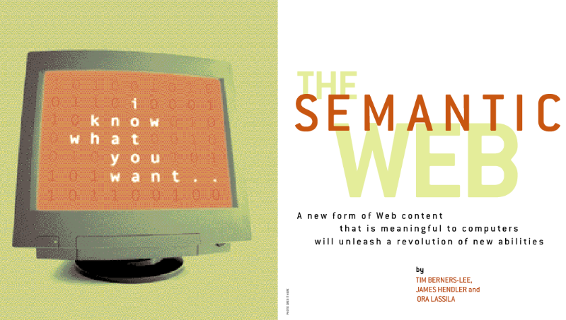
What is the Semantic Web
An extension of the current Web…
  … where information and services are given well-defined and explicitly represented meaning, …
  … so that it can be shared and used by humans and machines, ...
  ... better enabling them to work in cooperation
How?
  Promoting information exchange by tagging web content with machine processable descriptions of its meaning.
  And technologies and infrastructure to do this
Notes:
Why would such a thing be good.
Two angles: the user of the Grid and the middleware of the Grid.

Slide 3
The Semantic Web Vision
The Web was made possible through established standards
  TCP/IP for transporting bits down a wire
  HTTP & HTML for transporting and rendering hyperlinked text
Applications able to exploit this common infrastructure
  Result is the WWW as we know it
Generations
  1st generation web mostly handwritten HTML pages
  2nd generation (current) web often machine generated/active
    Both intended for direct human processing/interaction
  In the next generation web, resources should be more accessible to automated processes
    To be achieved via semantic markup
    Metadata annotations that describe content/function
The Syntactic Web
The Semantic Web

Slide 4
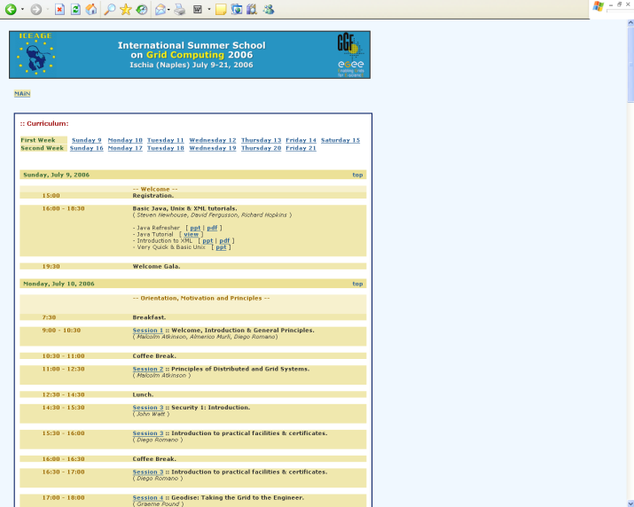
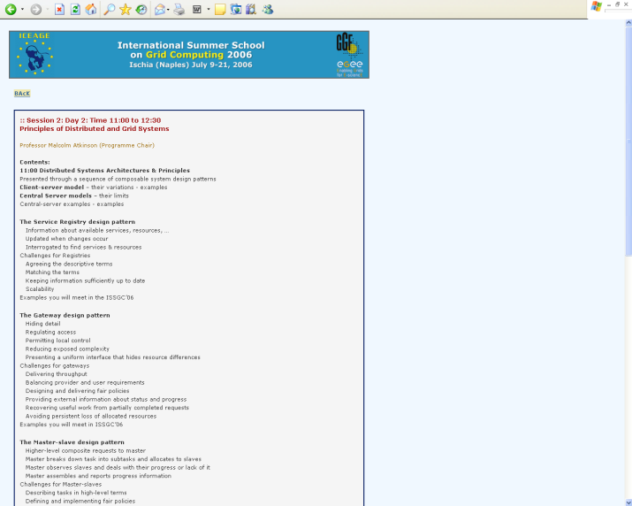
Where we are Today: the Syntactic Web
Resource
href
href
href
Resource
Resource
Resource
Resource
href
href
href
href
Resource
href
href
href
Resource
Resource
Resource
href
href
Resource
A place where computers do the presentation (easy) and people do the linking and interpreting (hard).
Why not get computers to do more of the hard work?

Slide 5
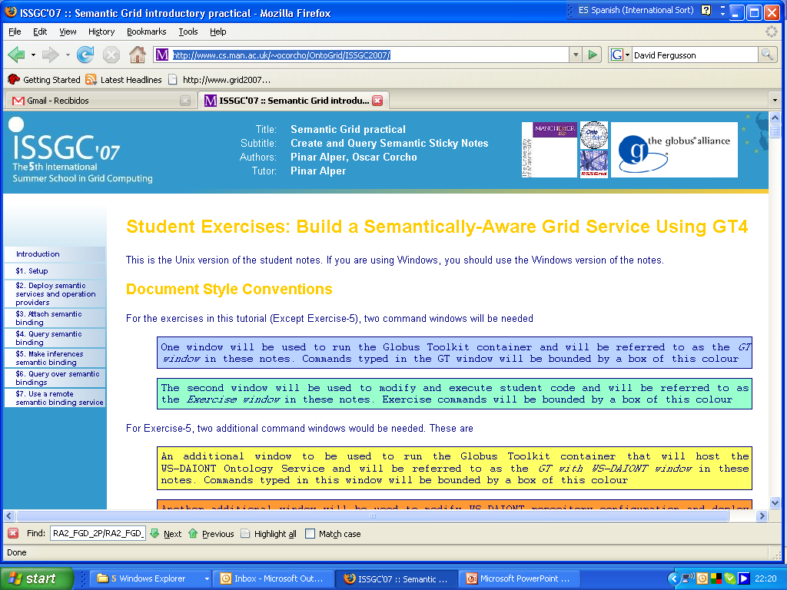
What’s the Problem?
Typical web page markup consists of:
  Rendering information (e.g., font size and colour)
  Hyper-links to related content
Semantic content is accessible to humans but not (easily) to computers…

Slide 6
Information we can see…
International Summer School on Grid Computing (ISSGC2007)
Semantic Grid practical
Pinar Alper, Oscar Corcho
Project logos… (sponsors/related projects/…?)
OntoGrid, RSSGRID, Globus
Student Exercises
Structured in seven chapters
Setup chapter
Instructions for each chapter
Code inside
Description of code
Material to change
Additional material
…

Slide 7
Information a machine can see…









…


…

Slide 8
Solution: XML markup with “meaningful” tags?
<name>
</name>
<date></date>
<location>
</location>
<introduction>
…
</introduction>
<speaker>
<bio></bio>
</speaker>
<speaker>
<bio></bio>
</speaker>
<registration>
<registration>

Slide 9
But What About…?
<conf>
</conf>
<date></date>
<place>
</place>
<introduction>
…
</introduction>
<speaker>
<bio></bio>
</speaker>
<speaker>
<bio></bio>
</speaker>
<registration>
<registration>

Slide 10
Still the Machine only sees…
<>
<>
<></>
<>
<>
<>
…
</>
<>
<></>
</>
<>
<></>
</>
<>
<>

Slide 11
Need to Add “Semantics”
External agreement on meaning of annotations
  E.g., Dublin Core for annotation of library/bibliographic information
    Agree on the meaning of a set of annotation tags
  Problems with this approach
    Inflexible
    Limited number of things can be expressed
Use Ontologies to specify meaning of annotations
  Ontologies provide a vocabulary of terms
  New terms can be formed by combining existing ones
    “Conceptual Lego”
  Meaning (semantics) of such terms is formally specified
  Can also specify relationships between terms in multiple ontologies

Slide 12
Ontology in Computer Science
An ontology is an engineering artifact:
  It is constituted by a specific vocabulary used to describe a certain reality, plus
  a set of explicit assumptions regarding the intended meaning of the vocabulary.
    Almost always including concepts and their classification
    Almost always including properties between concepts
    Similar to an object oriented model
Thus, an ontology describes a formal specification of a certain domain:
  Shared understanding of a domain of interest
  Formal and machine manipulable model of a domain of interest

Slide 13
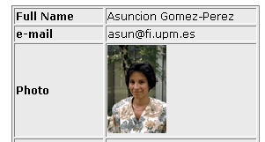
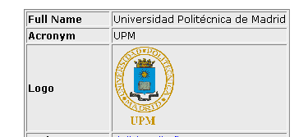


Ontologies and Metadata
Ontologies
Person
Belongs_To
Organization
xmlns:rdf='http://www.w3.org/1999/02/22-rdf-syntax-ns#'
xmlns:NS0='http://www.esperonto.net/semanticportal/RDFS/Person_Ontology#' xmlns:NS1='http://www.esperonto.net/semanticportal/RDFS/Organization_Ontology#'
Has_contact_Person
Subclass of
Subclass of
Associate Prof.
Partner
Instance of
Instance of
<rdf:Description rdf:about='Asunción Gómez-Pérez'>
<rdf:type rdf:resource=‘Associate Prof'/>
<NS0:Full_Name>A. GomezPerez</NS0:Full_Name>
<NS0:Belongs_To>UPM</NS0: Belongs_To >
<NS0:e-mail>asun@fi.upm.es</NS0:e-mail>
<rdf:Description rdf:about='UPM'>
<rdf:type rdf:resource='Partner'/>
<NS1:Acronym>UPM</NS1:Acronym>
<NS1:Has_Contact_Person>Asunción Gómez-Pérez
</NS1:Has_Contact_Person >
Annotation
(RDF)
Web Page
URL
http://www.esperonto.net
http://www.esperonto.net

Slide 14
Course objectives and structure
Provide the theoretical and practical basis over the scientific, methodological and technological foundations of the Semantic Web
  To be used in the construction of applications that integrate, combine and derive information
  Distributed and heterogeneous information
Structured
  Unit 1. Semantic Web introduction
  Unit 2. Ontology development
    RDF and RDF Schema
    OWL
    Ontology building methodologies
  Unit 3. Semanic Web
    Annotation
    Semantic similarity
    Semantic search

Slide 15
Course outline
Content | Duration (hours) | Lecturer | Day
Introduction to the Semantic Web | 3 | Asunción Gómez-Pérez | 19/5/2008
RDF and RDF Schema | 4 | Oscar Corcho Raúl García-Castro | 8/5/2008
OWL | 5 | Oscar Corcho Mcarmen Suárez | 13-14/5/2008
Ontology development methodologies | 6 | Asunción Gómez-Pérez Mcarmen Suárez | 21-22/5/2008
Annotation | 3 | Oscar Corcho | 10/6/2008
Semantic similarity | 1,5 | Asunción Gómez-Pérez | 11/6/2008
Semantic search | 1,5 | Oscar Corcho | 11/6/2008

