Slide 1



RDF and RDF Schema
Oscar Corcho, Raúl García Castro, Oscar Muñoz-García
{ocorcho,rgarcia}@fi.upm.es, omunoz@delicias.dia.fi.upm.es
http://www.oeg-upm.net/
Ontological Engineering Group
Laboratorio de Inteligencia Artificial
Facultad de Informática
Universidad Politécnica de Madrid
Campus de Montegancedo sn,
28660 Boadilla del Monte, Madrid, Spain
Work distributed under the license Creative Commons Attribution-Noncommercial-Share Alike 3.0

Slide 2


Main References
Gómez-Pérez, A.; Fernández-López, M.; Corcho, O. Ontological Engineering. Springer Verlag. 2003
Capítulo 4: Ontology languages
Brickley D, Guha RV (2004) RDF Vocabulary Description Language 1.0: RDF Schema. W3C Recommendation.
http://www.w3.org/TR/PR-rdf-schema
Lassila O, Swick R (1999) Resource Description Framework (RDF) Model and Syntax Specification. W3C Recommendation.
http://www.w3.org/TR/REC-rdf-syntax/
Prud’hommeaux E, Seaborne A (2008) SPARQL Query Language for RDF. W3C Recommendation.
http://www.w3.org/TR/rdf-sparql-query/
Jena web site: http://jena.sourceforge.net/
Jena API: http://jena.sourceforge.net/tutorial/RDF_API/
Jena tutorials: http://www.ibm.com/developerworks/xml/library/j-jena/index.html
http://www.xml.com/pub/a/2001/05/23/jena.html
SPARQL validator: http://www.sparql.org/validator.html
SPARQL implementations: http://esw.w3.org/topic/SparqlImplementations
SPARQL tutorials: http://jena.sourceforge.net/ARQ/Tutorial/
http://www.w3.org/2004/Talks/17Dec-sparql/intro/all.html
http://www.cs.man.ac.uk/~bparsia/2006/row-tutorial/

Slide 3
Table of Contents
An introduction to knowledge representation formalisms 30’
Resource Description Framework (RDF) 30’
  2.1. RDF primitives
  2.2. Reasoning with RDF
RDF Schema 30’
  3.1 RDF Schema primitives
  3.2 Reasoning with RDFS
RDF(S) management APIs 60’
RDF(S) query languages: SPARQL 45’
An example of an RDF(S)-based application 25’

Slide 4
Common Architecture of a Knowledge-based System
CONTROL
Explanation
Knowlege capture
Other interacting systems:
Databases
...
Interface with other systems
User Interface
Knowledge Base
InferenceEngine
Development Environment
Knowledge-based system generation tools
Programming languages

Slide 5
Knowledge Representation Formalisms. A Summary
Knowledge representation
  To store knowledge so that programs can process it and achieve the verisimilitude of human intelligence
Knowledge representation formalisms/techniques
  Originated from theories of human information processing.
  Since knowledge is used to achieve intelligent behavior, the fundamental goal of knowledge representation is to represent knowledge in a manner as to facilitate inferencing i.e. drawing conclusions from knowledge.
  Some examples are:
    First order logic
    Semantic networks and conceptual maps
    Frames
    Description logic
    Production rules
    Fuzzy logic
    Bayesian networks
    Etc.
These are the ones that we will analyse

Slide 6
First order logic. Basic elements
We can establish mappings between logical symbols and domain objects (universe of discourse)
Constants
First order logic
Set theory
Universe of
discourse
a
b
c
Socrates
Plato
Aristotle
Predicate symbols
h
m
t
person = {Socrates, Plato, Aristotle}
mortal = {Socrates, Plato, Aristotle}
masterOf = {(Socrates, Plato), (Plato, Aristotle)}
Formulae
∀ x (h (x) → m (x))
∃ x ∃ y (h (x) ∧ h (y) ∧ t(x, y))
h (a) ∧ h (b) ∧ h(c)
person ⊂ mortal
masterOf ≠ ∅ in the domain of persons
Socrates, Plato, Aristotle ∈ person

Slide 7
First order logic. Formalisation
Se tiene un robot que distribuye paquetes en oficinas. Se sabe que:
  Los paquetes de la habitación 27 son más pequeños que los de la habitación 28.
  Todos los paquetes de la misma habitación son del mismo tamaño.
  En un instante concreto el robot sabe que:
    i) El paquete A está en la habitación 27 ó 28 (pero no sabe en cuál).
    ii) El paquete B está en la habitación 27.
    iii) El paquete B no es más pequeño que el A.
  El robot quiere probar que el paquete A está en la habitación 27.
Formalización en lógica de predicados de primer orden Mariano Fernández López

Slide 8
First order logic. Formalisation. Solution
Se tiene un robot que distribuye paquetes en oficinas. Se sabe que:
  Los paquetes de la habitación 27 son más pequeños que los de la habitación 28.
    ∀x ∀y (paquete(x) ∧ situadoEn (x,h27) ∧ paquete(y) ∧ situadoEn (y,h28) → menor(x,y))
  Todos los paquetes de la misma habitación son del mismo tamaño.
    ∀x ∀y ∀h (paquete(x) ∧ paquete(y) ∧ habitacion(h) ∧ situadoEn (x,h) ∧ situadoEn (y,h)
    → igual(x,y))
  En un instante concreto el robot sabe que:
    i) El paquete A está en la habitación 27 ó 28 (pero no sabe en cuál).
      paquete(a) ∧ habitacion(h27) ∧ habitacion(h28) ∧ (situadoEn(a,h27) ∨ situadoEn(a,h28))
    ii) El paquete B está en la habitación 27.
      paquete(b) ∧ situadoEn(b,h27)
    iii) El paquete B no es más pequeño que el A.
      ¬menor(b,a)
  El robot quiere probar que el paquete A está en la habitación 27.
    ¿situadoEn(a,h27)?
Formalización en lógica de predicados de primer orden Mariano Fernández López

Slide 9
Semantic Network. Basic elements
Nodes
  They represent entities or concepts, or values
Edges
  They represent properties or relations
The semantics (mapping to the real world) depends on the tags used for nodes and edges
There is no predefined KR vocabulary
  Although sometimes there are structural edges
Entity/Concept
Value
property/relation
Node
Node
instanceOf
subclassOf
Entity
Concept
Concept
Concept

Slide 10
Semantic networks. Example
Paul and John are persons
El Prado is a museum
Paul knows that John visited El Prado in Madrid

Slide 11
Semantic networks. Example. Solution
Paul and John are persons
El Prado is a museum
Paul knows that John visited El Prado in Madrid
Person
instanceOf
instanceOf
John
Agente
Museum
Object
Voice
Know_1 Visit_1
instanceOf
Object
Agent
Active
Tense
Voice
El Prado
Paul
Place
Active
Tense
Present
Past
Madrid

Slide 12
Frames. Basic elements
CONCEPTS
FRAMES
Class
Instance
SLOTS
Relations
subclassOf
instanceOf
Facets
Sibling
Disjoint
Type
Min cardinality
Max cardinality
Multivalued
Inferences:
Property inheritance
Matching
Daemons
Non Disjoint
Ad hoc
Properties
Allowed values
Default values
Precondition
IfNeeded
IfModified
IfAdded
IfRemoved
of Class
of Instance
Facets
Frame
F₁
F₂
...
F_{n}
R₁
Description
Value
Procedure
Pointer
Properties
Relations
R_{n}

Slide 13
Vertebrado
Sistema central: Central
Esqueleto: Sí
Subclase-de
Subclase-de
Subclase-de
Subclase-de
Anfibio
Respiración: [Bronquial, pulmonar, cutánea, cavidad bucal]
Ambiente: [Terrestre, marino]
Piel: sin escamas
Nº cámaras corazón: 3
Pares nerviosos craneales: 10
Reptiles
Respiración: [Pulmonar]
Ambiente: [Terrestre, marino]
Piel: Con escamas
Nº cámaras corazón: 4
Pares nerviosos craneales: 12
Aves
Piel: Plumas
Ambiente: Terrestre
Respiración: Pulmonar
Nº cámaras corazón: 4
Pares nerviosos craneales: 12
Temperatura: Constante
Nº de patas: 2
Mamífero
Piel: Pelo
Ambiente: Terrestre
Respiración: Pulmonar
Nº cámaras corazón: 4
Pares nerviosos craneales: 12
Temperatura: Constante
Mama: Sí
Subclase-de
Subclase-de
Subclase-de
Subclase-de
Subclase-de
Subclase-de
Subclase-de
Rana
Color: Verde
Color abdomen: Blanco
Patas anteriores: Grandes
Patas posteriores: Pequeñas
Nº patas: 4
Sapo
Color: Verde
Verrugas: Sí
Patas anteriores: Grandes
Patas posteriores: Pequeñas
Nº patas: 4
Tortuga
Caparazón: Sí
Nº patas: 4
Serpiente
Nº patas: 0
Cetáceo
Nº patas: 0
Ambiente: Marino
Felino
Nº patas: 4
Carnívoro: Sí
Familia: Felinos
Cánido
Nº patas: 4
Carnívoro: Sí
Familia: Cánido
Subclase-de
Subclase-de
Subclase-de
Subclase-de
Subclase-de
Subclase-de
Tortuga marina
Ambiente: Marino
Color: [Rojo, Verde]
Tortuga terrestre
Ambiente: Terrestre
Color: [Negro, amarillo]
Doméstico: Sí
Gato
Doméstico: Sí
Persigue: Ratones
Maúlla: Sí
(*) Raza: [Siamés ...]
León
Doméstico: No
Perro
Doméstico: Sí
Leal: Sí
Ladra: Sí
(*) Raza: [Pekinés ...]
Lobo
Doméstico: No

Slide 14
Frames. Example
Men and women are persons
A person can be married to another person
Nobody can be a man and a woman at the same time
John, Paul and Michael are men
Mary and Anne are women
John is married to Mary
Paul is married to Anne

Slide 15
Frames. Example
Men and women are persons
A person can be married to another person
Nobody can be a man and a woman at the same time
John, Paul and Michael are men
Mary and Anne are women
John is married to Mary
Paul is married to Anne
Person
Married-to
subclassOf
subclassOf
Man
Disjoint
Woman
instanceOf
instanceOf
instanceOf
instanceOf
Married-to
instanceOf
John
Mary
Michael
Married-to
Paul
Anne

Slide 16
Description Logics. Basic elements
A subset of first order logic with good reasoning properties
Automatic classification
Invertebrate
Living Being
Living Being
Vertebrate
Plant
Subclass of
Cat
Subclass of
Dog
Subclass of
Invertebrate
Vertebrate
Plant
Automatic Classification
Subclass of
Subclass of
Dog
Cat
Frame-based design

Slide 17
KR Formalisms
Language
  Ontolingua/KIF
  OKBC
  OCML
  LOOM
  FLogic
  SHOE
  XOL
  OIL
  DAML+OIL
  RDF(S)
  OWL
Formalism
Frames
First order Logic
Description Logic
Semantic Networks

Slide 18
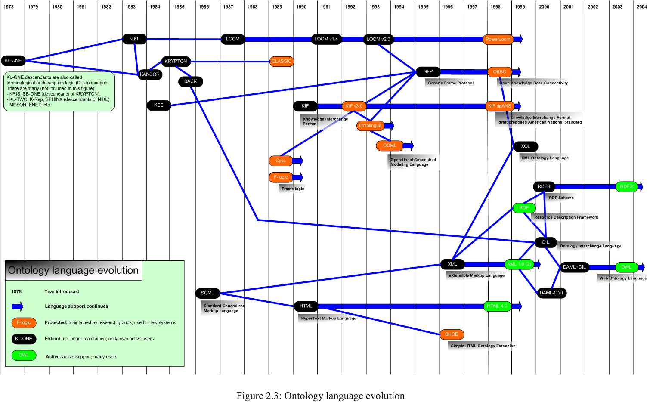
Ontology language evolution
DL languages
Frames+FOL
Markup languages

Slide 19
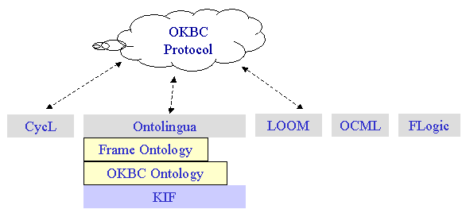
Ontology Languages (I)
Traditional ontology languages
  Ontolingua/KIF
  OKBC
  OCML
  LOOM
  FLogic

Slide 20
Ontology Languages (II)
Ontology markup languages
  Standards & Recommendations of W3C
    XML RDF(S)
  Ontology specification languages
    SHOE XOL
    OIL
    DAML+OIL
    OWL
OIL
DAML+OIL
OWL
RDFS
SHOE
(HTML)
SHOE
(XML)
XOL
RDF(S)
RDF
HTML
XML

Slide 21
Table of Contents
An introduction to knowledge representation formalisms
Resource Description Framework (RDF)
  2.1. RDF primitives
  2.2. Reasoning with RDF
RDF Schema
  3.1 RDF Schema primitives
  3.2 Reasoning with RDFS
RDF(S) management APIs
RDF(S) query languages: SPARQL
An example of an RDF(S)-based application

Slide 22
RDF: Resource Description Framework
W3C recommendation
RDF is a basic KR language, based on semantic networks
  Useful to represent metadata and describe any type of information in a machine- accessible way (aka data model)
  Resources are described in terms of properties
  and property values using RDF statements.
  Statements are represented as triples,
  consisting of a subject, predicate and
  object. [S, P, O]
Resource
property
Subject
Object
Statement
“Oscar Corcho García”
hasName
Oscar
hasColleague
Asun
hasHomePage
hasColleague
Raúl
http://www.fi.upm.es/

Slide 23
RDF (and other W3C Recommendations) and URIs
A URI (Unique Resource Identifiers) is a Web identifier
  e.g. http://www.oeg-upm.net/ontologies/people#Oscar
  URI ≠ URL
    If we open a Web browser and point to that URI, the corresponding object will not be downloaded or shown
    If URLs work for locating uniquely (with no collisions) a Web page/resource, why not using the same approach for identifying Web resources?
  Other valid URIs could be
    ftp://www.oeg-upm.net/ontologies/people#Oscar
    persons://www.oeg-upm.net/ontologies/people#Oscar
    ...
URIs allow identifying
  Individuals: http://www.oeg-upm.net/ontologies/people#Oscar
  Kinds of things: http://www.ontologies.org/ontologies/people#Person
  Properties of those things:
  http://www.ontologies.org/ontologies/people#hasColleague

Slide 24
RDF (and other W3C Recommendations) and URIs
For practical purposes, especially if handwritten, URIs are shortened using XML namespaces
  xmlns:oeg=“http://www.oeg-upm.net/ontologies/people#”
  oeg:Oscar is equivalent to http://www.oeg-upm.net/ontologies/people#Oscar
“Oscar Corcho García”
person:hasName
oeg:Oscar
person:hasColleague
oeg:Asun
person:hasColleague
person:hasHomePage
oeg:Raúl
“http://www.fi.upm.es/”

Slide 25
RDF (and other W3C Recommendations) and URIs
A set of URIs is sometimes known as a vocabulary
  The RDF Vocabulary
    The set of URIs used to describe the RDF concepts: rdf:Property, rdf:Resource, rdf:type, etc.
  The RDFS Vocabulary
    The set of URIs used in describing RDF Schema: rdfs:Class, rdfs:domain, etc.
  The ‘Person’ Vocabulary
    person:hasColleague, person:Person, person:Employee, etc.
“Oscar Corcho García”
person:hasName
oeg:Oscar
person:hasColleague
oeg:Asun
person:hasColleague
person:hasHomePage
oeg:Raúl
“http://www.fi.upm.es/”

Slide 26
RDF Serialisations
Normative
  RDF/XML (www.w3.org/TR/rdf-syntax-grammar/)
Alternative (for human consumption)
  N3 (http://www.w3.org/DesignIssues/Notation3.html)
  Turtle (http://www.dajobe.org/2004/01/turtle/)
  TriX (http://www.w3.org/2004/03/trix/)
  …
Important note: the order of RDF statements in a serialisation does not affect the behaviour of a parser/application

Slide 27
RDF Serialisations. RDF/XML
<?xml version="1.0"?>
<rdf:RDF
xmlns:rdf="http://www.w3.org/1999/02/22-rdf-syntax-ns#"
xmlns:person="http://www.ontologies.org/ontologies/people#"
xmlns="http://www.oeg-upm.net/ontologies/people#"
xml:base="http://www.oeg-upm.net/ontologies/people">
<rdf:Property rdf:about="http://www.ontologies.org/ontologies/people#hasHomePage"/>
<rdf:Property rdf:about="http://www.ontologies.org/ontologies/people#hasColleague"/>
<rdf:Property rdf:about="http://www.ontologies.org/ontologies/people#hasName"/>
<rdf:Description rdf:about="#Raúl"/>
<rdf:Description rdf:about="#Asun">
<person:hasColleague rdf:resource="#Raúl"/>
<person:hasHomePage>http://www.fi.upm.es</person:hasHomePage>
</rdf:Description>
<rdf:Description rdf:about="#Oscar">
<person:hasColleague rdf:resource="#Asun"/>
<person:hasName>Oscar Corcho García</person:hasName>
</rdf:Description>
</rdf:RDF>

Slide 28
RDF Serialisations. N3
@base <http://www.oeg-upm.net/ontologies/people >
@prefix person: <http://www.ontologies.org/ontologies/people#>
:Asun person:hasColleague :Raúl ;
person:hasHomePage “http://www.fi.upm.es/”.
:Oscar person:hasColleague :Asun ;
person:hasName “Oscar Corcho García”.

Slide 29

Exercise
Objective
  Get used to the different syntaxes of RDF
Tasks
  Take the text of an RDF file and create its corresponding graph
  Take an RDF graph and create its corresponding RDF/XML and N3 files

Slide 30
Exercise 1.a. Create a graph from a text file
Open the file StickyNote_PureRDF.rdf
Create the corresponding graph from it
Compare your graph with those of your colleagues

Slide 31
Exercise 1.b. Create RDF/XML and N3 text files from an RDF graph
Transform the following graph into RDF/XML and N3 syntaxes
Pepe
Agente
Objeto
Saber_1 Ver_1
Voz
Objeto
Agente
Activa
Tiempo
Voz
El Prado
Luis
Lugar
Activa
Tiempo
Presente
Pasado
Madrid

Slide 32
Blank nodes: structured property values
Most real-world data involves structures that are more complicated than sets of RDF triple statements
In RDF/XML, it is an <rdf:Description> node with no rdf:about
In N3, it is an _:oscarAddress
“Oscar Corcho García”
This intermediate URI does not
need to have a name
person:hasName
oeg:Oscar
person:hasPostalAddress
address:City
address:hasStreetName
city:BoadillaDelMonte
Campus de Montegancedo s/n

Slide 33
Typed literals
So far, all values have been presented as strings
XML Schema datatypes can be used to specify values (objects in some RDF triple statements)
In RDF/XML, this is expressed as:
  <rdf:Description rdf:about=”#Oscar”>
  <person:hasBirthDate
  rdf:datatype="http://www.w3.org/2001/XMLSchema#date">02/02/1976
  </person:hasBirthDate>
  </rdf:Description>
In N3, this is expressed as:
  oeg:Oscar person:hasBirthDate ”02/02/1976”^xsd:date .
oeg:Oscar
person:hasBirthDate
02/02/1976

Slide 34
RDF Containers
There is often the need to describe groups of things
  A book was created by several authors
  A lesson is taught by several persons
  etc.
RDF provides a container vocabulary
  rdf:Bag → A group of resources or literals, possibly including duplicate members, where the order of members is not significant.
  rdf:Seq → A group of resources or literals, possibly including duplicate members, where the order of members is significant.
  rdf:Alt → A group of resources or literals that are alternatives (typically for a single value of a property).
oeg:Oscar
person:hasEmailAddress
rdf:type
rdf:Seq
rdf:_1
rdf:_2
“ocorcho@fi.upm.es”
“oscar.corcho@upm.es”

Slide 35
RDF Reification
RDF statements about other RDF statements
  “Raúl believes that Oscar’s birthdate is on Feb 2nd, 1976 and that his e-mail address is ocorcho@fi.upm.es”
RDF Reification
  Allows expressing beliefs (and other modalities)
  Allows expressing trust models, digital signatures,etc.
  Allows expressing metadata about metadata
oeg:Raúl
modal:believes
oeg:Oscar
person:hasEmailAddress
person:hasBirthDate
“ocorcho@fi.upm.es”
02/02/1976

Slide 36
Main value of a structured value (scarcely used)
Sometimes one of the values of a structured value is the main one
  The weight of an item is 2.4 kilograms.
  The most important value is 2.4, which is expressed with rdf:value
product:Item1
product:hasWeight
rdf:value
units:hasWeightUnit
2.4
units:kilogram

Slide 37
Table of Contents
An introduction to knowledge representation formalisms
Resource Description Framework (RDF)
  2.1. RDF primitives
  2.2. Reasoning with RDF
RDF Schema
  3.1 RDF Schema primitives
  3.2 Reasoning with RDFS
RDF(S) management APIs
RDF(S) query languages: SPARQL
An example of an RDF(S)-based application

Slide 38
RDF inference. Graph matching techniques
RDF inference is based on graph matching techniques
Basically, the RDF inference process consists of the following steps:
  Transform an RDF query into a template graph that has to be matched against the RDF graph
    It contains constant and variable nodes, and constant and variable edges between nodes.
  Match against the RDF graph, taking into account constant nodes and edges.
  Provide a solution for variable nodes and edges.

Slide 39
RDF inference. Examples (I)
Sample RDF graph
Query: “Tell me who are the persons who have Asun as a colleague”
  Result: oeg:Oscar and oeg:Raúl
“Oscar Corcho García”
person:hasName
oeg:Oscar
person:hasColleague
oeg:Asun
person:hasColleague
person:hasHomePage
oeg:Raúl
“http://www.fi.upm.es/”
?
person:hasColleague
oeg:Asun

Slide 40
RDF inference. Examples (II)
Query: “Tell me which are the relationships between Oscar and Asun”
  Result: oeg:hasColleague
Query: “Tell me the homepage of Oscar colleagues”
  Result: “http://www.fi.upm.es/”
oeg:Oscar
?
oeg:Asun
oeg:Oscar
person:hasColleague
person:hasHomePage
?

Slide 41
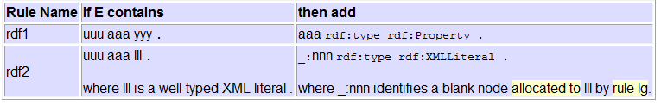
RDF inference. Entailment rules

Slide 42
Table of Contents
An introduction to knowledge representation formalisms
Resource Description Framework (RDF)
  2.1. RDF primitives
  2.2. Reasoning with RDF
RDF Schema
  3.1 RDF Schema primitives
  3.2 Reasoning with RDFS
RDF(S) management APIs
RDF(S) query languages: SPARQL
An example of an RDF(S)-based application

Slide 43
RDFS: RDF Schema
W3C Recommendation
RDF Schema extends RDF to enable talking about classes of resources, and the properties to be used with them.
  Class definition: rdfs:Class, rdfs:subClassOf
  Property definition: rdfs:subPropertyOf, rdfs:range, rdfs:domain
  Other primitives: rdfs:comment, rdfs:label, rdfs:seeAlso, rdfs:isDefinedBy
RDFS vocabulary adds constraints on models, e.g.:
  ∀x,y,z type(x,y) and subClassOf(y,z) → type(x,z)
ex:Person
ex:Animal
rdfs:subClassOf
ex:Person
rdf:type
ex:Oscar
rdf:type
ex:Animal

Slide 44
RDF(S) = RDF + RDF Schema. RDF/XML syntax
<?xml version="1.0"?>
<rdf:RDF
xmlns:rdf="http://www.w3.org/1999/02/22-rdf-syntax-ns#"
xmlns:person="http://www.ontologies.org/ontologies/people#"
xmlns:rdfs="http://www.w3.org/2000/01/rdf-schema#"
xmlns="http://www.oeg-upm.net/ontologies/people#"
xml:base="http://www.oeg-upm.net/ontologies/people">
<rdfs:Class rdf:about="http://www.ontologies.org/ontologies/people#Professor">
<rdfs:subClassOf>
<rdfs:Class rdf:about="http://www.ontologies.org/ontologies/people#Person"/>
</rdfs:subClassOf>
</rdfs:Class>
<rdfs:Class rdf:about="http://www.ontologies.org/ontologies/people#Lecturer">
<rdfs:subClassOf rdf:resource="http://www.ontologies.org/ontologies/people#Person"/>
</rdfs:Class>
<rdfs:Class rdf:about="http://www.ontologies.org/ontologies/people#PhDStudent">
<rdfs:subClassOf rdf:resource="http://www.ontologies.org/ontologies/people#Person"/>
</rdfs:Class>
…

Slide 45
RDF(S) = RDF + RDF Schema. RDF/XML syntax
…
<rdf:Property rdf:about="http://www.ontologies.org/ontologies/people#hasHomePage"/>
<rdf:Property rdf:about="http://www.ontologies.org/ontologies/people#hasColleague">
<rdfs:domain rdf:resource=" http://www.ontologies.org/ontologies/people#Person"/>
<rdfs:range rdf:resource=" http://www.ontologies.org/ontologies/people#Person"/>
</rdf:Property>
<rdf:Property rdf:about="http://www.ontologies.org/ontologies/people#hasName">
<rdfs:domain rdf:resource="http://www.w3.org/2002/07/owl#Thing"/>
</rdf:Property>
<person:PhDStudent rdf:ID="Raúl"/>
<person:Professor rdf:ID=“Asun">
<person:hasColleague rdf:resource="#Raúl"/>
<person:hasHomePage>http://www.fi.upm.es</person:hasHomePage>
</person:Professor>
<person:Lecturer rdf:ID="Oscar">
<person:hasColleague rdf:resource="#Asun"/>
<person:hasName>Oscar Corcho García</person:hasName>
</person:Lecturer>
</rdf:RDF>

Slide 46
RDF(S) Serialisations. N3
@base <http://www.oeg-upm.net/ontologies/people >
@prefix person: <http://www.ontologies.org/ontologies/people#>
person:hasColleague a rdf:Property;
rdfs:domain person:Person;
rdfs:range person:Person.
person:Professor rdfs:subClassOf person:Person.
person:Lecturer rdfs:subClassOf person:Person.
person:PhDStudent rdfs:subClassOf person:Person.
:Asun a person:Professor;
person:hasColleague :Raúl ;
person:hasHomePage “http://www.fi.upm.es/”.
:Oscar a person:Lecturer;
person:hasColleague :Asun ;
person:hasName “Oscar Corcho García”.
:Raúl a person:PhDStudent.
a is equivalent to rdf:type

Slide 47
Exercise
Objective
  Get used to the different syntaxes of RDF(S)
Tasks
  Take the text of an RDF(S) file and create its corresponding graph
  Take an RDF(S) graph and create its corresponding RDF/XML and N3 files

Slide 48
Exercise 2.a. Create a graph from a text file
Open the files StickyNote.rdf and StickyNote.rdfs
Create the corresponding graph from them
Compare your graph with those of your colleagues

Slide 49
Another example
event1
rdf:type
event
event2
local_event
rdf:type
15/05/2006
Personal_event
rdf:type
event5
rdf:type
rdf:type
involves
16/05/2006
event3
event4
involves
15/05/2006
involves
involves
CaroleGoble
OscarCorcho
PinarAlper
rdf:type
rdf:type
rdf:type
professor
researcher
Notes:
Consider the case we had sticky notes that contained information about events that are being held their dates and people involved in the events.
While this textual information is comprehendible by human users when it comes to machines being able to process them it is not very useful.
therefore we could annotate the note with information that would describe it and facilitate its sharing and discovery and all the other interesting stuff….

Slide 50
thing
subClassOf
event
subClassOf
Personal_event
subClassOf
local_event
subClassOf
involves
person
subClassOf
professor
subClassOf
researcher

Slide 51
Exercise 2.b. Create RDF/XML and N3 text files from an RDF(S) graph
Transform the following graph into RDF/XML and N3 syntaxes
Persona
rdf:type
rdf:type
Pepe
Agente
Museo
Objeto
Saber_1 Ver_1
Voz
Objeto
rdf:type
Agente
Activa
Tiempo
Voz
El Prado
Luis
Lugar
Activa
Tiempo
Presente
Pasado
Madrid

Slide 52
Table of Contents
An introduction to knowledge representation formalisms
Resource Description Framework (RDF)
  2.1. RDF primitives
  2.2. Reasoning with RDF
RDF Schema
  3.1 RDF Schema primitives
  3.2 Reasoning with RDFS
RDF(S) management APIs
RDF(S) query languages: SPARQL
An example of an RDF(S)-based application

Slide 53
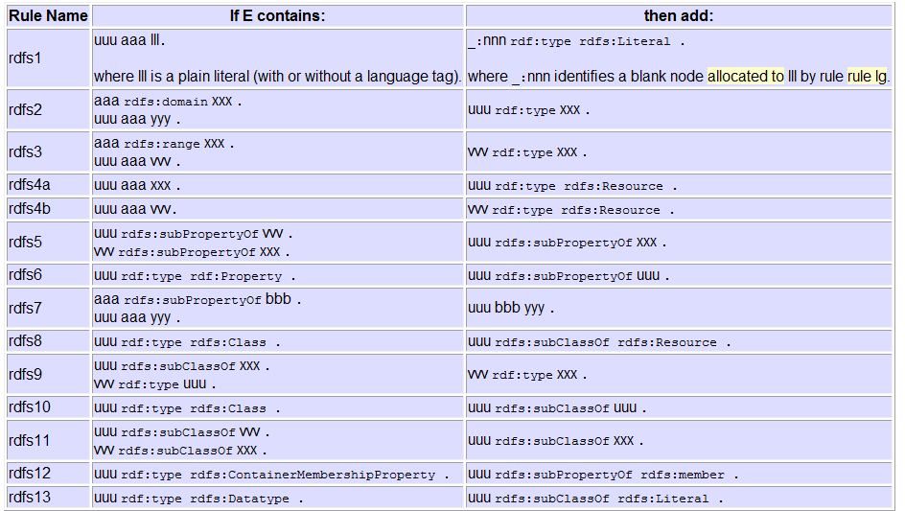
RDF(S) inference. Entailment rules

Slide 54
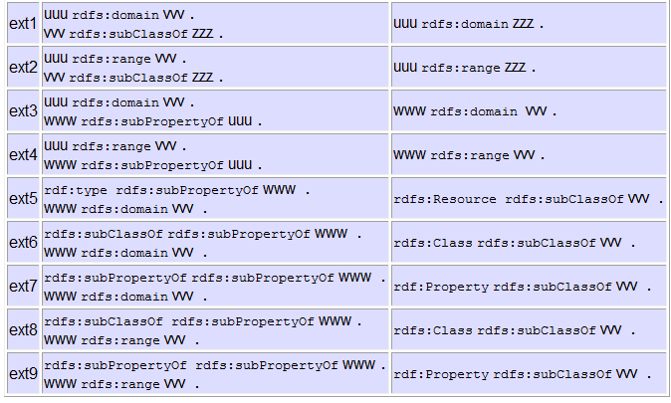
RDF(S) inference. Additional inferences

Slide 55
Exercise
Objective
  Understand how to RDF(S) reasoning works
Tasks
  Generate all possible RDF triples that can be inferred from an RDF(S) graph

Slide 56
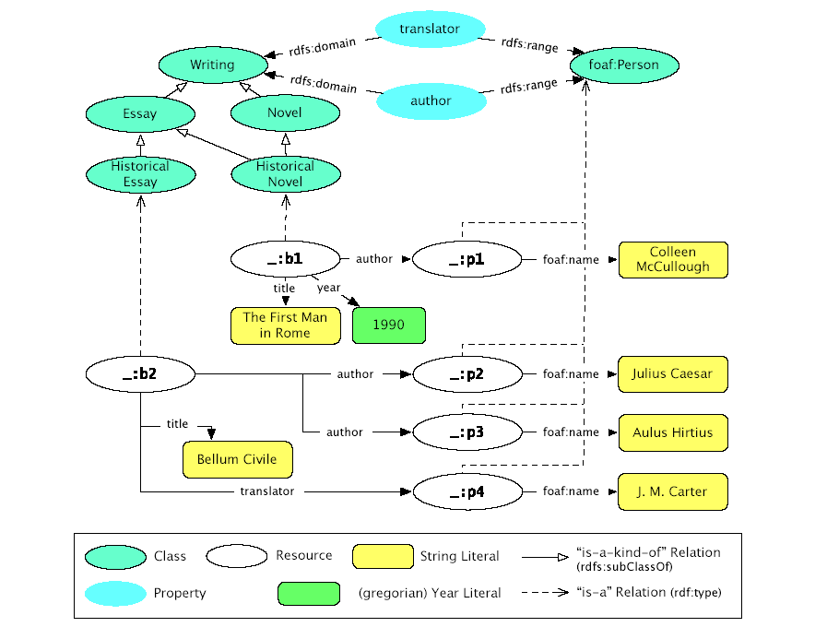

Slide 57
Exercise
Objective
  Understand how to use an RDF(S) development tool to create RDF(S) ontologies
Tasks
  Create the previous ontologies in an RDF(S) development tool

Slide 58
RDF(S) Example
RDFS
rdfs:Literal
rdfs:Class
rdf:Type
rdfs:range
Travel
rdfs:domain
arrivalDate
rdf:Type
rdfs:domain
rdfs:domain
rdfs:domain
departureDate
Company-name
singleFare
rdfs:range
rdf:Type
rdfs:range
rdfs:range
units:currencyQuantity
rdf:Type
time:Date
rdf:Type
rdf:Type
RDF
rdf:Property
rdf:Type
rdf:Type
Company-name
rdf:Type
“Iberia”
IB-4321
arrivalDate
singleFare
departureDate
10/11/2005
500 euros

Slide 59
Exercise
Objective
  Understand the features of RDF(S) for implementing ontologies, including its limitations
Tasks
  Take the ontologies previously defined and create their graphs
    First only include the vocabulary from the domain
    Then include references to the RDF and RDFS vocabularies

Slide 60
Domain description
Un lugar puede ser un lugar de interés.
Los lugares de interés pueden ser lugares turísticos o establecimientos, pero no las dos cosas a la vez.
Los lugares turísticos pueden ser palacios, iglesias, ermitas y catedrales.
Los establecimientos pueden ser hoteles, hostales o albergues.
Un lugar está situado en una localidad, la cual a su vez puede ser una villa, un pueblo o una ciudad.
Un lugar de interés tiene una dirección postal que incluye su calle y su número.
Las localidades tienen un número de habitantes.
Las localidades se encuentran situadas en provincias.
Covarrubias es un pueblo con 634 habitantes de la provincia de Burgos.
El restaurante “El Galo” está situado en Covarrubias, en la calle Mayor, número 5.
Una de las iglesias de Covarrubias está en la calle de Santo Tomás.

Slide 61
Sample resulting ontology
SpatialThing
NumeroHabitantes
Lugar
SituadoEn
Localidad
rdfs:Literal
Calle
rdfs:Literal
Numero
Provincia
DireccionPostal
Direccion
LugarDeInteres
Villa
Pueblo
Ciudad
LugarTuristico
Establecimiento
Palacio
Iglesia
Ermita
Catedral
Hotel
Hostal
Albergue

Slide 62
Table of Contents
An introduction to knowledge representation formalisms
Resource Description Framework (RDF)
RDF Schema
RDF(S) management APIs
  4.1 RDF(S) management APIs
  4.2 The Jena API, with a hands-on activity
RDF(S) query languages: SPARQL
An example of an RDF(S)-based application

Slide 63
Sample RDF APIs
RDF libraries for different languages:
  Java, Python, C, C++, C#, .Net, Javascript, Tcl/Tk, PHP, Lisp, Obj-C, Prolog, Perl, Ruby, Haskell
  List in http://esw.w3.org/topic/SemanticWebTools
Usually related to a RDF repository
Multilanguage:
  Redland RDF Application Framework (C, Perl, PHP, Python and Ruby): http://www.redland.opensource.ac.uk/
Java:
  Jena: http://jena.sourceforge.net/
  Sesame: http://www.openrdf.org/
PHP:
  RAP - RDF API for PHP: http://www4.wiwiss.fu-berlin.de/bizer/rdfapi/
Python:
  RDFLib: http://rdflib.net/
  Pyrple: http://infomesh.net/pyrple/

Slide 64
Jena
Java framework for building Semantic Web applications
Open source software from HP Labs:
The Jena framework includes:
  A RDF API
  An OWL API
  Reading and writing RDF in RDF/XML, N3 and N-Triples
  In-memory and persistent storage
  A rule based inference engine
  SPARQL query engine

Slide 65
Sesame
A framework for storage, querying and inferencing of RDF and RDF Schema
A Java Library for handling RDF
A Database Server for (remote) access to repositories of RDF data
Highly expressive query and transformation languages
  SeRQL, SPARQL
Various backends
  Native Store
  RDBMS (MySQL, Oracle 10, DB2, PostgreSQL)
  main memory
Reasoning support
  RDF Schema reasoner
  OWL DLP (OWLIM)
  domain reasoning (custom rule engine)

Slide 66
Table of Contents
An introduction to knowledge representation formalisms
Resource Description Framework (RDF)
RDF Schema
RDF(S) management APIs
  4.1 RDF(S) management APIs
  4.2 The Jena API, with a hands-on activity
RDF(S) query languages: SPARQL
An example of an RDF(S)-based application

Slide 67
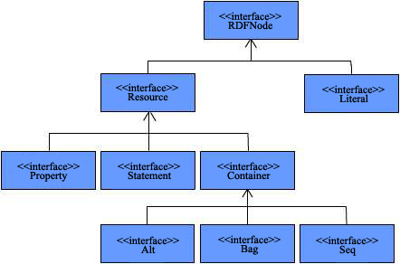
Jena API Structure

Slide 68
Data Model
http://.../JohnSmith
vcard: FN
John Smith
// some definitions
static String personURI = "http://somewhere/JohnSmith";
static String fullName = "John Smith";
// create an empty Model
Model model = ModelFactory.createDefaultModel();
// create the resource
Resource johnSmith = model.createResource(personURI);
// add the property
johnSmith.addProperty(VCARD.FN, fullName);

Slide 69
Another data model
http://.../JohnSmith
vcard:FN
vcard:N
John Smith
vcard:Given
vcard:Family
John
Smith
// some definitions
String personURI = "http://somewhere/JohnSmith"; String givenName = "John";
String familyName = "Smith";
String fullName = givenName + " " + familyName;
// create an empty
Model Model model = ModelFactory.createDefaultModel();
// create the resource
// and add the properties cascading style
Resource johnSmith = model.createResource(personURI)
.addProperty(VCARD.FN, fullName)
.addProperty(VCARD.N, model.createResource()
.addProperty(VCARD.Given, givenName)
.addProperty(VCARD.Family, familyName));

Slide 70
Statements
// list the statements in the Model
StmtIterator iter = model.listStatements();
// print out the predicate, subject and object of each statement
while (iter.hasNext())
{
Statement stmt = iter.nextStatement(); // get next statement
Resource subject = stmt.getSubject(); // get the subject
Property predicate = stmt.getPredicate(); // get the predicate
RDFNode object = stmt.getObject(); // get the object
System.out.print(subject.toString());
System.out.print(" " + predicate.toString() + " ");
if (object instanceof Resource) {
  System.out.print(object.toString());
  }
  else { // object is a literal
  System.out.print(" \"" + object.toString() + "\"");
  }
  System.out.println(" .");
} // end of while
http://somewhere/JohnSmith http://www.w3.org/2001/vcard-rdf/3.0#N anon:14df86:ecc3dee17b:-7fff
anon:14df86:ecc3dee17b:-7fff http://www.w3.org/2001/vcard-rdf/3.0#Family "Smith"
anon:14df86:ecc3dee17b:-7fff http://www.w3.org/2001/vcard-rdf/3.0#Given "John"
http://somewhere/JohnSmith http://www.w3.org/2001/vcard-rdf/3.0#FN
“John Smith" .

Slide 71
Writing RDF
Model model = ModelFactory.createDefaultModel();
Resource jsmith =
model.createResource(“http://somewhere/johnsmith”)
.addProperty(VCARD.FN, “John Smith”)
.addProperty(VCARD.N, model.createResource()
.addProperty(VCARD.Given,”John”)
.addProperty(VCARD.Family, “Smith”));
model.write(new PrintWriter(System.out));
model.write(System.out, "RDF/XML-ABBREV");
model.write(System.out, "N-TRIPLE");
<rdf:RDF
xmlns:rdf='http://www.w3.org/1999/02/22-rdf-syntax-ns#'
xmlns:vcard='http://www.w3.org/2001/vcard-rdf/3.0#'
>
<rdf:Description rdf:nodeID='A0'>
<vcard:Given>John</vcard:Given>
<vcard:Family>Smith</vcard:Family>
</rdf:Description>
<rdf:Description rdf:about='http://somewhere/johnsmith'>
<vcard:FN>John Smith</vcard:FN>
<vcard:N rdf:nodeID='A0'/>
</rdf:Description>
</rdf:RDF>

Slide 72
Reading RDF
// create an empty model
Model model = ModelFactory.createDefaultModel();
// use the FileManager to find the input file
InputStream in = FileManager.get().open( inputFileName );
if (in == null) {
throw new IllegalArgumentException("File not found");
}
// read the RDF/XML file
model.read(in, "");
// write it to standard out
model.write(System.out);
<rdf:RDF
xmlns:rdf='http://www.w3.org/1999/02/22-rdf-syntax-ns#'
xmlns:vcard='http://www.w3.org/2001/vcard-rdf/3.0#'
>
<rdf:Description rdf:nodeID="A0">
<vcard:Family>Smith</vcard:Family>
<vcard:Given>John</vcard:Given>
</rdf:Description>
<rdf:Description rdf:about='http://somewhere/JohnSmith/'>
<vcard:FN>John Smith</vcard:FN>
<vcard:N rdf:nodeID="A0"/>
</rdf:Description>
...
</rdf:RDF>

Slide 73
Navigating a model
// retrieve the John Smith vcard resource from the model
Resource vcard = model.getResource(johnSmithURI);
Three ways of retrieving property values:
// retrieve the value of the N property
Resource name = (Resource) vcard.getProperty(VCARD.N).getObject();
// retrieve the value of the N property
Resource name = vcard.getProperty(VCARD.N).getResource();
// retrieve the given name property
String fullName = vcard.getProperty(VCARD.N).getString();

Slide 74
Multiple values in properties
// add two nickname properties to vcard
vcard.addProperty(VCARD.NICKNAME, "Smithy")
.addProperty(VCARD.NICKNAME, "Adman");
// set up the output
System.out.println("The nicknames of \"" + fullName + "\" are:");
// list the nicknames
StmtIterator iter = vcard.listProperties(VCARD.NICKNAME);
while (iter.hasNext()) {
System.out.println(" " + iter.nextStatement() .getObject() .toString());
}

Slide 75
Querying a model
// select all the resources with a VCARD.FN property
ResIterator iter = model.listSubjectsWithProperty(VCARD.FN);
if (iter.hasNext()) {
System.out.println("The database contains vcards for:");
while (iter.hasNext()) {
System.out.println(" " + iter.nextStatement()
.getProperty(VCARD.FN) .getString());
}
} else {
System.out.println("No vcards were found in the database");
}
The database contains vcards for:
Sarah Jones
John Smith
Matt Jones
Becky Smith

Slide 76
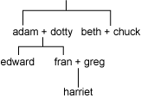
Create resources
// URI declarations
String familyUri = "http://family/";
String relationshipUri = "http://purl.org/vocab/relationship/";
// Create an empty Model
Model model = ModelFactory.createDefaultModel();
// Create a Resource for each family member, identified by their URI
Resource adam = model.createResource(familyUri+"adam");
Resource beth = model.createResource(familyUri+"beth");
Resource dotty = model.createResource(familyUri+"dotty");
// and so on for other family members
// Create properties for the different types of relationship to represent
Property childOf = model.createProperty(relationshipUri,"childOf");
Property parentOf = model.createProperty(relationshipUri,"parentOf");
Property siblingOf = model.createProperty(relationshipUri,"siblingOf");
Property spouseOf = model.createProperty(relationshipUri,"spouseOf");
// Add properties to adam describing relationships to other family members
adam.addProperty(siblingOf,beth);
adam.addProperty(spouseOf,dotty);
adam.addProperty(parentOf,edward);
// Can also create statements directly . . .
Statement statement = model.createStatement(adam,parentOf,fran);
// but remember to add the created statement to the model
model.add(statement);

Slide 77
Querying a model
// List everyone in the model who has a child:
ResIterator parents = model.listSubjectsWithProperty(parentOf);
// Because subjects of statements are Resources, the method returned a ResIterator
while (parents.hasNext()) {
// ResIterator has a typed nextResource() method
Resource person = parents.nextResource();
// Print the URI of the resource
System.out.println(person.getURI());
}
// Can also find all the parents by getting the objects of all "childOf" statements
// Objects of statements could be Resources or literals, so the Iterator returned
// contains RDFNodes
NodeIterator moreParents = model.listObjectsOfProperty(childOf);
// To find all the siblings of a specific person, the model itself can be queried
NodeIterator siblings = model.listObjectsOfProperty(edward, siblingOf);
// But it's more elegant to ask the Resource directly
// This method yields an iterator over Statements
StmtIterator moreSiblings = edward.listProperties(siblingOf);

Slide 78
Using selectors to query a model
// Find the exact statement "adam is a spouse of dotty"
model.listStatements(adam,spouseOf,dotty);
// Find all statements with adam as the subject and dotty as the object
model.listStatements(adam,null,dotty);
// Find any statements made about adam
model.listStatements(adam,null,null);
// Find any statement with the siblingOf property
model.listStatements(null,siblingOf,null);

Slide 79
Exercise
Objective
  Understand how to use an RDF(S) management API
Tasks
  Read an ontology in RDF(S) from two files:
    GP_Santiago.rdf (conceptualization)
    GP_Santiago.rdfs (instances)
  Write the class hierarchy of the ontology, including the instances of each class

Slide 80
Hands-on
To read an ontology in RDF(S) from two files:
  GP_Santiago.rdf (conceptualization)
  GP_Santiago.rdfs (instances)
To write the class hierarchy of the ontology, including the instances of each class:
Class Practica2:MedioTransporte
Class Practica2:Tren
Class Practica2:Bicicleta
Instance Practica2:GP_Santiago_Instance_70
Class Practica2:Automovil
Class Practica2:AutoBus
Class Practica2:APie
Class Practica2:InfraEstructuraTransporte
Class Practica2:ViaFerrea
Class Practica2:Sendero
Class Practica2:Carretera
Instance Practica2:A6
...

Slide 81
Set up
Requirements:
  Java JDK 5
  Eclipse (optional)
Create a directory for your project
Install Jena from the USB:
  Unzip Jena-2.5.5.zip/lib in the project directory
Copy the ontologies from the USB:
  Copy ontologies/rdf in the project directory
In Eclipse:
  Create a new Java project (from existing source)
  Append the Jena libraries to your classpath if needed (check JDK libs)
  Write Java code using the Jena API
  http://jena.sourceforge.net/javadoc/index.html
  Compile
  Run
Or copy the JenaProjectTemplate directory in your computer

Slide 82
Hints
Create ontology model:
  public static OntModel createOntologyModel(OntModelSpec spec)
Read the ontology in the file
  Model read(java.lang.String url)
Add all the statements in another model to this model
  Model add(Model m)

Slide 83
More hints
List root classes
  ExtendedIterator listHierarchyRootClasses()
List subclasses of a class
  ExtendedIterator listSubClasses(boolean direct)
List instances of a class
  ExtendedIterator listInstances(boolean direct)

Slide 84
Table of Contents
An introduction to knowledge representation formalisms
Resource Description Framework (RDF)
RDF Schema
RDF(S) management APIs
RDF(S) query languages: SPARQL
  5.1 RDF(S) query languages and SPARQL
  5.2 Turtle RDF syntax
  5.3 Graph patterns
5.4 Restricting values and solutions
5.5 SPARQL query forms
5.6 Hands-on activity
6. An example of an RDF(S)-based application

Slide 85
RDF(S) query languages
Languages developed to allow accessing datasets expressed in RDF(S) (and in some cases OWL)
Supported by the most important language APIs
  Jena (HP labs)
  Sesame (Aduna)
  Boca (IBM)
  ...
There are some differences wrt languages like SQL, such as
  Combination of different sources
  Trust management
  Open World Assumption
Application
Application
SQL queries
RQL, RDQL, etc., queries
Relational
DB
RDF(S)
OWL

Slide 86
Query types
Selection and extraction
  “Select all the essays, together with their authors and their authors’ names”.
  “Select everything that is related to the book ‘Bellum Civille’”
Reduction: we specify what it should not be returned
  “Select everything except for the ontological information and the book translators”
Restructuring: the original structure is changed in the final result
  “Invert the relationship ‘author’ by ‘is author of’”
Aggregation
  “Return all the essays together with the mean number of authors per essay”
Combination and inferences
  “Combine the information of a book called ‘La guerra civil’ and whose author is Julius Caesar with the book whose identifier is ‘Bellum Civille’”
  “Select all the essays, together with its authors and author names”, including also the instances of the subclasses of Essay.
  “Obtain the relationship ‘coauthor’ among persons who have written the same book”.

Slide 87
RDF(S) query language families
Triple database Query structure
Description graphs Query semantics
SquishQL Family
  SquishQL
  rdfDB Query Language
  RDQL
  BRQL
  TriQL
XPath, XSLT, Xquery
  XQuery for RDF
  XsRQL
  TreeHugger and RDFTwig
  RDFT, Nexus Query Language
  RDFPath, Rpath and RXPath
  Versa
RQL Family
  RQL
  SeRQL
  eRQL
Controlled natural language
  Metalog
Other
  Algae
  iTQL
  N3QL
  PerlRDF Query Language
  RDEVICE Deductive Language
  RDFQBE
  RDFQL
  TRIPLE
  WQL
XML repository Query syntax
SPARQL
W3C Recommendation
15 January 2008
Notes:
SquishQL. Triple database. Query structure. “Find statement whose subject is… and whose object is…”
RQL. Description graphs. Query semantics. “Find resources classified under… whose property value is…”
XQuery. XML repository. Query syntax. “Find description elements whose attribute value contains…”

Slide 88
SPARQL
SPARQL Protocol and RDF Query Language
Supported by: Jena, Sesame, IBM Boca, etc.
Features
  It supports most of the aforementioned queries
  It supports datatype reasoning (datatypes can be requested instead of actual values)
  The domain vocabulary and the knowledge representation vocabulary are treated differently by the query interpreters.
  It allows making queries over properties with multiple values, over multiple properties of a resource and over reifications
  Queries can contain optional statements
  Some implementations support aggregation queries
Limitations
  Neither set operations nor existential or universal quantifiers can be included in the queries
  It does not support recursive queries

Slide 89
SPARQL is also a protocol
SPARQL is a Query Language ...:
Find names and websites of contributors to PlanetRDF:
PREFIX foaf: <http://xmlns.com/foaf/0.1/>
SELECT ?name ?website
FROM <http://planetrdf.com/bloggers.rdf>
WHERE {
?person foaf:weblog ?website .
?person foaf:name ?name .
?website a foaf:Document }
... and a Protocol.
http://.../qps?query-lang=http://www.w3.org/TR/rdf-sparql-query/ &graph-id=http://planetrdf.com/bloggers.rdf&query=PREFIXfoaf: <http://xmlns.com/foaf/0.1/...
Services running SPARQL queries over a set of graphs
A transport protocol for invoking the service
Based on ideas from earlier protocol work such as Joseki
Describing the service with Web Service technologies

Slide 90
A simple SPARQL query
Data:
@prefix dc: <http://purl.org/dc/elements/1.1/> .
@prefix : <http://example.org/book/> .
:book1 dc:title "SPARQL Tutorial" .
Query:
SELECT ?title
WHERE
{
<http://example.org/book/book1> <http://purl.org/dc/elements/1.1/title> ?title .
}
Query result:
title
"SPARQL Tutorial"
A pattern is matched against the RDF data
Each way a pattern can be matched yields a solution
The sequence of solutions is filtered by: Project, distinct, order, limit/offset
One of the result forms is applied: SELECT, CONSTRUCT, DESCRIBE, ASK

Slide 91
Table of Contents
An introduction to knowledge representation formalisms
Resource Description Framework (RDF)
RDF Schema
RDF(S) management APIs
RDF(S) query languages: SPARQL
  5.1 RDF(S) query languages and SPARQL
  5.2 Turtle RDF syntax
  5.3 Graph patterns
5.4 Restricting values and solutions
5.5 SPARQL query forms
5.6 Hands-on activity
6. An example of an RDF(S)-based application

Slide 92
Turtle: URIs, blank nodes, literals
URIs
  Enclosed in <>
  <URI>
  or
  @prefix prefix <http://....>
  prefix:name
Blank Nodes
  :name
  or
  [] for a Blank Node used once
Literals
  "Literal"
  "Literal"@language
  """Long literal with
  newlines"""
Datatyped Literals
  "lexical form"^^datatype URI
  "10"^^xsd:integer
  "2006-09-04"^^xsd:date

Slide 93
Turtle: Triples and abbreviations
Triples separated by .
  :a :b :c . :d :e :f .
Common triple predicate and subject:
  :a :b :c, :d .
  which is the same as :a :b :c . :a :b :d .
Common triple subject:
  :a :b :c; :d :e .
  which is the same as: :a :b :c . :a :d :e .
Blank node as a subject
  :a :b [ :c :d ]
  which is the same as: :a :b _:x . _:x :c :d .
  for blank node _:x
RDF Collections
  :a :b ( :c :d :e :f )
  which is short for many triples

Slide 94
Table of Contents
An introduction to knowledge representation formalisms
Resource Description Framework (RDF)
RDF Schema
RDF(S) management APIs
RDF(S) query languages: SPARQL
  5.1 RDF(S) query languages and SPARQL
  5.2 Turtle RDF syntax
  5.3 Graph patterns
5.4 Restricting values and solutions
5.5 SPARQL query forms
5.6 Hands-on activity
6. An example of an RDF(S)-based application

Slide 95
Graph patterns
Basic Graph Patterns, where a set of triple patterns must match
Group Graph Pattern, where a set of graph patterns must all match
Optional Graph patterns, where additional patterns may extend the solution
Alternative Graph Pattern, where two or more possible patterns are tried
Patterns on Named Graphs, where patterns are matched against named graphs

Slide 96
Basic graph patterns: Multiple matches
@prefix foaf: <http://xmlns.com/foaf/0.1/> .
_:a foaf:name "Johnny Lee Outlaw" .
_:a foaf:mbox <mailto:jlow@example.com> .
_:b foaf:name "Peter Goodguy" .
_:b foaf:mbox <mailto:peter@example.org> .
_:c foaf:mbox <mailto:carol@example.org> .
PREFIX foaf: <http://xmlns.com/foaf/0.1/>
SELECT ?name ?mbox
WHERE
{ ?x foaf:name ?name .
?x foaf:mbox ?mbox }
name | mbox
"Johnny Lee Outlaw" | <mailto:jlow@example.com>
"Peter Goodguy" | <mailto:peter@example.org>

Slide 97
Basic graph patterns: Matching RDF literals
@prefix dt: <http://example.org/datatype#> .
@prefix ns: <http://example.org/ns#> .
@prefix : <http://example.org/ns#> .
@prefix xsd: <http://www.w3.org/2001/XMLSchema#> .
:x ns:p "cat"@en .
:y ns:p "42"^^xsd:integer .
:z ns:p "abc"^^dt:specialDatatype .
v
SELECT ?v WHERE { ?v ?p "cat" }
v
<http://example.org/ns#x>
SELECT ?v WHERE { ?v ?p "cat"@en }
v
<http://example.org/ns#y>
SELECT ?v WHERE { ?v ?p 42 }
SELECT ?v WHERE { ?v ?p "abc"^^<http://example.org/datatype#specialDatatype> }
v
<http://example.org/ns#z>

Slide 98
Basic graph patterns: Blank node labels in query results
@prefix foaf: <http://xmlns.com/foaf/0.1/> .
_:a foaf:name "Alice" .
_:b foaf:name "Bob" .
PREFIX foaf: <http://xmlns.com/foaf/0.1/>
SELECT ?x ?name
WHERE { ?x foaf:name ?name }
x | name
_:c | "Alice"
_:d | "Bob"
x | name
_:r | "Alice"
_:s | "Bob"
=

Slide 99
Group graph pattern
PREFIX foaf: <http://xmlns.com/foaf/0.1/>
SELECT ?name ?mbox
WHERE { { ?x foaf:name ?name . }
{ ?x foaf:mbox ?mbox . }
}
SELECT ?x
WHERE {}
PREFIX foaf: <http://xmlns.com/foaf/0.1/>
SELECT ?name ?mbox
WHERE { { ?x foaf:name ?name . }
{ ?x foaf:mbox ?mbox . FILTER regex(?name, "Smith")}
}

Slide 100
Optional graph patterns
@prefix foaf: <http://xmlns.com/foaf/0.1/> .
@prefix rdf: <http://www.w3.org/1999/02/22-rdf-syntax-ns#> .
_:a rdf:type foaf:Person .
_:a foaf:name "Alice" .
_:a foaf:mbox <mailto:alice@example.com> .
_:a foaf:mbox <mailto:alice@work.example> .
_:b rdf:type foaf:Person .
_:b foaf:name "Bob" .
PREFIX foaf: <http://xmlns.com/foaf/0.1/>
SELECT ?name ?mbox
WHERE { ?x foaf:name ?name .
OPTIONAL { ?x foaf:mbox ?mbox }
}
name | mbox
"Alice" | <mailto:alice@example.com>
"Alice" | <mailto:alice@work.example>
“Bob"

Slide 101
Multiple optional graph patterns
@prefix foaf: <http://xmlns.com/foaf/0.1/> .
_:a foaf:name "Alice" .
_:a foaf:homepage <http://work.example.org/alice/> .
_:b foaf:name "Bob" .
_:b foaf:mbox <mailto:bob@work.example> .
PREFIX foaf: <http://xmlns.com/foaf/0.1/>
SELECT ?name ?mbox ?hpage
WHERE { ?x foaf:name ?name .
OPTIONAL { ?x foaf:mbox ?mbox } .
OPTIONAL { ?x foaf:homepage ?hpage }
}
name | mbox | hpage
"Alice" |  | <http://work.example.org/alice/>
“Bob" | <mailto:bob@work.example>

Slide 102
Alternative graph patterns
@prefix dc10: <http://purl.org/dc/elements/1.0/> .
@prefix dc11: <http://purl.org/dc/elements/1.1/> .
_:a dc10:title "SPARQL Query Language Tutorial" .
_:a dc10:creator "Alice" .
_:b dc11:title "SPARQL Protocol Tutorial" .
_:b dc11:creator "Bob" .
_:c dc10:title "SPARQL" .
_:c dc11:title "SPARQL (updated)" .
PREFIX dc10: <http://purl.org/dc/elements/1.0/>
PREFIX dc11: <http://purl.org/dc/elements/1.1/>
SELECT ?title
WHERE { { ?book dc10:title ?title } UNION
{ ?book dc11:title ?title } }
title
"SPARQL Protocol Tutorial"
"SPARQL"
"SPARQL (updated)"
"SPARQL Query Language Tutorial"
SELECT ?x ?y
WHERE { { ?book dc10:title ?x } UNION
{ ?book dc11:title ?y } }
x | y
 | "SPARQL (updated)"
 | "SPARQL Protocol Tutorial"
"SPARQL"
"SPARQL Query Language Tutorial"
SELECT ?title ?author
WHERE
{ { ?book dc10:title ?title . ?book dc10:creator ?author }
UNION
{ ?book dc11:title ?title . ?book dc11:creator ?author }}
author | title
"Alice" | "SPARQL Protocol Tutorial"
“Bob” | "SPARQL Query Language Tutorial"

Slide 103
Patterns on named graphs
# Named graph: http://example.org/foaf/aliceFoaf
@prefix foaf:<http://.../foaf/0.1/> .
@prefix rdf:<http://.../1999/02/22-rdf-syntax-ns#> .
@prefix rdfs:<http://.../2000/01/rdf-schema#> .
_:a foaf:name "Alice" .
_:a foaf:mbox <mailto:alice@work.example> .
_:a foaf:knows _:b .
_:b foaf:name "Bob" .
_:b foaf:mbox <mailto:bob@work.example> .
_:b foaf:nick "Bobby" .
_:b rdfs:seeAlso <http://example.org/foaf/bobFoaf> .
<http://example.org/foaf/bobFoaf>
rdf:type foaf:PersonalProfileDocument .
# Named graph: http://example.org/foaf/bobFoaf
@prefix foaf:<http://.../foaf/0.1/> .
@prefix rdf:<http://.../1999/02/22-rdf-syntax-ns#> .
@prefix rdfs:<http://.../2000/01/rdf-schema#> .
_:z foaf:mbox <mailto:bob@work.example> .
_:z rdfs:seeAlso <http://example.org/foaf/bobFoaf> .
_:z foaf:nick "Robert" .
<http://example.org/foaf/bobFoaf>
rdf:type foaf:PersonalProfileDocument .

Slide 104
Patterns on named graphs II
PREFIX foaf: <http://xmlns.com/foaf/0.1/>
SELECT ?src ?bobNick
FROM NAMED <http://example.org/foaf/aliceFoaf>
FROM NAMED <http://example.org/foaf/bobFoaf>
WHERE
{
GRAPH ?src
{ ?x foaf:mbox <mailto:bob@work.example> .
?x foaf:nick ?bobNick
}
}
src | bobNick
<http://example.org/foaf/aliceFoaf> | "Bobby"
<http://example.org/foaf/bobFoaf> | "Robert"
PREFIX foaf: <http://xmlns.com/foaf/0.1/>
PREFIX data: <http://example.org/foaf/>
SELECT ?nick
FROM NAMED <http://example.org/foaf/aliceFoaf>
FROM NAMED <http://example.org/foaf/bobFoaf>
WHERE
{
GRAPH data:bobFoaf {
?x foaf:mbox <mailto:bob@work.example> .
?x foaf:nick ?nick }
}
nick
"Robert"

Slide 105
Table of Contents
An introduction to knowledge representation formalisms
Resource Description Framework (RDF)
RDF Schema
RDF(S) management APIs
RDF(S) query languages: SPARQL
  5.1 RDF(S) query languages and SPARQL
  5.2 Turtle RDF syntax
  5.3 Graph patterns
5.4 Restricting values and solutions
5.5 SPARQL query forms
5.6 Hands-on activity
6. An example of an RDF(S)-based application

Slide 106
Restricting values
@prefix dc: <http://purl.org/dc/elements/1.1/> .
@prefix : <http://example.org/book/> .
@prefix ns: <http://example.org/ns#> .
:book1 dc:title "SPARQL Tutorial" .
:book1 ns:price 42 .
:book2 dc:title "The Semantic Web" .
:book2 ns:price 23 .
PREFIX dc: <http://purl.org/dc/elements/1.1/>
SELECT ?title
WHERE { ?x dc:title ?title
FILTER regex(?title, "^SPARQL")
}
title
"SPARQL Tutorial"
PREFIX dc: <http://purl.org/dc/elements/1.1/>
SELECT ?title
WHERE { ?x dc:title ?title
FILTER regex(?title, "web", "i" )
}
title
"The Semantic Web"
PREFIX dc: <http://purl.org/dc/elements/1.1/>
PREFIX ns: <http://example.org/ns#>
SELECT ?title ?price
WHERE { ?x ns:price ?price .
FILTER (?price < 30.5)
?x dc:title ?title . }
title | price
"The Semantic Web" | 23

Slide 107
Value tests
Based on XQuery 1.0 and XPath 2.0 Function and Operators
XSD boolean, string, integer, decimal, float, double, dateTime
Notation <, >, =, <=, >= and != for value comparison
Apply to any type
BOUND, isURI, isBLANK, isLITERAL
REGEX, LANG, DATATYPE, STR (lexical form)
Function call for casting and extensions functions

Slide 108
Solution sequences and modifiers
Order modifier: put the solutions in order
Projection modifier: choose certain variables
Distinct modifier: ensure solutions in the sequence are unique
Reduced modifier: permit elimination of some non-unique solutions
Offset modifier: control where the solutions start from in the overall sequence of solutions
Limit modifier: restrict the number of solutions
SELECT ?name
WHERE { ?x foaf:name ?name ; :empId ?emp }
ORDER BY ?name DESC(?emp)
SELECT ?name
WHERE
{ ?x foaf:name ?name }
SELECT DISTINCT ?name
WHERE { ?x foaf:name ?name }
SELECT REDUCED ?name
WHERE { ?x foaf:name ?name }
SELECT ?name WHERE { ?x foaf:name ?name }
ORDER BY ?name
LIMIT 5
OFFSET 10
SELECT ?name
WHERE { ?x foaf:name ?name }
LIMIT 20

Slide 109
Table of Contents
An introduction to knowledge representation formalisms
Resource Description Framework (RDF)
RDF Schema
RDF(S) management APIs
RDF(S) query languages: SPARQL
  5.1 RDF(S) query languages and SPARQL
  5.2 Turtle RDF syntax
  5.3 Graph patterns
5.4 Restricting values and solutions
5.5 SPARQL query forms
5.6 Hands-on activity
6. An example of an RDF(S)-based application

Slide 110
SPARQL query forms
SELECT
  Returns all, or a subset of, the variables bound in a query pattern match.
CONSTRUCT
  Returns an RDF graph constructed by substituting variables in a set of triple templates.
ASK
  Returns a boolean indicating whether a query pattern matches or not.
DESCRIBE
  Returns an RDF graph that describes the resources found.

Slide 111
SPARQL query forms: SELECT
@prefix foaf: <http://xmlns.com/foaf/0.1/> .
_:a foaf:name "Alice" .
_:a foaf:knows _:b .
_:a foaf:knows _:c .
_:b foaf:name "Bob" .
_:c foaf:name "Clare" .
_:c foaf:nick "CT" .
PREFIX foaf: <http://xmlns.com/foaf/0.1/>
SELECT ?nameX ?nameY ?nickY
WHERE
{ ?x foaf:knows ?y ;
foaf:name ?nameX .
?y foaf:name ?nameY .
OPTIONAL { ?y foaf:nick ?nickY }
}
nameX | nameY | nickY
"Alice" | "Bob"
"Alice" | "Clare" | "CT"

Slide 112
SPARQL query forms: CONSTRUCT
@prefix foaf: <http://xmlns.com/foaf/0.1/> .
_:a foaf:name "Alice" .
_:a foaf:mbox <mailto:alice@example.org> .
PREFIX foaf: <http://xmlns.com/foaf/0.1/>
PREFIX vcard: <http://www.w3.org/2001/vcard-rdf/3.0#>
CONSTRUCT { <http://example.org/person#Alice> vcard:FN ?name }
WHERE { ?x foaf:name ?name }
Query result:
@prefix vcard: <http://www.w3.org/2001/vcard-rdf/3.0#> .
<http://example.org/person#Alice> vcard:FN "Alice" .

Slide 113
SPARQL query forms: ASK
@prefix foaf: <http://xmlns.com/foaf/0.1/> .
_:a foaf:name "Alice" .
_:a foaf:homepage <http://work.example.org/alice/> .
_:b foaf:name "Bob" .
_:b foaf:mbox <mailto:bob@work.example> .
PREFIX foaf: <http://xmlns.com/foaf/0.1/>
ASK { ?x foaf:name "Alice" }
Query result:
yes

Slide 114
SPARQL query forms: DESCRIBE
PREFIX ent: <http://org.example.com/employees#>
DESCRIBE ?x WHERE { ?x ent:employeeId "1234" }
Query result:
@prefix foaf: <http://xmlns.com/foaf/0.1/> .
@prefix vcard: <http://www.w3.org/2001/vcard-rdf/3.0> .
@prefix exOrg: <http://org.example.com/employees#> .
@prefix rdf: <http://www.w3.org/1999/02/22-rdf-syntax-ns#> .
@prefix owl: <http://www.w3.org/2002/07/owl#>
_:a exOrg:employeeId "1234" ;
foaf:mbox_sha1sum "ABCD1234" ;
vcard:N
[ vcard:Family "Smith" ;
vcard:Given "John" ] .
foaf:mbox_sha1sum rdf:type owl:InverseFunctionalProperty .

Slide 115
Exercise
Objective
  Understand how to perform SPARQL queries
Tasks
  Perform a set of SPARQL queries over the sample ontology.
    Browse to:
      http://my.computer.ip:8080/openrdf-workbench
    Select repository GP-native-rdfs
    Select the Query option from the left menu

Slide 116
Sample ontology
SpatialThing
NumeroHabitantes
Lugar
SituadoEn
Localidad
rdfs:Literal
Calle
rdfs:Literal
Numero
Provincia
DireccionPostal
Direccion
LugarDeInteres
Villa
Pueblo
Ciudad
LugarTuristico
Establecimiento
Palacio
Iglesia
Ermita
Catedral
Hotel
Hostal
Albergue

Slide 117
Queries on the model
1) Get all the classes
PREFIX rdfs: <http://www.w3.org/2000/01/rdf-schema#>
SELECT ?x WHERE { ?x a rdfs:Class. }
2) Get the subclasses of the class Establecimiento
PREFIX rdfs: <http://www.w3.org/2000/01/rdf-schema#>
PREFIX pr: <http://GP-onto.fi.upm.es/Practica2#>
SELECT ?x WHERE { ?x rdfs:subClassOf pr:Establecimiento. }
3) Get the instances of the class Ciudad
PREFIX pr: <http://GP-onto.fi.upm.es/Practica2#>
SELECT ?x WHERE { ?x a pr:Ciudad. }

Slide 118
Queries on the instances
4) Get the number of inhabitants of Santiago de Compostela
PREFIX pr: <http://GP-onto.fi.upm.es/Practica2#>
SELECT ?x WHERE { pr:Santiago_de_Compostela pr:NumeroHabitantes ?x. }
5) Get the number of inhabitants of Santiago de Compostela and of Arzua
PREFIX pr: <http://GP-onto.fi.upm.es/Practica2#>
SELECT ?x WHERE {
{pr:Santiago_de_Compostela pr:NumeroHabitantes ?x.}
UNION
{pr:Arzua pr:NumeroHabitantes ?x.}
}
6) Get different places with the inhabitants number, ordering the results by the name of the place (ascending)
PREFIX pr: <http://GP-onto.fi.upm.es/Practica2#>
PREFIX rdfs: <http://www.w3.org/2000/01/rdf-schema#>
SELECT ?x ?y WHERE { $sitio pr:NumeroHabitantes ?y;
rdfs:label ?x.}
ORDER BY ASC(?x)

Slide 119
Queries on the instances II
7) Get all the instances of Localidad with their inhabitant number (if it exists)
PREFIX pr: <http://GP-onto.fi.upm.es/Practica2#>
PREFIX rdfs: <http://www.w3.org/2000/01/rdf-schema#>
SELECT ?x ?y WHERE { $sitio a pr:Localidad;
rdfs:label ?x.
OPTIONAL {$sitio pr:NumeroHabitantes ?y.} }
8) Get all the places with more than 200.000 inhabitants
PREFIX pr: <http://GP-onto.fi.upm.es/Practica2#>
PREFIX rdfs: <http://www.w3.org/2000/01/rdf-schema#>
SELECT ?x ?y WHERE { $sitio pr:NumeroHabitantes ?y;
rdfs:label ?x.
FILTER(?y > 200000) }
9) Get postal data of Pazo de Breogan (calle, número, localidad, provincia)
PREFIX pr: <http://GP-onto.fi.upm.es/Practica2#>
PREFIX rdfs: <http://www.w3.org/2000/01/rdf-schema#>
SELECT ?calle ?numero ?poblacion ?provincia
WHERE { pr:Pazo_Breogan pr:SituadoEn $pob;
pr:Direccion $dir.
$pob rdfs:label ?poblacion;
pr:Provincia ?provincia.
$dir pr:Calle ?calle;
pr:Numero ?numero.}

Slide 120
Queries with inference
10) Get the subclasses of class Lugar
PREFIX rdfs: <http://www.w3.org/2000/01/rdf-schema#>
PREFIX pr: <http://GP-onto.fi.upm.es/Practica2#>
SELECT ?x WHERE { ?x rdfs:subClassOf pr:Lugar. }
11) Get the instances of class Localidad
PREFIX pr: <http://GP-onto.fi.upm.es/Practica2#>
SELECT ?x WHERE { ?x a pr:Localidad. }
Special query (SELECT *)
12) Get the values of all the variables in the query
PREFIX pr: <http://GP-onto.fi.upm.es/Practica2#>
SELECT * WHERE { ?x pr:NumeroHabitantes ?y. }

Slide 121
Different query forms
13) Describe the resource with rdfs:label "Madrid"
PREFIX rdfs: <http://www.w3.org/2000/01/rdf-schema#>
DESCRIBE ?x WHERE { ?x rdfs:label "Madrid". }
14) Construct the RDF(S) graph that directly relates all the touristic places with their respective provinces, using a new property called "estaEn".
PREFIX pr: <http://GP-onto.fi.upm.es/Practica2#>
CONSTRUCT {?x pr:estaEn ?y}
WHERE {
?x a pr:LugarTuristico;
pr:SituadoEn $pob.
$pob pr:Provincia ?y. }
15) Ask if there is some instance of Pueblo
PREFIX pr: <http://GP-onto.fi.upm.es/Practica2#>
ASK WHERE {?a a pr:Pueblo}
16) Ask if there is some instance of Ermita
PREFIX pr: <http://GP-onto.fi.upm.es/Practica2#>
ASK WHERE {?a a pr:Ermita}

Slide 122
Table of Contents
An introduction to knowledge representation formalisms
Resource Description Framework (RDF)
  2.1. RDF primitives
  2.2. Reasoning with RDF
RDF Schema
  3.1 RDF Schema primitives
  3.2 Reasoning with RDFS
RDF(S) management APIs
RDF(S) query languages: SPARQL
An example of an RDF(S)-based application

