Slide 1



1. Ontologies
Asunción Gómez-Pérez
{asun}@fi.upm.es
http://www.oeg-upm.net
Omtological Engineering Group
Laboratorio de Inteligencia Artificial
Facultad de Informática
Universidad Politécnica de Madrid
Campus de Montegancedo sn,
28660 Boadilla del Monte, Madrid, Spain

Slide 2
Table of Content
Ontologies
  Reuse and Sharing
  Definitions of Ontologies
  Modeling of Ontologies
  Type of Ontologies
  Searching Ontologies

Slide 3

The knowledge Sharing Initiative
“Building new Knowledge Based Systems today usually entails constructing new
knowledge bases from scratch. It could instead be done by assembling reusable components.
System developers would then only need to worry about creating the specialized knowledge and
reasoners new to the specific task of their systems. This new system would interoperate with
existing systems, using them to perform some of its reasoning. In this way,
declarative knowledge, problem-solving techniques, and reasoning services could all
be shared between systems. This approach would facilitate building bigger and better systems
cheaply. The infraestructure to support such sharing and reuse would lead to greater
ubiquity of these systems, potentially transforming the knowledge industry ...”
Neches, R.; Fikes, R.; Finin, T.; Gruber, T.; Patil, R.; Senator, T.; Swartout, W.R. Enabling Technology for Knowledge Sharing.
AI Magazine. Winter 1991. 36-56.

Slide 4
Ontological Engineering
It refers to the set of activities that concern
the ontology development process,
the ontology life cycle,
the methods and methodologies for building ontologies,
and the tool suites
and languages that support them.

Slide 5
Definitions of Ontologies (I)
1. “An ontology defines the basic terms and relations comprising the vocabulary of
a topic area, as well as the rules for combining terms and relations to define
extensions to the vocabulary”
Neches, R.; Fikes, R.; Finin, T.; Gruber, T.; Patil, R.; Senator, T.; Swartout, W.R. Enabling Technology for Knowledge Sharing.
AI Magazine. Winter 1991. 36-56.
2. “An ontology is an explicit specification of a conceptualization”
Gruber, T. A translation Approach to portable ontology specifications. Knowledge Acquisition. Vol. 5. 1993. 199-220.

Slide 6
Table of Content
Ontologies
  Reuse and Sharing
  Definitions of Ontologies
  Modeling of Ontologies
  Type of Ontologies
  Searching Ontologies

Slide 7
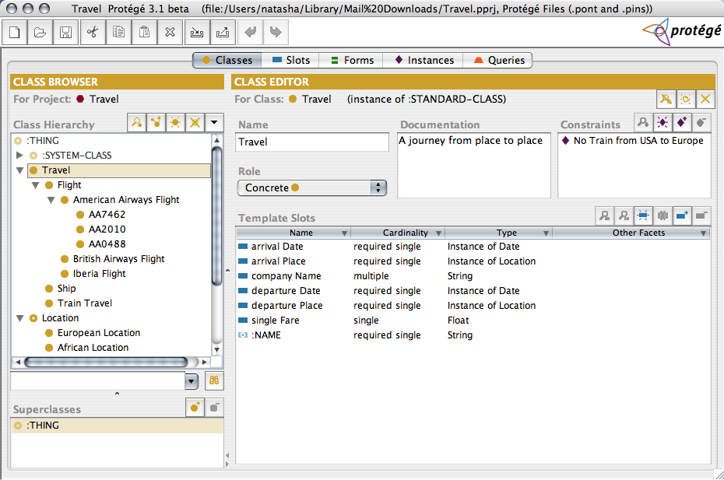

Slide 8
Definitions of Ontologies (III)
3. “An ontology is a formal, explicit specification of a shared conceptualization”
Machine-readable
Consensual
Knowledge
Concepts, properties
relations, functions,
constraints, axioms,
are explicitly defined
Abstract model and
simplified view of some
phenomenon in the world
that we want to represent
Ontologías
Studer, Benjamins, Fensel. Knowledge Engineering: Principles and Methods. Data and Knowledge Engineering. 25 (1998) 161-197

Slide 9
Definitions of Ontologies (IV)
Lightweight Ontologies :
  Include Concepts with properties and Taxonomies
  Do not include Axioms and constraints.
Heavyweight Ontologies :
  Include all the components
  Excellent!! If they have a lot of axioms.

Slide 10
Types of Ontologies
Lassila and McGuiness Classification
Thessauri “narrower term” relation
General Logical constraints
Formal is-a
Frames (properties)
Catalog/ID
Terms/ glossary
Informal is-a
Formal instance
Value Restrs.
Disjointness, Inverse, part-Of ...
Lassila O, McGuiness D. The Role of Frame-Based Representation on the Semantic Web.
Technical Report. Knowledge Systems Laboratory. Stanford University. KSL-01-02. 2001.

Slide 11
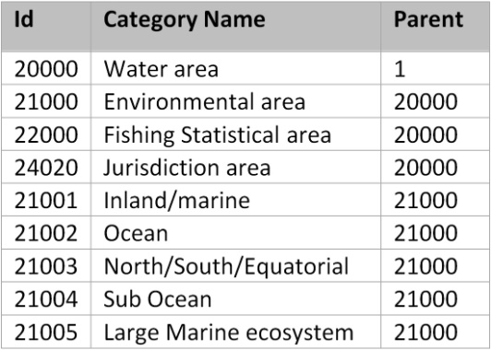
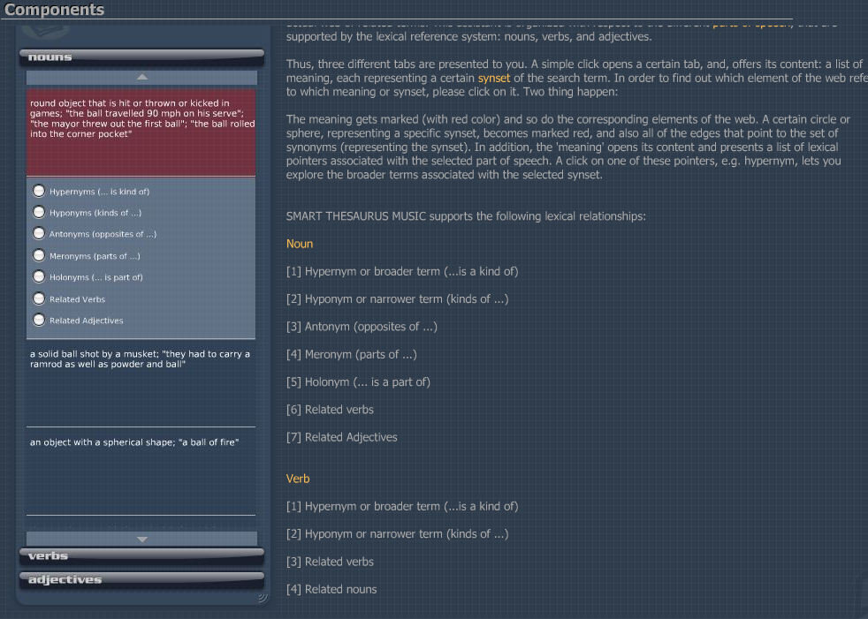
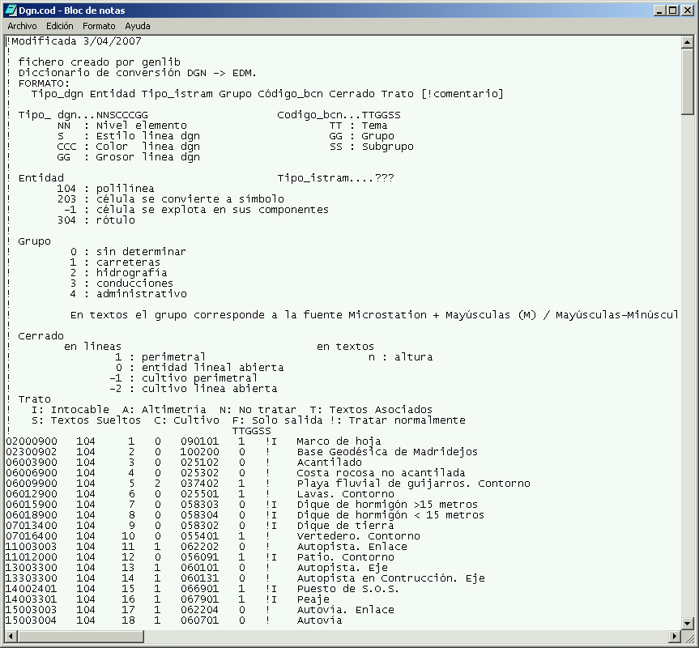

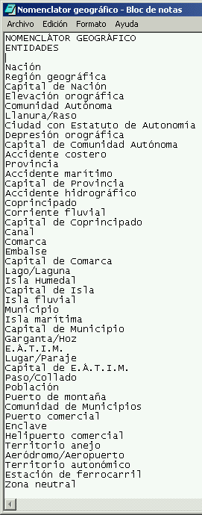
Catalog/ID
Glossary
Thessaurus
Informal is-a
Informal is-a
Tipos de relaciones
Catalog/ID
Informal is-a
Thessaurus

Slide 12
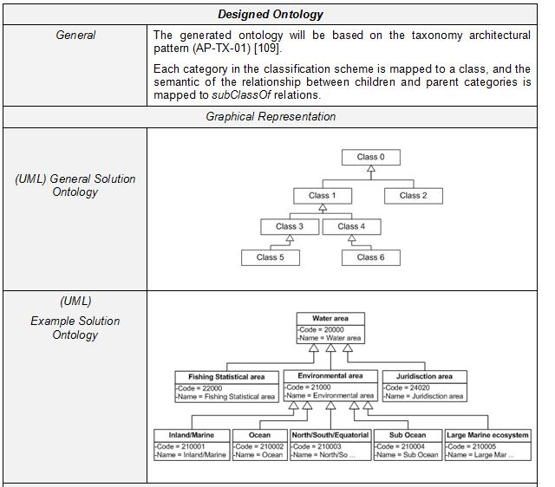
Formal instance
Frames (properties)
General Logical constraints
Disjointness, Inverse, part-Of ...
Formal is-a
Value Restrs.
Formal is-a with properties
(define-relation connects (?edge ?source ?target)
"This relation links a source and a target by an edge. The source and destination are considered as spatial points. The relation has the following properties: symmetry and irreflexivity."
:def (and (SpatialPoint ?source)
(SpatialPoint ?target)
(Edge ?edge))
:axiom-def
((=> (connects ?edge ?source ?target)
(connects ?edge ?target ?source)) ;symmetry
(=> (connects ?edge ?source ?target)
(not (or (part-of ?source ?target) ;irreflexivity
(part-of ?target ?source))))))
General Logical constraints
(define-class Travel (?travel)
"A journey from place to place"
:axiom-def
(and (Superclass-Of Travel Flight)
(Template-Facet-Value Cardinality
arrivalDate Travel 1)
(Template-Facet-Value Cardinality
departureDate Travel 1)
(Template-Facet-Value Maximum-Cardinality
singleFare Travel 1))
:def
(and (arrivalDate ?travel Date)
(departureDate ?travel Date)
(singleFare ?travel Number)
(companyName ?travel String)))
Value Restrs.
(define-class AmericanAirlinesFlight (?X)
:def (Flight ?X)
:axiom-def
(Disjoint-Decomposition AmericanAirlinesFlight
(Setof AA7462 AA2010 AA0488)))
(define-class Location (?X)
:axiom-def
(Partition Location
(Setof EuropeanLocation NorthAmericanLocation
SouthAmericanLocation AsianLocation
AfricanLocation AustralianLocation
AntarcticLocation)))
Disjointness

Slide 13
Table of Content
Ontologies
  Reuse and Sharing
  Definitions of Ontologies
  Modeling of Ontologies
  Type of Ontologies
  Searching Ontologies

Slide 14
Components of an Ontology
Concepts are organized in
taxonomies
Relations
R: C1 x C2 x ... x Cn-1 x Cn
Subclass-of: Concept 1 x Concept2
Connected to: Component1 x Component2
Functions
F: C1 x C2 x ... x Cn-1 --> Cn
Mother-of: Person --> Women
Price of a used car: Model x Year x Kilometers --> Price
Instances
Elements
Gruber, T. A translation Approach to portable
ontology specifications. Knowledge Acquisition.
Vol. 5. 1993. 199-220.
Axioms
Sentences which are always true

Slide 15

Documentation Taxonomy
Documentation
Subclase-de
Additional
Documentation
Management
Documentation
Publication
Technical
Documentation
Thesis
Subclase-de
Subclase-de
Subclase-de
Subclase-de
Templates
Master
Thesis
PhD
Thesis
Manual
Slides
Deliverable
Article
Book
Subclase-de
...
Agenda
Cost
Statement
EC
Templates
Fax
Mail
Minutes
Periodic
Report
Project
Proposal
...
...
...
Facultad de Informática. Universidad Politécnica de Madrid © Asunción Gómez Pérez

Slide 16
Modelling disjoint knowledge
class-Partition: a set of disjoint classes
Disjoint: Defines the set of classes in the partition as subclasses of the parent class.
This classification does not necessarily to be complete.
Exhaustive-Disjoint: Defines the set of classes in the partition as subclasses of the parent class.
This classification is complete.

Slide 17


Why disjoint knowledge is important (I)
Mammal
A. Gómez-Pérez. Evaluation of Ontologies.
International Journal of Intelligent Systems.
Vol. 16, Nº3. March 2001. PP391-410
Subclass-Of
Subclass-Of
Subclass-Of
Superclass-Of
Person
Dog
Cat
Subclass-Of
Instance-Of
Cartoon Dog
Pluto could be an instance of cat and dog
Semantic Error
Instance-Of
Pluto

Slide 18
Why disjoint knowledge is important (II)
Mammal
A. Gómez-Pérez. Evaluation of Ontologies.
International Journal of Intelligent Systems.
Vol. 16, Nº3. March 2001. PP391-410
Disjoint
Subclass-Partition
Person
Dog
Cat
Subclass-Of
Cartoon Dog
Instance-Of
Has-Instance
Instance-Of
Pluto can not be simultaneously a class of Cat and
Dog because they are disjoint
Pluto

Slide 19
Why disjoint knowledge is important (III)
Number
Instance-Of
Four is an instance of Odd
Disjoint
Subclass-Partition
4
Even
Odd
Gómez-Pérez. Evaluation of Ontologies.International Journal of Intelligent Systems. Vol. 16, Nº3. March 2001. PP391-410

Slide 20
Why disjoint knowledge is important (IV)
Number
Exhaustive-Disjoint
Instance-Of
Subclass-Partition
Odd
Even
4
Four is an instance of something in the partition

Slide 21
Relations between concepts
Project
Event
has associated event
is deliver in / has associated
has person leader
/ leads
has / is associated with
works in / has p p
has associated
is involved in / has p leader
has associated / is associated
is WP leader / has person leader
leads / has contractor leader
is associated with
Person
has involved partner / works in
Documentation
is author of / has author
participates in / is developed by
has contact person
Organization
has Q.A. partner
is contact person / has contact person
has authoring partner
belongs to / is formed by
has lead participant
generates / is generated by

Slide 22
Relationships between Person, Project and Documentation
has associated
WP workload
Milestone
has participant
with workload
is deliver in
has
Project
Workpackage
Task
is made up of
leads
Documentation
works in
is involved in
Person
is WP leader
Person
is author of
Deliverable
has contact person

Slide 23
Properties

Slide 24
Example of axioms
(define-axiom No-Train-from-USA-to-Europe
"It is not possible to travel from the USA to Europe by train"
:= (forall (?travel)
(forall (?city1)
(forall (?city2)
(=> (and (Travel ?travel)
(arrivalPlace ?travel ?city1)
(departurePlace ?travel ?city2)
(EuropeanLocation ?city1)
(USALocation ?city2))
(not (TrainTravel ?travel)))))))
(define-axiom No-Train-between-USA-and-Europe
"It is not possible to travel by train between the USA and Europe"
:= (forall (?travel)
(forall (?city1)
(forall (?city2)
(=> (and (Travel ?travel)
(arrivalPlace ?travel ?city1)
(departurePlace ?travel ?city2)
(or (and (EuropeanLocation ?city1)
(USALocation ?city2))
(and (EuropeanLocation ?city2)
(USALocation ?city1))))
(not (TrainTravel ?travel)))))))

Slide 25
Table of Content
Ontologies
  Reuse and Sharing
  Definitions of Ontologies
  Modeling of Ontologies
  Type of Ontologies
  Searching Ontologies

Slide 26
Types of Ontologies
Content Ontologies
Issue of the
Conceptualization
Domain O.
Representation O.
Scalpel, scanner
anesthetize, give birth
Conceptualization
of KR formalisms
Task O.
goal, schedule
to assign, to classify
Generic O.
Reusable across D.
General/Common O.
Things, Events, Time, Space
Causality, Behavior, Function
Domain O.
Reusable
Mizoguchi, R. Vanwelkenhuysen, J.; Ikeda, M.
Task Ontology for Reuse of Problem Solving Knowledge.
Towards Very Large Knowledge Bases:
Knowledge Building & Knowledge Sharing.
IOS Press. 1995. 46-59.
Application O.
Van Heist, G.; Schreiber, T.; Wielinga, B.
Using Explicit Ontologies in KBS
International Journal of Human-Computer Studies.
Vol. 46. (2/3). 183-292. 1997
Non reusable
Usable

Slide 27
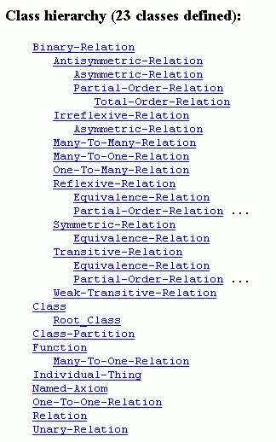
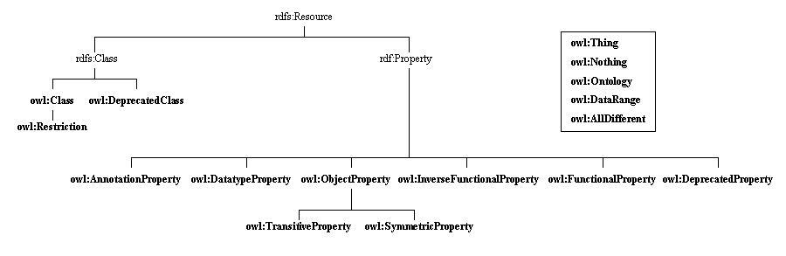
Knowledge Representation Ontologies
The Frame Ontology and the OKBC Ontology
(http://ontolingua.stanford.edu)
RDF and RDF Schema knowledge representation ontologies
(http://www.w3.org/1999/02/22-rdf-syntax-ns
http://www.w3.org/2000/01/rdf-schema)
OIL knowledge representation ontology
(http://www.ontoknowledge.org/oil/rdf-schema/2000/11/10-oil-standard)
DAML+OIL knowledge representation ontology
(http://www.daml.org/2001/03/daml+oil)
OWL knowledge representation ontology
(http://www.w3.org/2002/07/owl)

Slide 28

Definition of the relation SUBCLASS-OF in the Frame Ontology
(define-relation Subclass-Of (?child-class ?parent-class)
"Class C is a subclass of parent class P if and only if every instance of C is also an instance of P. A class may have multiple superclasses and subclasses. Subclass-of is transitive: if (subclass-of C1 C2) and (subclass-of C2 C3) then (subclass-of C1 C3). Object-centered systems sometimes distinguish between a subclass-of relationship that is asserted and one that is inferred. For example, (subclass-of C1 C3) might be inferred from asserting (subclass-of C1 C2) and (subclass-of C2 C3)..."
:iff-def
(and (Class ?parent-class)
(Class ?child-class)
(forall (?instance)
(=> (Instance-Of ?instance ?child-class)
(Instance-Of ?instance ?parent-class))))
:axiom-constraints
(Transitive-Relation Subclass-Of)
:issues
((:see-also direct-subclass-of)
(:see-also "In CycL, subclass-of is called #%allGenls
because it is a slot from a collection to all of its generalizations (superclasses)."
"In the KL-ONE literature, subclass relationships are also called subsumption relationships and ISA is sometimes used for subclass-of.")
("Why is it called Subclass-of instead of subclass or superclass?"
"Because the latter are ambiguous about the order of their arguments. We are following the naming convention that a binary relationship is read as an English sentence `Domain-element Relation-name Range-value'. Thus, `person subclass-of animal' rather than `person superclass animal'.")))
http://www-ksl.stanford.edu

Slide 29
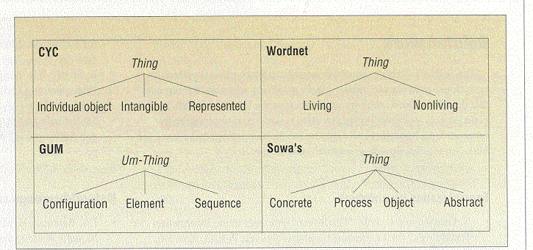
One Unique Top-Level Ontology?
Various proposals

Slide 30
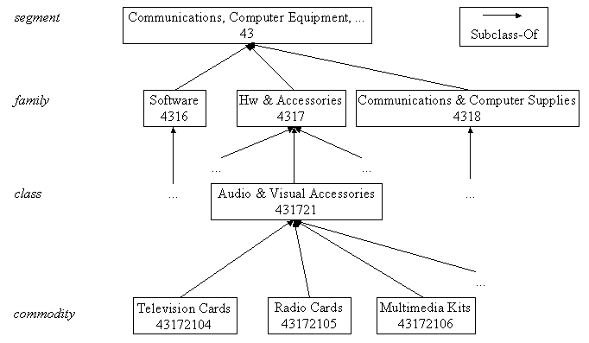
Domain Ontologies: e-Commerce Ontologies
The United Nations Standard Products and Services Codes (UNSPSC)
(http://www.unspsc.org/)
NAICS (North American Industry Classification System)
(http://www.census.gov/epcd/www/naics.html)
SCTG (Standard Classification of Transported Goods)
(http://www.statcan.ca/english/Subjects/Standard/sctg/sctg-menu.htm)
E-cl@ss
(http://www.eclass.de/)
RosettaNet
(http://www.rosettanet.org)

Slide 31
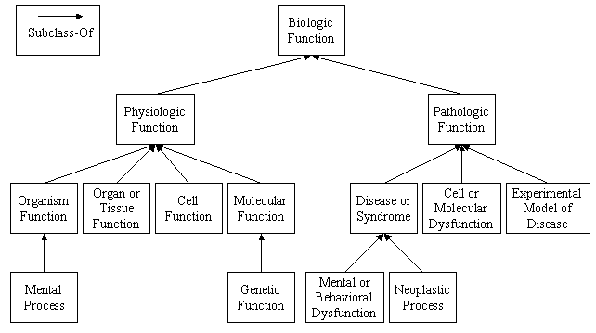

Domain Ontologies: Medical Ontologies
GALEN (http://www.opengalen.org/)
UMLS (Unified Medical Language System)
(http://www.nih.gov/research/umls/)
ON9 (http://saussure.irmkant.rm.cnr.it/ON9/index.html)
Rector AL, Bechhofer S, Goble CA, Horrocks I, Nowlan WA, Solomon WD (1997) The GRAIL concept modelling language for medical terminology. Artificial Intelligence in Medicine 9:139–171
Gangemi A, Pisanelli DM, Steve G (1998) Some Requirements and Experiences in Engineering Terminological Ontologies over the WWW. In: Gaines BR, Musen MA (eds) 11th International Workshop on Knowledge Acquisition, Modeling and Management (KAW'98). Banff, Canada, SHARE10:1–20

Slide 32
Libraries of Ontologies
Example library
Reusability
Usability
-
+
Application
Domain O. : heart-deseases
Application Domain
Task O.: surgery heart
Domain O.: body
Domain Task O.: plan-surgery
Generic Domain O.: components
Generic Task O.: plan
General/Common Ontologies: Time, Units, space, ...
-
+
Representation Ontology: Frame- Ontology
http://delicias.dia.fi.upm.es/mirror-server/ont-serv.html

Slide 33


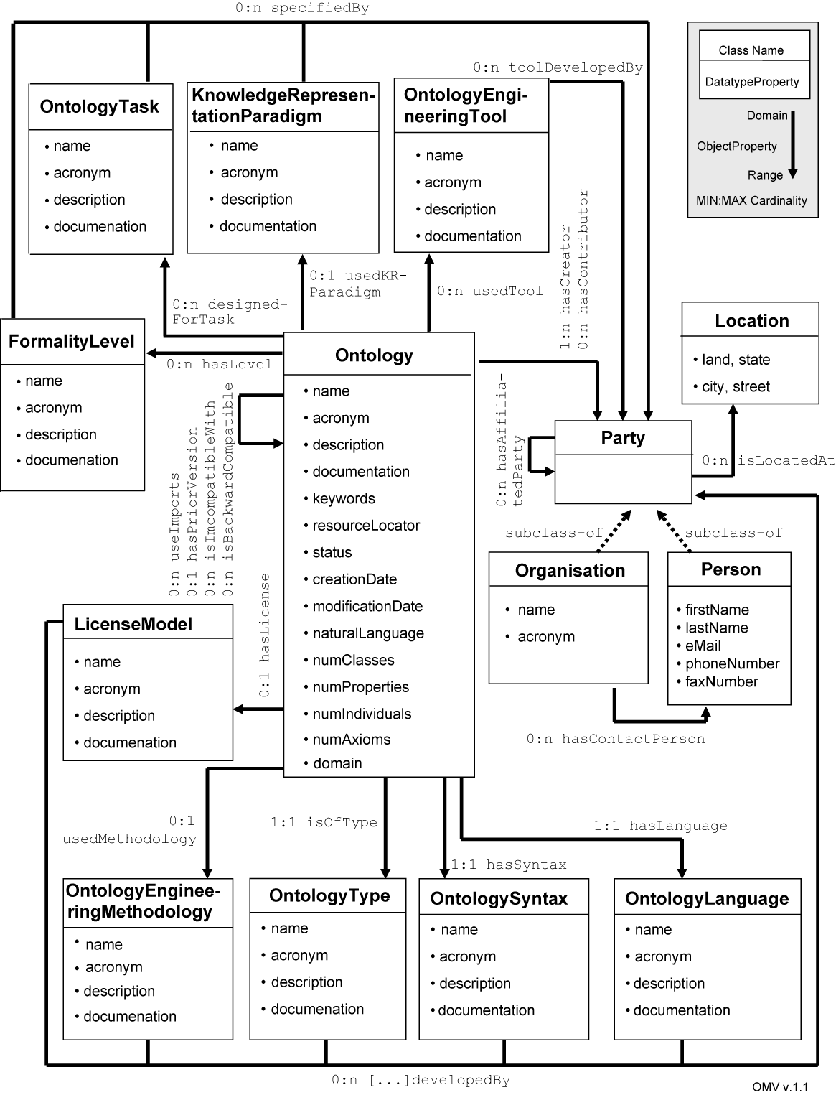



Searching Ontologies
O. Searching
O. Selection
OMV: Ontology Metadata Vocabulary
Ontology registries

Slide 34
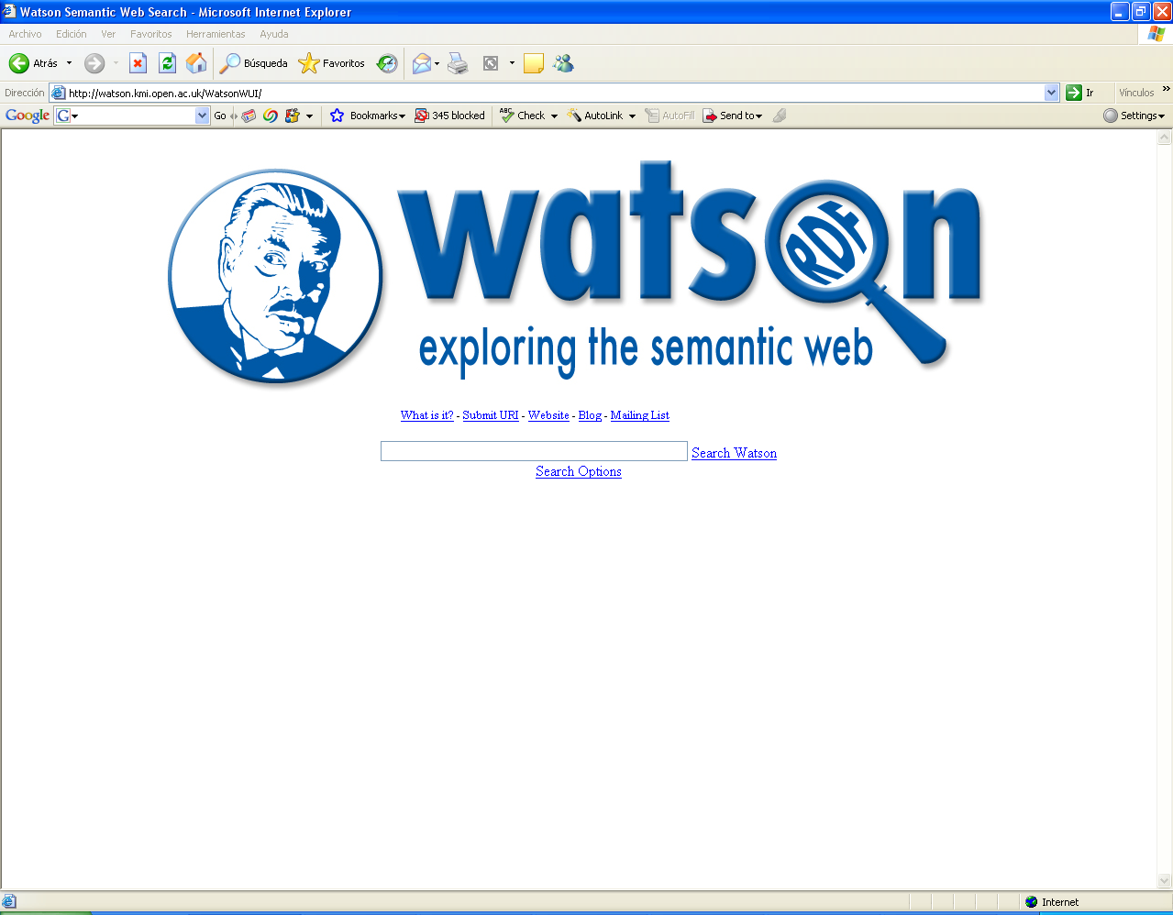

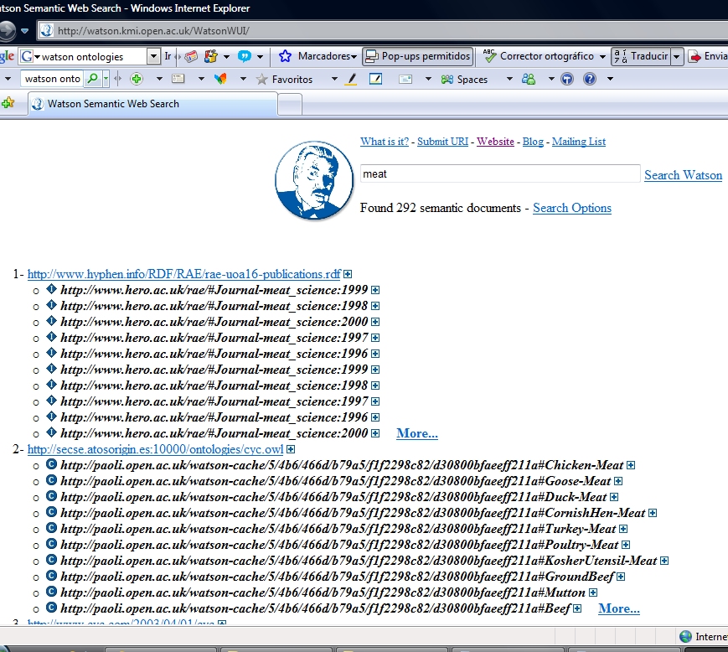
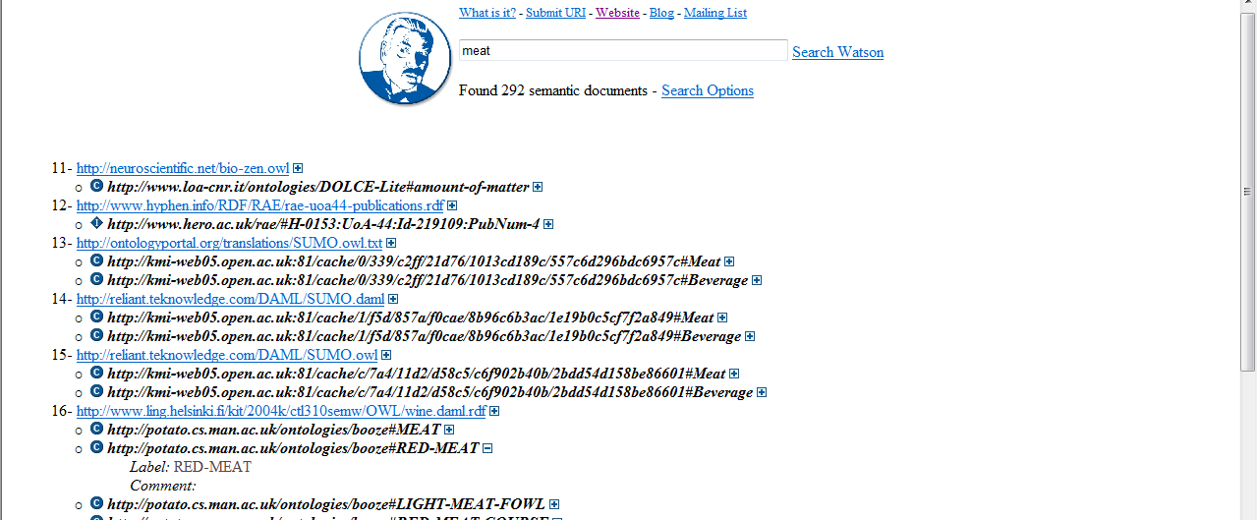

Slide 35
What is an Ontology?
Shared understanding of a domain
Repository of vocabulary
Formal definitions
Informal definitions

