Slide 1


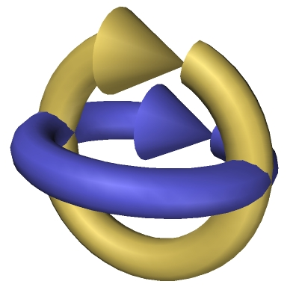
Main Components
Applications
Build Ontologies
Methodologies and Methods
Technological Support
Reasoners
Languajes

Slide 2
Table of Content
  Reuse and Sharing
  Definitions of Ontologies
  Modeling of Ontologies
  Approaches for building ontologies
  Type of Ontologies
  Ontological commitments
  Ontologies reuse other ontologies
  Searching ontologies
  Relevant ontologies

Slide 3
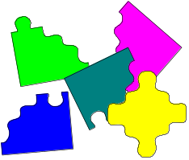
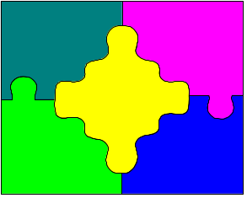


Reuse and Sharing
Reuse means to build new applications
assembling components already built
Sharing is when different
applications use the some resources
Areas:
Advantages:
Software
Knowledge
Communications
Interfaces
---
Less money
Less time
Less resources

Slide 4

The knowledge Sharing Initiative
“Building new Knowledge Based Systems today usually entails constructing new
knowledge bases from scratch. It could instead be done by assembling reusable components.
System developers would then only need to worry about creating the specialized knowledge and
reasoners new to the specific task of their systems. This new system would interoperate with
existing systems, using them to perform some of its reasoning. In this way,
declarative knowledge, problem-solving techniques, and reasoning services could all
be shared between systems. This approach would facilitate building bigger and better systems
cheaply. The infraestructure to support such sharing and reuse would lead to greater
ubiquity of these systems, potentially transforming the knowledge industry ...”
Neches, R.; Fikes, R.; Finin, T.; Gruber, T.; Patil, R.; Senator, T.; Swartout, W.R. Enabling Technology for Knowledge Sharing.
AI Magazine. Winter 1991. 36-56.

Slide 5
Reusable Knowledge Components
Ontologies
Problem Solving Methods
Describe domain knowledge in a generic way
and provide agreed understanding of a domain
Describe the reasoning process of a KBS in
an implementation and domain-independent manner
Interaction Problem
Representing Knowledge for the purpose of solving some problem
is strongly affected by the nature of the problem
and the inference strategy to be applied to the problem [Bylander et al., 88
Bylander Chandrasekaran, B. Generic Tasks in knowledge-based reasoning.: the right level of abstraction for knowledge acquisition.
In B.R. Gaines and J. H. Boose, EDs Knowledge Acquisition for Knowledge Based systems, 65-77, London: Academic Press 1988.

Slide 6
Ontological Engineering
It refers to the set of activities that concern
the ontology development process,
the ontology life cycle,
the methods and methodologies for building ontologies,
and the tool suites
and languages that support them.

Slide 7
Table of Content
  Reuse and Sharing
  Definitions of Ontologies
  Modeling of Ontologies
  Approaches for building ontologies
  Type of Ontologies
  Ontological commitments
  Ontologies reuse other ontologies
  Searching ontologies
  Relevant ontologies

Slide 8
Definitions of Ontologies (I)
1. “An ontology defines the basic terms and relations comprising the vocabulary of
a topic area, as well as the rules for combining terms and relations to define
extensions to the vocabulary”
Neches, R.; Fikes, R.; Finin, T.; Gruber, T.; Patil, R.; Senator, T.; Swartout, W.R. Enabling Technology for Knowledge Sharing.
AI Magazine. Winter 1991. 36-56.
2. “An ontology is an explicit specification of a conceptualization”
Gruber, T. A translation Approach to portable ontology specifications. Knowledge Acquisition. Vol. 5. 1993. 199-220.

Slide 9
Definitions of Ontologies (II)
3. An ontology is a hierarchically structured set of terms for describing a domain
that can be used as a skeletal foundation for a knowledge base.
B. Swartout; R. Patil; k. Knight; T. Russ. Toward Distributed Use of Large-Scale Ontologies
Ontological Engineering. AAAI-97 Spring Symposium Series. 1997. 138-148.
4. An ontology provides the means for describing explicitly the conceptualization
behind the knowledge represented in a knowledge base.
A. Bernaras;I. Laresgoiti; J. Correra. Building and Reusing Ontologies for Electrical Network Applications
ECAI96. 12th European conference on Artificial Intelligence. Ed. John Wiley & Sons, Ltd. 298-302.

Slide 10
Definitions of Ontologies (III)
5. “An ontology is a formal, explicit specification of a shared conceptualization”
Machine-readable
Consensual
Knowledge
Concepts, properties
relations, functions,
constraints, axioms,
are explicitly defined
Abstract model and
simplified view of some
phenomenon in the world
that we want to represent
Ontologías
Studer, Benjamins, Fensel. Knowledge Engineering: Principles and Methods. Data and Knowledge Engineering. 25 (1998) 161-197

Slide 11
Definitions of Ontologies (IV)
Lightweight Ontologies :
  Include Concepts with properties and Taxonomies
  Do not include Axioms and constraints.
Heavyweight Ontologies :
  Include all the components
  Excellent!! If they have a lot of axioms.

Slide 12
Table of Content
  Reuse and Sharing
  Definitions of Ontologies
  Modeling of Ontologies
  Approaches for building ontologies
  Type of Ontologies
  Ontological commitments
  Ontologies reuse other ontologies
  Searching ontologies
  Relevant ontologies

Slide 13
Components of an Ontology
Concepts are organized in
taxonomies
Relations
R: C1 x C2 x ... x Cn-1 x Cn
Subclass-of: Concept 1 x Concept2
Connected to: Component1 x Component2
Functions
F: C1 x C2 x ... x Cn-1 --> Cn
Mother-of: Person --> Women
Price of a used car: Model x Year x Kilometers --> Price
Instances
Elements
Gruber, T. A translation Approach to portable
ontology specifications. Knowledge Acquisition.
Vol. 5. 1993. 199-220.
Axioms
Sentences which are always true

Slide 14

Documentation Taxonomy
Documentation
Subclase-de
Additional
Documentation
Management
Documentation
Publication
Technical
Documentation
Thesis
Subclase-de
Subclase-de
Subclase-de
Subclase-de
Templates
Master
Thesis
PhD
Thesis
Manual
Slides
Deliverable
Article
Book
Subclase-de
...
Agenda
Cost
Statement
EC
Templates
Fax
Mail
Minutes
Periodic
Report
Project
Proposal
...
...
...
Facultad de Informática. Universidad Politécnica de Madrid © Asunción Gómez Pérez

Slide 15
Modelling disjoint knowledge
class-Partition: a set of disjoint classes
Disjoint: Defines the set of classes in the partition as subclasses of the parent class.
This classification does not necessarily to be complete.
Exhaustive-Disjoint: Defines the set of classes in the partition as subclasses of the parent class.
This classification is complete.

Slide 16


Why disjoint knowledge is important (I)
Mammal
A. Gómez-Pérez. Evaluation of Ontologies.
International Journal of Intelligent Systems.
Vol. 16, Nº3. March 2001. PP391-410
Subclass-Of
Subclass-Of
Subclass-Of
Superclass-Of
Person
Dog
Cat
Subclass-Of
Instance-Of
Cartoon Dog
Pluto could be an instance of cat and dog
Semantic Error
Instance-Of
Pluto

Slide 17
Why disjoint knowledge is important (II)
Mammal
A. Gómez-Pérez. Evaluation of Ontologies.
International Journal of Intelligent Systems.
Vol. 16, Nº3. March 2001. PP391-410
Disjoint
Subclass-Partition
Person
Dog
Cat
Subclass-Of
Cartoon Dog
Instance-Of
Has-Instance
Instance-Of
Pluto can not be simultaneously a class of Cat and
Dog because they are disjoint
Pluto

Slide 18
Why disjoint knowledge is important (III)
Number
Instance-Of
Four is an instance of Odd
Disjoint
Subclass-Partition
4
Even
Odd
Gómez-Pérez. Evaluation of Ontologies.International Journal of Intelligent Systems. Vol. 16, Nº3. March 2001. PP391-410

Slide 19
Why disjoint knowledge is important (IV)
Number
Exhaustive-Disjoint
Instance-Of
Subclass-Partition
Odd
Even
4
Four is an instance of something in the partition

Slide 20
Relations between concepts
Project
Event
has associated event
is deliver in / has associated
has person leader
/ leads
has / is associated with
works in / has p p
has associated
is involved in / has p leader
has associated / is associated
is WP leader / has person leader
leads / has contractor leader
is associated with
Person
has involved partner / works in
Documentation
is author of / has author
participates in / is developed by
has contact person
Organization
has Q.A. partner
is contact person / has contact person
has authoring partner
belongs to / is formed by
has lead participant
generates / is generated by

Slide 21
Relationships between Person, Project and Documentation
has associated
WP workload
Milestone
has participant
with workload
is deliver in
has
Project
Workpackage
Task
is made up of
leads
Documentation
works in
is involved in
Person
is WP leader
Person
is author of
Deliverable
has contact person

Slide 22
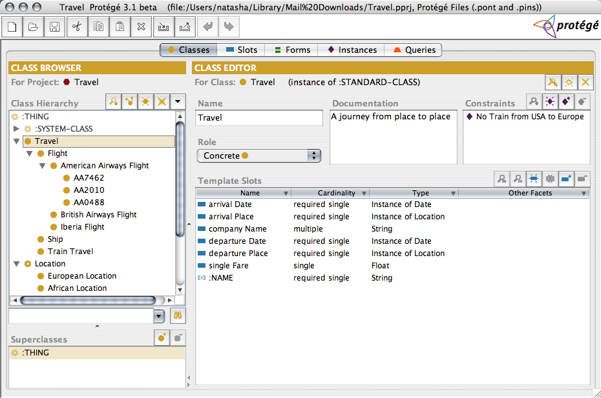
Properties

Slide 23
Example of axioms
(define-axiom No-Train-from-USA-to-Europe
"It is not possible to travel from the USA to Europe by train"
:= (forall (?travel)
(forall (?city1)
(forall (?city2)
(=> (and (Travel ?travel)
(arrivalPlace ?travel ?city1)
(departurePlace ?travel ?city2)
(EuropeanLocation ?city1)
(USALocation ?city2))
(not (TrainTravel ?travel)))))))
(define-axiom No-Train-between-USA-and-Europe
"It is not possible to travel by train between the USA and Europe"
:= (forall (?travel)
(forall (?city1)
(forall (?city2)
(=> (and (Travel ?travel)
(arrivalPlace ?travel ?city1)
(departurePlace ?travel ?city2)
(or (and (EuropeanLocation ?city1)
(USALocation ?city2))
(and (EuropeanLocation ?city2)
(USALocation ?city1))))
(not (TrainTravel ?travel)))))))

Slide 24
Key aspects of Ontological Engineering
Ontologies
  Single versus network of ontologies?
  Are ontologies built from scratch or reusing knowledge-aware resources?
  Are mappings used for solving conceptual mistmaches?
Instances
  Where are the data/instances?
    Instances are in the ontology
    Instances are in RDF files independently of the ontology
    Data are kept in the original sources
  Are instances distributed or centralized?
  Have instances a very high rate of changes?
  Heterogeneous provenance of instances
  Degrees of data quality
  Permissions

Slide 25
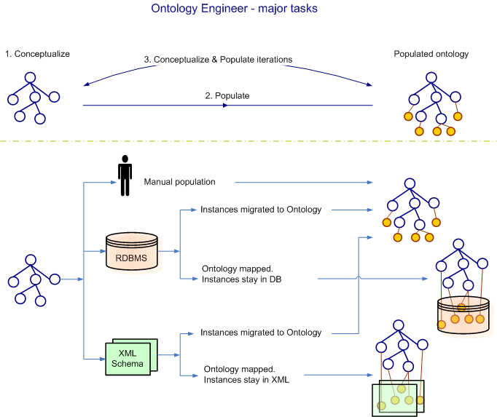
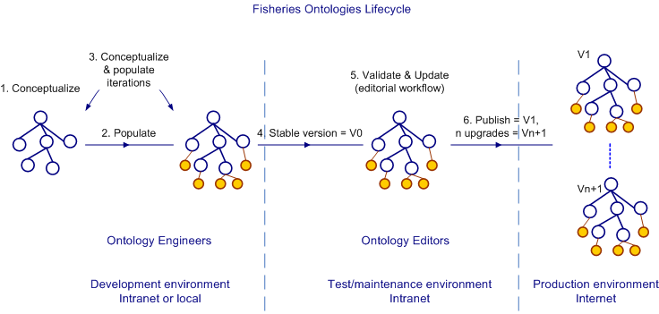
Where are the instances?
or

Slide 26
Table of Content
  Reuse and Sharing
  Definitions of Ontologies
  Modeling of Ontologies
  Approaches for building ontologies
  Type of Ontologies
  Ontological commitments
  Ontologies reuse other ontologies
  Searching ontologies
  Relevant ontologies

Slide 27
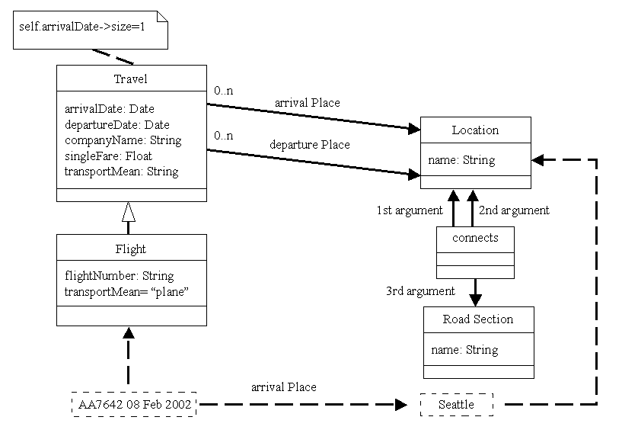
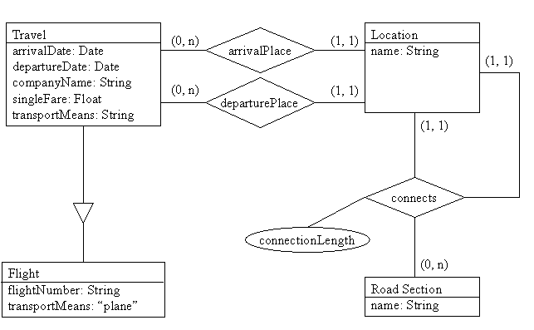
Approaches for building ontologies
UML
E/R Model
Description logic
Frames & Logic
….
Mammal
Birds
dog
Subclass of
Subclass of
….
Cat
…
Mammal
Subclass of
Automatic Classification
Birds
Subclass of
Subclass of
Dog
Cat
Design time

Slide 28
Using Frames and First Order Logic for Modeling Ontologies
(define-class Travel (?travel)
"A journey from place to place"
:axiom-def
(and (Superclass-Of Travel Flight)
(Template-Facet-Value Cardinality
arrivalDate Travel 1)
(Template-Facet-Value Cardinality
departureDate Travel 1)
(Template-Facet-Value Maximum-Cardinality
singleFare Travel 1))
:def
(and (arrivalDate ?travel Date)
(departureDate ?travel Date)
(singleFare ?travel Number)
(companyName ?travel String)))
(define-function Pays (?room ?discount) :-> ?finalPrice
"Price of the room after applying the discount"
:def (and (Room ?room) (Number ?discount)
(Number ?finalPrice)
(Price ?room ?price))
:lambda-body
(- ?price (/ (* ?price ?discount) 100)))
(define-relation connects (?edge ?source ?target)
"This relation links a source and a target by an edge. The source and destination are considered as spatial points. The relation has the following properties: symmetry and irreflexivity."
:def (and (SpatialPoint ?source)
(SpatialPoint ?target)
(Edge ?edge))
:axiom-def
((=> (connects ?edge ?source ?target)
(connects ?edge ?target ?source)) ;symmetry
(=> (connects ?edge ?source ?target)
(not (or (part-of ?source ?target) ;irreflexivity
(part-of ?target ?source))))))
(define-instance AA7462-Feb-08-2002 (AA7462)
:def ((singleFare AA7462-Feb-08-2002 300)
(departureDate AA7462-Feb-08-2002 Feb8-2002)
(arrivalPlace AA7462-Feb-08-2002 Seattle)))

Slide 29
Using Description Logics for Modeling Ontologies
(defconcept Travel
"A journey from place to place"
:is-primitive
(:and
(:all arrivalDate Date)(:exactly 1 arrivalDate)
(:all departureDate Date)(:exactly 1 departureDate)
(:all companyName String)
(:all singleFare Number)(:at-most singleFare 1)))
(defrelation Pays
:is
(:function (?room ?Discount)
(- (Price ?room) (/(*(Price ?room) ?Discount) 100)))
:domains (Room Number)
:range Number)
(defrelation connects
"A road connects two different cities"
:arity 3
:domains (Location Location)
:range RoadSection
:predicate
((?city1 ?city2 ?road)
(:not (part-of ?city1 ?city2))
(:not (part-of ?city2 ?city1))
(:or (:and (start ?road ?city1)(end ?road ?city2))
(:and (start ?road ?city2)(end ?road ?city1)))))
(tellm (AA7462 AA7462-08-Feb-2002)
(singleFare AA7462-08-Feb-2002 300)
(departureDate AA7462-08-Feb-2002 Feb8-2002)
(arrivalPlace AA7462-08-Feb-2002 Seattle))

Slide 30
Different Approaches to Build Ontologies
The formalism and the language limit the kind of knowledge that can be represented
All the aforementioned formalisms allow representing: classes, organized in class taxonomies, attributes, and binary relations
Only AI formalisms are specially prepared to model formal axioms either as independent components in the ontology or embedded in other components
A domain model is not necessarily an ontology only because it is written in Ontolingua or OWL, for the same reasons that we cannot say that a program is a knowledge-based system because it is written in Prolog
Although some languages are more appropriate than others to represent ontologies, a model is an ontology only if it is agreed and machine readable

Slide 31
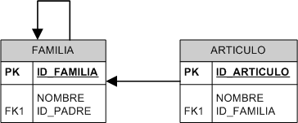
Modelización y consulta con BB.DD. (ejemplo práctico)
PROBLEMA: se desea modelizar un catálogo de artículos informáticos. Los artículos se clasifican en familias (monitores, impresoras, consumibles, juegos, aplicaciones de productividad, etc.). Una familia puede ser subfamilia de otra dada (monitor e impresora de hardware, juegos y aplicaciones de software, etc.). Un artículo pertenece a una familia data. Diseñar un modelo y escribir la consulta que permite obtener todos los productos de la familia Hardware.
Esquema de la BB.DD.:
Contenido de ejemplo de las tablas:
ID_FAMILIA | NOMBRE | ID_PADRE
1 | HARDWARE
11 | MONITOR | 1
111 | CRT | 11
112 | TFT | 11
12 | IMPRESORA | 1
13 | CONSUMIBLE | 1
2 | SOFTWARE
... | ... | ...
ID_ARTICULO | NOMBRE | ID_FAMILIA
8947 | SONY 15” | 112
4233 | HP LaserJet | 12
4343 | Toner Epson | 13
4323 | Tetris | 21
7984 | Microsoft Office | 22
4455 | AOC 17” | 111
3454 | Apple iLife | 22
... | ... | ...
Solución usando consultas SQL:
pila.push(“Hardware”) // Añade a una pila vacía la famila por la cual se comienza la exploración
resultado = {}
while not pila.empty() do // Mientras la pila de familias por explorar no se encuentre vacía hacer:
familia = pila.pop() // Se extrae una familia de la pila
resultSet = SQL.execute(“SELECT HIJO.ID_FAMILA FROM FAMILIA AS HIJO LEFT JOIN FAMILIA AS PADRE ON HIJO.ID_PADRE =
PADRE.ID_FAMILIA WHERE PADRE.ID_FAMILIA = ‘“ + familia + “’”) // Se obtienen las familias hijas
pila.pushAllFrom(resultset) // Se añaden las familias padres obtenidas a la pila
resultado.add(getArticulos(familia)) // Se añade al resultado los artículos propios de esa familia
end
function getArticulos(familia) // Función que obtiene los artículos de una familia dada
resultSet = SQL.execute(“SELECT ARTICULO_ID FROM ARTICULO WHERE FAMILIA_ID = ‘” + familia + “’”)
return resultSet
end

Slide 32
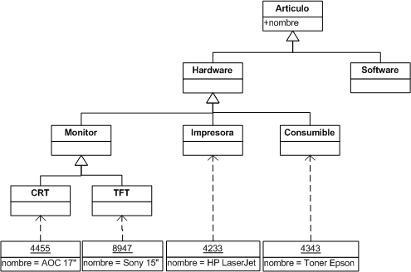

Modelización y consulta con Ontologías (mismo problema)
Ontología:
Solución usando consulta SPARQL:
resultado = SPARQL.execute(“
BASE http://delicias.dia.fi.upm.es/
SELECT $articulo
WHERE {$articulo a <Hardware>.}“)
¡¡¡Y solo con este código !!!
Programador sorprendido
Ventajas con respecto a la aproximación con bases de datos:
+ declarativo, - procedimental.
Los algoritmos de inferencia los implementa el razonador. El programador no se debe ocupar de ellos.
Al no tener que implementar el algoritmo se disminuye el riesgo de errores de programación.
La ontología se puede cambiar (p.e. ampliar) con mayor facilidad que el esquema de la base de datos.
Este ejemplo muestra únicamente la capacidad de inferencia con las taxonomías de clases. Existen otros tipos de inferencia dependiendo del formalismo elegido:
  Inferencia con taxonomías de propiedades.
  Clasificación automática.
  Equiparación.
  …

Slide 33
Table of Content
  Reuse and Sharing
  Definitions of Ontologies
  Modeling of Ontologies
  Approaches for building ontologies
  Type of Ontologies
  Ontological commitments
  Ontologies reuse other ontologies
  Searching ontologies
  Relevant ontologies

Slide 34
Types of Ontologies
Lassila and McGuiness Classification
Thessauri “narrower term” relation
General Logical constraints
Formal is-a
Frames (properties)
Catalog/ID
Terms/ glossary
Informal is-a
Formal instance
Value Restrs.
Disjointness, Inverse, part-Of ...
Lassila O, McGuiness D. The Role of Frame-Based Representation on the Semantic Web.
Technical Report. Knowledge Systems Laboratory. Stanford University. KSL-01-02. 2001.

Slide 35
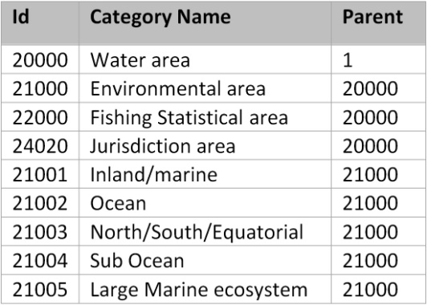
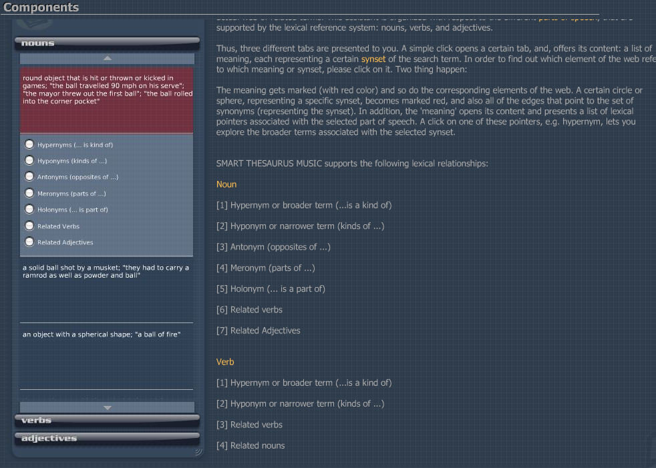
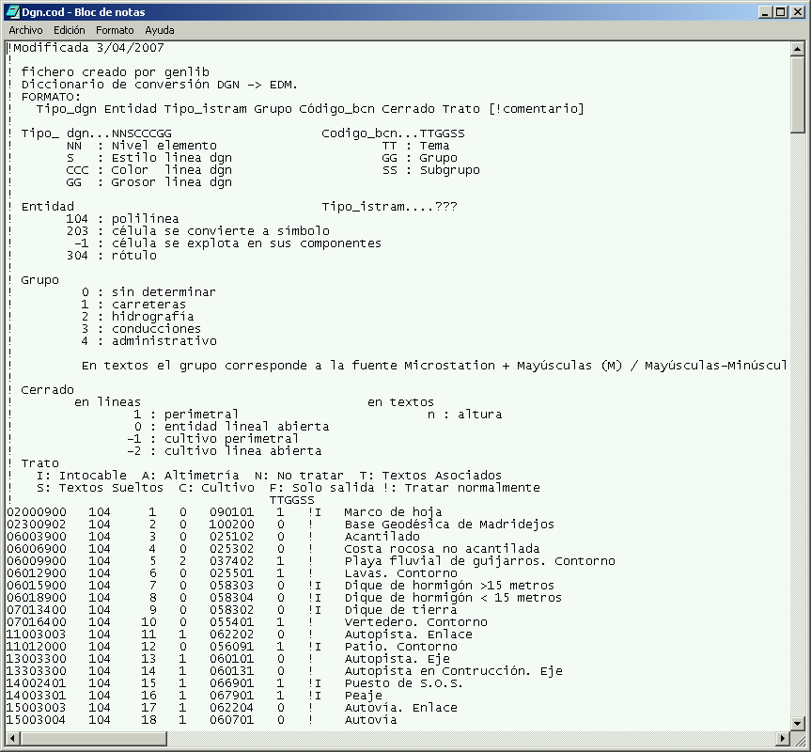

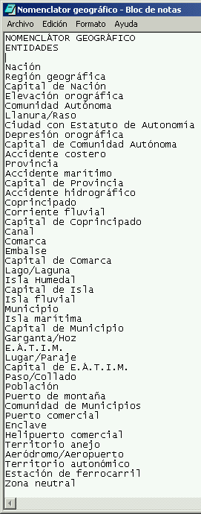
Catalog/ID
Glossary
Thessaurus
Informal is-a
Informal is-a
Tipos de relaciones
Catalog/ID
Informal is-a
Thessaurus

Slide 36
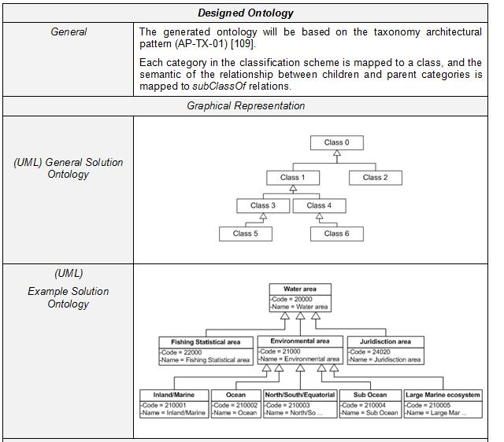
Formal instance
Frames (properties)
General Logical constraints
Disjointness, Inverse, part-Of ...
Formal is-a
Value Restrs.
Formal is-a with properties
(define-relation connects (?edge ?source ?target)
"This relation links a source and a target by an edge. The source and destination are considered as spatial points. The relation has the following properties: symmetry and irreflexivity."
:def (and (SpatialPoint ?source)
(SpatialPoint ?target)
(Edge ?edge))
:axiom-def
((=> (connects ?edge ?source ?target)
(connects ?edge ?target ?source)) ;symmetry
(=> (connects ?edge ?source ?target)
(not (or (part-of ?source ?target) ;irreflexivity
(part-of ?target ?source))))))
General Logical constraints
(define-class Travel (?travel)
"A journey from place to place"
:axiom-def
(and (Superclass-Of Travel Flight)
(Template-Facet-Value Cardinality
arrivalDate Travel 1)
(Template-Facet-Value Cardinality
departureDate Travel 1)
(Template-Facet-Value Maximum-Cardinality
singleFare Travel 1))
:def
(and (arrivalDate ?travel Date)
(departureDate ?travel Date)
(singleFare ?travel Number)
(companyName ?travel String)))
Value Restrs.
(define-class AmericanAirlinesFlight (?X)
:def (Flight ?X)
:axiom-def
(Disjoint-Decomposition AmericanAirlinesFlight
(Setof AA7462 AA2010 AA0488)))
(define-class Location (?X)
:axiom-def
(Partition Location
(Setof EuropeanLocation NorthAmericanLocation
SouthAmericanLocation AsianLocation
AfricanLocation AustralianLocation
AntarcticLocation)))
Disjointness

Slide 37
Types of Ontologies
Content Ontologies
Issue of the
Conceptualization
Domain O.
Representation O.
Scalpel, scanner
anesthetize, give birth
Conceptualization
of KR formalisms
Task O.
goal, schedule
to assign, to classify
Generic O.
Reusable across D.
General/Common O.
Things, Events, Time, Space
Causality, Behavior, Function
Domain O.
Reusable
Mizoguchi, R. Vanwelkenhuysen, J.; Ikeda, M.
Task Ontology for Reuse of Problem Solving Knowledge.
Towards Very Large Knowledge Bases:
Knowledge Building & Knowledge Sharing.
IOS Press. 1995. 46-59.
Application O.
Van Heist, G.; Schreiber, T.; Wielinga, B.
Using Explicit Ontologies in KBS
International Journal of Human-Computer Studies.
Vol. 46. (2/3). 183-292. 1997
Non reusable
Usable

Slide 38
Table of Content
  Reuse and Sharing
  Definitions of Ontologies
  Modeling of Ontologies
  Approaches for building ontologies
  Type of Ontologies
  Ontological commitments
  Ontologies reuse other ontologies
  Searching ontologies
  Relevant ontologies

Slide 39
Ontological Commitments
Agreements to use the vocabulary in a coherent and consistent manner (Gruber)
Connection between the ontology vocabulary and the meaning of the terms of such vocabulary
An agent commits (conforms) to an ontology if it “acts” consistently with the definitions
Example: What is a pipe?
9 definitions of the term flight from wordnet
Identification of the ontological commitment
Gruber, T.; Olsen, G. An Ontology for Engineering Mathematics.
Fourth International Conference on Principles of Knowledge Representation and Reasoning.
Ed by Doyle and Torasso. Morgan Kaufmann. 1994. Also as KSL-94-18.
Guarino, N.; Carrara, M.; Giaretta, P. Formalizing Ontological Commitments.
12th National Conference on Artificial Intelligence. AAAI-94. 1994. 560-567

Slide 40
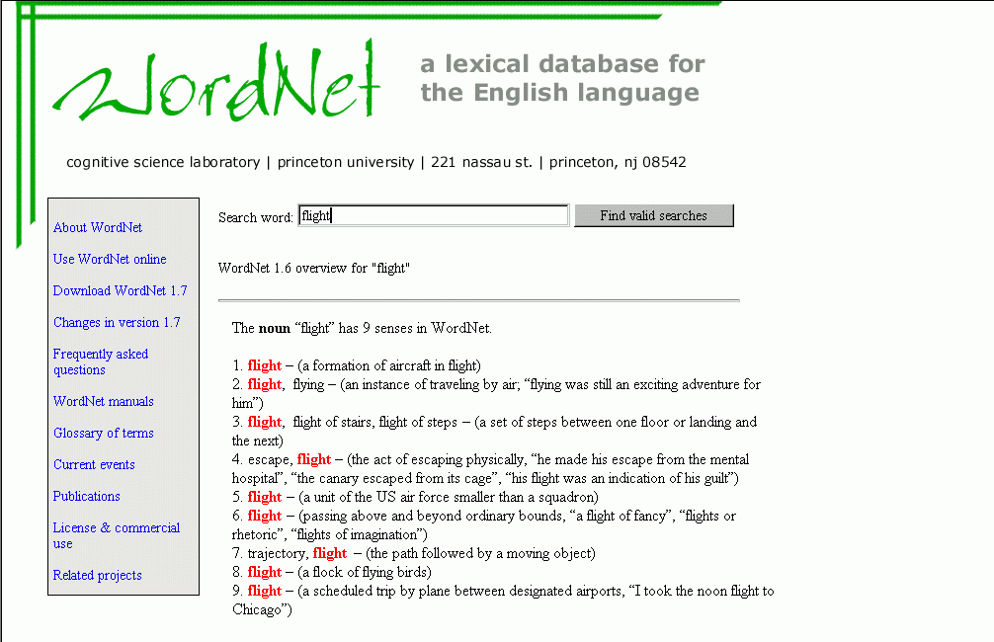
Ontological Commitments

Slide 41
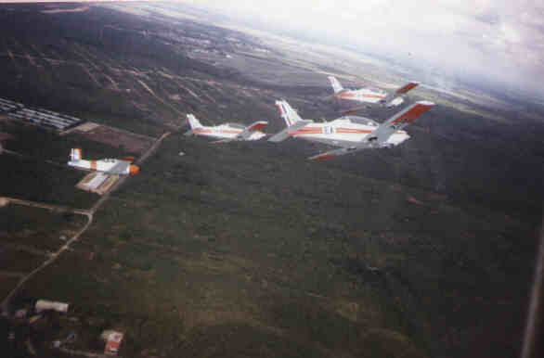
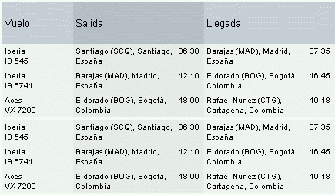
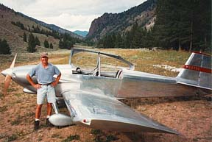

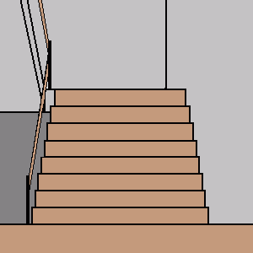

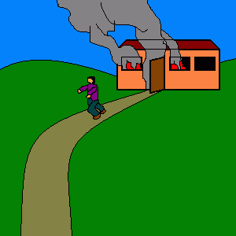
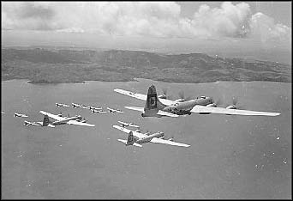


A formation of
aircraft in flight
A scheduled trip by plane between designated airports
An instance of traveling by air
A flock of flying birds
OC₁
OC₉
OC₂
OC₈
flight
A set or steps between one floor or landing for him
OC₃
OC₇
The path followed by a moving object
OC₄
OC₆
OC₅
The act of escaping physically
A unit of the US air force smaller than a squadron
Passing above and beyond ordinary bounds
(define-class Flight (?X)
"A journey by plane"
:axiom-def
(and (Subclass-Of Flight Travel)
(Template-Facet-Value Cardinality
flightNumber Flight 1))
:class-slots ((transportMeans "plane")))
flight

Slide 42
Table of Content
  Reuse and Sharing
  Definitions of Ontologies
  Modeling of Ontologies
  Approaches for building ontologies
  Type of Ontologies
  Ontological commitments
  Ontologies reuse other ontologies
  Searching ontologies
  Relevant ontologies

Slide 43
Libraries of Ontologies
Example library
Reusability
Usability
-
+
Application
Domain O. : heart-deseases
Application Domain
Task O.: surgery heart
Domain O.: body
Domain Task O.: plan-surgery
Generic Domain O.: components
Generic Task O.: plan
General/Common Ontologies: Time, Units, space, ...
-
+
Representation Ontology: Frame- Ontology
http://delicias.dia.fi.upm.es/mirror-server/ont-serv.html

Slide 44



Modular approach for ontology construction
Reusability
Usability
-
+
Application
Domain O. : Job Seeker, Job Offer
Domain O.: Economic Activity, Occupation, Education, Skill, Driving License, Compensation, Labour Regulatory, Competence
General/Common Ontologies: Time, Geography, Language
-
+
Representation Ontology: WSML

Slide 45
Table of Content
  Reuse and Sharing
  Definitions of Ontologies
  Modeling of Ontologies
  Approaches for building ontologies
  Type of Ontologies
  Ontological commitments
  Ontologies reuse other ontologies
  Searching ontologies
  Relevant ontologies

Slide 46


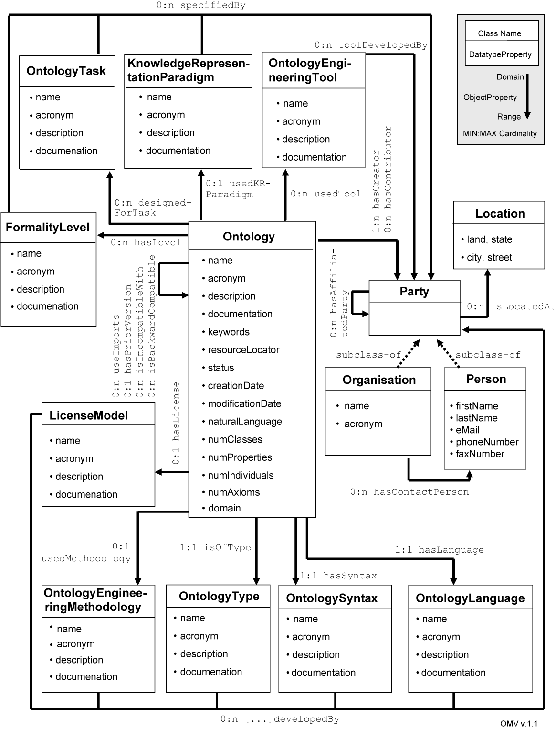



Searching Ontologies
O. Searching
O. Selection
OMV: Ontology Metadata Vocabulary
Ontology registries

Slide 47

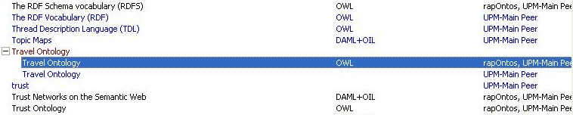
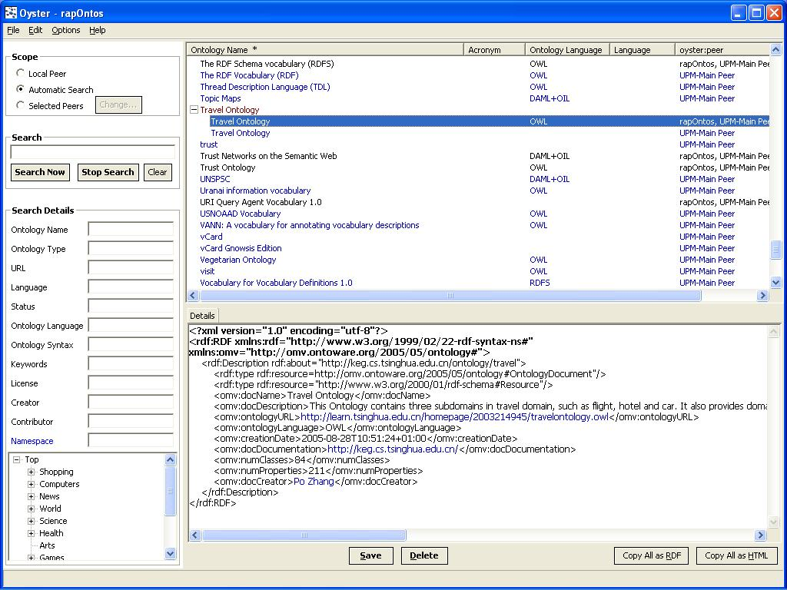
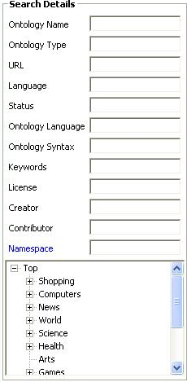
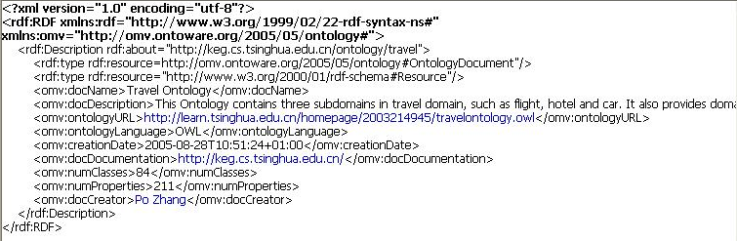
Searching ontologies: Obtain the set of candidate ontologies using Oyster
O. Searching
Query Scope
O. Assessment
O. Selection
Integration of Results
Semantic Search
Entry Details

Slide 48
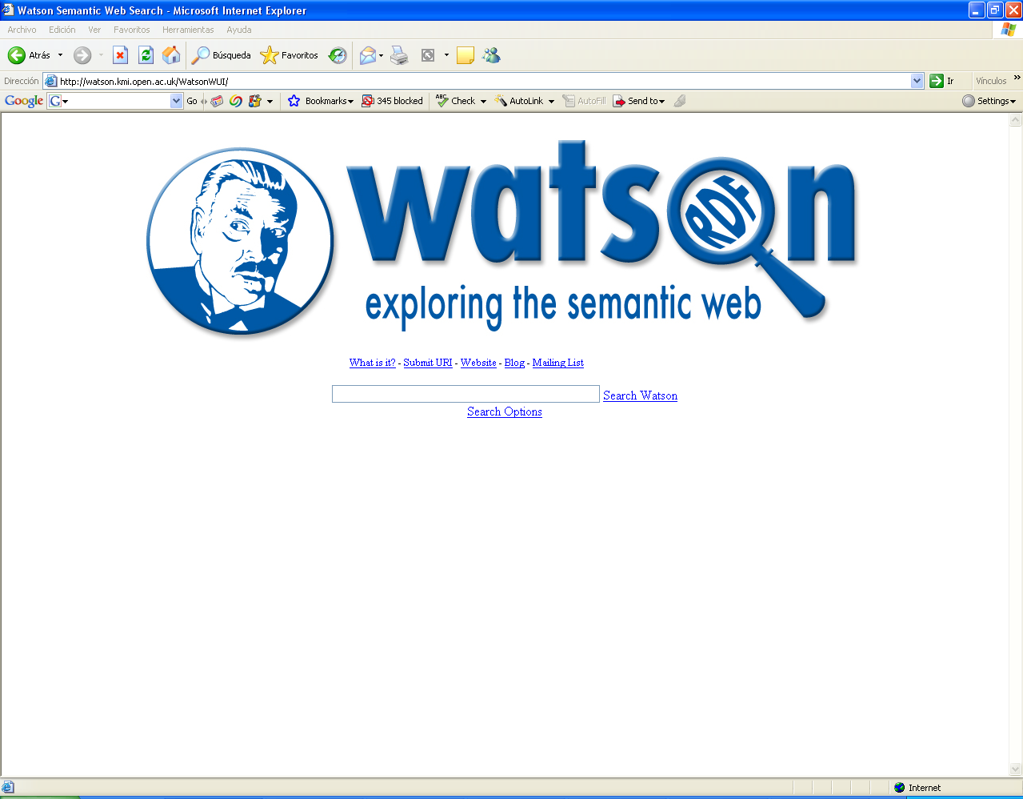
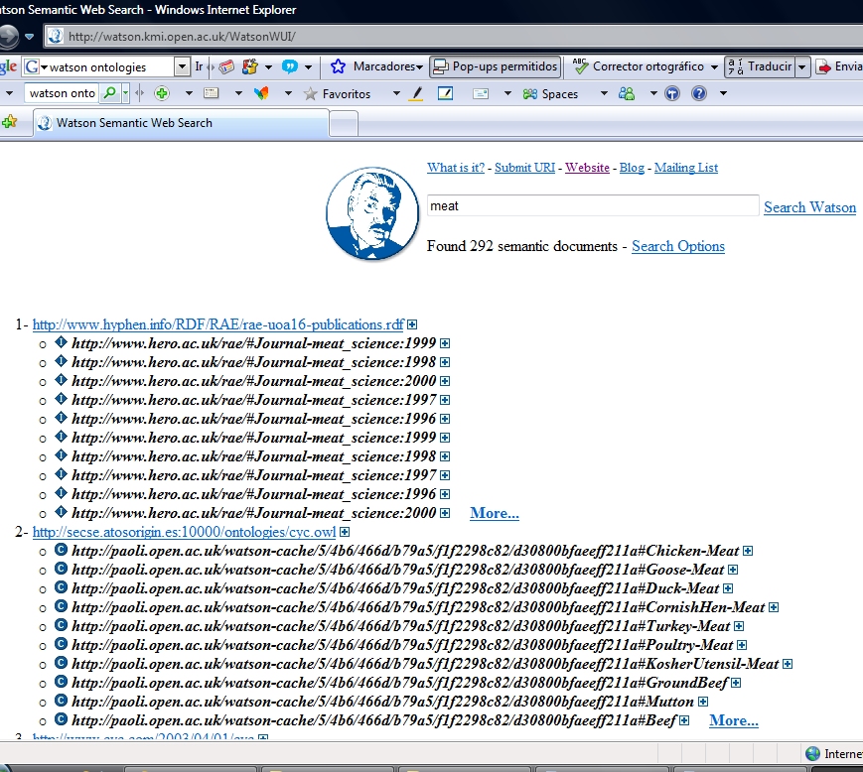
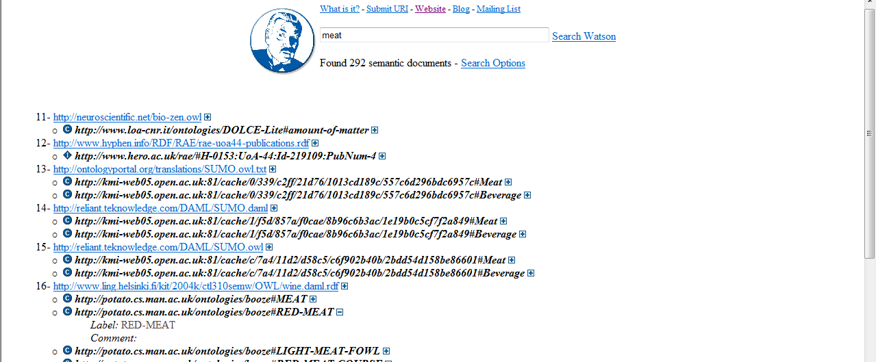

Slide 49
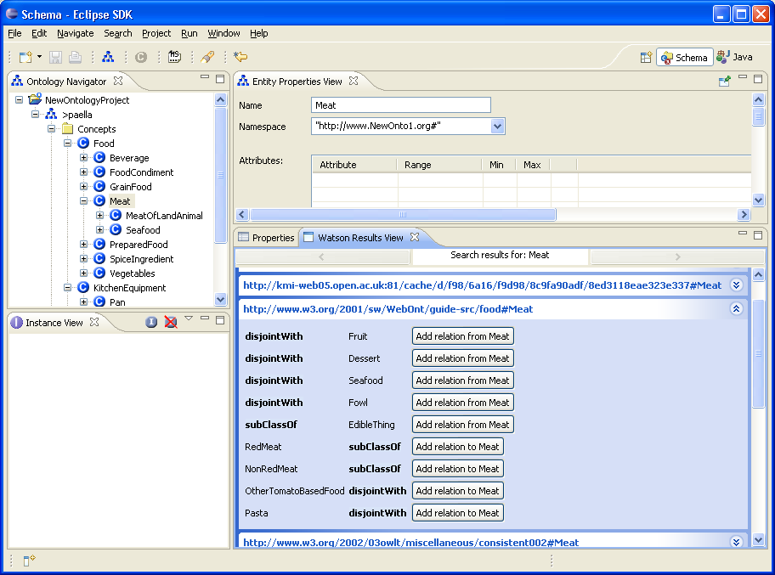
Watson plug-in in the NeOn Toolkit

Slide 50
Table of Content
  Reuse and Sharing
  Definitions of Ontologies
  Modeling of Ontologies
  Approaches for building ontologies
  Type of Ontologies
  Ontological commitments
  Ontologies reuse other ontologies
  Searching ontologies
  Relevant ontologies

Slide 51

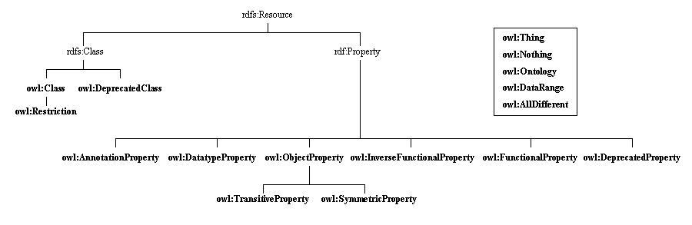
Knowledge Representation Ontologies
Knowledge Representation (KR) ontologies capture the
representation primitives used to formalize knowledge under a given KR paradigm.
The Frame Ontology and the OKBC Ontology
(http://ontolingua.stanford.edu)
RDF and RDF Schema knowledge representation ontologies
(http://www.w3.org/1999/02/22-rdf-syntax-ns
http://www.w3.org/2000/01/rdf-schema)
OWL knowledge representation ontology
(http://www.w3.org/2002/07/owl)
Gruber TR (1993a) A translation approach to portable ontology specification. Knowledge Acquisition 5(2):199–220
Chaudhri VK, Farquhar A, Fikes R, Karp PD, Rice JP (1998) Open Knowledge Base Connectivity 2.0.3. Technical Report.
http://www.ai.sri.com/~okbc/okbc-2-0-3.pdf
Lassila O, Swick R (1999) Resource Description Framework (RDF) Model and Syntax Specification. W3C Recommendation.
http://www.w3.org/TR/REC-rdf-syntax/
Dean M, Schreiber G (2003) OWL Web Ontology Language Reference. W3C Working Draft. http://www.w3.org/TR/owl-ref/

Slide 52
RDF and RDF Schema knowledge representation ontologies
Property name | domain | range
rdf:type | rdfs:Resource | rdfs:Class
rdf:subject | rdf:Statement | rdfs:Resource
rdf:predicate | rdf:Statement | rdf:Property
rdf:object | rdf:Statement | rdfs:Resource
rdf:value | rdfs:Resource | rdfs:Resource
rdf:first | rdf:List | rdfs:Resource
rdf:rest | rdf:List | rdf:List
rdfs:subClassOf | rdfs:Class | rdfs:Class
rdfs:subPropertyOf | rdf:Property | rdf:Property
rdfs:comment | rdfs:Resource | rdfs:Literal
rdfs:label | rdfs:Resource | rdfs:Literal
rdfs:seeAlso | rdfs:Resource | rdfs:Resource
rdfs:isDefinedBy | rdfs:Resource | rdfs:Resource
rdfs:member | rdfs:Resource | rdfs:Resource
rdfs:domain | rdf:Property | rdfs:Class
rdfs:range | rdf:Property | rdfs:Class
Table: Property descriptions of the RDF(S) KR ontology.

Slide 53
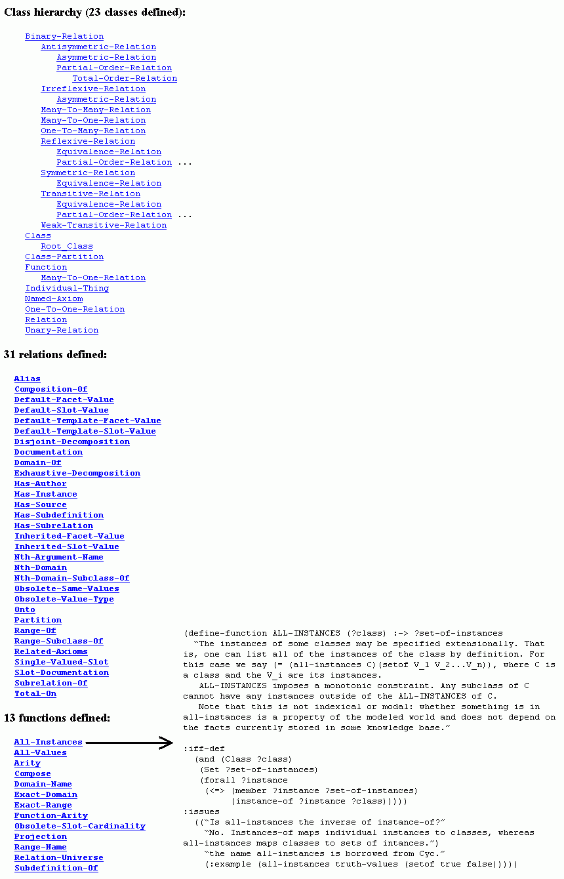

Slide 54

Definition of the relation SUBCLASS-OF in the Frame Ontology
(define-relation Subclass-Of (?child-class ?parent-class)
"Class C is a subclass of parent class P if and only if every instance of C is also an instance of P. A class may have multiple superclasses and subclasses. Subclass-of is transitive: if (subclass-of C1 C2) and (subclass-of C2 C3) then (subclass-of C1 C3). Object-centered systems sometimes distinguish between a subclass-of relationship that is asserted and one that is inferred. For example, (subclass-of C1 C3) might be inferred from asserting (subclass-of C1 C2) and (subclass-of C2 C3)..."
:iff-def
(and (Class ?parent-class)
(Class ?child-class)
(forall (?instance)
(=> (Instance-Of ?instance ?child-class)
(Instance-Of ?instance ?parent-class))))
:axiom-constraints
(Transitive-Relation Subclass-Of)
:issues
((:see-also direct-subclass-of)
(:see-also "In CycL, subclass-of is called #%allGenls
because it is a slot from a collection to all of its generalizations (superclasses)."
"In the KL-ONE literature, subclass relationships are also called subsumption relationships and ISA is sometimes used for subclass-of.")
("Why is it called Subclass-of instead of subclass or superclass?"
"Because the latter are ambiguous about the order of their arguments. We are following the naming convention that a binary relationship is read as an English sentence `Domain-element Relation-name Range-value'. Thus, `person subclass-of animal' rather than `person superclass animal'.")))
http://www-ksl.stanford.edu

Slide 55
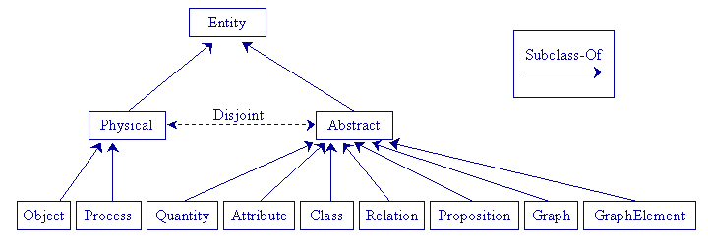
Top-level Ontologies
Top-level Ontologies or Upper-level Ontologies describe very general concepts and
provide general notions under which all root terms in existing ontologies should be linked.
Top-level ontologies of universals and particulars (http://webode.dia.fi.upm.es/)
Sowa’s top-level ontology (http://www.jfsowa.com/ontology/toplevel.htm)
Cyc’s upper ontology
(http://www.cyc.com/cyc-2-1/cover.html)
The Standard Upper Ontology (SUO)
(http://suo.ieee.org/)
Guarino N, Welty C (2000) A Formal Ontology of Properties. In: Dieng R, Corby O (eds) 12th International Conference in Knowledge Engineering and Knowledge Management (EKAW’00). Juan-Les-Pins, France. (Lecture Notes in Artificial Intelligence LNAI 1937) Springer-Verlag, Berlin, Germany, pp 97–112
Gangemi A, Guarino N, Oltramari A (2001) Conceptual analysis of lexical taxonomies: the case of Wordnet top-level. In: Smith B, Welty C (eds) International Conference on Formal Ontology in Information Systems (FOIS'01). Ogunquit, Maine. ACM Press, New York, pp 3–15
Sowa JF (1999) Knowledge Representation: Logical, Philosophical, and Computational Foundations. Brooks Cole Publishing Co., Pacific Grove, California
Lenat DB, Guha RV (1990) Building Large Knowledge-based Systems: Representation and Inference in the Cyc Project. Addison-Wesley, Boston, Massachusetts
Pease RA, Niles I (2002) IEEE Standard Upper Ontology: A Progress Report. The Knowledge Engineering Review 17(1):65–70

Slide 56
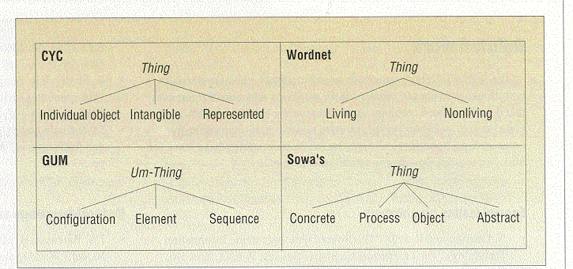
One Unique Top-Level Ontology?
Various proposals

Slide 57
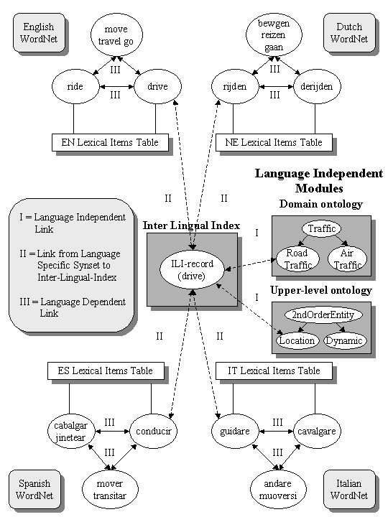
Linguistic Ontologies
WordNet (http://www.hum.uva.nl/~ewn/gwa.htm)
EuroWordNet (http://www.hum.uva.nl/~ewn/)
The Generalized Upper Model
(http://www.darmstadt.gmd.de/publish/komet/gen-um/newUM.html)
The Mikrokosmos ontology (http://crl.nmsu.edu/mikro [user and password are required])
SENSUS (http://www.isi.edu/natural-language/projects/ONTOLOGIES.html)
Miller GA (1995) WordNet: a lexical database for English. Communications of the ACM 38(11):39–41
Miller GA, Beckwith R, Fellbaum C, Gross D, Miller K (1990) Introduction to WordNet: An on-line lexical database. International Journal of Lexicography 3(4):235–244
Vossen P (ed) (1999) EuroWordNet General Document. Version 3. http://www.hum.uva.nl/ewn/
Vossen P (ed) (1998) EuroWordNet: A Multilingual Database with Lexical Semantic Networks. Kluwer Academic Publishers, Dordrecht, The Netherlands
Bateman JA, Fabris G, Magnini B (1995) The Generalized Upper Model Knowledge Base: Organization and Use. In: Mars N (ed) Second International Conference on Building and Sharing of Very Large-Scale Knowledge Bases (KBKS '95). University of Twente, Enschede, The Netherlands. IOS Press, Amsterdam, The Netherlands, pp 60–72
Mahesh K (1996) Ontology development for machine translation: Ideology and Methodology. Technical Report MCCS-96-292. Computing Research Laboratory, New Mexico State University, Las Cruces, New Mexico. http://citeseer.nj.nec.com/mahesh96ontology.html
Mahesh K, Nirenburg S (1995) Semantic classification for practical natural language processing. In: Schwartz RP, Kwasnik BH, Beghtol C, Smith PJ, Jacob E (eds) 6th ASIS SIG/CR Classification Research Workshop: An Interdisciplinary Meeting. Chicago, Illinois, pp 79–94
Swartout B, Ramesh P, Knight K, Russ T (1997) Toward Distributed Use of Large-Scale Ontologies. In: Farquhar A, Gruninger M, Gómez-Pérez A, Uschold M, van der Vet P (eds) AAAI’97 Spring Symposium on Ontological Engineering. Stanford University, California, pp 138–148

Slide 58
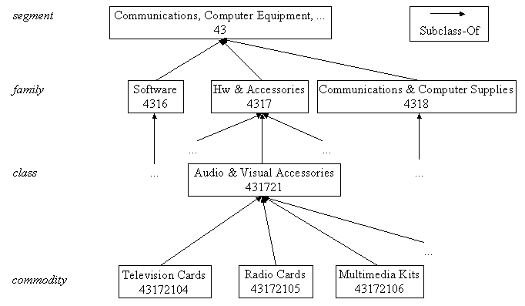
Domain Ontologies: e-Commerce Ontologies
The United Nations Standard Products and Services Codes (UNSPSC)
(http://www.unspsc.org/)
NAICS (North American Industry Classification System)
(http://www.census.gov/epcd/www/naics.html)
SCTG (Standard Classification of Transported Goods)
(http://www.statcan.ca/english/Subjects/Standard/sctg/sctg-menu.htm)
E-cl@ss
(http://www.eclass.de/)
RosettaNet
(http://www.rosettanet.org)

Slide 59
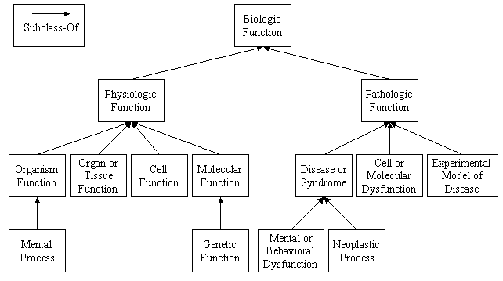
Domain Ontologies: Medical Ontologies
GALEN http://www.co-ode.org/galen/
UMLS (Unified Medical Language System)
(http://www.nih.gov/research/umls/)
ON9 (http://saussure.irmkant.rm.cnr.it/ON9/index.html)
Rector AL, Bechhofer S, Goble CA, Horrocks I, Nowlan WA, Solomon WD (1997) The GRAIL concept modelling language for medical terminology. Artificial Intelligence in Medicine 9:139–171
Gangemi A, Pisanelli DM, Steve G (1998) Some Requirements and Experiences in Engineering Terminological Ontologies over the WWW. In: Gaines BR, Musen MA (eds) 11th International Workshop on Knowledge Acquisition, Modeling and Management (KAW'98). Banff, Canada, SHARE10:1–20

Slide 60
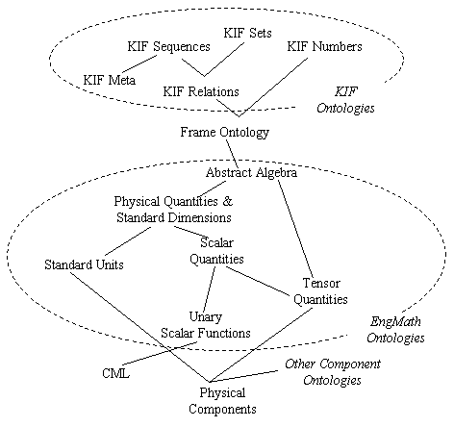
Domain Ontologies: Engineering Ontologies
EngMath
PhysSys
Gruber TR, Olsen G (1994) An ontology for Engineering Mathematics. In: Doyle J, Torasso P, Sandewall E (eds) Fourth International Conference on Principles of Knowledge Representation and Reasoning. Bonn, Germany. Morgan Kaufmann Publishers, San Francisco, California, pp 258–269
Borst WN (1997) Construction of Engineering Ontologies. Centre for Telematica and Information Technology, University of Tweenty. Enschede, The Netherlands

Slide 61
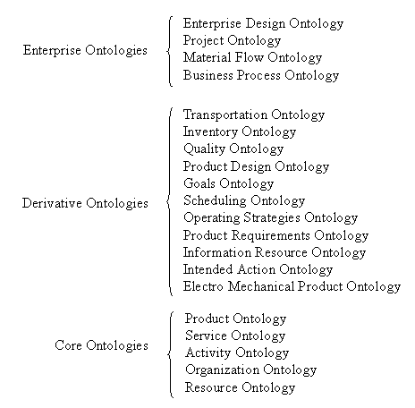
Domain Ontologies: Enterprise Ontologies
Enterprise Ontology (http://www.aiai.ed.ac.uk/~entprise/enterprise/ontology.html)
TOVE (http://www.eil.utoronto.ca/tove/toveont.html)
Uschold M, King M, Moralee S, Zorgios Y (1998) The Enterprise Ontology. The Knowledge Engineering Review 13(1):31–89
Fox MS (1992) The TOVE Project: A Common-sense Model of the Enterprise. In: Belli F, Radermacher FJ (eds) Industrial and Engineering Applications of Artificial Intelligence and Expert Systems. (Lecture Notes in Artificial Intelligence LNAI 604) Springer-Verlag, Berlin, Germany, pp 25–34

Slide 62
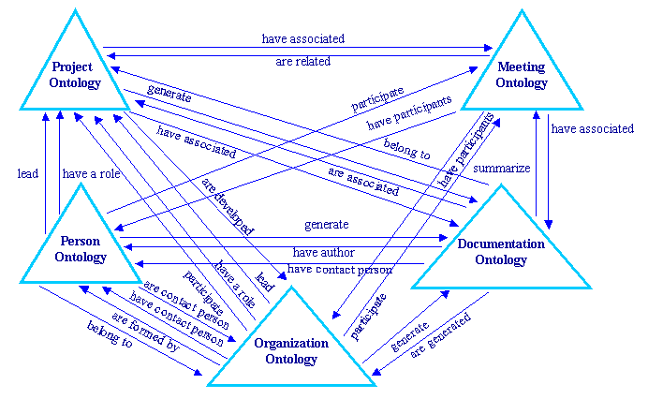
Domain Ontologies: Knowledge Management Ontologies
(KA)² ontologies (http://ka2portal.aifb.uni-karlsruhe.de)
R&D projects (http://www.esperonto.net/)
Decker S, Erdmann M, Fensel D, Studer R (1999) Ontobroker: Ontology Based Access to Distributed and Semi-Structured Information. In: Meersman R, Tari Z, Stevens S (eds) Semantic Issues in Multimedia Systems (DS-8), Rotorua, New Zealand. Kluwer Academic Publisher, Boston, Massachusetts. pp 351–369

Slide 63
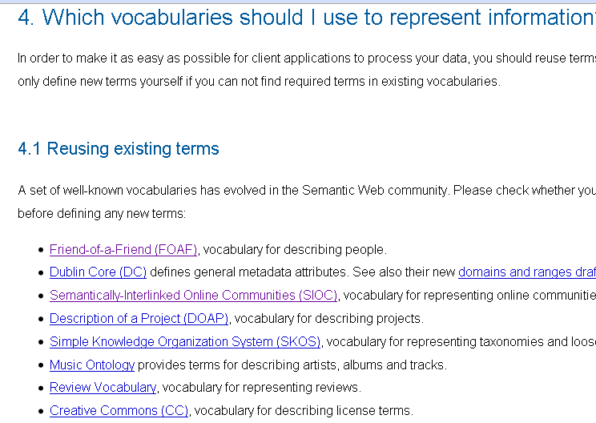

Linked data ontologies
http://www4.wiwiss.fu-berlin.de/bizer/pub/LinkedDataTutorial/#whichvocabs
This is not enough

Slide 64
Linked data ontologies
Features
  Lightweight :
    Taxonomies and a few properties
  Consensuated vocabularies
    To avoid the mapping problems
  Multilingual
    Linked data are multilingual
The NeOn methodology can help to
  Re-enginer Non ontological resources into ontologies
    Pros: use domain terminology already consensuated by domain experts
  Withdraw in heavyweight ontologies those features that you don’t need
  Reuse existing vocabularies

Slide 65
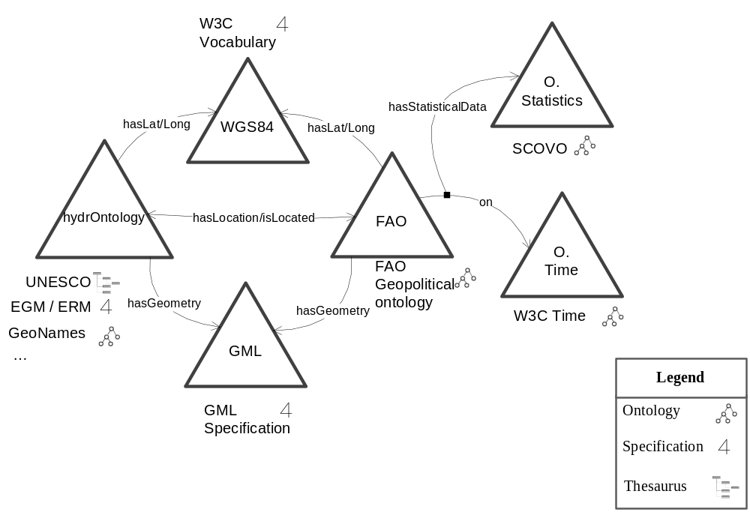




Geolinked data ontologies
WGS84 Geo Positioning: an RDF vocabulary
scv:Dimension
scv:Item
scv:Dataset
hydrographical phenomena (rivers, lakes, etc.)
Vocabulary for instants, intervals, durations, etc.
Names and international code systems for territories and groups
Ontology for OGC Geography Markup Language
Classes | 33 | 33
Object Properties | 44 | 44
Data Properties | 318 | 318
reused
Following the INSPIRE
(INfrastructure for SPatial InfoRmation in Europe) recommendation.
hydrOntology,SCOVO, FAO Geopolitcal, WGS84, GML, and Time

Slide 66
What is an Ontology?
Shared understanding of a domain
Repository of vocabulary
Formal definitions
Informal definitions

