Slide 1
IBM-SUR Award
Ontology Engineering Group
Universidad Politécnica de Madrid

Slide 2
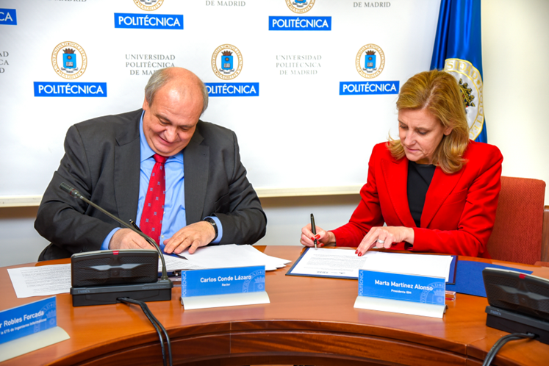
Project
“Application of the IBM Watson ecosystem for providing technology intelligence services to small and medium enterprises”
IBM Shared University Research Award
Started on 01/12/2015. As of 09/2016 in its second phase

