Slide 1


AEMPS-OEG. Adverse reaction identification in drug fact sheets
Asunción Gómez Pérez, Raúl García Castro, Guadalupe Aguado de Cea , Pablo Calleja Ibáñez
asun@fi.upm.es
rgarcia@fi.upm.es
lupe@fi.upm.es
pcalleja@fi.upm.es
Facultad de Informática
Universidad Politécnica de Madrid
Campus de Montegancedo s/n
28660 Boadilla del Monte, Madrid, Spain
Date: 19. September 2015

Slide 2
Index
Project target
Challenges
General overview
Corpus extraction
Entity recognition
Mapping
Evaluation
The drug fact sheet ontology

Slide 3
1. Project target
1- Drug Name
Sycrest 5 mg
Drug fact sheet
2- Composition
Each sublingual dose contains 5mg
Official document of the drug with the essential information
Oriented to specialist
Common structure format
In Natural Language
3- Administration
Sublingual dose
4- Therapeutic information
Sycrest is indicated for the maniac episodes treatment
5- Posology
Twice per day (morning and night)
6- Adverse reactions
The most frequent adverse reactions are somnolence and anxiety
Project Target
Identification of adverse reactions to automatize pharmacological surveillance processes over the population
………………………………………………………….
Drug fact sheet of Sycrest 5 mg

Slide 4


2. Challenges
Named Entity recognition
Entity mapping
Disease identification based on lexical-syntactic patterns and dictionaries
Patterns are dependent of the semantic value of the disease (adverse reaction)
Homogeneous term search on terminologies or dictionaries
Unique representation for a disease
Algorithm to provide best candidates without false positives
1- Drug Name
Sycrest 5 mg
4- Therapeutic information
Sycrest is indicated for the maniac episodes treatment
MedDRA Dictionary
6- Adverse reactions
The most frequent adverse reactions are somnolence and anxiety
Mapping
6- Adverse reactions
The most frequent adverse reactions are somnolence and anxiety
Medical Dictionary for Regulatory Activities
Drug fact sheet of Sycrest 5 mg

Slide 5




3. General overview
Drug fact sheets
Phase 0:
Corpus extraction
Sycrest 5 mg.
Se observaron aumentos de los niveles de prolactina en algunos pacientes tratados con Sycrest.
Adverse reactions
corpus
Frecuentes | Raras
Ansiedad | -
- | Neutropenia
MedDRA: 10002855
Ansiedad
Lexical-syntactic patterns
Phase 1:
Entity recognition
MedDRA: 10029354
Neutropenia
MedDRA
dictionary
Recognized diseases in corpus
Phase 2:
Mapping to MedDRA
Synonyms
MedDRA: 10005780
Prolactina aumentada
Recognized diseases
with their MedDRA concept in corpus

Slide 6
3. General overview- Evaluation
Drug fact sheets
Phase 0:
Corpus extraction
Drug fact sheet
corpus
Lexical-syntactic patterns
Phase 1:
Entity recognition
AEMPS Gold Standard
Annotated drug fact sheets
MedDRA
dictionary
Recognized diseases
Evaluation 1
Phase 2:
Mapping to MedDRA
Synonyms
AEMPS Gold Standard
Mapping Terms
Recognized diseases
with their MedDRA concept
Evaluation 2

Slide 7
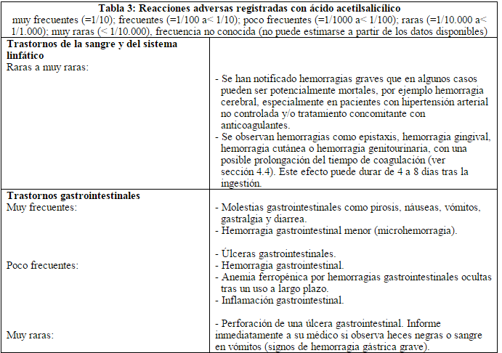
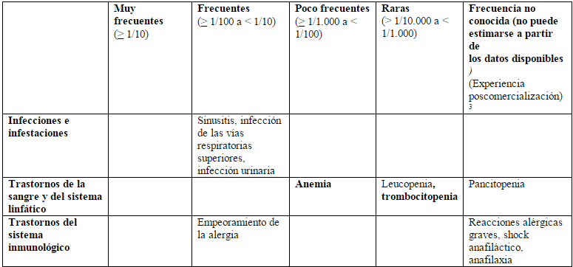
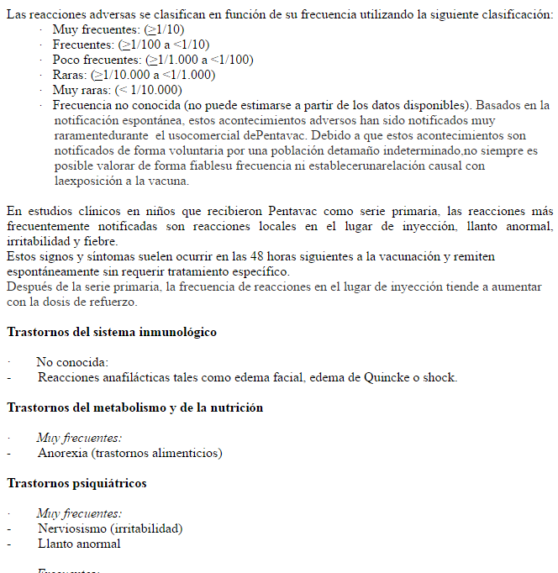
Phase 0. Corpus extraction
Drug fact sheets
Phase 0:
Corpus extraction
Adverse reactions
corpus
Adverse reaction example 2
Adverse reaction example 2
Adverse reaction example 3

Slide 8

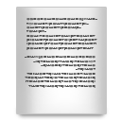
Phase 0. Corpus extraction
Information Segments: Minimal division of information
The corpus is created by information segments
Table cells
Information segments
Corpus of information segments
Paragraphs
Information segments

Slide 9
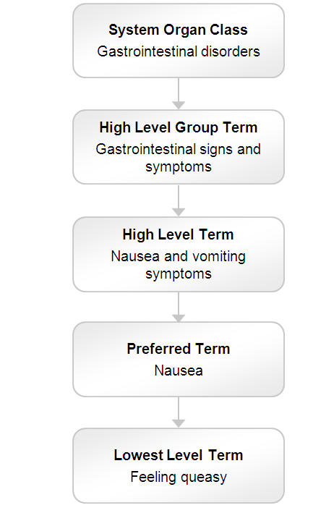
Phase 1. Entity recognition
Adverse reactions
corpus
Lexical-syntactic patterns
Phase 1:
Entity recognition
MedDRA
dictionary
Recognized diseases in corpus
MedDRA:
Used as a gazetteer list
Prefered terms and Lower Level terms are taken
MedDRA Hierarchy

Slide 10


Phase 1. Entity recognition
Patterns
Patterns example
Aumento de +
Incremento de +
Disminución +
Trastornos +
….
To identify adverse reactions
Affixes are used to detect diseases (Hiper_, _Itis)
Antipatterns
Patterns that identify a therapeutic indication diasease
Gate architecture
Tokeniser
Sentence Splitter
POS Tagger
Gazetteer
(MedDRA)
JAPE
Rules:
Patterns
Antipatterns
Information segment
Notes:
Se anota la frase para no extraer las enfermedades identificadas.
Ej. Pacientes con, tratamiento de, ensayos clínicos de, etc.
REVISAR ESTA

Slide 11
Phase 2. Mapping to MedDRA
Recognized diseases in corpus
Phase 2 has two process:
Term expansion with synonyms.
Mapping algorithm with MedDRA
MedDRA
dictionary
Phase 2:
Mapping to MedDRA
Synonyms
Recognized diseases
with their MedDRA concept in corpus
Synonyms
aumentado | incremento | elevado | alto | incrementado
disminuida | descenso | disminución | bajo | pérdida
cambio | fluctuación | alteración | anormalidad | anormal

Slide 12
Phase 2. Mapping to MedDRA
Term expansion
Classification of words
All the possible combinations in which the adverse reaction can appear are generated
The combinations are based on synonyms of words
Key words (Nouns)
Others
Original combination (C1)
Synonyms combination 3 (C3)
incrementos
colesterol
sangre
colesterol
elevado
sangre
Use of synonyms
Use of synonyms
Synonyms combination 1(C2)
Synonyms combination 2 (C4)
colesterol
incrementado
sangre
colesterol
aumentado
sangre
Combinations for “Incrementos del colesterol en sangre”
Notes:
the grammatical number and
Poner ejemplo

Slide 13
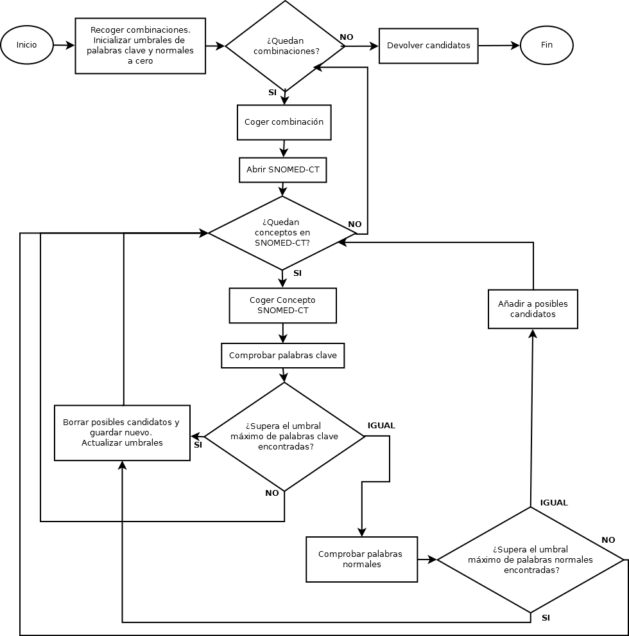
Phase 2. Mapping to MedDRA
Mapping algorithm
The algorithm stores the concepts with more words in common with the combination
Abrir terminología
¿Quedan términos?
Coger término

Slide 14
Mapping example
Incrementos colesterol sangre
Candidate list
Colesterol elevado sangre
Abrir terminología
Key words:
1
0
2
Normal words:
1
¿Quedan términos?
0
10048002 Colesterol disminuido en sangre
100310700 Trastornos del colesterol
10005425-Colesterol elevado en sangre
Coger término
Notes:
Poner ejemplo

Slide 15
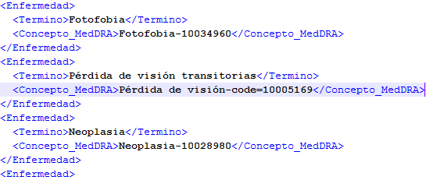
6.2 Publishing results
XML Format
<Id> F00016 </Id>
<Seccion id=4.8 >
<Enfermedad>
<Termino />
<Concepto_Meddra />
</Enfermedad>
<Enfermedad>
<Termino />
<Concepto_Meddra />
</Enfermedad>
</Seccion>
Notes:
Cambiar el formato

Slide 16

7. Evaluation
Gold standard
Drug fact sheets
80 Drug fact sheet with annotated adverse reactions
MedDRA terms provided for the adverse reactions
Phase 0:
Corpus extraction
Drug fact sheet
corpus
Lexical-syntactic patterns
Phase 1:
Entity recognition
AEMPS Gold Standard
Annotated drug fact sheets
MedDRA
dictionary
Recognized diseases
Evaluation 1
Phase 2:
Mapping to MedDRA
Synonyms
AEMPS Gold Standard
Mapping Terms
Recognized diseases
with their MedDRA concept
Evaluation 2

Slide 17

1. Gold Standard del sistema de RA
 | Precision | Recall | F-Measure
Evaluation 1. NER | 89.14 | 85.94 | 87.51
Evaluation 2. Mapping | 84.43 | 85.94 | 85.17
1- Named entity recognition evaluation
Standardization problem
Noise in some MedDRA terms
Hard to improve the results
2- MedDRA mapping evaluation
10.09% of the failure are due to unknown mappings
More synonyms are needed
Notes:
True : 84.43%
Bad : 5.47%
Unk :

Slide 18
8. The drug fact sheet ontology
Farmaceutical form
Composition
Fact Sheet
CIE-10 Concept
Described by
Is presented
Composed by
Has CIE-10 mapping
Has adverse reaction
Drug
Disorder
Overdose
Not indicated with
Overdose in
Indicated with
Has SNOMED-CT
mapping
Has effect
Administrated by
Has MedDRA
mapping
Administration
MedDRA
concept
SNOMED-CT
concepto
Effect
Has interaction
Interacts with
Interaction
Has risk
Risk

Slide 19
8. The drug fact sheet ontology core
Fact Sheet
Described by
Has adverse reaction
Drug
Disorder
Indicated with
Has SNOMED-CT
mapping
Has MedDRA
mapping
MedDRA
concept
SNOMED-CT
concept
F00015
Tiene mapeo
con MedDRA
Produce reacción adversa
Angioedema
10002424-Angioedema
Descrito por
Candesartán
16 mg EFG
Tiene mapeo
con MedDRA
Incrementos del colesterol
10005425-Colesterol elevado en sangre
Produce reacción adversa

Slide 20
AEMPS-OEG. Adverse reaction identification in drug fact sheets
Asunción Gómez Pérez, Raúl García Castro, Guadalupe Aguado de Cea , Pablo Calleja Ibáñez
asun@fi.upm.es
rgarcia@fi.upm.es
lupe@fi.upm.es
pcalleja@fi.upm.es
Facultad de Informática
Universidad Politécnica de Madrid
Campus de Montegancedo s/n
28660 Boadilla del Monte, Madrid, Spain
Date: 19. September 2015

