Slide 1
Medical domain
Asunción Gómez Pérez
asun@fi.upm.es
ETSI Informaticos
Universidad Politécnica de Madrid
Campus de Montegancedo s/n
28660 Boadilla del Monte, Madrid, Spain

Slide 2



Medical domain
2009
Development of the Ontology Network Specification Requirements and Conceptualization
Identification of diseases for which the drug is prescribed in order to obtain more control over the national demand
2014
Identification of adverse reactions to automatize pharmacological surveillance processes over the population
2015

Slide 3
Collaboration with World Health Organization
ICPS: International Classification for Patient Safety
To transform the ICPS into an ontology network
From ontology specification to implementation
Specific domains:
Falls
Pressure ulcer
Reuse:
Ontological resources
Non-Ontological resources
No public results

Slide 4
Domains and resources analysis

Slide 5
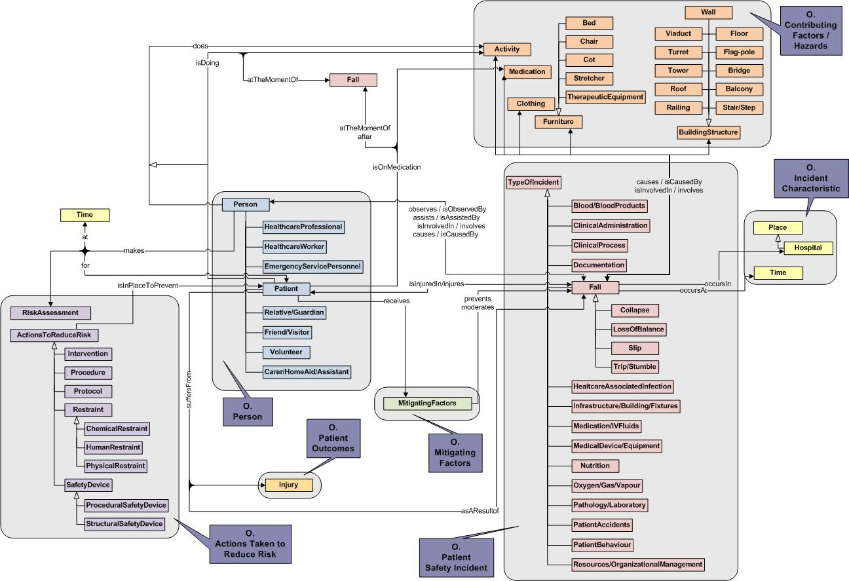
High level conceptual model

Slide 6
Input (Project 1 and 2)
Drug fact sheet
Official document of the drug with the essential information
In Natural Language
No common format
Project 1 focuses on the identification of diseases for which the drug is prescribed
Drug Name
Asenapina
Therapeutical information
For patients with schizophrenia.
Adverse reactions
May produce headaches.
Project 2 focuses on the identification of of adverse reactions
………………………………………………………….
Drug fact sheet of Asenapina

Slide 7



Performed tasks
Natural Language Processing
Mapping
Disease identification based on lexical-syntactic patterns and dictionaries
Patterns are dependent of the semantic value of the disease (Prescribed for or adverse reaction)
Homogeneous term search on terminologies or dictionaries
Unique representation for a disease
Algorithms to provide best candidates without false positives
Drug Name
Asenapina
Therapeutical information
For patients with schizophrenia.
SNOMED-CT
Therapeutical information
For patients with schizophrenia.
Mapping
Systematized Nomenclature of Medicine – Clinical Terms
Adverse reactions
May produce headaches.
Adverse reactions
May produce headaches.
Mapping
MedDRA Dictionary
………………………………………………………….
Drug fact sheet of Asenapina
Medical Dictionary for Regulatory Activities

