Slide 1
Data-driven Language Technologies
Jorge Gracia, Elena Montiel-Ponsoda, and Víctor Rodríguez-Doncel
(on behalf of the DDLT group)
Ontology Engineering Group
http://www.oeg-upm.net
Universidad Politécnica de Madrid

Slide 2
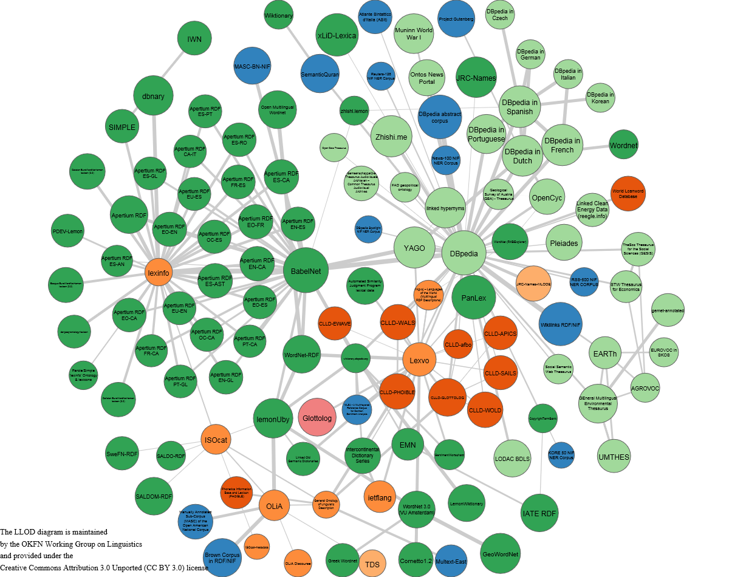
Data-driven Language Technologies
Data-driven Language Technologies
Models, guidelines, tools and resources for the Multilingual Web of Data
Multilingual ontologies and linked data
Linguistic linked data
Lexicographic resources
Terminological resources
Ontology Localization
Guided question aswering
Cross-lingual linking
NLP applications
Term extraction
Named entity recognition
Opinion mining
Word sense disambiguation
Cognitive computing
Natural language generation

Slide 3

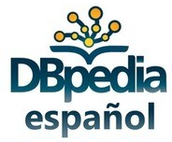








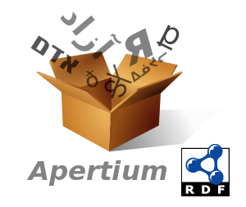
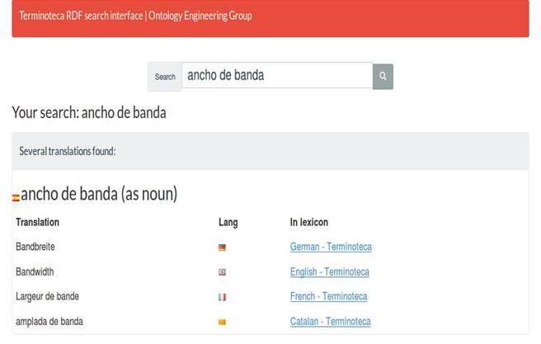
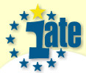
Multilingual Ontologies and Linked Data
2006
2008
2007
2010
2009
2012
2011
2013
2014
2015
2016
2017
LIR
v
Ontolex
LabelTranslator
Lemonade
interQA
Guidelines for Ontology Localization
Guidelines for Multilingual Linked Data
Multilingual Lexico-syntactic patterns
Tools
Models
Guidelines
Resources

Slide 4





NLP Applications
1998-2001
2015
2016
2014
2007
…
2013
2002
…
2008
2017
WSD
OntoTagger
Sentiment
Analysis
IBM Watson
(Technology Watch)
ONTOGENERATION
BaDELE3000
Calíope
OntolingAnnot
ontologies
Semantic Annotation of Medical Texts
Tools
Models
Guidelines
Resources

Slide 5



Main standardisation activities
BPMLOD: Best Practices for Multilingual Linked Open Data community group
ONTOLEX: Ontology Lexica community group
LD4LT: Linked Data for Language Technologies Community Group
OWLG: Working Group on Open Data in Linguistics
ISO/TC 37/SC 3 Systems to manage terminology, knowledge and content
ISO/TC 37/SC 4 Language resource management

