Slide 1
Ontological Engineering
Asunción Gómez Pérez
asun@fi.upm.es
ETSI Informaticos
Universidad Politécnica de Madrid
Campus de Montegancedo s/n
28660 Boadilla del Monte, Madrid, Spain

Slide 2
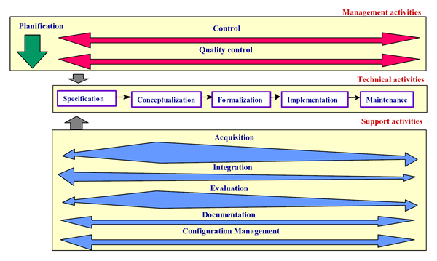
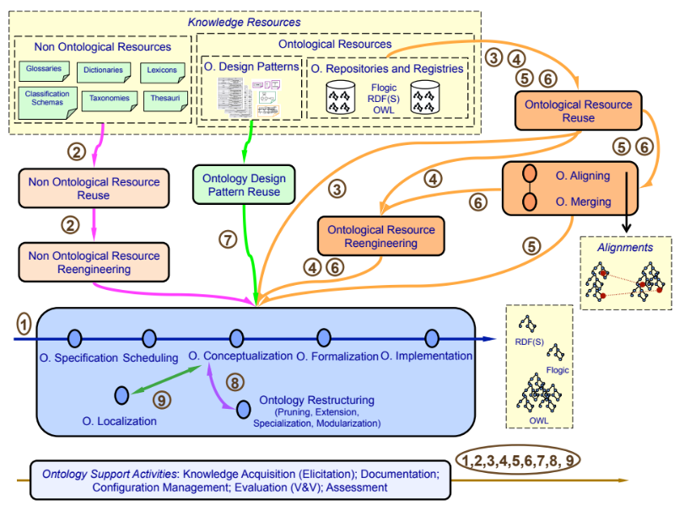
Methodologies
METHONTOLOGY (1997)
METHONTOLOGY and NeOn methodologies for building Networks of Ontologies
  Scheduling
  Requirement Specification
  Reuse
  Non Ontological Resource Reuse and Reengineering
  Localization
  Mapping
  Ontology Design Patterns
  Change Propagation
NeOn (2010)
Ontology Engineering Group

Slide 3
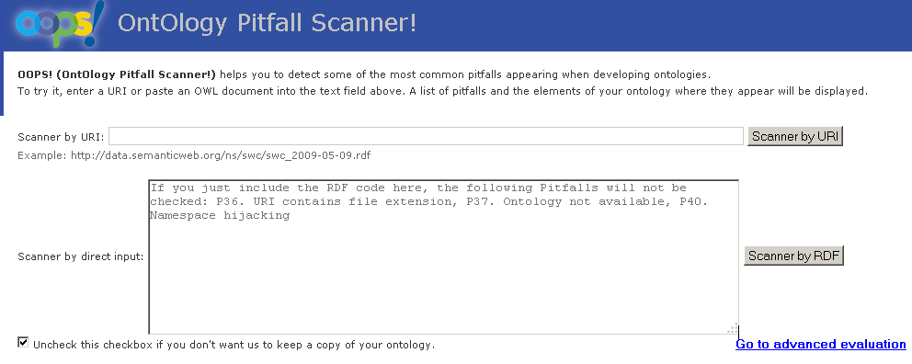

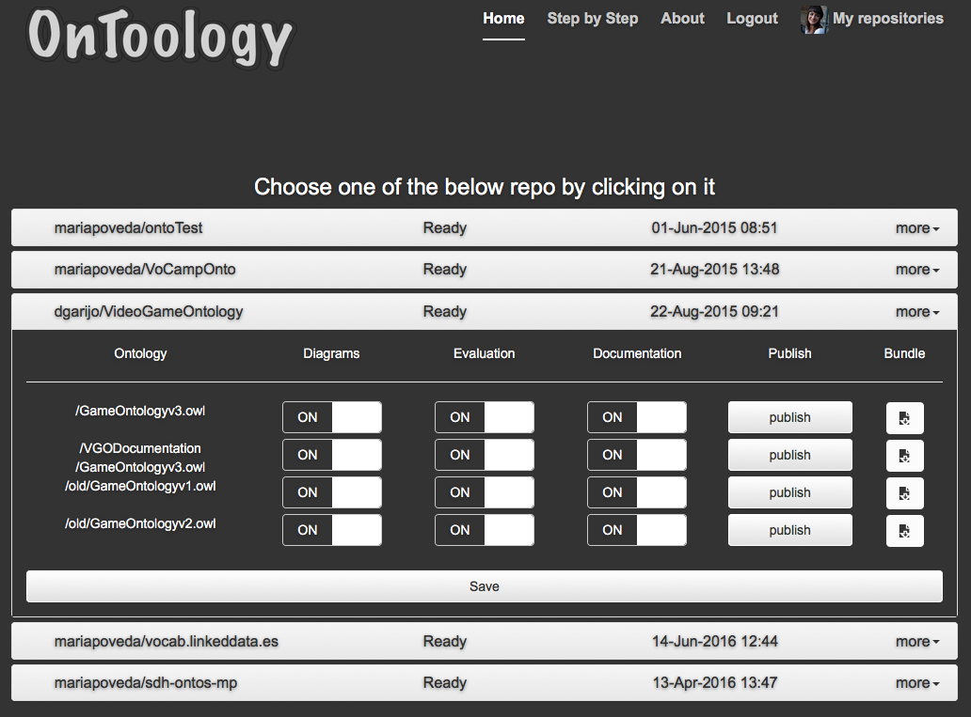


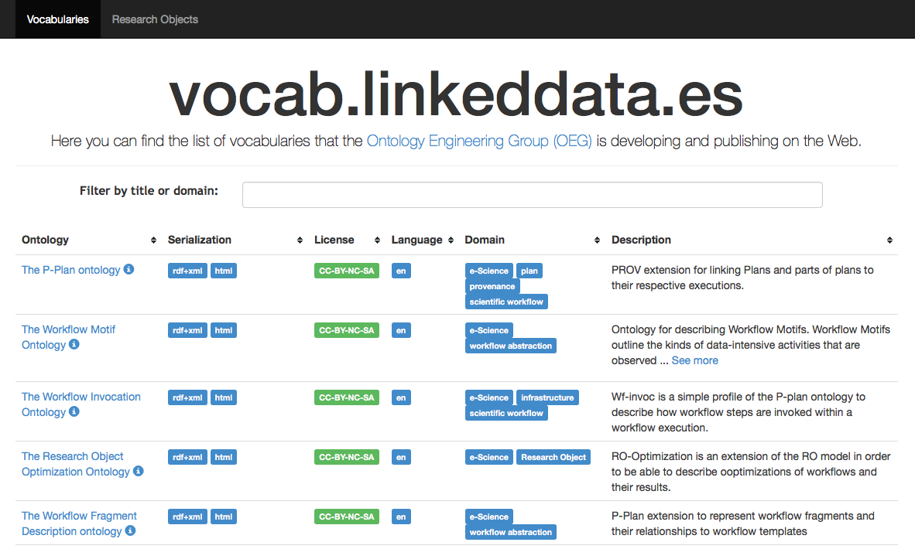

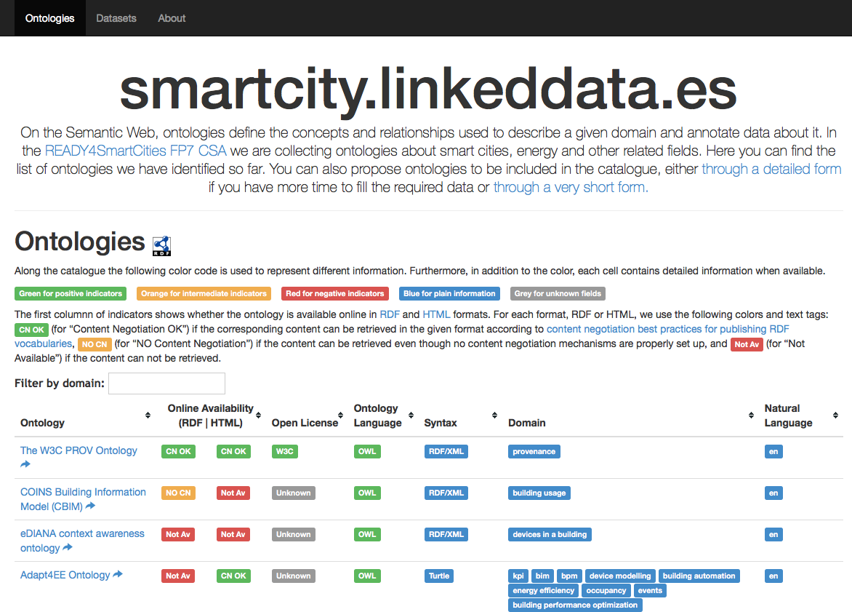
Tooling
Ontology evaluation
  OOPS! OntOlogy Pitfall Scanner http://oops.linkeddata.es/
Vocabulary documentation
  HTML: Widoco https://github.com/dgarijo/Widoco/
  Diagrams: AR2DTool http://ar2dtool.linkeddata.es/
  Vocabulary distributed development
  OnToology http://ontoology.linkeddata.es/
  Vocabulary registry
    OEG vocabularies http://vocab.linkeddata.es/
    Smart Cities http://smartcity.linkeddata.es/
Ontology Engineering Group

Slide 4
URLs
vocab.linkeddata.es
    URL: http://vocab.linkeddata.es/
    GitHub: https://github.com/mariapoveda/vocab.linkeddata.es/
vocabLite
  GitHub: https://github.com/dgarijo/vocabLite
OnToology
  URL: http://ontoology.linkeddata.es
  GitHub: https://github.com/OnToology/OnToology/
AR2DTool
  URL: http://ar2dtool.linkeddata.es/
  GitHub: https://github.com/idafensp/ar2dtool
Widoco
  Github: https://github.com/dgarijo/Widoco/
OOPS!
  Web application: http://oops.linkeddata.es/
  Web service: http://oops-ws.oeg-upm.net/
Vocabularium
  GitHub: https://github.com/SmartDeveloperHub/sdh-vocabulary/tree/feature/publisher
Notes:
Additional links to software and applications.

