Slide 1

DrInventor
promoting scientific creativity
Oscar Corcho <ocorcho@fi.upm.es>
Carlos Badenes <cbadenes@fi.upm.es>
Ontology Engineering Group
Universidad Politécnica de Madrid
2016
ICT-2013.8.1 611383

Slide 2
Corpus
ACM Siggraph Conference Papers
1.492 papers 83.453 words 576 terms 7 topics

Slide 3
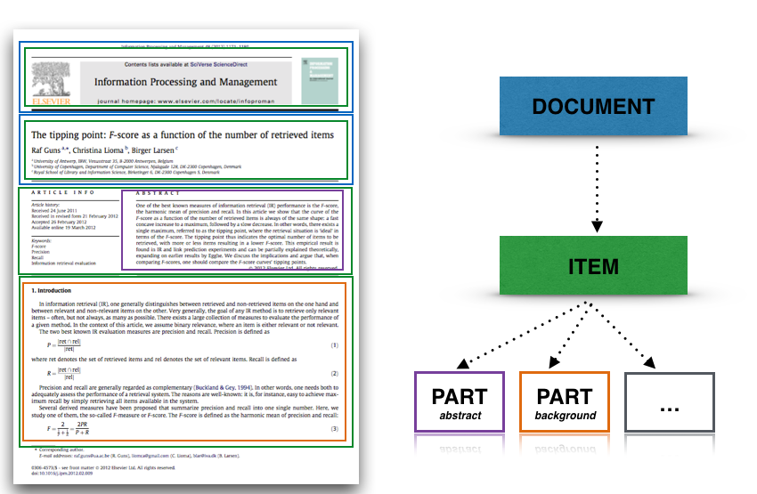
Content-based Indexing
challenge
background
approach
outcome
future work
Identification and composition of inner parts of a document:

Slide 4


Reading path based on similar documents/parts
START
Ziwei Liu, Lu Yuan, Xiaoou Tang, Matt Uyttendaele, and Jian Sun. 2014.
“Fast burst images denoising”
ACM Trans. Graph. 33, 6, Article 232 (November 2014), 9 pages
0.714
Jongmin Baek, Dawid Pająk, Kihwan Kim, Kari Pulli, and Marc Levoy. 2013.
“WYSIWYG computational photography via viewfinder editing”
ACM Trans. Graph. 32, 6, Article 198 (November 2013), 10 pages
0.763
Vivek Kwatra, Arno Schödl, Irfan Essa, Greg Turk, and Aaron Bobick. 2003.
“Graphcut textures: image and video synthesis using graph cuts”
ACM Trans. Graph. 22, 3 (July 2003), 277-286
0.705
Christian Schulz, Christoph von Tycowicz, Hans-Peter Seidel, and Klaus Hildebrandt. 2014.
“Animating deformable objects using sparse spacetime constraints”
ACM Trans. Graph. 33, 4, Article 109 (July 2014), 10 pages
END

Slide 5
similar documents/parts based on topic distribution
Ondrej Stava, Juraj Vanek, Bedrich Benes, Nathan Carr, and Radomír Měch. 2012
“Stress relief: improving structural strength of 3D printable objects”.
ACM Trans. Graph. 31, 4, Article 48 (July 2012), 11 pages.
Karthik Raveendran, Chris Wojtan, Nils Thuerey, and Greg Turk. 2014.
“Blending liquids”.
ACM Trans. Graph. 33, 4, Article 137 (July 2014), 10 pages.
0.95
Jongmin Kim, Yeongho Seol, Taesoo Kwon, and Jehee Lee. 2014
“Interactive manipulation of large-scale crowd
animation”.
ACM Trans. Graph. 33, 4, Article 83 (July 2014), 10 pages
0.99
Bernhard Thomaszewski, Stelian Coros, Damien Gauge, Vittorio Megaro,
Eitan Grinspun, and Markus Gross. 2014
“Computational design of
linkage-based characters”.
ACM Trans. Graph. 33, 4, Article 64 (July 2014), 9 pages.
0.97
……

Slide 6

documents/parts matching given a text
challenge part of paper: “The Cartoon Animation Filter”
0.757
“animation”
challenge part of paper: “Synchronized Multi-Character Motion Editing"
0.743
……
0.271
Jue Wang, Steven M. Drucker, Maneesh Agrawala,
and Michael F. Cohen. 2006
“The Cartoon Animation Filter”.
ACM Trans. Graph. 25, 3 (July 2006), 1169-1173

Slide 7
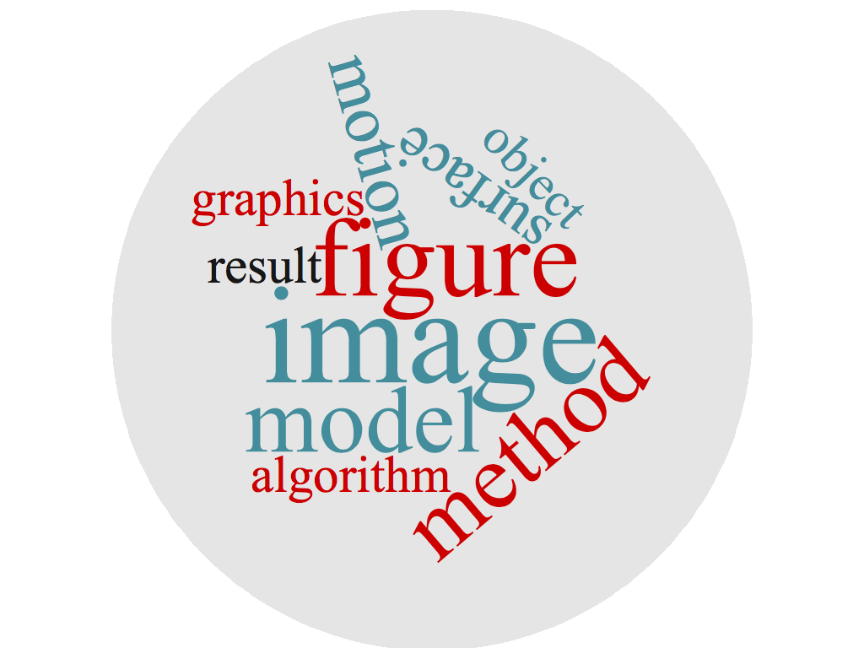
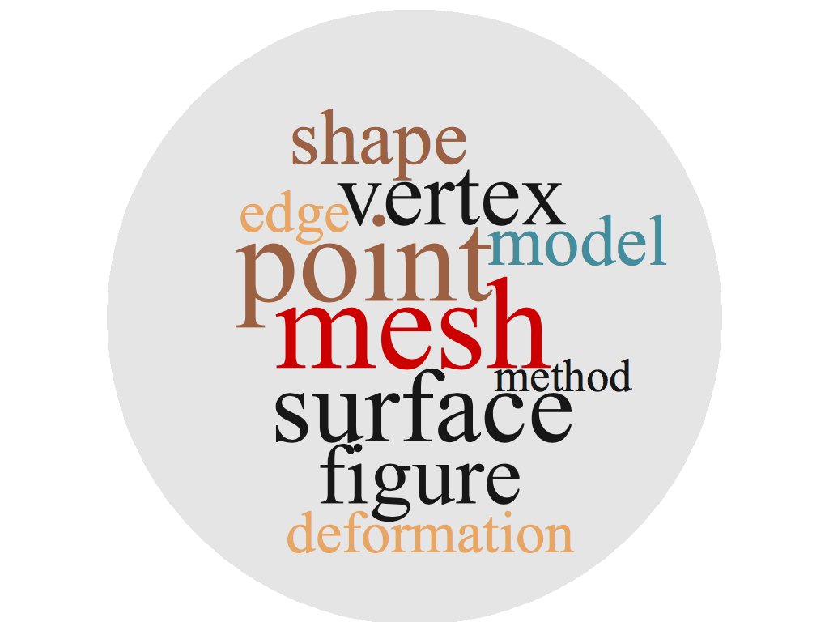
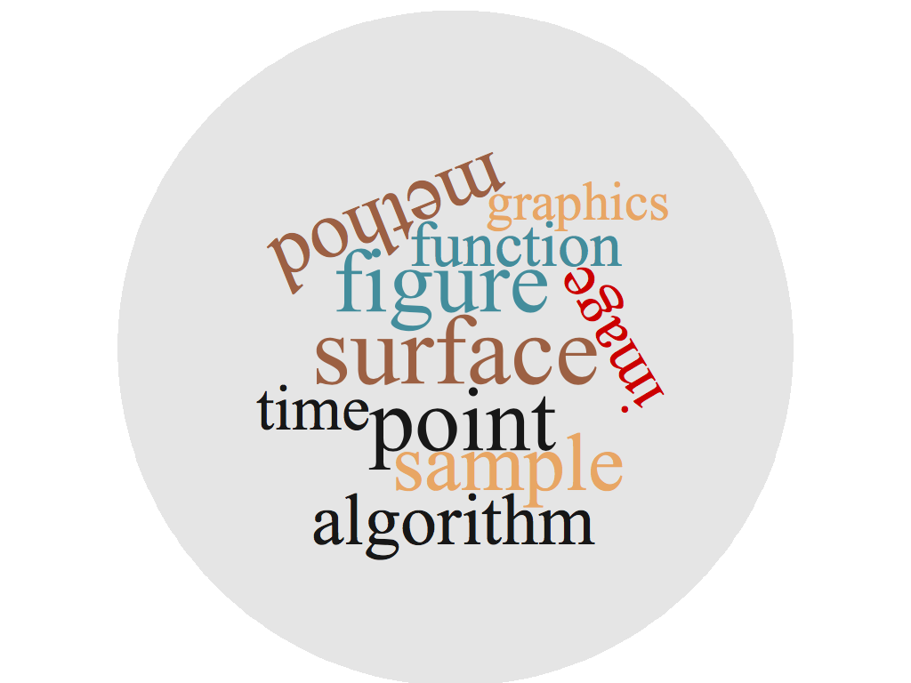
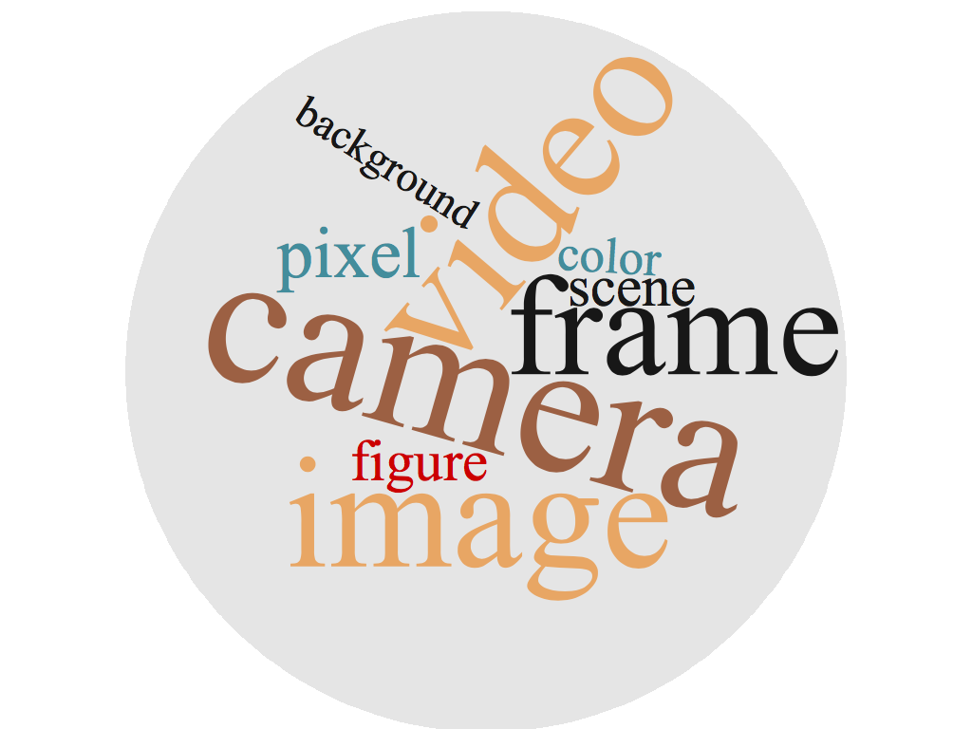
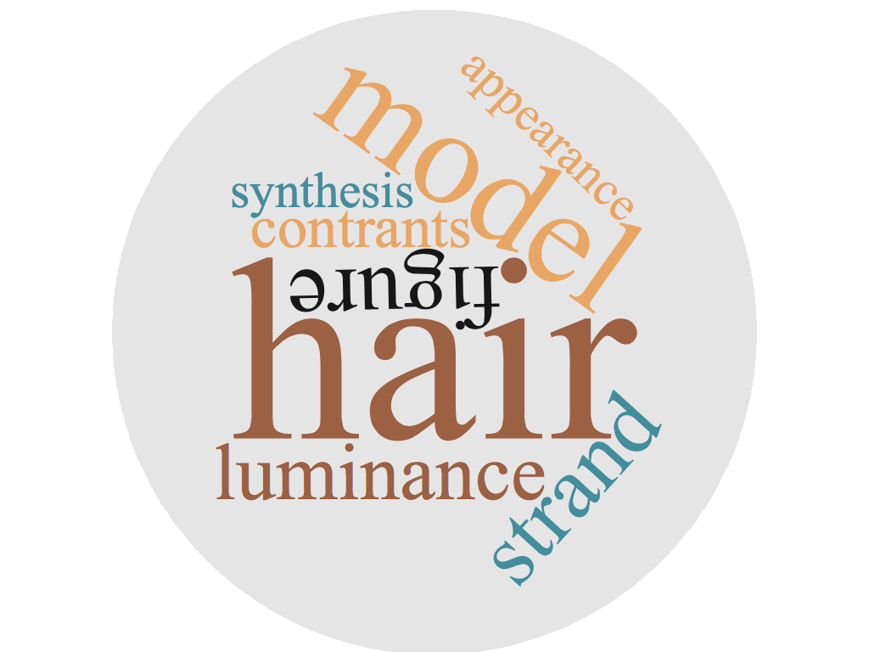
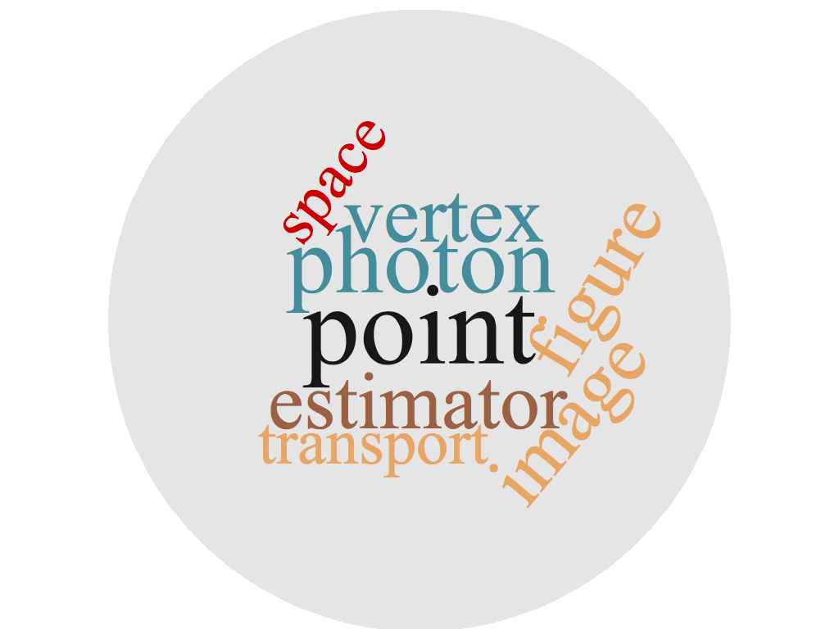
temporal evolution of research areas
2014
2015
2016

