Slide 1

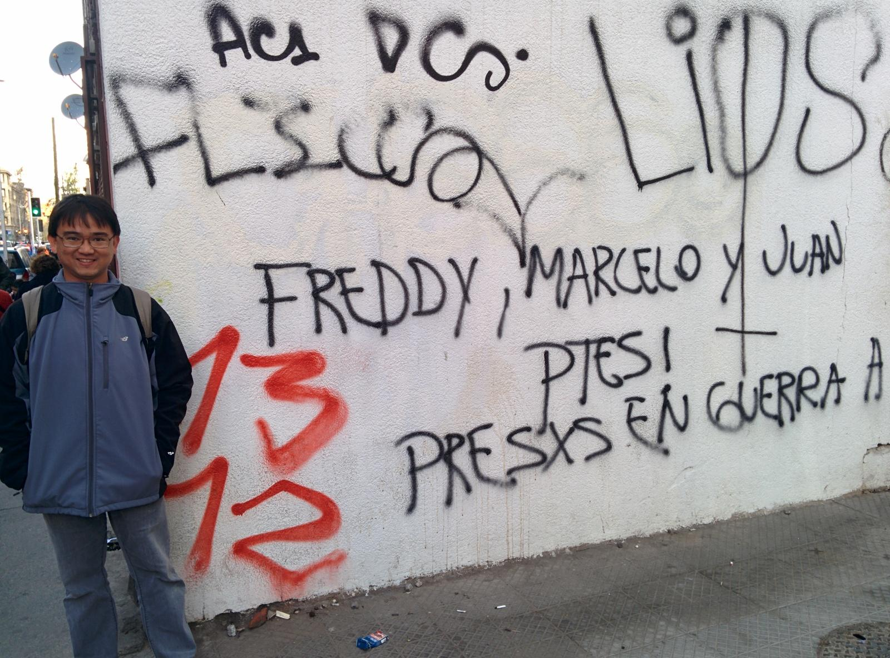
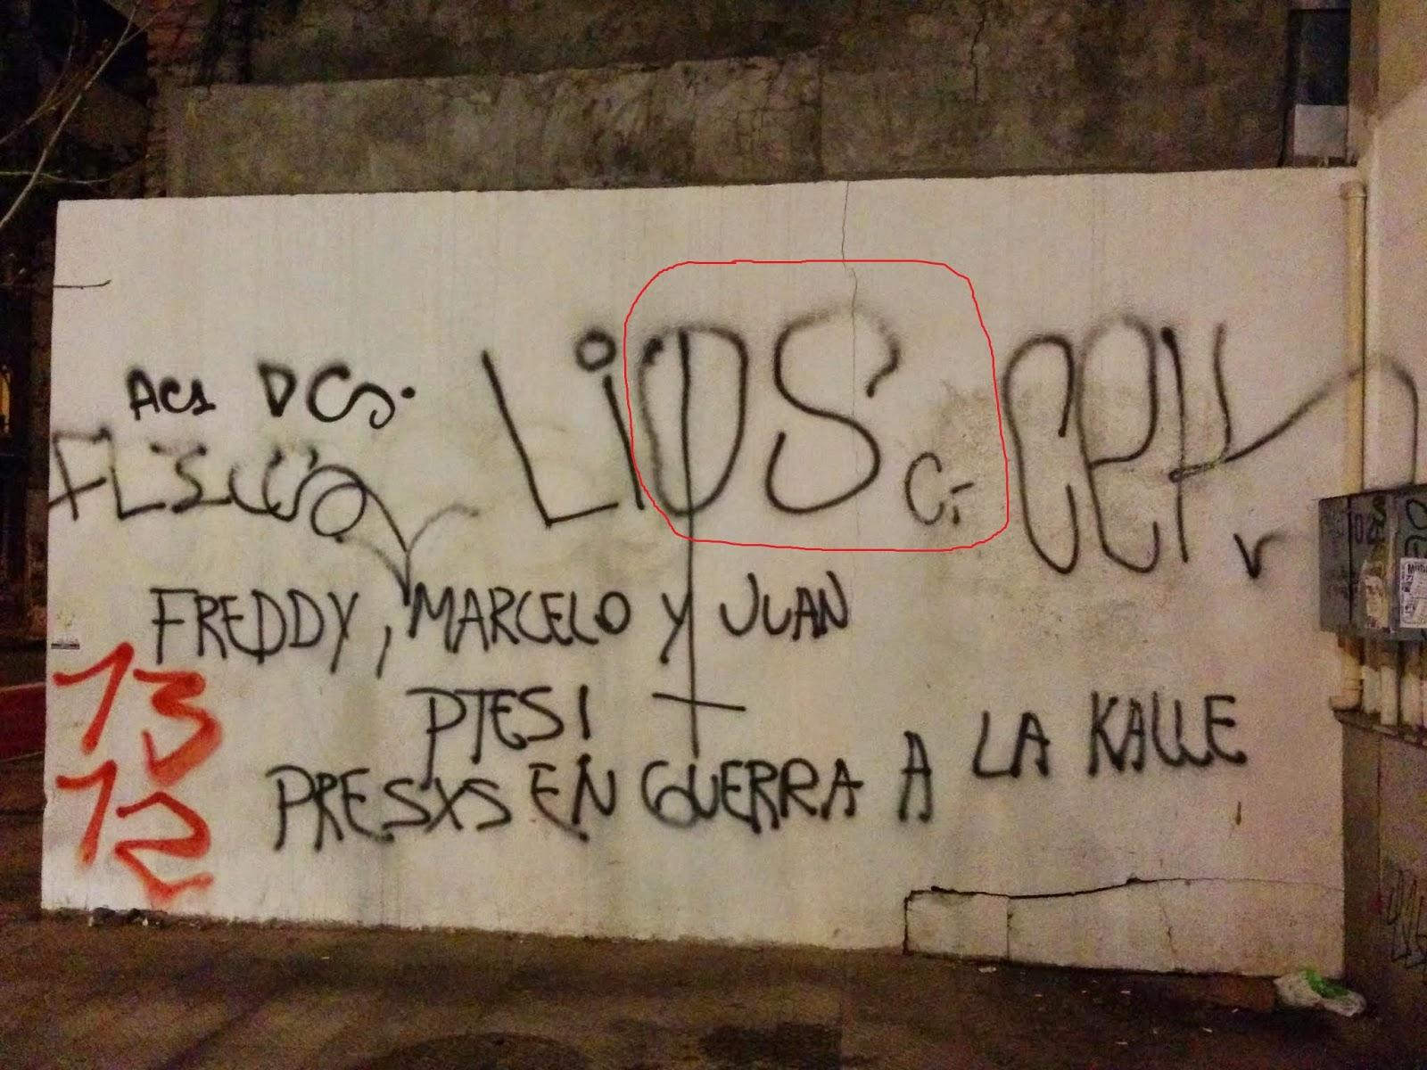
Work at PUC
Freddy Priyatna, Marcelo Arenas, Juan Sequeda, Oscr Corcho
OEG
October 2nd, 2014
https://www.google.com/maps/@-33.4482864,-70.6534626,3a,75y,257.04h,80.36t/data=!3m4!1e1!3m2!1sdq-IAOCo7g1DK5gpHJq_Iw!2e0?hl=es-419

Slide 2
The Title
Option 1: On the Expressive Power of Direct Mapping and its Relationship with R2RML
Option 2: Making morph-RDB out-of-business

Slide 3

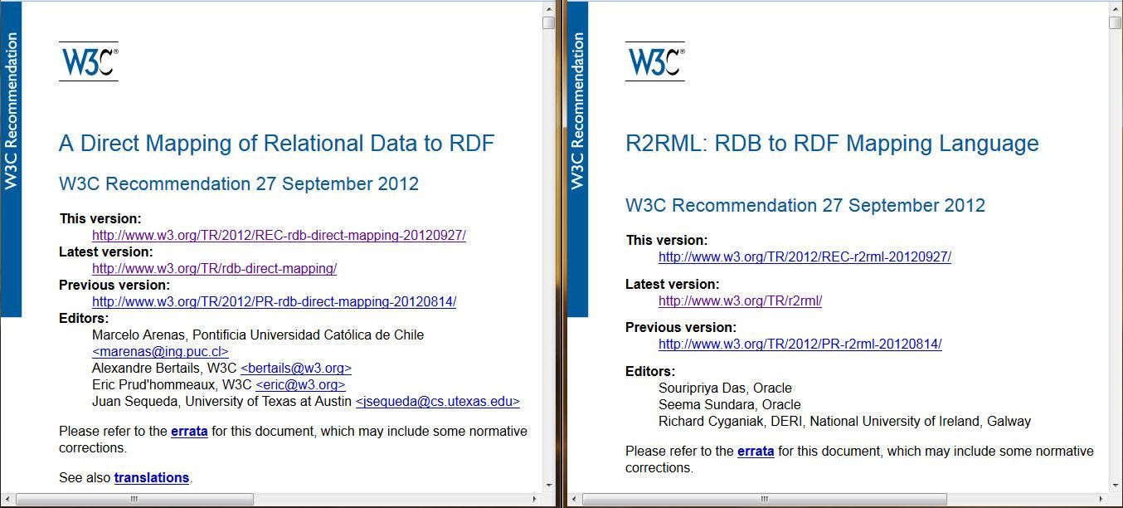

Slide 4
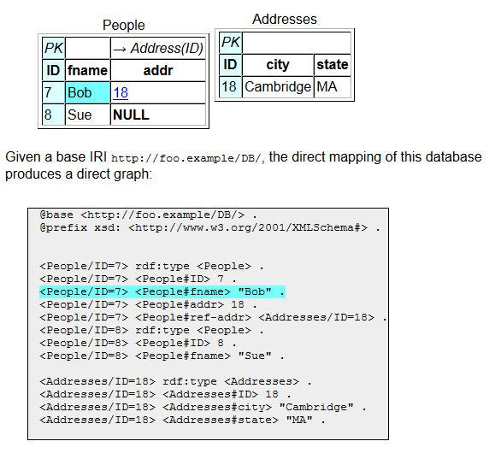
Direct Mapping
One-click system
Semantics in datalog (in the spec)
Studied Properties (Sequeda et. al. WWW 2012)
http://www.w3.org/TR/rdb-direct-mapping/

Slide 5
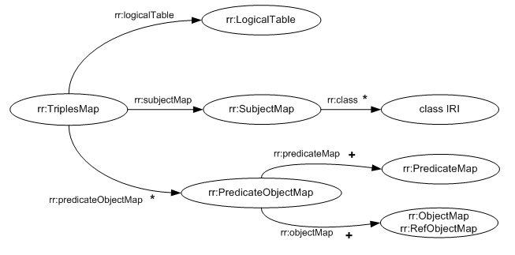
R2RML
http://www.w3.org/TR/r2rml/

Slide 6
R2RML Example
DEPT
DEPTNO | DNAME | LOC
10 | APPSERVER | NEW YORK
<TriplesMapDept>
rr:logicalTable [ rr:tableName "DEPT" ];
rr:subjectMap [
rr:template “http://data.example.com/department/{DEPTNO}”;
rr:class ex:Department; ];
rr:predicateObjectMap [
rr:predicateMap [ rr:constant ex:name;]
rr:objectMap [ rr:column “DNAME”; ];
rr:predicateObjectMap [
rr:predicateMap [ rr:constant ex:location; ]
rr:objectMap [ rr:column “LOC”; ]
]; .
<http://data.example.com/department/10> rdf:type ex:Department.
<http://data.example.com/department/10> ex:name "APPSERVER".
<http://data.example.com/department/10> ex:location "NEW YORK".

Slide 7
R2RML Example
EMP
<TriplesMapEmp>
rr:logicalTable [ rr:tableName "EMP" ];
rr:subjectMap [
rr:template “http://data.example.com/employee/{EMPNO}”;
rr:class ex:Employee; ];
rr:predicateObjectMap [
rr:predicateMap [ rr:constant ex:name; ]
rr:objectMap [ rr:column “ENAME”; ];
rr:predicateObjectMap [
rr:predicateMap [ rr:constant ex:department; ]
rr:objectMap [
rr:parentTriplesMap <#TriplesMapDept>;
rr:joinCondition [
rr:child "DEPTID"; rr:parent "DEPTNO";
];
]
];.
EMPNO | ENAME | JOB | DEPTID
7369 | SMITH | CLERK | 10
<http://data.example.com/employee/7369> rdf:type ex:Employee.
<http://data.example.com/employee/7369> ex:name "SMITH".
<http://data.example.com/employee/7369> ex:department <http://data.example.com/department/10>.

Slide 8
What is missing?
Formal study of the relationship between R2RML <-> DM:
  Expressive power
    DM -> R2RML (obvious, next slide)
    R2RML -> DM ( ? )
  Fundamental properties
    Information Preservation
    Query Result Preservation

Slide 9
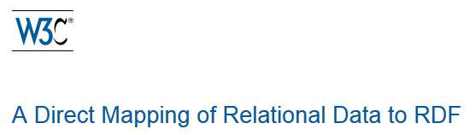
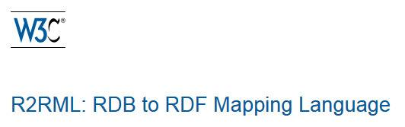
Information Preservation: Example
PERSON
EMP
<TMEmp> a rr:TriplesMap;
rr:logicalTable [ rr:tableName “EMP” ];
rr:subjectMap [
rr:template “:PERSON/PERSONID={EID}.LASTNAME={LNAME}”;
rr:class PERSON; rr:termType rr:blankNode;
];
rr:predicateObjectMap [
rr:predicateMap [ rr:constant PERSON#PERSONID];
rr:objectMap [ rr:column "EID"];
];
rr:predicateObjectMap [
rr:predicateMap [ rr:constant PERSON#LASTNAME];
rr:objectMap [ rr:column "LNAME"];
]
].
PERSONID | LASTNAME
7369 | Smith
PK
EID | LNAME
7369 | Smith
:PERSON/PERSONID=7369.LASTNAME=Smith rdf:type <PERSON> .
:PERSON/PERSONID=7369.LASTNAME=Smith <PERSON#PERSONID> "7369" .
:PERSON/PERSONID=7369.LASTNAME=Smith <PERSON#LASTNAME> "Smith" .

Slide 10



Preliminaries
Database schema: R
Database instance: I
SQL query: Q
View Definition is a query Q over R
View is the result of query evaluation Q over I
Direct Mapping: DM
R2RML Mapping Document: M
M evaluated over I: [[M]]_{I}
DM evaluated over I: [[DM]]_{I}
Substitution:
SPARQL Query: P, P₁, P₂

Slide 11
Preliminaries
R2RML_{Lite}
no termtype (blanknode, literal,IRI)
no datatype (xsd:dateTime, xsd:positiveInteger, etc)
no language tag (english, spanish, etc)

Slide 12
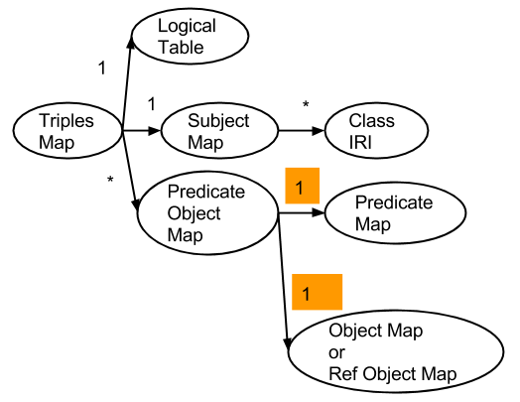
Preliminaries
R2RML Mappings 1st Normal Form

Slide 13
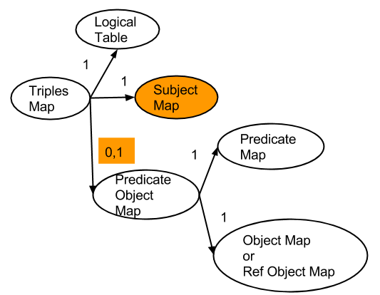
Preliminaries
R2RML Mappings 2nd Normal Form

Slide 14
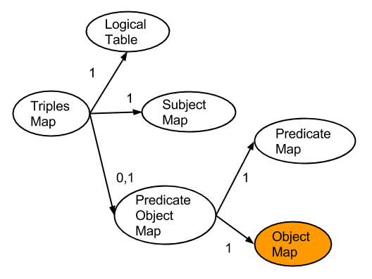
Preliminaries
R2RML Mappings 3rd Normal Form

Slide 15
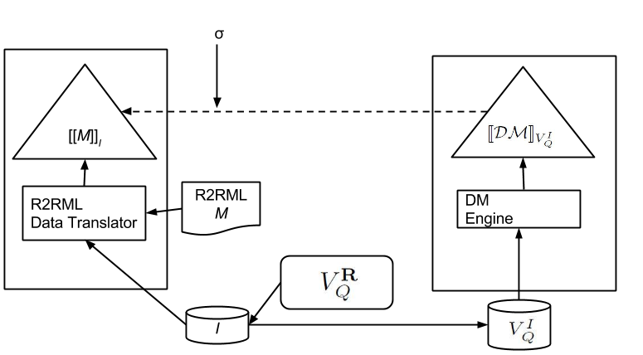
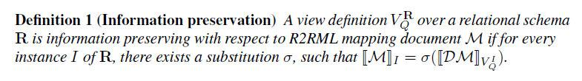
Information Preservation (IP) of View Definitions

Slide 16
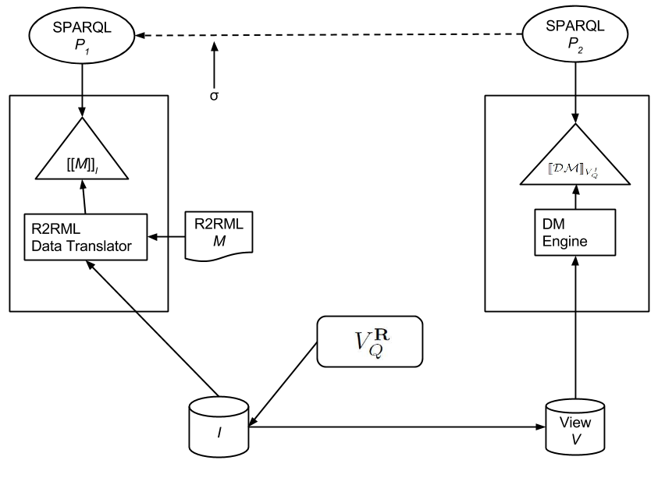
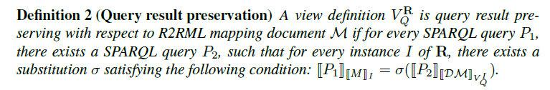
Query Result Preservation (QRP) of View Definitions

Slide 17


IP Problem (IPP)
Given a relational schema R and R2RML mapping document M, find substitution and query that satisfy the Information Preservation Property

Slide 18
QRP Problem
Given a relational schema R, an R2RML mapping document M, and a query P₁, find substitution , view definition , , and query P₂ that satisfy the Query Result Preservation Property

Slide 19
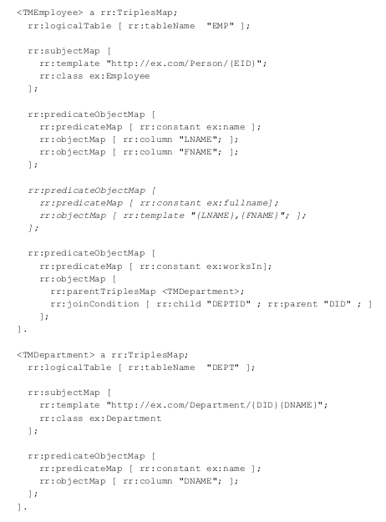



Running Example
EMP
PK |  |  |  | -> DEPT (DID)
EID | LNAME | FNAME | JOB | DEPTID
7369 | Smith | Adam | Clerk | 10
DEPT
PK
DID | DNAME | LOC
10 | AppServer | New York
<http://ex.com/Person/7369> rdf:type ex:Employee.
<http://ex.com/Person/7369> ex:name "SMITH".
<http://ex.com/Person/7369> ex:name "ADAM".
<http://ex.com/Person/7369> ex:fullname "SMITH,ADAM".
<http://ex.com/Person/7369> ex:worksIn <http://ex.com/Department/10APPSERVER>.
<http://ex.com/Department/10APPSERVER> rdf:type ex:Department.
<http://ex.com/Department/10APPSERVER> ex:name "APPSERVER".

Slide 20
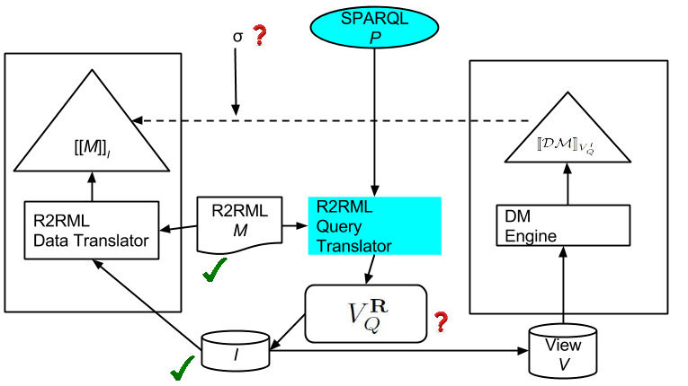
Our Approach for Solving the IP Problem

Slide 21
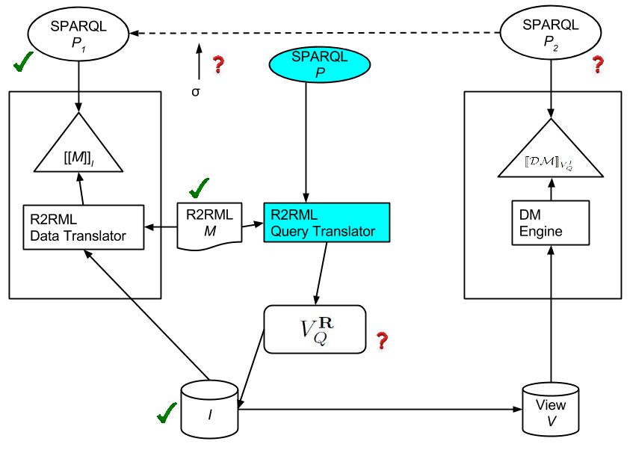
Our Approach for Solving QRP Problem

Slide 22
IP Problem
Vertical Approach
Normalize mappings in M_{Lite} form to M where M is in 3rd NF
Set Q = trans(P, M)
  P = SELECT ?s AS ?rdf:subject ?p AS ?rdf:predicate ?o AS ?rdf:object WHERE { ?s ?p ?o }.
Set = CREATE VIEW rdf:statement AS Q;
Set =
  Replace rdf:Statement#rdf:subject with rdf:subject
  Replace rdf:Statement#rdf:predicate with rdf:predicate
  Replace rdf:Statement#rdf:object with rdf:object

Slide 23
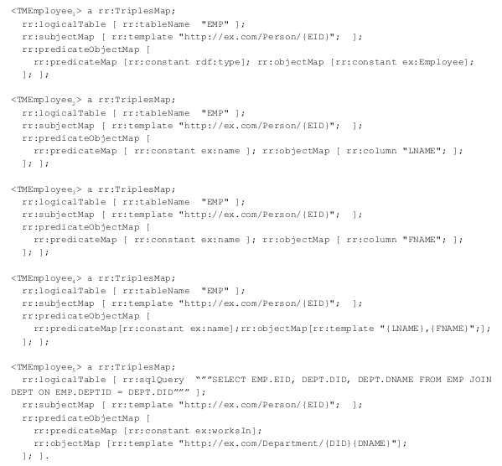
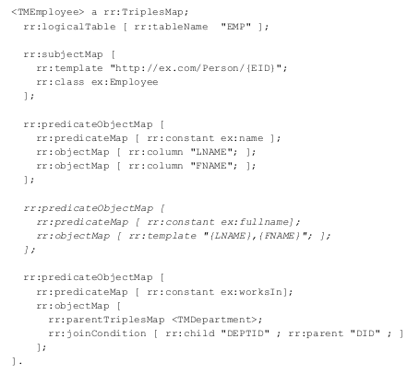
IP Problem
Approach - Step 1
Normalize Mappings

Slide 24
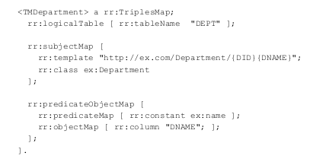
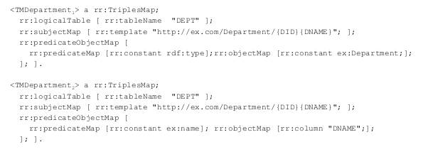
IP Problem Approach - Step 1
Normalize Mappings

Slide 25
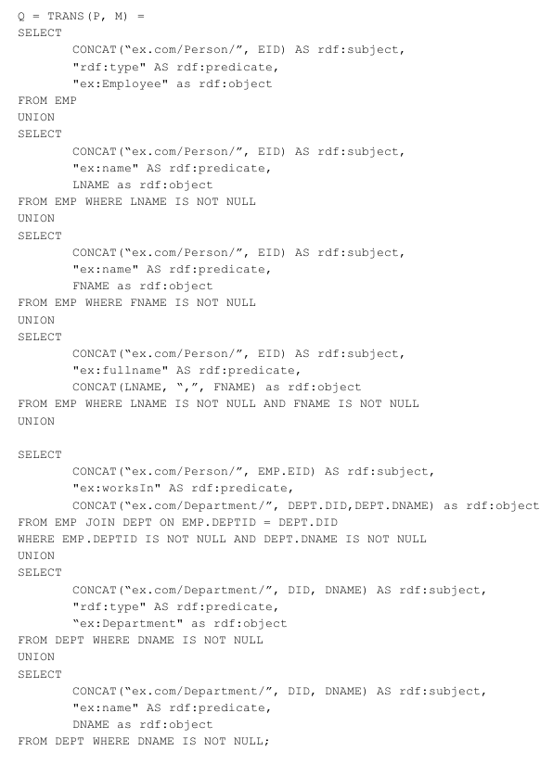
IP Problem Approach - Step 2
Generating Q
Set Q = trans(P, M)
P = SELECT
?s AS ?rdf:subject
?p AS ?rdf:predicate
?o AS ?rdf:object
WHERE { ?s ?p ?o }.

Slide 26
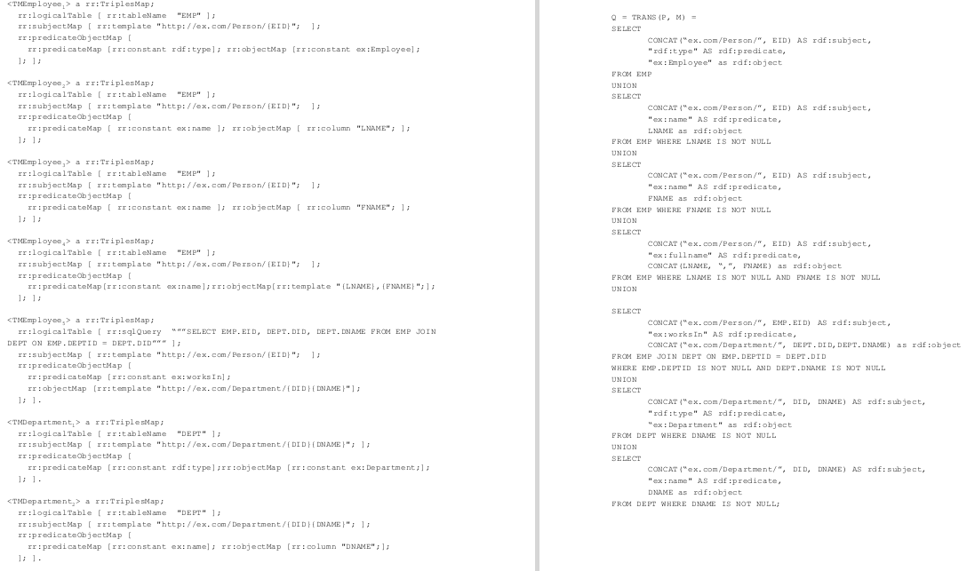
IP Problem Approach - Step 2 Generating Q

Slide 27
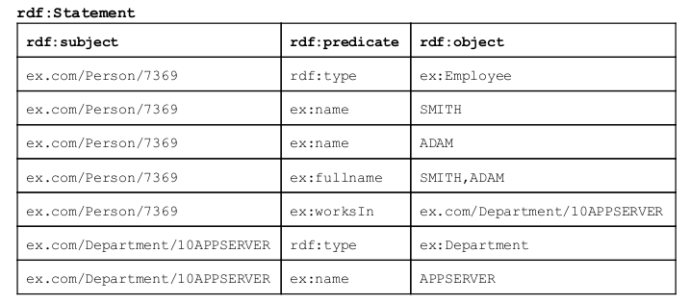
IP Problem
Approach - Step 3
Generating View
Set = CREATE VIEW rdf:statement AS Q;

Slide 28
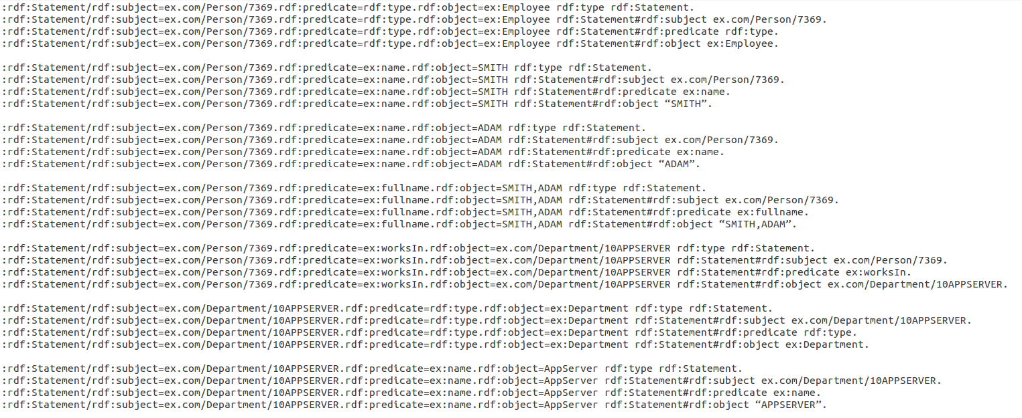

IP Problem
Approach - Step 3
DM Evaluation

Slide 29
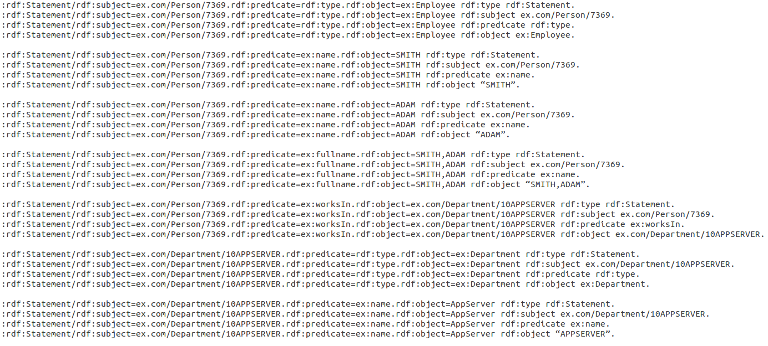

IP Problem
Approach - Step 4
Substitution
Set =
Replace rdf:Statement#rdf:subject with rdf:subject
Replace rdf:Statement#rdf:predicate with rdf:predicate
Replace rdf:Statement#rdf:object with rdf:object

Slide 30
IP Problem
Solved
<http://ex.com/Person/7369> rdf:type ex:Employee.
<http://ex.com/Person/7369> ex:name "SMITH".
<http://ex.com/Person/7369> ex:name "ADAM".
<http://ex.com/Person/7369> ex:fullname "SMITH,ADAM".
<http://ex.com/Person/7369> ex:worksIn <http://ex.com/Department/10APPSERVER>.
<http://ex.com/Department/10APPSERVER> rdf:type ex:Department.
<http://ex.com/Department/10APPSERVER> ex:name "APPSERVER".

Slide 31
QRP Problem
Vertical Approach
Normalize mappings in M_{Lite} form to M where M is in 3rd NF
Set Q = trans(P, M)
  P = SELECT ?s AS ?rdf:subject ?p AS rdf:predicate ?o AS rdf:object WHERE { ?s ?p ?o }.
Set = CREATE VIEW rdf:statement AS Q;
Set = {}
For P₁ = SELECT ?s ?p ?o WHERE {?s ?p ?o}
set P₂ = SELECT ?s ?p ?o WHERE {
?st a rdf:Statement .
?st rdf:Statement#rdf:subject ?s .
?st rdf:Statement#rdf:predicate ?p .
?st rdf:Statement#rdf:object ?o .}

Slide 32
QRP Problem
Approach - Step 1-3
Same as IPP Approach 1 Step 1-3
Normalize M_{Core} to M where M is in 3rd NF
Set Q = trans(P, M)
  P = SELECT ?s AS ?rdf:subject ?p AS rdf:predicate ?o AS rdf:object WHERE { ?s ?p ?o }.
Set = CREATE VIEW rdf:statement AS Q;

Slide 33
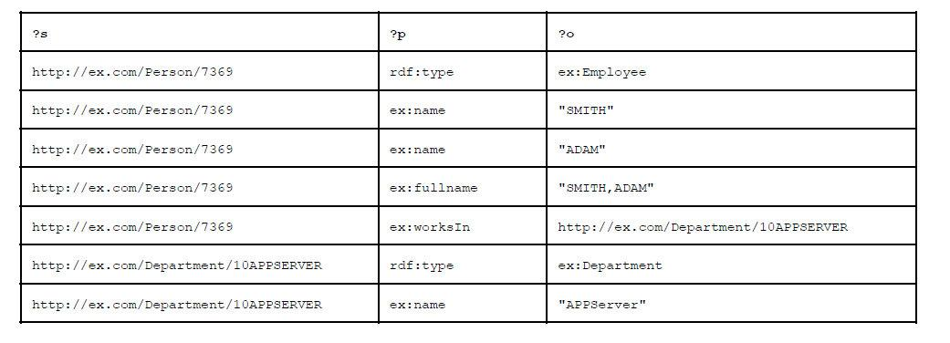

QRP Problem
Approach - Step 4 (P₁)
P₁ = SELECT ?s ?p ?o
WHERE {?s ?p ?o}
<http://ex.com/Person/7369> rdf:type ex:Employee.
<http://ex.com/Person/7369> ex:name "SMITH".
<http://ex.com/Person/7369> ex:name "ADAM".
<http://ex.com/Person/7369> ex:fullname "SMITH,ADAM".
<http://ex.com/Person/7369> ex:worksIn <http://ex.com/Department/10APPSERVER>.
<http://ex.com/Department/10APPSERVER> rdf:type ex:Department.
<http://ex.com/Department/10APPSERVER> ex:name "APPSERVER".

Slide 34

QRP Problem
Approach Step 4 (P₂)
P₂ = SELECT ?s ?p ?o WHERE {
?st a rdf:Statement .
?st rdf:Statement#rdf:subject ?s .
?st rdf:Statement#rdf:predicate ?p .
?st rdf:Statement#rdf:object ?o .}

Slide 35

QRP Problem Solved
= {}

Slide 36
Summary
R2RML <-> DM
  DM -> R2RML (obvious)
  R2RML -> DM ( ? )
    R2RML_{Lite}
We say they are “equivalent”, if
  Information preservation property holds
  Query result preservation property holds
The consequence
  R2RML engine (morph-RDB, D2RQ, ontop, etc) is not the only option for evaluating R2RML_{Lite} mappings

Slide 37
Future Work (FW) and Conclusions (C)
FW1: Supporting more expressive R2RML fragment
FW2: Use horizontal approach (see next slide)
C1: DM + View + Substitution is as expressive as R2RML_{Lite}
C2: Be very careful when choosing your internship topic!

Slide 38
(FW2) Sneak Peek of Horizontal Approach
Use mappings NF1
Use self-join elimination
Without reification
Generate multiple tables, not a single triples table in the view
P_{Department} = SELECT ?s ?ex_name ?ex_department WHERE {
  ?s rdf:type ex:Department .
  ?s ex:name ?ex_name . }
P_{Employee} = SELECT ?s ?ex_name ?ex_fullname ?ex_department WHERE {
  ?s rdf:type ex:Employee .
  ?s ex:name ?ex_name .
  ?s ex:fullname ?ex_fullname .
  ?s ex:worksIn ?ex_worksIn. }

