Slide 1
Workplan for stay at ISI
(Jun 10th – Sept 8th)
José Mora
jmora@fi.upm.es
Facultad de Informática
Universidad Politécnica de Madrid
Campus de Montegancedo s/n
28660 Boadilla del Monte, Madrid, Spain

Slide 2
Table of Contents
Technical scenario
Generic action cycle
Conceptual Scenario
Action cycle applied to conceptual scenario

Slide 3


Technical scenario
Query
A
A

Slide 4
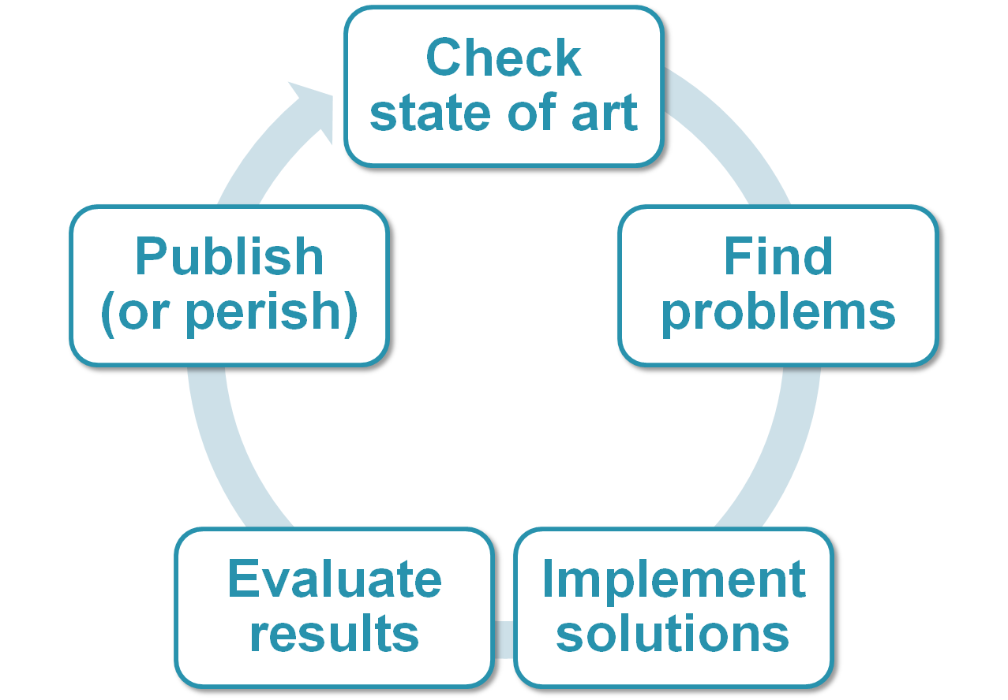
Generic action cycle

Slide 5
Conceptual scenario
Test cases
Queries
Information sources
Descriptions
…
Solution
Plan:
Concurrent
Level of detail
Syntax
…
Web services integration (Argos)
EntitiBases: massive integration of heterogeneous information
4Projects on bioinformatic Information Integration
Phoebus
Mercury
Apollo
Prometheus
Theseus
Heracles
Quality
Quality
Legacy systems
De facto: RDF &SPARQL
Expressiveness? OWL? OWL2?
Planning-by-rewriting
Semantics
Semantic
Planning
Planning
Solution search
Plan bunches of inferences
Physical vs logical plans
Reasoning
Reasoning
Saturation?

Slide 6

Action cycle applied to conceptual scenario
 | Check SoA | Find problem | Implement solution | Evaluate result
Ambite’s commands | 1-12w
Semantic Triple Match | 1w | 1w | 3w | 1w
Reasoning (Sat-ELHIO?) | 1w | 2w | 4w | 2w
Reasoning-by-planning | 3w | 2w | 5w | 2w
IntraDB planning | 2w | 3w | 6w | 1w
New Planning | 2w | 4w | 3w | 3w
Quality model | 3w | 4w | 1w | 1w

Slide 7
Workplan for stay at ISI
(Jun 10th – Sept 8th)
José Mora
jmora@fi.upm.es
Facultad de Informática
Universidad Politécnica de Madrid
Campus de Montegancedo s/n
28660 Boadilla del Monte, Madrid, Spain

Slide 8
Semantic triple match
Sources described with several triples instead of single n-ary predicates.
Requires graph matching in query preconditions
  Allows partial match
  Allows composition of conditions
Postconditions require more complex unifications
Merging of information is more straigtforward
Constraints on the information after merging (decomposed query) should not be less (correctness) or more (completude) than in the original query
This problem may already be solved in ISI at the current time

Slide 9
Reasoning – Saturation with ELHIO
Pérez-Urbina shared the code to rewrite queries reasoning with DL- ELHIO¬
AFAIK, that has not been done in the ISI, the reasoning capabilities are quite restricted
I’ve worked with the code from Pérez-Urbina, now it considers the availability of predicates to rewrite to those retrievable
It could be possible to join both systems and add reasoning capabilities to the systems in ISI
It could be possible to use different reasoning techniques that materialize the inferences from an ontology and perform query planning from there
It could be possible
It may also be the case that they don’t use really complex ontologies and reasoning is irrelevant, a lattice may be enough

Slide 10
Reasoning-by-planning
If the ontology is too big or too expressive saturation is not possible
Planning can be used to choose the inference steps to perform, this possibility should be explored
The selection performed by planning introduces a big overhead over the operations to perform
  The operations should be grouped in bunches to reduce overhead
Planning-by-rewriting should be the planning method used, new operators should be added for the inference
  These operators depend on the expressiveness of the available ontologies

Slide 11
IntraDB planning
Planning so far decides the sources to query, the information to retrieve and the information to use
A higher granularity is possible and SQL queries could be composed using planning
Planning-by-rewriting should be the planning method used, new operators should be added for the composition

Slide 12
New Planning
Planning-by-Rewriting (PbR) is a state of the art planning algorithm
Probably it is not perfect yet
In this case the limitations and problems of PbR should be studied and the focus would be set on solving them

Slide 13
Quality model
There are two main approaches to define such a model, formal and empiric. The properties of the information sources in ISI could help to define the quality model empirically

Slide 14
Workplan for stay at ISI
(Jun 10th – Sept 8th)
José Mora
jmora@fi.upm.es
Facultad de Informática
Universidad Politécnica de Madrid
Campus de Montegancedo s/n
28660 Boadilla del Monte, Madrid, Spain

