Slide 1

NeOn Methodology for Building Ontology Networks
Asunción Gómez-Pérez
Mari Carmen Suárez-Figueroa
{asun, mcsuarez}@fi.upm.es
Ontology Engineering Group. Departamento de Inteligencia Artificial
Facultad de Informática
Universidad Politécnica de Madrid

Slide 2

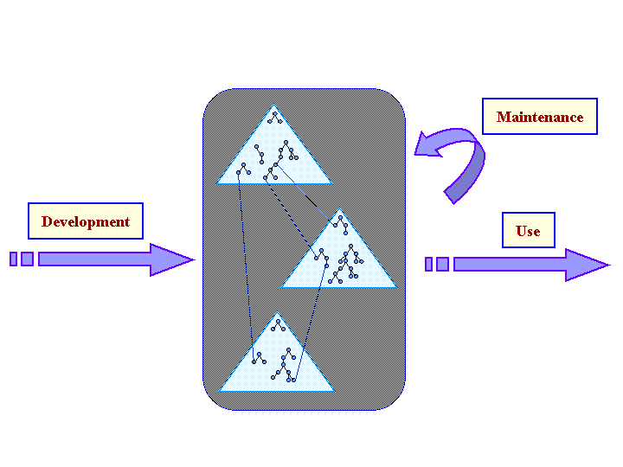
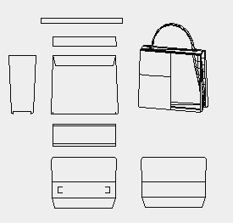

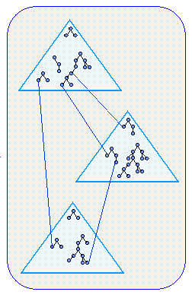
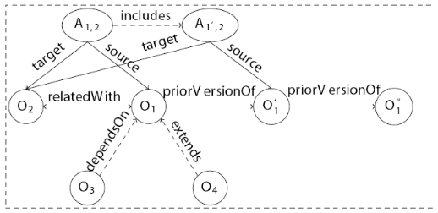
New Trend in Ontology Development
The development of ontologies in different international and national projects have revealed that there are different alternative ways to build ontologies.
Esperonto | Knowledge Web | SEEMP & UMLS Project | SEKT
From Scratch
O₃
Argumentative
Development
O₁
O₂
Non-Ontological
Resource Reuse
Ontology Design Patterns
O. Versioning
O. Alignment
The Semantic Web of the future will be characterized by using a very large number of ontologies embedded in ontology networks built by distributed teams in a collaborative way.
Thus, it is not premature to affirm that a new trend in ontology development is starting, whose emphasis is on the reuse and possible subsequent reengineering of knowledge-aware resources, the collaborative and argumentative ontology development, and the building of ontology networks.

Slide 3
Our Aim: The NeOn Methodology Framework
To create the NeOn Methodology for Building Ontology Networks to support both the collaborative aspects of ontology development and the reuse and dynamic evolution of networked ontologies.
We have identified a set of nine scenarios for building ontologies and ontology networks
  emphasizing the reuse of existing knowledge resources (ontological and non-ontological),
  generalizing from previous experiences,
  covering the drawbacks of the existing methodologies, and
  taking into account the new trends based on collaboration, context and dynamism.

Slide 4
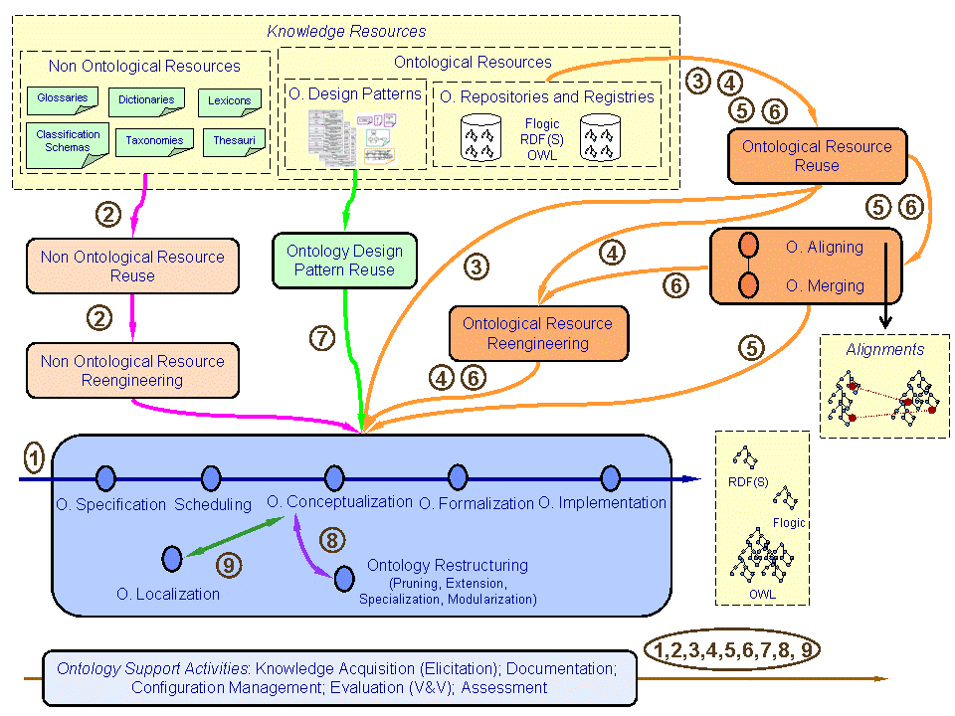
9 Scenarios for Building Ontology Networks

Slide 5
Scenario 1: From Specification to Implementation
Develop the ontology network from scratch
Ontology requirements specification activity, whose objective of this activity is to output the ontology requirements specification document (ORSD).
A quick search for knowledge-aware resources using the terms appearing in the ORSD as input. The search results allow knowing which types of resources are available for a possible reuse during the ontology network development.
Scheduling activity using the ORSD and the results of the quick search.
After this activity, the ontology developers should carry out the ontology conceptualization, the ontology formalization, and the ontology implementation activities following METHONTOLOGY or On-To-Knowledge.

Slide 6
Scenario 2: Reusing and Re-engineering Non-ontological Resources
Reusing existing non-ontological resources (NOR) for speeding up the ontology building process
Non-ontological resource reuse process for deciding, according to the requirements specified in the ORSD, which existing NORs can be reused to build the ontology. The activities to be performed during such a process are
  to search non-ontological resources,
  to assess the set of candidate non-ontological resources, and
  to select the most appropriate non-ontological resources.
Non-ontological resource re-engineering process The activities to be performed during such a process are: non-ontological resource reverse engineering, transformation, and ontology forward engineering.

Slide 7
Scenario 3: Reusing Ontological Resources
Use existing ontological resources for building ontology networks
Different ways of reusing ontological resources:
  ontologies can be reused as a whole;
  only one part or module can be reused; and
  ontology statements can be reused.
For integrating the ontological resources to be reused, ontology developers can decide:
  to reuse them such as they are in the ontology network being developed following the activities of Scenario 1
  to perform a re-engineering process following Scenario 4
  to merge several ontological resources to obtain a new ontological resource following Scenarios 5 or 6.

Slide 8
Scenario 4: Reusing and Re-engineering Ontological Resources
Reuse existing ontological resources and re-engineer them before their integration in the ontology network.
The ontological resource re-engineering process is composed of the following activities:
  ontological resource reverse engineering
  ontological resource restructuring
  ontological resource forward engineering.
These activities might be carried out at four different levels, depending on the needs of each particular case:
    at the specification level,
    at the conceptualization level,
    at the formalization level, and
    at the implementation level.

Slide 9
Scenario 5: Reusing and Merging Ontological Resources
Reuse and merge existing ontological resources in the development of the ontology network.
First, ontology developers should carry out the ontology aligning activity and obtain a set of alignments among the selected ontological resources.
Once the ontology alignments have been established, ontology developers can merge the ontological resources using such alignments to obtain a new ontological resource.

Slide 10
Scenario 6: Reusing, merging and re-engineering ontological resources
Ontology developers reuse, merge, and re-engineer existing ontological resources in the ontology network building.
This scenario has the same sequence of activities as Scenario 5; however, here ontology developers can decide not to use the set of merged ontological resource such as it is, but to re-engineer it.

Slide 11
Scenario 7: Reusing ontology design patterns
Access ODPs repositories to reuse ODPs for different purposes:
  to reduce modeling difficulties,
  to speed up the modeling process, or
  to check the adequacy of modeling decisions
http://ontologydesignpatterns.org

Slide 12
Scenario 8: Restructuring ontological resources
Restructure ontological resources to be integrated in the ontology network being built.
The ontology restructuring activity can be performed in the following ways:
  modularizing the ontology in different ontology modules;
  pruning the branches of the taxonomy not considered necessary;
  extending the ontology including (in width) new concepts and relations; and
  specializing those branches that require more granularity and including more specialized domain concepts and relations.

Slide 13
Scenario 9: Localizing ontological resources
Ontology developers adapt an existing ontology to one or various languages and culture communities, obtaining as a result a multilingual ontology.
Once the ontology has been conceptualized, its adaptation to a particular natural language different from the language used in the conceptualization can be required.
Such an adaptation requires the translation of all ontology labels into one or several natural languages, being these languages other than the original language of the conceptualization.

Slide 14
9 Scenarios for Building Ontology Networks
In the framework of the NeOn Methodology there are prescriptive methodological guidelines for carrying out processes and activities involved in
  Scenario 1 (ontology requirements specification and scheduling),
  Scenario 2,
  Scenario 3,
  Scenario 7,
  Scenario 8 (ontology modularization), and
  Scenario 9; and also
  for ontology evaluation and ontology evolution.

