Slide 1


When your mind is harsher than Reviewer #3: overcoming anxiety, depression and impostor syndrome in Academia
Julia Bosque Gil & Idafen Santana,
Ontology Engineering Group (OEG)
jbosque@fi.upm.es
@jbosgil
25.10.2018
ETSINF
Notes:
Cambiar la licencia por la que aplique.

Slide 2

Disclaimer
I am not a psychologist or have any qualifications in the field.
The following talk is intended to give some descriptions of certain mental dark places common in scholars in Academia, especially in PhD and post-docs.
The ultimate goal of this is to promote discussion among group members to share their experiences and advice.
This is not a talk about how Academia should be, but a talk about how it can provide, along with some personality traits, the perfect scenario for these mental dark places to arise.
The "Overcoming" in the title of the talk does not mean my inner battle is over.

Slide 3
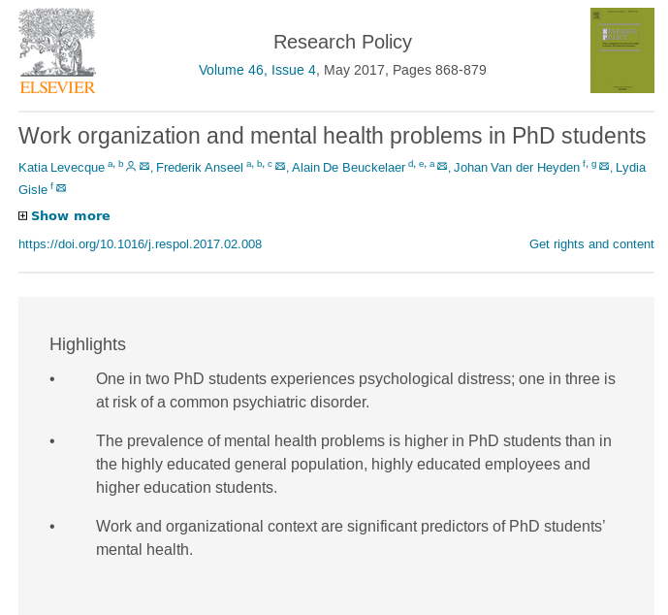


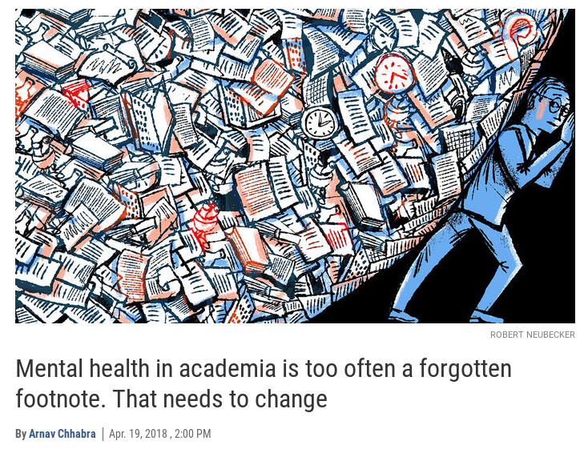
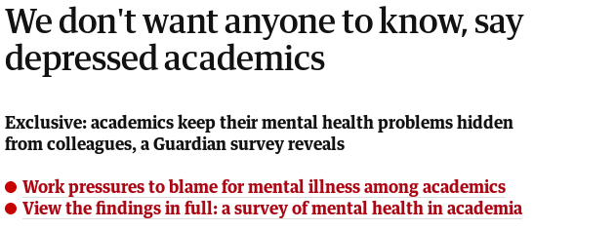
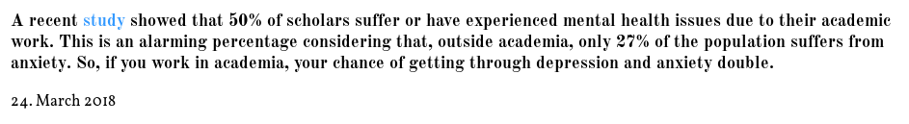
Some alarming headlines

Slide 4
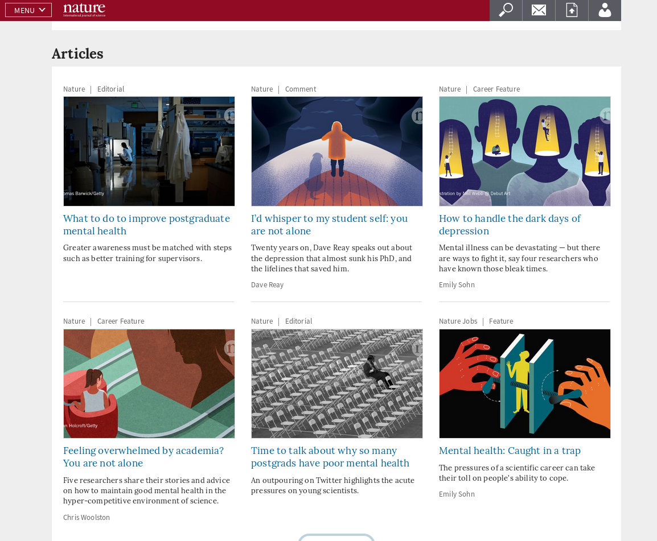
The facts

Slide 5
Some alarming numbers
1/2 PhD students experiences psychological distress. 1/3 is at risk of a common psychiatric disorder [1]
50% of scholars suffer or have experienced mental health issues due to their academic work [1] as quoted in [3] Outside academia, only 27% of the population suffers from anxiety [3]
In a survey to 2,500 academics (UK)[2]:
over half (61%) of the respondents say that none of their colleagues are aware of their mental health problems
(66%) say they have not spoken to someone in a senior position about their mental health problems.
reported conditions are anxiety (83%), depression (75%) and panic attacks (42%)
>25% of all medical students worldwide struggle with depression. 11% have thoughts of suicide. Only 15% percent who screened positive for depression sought psychiatric help. [4]

Slide 6
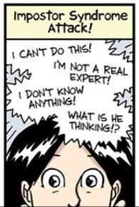
Basic terminology: Impostor Syndrome
"I don't know enough"

Slide 7

Basic terminology: Impostor Syndrome
"I definitely should have known this and that"
"They don't know I don't know enough. Those who think I do know enough, they are not aware of everything I don't know and should know...so they don't count"
"I got this far, it was difficult, yes, but you...just do it. That was different, it is not as hard as this"
"Someday they will find out I don't know enough and then what?"
"I don't have impostor syndrome, in my case all this is true"

Slide 8
Triggers
Trying to write (thesis, proposal, etc.)
Finding and reading bibliography
Both negative and positive reviews
Conference coffee breaks
Conference talks
Social media

Slide 9
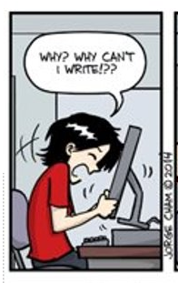
Basic terminology: Genius Complex
"I am too slow/too unproductive to do this. In contrast to me, some people seem to be naturally good at this, maybe I just don't have that talent""
www.phdcomics.com

Slide 10
Basic terminology: Genius Complex
Am I the only one who finds this really hard?
Maybe this isn't supposed to be that difficult and I am just slow
This person, at my age/stage, had accomplished double than me. Maybe I just don't have that talent. Maybe Academia is not my place.
By this point, I should have accomplished n things and I have not.

Slide 11
Our daily triggers
Everything which involves processing other people's successes and results: social media, bib. metrics, others' CV, etc.
Not everyone acknowledges that things are difficult sometimes
Unrealistic goals we set up to ourselves
The adverb just used to make a task sound easier:
"You just need to publish more!"
"Just write the thesis in three years and find a job!

Slide 12

Basic terminology: deadline anxiety
"I can't possible make it to this deadline"

Slide 13
Basic terminology: deadline anxiety
Temporary anxiety cause by a specific deadline (academic or bureaucratic)
If tomorrow I work 14 hours and the day after tomorrow I sleep 2 and then I sleep only a couple of hours each day of the weekend, this could work. Exhaustion.
I won't get the <signature/paper/process> closed on time and there isn't anything I can do!
If I fail there, <list of terrible things involving more deadlines/requisites/expected CV> will happen + impostor + genius complex effects.

Slide 14
Our daily triggers
Paper deadlines
Bureaucracy and everything it involves
Unanswered e-mails piling up
Requisites and expectations to meet in order to advance

Slide 15
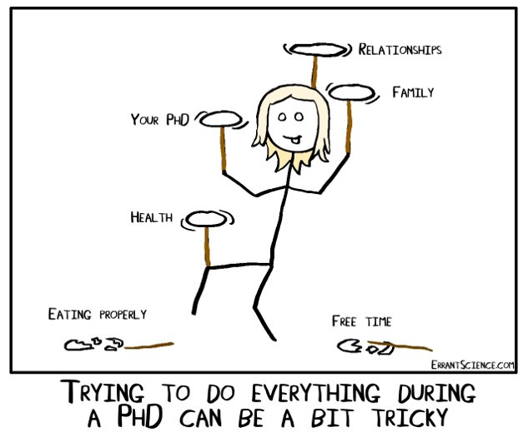
Basic terminology: general anxiety

Slide 16
Basic terminology: general anxiety
The previous picture summarizes it all
"I can't cope with life right now"
"No one outside Academia understands this and the people inside seem just fine [impostor + genius complex attack in 3...2...1...CRY!]

Slide 17

Our daily triggers
Mix all the triggers and feelings in the previous slides and you got it

Slide 18
Basic terminology: frustration and motivation loss
"But what kind of life am I going to have in this dynamics? What if all this is not worth it? Why am I doing this at all?"

Slide 19
Basic terminology: frustration and motivation loss
Is all this really worth it? It feels I am 'missing' life doing this.
Am I really doing/contributing significantly to something relevant?
Really, who cares about all this in real life? Who reads this anyway?
What am I doing with my life?
But, if I don't continue on with this, what do I do?
What If this is the only thing I am trained to do?
Am I going be happy at all?

Slide 20
Daily triggers
Constant exposure to impostor syndrome, genius complex, deadline anxiety and general anxiety
Rejections
Limited free time to 'disconnect'

Slide 21
Opening up! Discussion
Had you ever heard of these mental dark places before?
Have you ever experienced any of this?
Impostor syndrome (I don't know enough)
Genius complex (I am not as talented as others)
Deadline anxiety (I cannot make it)
General anxiety (I cannot cope with life)
Frustration and motivation loss (is this worth it at all?)
What are your coping strategies? Have you ever received some advice (e.g. from more experienced scholars)?
What do you think plays a role in preventing/overcoming this?

Slide 22
Take-home message
For students: if you feel any of this...
… detect what it is.
… remember you are not alone.
… there is no shame in feeling any of this, overcoming it it's part of the process.
… these feelings may lead to depression, bitter your character or affect other aspects of your life.
… seek help if this starts affecting your happiness.

Slide 23
Take-home message
For advisors/seniors:
… remember that we don't always show/talk about these feelings.
… your reinforcement means a lot until we reach the point when we do not depend on it.
… it's our responsibility to get our things together, but your support can have significant consequences on us getting through.

Slide 24
References
[1] Levecque, K., Anseel, F., De Beuckelaer, A., Van der Heyden, J., & Gisle, L. (2017). Work organization and mental health problems in PhD students. Research Policy, 46(4), 868-879.
[2] https://www.theguardian.com/higher-education-network/blog/2014/may/08/academics-mental-health-suffering-silence-guardian-survey
[3] The Side Effect of Academic Life: How to Deal with Depression and Axiety (Blog: The female scientist, https://thefemalescientist.com/guide/teresa-ambrosio/1836/the-side-effect-of-academic-life-how-to-deal-with-depression-and-anxiety/. Last accessed 24.10.2018)

Slide 25
When your mind is harsher than Reviewer #3: overcoming anxiety, depression and impostor syndrome in Academia
Julia Bosque Gil & Idafen Santana,
Ontology Engineering Group (OEG)
jbosque@fi.upm.es
@jbosgil
25.10.2018
ETSINF
Notes:
Cambiar la licencia por la que aplique.

