Slide 1
OEG results in the IoT domain
Ontology Engineering Group
Universidad Politécnica de Madrid

Slide 2
Semantic interoperability in the IoT
IoT value creation requires collaboration
between networks of cross-domain devices and services
Interoperability
Discovery
Exchange
Understanding
Data
Ontologies
Express shared meaning
Ensure consistency
Content
Context
Physical
time, location, etc.
Need open standards!
Application
tasks, goals, etc.

Slide 3
Overview of the W3C Semantic Sensor Network ontology
deploymentProcesPart only
Deployment
System
OperatingRestriction
hasSubsystem only, some
hasSurvivalRange only
SurvivalRange
DeploymentRelatedProcess
hasDeployment only
System
Deployment
hasOperatingRange only
OperatingRange
deployedSystem only
deployedOnPlatform only
Process
inDeployment only
Device
Input
hasInput only
onPlatform only
Device
Process
PlatformSite
Platform
attachedSystem only
Output
hasOutput only, some
Data
SSO Pattern
isProducedBy some
Sensor
implements some
Sensing
hasValue some
SensorOutput
sensingMethodUsed only
detects only
SensingDevice
observes only
ObservationValue
Stimulus
isProxyFor only
Property
includesEvent some
observedProperty only
isPropertyOf some
observationResult only
observedBy only
hasProperty only, some
Observation
featureOfInterest only
FeatureOfInterest
MeasuringCapability
ConstraintBlock
hasMeasurementCapability only
forProperty only
inCondition only
inCondition only
MeasurementCapability
Condition

Slide 4
Sensor capabilities example
“Sensor001 can measure wave heights with a minimum value of 1.2 and a maximum one of 3.6”
Sensor
Property
observes
Sensor001
cd:WaveHeight
hasMeasurementCapability
MeasurementCapability
forProperty
WaveHeightMeasurementCapability
dul:UnitOfMeasure
ObservationValue
hasMeasurementProperty
MeasurementProperty
hasQuantityValue
MeasurementRange
WaveHeightValue_1
3.6
hasQuantityUnitOfMeasure
hasMeasurementPropertyMaxValue
meter
hasQuantityUnitOfMeasure
WaveHeightMeasurementRange_1
WaveHeightValue_2
hasMeasurementPropertyMinValue
1.2
hasQuantityValue

Slide 5
Sensor data example
Location | Zone | Sensor | Air quality
...
La Vaguada | Hall floor 1 | Air sensor 007 | 3
La Vaguada | Stairs floor 1 | Air sensor 008 | 4
La Vaguada | Hall floor 2 | Air sensor 009 | 4
...
Location
FeatureOfInterest
Property
Sensor
includesElement
hasProperty
observes
LaVaguada
HallFloor1
AirQuality
AirSensor007
observedProperty
isProducedBy
featureOfInterest
Observation
SensorOutput
Observation0844
Output37832
“3”^^xsd:int
observationResult
hasValue

Slide 6
Web of Things ontology
Aligned with the W3C Web of Things IG

Slide 7
Web of Things example
“LED Lamp (Thing) that supports multiple protocols (CoAP and HTTP), mediaTypes (JSON and EXI), and security policies (it requires a JWT for interaction). It also shows the definition of the endpoint information in a global manner.”

Slide 8
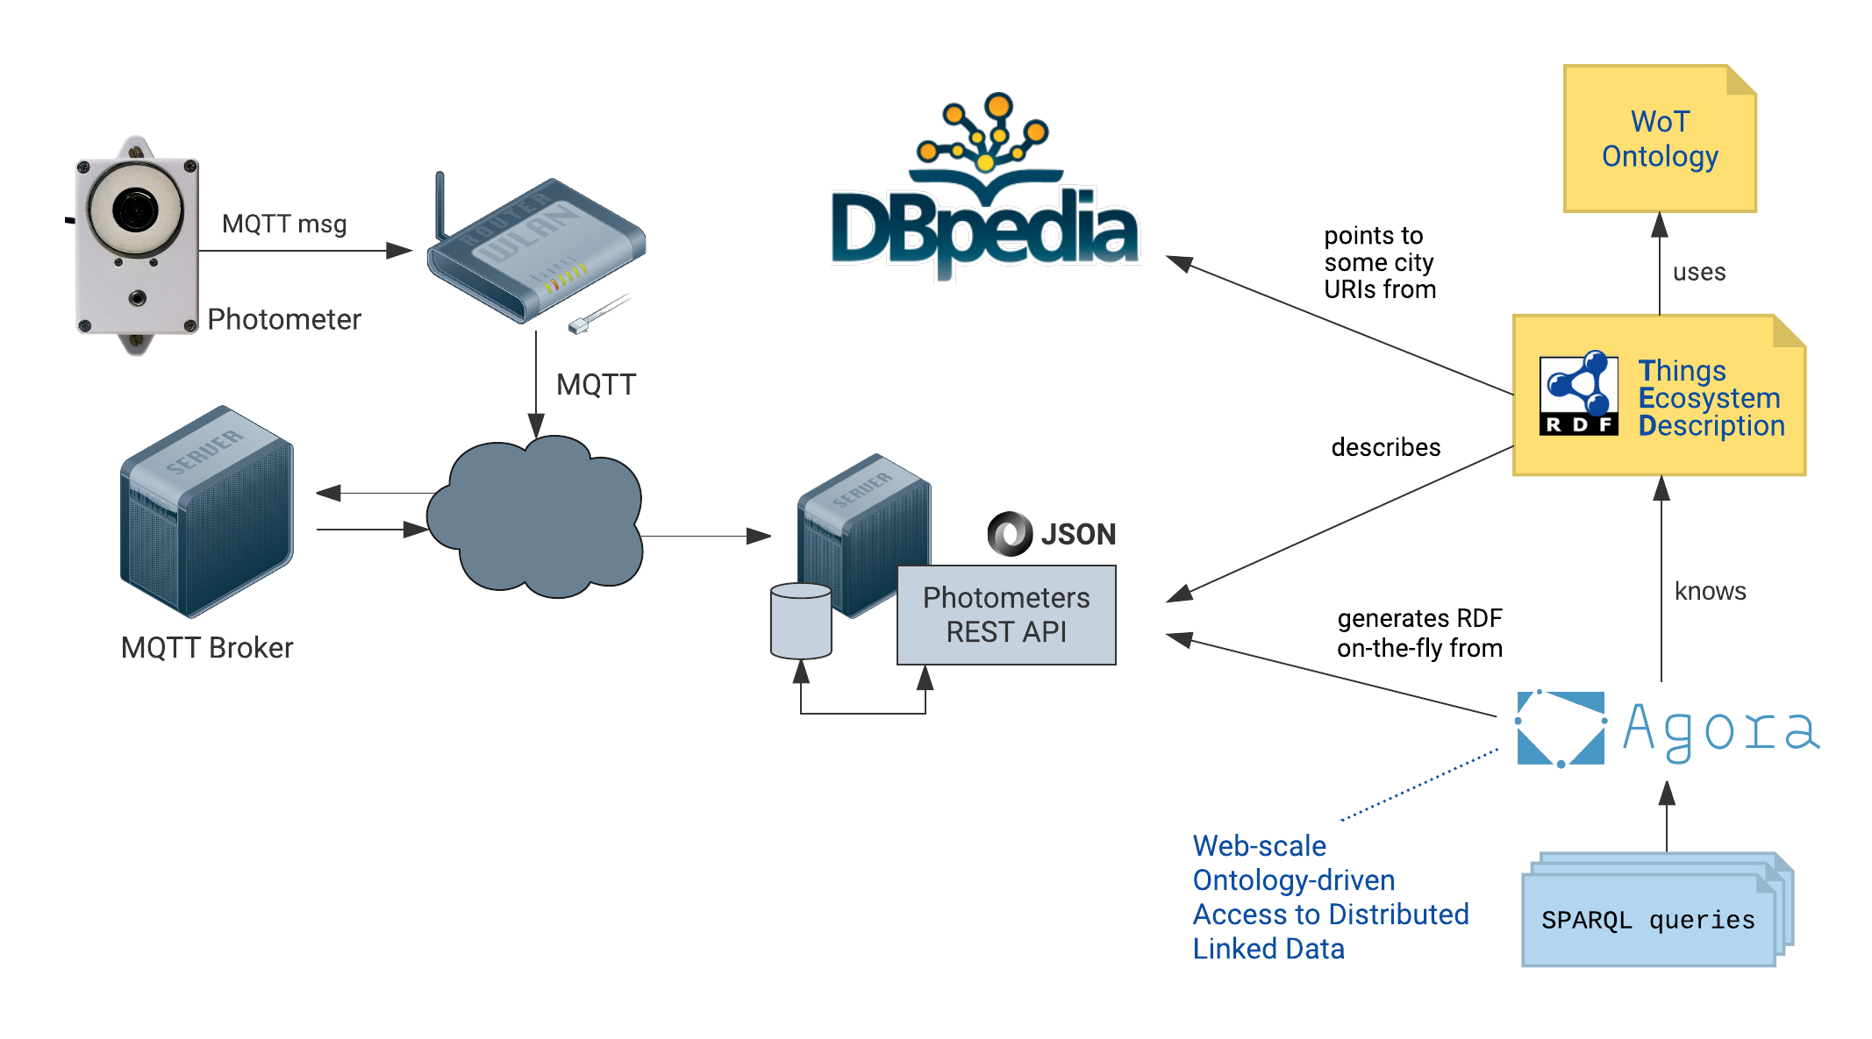

Web of Things prototype - City Light Pollution
Architecture – Integrating photometer streams and DBpedia
Photometers measure…
Sky & ambient temperature
Sky brightness
Position (lat, long)

Slide 9
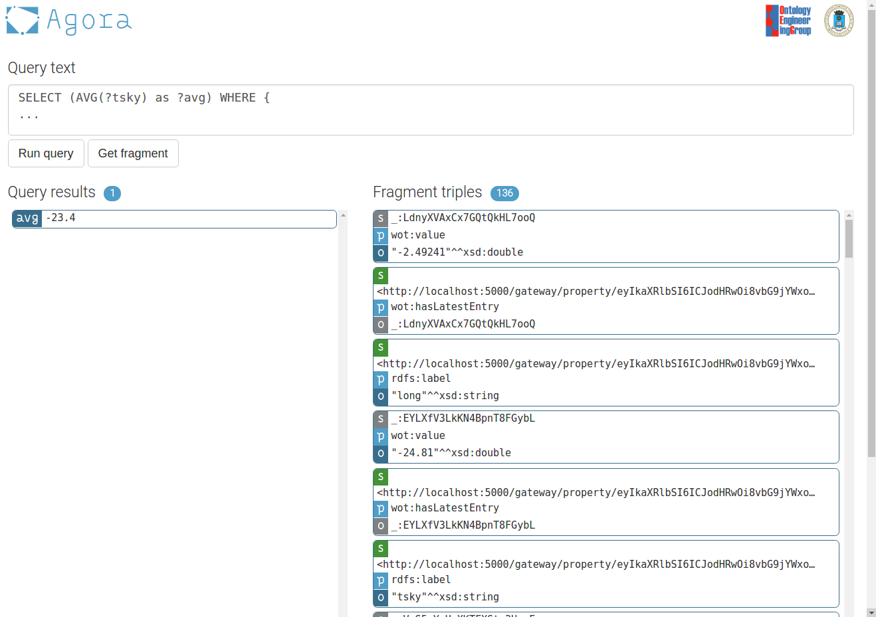
Access to distributed (WoT) Linked Data
Agora SPARQL interface – What is the average sky temperature in Madrid right now?
SELECT (AVG(?tsky as ?avg) WHERE {
{
?w wot:offersInteraction [
rdfs:label “lat”;
wot:hasLatestEntry [
wot:value ?tlat
]
] .
?w wot:offersInteraction [
rdfs:label “long”;
wot:hasLatestEntry [
wot:value ?tlong
]
] .
?w wot:offersInteraction [
rdfs:label “tsky”;
wot:hasLatestEntry [
wot:value ?tsky
]
] .
}
{
[] a sch:Place ;
foaf:name ?name ;
geo:lat ?lat ;
geo:long ?long
}
FILTER(STR(?name)=“Madrid” && (?tlong-?long)*(?long-?tlong) < 1 && (?tlat-?lat)*(?lat-?tlat) < 1)
}

Slide 10





Projects and initiatives
2008
Data streams
SSN XG 2009
2010
Ontology development
SDW WG 2015
2016
SAREF 2016

Slide 11
Results
Ontology-based access to streaming data sources
Sensor networks and sensor data representation
SSN XG
Sensor data representation. W3C incubator group
Ontology-based access to streaming data sources
SPARQL-based access to streaming data
SDW WG
Sensor data representation. W3C working group
IoT infrastructure and IoT data representation
APIs for IoT data
SAREF
Smart appliances data representation. Extensions for environment and buildings. ETSI STF

