Slide 1


OWL API
May 2008
Mari Carmen Suárez-Figueroa, Oscar Corcho
{mcsuarez, ocorcho}@fi.upm.es
Ontology Engineering Group. Departamento de Inteligencia Artificial
Facultad de Informática
Universidad Politécnica de Madrid

Slide 2
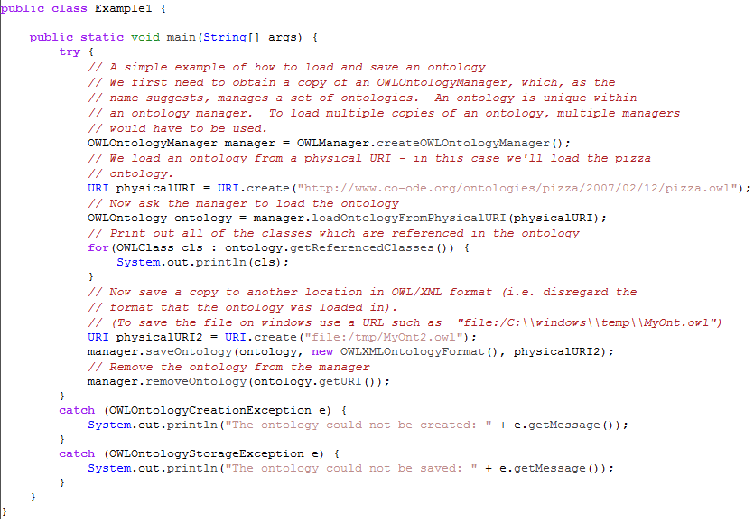
Loading and Saving an Ontology

Slide 3
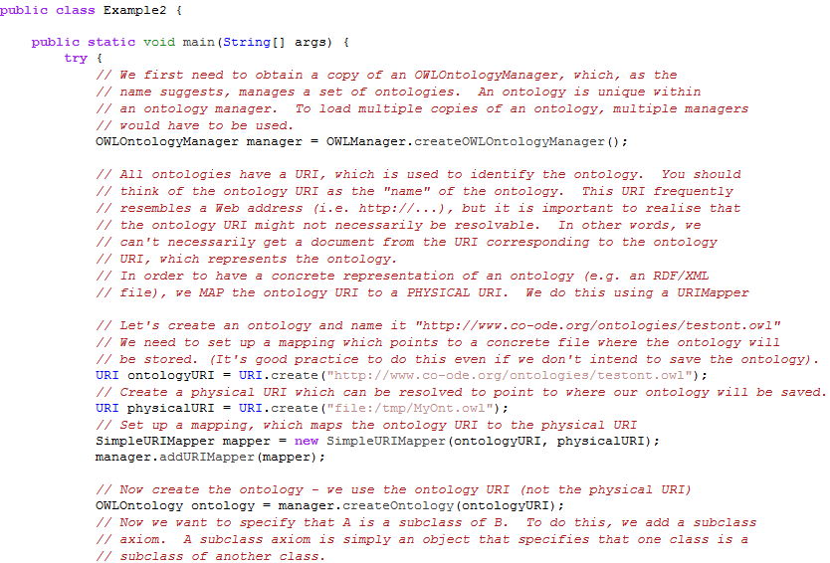
Creating an Empty Ontology, Adding Axioms, and Saving (I)

Slide 4
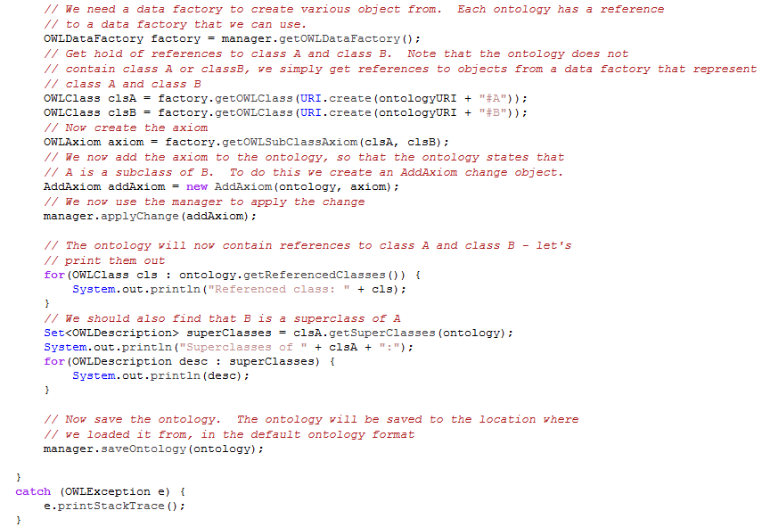
Creating an Empty Ontology, Adding Axioms, and Saving (II)

Slide 5
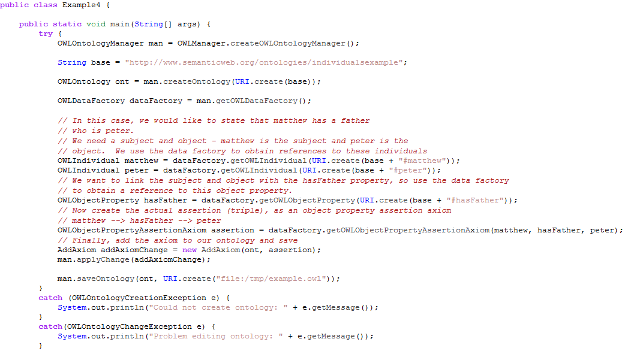
Adding an Object Property

Slide 6
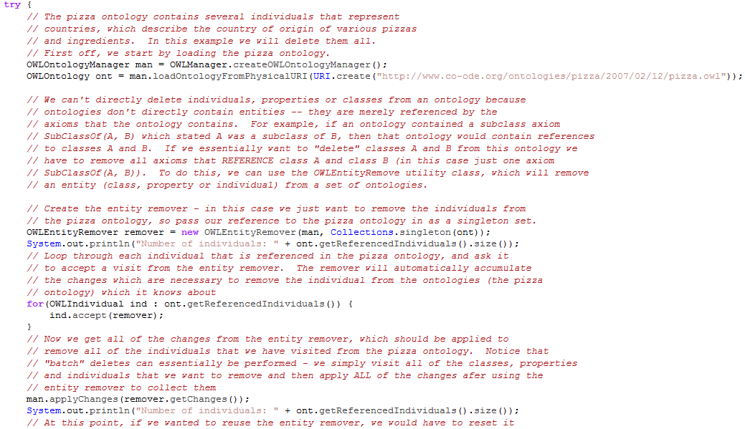
Deleting Entities

