Slide 1
Document Analysis
based on
Operation Punica
Oscar Corcho <ocorcho@fi.upm.es>
Carlos Badenes <cbadenes@fi.upm.es>
Ontology Engineering Group
Universidad Politécnica de Madrid
2015

Slide 2



Outline
CORPUS
METHODS
RESULTS
Optical Character Recognition (OCR)
Natural Language Processing (tokenization, Stemming, pos-tagging)
Entity Recognition
Topic Modeling (LDA)
Word Embedding (Word2Vec)
51 volumes ( 7.6 Gb ) that are part of the preliminary investigation of Operation Punica
Scanned documents (PDF)
Companies
People
Places
Keywords
Relations

Slide 3
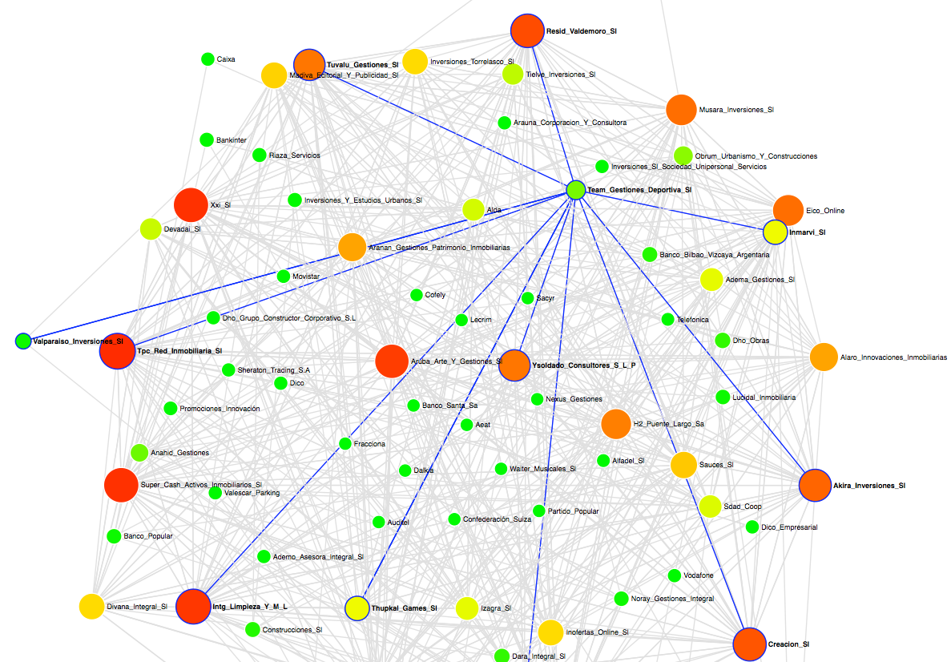
Companies

Slide 4
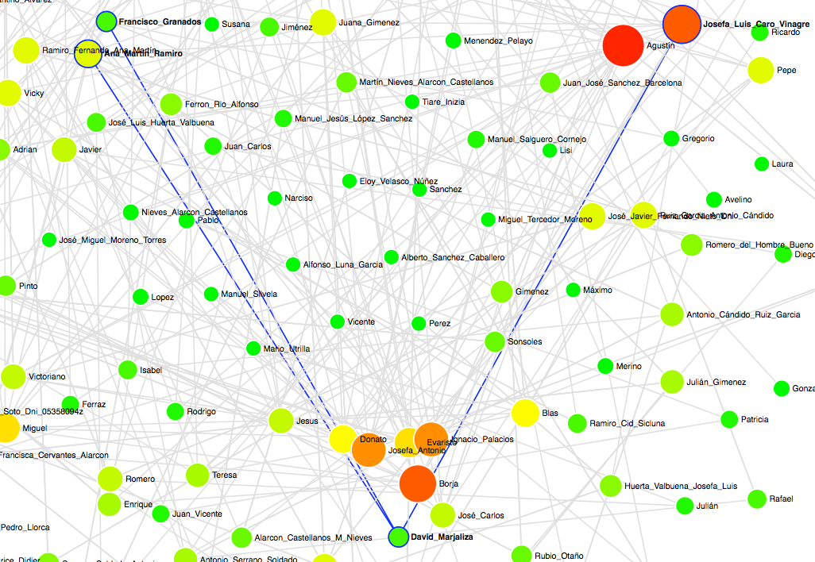
People

Slide 5
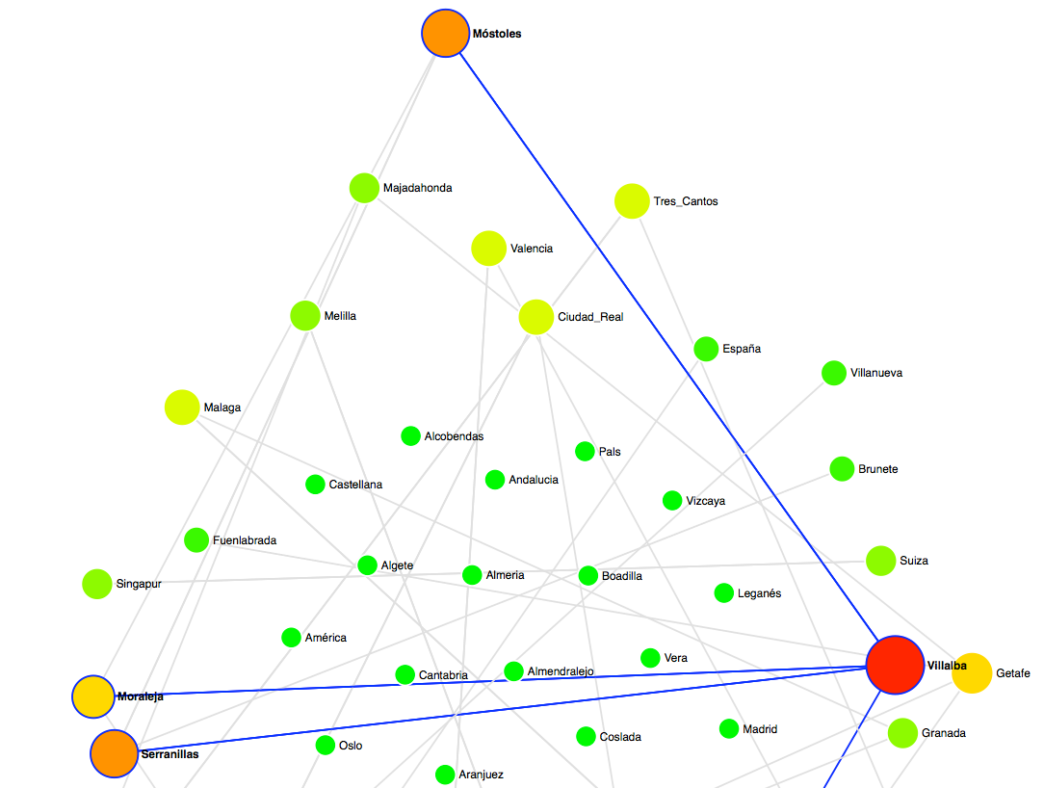
Places

Slide 6
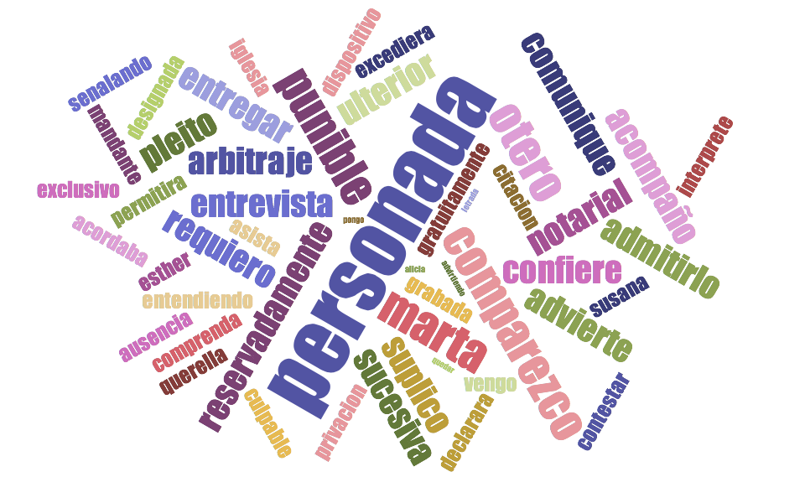
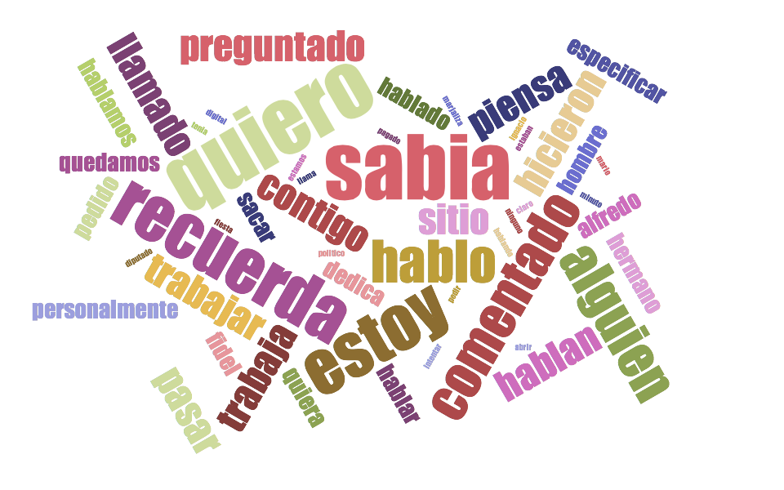
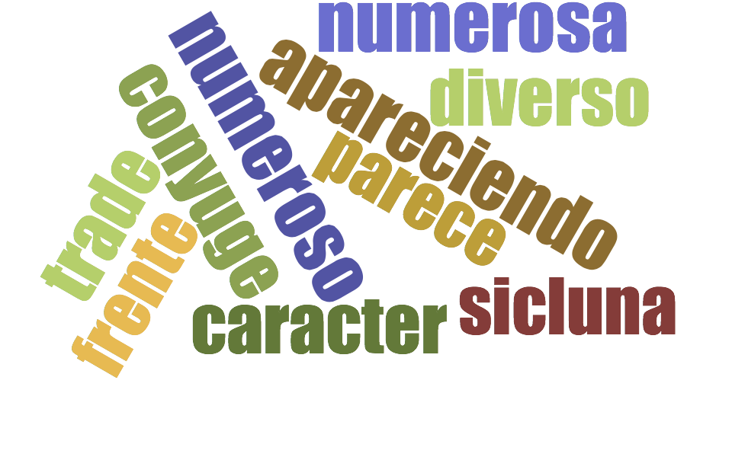
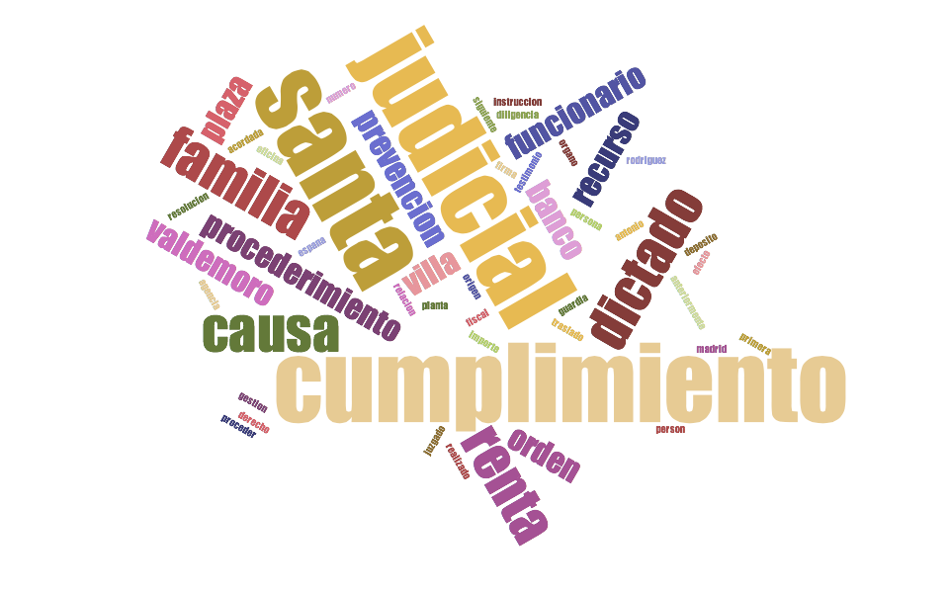
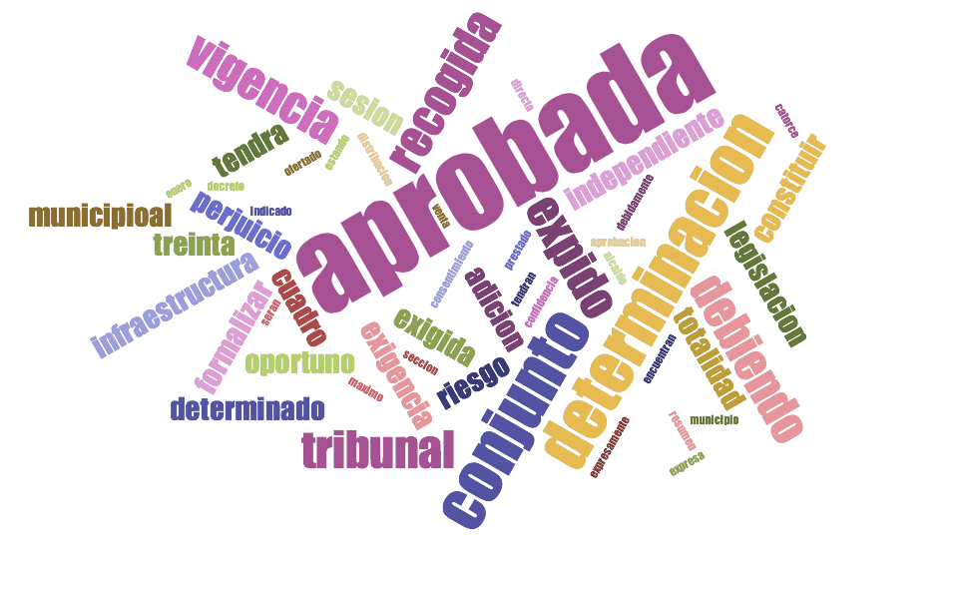
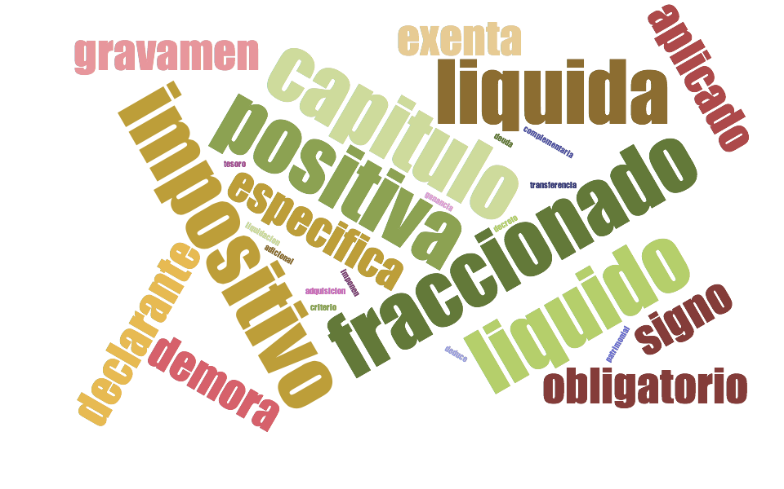
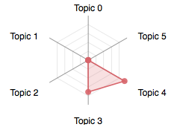
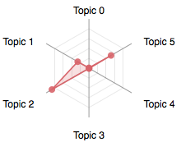
Keywords and Content Distribution
Topic 0
Topic 1
Topic 2
Topic 3
Topic 4
Topic 5
Volume 2
Volume 42

Slide 7
Context-based Relations
 | fase | defenderse | testimonio | posibilidad | sumarial
causa | 1.201 | 1.192 | 1.179 | 1.163 | 1.161
 | intervenido | evidencia | cargador | contraseña | ordenador
despacho | 1.121 | 1.117 | 1.080 | 1.073 | 1.068
 | barco | desconoce | nunca | manifiesta | Madiva
dinero | 1.079 | 1.075 | 1.047 | 1.039 | 1.003

