Slide 1


Semantic Web Rule Language
May 2008
Mari Carmen Suárez-Figueroa, Oscar Corcho
{mcsuarez, ocorcho}@fi.upm.es
Ontology Engineering Group. Departamento de Inteligencia Artificial
Facultad de Informática
Universidad Politécnica de Madrid

Slide 2
What is SWRL? (I)
SWRL is an acronym for Semantic Web Rule Language.
SWRL is intended to be the rule language of the Semantic Web.
SWRL is based on OWL: all rules are expressed in terms of OWL concepts (classes, properties, individuals, literals…).
SWRL is a combination of: OWL DL, OWL Lite, and RuleML.
SWRL extends OWL by means of including Horn-like rules.

Slide 3
What is SWRL? (II)
SWRL rules describes:
  Body (Antecedente) ⇨ Head (Consecuente)
Body and Head are composed by one or more atoms.
If Body is Empty, it implies true.
If Head is Empty, it implies that the Body is false.
Atoms can be: C(x), P(x,y), sameAs(x,y).
Examples:
Person(?p) ^ hasSibling(?p, ?s) ^ Man(?s) -> hasBrother(?p, ?s)
Person(Fred) ^ hasSibling(Fred, ?s) ^ Man(?s) -> hasBrother(Fred, ?s)

Slide 4
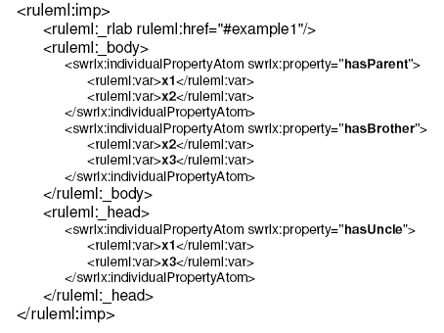
SWRL: Syntax XML Example
Example:
hasParent (?x,?y) ^ hasBrother(?y, ?z) → hasUncle(?x, ?z)

Slide 5
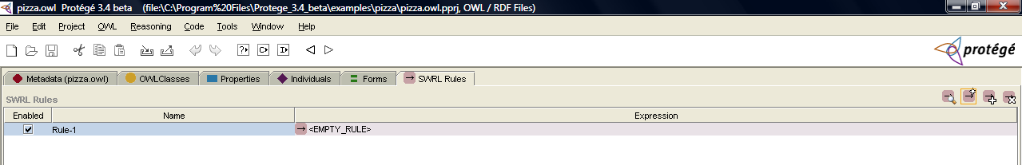
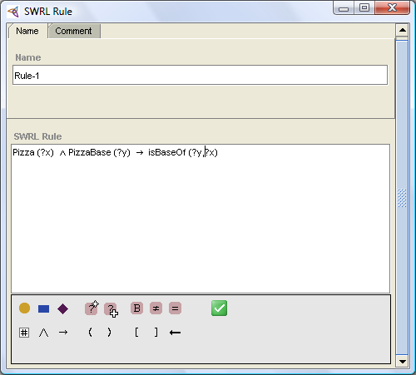
What is SWRL Tab?
The SWRL Tab is an extension to the Protégé-OWL Pluginthat permits the creation and execution of SWRL rules.
The editor can be used to create SWRL rules, edit existing SWRL rules, and read and write SWRL rules.

