Slide 1
SparqlDQP
Stay at EPCC & NeSC
Carlos Buil Aranda
Ontology Engineering Group
Facultad de Informática
Universidad Politécnica de Madrid
cbuil@fi.upm.es
5th November 2009
Notes:
Hello everybody, my name is Carlos Buil and I will present you the work I did during my stay in Edinburgh, at EPCC and NeSC

Slide 2
Table of Contents
Introduction
OGSA-DAI & OGSA-DQP
SparqlDQP
Future work
Way of working at
  EPCC
  NeSC
Conclusions
Notes:
This is the outline of the presentation: intro, in which I detail the problems/existing approaches of querying federated RDF repositories
Then I will introduce you to OGSA-Dai and DQP, briefly
Once you know the basics I will explain to you the work I did at EPCC, which is the development of SparqlDQP: a federates and optimises queries to RDF repositories using Sparql
I will tell you the next steps I will address in the next section, just before I explain to you how people work at EPCC and NeSC
Finally I will draw some conclusions about all the presentation

Slide 3
Table of Contents
Introduction
OGSA-DAI & OGSA-DQP
SparqlDQP
Way of working at
  EPCC
  NeSC
Conclusions

Slide 4
Introduction
Can RDB2RDF Tools Feasibly Expose Large Science Archives for Data Integration?, ESWC 2009
  No, among other reasons there is no research in Sparql Query Optimisation (authors dixit)
Currently there are only a few approaches to federate SPARQL queries
  Networked Graphs (Staab WWW2008)
  Executing SPARQL Queries over the Web of Linked Data (Hartig, Bizer, Freytag, ISWC09)
  DARQ (2006)
  SemWIQ (Langegger, iiWAS2008)
Problems from the previous approaches
  They implement a basic system for optimising Sparql queries
  They do not take into account blank nodes
Notes:
First, in the motivation, there is the paper at ESWC09 in which the authors state that RDB2RDF tools are not useful in eScience or with large quantities of data. They performed some experiments and they arrived to the conclusion that these systems + sparql are too slow, it is worth to use relational db. Among other reasons they said that query optimisation techniques for SPARQL are not mature enough. And it is easy to see that there are not many systems that allow people to query linked data or data in RDF.
These approaches are the following:
- Networked graphs: semaplorer, allows to define aset of rdf graphs which can be queried
- Sem Web client library, which is described in this paper: allows to query the sem web
- DARQ: Jena’s distributed query engine
- SemWIQ: system mediator-wrapper based that queries multiple data sources
The most important problem of them is that they do not optimise the queries (or just basic optimisation) but SemWIQ which is the nicest system for me, but it has some other limitations: I have not see data WF there, I suppose they have indirect access since it is implemented over a Grid middleware, but not sure, and others.
it is a system for accessing heterogeneous sources of data. Based on wrapper-mediator technology. Ontology in the mediator which is possible to query using sparql. It generates query plans which are optimised, using IDP algorithm (Iterative Data Programming alg) used in SQL optimisations, not useful for large query plans.
Difference with my approach: I’m not using a wrapper which may lead to bad performance (to be tested), I use directly SQL operators, easily extensible (seems that SemWIQ too), they use statistics (I do not), I use indirect access, OGSA-DAI robustness is a pro, integration with other sources of data via direct queries, but they use Grid services as well (even thought that they do not say anything about indirect access). I have possibility of create data workflows. They do not specify anything about

Slide 5
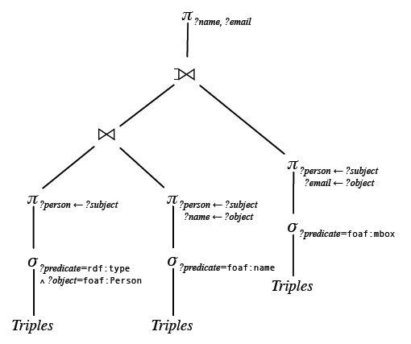
Introduction
Proposal: use existing techniques for SQL query optimisation in SPARQL
Why?
  A relational algebra for SPARQL, Richard Cyganiak (2005)
  The expressive power of SPARQL, Renzo Angles and Claudio Gutierrez (2008)
SELECT ?name ?email
WHERE {
?person rdf:type foaf:Person .
?person foaf:name ?name .
OPTIONAL { ?person foaf:mbox ?email }
}
Notes:
So my proposal is to optimise sparql using some of the available SQL techniques. Why? These two papers, the first one describes the semantics of sparql in terms of a LQP and the second states that Relational Algebra and Sparql have the same expressive power, one can be translated to the other.
Here is an example...

Slide 6
Table of Contents
Introduction
OGSA-DAI & OGSA-DQP
SparqlDQP
Reasoning Web Summer School
Way of working at
  EPCC
  NeSC
Conclusions
Notes:
Now I will explain to you the technology I used to do this: OGSA-DAI and DQP

Slide 7
OGSA-DAI
OGSA-DAI is
  An extensible framework that allows to
  Access, integrate, transform and deliver
  Distributed and heterogeneous sources of data
  Implements part of the WS-DAI specification
OGSA-DAI key elements are
  Resources (Data Resource)
  Activities (=operations or named unit of functionality)
  Workflows (=composition of activities)
    Pipeline workflow (A set of chained activities executed in parallel with data flowing between the activities)
    Sequence workflow
    Parallel workflow
OGSA-DAI provides indirect access to data resources
Notes:
Example activities include
Execute an SQL query
ZIP a batch of data
List the files in a directory
Execute an XSL transform on an XML document
Deliver data to an FTP server
A data request execution resource, or DRER, accepts requests from clients, executes these and possibly returns results. A DRER is associated with 0 or more OGSA-DAI data resources. A DRER can be viewed as a workflow management and execution resource.
Carlos Buil Aranda

Slide 8
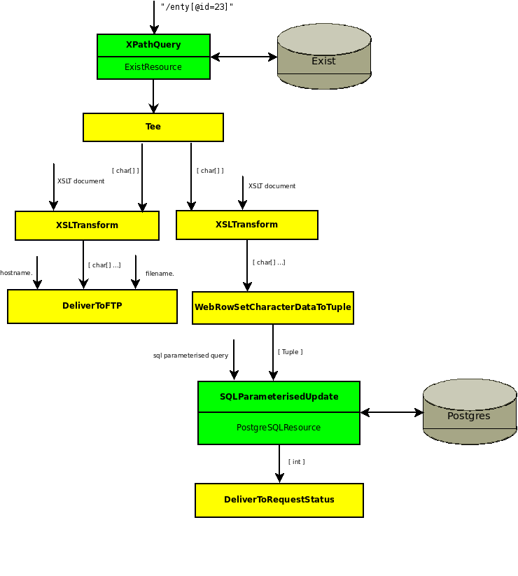
OGSA-DAI
Notes:
Example of OGSA-DAI workflow

Slide 9
OGSA-DQP
OGSA-DQP
  Developed by Universities of Manchester and Newcastle
  Refactored for OGSA-DAI 3.0 by EPCC as part of the NextGrid project OGSA-DAI DQP package
Multiple tables on multiple databases are exposed to clients as multiple tables in one “virtual database”
Clients are unaware of the multiple databases
Databases can be exposed
  EITHER within one OGSA-DAI server
  OR via multiple remote OGSA-DAI servers
Source: http://www.ogsadai.org.uk/documentation/presentations/ogf25/OGF-25-OGSA-DAI-Tutorial.pdf
Notes:
OGSA-DQP was an extension to OGSA-DAI, now it is integratid in OD, developed initially by univs of Manchester and Newcastle and refactored for OGSA-DAI 3.0
Allows users to see multiple databases as one single virtual DB. Clients do not realise of that there are several databases

Slide 10
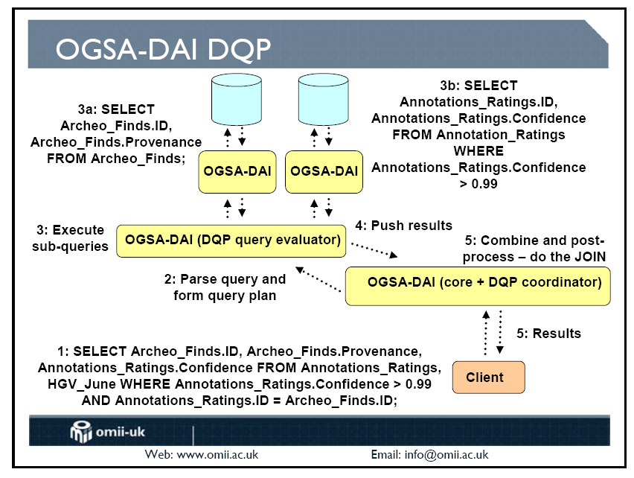
OGSA-DQP
Source: http://www.ogsadai.org.uk/documentation/presentations/ogf25/OGF-25-OGSA-DAI-Tutorial.pdf
Notes:
Example...

Slide 11
Table of Contents
Introduction
OGSA-DAI & OGSA-DQP
RDF Resource & SparqlDQP
Future work
Way of working at
  EPCC
  NeSC
Conclusions
Notes:
And now I will explain to you how I extended OD and ODQP with support for RDF and Sparql

Slide 12

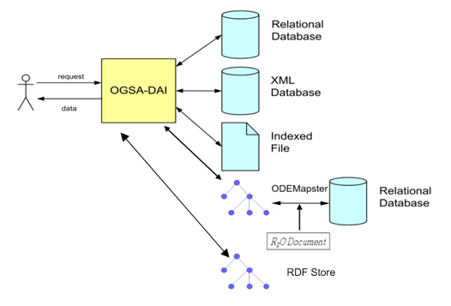
RDF Resource
Notes:
First, the RDF extension of OGSA_DAI... Two new resources, queryable using Sparql...

Slide 13
SparqlDQP
Proposal:
  Extend OGSA-DQP with a new query language: SPARQL
  SPARQL is “similar” to SQL
    Both have the same expressive power
    It is possible to use DQP operators for SPARQL
  Current status: optimising simple SPARQL queries
PREFIX p: <http://dbpedia.org/property/>
SELECT ?dbpediaResource.player ?RDFResource.club
FROM dbpediaResource: <http://dbpedia.org/sparql/>
FROM RDFResource: <http://dbpedia.org/sparql/>
WHERE{
?dbpediaResource.player p:cityofbirth <http://dbpedia.org/resource/Stryn>.
OPTIONAL {?RDFResource.player p:currentclub ?RDFResource.club}}
Notes:
And now that we can query RDF resources, we extend DQP with Sparql, extending a little bit Sparql as well. In bold there are the extensions I did to Sparql, I specify which resource I’m querying...

Slide 14
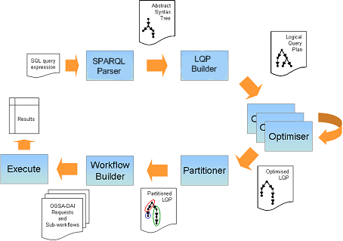
SparqlDQP workflow
Notes:
And now I will show you how this query is processed. This is the workflow that DQP follows and I extended it to manage Sparql, not only SQL.

Slide 15

SparqlDQP workflow
Notes:
First, the we need to read a Sparql query, so I implemented a Sparql parser that reads the previous query and creates an Abstract Syntaxt Tree

Slide 16
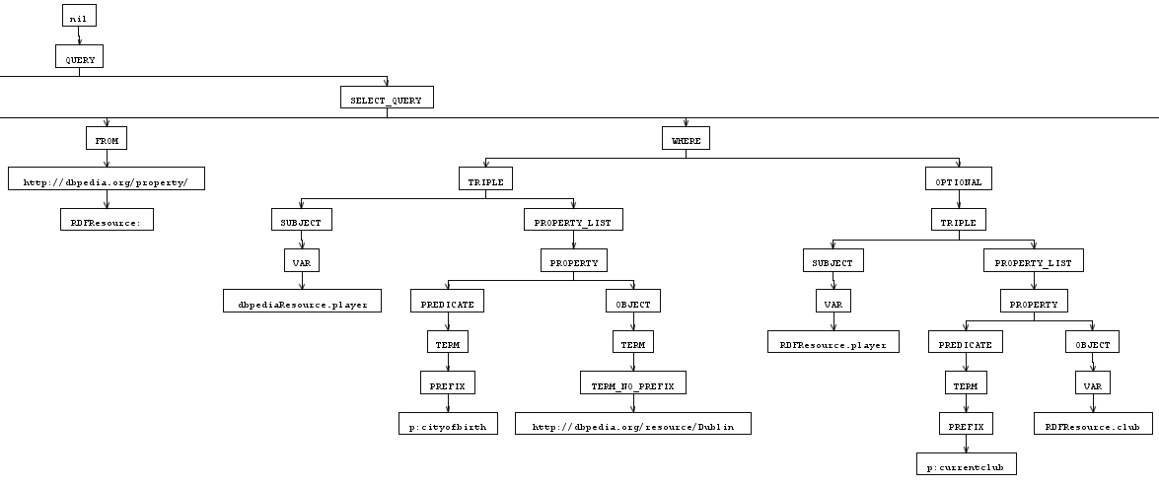
Sparql Parser
Based on Sparql-g Grammar (which is based on the WWW Sparql recommendation)
Use of Antlr to create an AST from the grammar
Notes:
It is based on the Sparql-g grammar, which is compliant with the WWW Sparql recommendation
I used antlr, which is a which is a tool for building parsers among other things. I created the following AST which afterwards can be manipulated, triples, where, subject, predicate, object, etc.

Slide 17

SparqlDQP workflow
Notes:
Next, once we have recognised all the elements from the query, we create the Sparql LQP

Slide 18
Sparql LQP Builder
The LQP builder crawls the AST and builds an LQP
The Sparql LQP builder uses OGSA-DQP operators
  RDF Table Scan Operator (not DQP)
  DQP (SQL) Select Operator
  DQP (SQL) Project Operator
  DQP (SQL) Inner theta join (with an equality) for triple patterns
  DQP (SQL) Left Outer Join for OPTIONAL
Notes:
The LQP builder crawls the AST and builds the LQP
I use the operators that DQP has for SQL: select, project, inner theta join and left outer join

Slide 19
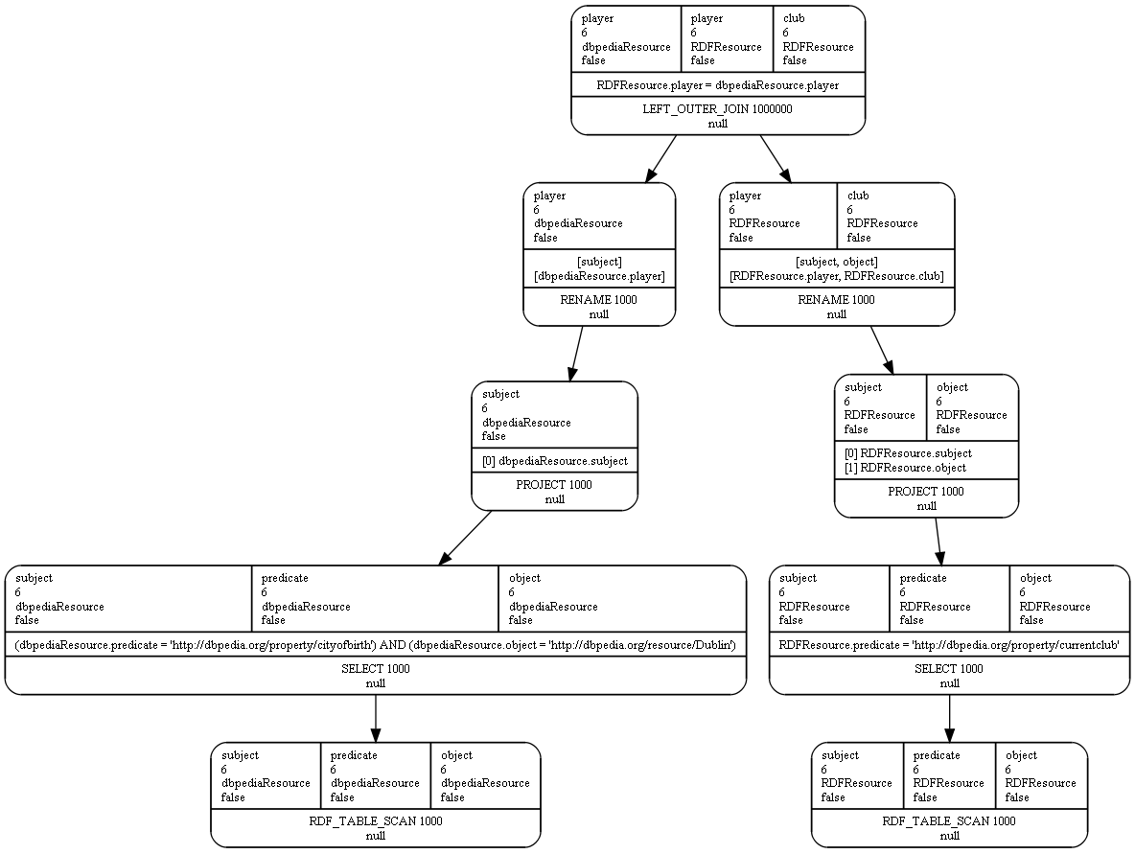
Sparql LQP Builder Output
Notes:
This is the LQP generated from the previous query
RDF triple scan here which reads all the triple store, projects, selects, joins, etc.

Slide 20

SparqlDQP workflow
Notes:
Next, once we have the LQP we have to optimise it, because as you saw before is not really optimal

Slide 21
Optimisers
Configuration file in which the existing optimisers are defined
  Executed in a specific order
  Currently running
    Query normaliser
    Partitioning Optimiser
    RDF Table Scan implosion optimiser
RDF Table Scan implosion optimiser
  Merges the initial RDF scan, select and project
Notes:
The optimisers are specified in a configuration file, and the order of them matters
Currently there are implemented just 3: query normaliser, which eliminates unnecessary operators, partitioner, which distributes (partitions) the query and RDF table scan implosion, which merges the final set of operators...

Slide 22

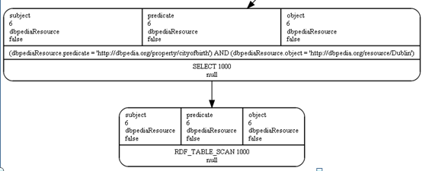
SparqlDQP optimisations
Notes:
The first optimisation to apply is the RDF table scan implosion optimisation

Slide 23
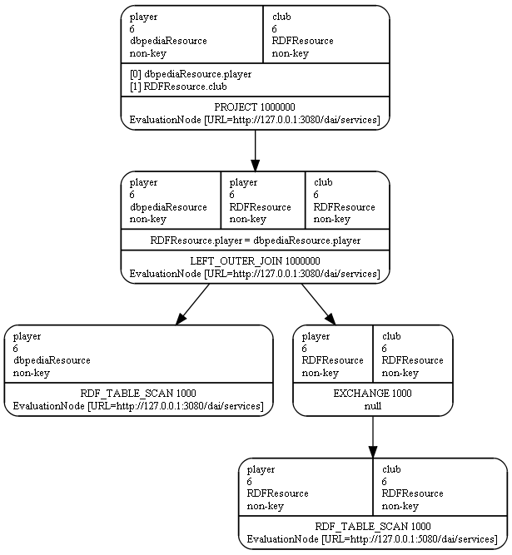
Optimised LQP

Slide 24

SparqlDQP workflow

Slide 25
Partitioner
Partitions the SparqlLQP in the available nodes
OGSA-DQP knows all the nodes
  IP
  Resources in the node
  The partitioner is included in the optimisers chain
OGSA-DQP knowing the LQP and the nodes creates an execution plan which is distributed across these nodes
Important:
  OGSA-DQP for SQL has a dictionary with the SQL database statistics
  For SPARQL there are missing key statistics for improving the optimisations
Notes:
Partitioner, it is specified as a stage in the workflow but it is a optimisation

Slide 26

SparqlDQP workflow
Notes:
Now, once we have a query plan optimised, we have to execute it across the nodes

Slide 27
Workflow Builder
At this stage an executable workflow is created
  It is created from the optimised LQP
It uses the OGSA-DAI activity SQLQueryActivity
  We do not modify anything from this activity
  The Sparql LQP is sent to the SQL activity
  And a workflow is created
  This is possible because the RDF resource (which runs the final query) is totally integrated within OGSA-DAI & DQP
  Result formats between activities accessing resources are the same
  Possibility of creating data workflows combining RDF data and SQL data

Slide 28

SparqlDQP execution
Notes:
We execute it

Slide 29
The results
Problems with the results retrieved from DBPedia: I do not get all of them, limited to a certain amount, solution on its way
(previous) query:
PREFIX p: <http://dbpedia.org/property/>
SELECT ?dbpediaResource.player ?RDFResource.club
FROM dbpediaResource: <http://dbpedia.org/property/>
FROM RDFResource: <http://dbpedia.org/property/>
WHERE{
?dbpediaResource.player p:cityofbirth <http://dbpedia.org/resource/Stryn>.
OPTIONAL {?RDFResource.player p:currentclub ?RDFResource.club}}
Notes:
After the execution we get the results. I have a problem which is that sometimes I make a very expensive query and I do not get all the results I want

Slide 30
Results
Results:
player - club -
http://dbpedia.org/resource/Jarle_Flo - null -
http://dbpedia.org/resource/H%C3%A5vard_Flo - null -
http://dbpedia.org/resource/Tore_Andr%C3%A9_Flo - null -
http://dbpedia.org/resource/Jostein_Flo - Strømsgodset (director of football) -
http://dbpedia.org/resource/Per_Egil_Flo - null -
Notes:
These are the results, most of the nulls is because I did a too expensive query

Slide 31
Table of Contents
Introduction
OGSA-DAI & OGSA-DQP
RDF Resource & SparqlDQP
Future work
Way of working at
  EPCC
  NeSC
Conclusions
Notes:
Now, future work (2 months time)

Slide 32
Future work (I)
Improve the operators used by Sparql DQP
  isURI
  Regex
  notBound
  etc.
Solve DBPedia problem
Add statistics to SparqlDQP
Use several RDF repositories
  Currently only using DBPedia
  Use Web services like http://sameas.org/ to obtain and link several RDF repositories
Complete the SPARQL grammar
Notes:
First thing is to inish with some basic things of SPARQL, like Filters
Complete the sparql grammar

Slide 33
Future Work (II)
Study the semantics of Sparql to create new optimisers
Create new optimisers based:
  On SPARQL
  How SQL optimisers work in SPARQL?
Create data workflows using other OGSA-DAI resources
Integrate in one single query queries to RDF stores and SQL DB?

Slide 34
Future work (III)
Solve problems with blank nodes
  Example: query several foaf profiles
  Blank nodes used as identifiers
  Claudio Gutierrez’s group is working in exactly this problem
  Already contacted for information
PREFIX foaf: <http://xmlns.com/foaf/0.1/>
SELECT ?person ?name ?mbox WHERE
{ ?person foaf:name ?name .
OPTIONAL { ?person foaf:mbox ?mbox}
}
Notes:
And next solve the problems with blank nodes. I contacted Marcelo Arenas (colleague of Claudio Gutierrez) and they are working in exactly the same but in a more theoretical approach

Slide 35
Table of Contents
Introduction
OGSA-DAI & OGSA-DQP
RDF Resource & SparqlDQP
Future work
Way of working at
  EPCC
  NeSC
Conclusions

Slide 36
Way of working at EPCC
EPCC (Edinburgh Parallel Computing Centre)
Is a software production centre mainly
OGSA-DAI example
  The team is focused on a product
  The leader of the team (Ally Hume) specifies a set of actions
  The team executes the actions
  Example: performance was poor in a specific type of query (median filter)
    Yourkit4java for performance measures
    Find the problem
    Try to solve it
    All the team (about 6 people working on that) was very united
Notes:
Another thing to take into account is the way of working of other research groups. I was visiting mainly the EPCC but I also went several times to NeSC.
The first one, EPCC is mainly a software roduction centre, very aligned with research and NeSC
The focus in a software product, an example is OGSA-DAI

Slide 37
Way of working at NeSC
National eScience Centre
More academic focused than EPCC
Every week session on what papers are we going to publish, ideas, papers published and deadlines
More research focused
  Example: talking to people from different groups
  EPCC focused on the poor performance of the automatic composition of data mining workflows in ADMIRE
    There are going to be many problems there
  NeSC focused on wow! We are getting nice results and we will publish them!

Slide 38
Table of Contents
Introduction
OGSA-DAI & OGSA-DQP
RDF Resource & SparqlDQP
Future work
Way of working at
  EPCC
  NeSC
Conclusions

Slide 39
Conclusions
Created a OGSA-DAI resource for accessing RDF data
Created a Sparql query processor
  Which distributes and optimises queries
Used equivalence with SQL operators
  A complete set of test must be performed
Found problems using blank nodes
For optimising Sparql queries is mandatory to understand the semantics of Sparql
Organisations: Two different ways of working
  EPCC: production focused
  NeSC: research/academic focused

Slide 40
SparqlDQP
Stay at EPCC & NeSC
Carlos Buil Aranda
Ontology Engineering Group
Facultad de Informática
Universidad Politécnica de Madrid
cbuil@fi.upm.es
5th November 2009

Slide 41
SparqlDQP Features
Adapted SPARQL grammar for distributed SPARQL
  SELECT ?dbpedia.person FROM dbpedia WHERE {...}
Query plan similar to SQL query plans
  SQL optimisations can be applied to them
Current Optimisers
  Query Normaliser
  Partitioner
  RDF Table Scan Implosion
Automatic creation of data workflows
Distribution across the OGSA-DAI nodes

Slide 42
Sample Queries
PREFIX p: <http://dbpedia.org/property/>
SELECT ?dbpediaResource.player ?RDFResource.club
FROM dbpediaResource: <http://dbpedia.org/sparql>
FROM RDFResource: <http://dbpedia.org/sparql>
WHERE{
?dbpediaResource.player p:cityofbirth <http://dbpedia.org/resource/Stryn>.
?dbpediaResource.player p:countryofbirth <http://dbpedia.org/resource/Norway>
OPTIONAL {?RDFResource.player p:currentclub ?RDFResource.club}}
PREFIX p: <http://dbpedia.org/property/>
SELECT ?dbpediaResource.player ?RDFResource.club
FROM dbpediaResource: <http://dbpedia.org/sparql>
FROM RDFResource: <http://dbpedia.org/sparql>
WHERE{" +
?dbpediaResource.player p:cityofbirth <http://dbpedia.org/resource/Dublin>.
OPTIONAL {?RDFResource.player p:currentclub ?RDFResource.club}}

Slide 43
Way of working at EPCC
Software production Centre
  Focused on a software product
  High performance test

