Slide 1



OWL and SWRL
Oscar Corcho, María del Carmen Suárez de Figueroa Baonza
ocorcho@fi.upm.es, mcsuarez@delicias.dia.fi.upm.es
http://www.oeg-upm.net/
Ontological Engineering Group
Laboratorio de Inteligencia Artificial
Facultad de Informática
Universidad Politécnica de Madrid
Campus de Montegancedo sn,
28660 Boadilla del Monte, Madrid, Spain
Work distributed under the license Creative Commons Attribution-Noncommercial-Share Alike 3.0

Slide 2



Main References
Gómez-Pérez, A.; Fernández-López, M.; Corcho, O. Ontological Engineering. Springer Verlag. 2003
Capítulo 4: Ontology languages
Baader F, McGuinness D, Nardi D, Patel-Schneider P (2003)
The Description Logic Handbook: Theory, implementation and applications.
Cambridge University Press, Cambridge, United Kingdom
Dean M, Schreiber G (2004) OWL Web Ontology Language Reference. W3C Recommendation.
http://www.w3.org/TR/owl-ref/
Horrocks I, Patel-Schneider PF, Boley H, Tabet S, Grosof B, Dean M (2004) SWRL: A Semantic Web Rule Language
Combining OWL and RuleML. W3C Member Submission. http://www.w3.org/Submission/SWRL/
Jena web site: http://jena.sourceforge.net/
Jena API: http://jena.sourceforge.net/tutorial/RDF_API/
Jena tutorials: http://www.ibm.com/developerworks/xml/library/j-jena/index.html
http://www.xml.com/pub/a/2001/05/23/jena.html
Pellet: http://pellet.owldl.com/
RACER: http://www.racer-systems.com/
FaCT++: http://owl.man.ac.uk/factplusplus/

Slide 3
Table of Contents
An introduction to Description Logics 60’
Web Ontology language (OWL) 60’
  2.1. OWL primitives
  2.2. Reasoning with OWL
OWL Development Tools: Protégé 75’
  3.1 Basic OWL edition
  3.2 Advanced OWL edition: restrictions, disjointness, etc.
OWL management APIs 30’
  4.1 An example of an OWL-based application
SWRL 15’

Slide 4
Description Logics
A family of logic based Knowledge Representation formalisms
  Descendants of semantic networks and KL-ONE
  Describe domain in terms of concepts (classes), roles (relationships) and individuals
    Specific languages characterised by the constructors and axioms used to assert knowledge about classes, roles and individuals.
    Example: ALC (the least expressive language in DL that is propositionally closed)
      Constructors: boolean (and, or, not)
      Role restrictions
Distinguished by:
  Formal semantics (typically model theoretic)
    Decidable fragments of FOL
    Closely related to Propositional Modal & Dynamic Logics
  Provision of inference services
    Sound and complete decision procedures for key problems
    Implemented systems (highly optimised)

Slide 5
DL Architecture
Knowledge Base
Tbox (schema)
Man ⊆ Human ∩ Male
Happy-Father ⊆ Man ∩ ∀ has-child Female ∩ …
Interface
Inference System
Abox (data)
John ∈ Happy-Father
(John, Mary) ∈ has-child
John ∈ (= 1 has-child)

Slide 6
Most common constructors in class definitions
Intersection: C₁ ∩ ... ∩ C_{n} Human ∩ Male
Union: C₁ ∪ ... ∪ C_{n} Doctor ∪ Lawyer
Negation: ¬C ¬Male
Nominals: {x₁} ∪ ... ∪ {x_{n}} {john} ∪ ... ∪ {mary}
Universal restriction: ∀P.C ∀hasChild.Doctor
Existential restriction: ∃P.C ∃hasChild.Lawyer
Maximum cardinality: ≤nP ≤3hasChild
Minimum cardinality: ≥nP ≥1hasChild
Specific Value: ∃P.{x} ∃hasColleague.{Matthew}
Nesting of constructors can be arbitrarily complex
  Person ∩ ∀hasChild.(Doctor ∪ ∃hasChild.Doctor)
Lots of redundancy
  A∪B is equivalent to ¬(¬ A ∩ ¬B)
  ∃P.C is equivalent to ¬∀P. ¬C

Slide 7
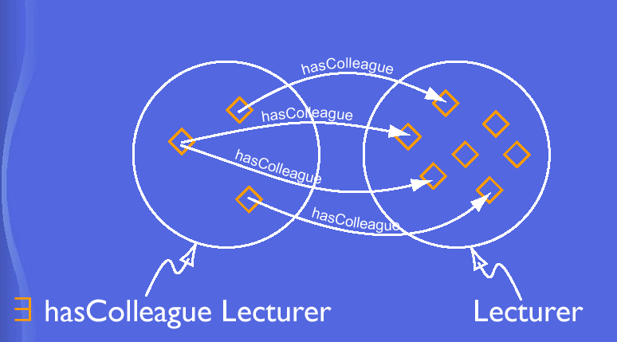
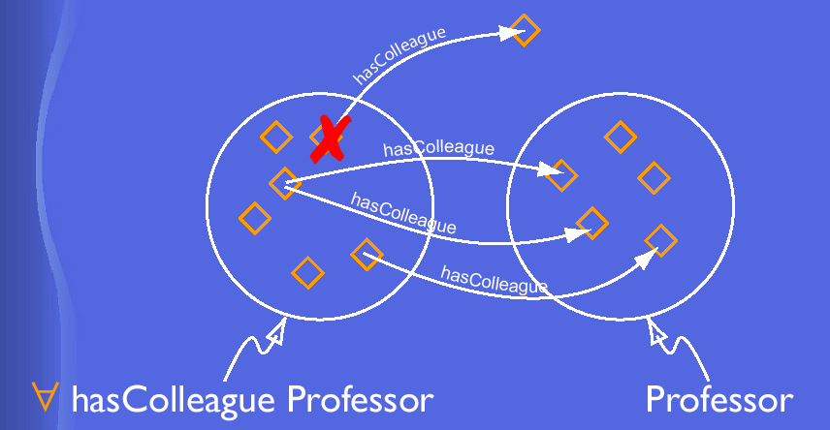
Existential and Universal Restrictions

Slide 8
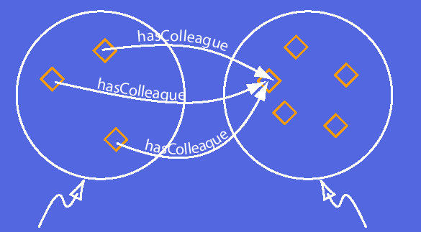
Specific value
∃hasColleague.{Matthew}
Persons

Slide 9
Most common axioms in class, property and individual definitions
Classes
  Subclass C1 ⊆ C2 Human ⊆ Animal ∩ Biped
  Equivalence C1 ≡ C2 Man ≡ Human ∩ Male
  Disjointness C1 ∩ C2 ⊆ ⊥ Male ∩ Female ⊆ ⊥
Properties/roles
  Subproperty P1 ⊆ P2 hasDaughter ⊆ hasChild
  Equivalence P1 ≡ P2 cost ≡ price
  Inverse P1 ≡ P2⁻ hasChild ≡ hasParent⁻
  Transitive P+ ⊆ P ancestor+ ⊆ ancestor
  Functional Τ ⊆ ≤1P T ⊆ ≤1hasMother
  InverseFunctional Τ ⊆ ≤1P⁻ T ⊆ ≤1hasPassportID⁻
Individuals
  Equivalence {x1} ≡ {x2} {oeg:OscarCorcho} ≡ {img:Oscar}
  Different {x1} ≡ ¬{x2} {john} ≡ ¬{peter}
Most axioms are reducible to inclusion (∪)
  C ≡ D iff both C ⊆ D and D ⊆ C
  C disjoint D iff C ⊆ ¬D

Slide 10
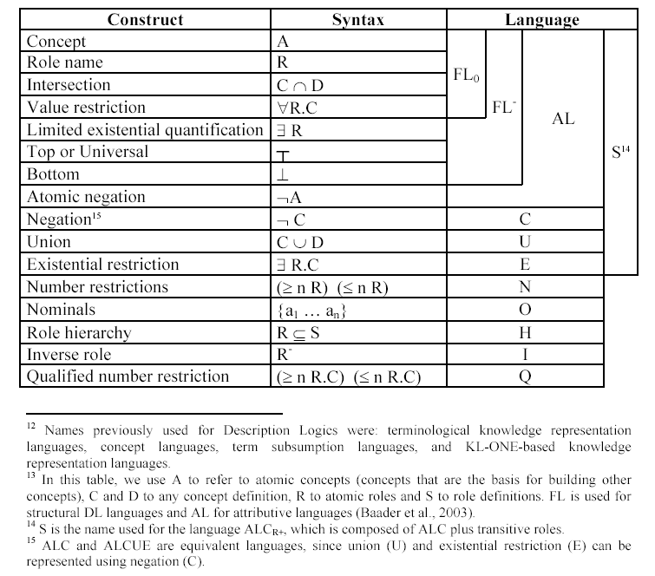
DL constructors and DL languages
{Colombia, Argentina, México, ...} → MercoSur countries
≤2 hasChild.Female, ≥1 hasParent.Male
Other:
Concrete datatypes: hasAge.(<21)
Transitive roles: hasChild* (descendant)
Role composition: hasParent o hasBrother (uncle)
OWL is SHOIN(D+)

Slide 11
Some basic DL modelling guidelines
X must be Y, X is an Y that... → X ⊆ Y
X is exactly Y, X is the Y that... → X ≡ Y
X is not Y (not the same as X is whatever it is not Y) → X ⊆ ¬Y
X and Y are disjoint → X ∩ Y ⊆ ⊥
X is Y or Z → X ⊆Y∪Z
X is Y for which property P has
only instances of Z as values → X ⊆ Y ∩ (∀P.Z)
X is Y for which property P has at
least an instance of Z as a value → X ⊆ Y ∩ (∃P.Z)
X is Y for which property P has at
most 2 values → X ⊆ Y∩ (≤ 2.P)
Individual X is a Y → X∈Y

Slide 12

Description Logics Formalisation
Develop a sample ontology in the domain of people, pets, vehicles, and newspapers
- Understand how to formalise knowledge in description logics

Slide 13
Chunk 1. Formalize in DL
1. Concept definitions:
  Grass and trees must be plants. Leaves are parts of a tree but there are other parts of a tree
  that are not leaves. A dog must eat bones, at least. A sheep is an animal that must only eat
  grass. A giraffe is an animal that must only eat leaves. A mad cow is a cow that eats brains
  that can be part of a sheep.
2. Restrictions:
Animals or part of animals are disjoint with plants or parts of plants.
3. Properties:
Eats is applied to animals. Its inverse is eaten_by.
4. Individuals:
Tom.
Flossie is a cow.
Rex is a dog and is a pet of Mick.
Fido is a dog.
Tibbs is a cat.

Slide 14
Chunk 2. Formalize in DL
1. Concept definitions:
Bicycles, buses, cars, lorries, trucks and vans are vehicles. There are several types of
companies: bus companies and haulage companies.
An elderly person must be adult. A kid is (exactly) a person who is young. A man is a person
who is male and is adult. A woman is a person who is female and is adult. A grown up is a
person who is an adult. And old lady is a person who is elderly and female. Old ladies
must have some animal as pets and all their pets are cats.
2. Restrictions:
Youngs are not adults, and adults are not youngs.
3. Properties:
Has mother and has father are subproperties of has parent.
4. Individuals:
Kevin is a person.
Fred is a person who has a pet called Tibbs.
Joe is a person who has at most one pet. He has a pet called Fido.
Minnie is a female, elderly, who has a pet called Tom.

Slide 15
Chunk 3. Formalize in DL
1. Concept definitions:
A magazine is a publication. Broadsheets and tabloids are newspapers. A quality broadsheet
is a type of broadsheet. A red top is a type of tabloid. A newspaper is a publication that must
be either a broadsheet or a tabloid.
White van mans must read only tabloids.
2. Restrictions:
Tabloids are not broadsheets, and broadsheets are not tabloids.
3. Properties:
The only things that can be read are publications.
4. Individuals:
Daily Mirror
The Guardian and The Times are broadsheets
The Sun is a tabloid

Slide 16
Chunk 4. Formalize in DL
1. Concept definitions:
A pet is a pet of something. An animal must eat something. A vegetarian is an animal
that does not eat animals nor parts of animals. Ducks, cats and tigers are animals.
An animal lover is a person who has at least three pets. A pet owner is a person who
has animal pets. A cat liker is a person who likes cats. A cat owner is a person who has
cat pets. A dog liker is a person who likes dogs. A dog owner is a person who has dog pets.
2. Restrictions:
Dogs are not cats, and cats are not dogs.
3. Properties:
Has pet is defined between persons and animals. Its inverse is is_pet_of.
4. Individuals:
Dewey, Huey, and Louie are ducks.
Fluffy is a tiger.
Walt is a person who has pets called Huey, Louie and Dewey.

Slide 17
Chunk 5. Formalize in DL
1. Concept definitions
A driver must be adult. A driver is a person who drives vehicles. A lorry driver is a person who
drives lorries. A haulage worker is who works for a haulage company or for part of
a haulage company. A haulage truck driver is a person who drives trucks ans works for part of
a haulage company. A van driver is a person who drives vans. A bus driver is a person who
drives buses. A white van man is a man who drives white things and vans.
2. Restrictions:
--
3. Properties:
The service number is an integer property with no restricted domain
4. Individuals:
Q123ABC is a van and a white thing.
The42 is a bus whose service number is 42.
Mick is a male who read Daily Mirror and drives Q123ABC.

Slide 18
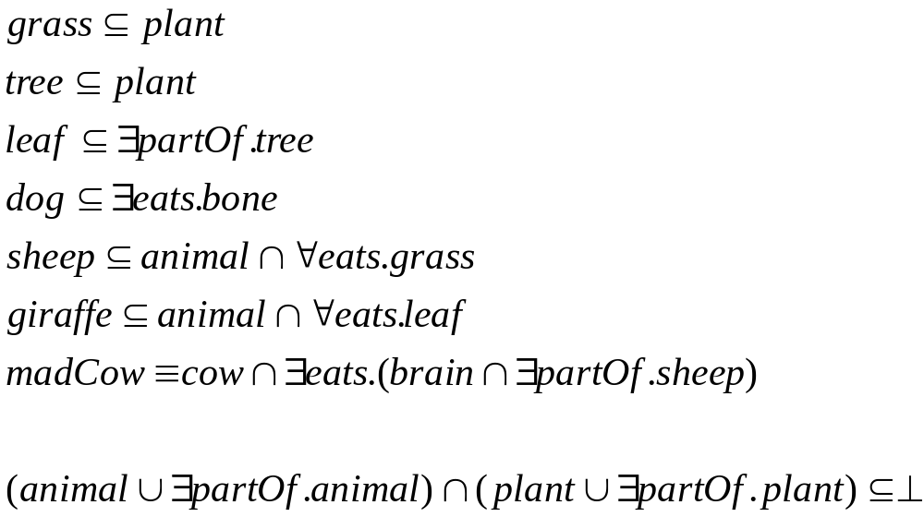
Chunk 1. Formalisation in DL

Slide 19
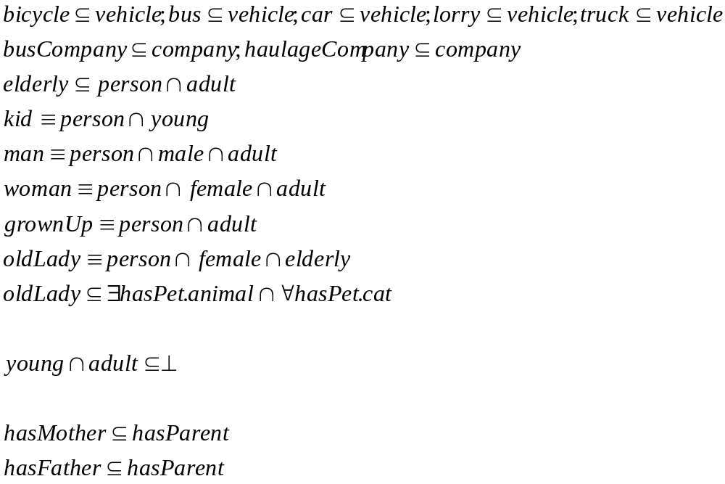
Chunk 2. Formalisation in DL

Slide 20
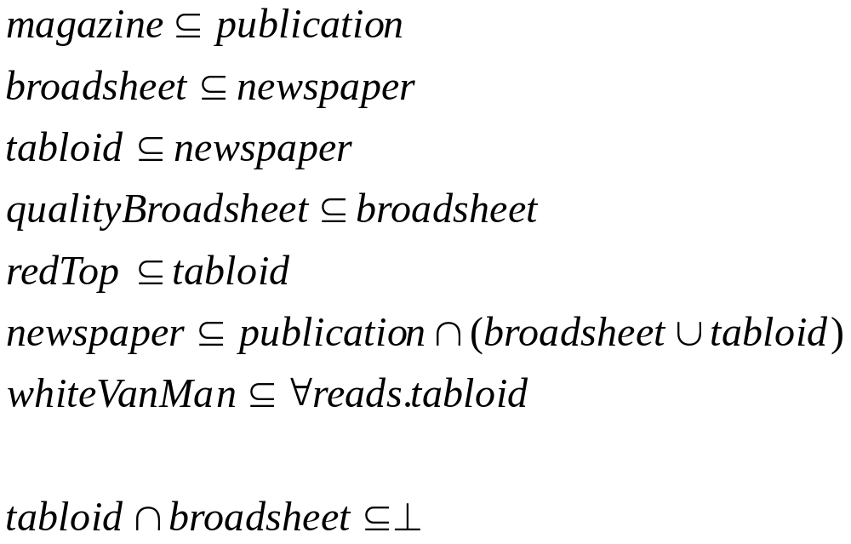
Chunk 3. Formalisation in DL

Slide 21
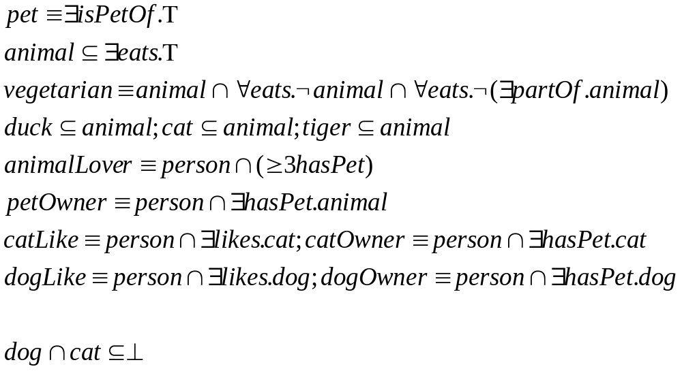
Chunk 4. Formalisation in DL

Slide 22
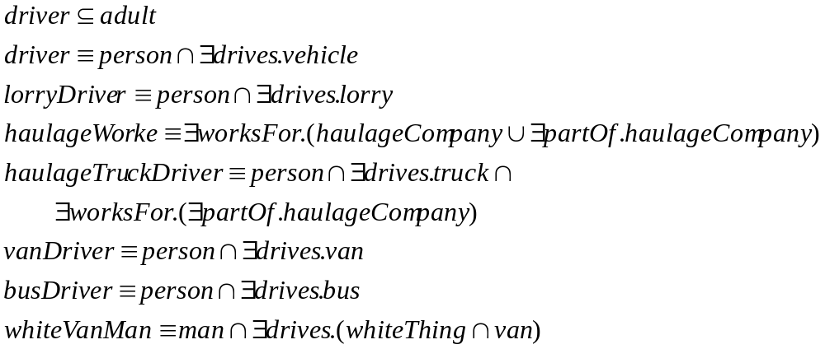
Chunk 5. Formalisation in DL

Slide 23
Table of Contents
An introduction to Description Logics
Web Ontology language (OWL)
  2.1. OWL primitives
  2.2. Reasoning with OWL
OWL Development Tools: Protégé
  3.1 Basic OWL edition
  3.2 Advanced OWL edition: restrictions, disjointness, etc.
OWL management APIs
  4.1 An example of an OWL-based application
SWRL

Slide 24
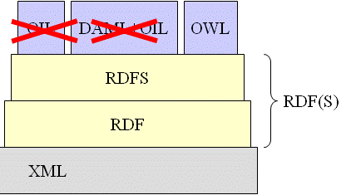
OWL
Web Ontology Language
Built on top of RDF(S) and renaming DAML+OIL primitives
3 layers:
OWL Lite
  A small subset of primitives
  Easier for frame-based tools to transition to
OWL DL
  Description logic
  Decidable reasoning
OWL Full
  RDF extension, allows metaclasses
Several syntaxes:
Abstract syntax
Manchester syntax
RDF/XML

Slide 25
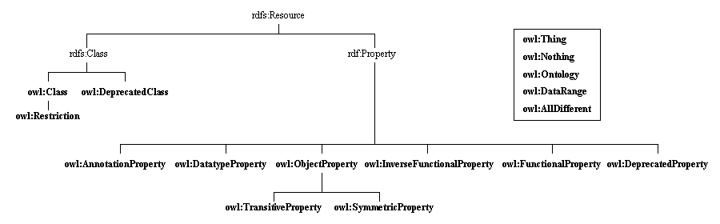
Class taxonomy of the OWL KR ontology

Slide 26
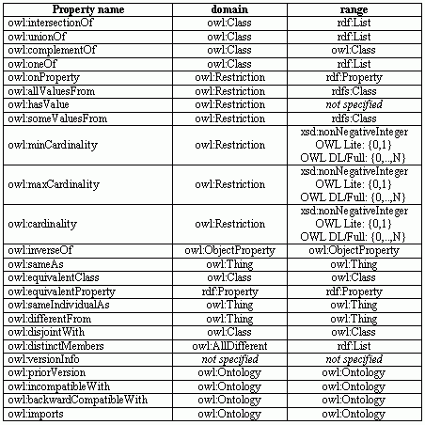
Property list of the OWL KR ontology

Slide 27
OWL: Most common constructors in class definitions and axioms for classes, properties and individuals
Intersection: C₁ ∩ ... ∩ C_{n} intersectionOf Human ∩ Male
Union: C₁ ∪ ... ∪ C_{n} unionOf Doctor ∪ Lawyer
Negation: ¬C complementOf ¬Male
Nominals: {x₁} ∪ ... ∪ {x_{n}} oneOf {john} ∪ ... ∪ {mary}
Universal restriction: ∀P.C allValuesFrom ∀hasChild.Doctor
Existential restriction: ∃P.C someValuesFrom ∃hasChild.Lawyer
Maximum cardinality: ≤nP maxCardinality ≤3hasChild
Minimum cardinality: ≥nP minCardinality ≥1hasChild
Specific Value: ∃P.{x} hasValue ∃hasColleague.{Matthew}
Subclass C1 ⊆ C2 subClassOf Human ⊆ Animal ∩ Biped
Equivalence C1 ≡ C2 equivalentClass Man ≡ Human ∩ Male
Disjointness C1 ∩ C2 ⊆ ⊥ disjointWith Male ∩ Female ⊆ ⊥
Subproperty P1 ⊆ P2 subPropertyOf hasDaughter ⊆ hasChild
Equivalence P1 ≡ P2 equivalentProperty cost ≡ price
Inverse P1 ≡ P2- inverseOf hasChild ≡ hasParent-
Transitive P+ ⊆ P TransitiveProperty ancestor+ ⊆ ancestor
Functional Τ ⊆ ≤1P FunctionalProperty T ⊆ ≤1hasMother
InverseFunctional Τ ⊆ ≤1P- InverseFunctionalProperty T ⊆ ≤1hasPassportID-
Equivalence {x1} ≡ {x2} sameIndividualAs {oeg:OscarCorcho}≡{img:Oscar}
Different {x1} ≡ ¬{x2} differentFrom, AllDifferent {john} ≡ ¬{peter}

Slide 28
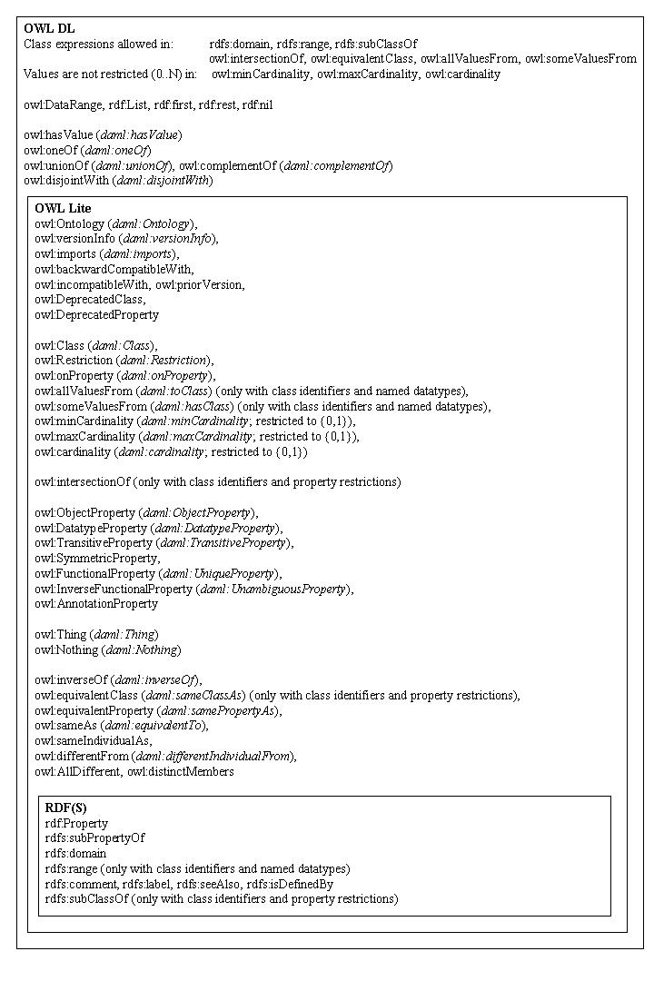

Slide 29

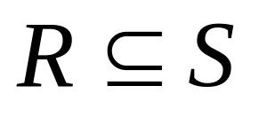


Slide 30


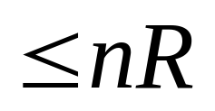
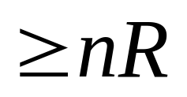
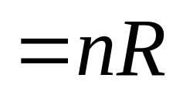


Slide 31
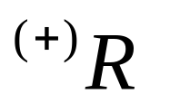


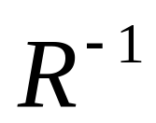

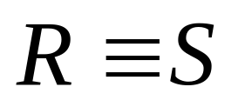
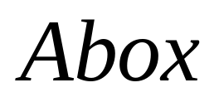

Slide 32

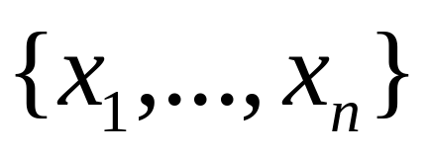
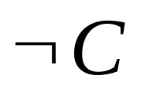



Slide 33
Table of Contents
An introduction to Description Logics
Web Ontology language (OWL)
  2.1. OWL primitives
  2.2. Reasoning with OWL
OWL Development Tools: Protégé
  3.1 Basic OWL edition
  3.2 Advanced OWL edition: restrictions, disjointness, etc.
OWL management APIs
  4.1 An example of an OWL-based application
SWRL

Slide 34
Basic Inference Tasks
Subsumption – check knowledge is correct (captures intuitions)
  Does C subsume D w.r.t. ontology O? (in every model I of O, C^{I} ⊆ D^{I} )
Equivalence – check knowledge is minimally redundant (no unintended synonyms)
  Is C equivalent to D w.r.t. O? (in every model I of O, C^{I} = D^{I} )
Consistency – check knowledge is meaningful (classes can have instances)
  Is C satisfiable w.r.t. O? (there exists some model I of O s.t. C^{I} ≠ ∅ )
Instantiation and querying
  Is x an instance of C w.r.t. O? (in every model I of O, x^{I} ∈ C^{I} )
  Is (x,y) an instance of R w.r.t. O? (in every model I of O, (x^{I},y^{I}) ∈ R^{I} )
All reducible to KB satisfiability or concept satisfiability w.r.t. a KB
Can be decided using highly optimised tableaux reasoners

Slide 35
Tableaux Algorithms
Try to prove satisfiability of a knowledge base
How do they work
  They try to build a model of input concept C
    Tree model property
      If there is a model, then there is a tree shaped model
    If no tree model can be found, then input concept unsatisfiable
  Decompose C syntactically
    Work on concepts in negation normal form (De Morgan’s laws)
    Use of tableaux expansion rules
    If non-deterministic rules are applied, then there is search
  Stop (and backtrack) if clash
    E.g. A(x), ¬A(x)
  Blocking (cycle check) ensures termination for more expressive logics
The algorithm finishes when no more rules can be applied or a conflict is detected

Slide 36
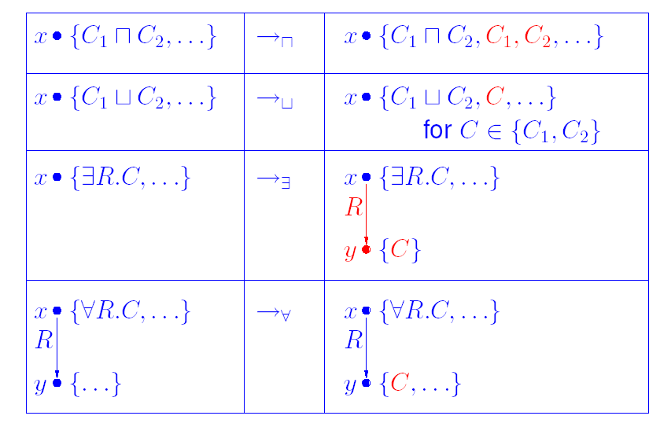
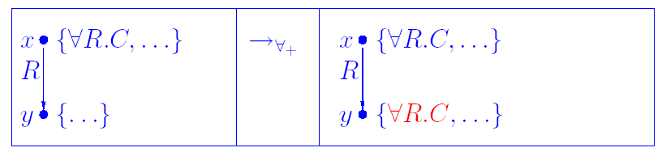
Tableaux rules for ALC and for transitive roles

Slide 37
Tableaux example
Example
  a

Slide 38
Description Logics Reasoning with Tableaux
Use tableaux algorithms to determine whether the following formulae are satisfiable or not
Exercise 1: ∃R.(∃R.D) ∧ ∃S.¬D ∧∀S.(∃R.D)
Exercise 2: ∃R.(C∨D) ∧ ∀R.¬C ∧ ¬∃R.D

Slide 39
Description Logics Reasoning
Develop a sample ontology in the domain of people, pets, vehicles, and newspapers
- Understand the basic reasoning mechanisms of description logics
Subsumption
Automatic classification: an ontology built collaboratively
Instance classification
Detecting redundancy
Consistency checking: unsatisfiable restrictions in a Tbox (are the classes coherent?)

Slide 40
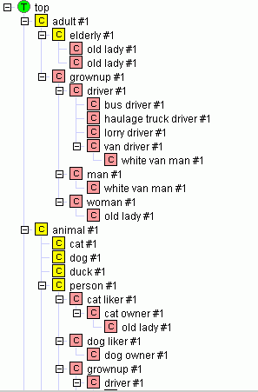
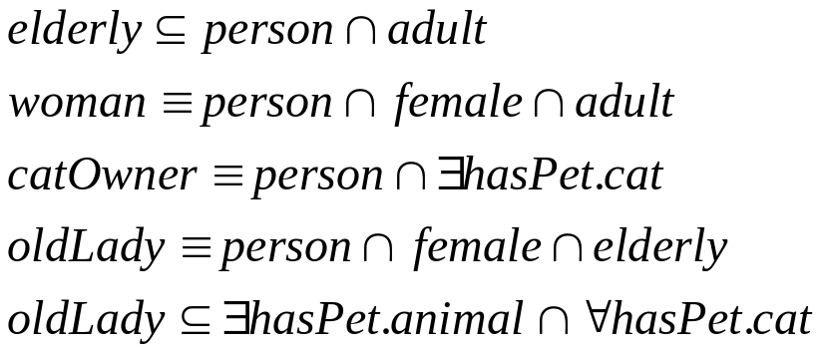
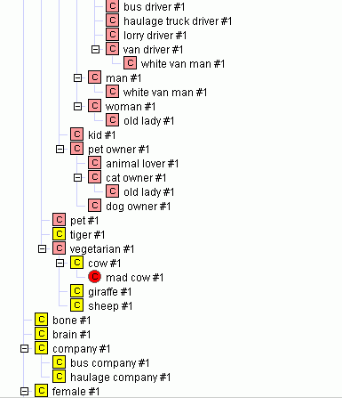
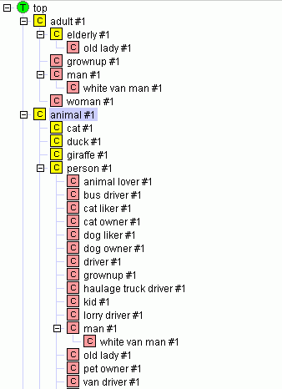
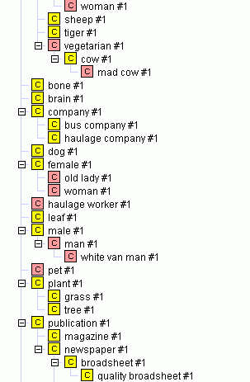
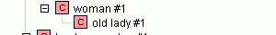
Interesting results (I). Automatic classification
And old lady is a person who is elderly and female.
Old ladies must have some animal as pets and all their pets are cats.
We obtain:
Old ladies must be women.
Every old lady must have a pet cat
Hence, every old lady must be a cat owner

Slide 41
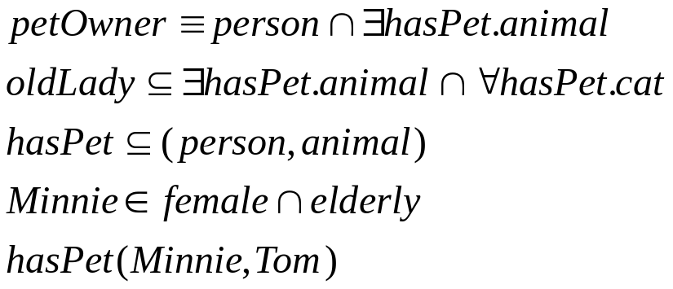
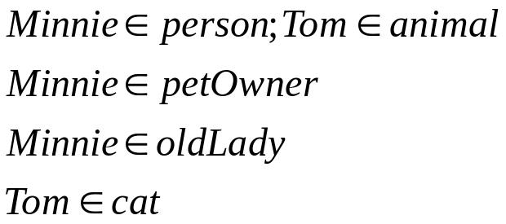
Interesting results (II). Instance classification
A pet owner is a person who has animal pets
Old ladies must have some animal as pets and all their pets are cats.
Has pet has domain person and range animal
Minnie is a female, elderly, who has a pet called Tom.
We obtain:
Minnie is a person
Hence, Minnie is an old lady
Hence, Tom is a cat

Slide 42
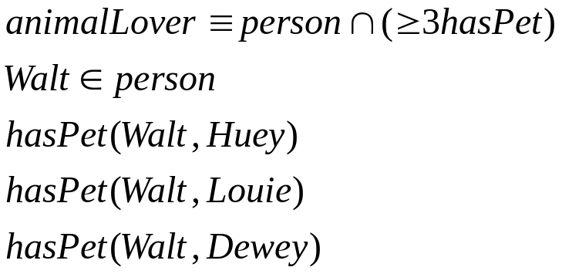

Interesting results (III). Instance classification and redundancy detection
An animal lover is a person who has at least three pets
Walt is a person who has pets called Huey, Louie and Dewey.
We obtain:
Walt is an animal lover
Walt is a person is redundant

Slide 43
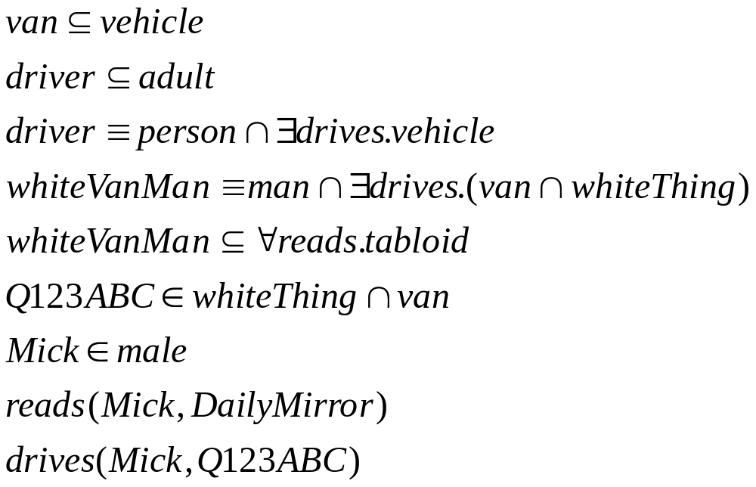
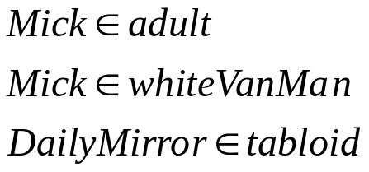
Interesting results (IV). Instance classification
A van is a type of vehicle
A driver must be adult
A driver is a person who drives vehicles
A white van man is a man who drives vans and white things
White van mans must read only tabloids
Q123ABC is a white thing and a van
Mick is a male who reads Daily Mirror and drives Q123ABC
We obtain:
Mick is an adult
Mick is a white van man
Daily Mirror is a tabloid

Slide 44
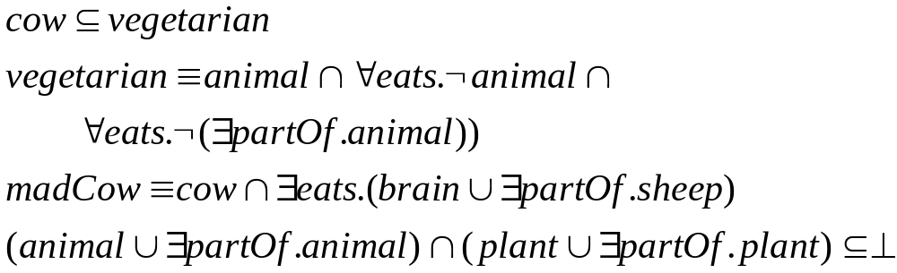
Interesting results (V). Consistency checking
Cows are vegetarian.
A vegetarian is an animal that does not eat animals nor parts of animals.
A mad cow is a cow that eats brains that can be part of a sheep
We obtain:
  Mad cow is unsatisfiable

Slide 45
When to use a classifier
At author time (pre-coordination): As a compiler
  Ontologies will be delivered as “pre-coordinated” ontologies to be used without a reasoner
  To make extensions and additions quick, easy, and responsive, distribute developments, empower users to make changes
  Part of an ontology life cycle
At delivery time (post-coordination): as a normalisation service
  Many fixed ontologies are too big and too small
    Too big to find things; too small to contain what you need
      Create them on the fly
  Part of an ontology service
At application time (inference): as a reasoner
  Decision support, query optimisation, schema integration, etc.
  Part of a reasoning service

Slide 46
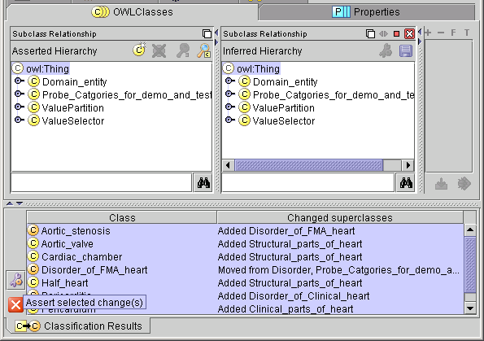
1. Pre-coordinated delivery: classifier as compiler
Develop an ontology
  A classifier can be used to detect and correct inconsistencies
Classify the ontology
Commit classifier results to a pre-coordinated ontology
Deliver it
  In OWL-Lite or RDFS
Use RDQL, SPARQL, or your favourite RDF(S) query tool
Assert (“Commit”) changes inferred by classifier

Slide 47
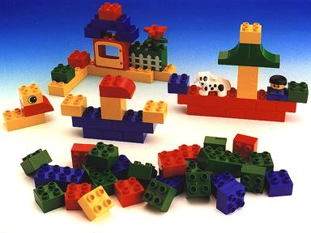
2. Post Coordination: classifier as a service
Logic based ontologies act as a conceptual lego
  Modularisation/Normalisation is needed to make them easier to maintain
gene
hand
protein
extremity
body
cell
expression
chronic
Lung
acute
inflammation
infection
abnormal
normal
bacterial
deletion
polymorphism
ischaemic

Slide 48
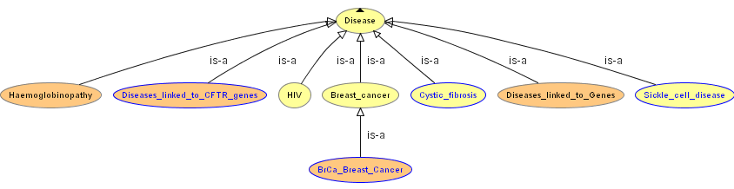
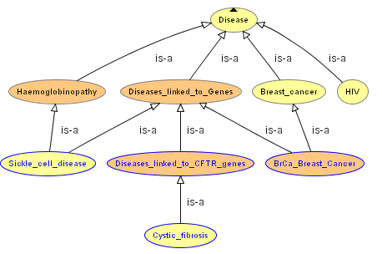
2. Post Coordination. Example (I)
Build a simple tree
Let the classifier organise it
and check consistency

Slide 49
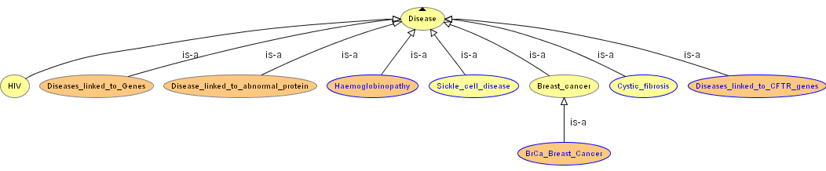
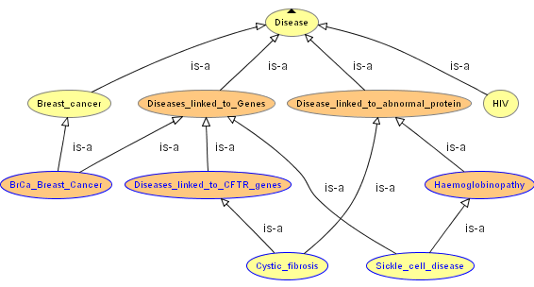
2. Post Coordination. Example (II)
Add more abstractions if needed
Let the classifier organise
it again and
check consistency!!

Slide 50
3. Inference at application run-time
Cows are vegetarian.
A vegetarian is an animal that does not eat animals nor parts of animals.
A mad cow is a cow that eats brains that can be part of a sheep
We obtain:
  Mad cow is unsatisfiable

Slide 51
OWL Classifier limitations
Numbers and strings
  Simple concrete data types in spec
  User defined XML data types enmeshed in standards disputes
  No standard classifier deals with numeric ranges
    Although several experimental ones do
is-part-of and has-part
  Totally doubly-linked structures scale horridly
Handling of individuals
  Variable with different classifiers
  oneOf works badly with all classifiers at the moment

Slide 52
Table of Contents
An introduction to Description Logics
Web Ontology language (OWL)
  2.1. OWL primitives
  2.2. Reasoning with OWL
OWL Development Tools: Protégé
  3.1 Basic OWL edition
  3.2 Advanced OWL edition: restrictions, disjointness, etc.
OWL management APIs
  4.1 An example of an OWL-based application
SWRL

Slide 53
Table of Contents
An introduction to Description Logics
Web Ontology language (OWL)
  2.1. OWL primitives
  2.2. Reasoning with OWL
OWL Development Tools: Protégé
  3.1 Basic OWL edition
  3.2 Advanced OWL edition: restrictions, disjointness, etc.
OWL management APIs
  4.1 An example of an OWL-based application
SWRL

Slide 54


Slide 55
Table of Contents
An introduction to Description Logics
Web Ontology language (OWL)
  2.1. OWL primitives
  2.2. Reasoning with OWL
OWL Development Tools: Protégé
  3.1 Basic OWL edition
  3.2 Advanced OWL edition: restrictions, disjointness, etc.
OWL management APIs
  4.1 An example of an OWL-based application
SWRL

Slide 56
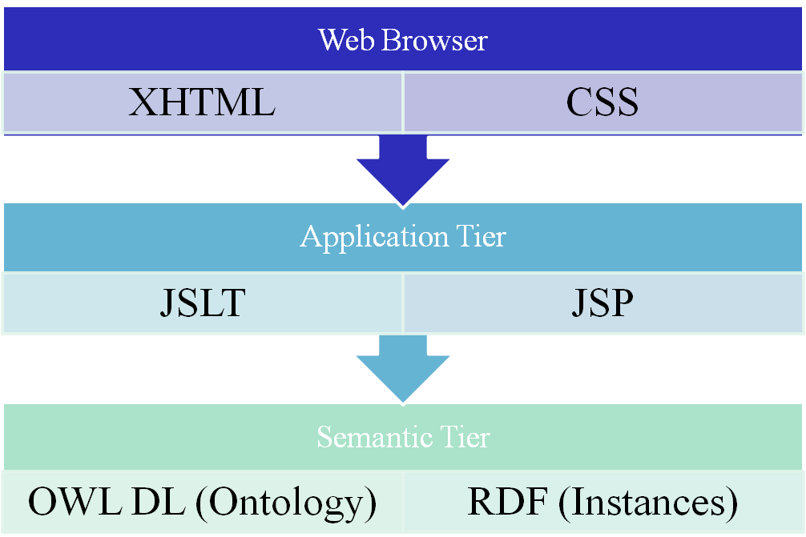

Application Architecture
Client Side
HTTP
Jena Java API
Server Side

Slide 57
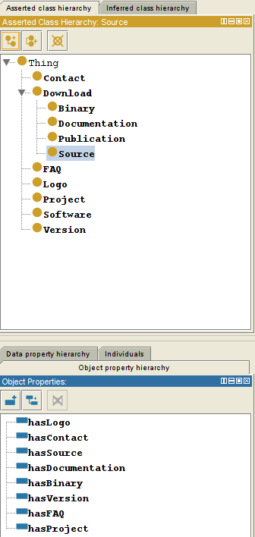
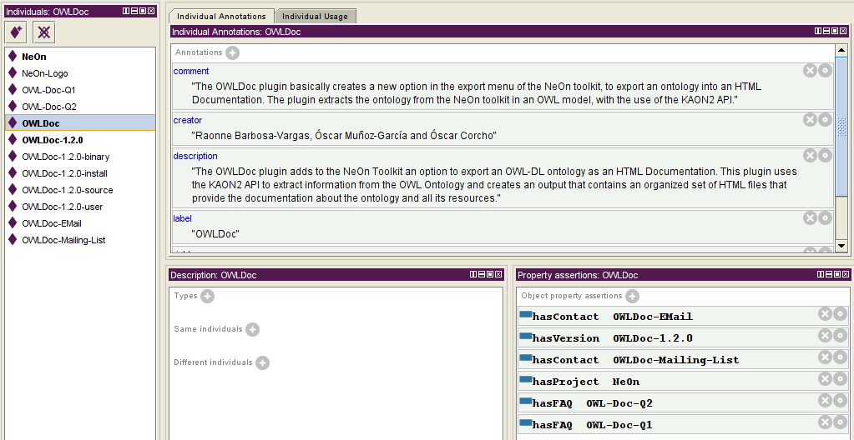
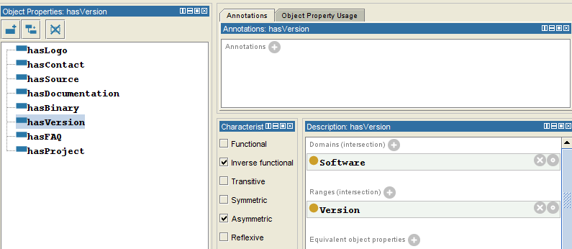
Software Ontology

Slide 58
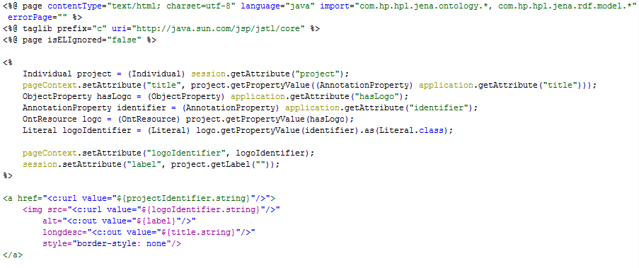
Example Code (logo.jsp)
Jena Code
JSLT Code

Slide 59
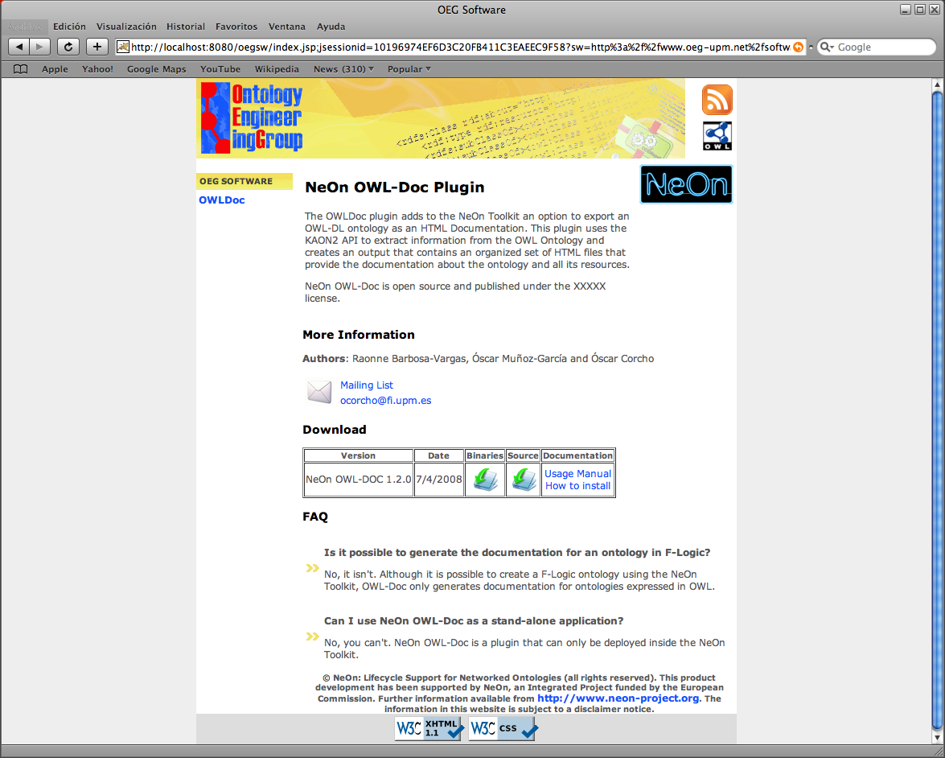
Screenshot

Slide 63
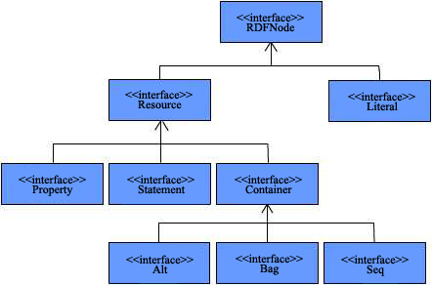
Jena API Structure

Slide 64
Data Model
http://.../JohnSmith
vcard: FN
John Smith
// some definitions
static String personURI = "http://somewhere/JohnSmith";
static String fullName = "John Smith";
// create an empty Model
Model model = ModelFactory.createDefaultModel();
// create the resource
Resource johnSmith = model.createResource(personURI);
// add the property
johnSmith.addProperty(VCARD.FN, fullName);

Slide 65
Another data model
http://.../JohnSmith
vcard:FN
vcard:N
John Smith
vcard:Given
vcard:Family
John
Smith
// some definitions
String personURI = "http://somewhere/JohnSmith"; String givenName = "John";
String familyName = "Smith";
String fullName = givenName + " " + familyName;
// create an empty
Model Model model = ModelFactory.createDefaultModel();
// create the resource
// and add the properties cascading style
Resource johnSmith = model.createResource(personURI)
.addProperty(VCARD.FN, fullName)
.addProperty(VCARD.N, model.createResource()
.addProperty(VCARD.Given, givenName)
.addProperty(VCARD.Family, familyName));

Slide 66
Statements
// list the statements in the Model
StmtIterator iter = model.listStatements();
// print out the predicate, subject and object of each statement
while (iter.hasNext())
{
Statement stmt = iter.nextStatement(); // get next statement
Resource subject = stmt.getSubject(); // get the subject
Property predicate = stmt.getPredicate(); // get the predicate
RDFNode object = stmt.getObject(); // get the object
System.out.print(subject.toString());
System.out.print(" " + predicate.toString() + " ");
if (object instanceof Resource) {
  System.out.print(object.toString());
  }
  else { // object is a literal
  System.out.print(" \"" + object.toString() + "\"");
  }
  System.out.println(" .");
} // end of while
http://somewhere/JohnSmith http://www.w3.org/2001/vcard-rdf/3.0#N anon:14df86:ecc3dee17b:-7fff
anon:14df86:ecc3dee17b:-7fff http://www.w3.org/2001/vcard-rdf/3.0#Family "Smith"
anon:14df86:ecc3dee17b:-7fff http://www.w3.org/2001/vcard-rdf/3.0#Given "John"
http://somewhere/JohnSmith http://www.w3.org/2001/vcard-rdf/3.0#FN
“John Smith" .

Slide 67
Writing RDF
Model model = ModelFactory.createDefaultModel();
Resource jsmith =
model.createResource(“http://somewhere/johnsmith”)
.addProperty(VCARD.FN, “John Smith”)
.addProperty(VCARD.N, model.createResource()
.addProperty(VCARD.Given,”John”)
.addProperty(VCARD.Family, “Smith”));
model.write(new PrintWriter(System.out));
model.write(System.out, "RDF/XML-ABBREV");
model.write(System.out, "N-TRIPLE");
<rdf:RDF
xmlns:rdf='http://www.w3.org/1999/02/22-rdf-syntax-ns#'
xmlns:vcard='http://www.w3.org/2001/vcard-rdf/3.0#'
>
<rdf:Description rdf:nodeID='A0'>
<vcard:Given>John</vcard:Given>
<vcard:Family>Smith</vcard:Family>
</rdf:Description>
<rdf:Description rdf:about='http://somewhere/johnsmith'>
<vcard:FN>John Smith</vcard:FN>
<vcard:N rdf:nodeID='A0'/>
</rdf:Description>
</rdf:RDF>

Slide 68
Reading RDF
// create an empty model
Model model = ModelFactory.createDefaultModel();
// use the FileManager to find the input file
InputStream in = FileManager.get().open( inputFileName );
if (in == null) {
throw new IllegalArgumentException("File not found");
}
// read the RDF/XML file
model.read(in, "");
// write it to standard out
model.write(System.out);
<rdf:RDF
xmlns:rdf='http://www.w3.org/1999/02/22-rdf-syntax-ns#'
xmlns:vcard='http://www.w3.org/2001/vcard-rdf/3.0#'
>
<rdf:Description rdf:nodeID="A0">
<vcard:Family>Smith</vcard:Family>
<vcard:Given>John</vcard:Given>
</rdf:Description>
<rdf:Description rdf:about='http://somewhere/JohnSmith/'>
<vcard:FN>John Smith</vcard:FN>
<vcard:N rdf:nodeID="A0"/>
</rdf:Description>
...
</rdf:RDF>

Slide 69
Navigating a model
// retrieve the John Smith vcard resource from the model
Resource vcard = model.getResource(johnSmithURI);
Three ways of retrieving property values:
// retrieve the value of the N property
Resource name = (Resource) vcard.getProperty(VCARD.N).getObject();
// retrieve the value of the N property
Resource name = vcard.getProperty(VCARD.N).getResource();
// retrieve the given name property
String fullName = vcard.getProperty(VCARD.N).getString();

Slide 70
Multiple values in properties
// add two nickname properties to vcard
vcard.addProperty(VCARD.NICKNAME, "Smithy")
.addProperty(VCARD.NICKNAME, "Adman");
// set up the output
System.out.println("The nicknames of \"" + fullName + "\" are:");
// list the nicknames
StmtIterator iter = vcard.listProperties(VCARD.NICKNAME);
while (iter.hasNext()) {
System.out.println(" " + iter.nextStatement() .getObject() .toString());
}

Slide 71
Querying a model
// select all the resources with a VCARD.FN property
ResIterator iter = model.listSubjectsWithProperty(VCARD.FN);
if (iter.hasNext()) {
System.out.println("The database contains vcards for:");
while (iter.hasNext()) {
System.out.println(" " + iter.nextStatement()
.getProperty(VCARD.FN) .getString());
}
} else {
System.out.println("No vcards were found in the database");
}
The database contains vcards for:
Sarah Jones
John Smith
Matt Jones
Becky Smith

Slide 72

Create resources
// URI declarations
String familyUri = "http://family/";
String relationshipUri = "http://purl.org/vocab/relationship/";
// Create an empty Model
Model model = ModelFactory.createDefaultModel();
// Create a Resource for each family member, identified by their URI
Resource adam = model.createResource(familyUri+"adam");
Resource beth = model.createResource(familyUri+"beth");
Resource dotty = model.createResource(familyUri+"dotty");
// and so on for other family members
// Create properties for the different types of relationship to represent
Property childOf = model.createProperty(relationshipUri,"childOf");
Property parentOf = model.createProperty(relationshipUri,"parentOf");
Property siblingOf = model.createProperty(relationshipUri,"siblingOf");
Property spouseOf = model.createProperty(relationshipUri,"spouseOf");
// Add properties to adam describing relationships to other family members
adam.addProperty(siblingOf,beth);
adam.addProperty(spouseOf,dotty);
adam.addProperty(parentOf,edward);
// Can also create statements directly . . .
Statement statement = model.createStatement(adam,parentOf,fran);
// but remember to add the created statement to the model
model.add(statement);

Slide 73
Querying a model
// List everyone in the model who has a child:
ResIterator parents = model.listSubjectsWithProperty(parentOf);
// Because subjects of statements are Resources, the method returned a ResIterator
while (parents.hasNext()) {
// ResIterator has a typed nextResource() method
Resource person = parents.nextResource();
// Print the URI of the resource
System.out.println(person.getURI());
}
// Can also find all the parents by getting the objects of all "childOf" statements
// Objects of statements could be Resources or literals, so the Iterator returned
// contains RDFNodes
NodeIterator moreParents = model.listObjectsOfProperty(childOf);
// To find all the siblings of a specific person, the model itself can be queried
NodeIterator siblings = model.listObjectsOfProperty(edward, siblingOf);
// But it's more elegant to ask the Resource directly
// This method yields an iterator over Statements
StmtIterator moreSiblings = edward.listProperties(siblingOf);

Slide 74
Using selectors to query a model
// Find the exact statement "adam is a spouse of dotty"
model.listStatements(adam,spouseOf,dotty);
// Find all statements with adam as the subject and dotty as the object
model.listStatements(adam,null,dotty);
// Find any statements made about adam
model.listStatements(adam,null,null);
// Find any statement with the siblingOf property
model.listStatements(null,siblingOf,null);

Slide 75
Exercise
Objective
  Understand how to use an RDF(S) management API
Tasks
  Read an ontology in RDF(S) from two files:
    GP_Santiago.rdf (conceptualization)
    GP_Santiago.rdfs (instances)
  Write the class hierarchy of the ontology, including the instances of each class

Slide 76
Hands-on
To read an ontology in RDF(S) from two files:
  GP_Santiago.rdf (conceptualization)
  GP_Santiago.rdfs (instances)
To write the class hierarchy of the ontology, including the instances of each class:
Class Practica2:MedioTransporte
Class Practica2:Tren
Class Practica2:Bicicleta
Instance Practica2:GP_Santiago_Instance_70
Class Practica2:Automovil
Class Practica2:AutoBus
Class Practica2:APie
Class Practica2:InfraEstructuraTransporte
Class Practica2:ViaFerrea
Class Practica2:Sendero
Class Practica2:Carretera
Instance Practica2:A6
...

Slide 77
Set up
Requirements:
  Java JDK 5
  Eclipse (optional)
Create a directory for your project
Install Jena from the USB:
  Unzip Jena-2.5.5.zip/lib in the project directory
Copy the ontologies from the USB:
  Copy ontologies/rdf in the project directory
In Eclipse:
  Create a new Java project (from existing source)
  Append the Jena libraries to your classpath if needed (check JDK libs)
  Write Java code using the Jena API
  http://jena.sourceforge.net/javadoc/index.html
  Compile
  Run
Or copy the JenaProjectTemplate directory in your computer

Slide 78
Hints
Create ontology model:
  public static OntModel createOntologyModel(OntModelSpec spec)
Read the ontology in the file
  Model read(java.lang.String url)
Add all the statements in another model to this model
  Model add(Model m)

Slide 79
More hints
List root classes
  ExtendedIterator listHierarchyRootClasses()
List subclasses of a class
  ExtendedIterator listSubClasses(boolean direct)
List instances of a class
  ExtendedIterator listInstances(boolean direct)

