Slide 1

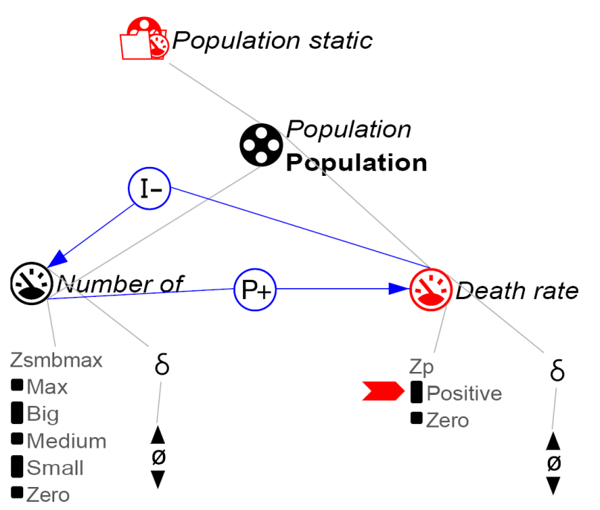
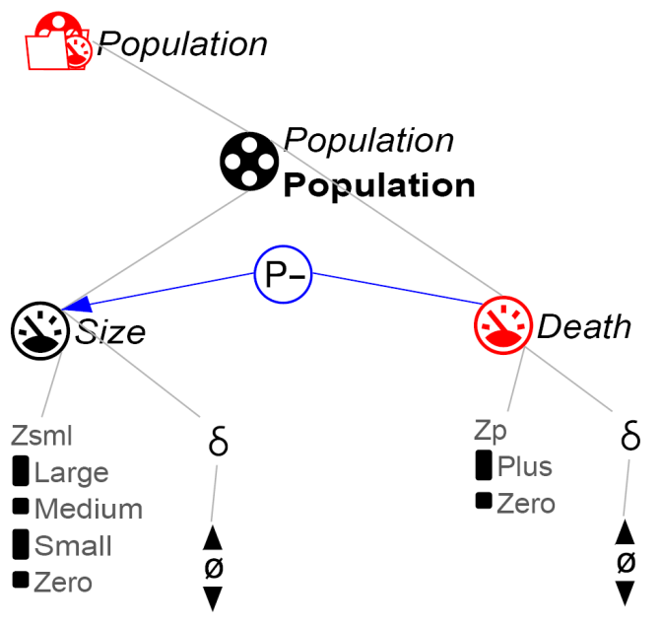
http://dbpedia.org/resource/Mortality_rate
Reference model
Learner model
Preliminary mapping: Death_rate ≡ Death
Grounding-based alignment in DynaLearn

