Slide 1
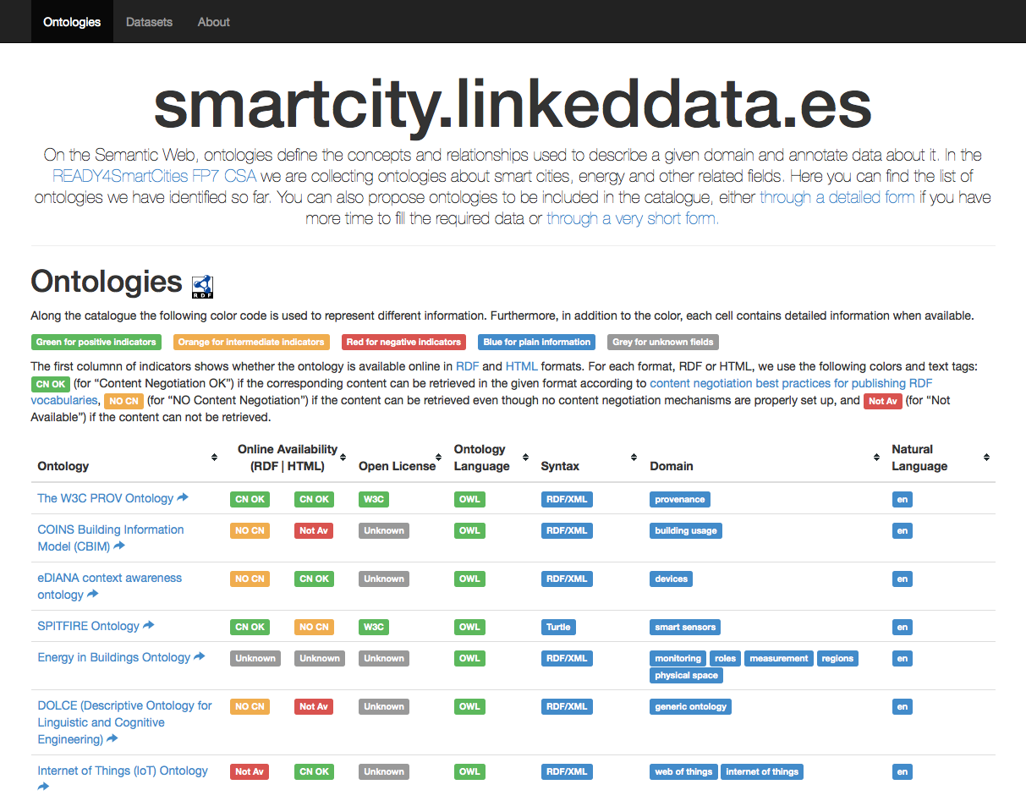
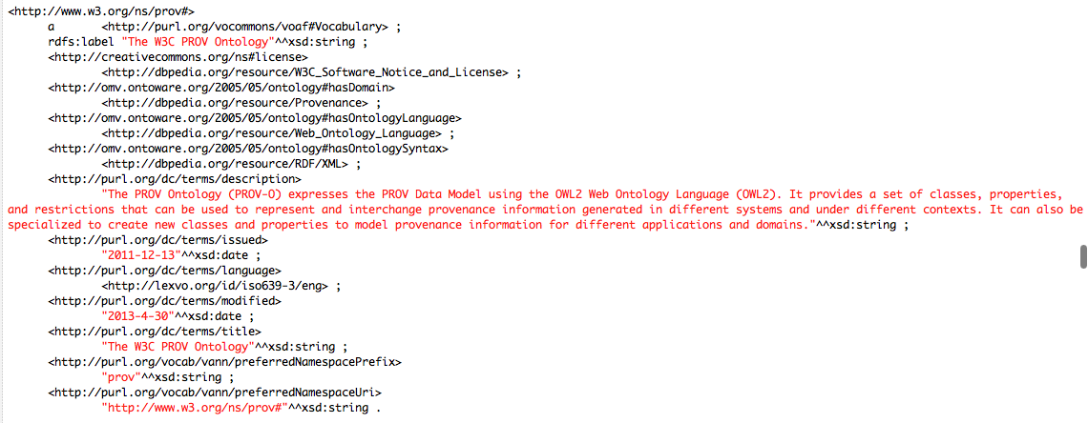
This is how I use DBpedia
HTML representation
DBpedia is used to represent the domains the ontologies and datasets might cover.
Also use of DBpedia for licences, ontology languages and syntaxes.
RDF representation
Ontology Engineering Group

