Slide 1

Smart Cities
(READY4SmartCities)
Asunción Gómez Pérez
asun@fi.upm.es
ETSI Informaticos
Universidad Politécnica de Madrid
Campus de Montegancedo s/n
28660 Boadilla del Monte, Madrid, Spain
Participants: María Poveda Villalón, Raúl García Castro

Slide 2
READY4SmartCities
READY4SmartCities project contributes in creating a common approach on Smart Cities.
In co-operation with different stakeholders (engineering specialists, ICT and RES
providers, energy companies) the main goals are:
To deliver a new data ecosystem that will accommodate cross-domain data and will allow the exploitation of such data at global scale
To identify an holistic and shared vision, allowing feasible step-by-step action plans for relevant stakeholder groups to develop and use ICT-based solutions for energy system in urban and rural communities towards future Smart Cities
To identify a set of ontologies relevant to Smart Cities and the different requirements and guidelines on how to use data described according to those ontologies
Notes:
I will focus on the third goal. Using ontologies to describe data not only provides semantic and reasoning power to your data but also make different datasets interoperable. In addition one could get extra value of publishing their data set as linked data.

Slide 3
Motivation for an eeOntology Catalogue
Facilitate ontology reuse
  There are many ontologies (and other resources) useful to describe energy and cross-domain data
One place to discover ontologies
  It is not trivial to find them
Specific for energy efficiency and smart cities
  Search engines and ontology registries are too general or off-topic (biology, environment, etc.)
Ontology assessment
  The quality of ontologies in the Web is unknown

Slide 4
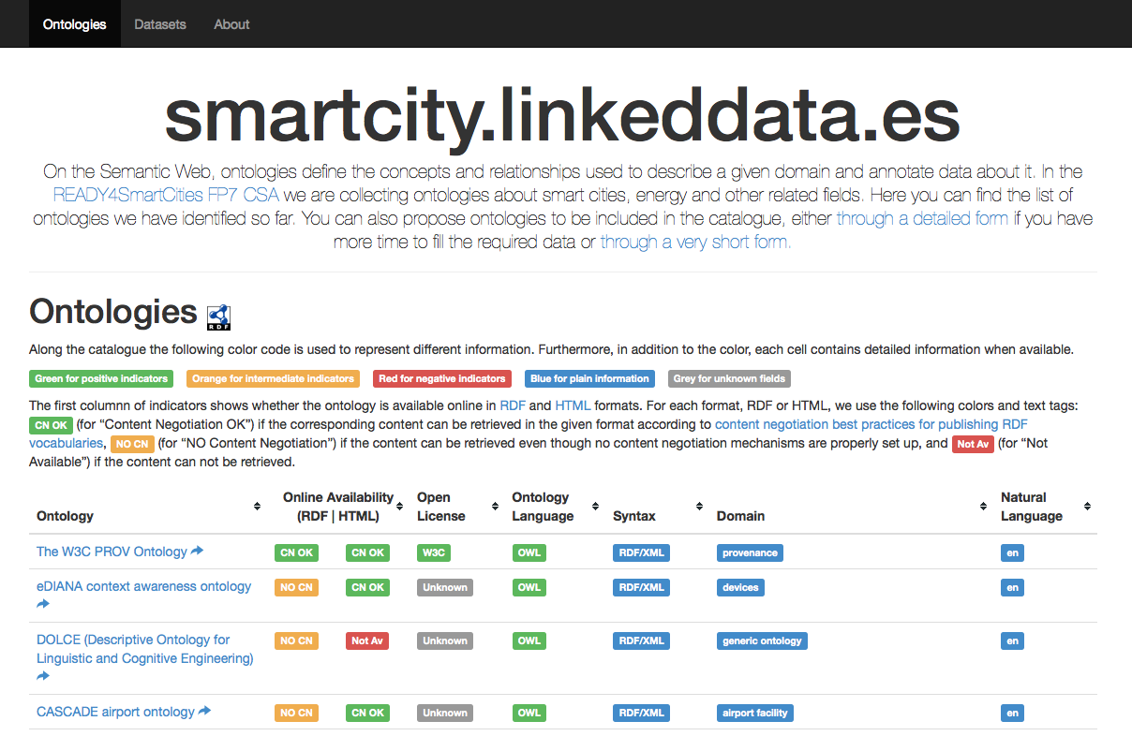
http://smartcity.linkeddata.es/
Link to RDF dump
Quality indicators
Metadata
Detailed description page
Go to ontology
Information gathered during the catalogue generation
Information gathered from the on-line form

Slide 5
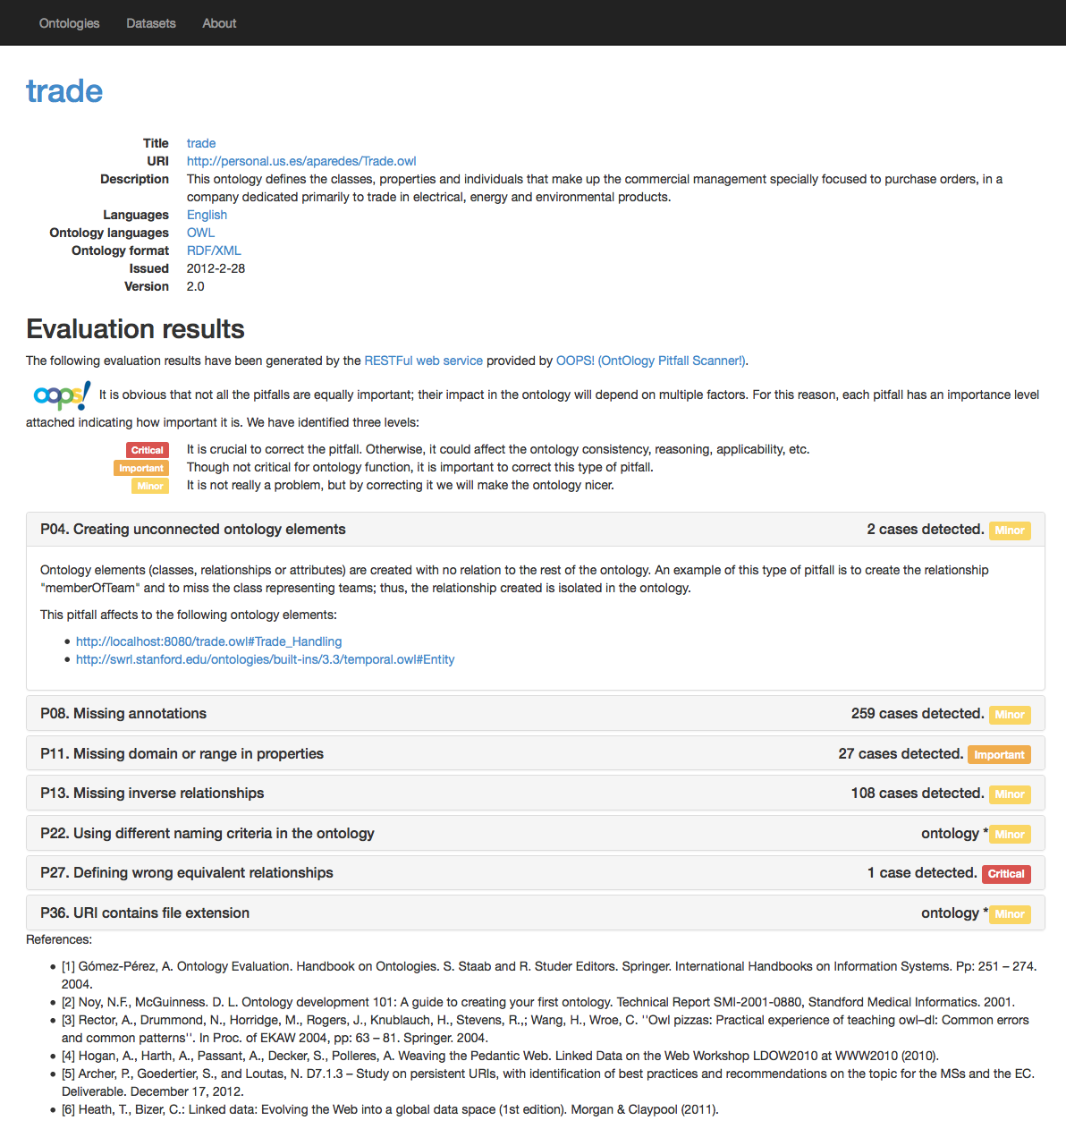

Web application - Details of an ontology
Detailed information
Title of the detected pitfall
Pitfall frequency
Pitfall description
Ontology elements affected
Importance level
Evaluation results generated by
http://oops.linkeddata.es

