Slide 1

Formalization and Experiences of R2RML-based SPARQL to SQL query translation using Morph
Freddy Priyatna, Oscar Corcho
Ontology Engineering Group
Universidad Politécnica de Madrid
Madrid, Spain
[fpriyatna,ocorcho]@fi.upm.es
Juan Sequeda
Dept. of Computer Science
University of Texas at Austin
Austin, USA
jsequeda@cs.utexas.edu
OEG, March 27th, 2014

Slide 2


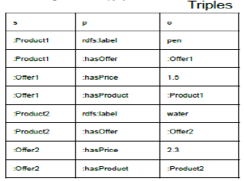







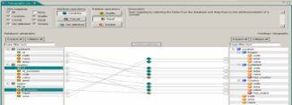



Motivation
SELECT ?nombre ?precio
WHERE {
:Product1 a bsbm:Product
:Product1 rdfs:label ?nombre
OPT { :Product1 :hasPrice ?precio}
}
Query Translation
<TMProduct> a rr:TriplesMap;
rr:logicalTable [
rr:tableName "Product" ];
rr:subjectMap [ a rr:Subject;
rr:class bsbm:Product;
rr:template "http://ex.com/Product{nr}"; ];
rr:predicateObjectMap [
rr:predicateMap [ rr:constant rdfs:label ];
rr:objectMap [ rr:column "label"; ]; ];
SELECT p.label, o.price
FROM product p
LEFT JOIN offer o
ON p.nr=o.product
WHERE product=1
Data Translation
nr | label
1 | pen
2 | water
nr | product | price
1 | 1 | 1.5
2 | 2 | 2.5
Introduction
Query Translation
Evaluation
Conclusion

Slide 3






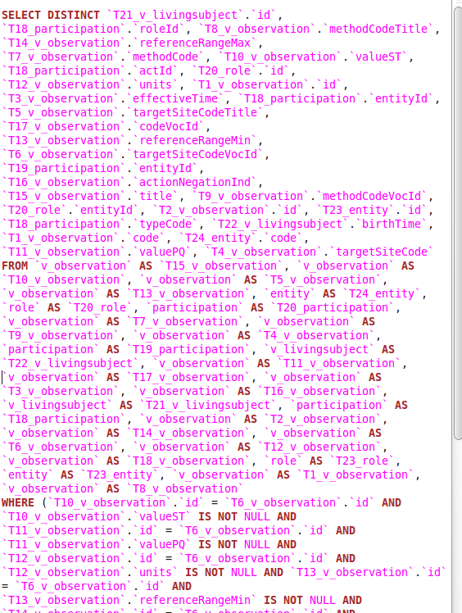
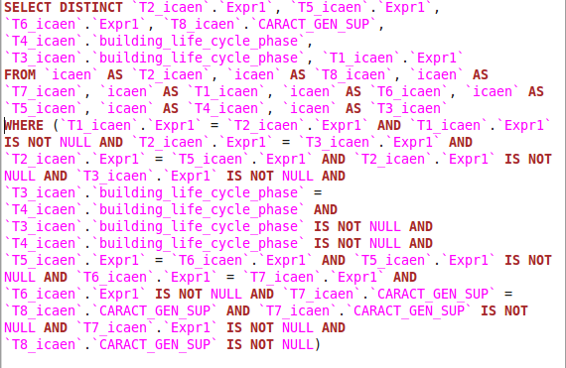
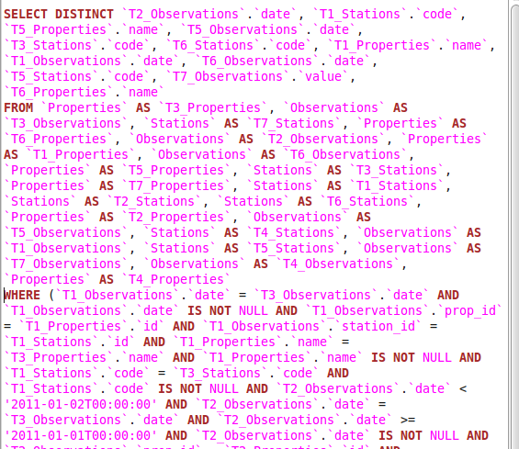


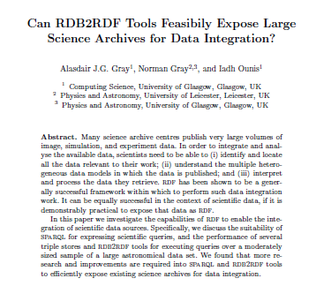


SPARQL to SQL: whose problem?
“It is currently unfeasible to use rdb2rdf tools to expose” large science
archives for data integration.
Title
Conclusion
Introduction
Query Translation
Evaluation

Slide 4



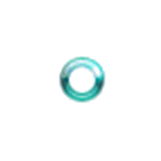
Challenges
Query answering takes a lot of time
  Inefficient queries
  Some calculation is performed on memory
Can’t be evaluated
  Too many tables
Lack of formalization
Title
Conclusion
Introduction
Query Translation
Evaluation

Slide 5
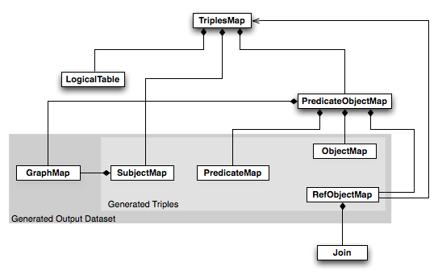
Background & Related Work
R2RML
TriplesMap -> RDF Triples
LogicalTable: Base Table or SQL Query
SubjectMap -> subject
PredicateObjectMap
  PredicateMap -> predicate
  ObjectMap -> object
  RefObjectMap: join
Query Translation in RDB2RDF
Query Translation in Triples Stores
Chebotko
Elliot
R2O
D2R
Ontop
Unbehauen
Garrote
Title
Conclusion
Introduction
Query Translation
Evaluation

Slide 6







R2RML-based Query Translation
SELECT ….
WHERE { ….
OPT { …. }
}
Query Translation
SELECT …
FROM …
JOIN … ON
WHERE …
Data Translation
Query translation approaches applied for the implementation of query evaluation over RDB-backed triple stores can be extended to work with R2RML mappings
R2RML-based query translation can be optimized, while preserving semantics, so that they can be applied in real-world cases
Introduction
Query Translation
Evaluation
Conclusion

Slide 7
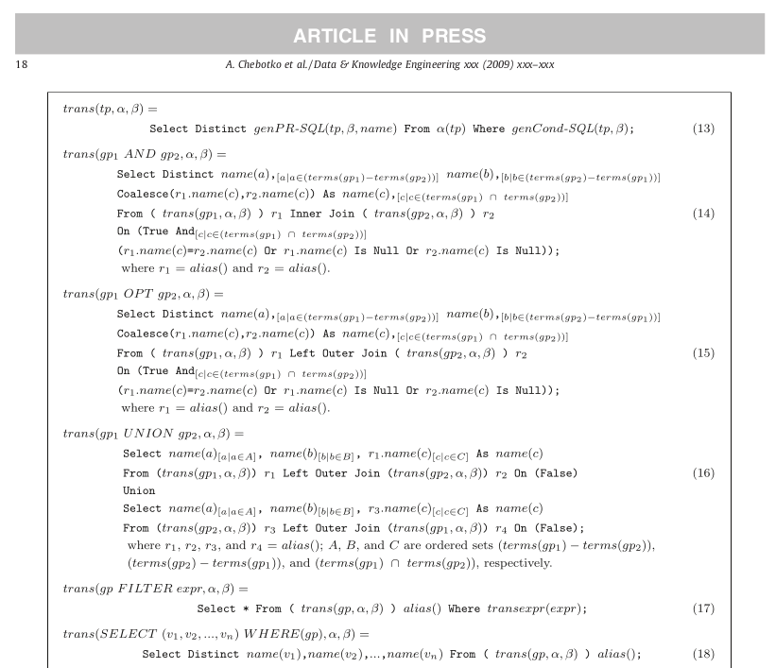
Extension of trans function
trans(tp)
  Step1: Multiple mapped TriplesMaps
    Ex: :fred hasID ?fredID
      TriplesMapStudent
      TriplesMapResearcher
    UNION of trans(tp, tm)
    m is TriplesMap corresponding to the triple pattern tp
  Step2: Unbounded predicate
    Ex: :fred ?p ?o
      :fred hasID ?o
      :fred hasName ?o
    UNION of trans(tp, tm, predicateURI)
    predicateURI is the mapped predicate defined in tm
trans(tp, tm, predicateURI) =
SELECT genPRSQL(tp, beta, name)
FROM alpha
WHERE genCondSQL(tp)
Introduction
Query Translation
Evaluation
Conclusion

Slide 8
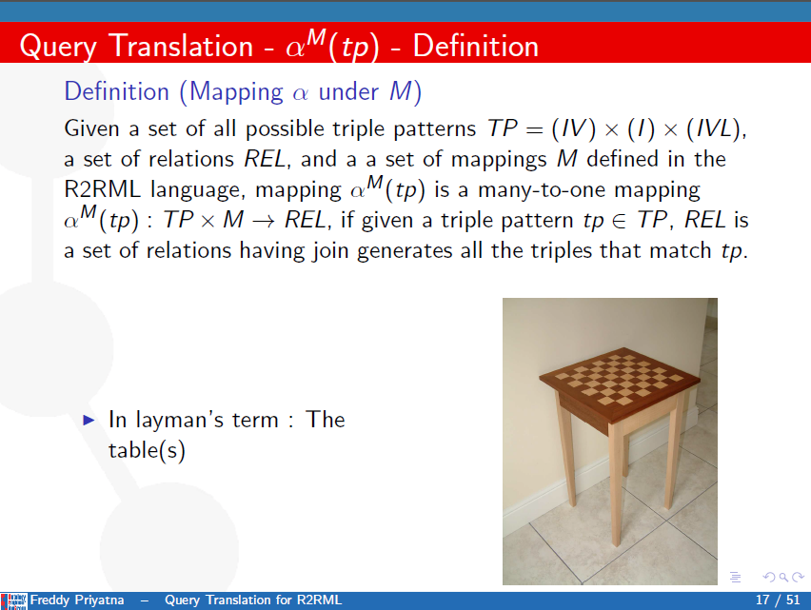
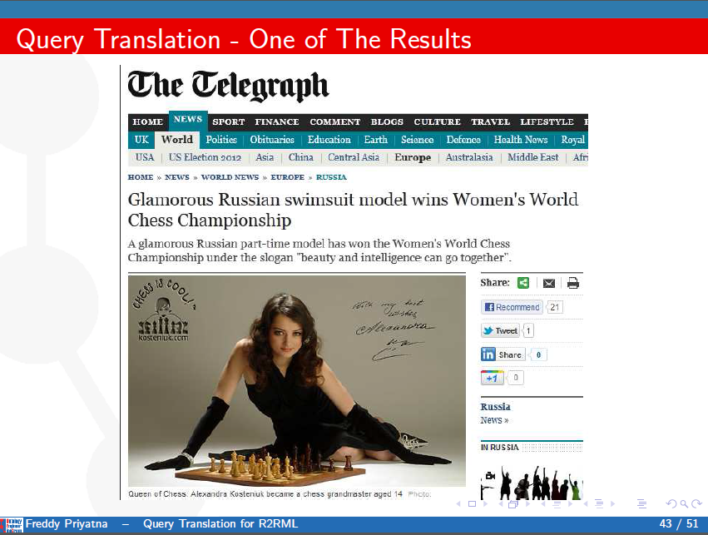
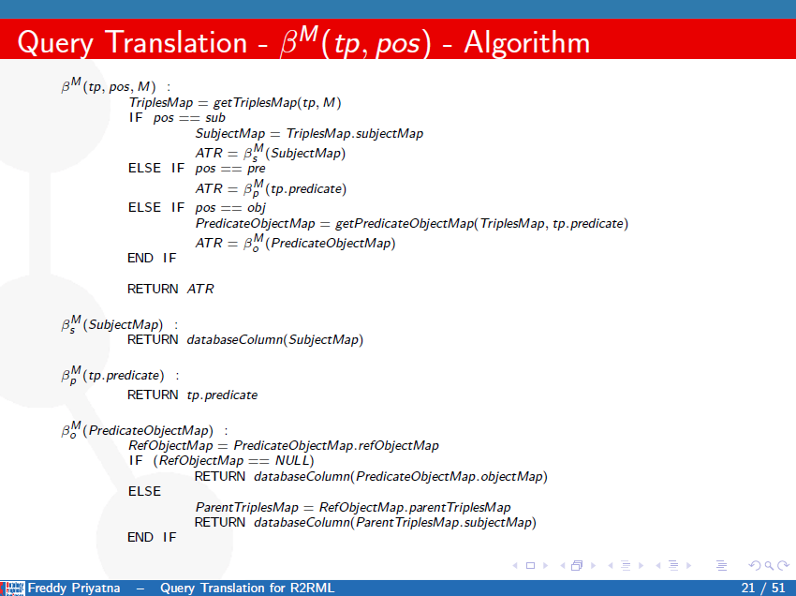
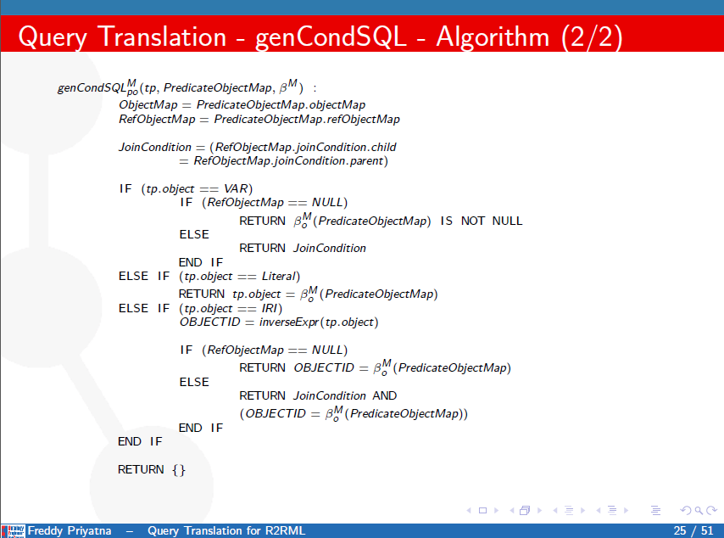

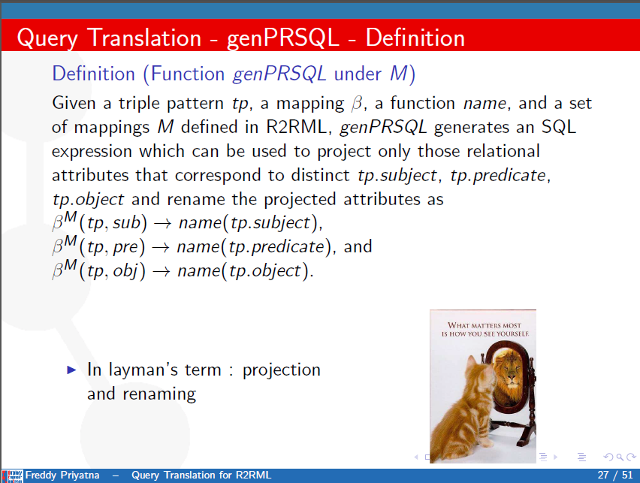

Previously on Morph …
Introduction
Query Translation
Evaluation
Conclusion

Slide 9
R2RML-based Query Translation: Examples
<TMProduct> a rr:TriplesMap;
rr:logicalTable [ rr:tableName "Product" ];
rr:subjectMap [ a rr:Subject; rr:class bsbm:Product;
rr:template "http://ex.com/Product/{nr}"; ];
rr:predicateObjectMap [
rr:predicateMap [ rr:constant :hasProductName];
rr:objectMap [ rr:column "label"; ]; ];
rr:predicateObjectMap [
rr:predicateMap [ rr:constant :hasProductOffer ];
rr:objectMap [ rr:parentTriplesMap <TriplesMapOffer>;
rr:joinCondition [ rr:child "nr" ; rr:parent "product" ; ] ];
].
<TMOffer> a rr:TriplesMap;
rr:logicalTable [ rr:tableName "Offer" ];
rr:subjectMap [ a rr:Subject; rr:class bsbm:Offer;
rr:template "http://ex.com/Offer/{nr}"; ];
rr:predicateObjectMap [
rr:predicateMap [ rr:constant bsbm:price ];
rr:objectMap [ rr:column "price"; ]; ].
Trans(tp, tm, predicateURI) = SELECT genPRSQL(tp, beta, name)
FROM alpha(tp)
WHERE genCondSQL(tp)
tp | Alpha(tp) | Beta(tp, pos) | genCondSQL(tp) | genPRSQL(tp, Beta, name)
?product :hasProductName ?prodName | { Product } | Sub:Product.nr Pre:’ hasProductName ’ Obj: Product.label | Product.label IS NOT NULL | Product.nr AS var_product ‘hasProductNamel' AS iri_hasProductName Product.label AS var_prodName
:Product/1 :hasProductOffer :Offer/3847 | { Product, Offer } | Sub: Product.nr Pre: ‘hasProductOffer ’ Obj: Offer.nr | Product.nr=1 AND Product.nr=Offer.product AND Offer.nr=3847 | Product.nr AS iri_Product1 ‘hasProductOffer’ AS iri_hasProductOffer Offer.nr AS iri_Offer3847
Introduction
Query Translation
Evaluation
Conclusion

Slide 10
Query Optimizations
SPARQL
SELECT DISTINCT ?pr ?productLabel
?productComment ?productProducer
WHERE {
?pr hasLabel ?label .
?pr hasComment ?comment .
?pr hasProducer ?producer .
}
Naïve Translation
SELECT DISTINCT pr, productLabel, productComment, productProducer
FROM (
SELECT p_1.pr, p_1.productLabel,
p_2_3.productComment, p_2_3.productProducer
FROM
(SELECT nr AS pr, label AS productLabel FROM product
WHERE nr IS NOT NULL AND label IS NOT NULL) p_1,
(SELECT p_2.pr, p_2.productComment, p_3.productProducer FROM
(SELECT nr AS pr, comment AS productComment FROM product
WHERE nr IS NOT NULL AND comment IS NOT NULL) p_2,
(SELECT nr AS pr, producer AS productProducer FROM product
WHERE nr IS NOT NULL AND producer IS NOT NULL) p_3
WHERE p_2.pr= p_3.pr) p_2_3
WHERE p_1.pr = p_2_3.pr
) gp
Self-join elimination
SELECT DISTINCT pr, productLabel, productComment, productProducer
FROM
(SELECT p.nr AS pr, p.label AS productLabel
, p.comment as productComment, p.producer AS productProducer
FROM product p
WHERE p.nr IS NOT NULL AND p.label IS NOT NULL
AND p.comment IS NOT NULL AND p.producer IS NOT NULL
) gp
Subquery Elimination
SELECT DISTINCT p1.nr AS pr, p1.label AS productLabel,
p2.comment AS productComment, p3.producer AS productProducer
FROM product p1, product p2, product p3
WHERE p1.nr = p2.nr AND p2.nr = p3.nr
AND p1.nr IS NOT NULL AND p2.nr IS NOT NULL
AND p3.nr IS NOT NULL AND p1.label IS NOT NULL
AND p2.comment IS NOT NULL AND p3.producer IS NOT NULL
Both
SELECT DISTINCT p.nr AS pr, p.label AS productLabel,
p.comment AS productComment, p.producer AS productProducer
FROM product p
WHERE p.nr IS NOT NULL AND p.label IS NOT NULL
AND p.comment IS NOT NULL AND p.producer IS NOT NULL
Introduction
Query Translation
Evaluation
Conclusion

Slide 11





Implementation and Evaluation
Morph: R2RML Engine
  https://github.com/fpriyatna/morph
LDP Interface
Mapping Reader
Data Translator
Query Translator
SPARQL-DQP
RDB
GFT
Synthetic benchmark
  BSBM (Ecommerce)
Three Spanish/EU projects
  BizkaiSense (Enviromental)
  Repener (Energy)
  Integrate (Clinical)
Title
Conclusion
Introduction
Query Translation
Evaluation

Slide 12
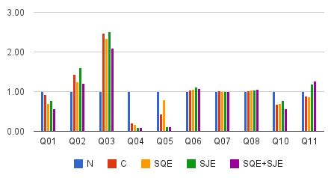
Evaluation: Synthetic Benchmark
Diverse type of operators/patterns
Diverse type of solution modifiers
Combination between low/high selectivity
100 millions triples
10 SELECT queries
  Native (N)
  Naive (C)
  Subquery Elimination (SQE)
  Selfjoin Elimination (SJE)
  SQE+SJE
  20 run for each query
Similar performance for queries types (N, C, SQE, SJE, SQE+SJE) for most queries
  Non-corelated subquery elimination
  Joins over indexes columns
Q04
  N: correlated subquery
  Others: joins
Q05
  Join order
Native queries should have been better optimized
Introduction
Query Translation
Evaluation
Conclusion

Slide 13
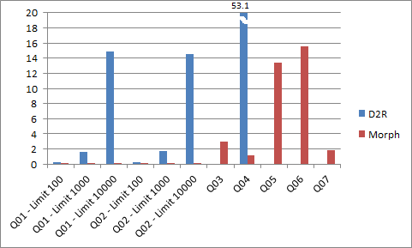
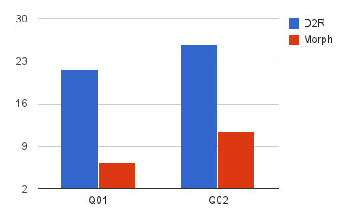
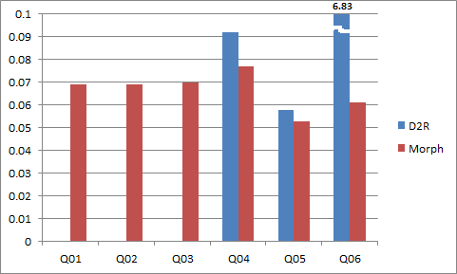
Evaluation: Real Cases
Project Name | Tipical Queries | Result | Observation
BizkaiSense | Q01: observations coming from a particular weather or air quality station Q03: the average measures by property for a given week Q05: the maximum measure in all the stations for each property in a given day |  | Morph queries takes less time Q3, Q5, Q7 by D2R queries are not able to be evaluated
RÉPENER | Q01: buildings and their climatezone and building life cycle phase Q02: all buildings and their climatezone, building life cycle phase, and conditioned floor area. |  | Morph queries are 2-3x faster
Integrate | Q01/Q02/Q03 are similarly structured, with a code that specifies whether to obtain tumor size, tumor stage, or pregnant women. Q04 obtains multiple participants who have been treated with Antracyclines Q05 obtains demographic information (people that are older than 30 years old) Q06 obtains images andinformation that a diagnosis is based on |  | Too many joined-tables error message for D2R Q01/Q02/Q30 Similar performance of Morph and D2R for Q04 and Q05 Significantly faster for Morph Q06 vs D2R Q06
Introduction
Query Translation
Evaluation
Conclusion

Slide 14

Conclusion & Future Work
Employing Semantics Query Optimizations for exploiting more indexes
Making our implementation via Web Service
Introduction
Query Translation
Evaluation
Conclusion

Slide 15




Some Pictures

Slide 16
Formalization and Experiences of R2RML-based SPARQL to SQL query translation using Morph
Freddy Priyatna, Oscar Corcho
Ontology Engineering Group
Universidad Politécnica de Madrid
Madrid, Spain
[fpriyatna,ocorcho]@fi.upm.es
Juan Sequeda
Dept. of Computer Science
University of Texas at Austin
Austin, USA
jsequeda@cs.utexas.edu
OEG, March 27th, 2014

