Slide 1


Preliminary Results in Tag Disambiguation using DBpedia
Andrés García-Silva†, Martin Szomszor‡, Harith Alani ‡, Oscar Corcho†
† {hgarcia, ocorcho}@fi.upm.es
Facultad de Informática
Universidad Politécnica de Madrid
Campus de Montegancedo s/n
28660 Boadilla del Monte, Madrid, Spain
‡{mns2, h.alani}@ecs.soton.ac.uk
School of Electronics and
Computer Science,
University of Southampton,
SO16 1BJ, UK.

Slide 2
Table of Contents
1. Introduction
  1.1 Folksonomies & problems
  1.2 Association of semantics to tags
  2. State of the Art
3. Context & Disambiguation
  2.1 Context in dictionary based approaches
  2.2 Context in folksonomies
4. Tagora sense repository
5. Disambiguation approach
6. Preliminary results
7. Conclusions and future work

Slide 3
Table of Contents
1. Introduction
  1.1 Folksonomies & problems
  1.2 Association of semantics to tags
  2. State of the Art
3. Context & Disambiguation
  2.1 Context in dictionary based approaches
  2.2 Context in folksonomies
4. Tagora sense repository
5. Disambiguation approach
6. Preliminary results
7. Conclusions and future work

Slide 4




Introduction
Folksonomy*
  The result of free tagging information and objects for one´s own retrieval (Anything with an URL)
  Tagging is done in a social environment
  People use their own vocabulary
* http://www.vanderwal.net/folksonomy.html

Slide 5
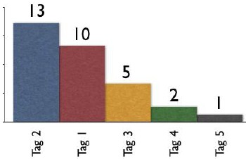






Introduction
Broad folksonomy*
Narrow folksonomy*
Vocabulary emergence
Resource creator
Resource
Resource
* www.vanderwal.net

Slide 6
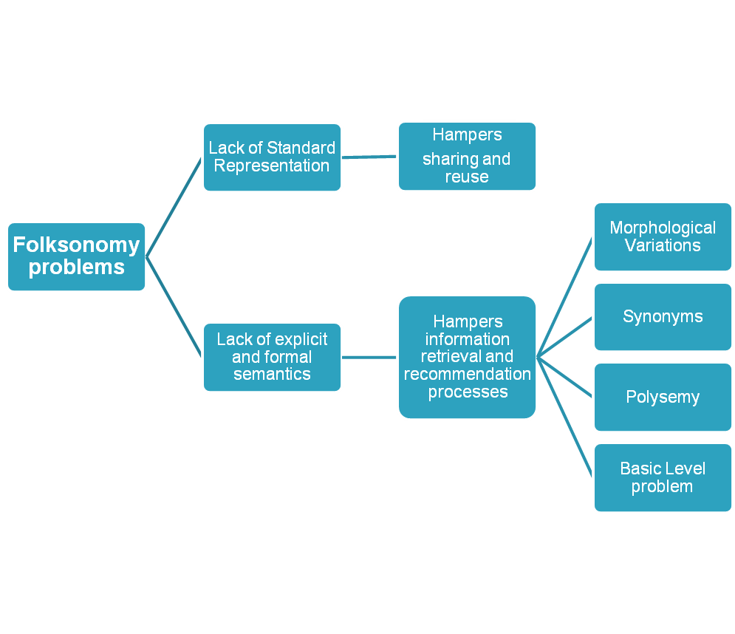
Folksonomy problems
Introduction
Solutions
Ontologies for folksonomies
Semantics association to tags

Slide 7
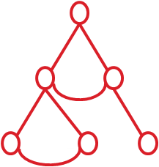

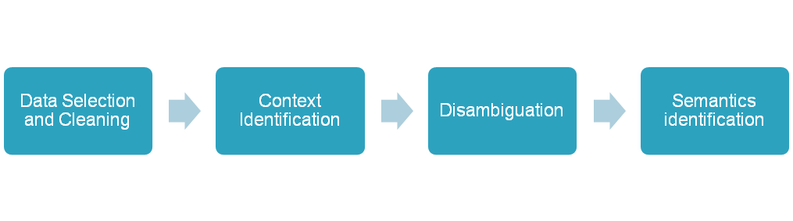


Introduction
Ontology
Ontology
Tag
Semantics association to tags
Folksonomy

Slide 8
Table of Contents
1. Introduction
  1.1 Folksonomies & problems
  1.2 Association of semantics to tags
  2. State of the Art
  3. Context & Disambiguation
  2.1 Context in dictionary based approaches
  2.2 Context in folksonomies
4. Tagora sense repository
5. Disambiguation approach
6. Preliminary results
7. Conclusions and future work

Slide 9
State of the Art
 | Technique | Semantic Resource | Automatic
Specia and Motta, 2007 | Groups and subgroups of tags Manual association of ontology concepts | Ontologies found using Swoogle | Partially
Angeletou et al., 2008 | Wordnet sense to each tag according to its context Association of ontology concepts using the sense information | Ontologies found using Watson search engine. | Yes
Hamasaky et al., 2007 | - User tags are preconcepts Two preconcepts are merged if they share the same user/resource No explicit semantics | - | Yes
Our contribution:
Automatic approach to associate semantics to tags relying on DBpedia as semantic resource.
Disambiguation algorithm inspired by well known information retrieval techniques
Several context definition as a way to ameliorate tagging data scarceness in the disambiguation process.
Specia, L., Motta, E., Integrating Folksonomies with the Semantic Web. In Proceedings of the 4th European Conference on the Semantic Web: Research and Applications, Innsbruck, Austria (2007)
Hamasaki, M., Matsuo, Y., Nisimura, T., Takeda, H., Ontology Extraction using Social Network. In International Workshop on Semantic Web for Collaborative Knowledge Acquisition, Hyderabad, India (2007)
Angeletou, S., Sabou, M., Motta, E., Semantically Enriching Folksonomies with FLOR. In 1st International Workshop on Collective Semantics: Collective Intelligence & the Semantic Web (CISWeb 2008), Tenerife, Spain (2008).

Slide 10
Table of Contents
1. Introduction
  1.1 Folksonomies & problems
  1.2 Association of semantics to tags
  2. State of the Art
3. Context & Disambiguation
  2.1 Context in dictionary based approaches
  2.2 Context in folksonomies
4. Tagora sense repository
5. Disambiguation approach
6. Preliminary results
7. Conclusions and future work

Slide 11
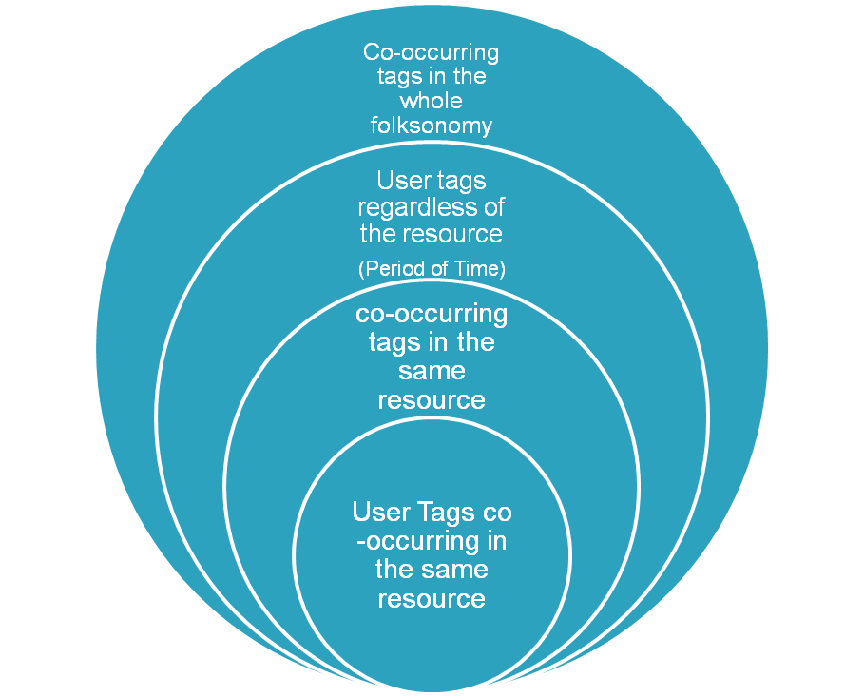
Context & disambiguation
First disambiguation approach relying on a dictionary (Lesk, 1998)
  Definitions of the word to disambiguate & of each word in the context.
    Context: The words appearing in the sentence
  Definitions of the words in the context are compared against the definitions of the word to disambiguate.
Contexts in folksonomies
Problems: When the definitions are short. (Sanderson, 2000)
Lesk, M., “They said true things, but called them by wrong names” – vocabulary problems in retrieval systems. in Proc. 4th Annual Conference of the University of Waterloo Centre for the New OED (1998)
Sanderson, M., Retrieving with Good Sense. In Information Retrieval 2(1): 47-67 (2000)

Slide 12

Tagora Sense Repository
Linked data enabled service endpoint
  Metadata about tags and their possible senses.
    Wikipedia pages -> Disambiguation or Redirection links
    Terms and frequencies
    DBpedia resource related to each Wikipedia page.
  Query using:
    REST -> http://tagora.ecs.soton.ac.uk/tag/apple
    SPARQL end-point.
  Result: RDF document
DBpedia coverage:
  2.6 million things, 213,000 people, 328,000 places, 57,000 music albums, 36,000 films, 20,000 companies.
    Wordnet as of 2006 contains about 150,000 words
  Named entity recognition
  Classes, Instances, and semantic relations

Slide 13
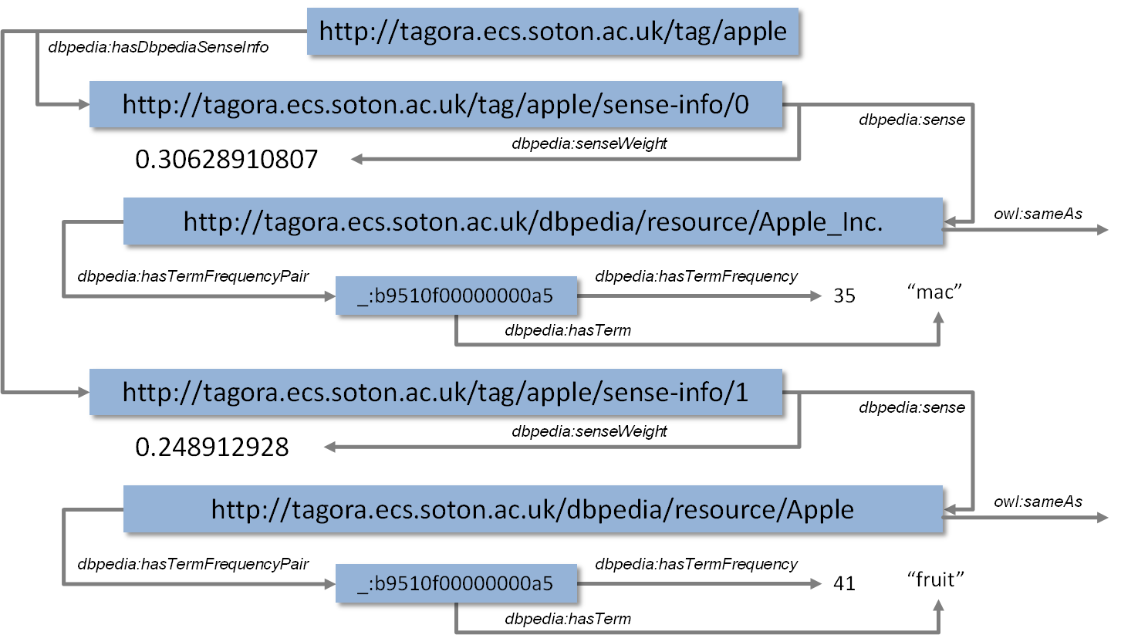
Tagora sense repository
Linked data representation of tag senses

Slide 14
Table of Contents
1. Introduction
  1.1 Folksonomies & problems
  1.2 Association of semantics to tags
  2. State of the Art
3. Context & Disambiguation
  2.1 Context in dictionary based approaches
  2.2 Context in folksonomies
4. Tagora sense repository
5. Disambiguation approach
6. Preliminary results
7. Conclusions and future work

Slide 15

Disambiguation Approach
The algorithm selects among a set of candidate DBpedia resources, the one that describe better the meaning of an ambiguous tag according to its context.
The candidate DBpedia resources and the tag context are represented as vectors using a common vocabulary.
  The common vocabulary is the union of the most frequent terms in each wikipedia page related to each Dbpedia resource.
The tag context vector is compared against each DBpedia resource vector using the cosine of the angle as similarity measure.
The most similar DBpedia entry is selected as the one representing the meaning of the analyzed tag

Slide 16
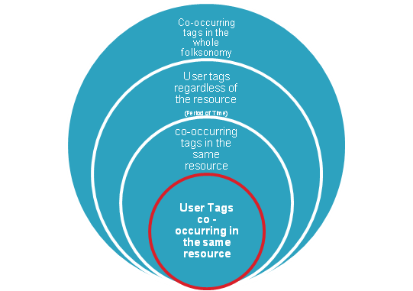
Disambiguation Approach
Tagging activity:
  User u has tagged the resource r = http://www.nature.com with the tags nature, news, science.
Context(u, nature, r) = {nature, news, science}
Senses(Nature) = {dbpedia:Nature, dbpedia: Nature_(journal)}
  Terms(dbpedia:Nature) = {(life,62), (nature,46), (earth,32)}
  Terms(dbpedia:Nature_(journal)) = {(nature,77), (science,29), (scientific,25)}
Voc(nature) = { life, nature, earth, science, scientific }
V_{context}= (0,1,0,1,0)
V_{nature}= (62,46,32,0,0)
V_{nature(journal)}= (0,77,0,29,25)
Sim(V_{context}, V_{nature}) = 0,389 Sim(V_{context}, V_{nature(journal)}) = 0,872

Slide 17
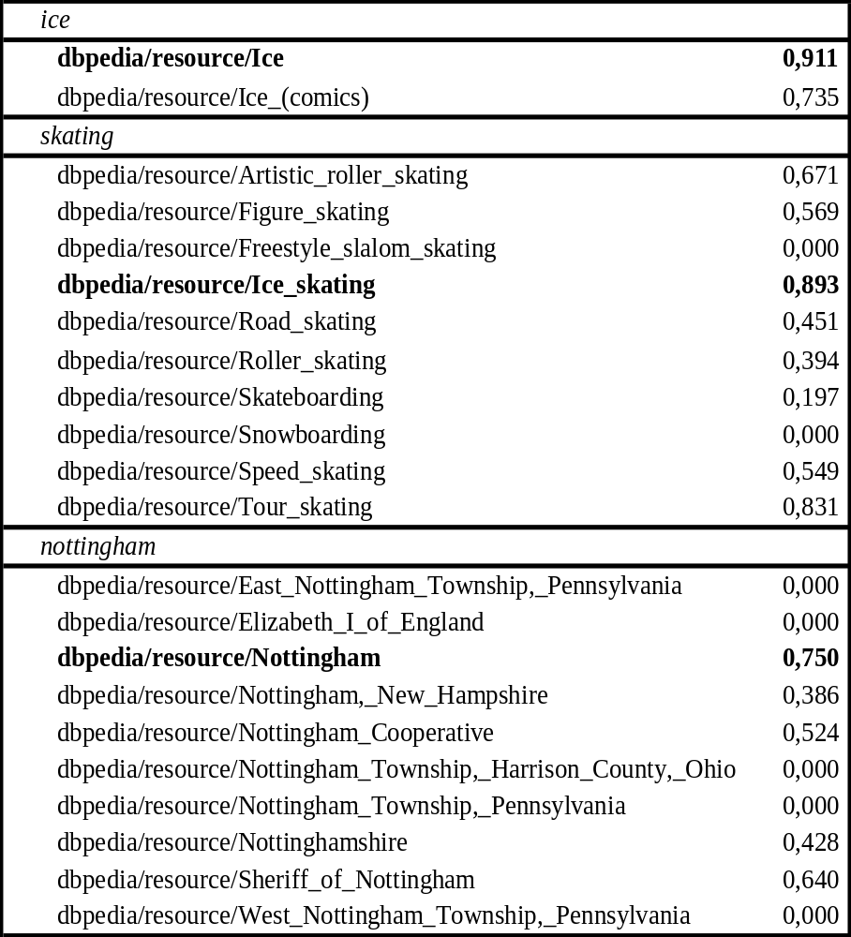
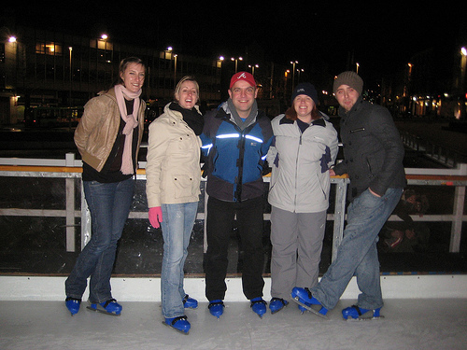
Preliminary Results
Some user x has tagged a picture r with the tags ice, iceskating, nottingham, and skating.

Slide 18
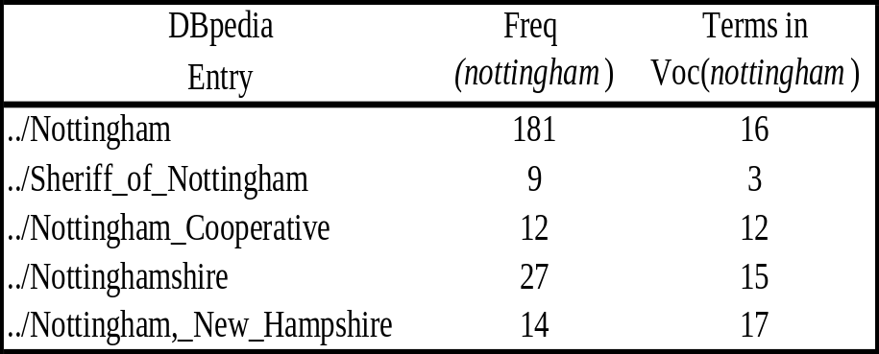
Preliminary Results
Issues affecting the disambiguation process
  Dbpedia resources with lower number of terms in Voc(tag)
    When the context has few terms, it’s likely that shorter sense vectors are more similar to the context vector than longer sense vectors.
  When none of the tags in the context appears in Voc(tag) the sense selection is carried out in terms of freq(tag)

Slide 19
Table of Contents
1. Introduction
  1.1 Folksonomies & problems
  1.2 Association of semantics to tags
  2. State of the Art
3. Context & Disambiguation
  2.1 Context in dictionary based approaches
  2.2 Context in folksonomies
4. Tagora sense repository
5. Disambiguation approach
6. Preliminary results
7. Conclusions and future work

Slide 20
Conclusions & Future Work
Conclusions:
  Inspired by IR techniques we have presented a tag disambiguation algorithm relying on DBpedia & Wikipedia information.
    Vector representation of the tag contexts and Dbpedia resources using a common vocabulary based on term frequency.
    Preliminary results and some identified problems:
      Few terms in the context
      Terms in the context do not appear in the common vocabulary
      Few terms in the Dbpedia resource
  We have presented different definitions of contexts for tagging activities as a way to ameliorate tagging data scarceness.

Slide 21
Conclusions & Future Work
  Future Work
  Improve current results
    Test the approach in a large tag set with the different contexts.
    Sophisticated similarity measures
    Study tagging activities in specific domains.
    Extract more context information from the tagged resource (text documents)
  Evaluation of the aproach
    Evaluation using Precision and Recall
    Test bed and Standard evaluation metrics
  Applications
    Use DBpedia semantic information to evolve domain ontologies
    Use DBpedia semantic information to improve searching and recommendation processes.

