Slide 1

International Classification for Patient Safety (ICPS) a Project funded by the World Alliance for Patient Safety of the World Health Organization (WHO)
María Poveda, Elena Montiel-Ponsoda,
Mari Carmen Suárez-Figueroa, and Oscar Corcho
Ontology Engineering Group. Departamento de Inteligencia Artificial.
Facultad de Informática, Universidad Politécnica de Madrid.
Campus de Montegancedo s/n.
28660 Boadilla del Monte. Madrid. Spain
mpoveda@delicias.fi.upm.es, {emontiel, mcsuarez, ocorcho}@fi.upm.es
Date: 17/12/2009

Slide 2
Introduction
Objectives of the International Classification for Patient Safety (ICPS) Project:
  To create a conceptualization of the patient safety domain to enable an efficient monitoring, analysis and interpretation of the info.
  To enable interoperability with existing international classifications.
  To improve patient care and health policy plans all over the world.
Methodological background: NeOn Methodology
  Focus on: ontology networks (modularity), reuse of existing resources, adaptation in the interface generation
Initial domains for ontology development:
  Falls & Pressure Ulcer
ICPS Ontologies

Slide 3
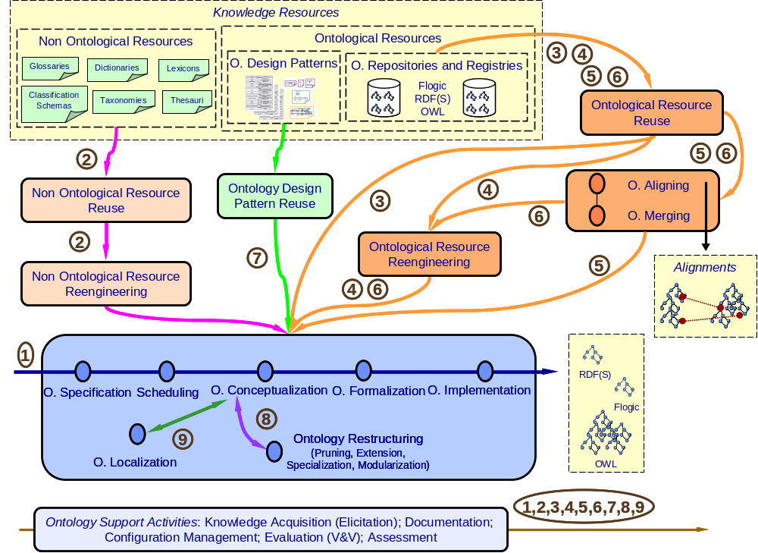

Methodological Background: NeOn Methodology
Thread 2
Thread 4
ICPS Ontologies

Slide 4
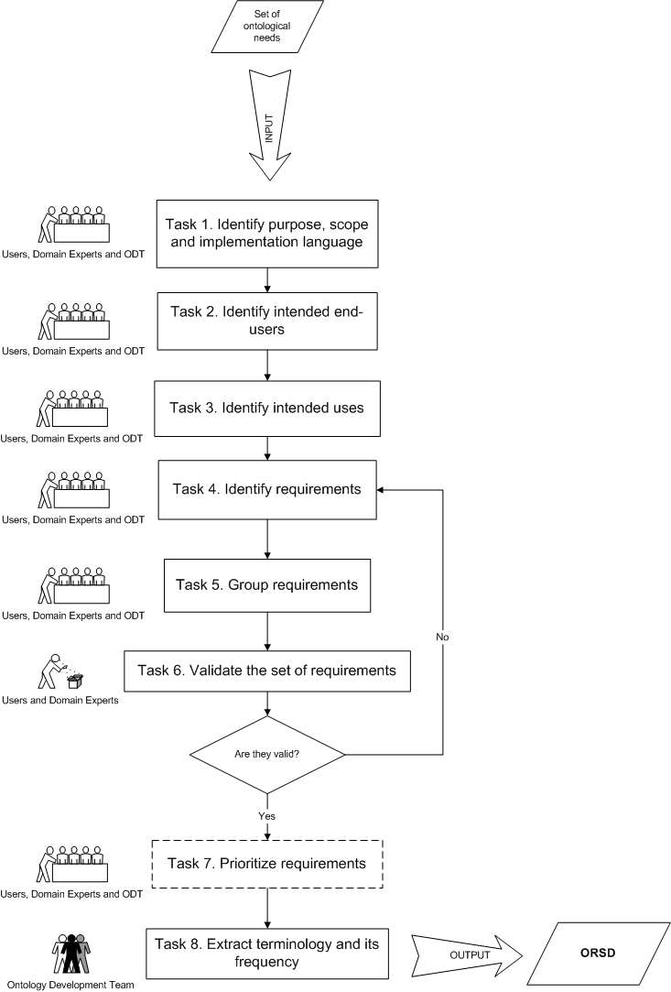
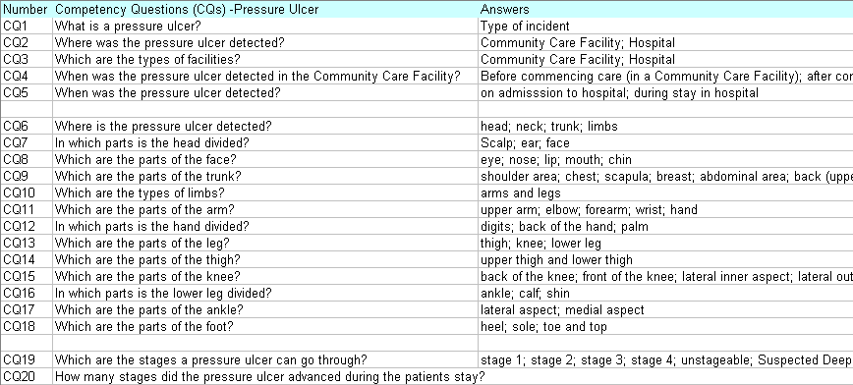

Ontology Specification Requirements
The International Classification for Patient Safety (ICPS) project is intended to facilitate “description, comparison, measurement, monitoring, analysis and interpretation of information to improve patient care, and for epidemiological and health policy planning purposes”. The ontology language in which the ontologies are going to be implemented is OWL.
Health care professionals, developers of patient safety reporting systems, Ministries of Health...
Comparing data, trending patient safety incident data, investigating patient safety incidents...
[Suárez-Figueroa, et al., 2007]
M.C. Suárez-Figueroa, G. Aguado de Cea, C. Buil, K. Dellschaft, M. Fernández-López, A. García, A. Gómez-Pérez, G. Herrero, E. Montiel-Ponsoda, M. Sabou, B. Villazon-Terrazas, Z. Yufei. NeOn D5.4.1: NeOn Methodology for Building Contextualized Ontology Networks. NeOn project. http://www.neon-project.org. February 2008.
ICPS Ontologies

Slide 5
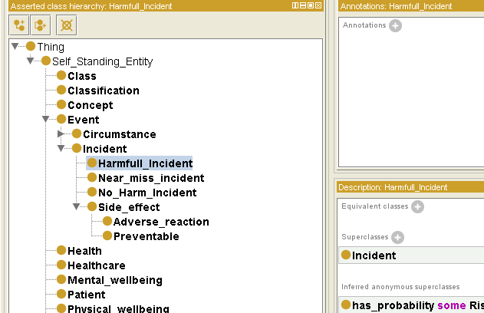
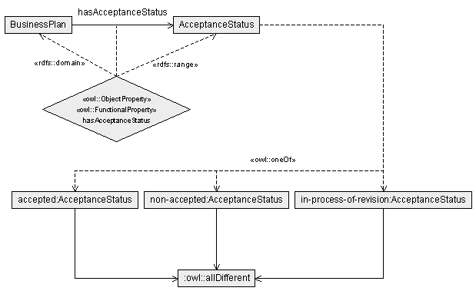
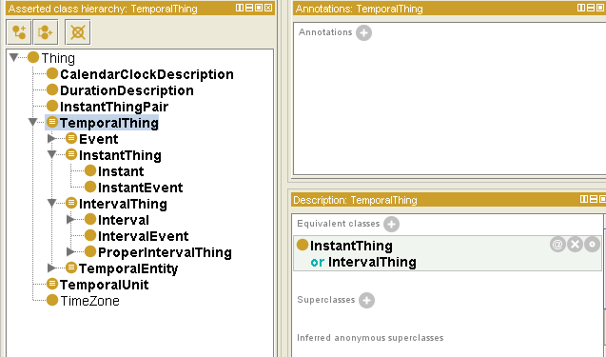
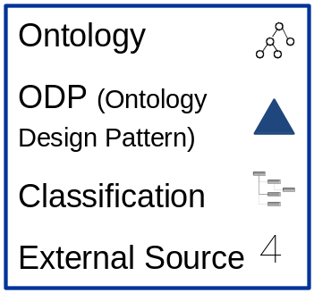
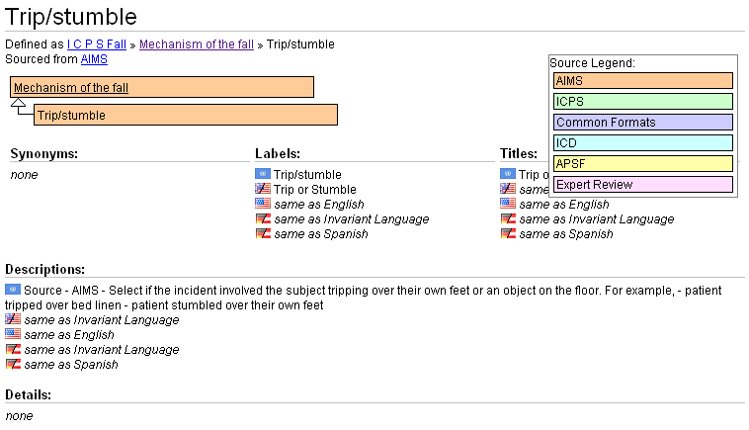
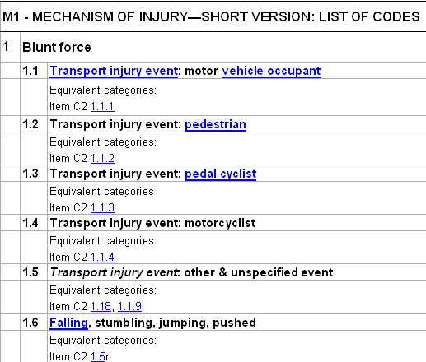
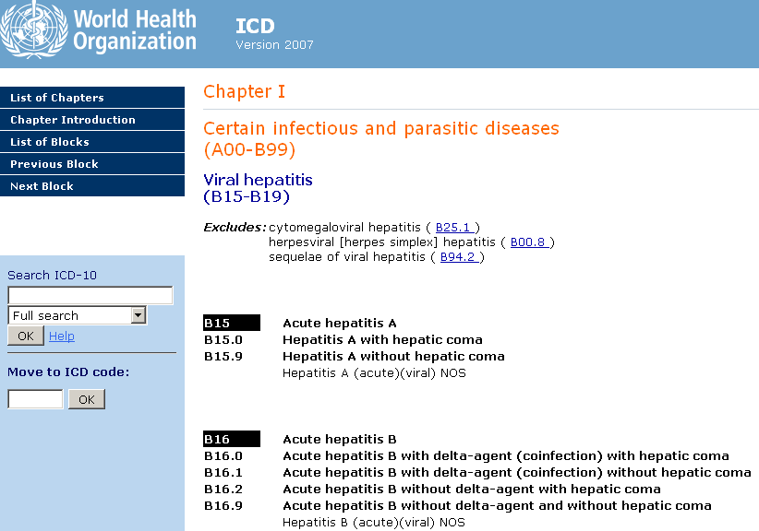
Candidate Reusable Resources
Logical Pattern Specified Values: Set of Individuals
ICECI
ICPS Ontologies
ICPS Ontologies

Slide 6
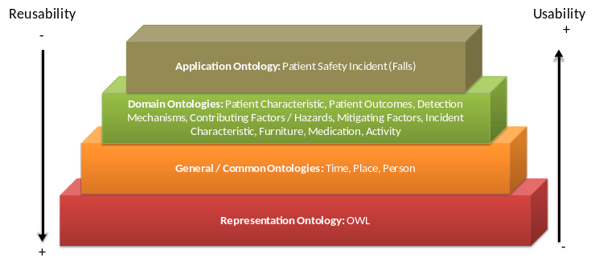
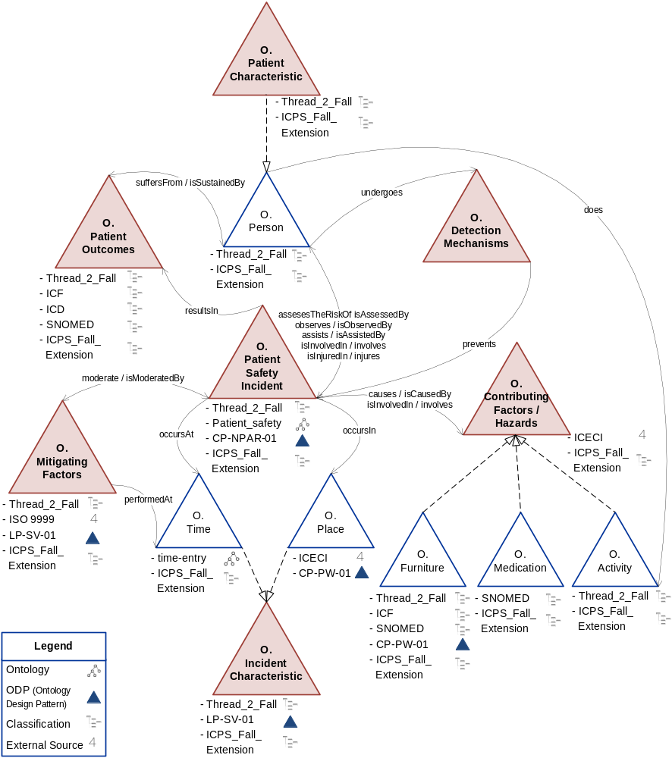
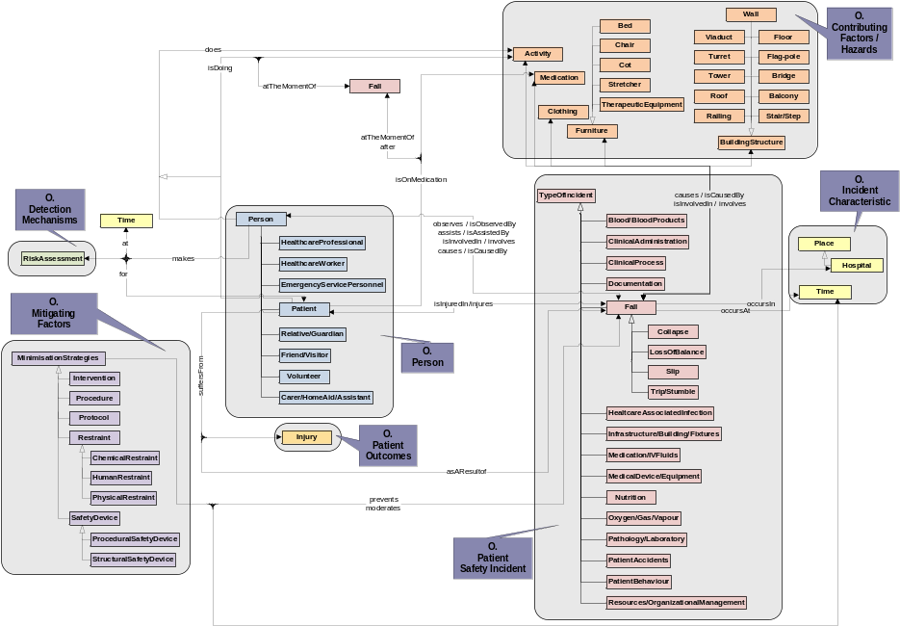
Ontology Conceptualization (I)
Upper Level Conceptual Model:
  Identify main concepts and domains
  Identify main relationships
  Identify possible resources to reuse
    Ontological Resources
    Non Ontological Resources
    Ontology Desing Patterns
Pyramid of reusable/usable ontologies
Detailed Conceptual Model:
  Identify taxonomies and main concepts within domains
  Identify binary and n-ary relationships
  Identify mereologies
ICPS Ontologies

Slide 7
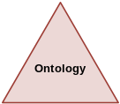
Ontology Conceptualization (II)
Falls Ontology Upper Level Conceptual Model
Aligned with the ICPS framework
ICPS Ontologies

Slide 8
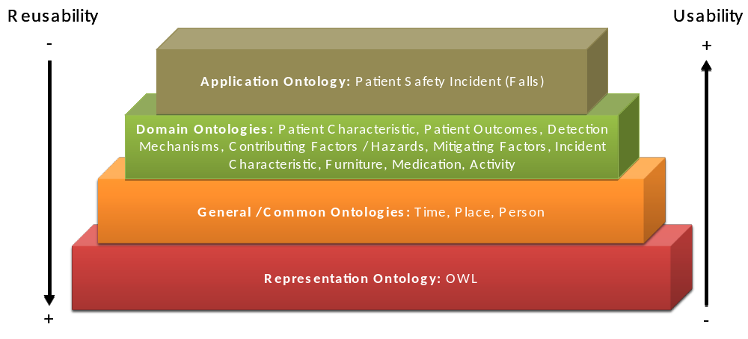
Ontology Conceptualization (IV)
Falls Ontology Pyramid
ICPS Ontologies

Slide 9
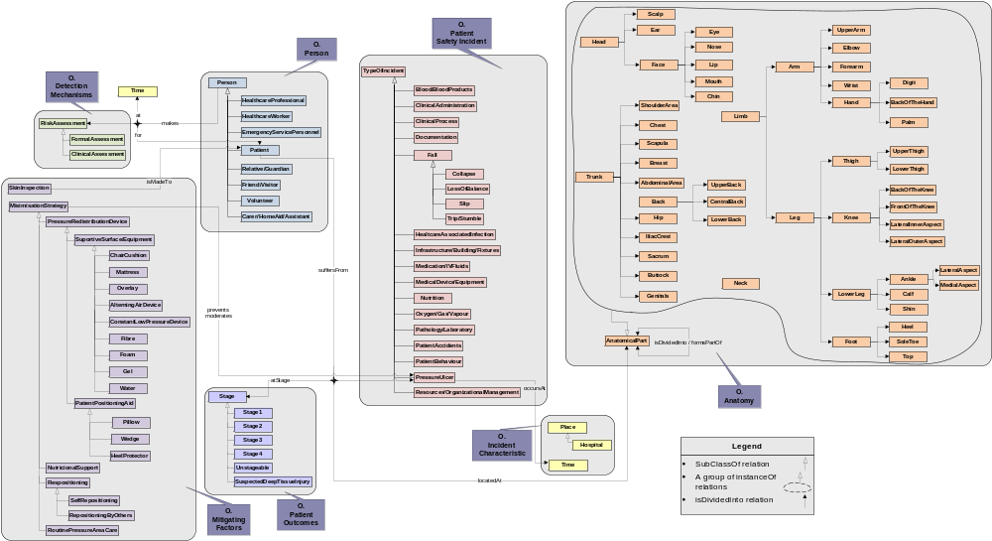
Ontology Conceptualization (V)
Pressure Ulcer Ontology Detailed Conceptual Model
N-ary Relationship
Taxonomy
Mereology
Binary Relationship
ICPS Ontologies

Slide 10
International Classification for Patient Safety (ICPS) a Project funded by the World Alliance for Patient Safety of the World Health Organization (WHO)
María Poveda, Elena Montiel-Ponsoda,
Mari Carmen Suárez-Figueroa, and Oscar Corcho
Ontology Engineering Group. Departamento de Inteligencia Artificial.
Facultad de Informática, Universidad Politécnica de Madrid.
Campus de Montegancedo s/n.
28660 Boadilla del Monte. Madrid. Spain
mpoveda@delicias.fi.upm.es, {emontiel, mcsuarez, ocorcho}@fi.upm.es
Date: 17/12/2009

