Slide 1
International Summer School on Grid Computing 2008
Carlos Buil Aranda
Notes:
Carlos Buil Aranda

Slide 2
Table of Contents
Introduction
Grid important technologies
  Security
  Computational Resources & Job management
  HTP (High Throughput Computing)
  Grid Architectures
  Distribution of data
  Desktop Grids
Grid Middleware
  UNICORE
  Condor
  Globus
  gLite
  MS-HPC
Interfaces to Grid middleware
  SAGA
  Services and Workflows
Notes:
En esta presentacion os voy a describir lo que aprendí en la ISSGC08 de este año. Os aré una pequeña introducción a lo que es el Grid, en que se basa y cuales son las aplicaciones más importantes. Una vez visto esto pasaré a la infraesteuctura, sobre qué conceptos tecnologicos se apoya la computación Grid y posteriormente pasaré a describir brevemente unos cuantos sistemas que implementan las tecnologías anteriores. Una vez explicado el middleware os hablaré de las aplicaciones que pueden acceder a ese middleware para hacernos la vida más fácil.
Carlos Buil Aranda

Slide 3
Introduction - Grid & Related Paradigms
Distributed Computing
Loosely coupled
Heterogeneous
Single Administration
Cluster
Tightly coupled
Homogeneous
Cooperative working
Grid Computing
Large scale
Cross-organizational
Geographical distribution
Distributed Management
Utility Computing
Computing “services”
No knowledge of provider
Enabled by grid technology
Source: Hiro Kishimoto GGF17 Keynote May 2006
Notes:
What is Grid computing? Grid computing is the distribution of resources in order to enable the users to access these resources in away they are not aware where these resources are. Concept: Grid is about distribution of resouces (hardware and software) and collaboration between these users.

Slide 4
Introduction – The Grid
What does the Grid provide?
  Combine different and heterogeneous systems
    Heterogeneity of data, systems, instruments, research processes, etc.
  Grids provide virtual communities (virtual homogeneity)
  Component for e-Infrastructure
Why use/build Grids?
  New Research: enabling new ways of doing research in many disciplines
  Economic reasons
  Computer science reasons (distributed systems problems)
Notes:
Here I explain what the grid provides. This slide complements the previous one (here I explain what is the basis for the grid)
A bit unnecessary if I just want to come briefly to Grids. I’ll check
Carlos Buil Aranda

Slide 5
Introduction - eScience
What is e-Science?
  E-Science is the application of the Grid infrastructure in order to obtain a better, faster or new research result in ALL research disciplines
What is e-Infrastructure?
  “e-Infrastructure is the term used for the distributed computing infrastructure that provides shared access to large data collections, advanced ICT tools for data analysis, large-scale computing resources and high performance visualisation”
  Not only Grids but also networks, data centre and specially enabling collaboration techniques.
Collaboration
Notes:
Here I link with the previously described infrastructure. The grid provides homogeneity, resources and enables collaboration. What does e-Science need? Resources and collaboration. What is enabling e-Science? Answer: e-Infrastructure. What is e-Infrastructure? Among other things, Grid infrastructure.
Carlos Buil Aranda

Slide 6
Table of Contents
Introduction
Grid important technologies
  Security
  Computational Resources & Job management
  HTP (High Throughput Computing)
  Grid Architectures
  Distribution of data
  Desktop Grids
Grid Middleware
  UNICORE
  Condor
  Globus
  gLite
  MS-HPC
Interfaces to Grid middleware
  SAGA
  Services and Workflows

Slide 7
Grid Security
Different clusters access to other clusters information
Why should the OEG cluster trust the cluster UPC in Barcelona? Who do I know they are who they say they are?
  Sensitive information must be protected
  The cluster resources must be protected
Communication happens through internet
  Internet is not the most secure channel
Two levels of security
  Network level security (Authentication)
  VO level security (Authorization)

Slide 8





Grid Security Infrastructure (GSI)
Security at network level: Public Key Infrastructure (PKI)
Based on pair of keys: Public and Private keys
Sends CA Root Certificate
Generates and sends public key and requests public certificate
User
Certification Authority
Private key encrypted and stored
New generated Cetificate

Slide 9

Grid Security Infrastructure (GSI)
User A
Hash A
Signature
User B
public Key
Users interchange public keys
User B
Private Key
Signature
User B
Notes:
Carlos Buil Aranda

Slide 10


PKI in action – the big picture
Hash function
Paul’s keys
Paul
message
message
Hash A
private
public
Digital Signature
Digital Signature
Mutual authentication and exchanging public keys: SSL protocol
John
John’s keys
message
message
Hash B
= ?
private
public
Hash A
Digital Signature
Hash function
Notes:
ISSGC'08: Balatonfüred,Hungary - 6th-18th July 2008

Slide 11
Grid Security
VO Security
  To what resources can user X access?
  Authorization problem
    Keeping a database on every site
    Keeping a list centrally
Delegation of access rights
  Proxy certificates

Slide 12
Distributed Systems Principles
P.H. Enslow, “What is a Distributed Data Processing System?” Computer, January 1978
  High Availability and Reliability
  High System Performance
  Ease of Modular and Incremental Growth
  Automatic Load and Resource Sharing
  Good Response to Temporary Overloads
  Easy Expansion in Capacity and/or Function
Notes:
Be careful, link always this to distribution of resources and collaboration
Carlos Buil Aranda

Slide 13
Distributed Systems Principles (problems)
Distributed systems problems
  Lack of Knowledge
    Due to technical reasons (latency, failures, tec.), human reasons (incomplete knowledge, lack of understanding, poor models)
  Heterogeneity
    Hardware heterogeneity (computer architectures, storage systems, input instruments), OS heterogeneity, different implementations systems
  Latency
    It always be there (and probably it will get worse due to geographic scale, system complexity, processing time)
  Unreliability
    Failures can happen (Network outages, Power outages, software errors, etc.)
  Autonomy & Change
    Changes on local systems, services
Notes:
Here I link what is Grid, e-Science and e-Infrastructure with distributed systems. How? Answer: distributed systems enable Grids and the necessary e-Infrastructure
Carlos Buil Aranda

Slide 14
Distributed Systems Principles (Service Oriented Architecture)
Registries
Request a service, sends description
Register an available service
Returns possible matches
Service
Consumers
Services
Request Operation
Operation Return
Notes:
Maybe unnecessary slide. Too simple. Maybe it can be used to link the architecture needed by the Grid infrastructure to the job submission. In the end, what I do when I submit a job is to send a request to a service that is available, right? Next slide: connecting significant computer resources, job submission, etc
Carlos Buil Aranda

Slide 15
Computational Resources & Job management
Multiprocessor systems
  Shared memory
  Distributed memory
  Distributed shared memory
Usage
  submission of jobs by the users
  Processing of these jobs
  High amount of jobs, resources are not so large
Ways for managing submission of jobs is required
  Time sharing
  Space sharing
Notes:
Here I start talking about computational resources. First, describing a bit what resources are needed by computational jobs. Jobs have to be executed somewhere. These resources are multiprocessor systems. Short description of them. How can I use these multiprocessor systems? By submitting jobs to them. Of course, these need to be managed in some way. Time and space sharing: brief description.
Carlos Buil Aranda

Slide 16
Job submission
High heterogeneity of computational resources:
  Different types of machines, OS, requirements for submission, memory, cores, duration of the tasks, etc.
Abstraction is needed for submitting jobs
  JSDL: Job Submission Description Language
  OGF standard
  Every system has its own submission language
JSDL
  XML based
  Defines the job requirements (type of processor, OS, memory, etc.) and parameters (inputs, outputs, etc.)
  It is not possible to submit jobs directly to resources

Slide 17

JSDL Example
<jsdl:JobDefinition xmlns="http://www.example.org/"
xmlns:jsdl="http://schemas.ggf.org/jsdl/2005/11/jsdl"
xmlns:jsdl-posix="http://schemas.ggf.org/jsdl/2005/11/jsdl-posix"
xmlns:xsi="http://www.w3.org/2001/XMLSchema-instance">
<jsdl:JobDescription>
<jsdl:JobIdentification>
<jsdl:JobName>Simple Application GW Template vs JSDL</jsdl:JobName>
<jsdl:Description> This is a simple example to describe the main
differences between GW Template and the JSDL schema.
</jsdl:Description>
</jsdl:JobIdentification>
<jsdl:Application>
<jsdl:ApplicationName>ls</jsdl:ApplicationName>
<jsdl-posix:POSIXApplication>
<jsdl-posix:Executable>/bin/ls</jsdl-posix:Executable>
<jsdl-posix:Argument>-la file.txt</jsdl-posix:Argument>
<jsdl-posix:Environment name="LD_LIBRARY_PATH">/usr/local/lib</jsdl-posix:Environment>
<jsdl-posix:Input>/dev/null</jsdl-posix:Input>
<jsdl-posix:Output>stdout.${JOB_ID}</jsdl-posix:Output>
<jsdl-posix:Error>stderr.${JOB_ID}</jsdl-posix:Error>
</jsdl-posix:POSIXApplication>
</jsdl:Application>
<jsdl:Resources>
<jsdl:CandidateHost>
<jsdl:HostName>*.dacya.ucm.es</jsdl:HostName>
</jsdl:CandidateHost>
<jsdl:CPUArchitecture>
<jsdl:CPUArchitectureName>x86_32</jsdl:CPUArchitectureName>
</jsdl:CPUArchitecture>
</jsdl:Resources>

Slide 18
Execution & Job management
Initiating/submitting, monitoring and managing jobs
  Translate job to the target system language, submit the job, get the job status, cache the job if something goes wrong, etc.
Handling and organizing all the job data
  Manage the job data (internal directories, intermediate data used by the jobs, etc.). All these data is preserved/organized after the successful job completion.
Coordinating and scheduling jobs
  Coordinate workflow resources, manage the initiation of the workflow execution, monitor the workflow, etc.
Notes:
Execution and job management is divided in:
- Initiating/submitting jobs
- Handling of data
- coordinating and scheduling multi-step? jobs
Carlos Buil Aranda

Slide 19
High Throughput Computing
Provide to the users a high amount of computational resources
  Goal: be able to maintain a high number of processes running with high performance and reliability
  Reliability is a key question in these systems
High amount of resources
High availability of these resources
  The greater the degree of replication of resources, the better the ability of the system to maintain high reliability and performance
Principal unity of control
  One unit that leads the goal of all resources working together
Transparency for the user
  Remember VOs?
Component autonomy
  The resources are independent of allowing or not the use of their capabilities
Notes:
How do I link this to the previous slides? Up until now we have seen one system resources: multiprocessor systems with powerful processors and large amount of memory. Now, another type of systems: those that are based not in large scale computers but in a high amount of computers that process large amount of operations. This time, to divide the job is the most important.
Carlos Buil Aranda

Slide 20
Distributed Data Management
Data characteristics
  Distributed, produced in large quantities, etc.
  Where the data is used?
    Scientific applications consume large amounts of data
  Problems
    Storage is not a problem anymore
    Computing power is still a problem
      But not a big deal, we still produce large amounts of data but storage systems and processing systems are growing
    New problem: the power needed to analyse/use the data
Notes:
Stop and analsye this thing about computing power: it is a problem!!
Carlos Buil Aranda

Slide 21
Principles of Distributed Data Management (I)
Data Processing, data access, data replication
Data processing
  Co-scheduling: moving computation to data
  Desirable for large amounts of data
  Problems
    assure required data near execution host is online
    second code near data without long wait time
    Clean up after execution or failure
    Evtl. licence availability
    ~70% of all failures in distributed systems are due to failure to properly manage data
  Complexities
    some data can not be distributed
    metadata stores use to be central (information about the execution of a process, for example)
Notes:
Find an example of data that can not be distributed!!!!
This is not processing data. This is data management. So, with these four main topics what we can do is first process the data (co-scheduling), second we access the data (streaming and caching) and third we create replicas of the data.
Carlos Buil Aranda

Slide 22
Principles of Distributed Data Management (II)
Remote Data Access
  Streaming
    Direct access to the information: it is processed when it is accessed/created
  Caching
    Use local data caches
  Difficulties
    Data validity
Replication
  Keeping replicas of data in many places in a Grid
    It is possible to keep data close to the computation system allowing to:
    Improving throughput and efficiency
    Reducing latency
    Both problems previously stated (see previous slide)
  Replica problems
    Consistency of replicas
    Locating the replicas
    Where do I store replicas? Country problems, legal issues
    Semantically equivalent but not identical replicas
Notes:
Careful with data validity
Carlos Buil Aranda

Slide 23
Principles of Distributed Data Management (III)
Space Management
  assure that target has enough space
  output can be written
File Transfer
  Grid ftp
  Reliable GridFTP
  System’s own implementations
Trust
  Site policies: Do not trust the users
    Who can access what information
  VO policies: Do not trust the sites
    Accessing sensitive data
    Managing user and group at VO level
  An agreement must be achieved
Notes:
Maybe talk a bit more about data transfer and management. Afterwards, in the description of the systems (condor, globus, etc)
Carlos Buil Aranda

Slide 24
Distributed File Management
Distributed File Systems
  Wide Area File Access
  Storage Resource Manager SRM interface to File Storage
    Exists OGF Standard
  Difficulties
    Scaling issues (servers, clients, updates), secutiry
Managed Storage Systems
  Stores data in the order of Petabytes
  Total-throughput scales with the size of the installation
  Supports several hundreds to thousands of clients
  Adding / removing storage nodes w/o system interruption
Notes:
Once we have seen the principles of data management we see the systems that implement the previous concepts
Carlos Buil Aranda

Slide 25
Others
Google File System
  MapReduce parallel data programming model
    Allows for automatic parallelization of data intensive tasks
    Generate intermediate key/value pairs for a regular key/value
    Reduce(merge) all generated ones back together
  GoggleFS filesystem – Open Hadoop implementation
Hadoop
  NOT for Wide Area yet
  Built with reliability in mind for commodity hardware
  Optimized for streaming access, not generic posix
  Built in java for large files
  Write once read many patterns best
  Very new, changing fast
  Watch out for scaling

Slide 26
Distributed Data Mining
Large amounts of distributed data
It is possible to extract useful information from the data generated
Possibility of distributing data mining processes
  Adaptation of data mining processes to a distributed environment
ADMIRE
  Advanced Data Mining and Integration research for Europe
  Accelerate access to and increase the benefits from data exploitation;
  Deliver consistent and easy to use technology for extracting information and knowledge;
  Cope with complexity, distribution, change and heterogeneity of services, data, and processes, through abstract view of data mining and integration; and
  Provide power to users and developers of data mining and integration processes.
Notes:
Once we have seen how to store and manage the data it is time to get some results from it. By using data mining techniques over the grid resources we can access large amounts of data and extract useful information (or not) from it.
Talk about High Productivity Analytics System and how to apply the CRISP-DM model for data mining in a Grid environment. Division of the CRISP-DM in processes that use sets of data. Distribute the access to them.
Examples of Data Mining techniques in Grid Systems: SPRINT – Scalable PaRallelizable INduction of decision Tree
What part of Grid are we using here? Distributiuon of data? Distribution of processes? Distribution of services?
Carlos Buil Aranda

Slide 27
GridMiner Data Mining Model
Virtual Organization
        Service
        Provider
Business
understanding
Data
understanding
Data provider
Service
Provider
User
Data
Preparation
Data
GridMiner
Deployment
Service
Provider
Modeling
Evaluation
CRISP-DM, SPSS
Slide by Peter Brezany – ISSGC08 Balatonfüred, Hungary
Notes:
ISSGC'08: Balatonfüred,Hungary - 6th-18th July 2008

Slide 28
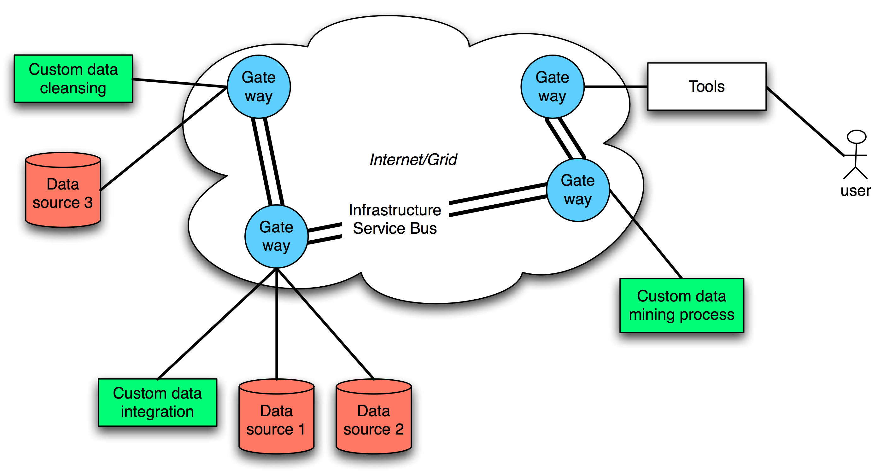
ADMIRE’s High-Level Architecture
Unified Systems
Management
Technologies

Slide 29
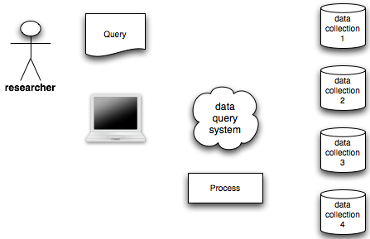
Data Access and Integration
Gather data from different and distributed sources
Scientists/researchers make queries to different data sources
DAI system distributes the queries
DAI system integrates and process the results to form the requested data
The data is processed as the user demanded
Notes:
Should I talk about streaming? Of course, improve this
Carlos Buil Aranda

Slide 30
Data Access and Integration
Gather data from different and distributed sources
Scientists/researchers make queries to different data sources
DAI system distributes the queries
DAI system integrates and process the results to form the requested data
The data is processed as the user demanded
Notes:
Should I talk about streaming? Of course, improve this
Carlos Buil Aranda

Slide 31
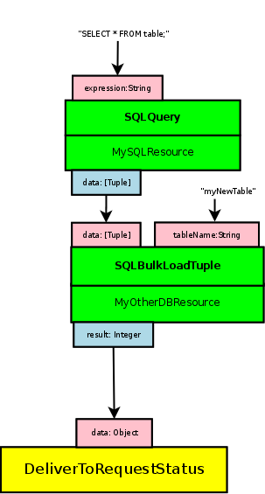
OGSA-DAI
OGSA-DAI is
  An extensible framework that allows to
  Access, integrate, transform and deliver
  Distributed and heterogeneous sources of data
OGSA-DAI key elements are
  Resources (Data request execution resource, Data Resource)
  Activities (=operations or named unit of functionality)
    Activity connectors for connecting inputs and outputs of different activities
  Workflows (=composition of activities)
    Pipeline workflow (A set of chained activities executed in parallel with data flowing between the activities)
    Sequence workflow
    Parallel workflow
Notes:
Example activities include
Execute an SQL query
ZIP a batch of data
List the files in a directory
Execute an XSL transform on an XML document
Deliver data to an FTP server
A data request execution resource, or DRER, accepts requests from clients, executes these and possibly returns results. A DRER is associated with 0 or more OGSA-DAI data resources. A DRER can be viewed as a workflow management and execution resource.
Carlos Buil Aranda

Slide 32
Desktop Grids
Resource Donors and Users
  if U ~ D => generic Grid model
  if U >> D => service Grid model
  if U << D => desktop Grid model
Generic Grids
  Anyone can donate resources, heterogeneity, run own applications
Service Grids
  Push Model
  Guaranteed service
  Many users: anyone can use the assigned resources for running their own applications

Slide 33
Desktop Grids (II)
Desktop Grid model
Dynamic resource donation
  Based on desktop computers
  More donors of resources than consumers
  Not guaranteed service
  Pull model
  Not large number of grid applications
BOINC (Berkeley Open Infrastructure for Network Computing)
  A donor (participant) can define the distribution of idle CPU time for different projects

Slide 34
Table of Contents
Introduction
Grid technologies
  Security
  Job submission
  HTP (High Throughput Computing)
  Grid Architectures
  Distribution of data
  Desktop Grids
Grid Middleware
  UNICORE
  Condor
  Globus
  gLite
  MS-HPC
Interfaces to Grid middleware
  Services and Workflows

Slide 35
Grid Middleware
Middleware between the computational resources and the users (computer scientists, researchers)
The middleware interacts with both
  User requirements
  Available resources
Provides
  Security infrastructure, job management, data management, job monitoring
Different implementations for different Grid systems
  Supercomputers, large clusters, high amount of personal computers,

Slide 36
UNICORE
Uniform Interface to Computing Resources
UNICORE is a Grid middleware that provides seamless, secure, and intuitive access to distributed Grid resources
  Grid resources: supercomputers or clusters systems
Submitting a job
  Client establishes a SSL connection with the UNICORE gateway
  XUUDB checks the user
  UNICOREX send the job to TSI
TSI (Target System Interface)
  Executes the job
Notes:
Añadir ejemplo de submit job!!!!
Why UNICORE? Need of a common interface for accessing computational resources. AKA meta layer on top of Grid resources. Skip it until the middleware section.
Describe the architecture:
- Main components when submitting a Job: registry, gateway, unicorex (central processing unit), XUUDB (user database), TSI (Target System Interface)
- Security?
-
Carlos Buil Aranda

Slide 37
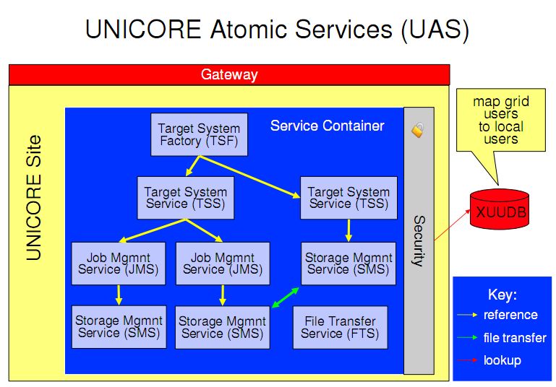
UNICORE (II)

Slide 38
System 1 Submit job file
{
Executable: "/bin/date",
Arguments: ["-v", "-d"],
Environment: ["SHELL=/bin/bash", "JAVA_OPTS=-v"],
Imports: [
{ File: myfile, To: uspaceFile },
],
Exports: [
{ File: uspaceOutFile, To: "localName" },
{ File: otherUspaceOutFile, To: "otherLocalName"},
],
Stage in: [
{
From: "RBYTEIO:http://localhost:8080/XNJS/etcetc",
To: "uspaceFileName"
}
],
Stage out: [
{
From: stdout,
To: "RBYTEIO:http://someserver/someresource"
}
],
Resources: {
Memory: 128000000,
CPUs: 32,
Nodes: 4,
Runtime: 3600
}
User name: fred,
User email: fred@fred.invalid
Name: my test job,
Description: a sample job,
}

Slide 39
Condor
Grid middleware for HTC systems
Installed in a large number of computer
Key concepts:
  Matchmaker
    Get an agreement between users of resources and providers of resources (machines)
    Machine requirements: only jobs from OEG computers, only work from 6pm to 4am
    Users requirements: to be executed only on Linux machines, dual core processor
    ClassAd file represents the state of jobs and machines
  Submitting a job
    Selecting the job universe (vanilla, Java, standard, MPI, etc.)
    Using a job description file, possibility of monitoring jobs
  Job dependencies (DAGMan)
High importance to the system reliability
  Job checkpoints, parameter sweep management (clusters and processes)
Notes:
Condor is a HTC system. First, explain it. Second, explain the key features: matchmaker
Master worker? Maybe too much
Carlos Buil Aranda

Slide 40
System 2 Submit job file
Universe = vanilla
Executable = my_job
Log = my_job.log
InitialDir = run_$(Process)
ShouldTransferFiles = IF_NEEDED
Transfer_input_files = dataset$(Process), common.data
Requirements = Memory >= 256 && Disk > 10000
Rank = (KFLOPS*10000) + Memory
Queue 600

Slide 41
Globus
Globus is a Grid middleware that provides means for building collaborative and distributed applications
  It is a middleware that solves the problem of heterogeneity between user applications and computing resources
Core runtime
Security (Authentication and authorization)
  GSI (Grid Security Infrastructure), X509 standard, VOMS (Virtual Organization Membership Service)
Execution management
  Supports the GRAM interface (Grid Resource Allocation and Management)
  It provides a single protocol for communicating with different batch/cluster job schedulers.
Data management
  GridFTP (XIO), RFT, Replica Location Service, OGSA-DAI
Monitoring
  Monitoring and Discovery System (MDS4): information providers, collective services, clients

Slide 42
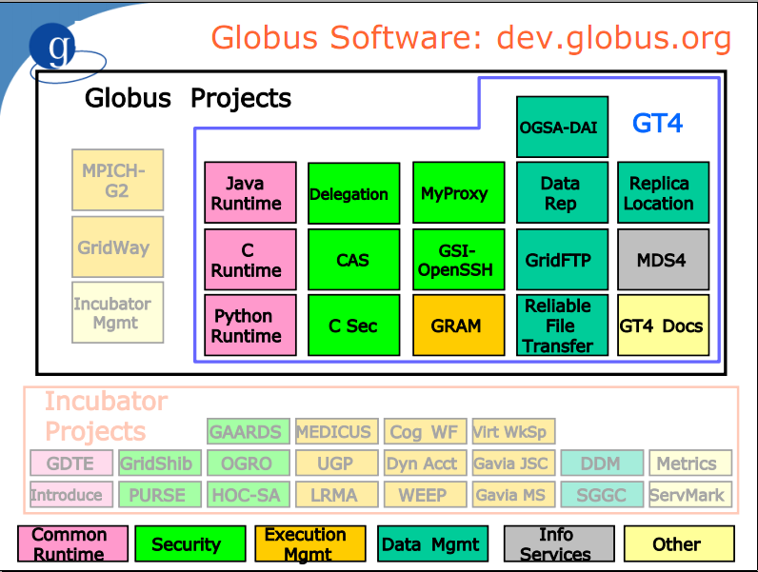
GLOBUS (II)

Slide 43
System 3 Submit job file
<job>
<executable>${GLOBUS_USER_HOME}/genr</executable>
<argument>5</argument>
<argument>4</argument>
<stdout>${GLOBUS_USER_HOME}/genr.out.${GLOBUS_USER_NAME}</stdout>
<fileStageIn>
<transfer>
<sourceUrl>gsiftp://tc02.nesc.ed.ac.uk:2812/tmp/my_genr</sourceUrl>
<destinationUrl>file:///${GLOBUS_USER_HOME}/genr</destinationUrl>
</transfer>
</fileStageIn>
<fileStageOut>
<transfer>
<sourceUrl>file:///${GLOBUS_USER_HOME}/genr.out.${GLOBUS_USER_NAME}</sourceUrl>
<destinationUrl>gsiftp://tc02.nesc.ed.ac.uk:2812/tmp/</destinationUrl>
</transfer>
</fileStageOut>
<fileCleanUp>
<deletion>
<file>file:///${GLOBUS_USER_HOME}/genr</file>
</deletion>
<deletion>
<file>file:///${GLOBUS_USER_HOME}/genr.out.${GLOBUS_USER_NAME}</file>
</deletion>
</fileCleanUp>
</job>

Slide 44

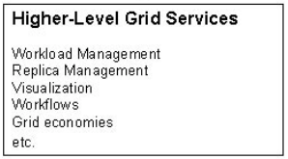
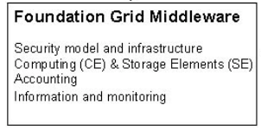
gLite
Is a Grid middleware powering the EGEE infrastructure
  EGEE is the largest interdisciplinary Grid infrastructure in the world
  Provides the necessary components to process the users jobs (security, workflow management, metadata management, etc.
  Middleware Structure:

Slide 45
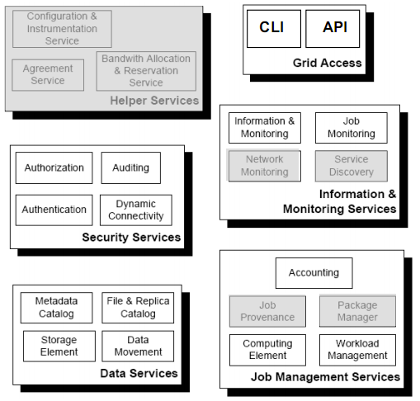
gLite Services Decomposition

Slide 46
System 4 Submit job file
Type = "Job";
JobType = "Normal";
Executable = "startGen4.sh";
Environment = {"CLASSPATH=./gfal.jar:./gint.jar",“
LD_LIBRARY_PATH=.:$LD_LIBRARY_PATH",
"LCG_GFAL_VO=gilda","LCG_RFIO_TYPE=dpm"};
Arguments = " 0 0 10 4 10000 aliserv6.ct.infn.it
lfn:/grid/gilda/valeria/2000pillar.dat /gilda/issgc07/";
StdOutput = "sample.out";
StdError = "sample.err";
InputSandbox = {"startGen4.sh","gint.jar","gfal.jar",
"libGFalFile.so"};
OutputSandbox = {"sample.err","sample.out", "sample.log"};
Requirements = Member("GLITE-3_0_0“
,other.GlueHostApplicationSoftwareRunTimeEnvironment);

Slide 47
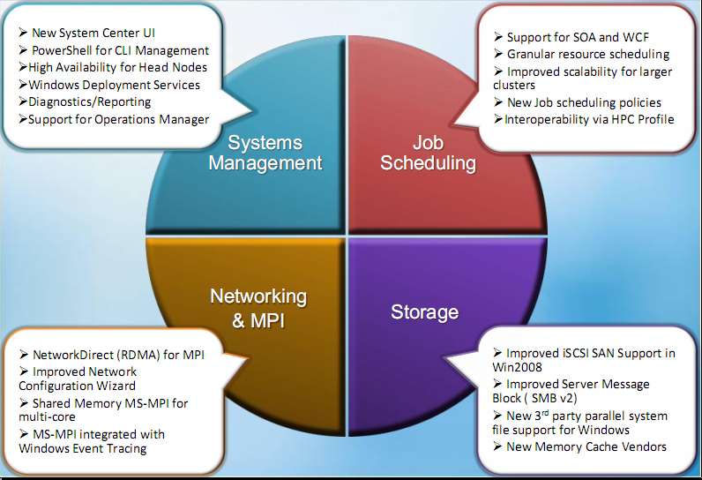
MS-HPC

Slide 48
MS-HPC (II)
“Engagement with standards”
  High heterogeneity of computer systems (different types of computers with different types of OS)
  Use of standards for achieving interoperability
  File sharing
  SUA (Subsytem for Unix-based Applications)
  SCOM (Systems Centre Operations management)
    Monitoring
  MS-HPC support standard specifications
    Basic Execution Service (BES), JSDL, etc.

Slide 49
System 5 Submit job file
<jsdl:JobDefinition>
<jsdl:JobDescription>
<jsdl:JobIdentification>
</jsdl:JobIdentification>
<jsdl:Application>
<jsdl-hpcp:HPCProfileApplication name="HostDate" >
<jsdl-hpcp:Executable>C:\GridSchool\sfk\scan.bat
</jsdl-hpcp:Executable>
<jsdl-hpcp:Input></jsdl-hpcp:Input>
<jsdl-hpcp:Output>output.txt</jsdl-hpcp:Output>
</jsdl-hpcp:HPCProfileApplication>
</jsdl:Application>
<jsdl:Resources>
<jsdl:ExclusiveExecution>false</jsdl:ExclusiveExecution>
<jsdl:TotalCPUCount/>
</jsdl:Resources>
<jsdl:DataStaging>
</jsdl:DataStaging>
</jsdl:JobDescription>
</jsdl:JobDefinition>

Slide 50
Submission script
#!/usr/bin/env perl
open(SUBMIT, ">submit-big");
print SUBMIT "Universe = java\n";
print SUBMIT "Executable = sfkscanner.jar\n";
print SUBMIT "jar_files = sfkscanner.jar,issgc_sfk_nesc.jar\n";
print SUBMIT "Log = explorer.log\n";
print SUBMIT "Output = explorer.\$(PROCESS).output\n";
print SUBMIT "Error = explorer.\$(PROCESS).error\n";
print SUBMIT "transfer_input_files = BoxData.txt,PillarsData2.txt.en\n";
print SUBMIT "should_transfer_files = YES\n";
print SUBMIT "when_to_transfer_output = ON_EXIT\n";
print SUBMIT "\n";
#my $y;
for ($x = -15; $x < -11.12; $x += 0.1) {
for ($y = 9861.9; $y < 9862.49 ; $y += 0.1 ) {
# my $xx = $x + 10; #-15.0
# my $yy = $y + 10; #9861.9
# my $zz = $z; #-11.12
# my $ff = $f; #9862.49
print SUBMIT "Arguments = uk.ac.nesc.toe.sfk.radar.Scanner ";
print SUBMIT "$x $y -11.12 9862.49 0.001\n";
print SUBMIT "Queue\n";
print SUBMIT "\n";
}
}
close(SUBMIT);
exit 0;

Slide 51
Table of Contents
Introduction
Grid Technologies
  Security
  Job submission
  HTP (High Throughput Computing)
  Grid Architectures
  Distribution of data
  Desktop Grids
Grid Middleware
  UNICORE
  Condor
  Globus
  gLite
  MS-HPC
Middleware between Grid Middleware and end users
  Services and Workflows

Slide 52
SAGA
Simple API for Grid Applications (SAGA)
  SAGA is a simple API (as it sounds)
  SAGA is an emerging standard
What is the Grid (brief reminder)
  Dynamic
  Heterogeneous
  Complex
What SAGA provides?
  A high level abstraction hiding middleware details
  Details of distribution are hidden
  Simple API to access the existing Grid middleware
  Is a client side software
Notes:
Up until now we have seen multiprocessor systems, HTC systems and there are middleware that provide access to these systems. These middleware are Globus, gLite, UNICORE, MS-HPC and others. Each of them needs a program for allowing the user to create operations like copy a file. SAGA provides a new layer of abstraction on top of the middleware’s commands facilitating the job of the programmer.
Carlos Buil Aranda

Slide 53
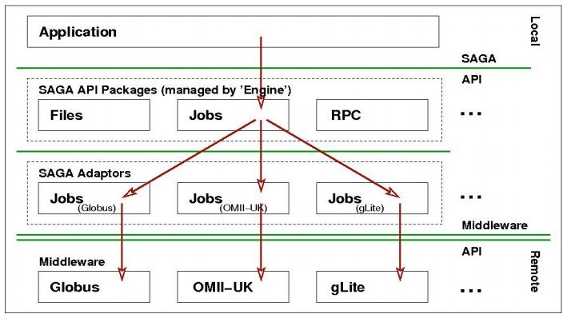
SAGA Architecture

Slide 54
SAGA Example
void copy_file(std::string source_url, std::string target_url)
{
try {
saga::file f(source_url);
f.copy(target_url);
}
catch (saga::exception const &e) {
std::cerr << e.what() << std::endl;
}
}
int copy_file (char const* source, char const* target)
{
globus_url_t source_url;
globus_io_handle_t dest_io_handle;
globus_ftp_client_operationattr_t source_ftp_attr;
globus_result_t result;
globus_gass_transfer_requestattr_t source_gass_attr;
globus_gass_copy_attr_t source_gass_copy_attr;
globus_gass_copy_handle_t gass_copy_handle;
globus_gass_copy_handleattr_t gass_copy_handleattr;
globus_ftp_client_handleattr_t ftp_handleattr;
globus_io_attr_t io_attr;
int output_file = -1;
if ( globus_url_parse (source_URL, &source_url) != GLOBUS_SUCCESS
printf ("can not parse source_URL \"%s\"\n", source_URL);
return (-1);
}
…

Slide 55
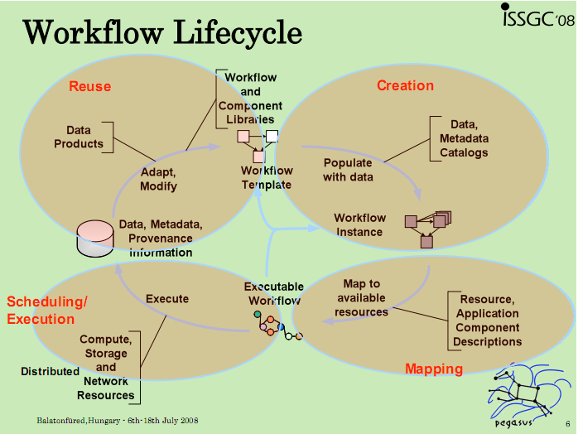
Workflow Principles
Scientific workflows
  Allow to compose applications from other execution units/programs
  Provide automation for the applications
  Types of workflow applications
    provide a service to a community
    supporting community based analysis
    process large amounts of shared data on shared resources
  Critical issues
    Find the right components
    set the right parameters
    find the right data
    connect appropriate pieces together
Workflow lifecycle
  Creation
  Mapping
  Planning/execution
  Reuse

Slide 56
Workflow principles (lifecycle I)
Creation
  Find the right components
  set the right parameters
  find the right data
  connect appropriate pieces together
Mapping
  Map tasks to available resources
  Where to run the computation units?
  What data do I have to access?

Slide 57
Workflow principles (lifecycle II)
Scheduling/execution
  Consists in the execution of the planned workflows in other systems
    Workflow systems send tasks to systems like Condor or Globus (depending on what specific functionality want to use)
Reuse
  how to find what is already there?
  how to determine the quality of what is already there?
  how to invoke an existing workflow?
  how to share a workflow with a colleague?
  how to share a workflow with a competitor?

Slide 58
Conclusions (I)
Grid is about collaboration and sharing resources
  Computational resources (large amount of computers, large systems)
  Data resources
New ways for doing research in many and different areas
  High use of computing resources
  Data intensive applications
  Distributed applications
  Grid creates virtual homogeneity of resources (virtualization)
  E-Science, e-Infrastructure, grid security
Virtual homogeneity
  Standards

Slide 59
Conclusions (II)
Systems provide similar functionalities but:
  UNICORE focused in large scale systems (high computing power)
  Condor focused in high amount of jobs and computers
  Globus focused in high amount of computers
  gLite high amount of computers/large infrastructure
Same as data management in Grids:
  Every problem (high rate of data generation, high amounts of data, high distribution of data) has its own solution
Workflow systems allow to compose and submit complex jobs
Notes:
Buscar los challenges de cada tecnologia / grupo de tecnologias: analisis de los datos, sintesis de los datos -> generar opinion
Relacionar como sirve todo esto para la tesis
Carlos Buil Aranda

Slide 60
Distributed Reasoning
Distribution of data/ontologies
  Where are the classes/properties/relations
  Where are the instances
  How to access them
  Availability of the resources
Distribution of processes
  What processes can I distribute?
  Where do I send these processes?
  Reliability of the system
  Gather and join the results
  Possible use of workflow systems/scripts?

