Slide 1
TSI2007-65677C02-01
(Octubre 2007)
logo
GeoBuddies: Social Semantic Annotation
With mobile devices in the “Camino de Santiago”
Project Coordinator: Asunción Gómez-Pérez, UPM
1 de Octubre 2007 - 30 Septiembre 2010

Slide 2
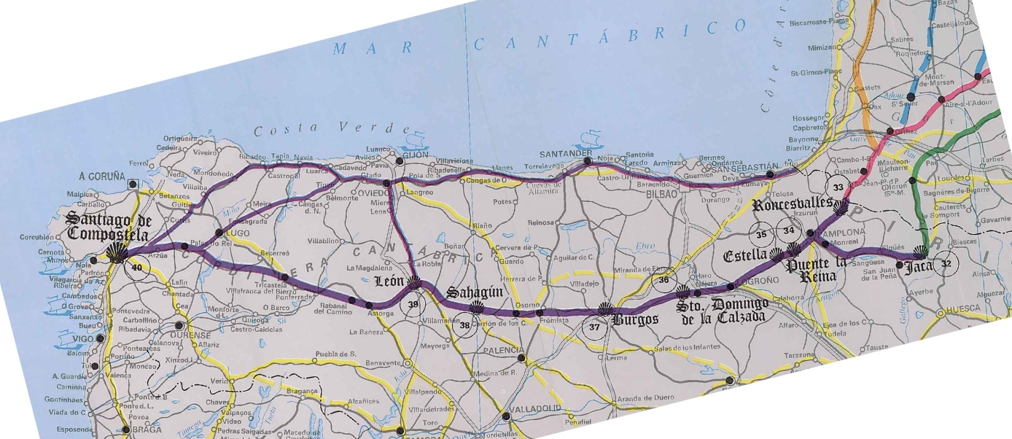
A pilgrim in St. James’ Way
(Camino de Santiago)
Diverse routes for pilgrims (almost DIY)
Self-emergent community of pilgrims
  People that talk about their experiences during the way
  People that join together in the joy of walking
  Mobile users
People want to
  Find interesting locations
  Find community services
  Provide information

Slide 3


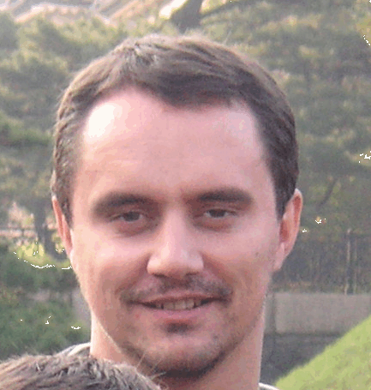

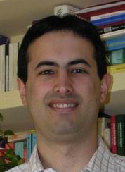

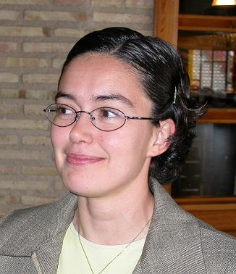
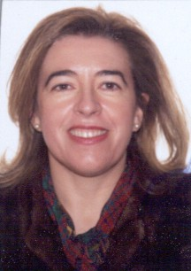
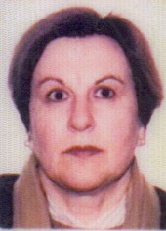
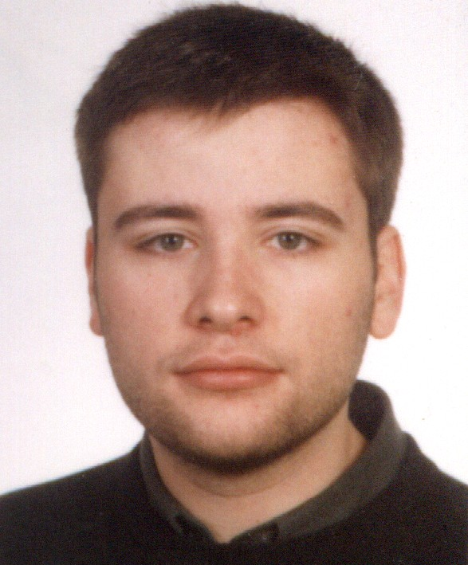
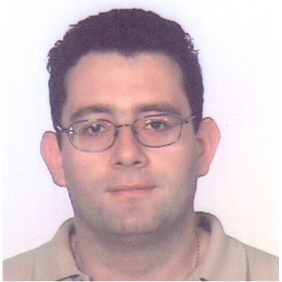
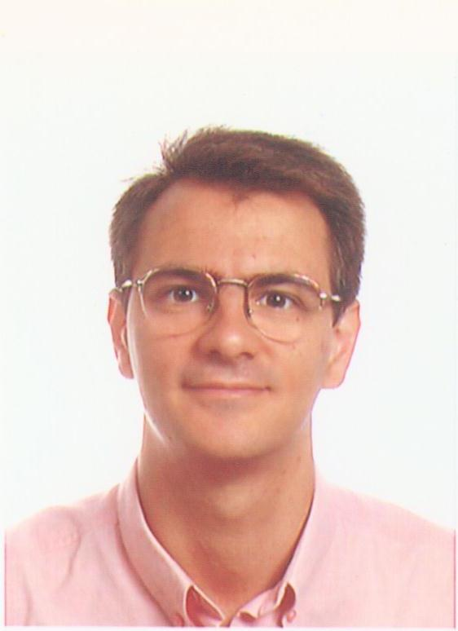
Join project UPM-USC
UPM
Asunción Gómez Pérez
Guadalupe Aguado de Cea
Óscar Corcho García
Inmaculada Álvarez de Mon
Rosario Plaza Arteche
(UPM)
Maria Pérez
(Data transfer and reliability)
Pilar Herrero
(Data transfer and reliability)
Ana Ibarrola
(Admon)
Raúl García Castro
(FPI- UPM)
Angel López Cima
(Semantic Portal)
Raul García
(Benchmarking)
Mª Carmen Suárez de Figueroa
(Onto methodologies)
Miguel Esteban
(Semantic Grid)
Rafael González Cabero
(SWS)
USC
Manuel Lama Penín
( Service composition & execution)
Eduardo
(Collaborative filtering)
External Members
Mariano Fernández López
(CEU)
Antonio Pareja Lora
(UCM)
2 Full professor
7 Associate Professors
2 Assistant Professors
4 PhD Students

Slide 4
Expertise
Project Topics | UPM | USC | CEU | UCM
Ontologies | x | x | x | x
Social tagging | x | x
Collaborative filtering |  | x
Service composition and execution |  | x
Data transfer and reliability | x
Grid and Semantic Grid | x

Slide 5
Project Goals
User-centered geomatic information and services, anywhere anytime, for pilgrims in the “Camino de Santiago”
Main research topics
Ontology based integration information → Harmonize multilingual and heterogeneous geo-DB
Social tagging of resources and services → to derive user communities
Collaborative filtering → recommendations based on user communities
Service composition and execution → creation and use of added-value services based on the user’s context
Data transfer and reliability in mobile environments → relevant data is always available to services and mobile devices
Main outcomes:
Geobuddies Platform (WP1)
Development of an application for pilgrims in the “Camino de Santiago” ( WP8)
A set of services
  Ontology-based information integration from heterogeneous multilingual databases (WP2)
  Social tagging of resources and services (WP3)
  Collaborative filtering and recommendation based on user communities (WP4)
  Context-aware data transfer and reliability for mobile environments (WP5)
  for ontology-based service dynamic composition and their execution (wp6)
  Xxxxx (WP7)

Slide 6
WP structure and responsable person
WP 10 Project management (UPM-Asun)
WP 9 Dissemination, transfer and exploitation (UPM-Asun)
WP 2
Ontology-based
multilingual information integration
(UPM-Asun)
WP 3
Semantic social tagging
(UPM-Lupe)
WP 4
Collaborative filtering based on user communities
(USC-Eduardo)
WP 5
Data transfer in mobile environments
(UPM-María)
WP 6
Dynamic composition and execution of services
(USC-Manuel)
WP 7
User interfaces and user interaction models
(USC-Eduardo)
WP 1
GeoBuddies: Platform to support geomatic mobile applications
(UPM-Oscar)
WP 8
Application: El Camino de Santiago
(USC-??)

Slide 7
Goals, WP and main results
Objective 3
Ontology-based information integration from heterogeneous multilingual databases
Mapping discovery algorithm
Implementation
Validation
Objective 4
Development of a service for tagging resources and services
Algorithm for Semantic Web 2.0 annotations
Implementation
Validation
Objective 5
Development of services for collaborative filtering and recommendation based on user communities
Algorithm for collaborative filtering
Implementation
Validation
Objective 6
Development of services for context-aware data transfer and reliability
Algorithms for transferring data
Algorithms for reliability
Implementation
Validation
Objective 7
Development of a service for ontology-based service dynamic composition and their execution
Execution engine for ontology-based composed services
Algorithm for dynamic generation of composed services
Implementation and validation
WP2
WP3
WP4, WP6
WP5
WP6
Result
Result
Result
Result
Result
The mapping discovery algorithm + service implementation
The algorithm for Semantic Web 2.0 annotations + service implementation
The algorithm for collaborative filtering + service implementation
The algorithms for transferring data and reliability + services implementation
The algorithm for dynamic generation of composed services + service implementation
Objective 2
Development of a platform (GeoBuddies) to support user-centered geomatic applications
Ontology-based multilingual information integration
Tagging of resources and services
Collaborative filtering
Context-aware data transfer
Added-value service dynamic composition and execution
WP1
Result
The GeoBuddies platform
Objective 1
Development of an application for pilgrims in the “Camino de Santiago”
Ubiquitous access to resources and services
Tagging resources
Upload to Web2.0
3 prototypes
.- m12,24,36
WP7, WP8
Result
The “Camino de Santiago” application
WP9 Dissemination, transfer and exploitation

Slide 8
Milestones
Month | Milestones
0 | Kick off meeting
6 | Specification of the application functionalities Identification of potential technologies Specification of the GeoBuddies platform requirements
12 | First prototype: implementation with existing technology
24 | Second prototype: implementation including research results
32 | Third prototype: implementation including real data and refined research results
36 | Final validation and exploitation

Slide 9
Management Structure
Project Coordinator: Asunción Gómez-Pérez
Proyecto UPM: Oscar Corcho
Proyecto USC: Manuel Lama
WP Leaders
WP1 (Plataforma): Oscar Corcho
WP2 (Integración información multilingüe): Asun
WP3 (Etiquetado social): Lupe
WP4 (Comunidades): Eduardo
WP5 (Transferencia de Datos): María
WP6 Composición Servicios: Manuel
WP7 (nuevas interfaces): Eduardo
WP8 (Aplicación): Manuel
WP9 (Diseminación, transfer, Exploitation): Asun
WP10 (Management): Asun, Ana

Slide 10
Management Tasks
Gestión Operativa
Gestión Técnica
Gestión Financiera (Ana Ibarrola)
Gestión legal y de conocimientos
Reportes anuales
  Asun, Oscar
  Manuel

Slide 11
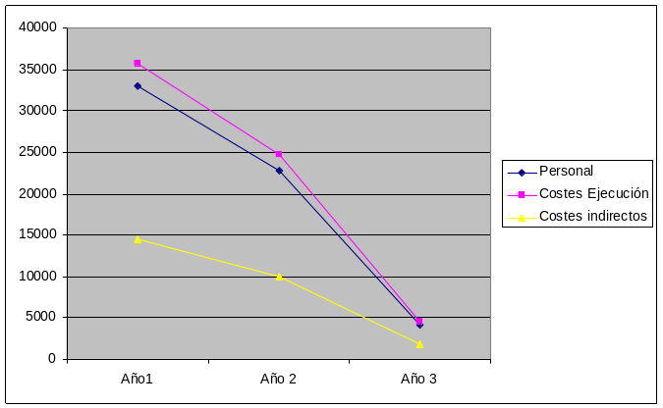
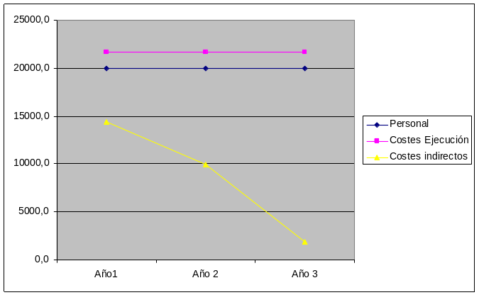
Distribución Presupuesto UPM del MEC
 | Año1 | Año 2 | Año 3 | Total
Personal | 33000 | 22800 | 4200 | 60000
Costes Ejecución | 35750 | 24700 | 4550 | 65000
Costes indirectos | 14437,5 | 9975 | 1837,5 | 26250
Total | 83187,5 | 57475 | 10587,5 | 151250
Distribución presupuesto UPM
 | Año1 | Año 2 | Año 3 | Total
Personal | 20000,0 | 20000,0 | 20000,0 | 60000,0
Costes Ejecución | 21666,7 | 21666,7 | 21666,7 | 65000,0
Costes indirectos | 14437,5 | 9975,0 | 1837,5 | 26250,0
Total | 56104,2 | 51641,7 | 43504,2 | 151250,0

Slide 12

Distribución Año 1 presupuesto UPM
N. personas: 12
Becario FPI → Anotación
Distribución Costes ejecución
Viajes a Santiago: 0,2%
Viajes Conf. 0,5
Equipos: 0,25
Otros: 0,05
Personal |  | 21.800,00
German | 5.000,00
Saquicela | 16.800,00
Costes Ejecución |  | 21.666,67
V. Santiago | 4.333,33
V. Conferencias | 10.833,33
Equipos | 5.416,67
Otros | 1.083,33
Un viaje por Investigador
Directamente relacionado con Geobuddies.
Geobuddies en Acknowledgments

Slide 13
Distribución Año 1 presupuesto USC
N. personas:
Distribución Costes ejecución
Viajes a Santiago: 0,2%
Viajes Conf. 0,3
Equipos: 0,25
Pruebas: 0,2
Otros: 0,05

Slide 14
Logística
Reuniones
  2 plenarias
  Reuniones de integración (Mayo - Junio)
  1 reunión mensual virtual
Listas de correo

