Slide 1

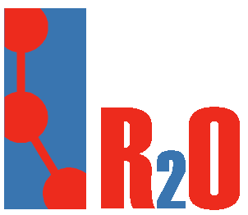

Boris Villazón-Terrazas, Freddy Priyatna
bvillazon@fi.upm.es, fpriyatna@delicias.dia.fi.upm.es
Ontology Engineering Group. Laboratorio de Inteligencia Artificial
Departamento de Inteligencia Artificial
Facultad de Informática
Universidad Politécnica de Madrid

Slide 2
ToC
Introduction
R₂O
  ConceptMap definition
  AttributeMap definition
  RelationMap definition
ODEMapster
  Query Driven
  Massive batch data upgrade
FAO Use Case
Multiple Database to RDF

Slide 3
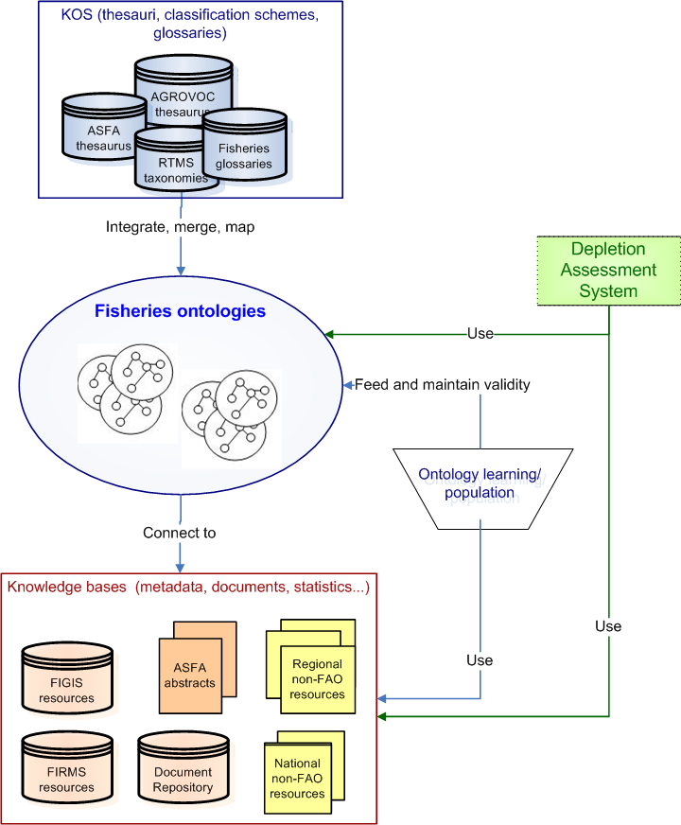
Introduction
Ontologies that will be used by the FSDAS (Ontology Driven Fisheries Stock Depletion Alert System )
Notes:
Marta: ultima immagine FSDAS

Slide 4

Existing approaches
1
2
To build a new ontology from a database schema and content (OntoStudio, KaOn Reverse)
2. To map the ontology created in approach (1) to a legacy ontology (NeOn toolkit UKARL)
3. To map an existing DB to a legacy ontology (NeOn Toolkit UPM)
3
new ontology
existing ontology

Slide 5
ToC
Introduction
R₂O
  ConceptMap definition
  AttributeMap definition
  RelationMap definition
ODEMapster
  Query Driven
  Massive batch data upgrade
FAO Use Case
Multiple Database to RDF

Slide 6

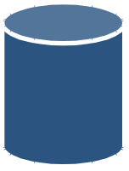
R₂O
R₂O is an extensible, fully declarative language to describe mappings between relational database schemas and ontologies.
Organization
<xml>
R₂O Mapping
</xml>
Persons
University
RDB
Professor
Relational Model
Student
Ontology

Slide 7
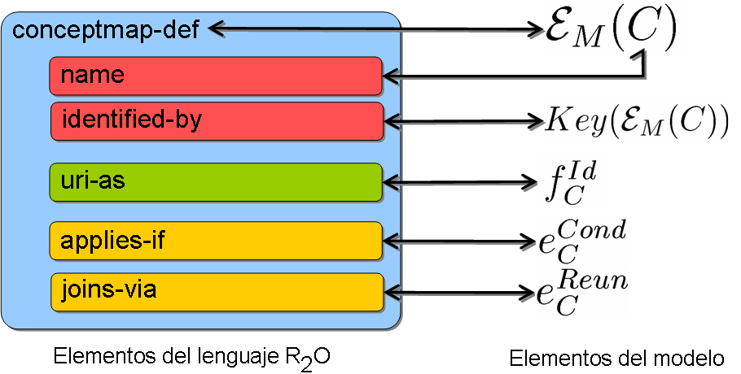
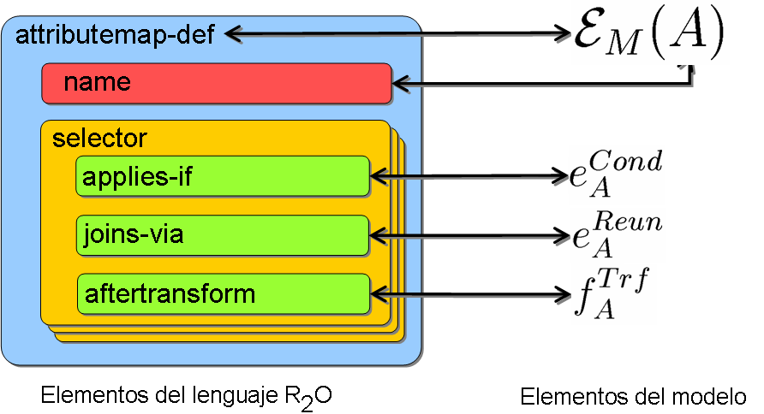
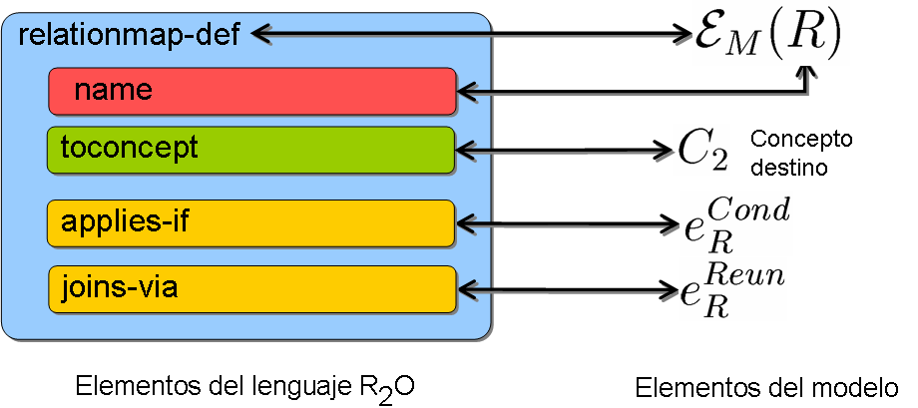
R₂O Basic Syntax
<conceptmap-def name="Customer">
<identified-by> Table key </identified-by>
<uri-as> operation </uri-as>
<applies-if> condition </applies-if>
<joins-via> expression </joins-via>
<documentation>description …</documentation>
<described-by>attributes,relations</described-by>
</conceptmap-def>
<attributemap-def name="http://esperonto/ff#Title">
<aftertransform>
<operation oper-id="constant">
<arg-restriction on-param="const-val">
<has-column>fsb_ajut.titol</has-column>
</arg-restriction>
</operation>
</aftertransform>
</attributemap-def>
<relationmap-def name="http://esperonto/ff#isCandidateFor">
<to-concept name="http://esperonto/ff#FundOpp">
<joins-via>
<operation oper-id=“equals">
<arg-restriction on-param="value1">
<has-column>fsb_ajut.id</has-column>
</arg-restriction>
<arg-restriction on-param="value2">
<has-column>fsb_candidate.forFund</has-column>
</arg-restriction>
</operation>
</joins-via>
</relationmap-def>

Slide 8
ToC
Introduction
R₂O
  ConceptMap definition
  AttributeMap definition
  RelationMap definition
ODEMapster
  Query Driven
  Massive batch data upgrade
FAO Use Case
Multiple Database to RDF

Slide 9
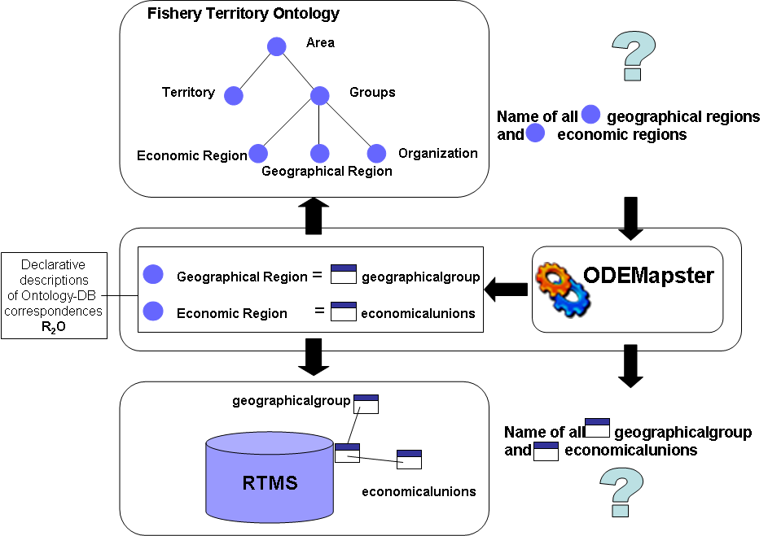
ODEMapster
The ODEMapster processor generates Semantic Web instances from relational instances based on the mapping description expressed in the R₂O document
  Batch process: DB records migrated to the ontology
  On demand: Querying the DB in terms of ontological terms

Slide 10
ToC
Introduction
R₂O
  ConceptMap definition
  AttributeMap definition
  RelationMap definition
ODEMapster
  Query Driven
  Massive batch data upgrade
FAO Use Case
Multiple Database to RDF

Slide 11









FAO Use Case
Land
areas
Fishing
areas
Biological
entities
Fisheries
commodities
Vessel types
and size
Gear
types
R₂O
Document
R₂O
Document
R₂O
Document
R₂O
Document
R₂O
Document
R₂O
Document
FAO
RTMS DB
http://www.fao.org/aims/aos/fi/

Slide 12
ToC
Introduction
R₂O
  ConceptMap definition
  AttributeMap definition
  RelationMap definition
ODEMapster
  Query Driven
  Massive batch data upgrade
FAO Use Case
Multiple Database to RDF

Slide 13
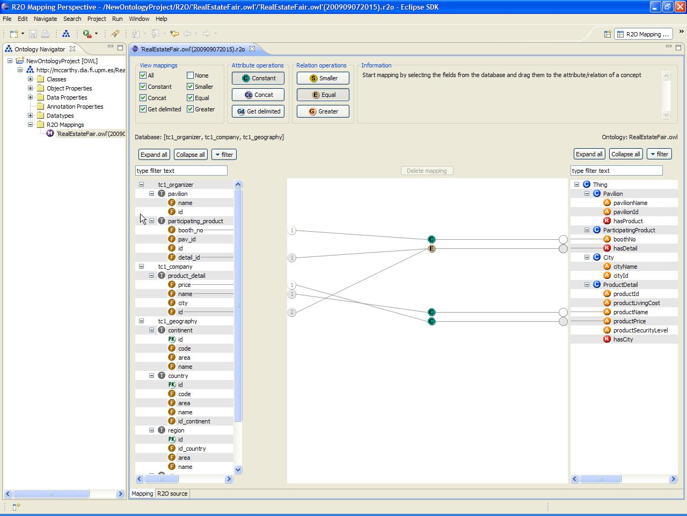
Mapping Design
3 Mapping Creation Steps
  Load Ontology
  Load Database(s)
  Create mapping
2 Usage Modes
  Online mode (run time query execution)
  Offline mode (materialized RDF dump)

Slide 14
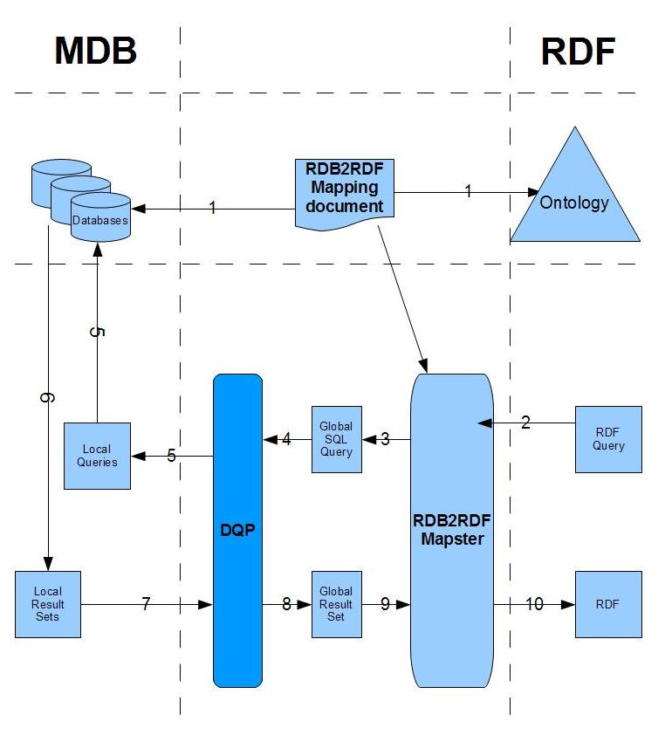
MDB2RDF
Mapping defined
RDF Query Posed
RDF Query to Global Query
Global query is sent to DQP
DQP distributes global queries into local queries and evalute them
Databases return local results
Local results sent to DQP
DQP integrates the results into global result
Global result is sent to be transformed into RDF
RDF documents containing RDF instances

Slide 15
Boris Villazón-Terrazas, Freddy Priyatna
bvillazon@fi.upm.es, fpriyatna@delicias.dia.fi.upm.es
Ontology Engineering Group. Laboratorio de Inteligencia Artificial
Departamento de Inteligencia Artificial
Facultad de Informática
Universidad Politécnica de Madrid

