Slide 1
OEG results in the energy and buildings domain
Ontology Engineering Group
Universidad Politécnica de Madrid

Slide 2
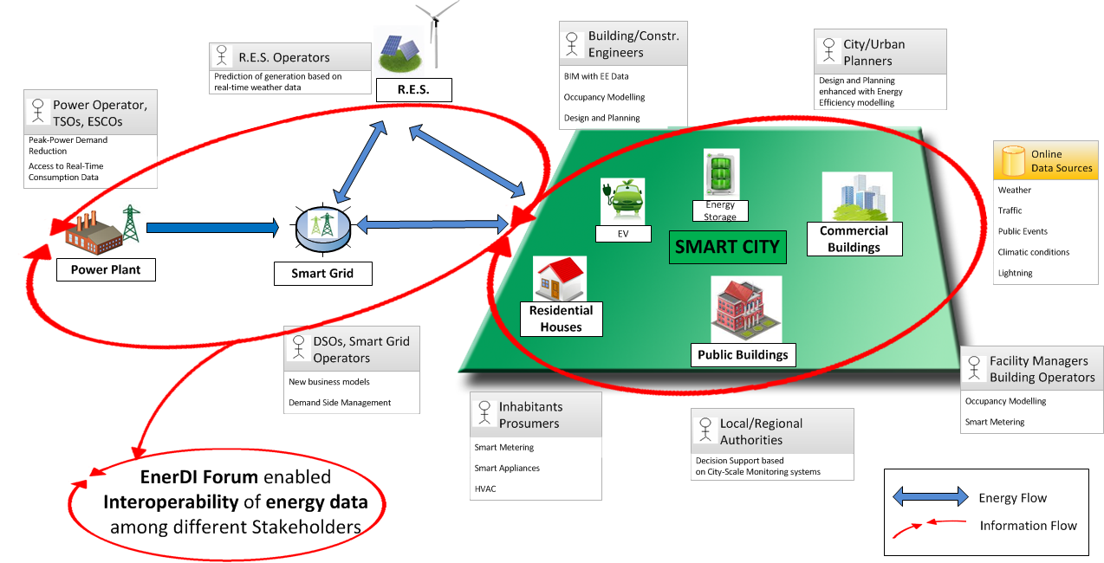
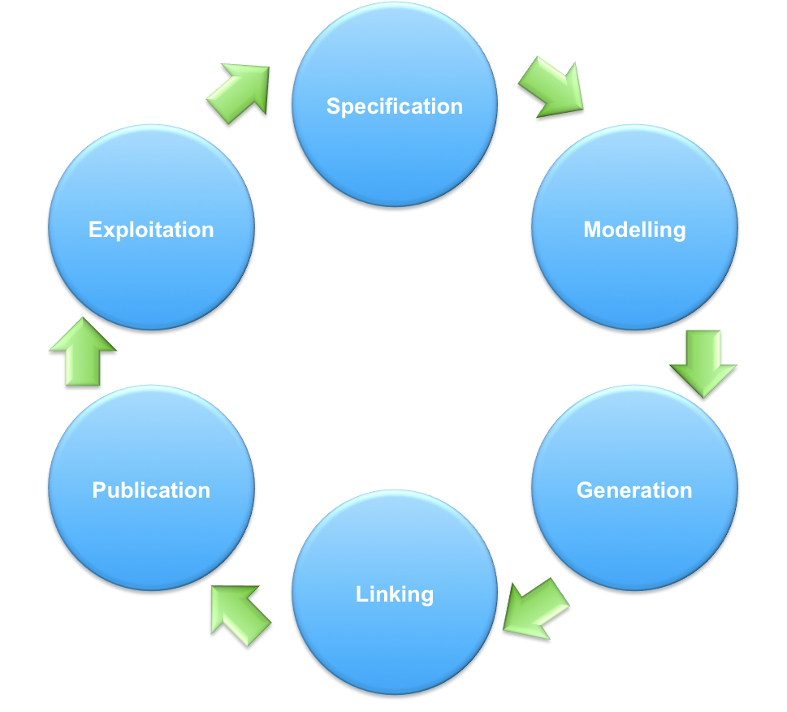
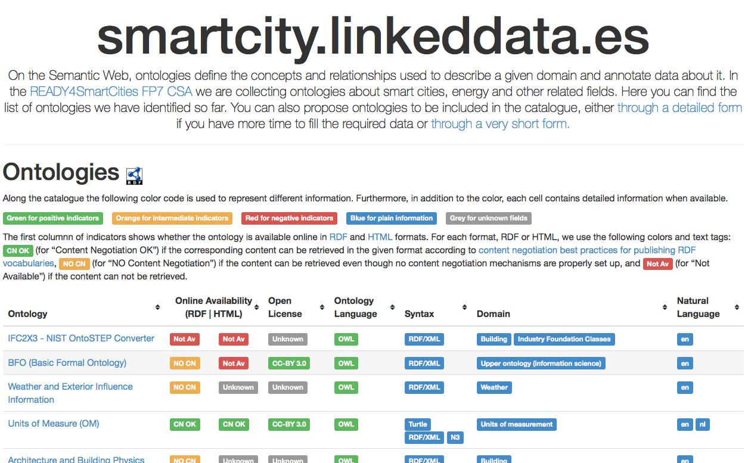
New energy data ecosystem
READY4SmartCities
Enabler 1: Ontology and Dataset Catalogues
Enabler 2: Guidelines for (Linked) Energy Data

Slide 3


Projects and initiatives
2013
LBD CG 2014

Slide 4
Results
Guidelines for the generation, publication and exploitation of Energy Linked Data
Ontology catalogue for smart cities
LBD CG
Use cases for Linked Building Data
Representation of building (BIM) data based on IFC

Slide 5
Guidelines for Energy Data
GENERATION
PUBLICATION
EXPLOITATION

Slide 6
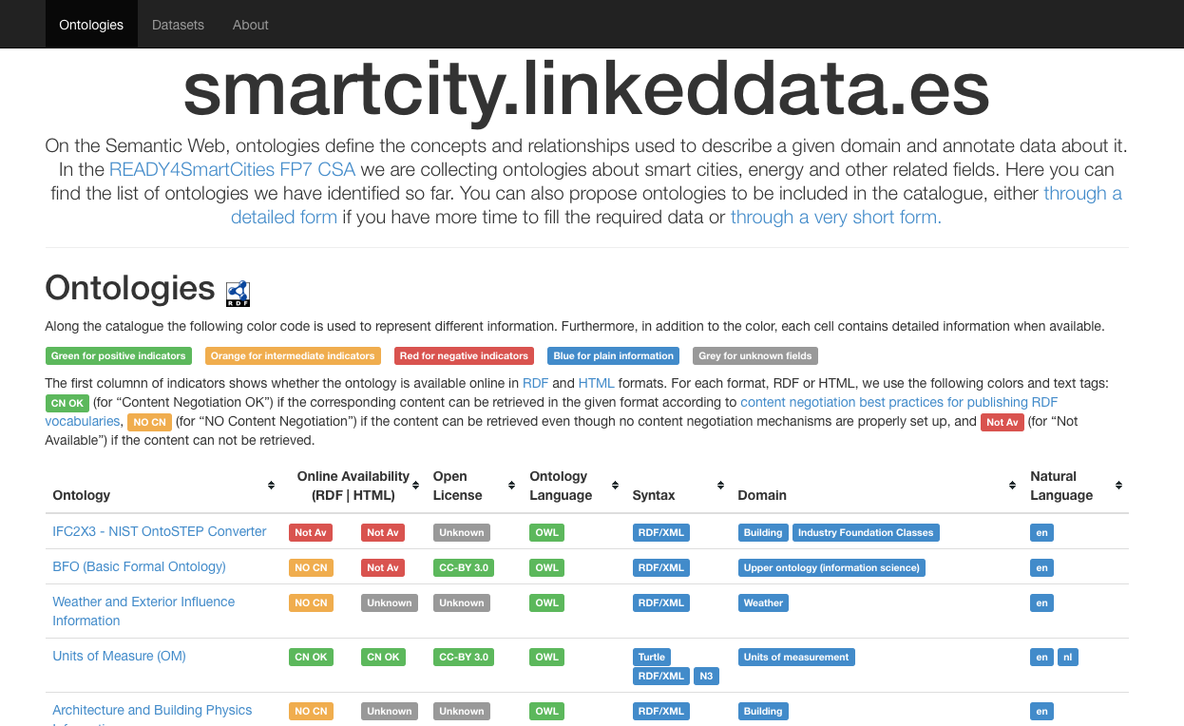
Ontology Catalogue
Link to RDF dump
Quality indicators
Metadata
Ontology title and URI (hyperlink)
Information gathered during the catalogue generation
Information gathered from the on-line form

