Slide 1

Towards efficient processing of
RDF data streams
Alejandro Llaves
Javier D. Fernández
Oscar Corcho
Ontology Engineering Group
Universidad Politécnica de Madrid
Madrid, Spain
allaves@fi.upm.es
UPM, October 16th 2014

Slide 2
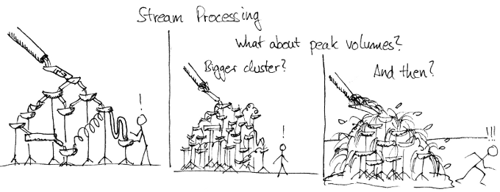
http://blog.mikiobraun.de/

Slide 3
Outline
Introduction
Background: Storm and Lambda Architecture
Approach
  Architecture design
  Storm-based operators for querying RDF streams
  RDF stream compression
Conclusions & future work
SIMON Project

Slide 4
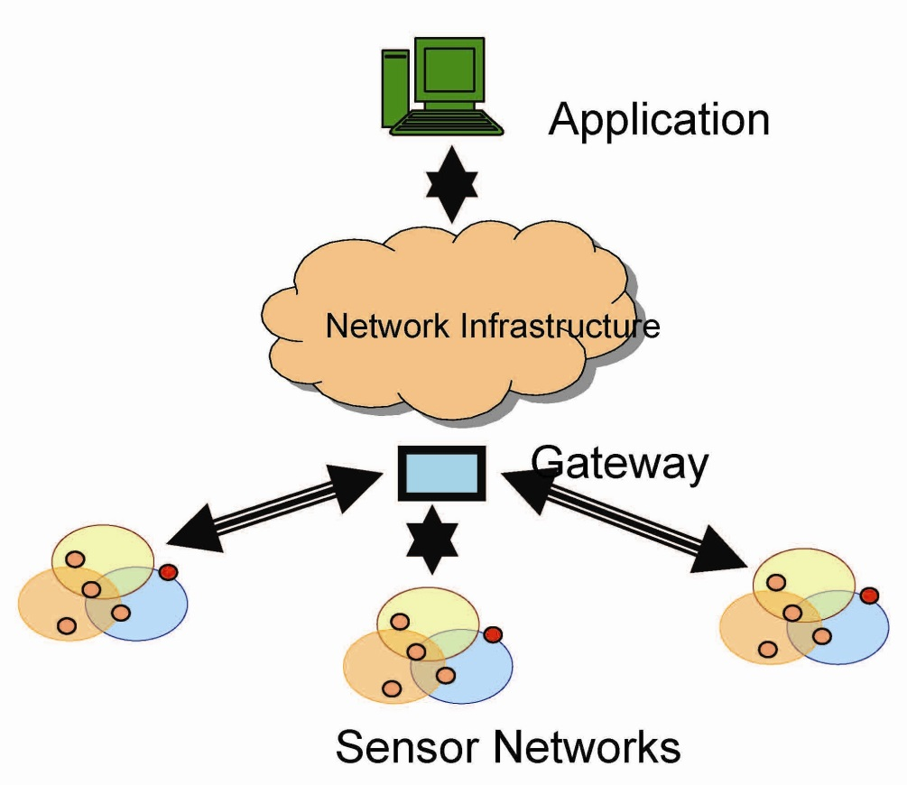




Introduction
Source: http://webnotations.com
Origins of Linked Stream Data
Extracting information from data stream is complex: heterogeneity, rate of generation, volume, provenance,…
Challenges
  C1. Scalable processing of user queries over RDF streams
  C2. Continuous transmission of data increases latency
  C3. Integration of historical and real-time data with background knowledge

Slide 5

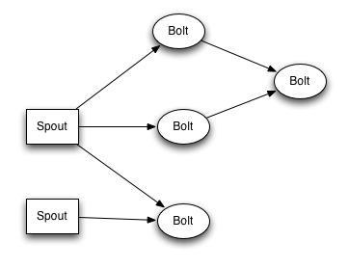
Background
Storm - http://storm.incubator.apache.org/
Distributed system for real-time processing of streams
Why Storm?
  Simple processing model (parallelization)
  Open source community backing the project
  Used by relevant companies, e.g. Twitter.
Lambda Architecture
Batch layer: stores ALL the incoming data in an immutable master dataset and pre-computes batch views on historic data.
Serving layer: indexes views on the master dataset.
Real-time processing layer: requests data views depending on incoming queries.

Slide 6
Approach: morph-streams++
Goal: to develop a stream processing engine capable of adapting to changing conditions, such as changing rates of input data, failure of processing nodes, or distribution of workload, while serving complex continuous queries.
Methodology
State of the art of (RDF) stream processing
Evaluate how to parallelize SPARQLStream queries
Implementation of RDF query operators
Optimize parallelization for common queries
Design self-adaptive strategies that allow the engine to react in front of changes

Slide 7
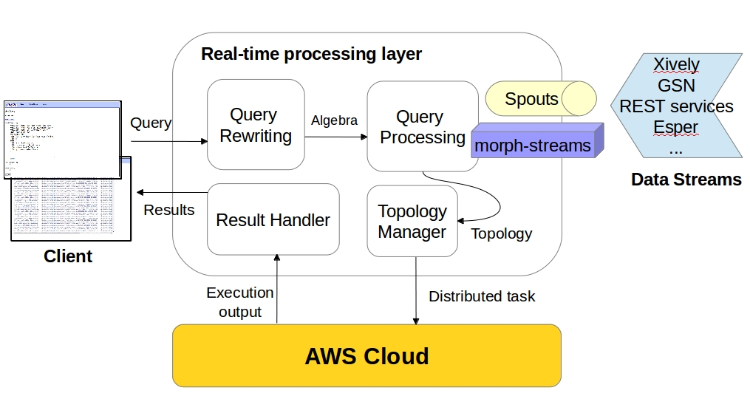
Architecture design

Slide 8
Storm-based operators for querying RDF streams
Triple2Graph operator
Time Window operator
Simple Join operator
Projection operator
Triple2Graph
  Stream<s, p, o>
  Stream<Graph, t>
(graph starter)
Windowing
Stream<Graph, t>
  Stream<Set<Graph>>
(window size,
emission time)
Simple Join
  Stream<Set<Tuple>, Set<Tuple>>
  Stream<Set<Tuple>>
(join attribute)
Project
  Stream<Tuple<i1, i2,..., in>>
  Stream<Tuple<o1, o2,..., on>>
(input, output)

Slide 9
Storm-based operators for querying RDF streams
Storm topology example
SELECT ?obs.value ?sensors.location
FROM NAMED STREAM <obs> [60 SEC TO NOW]
FROM NAMED STREAM <sensors> [60 SEC TO NOW]
WHERE obs.sensorId = SENSORS.id ;
Windowing
Windowing
Simple Join
Windowing
<t0, t2...>
Windowing
Project
Triple2Graph
Windowing
Windowing
Simple Join
Windowing
<t1, t3...>
Windowing
SPOUT
<obs>
Project
Output
Windowing
Windowing
<t0, t2...>
Simple Join
Project
Triple2Graph
Windowing
Windowing
SPOUT
<sensors>
Windowing
Windowing
<t1, t3...>
Simple Join
Windowing
Windowing
Project

Slide 10
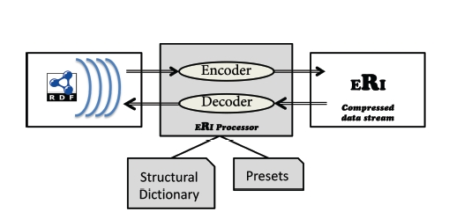
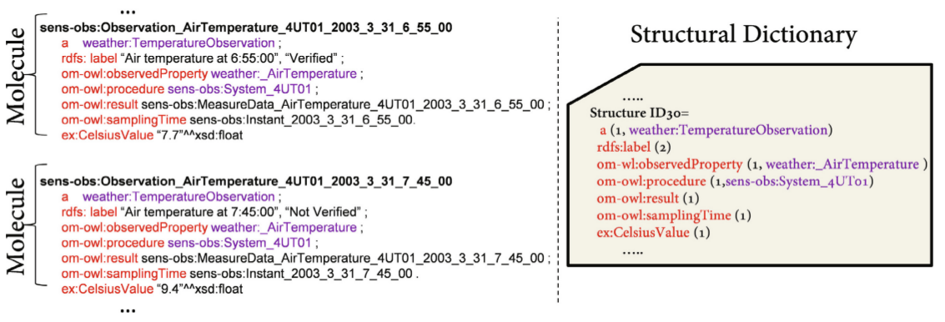
RDF stream compression (1/2)
Efficient RDF Interchange (ERI) format
Based on Efficient XML Interchange (EXI)
Main assumption: RDF streams have regular structure and are redundant
Information encoded at 2 levels
  Structural dictionary
  Presets (values)
Example: SSN observations

Slide 11

RDF stream compression (2/2)
Evaluation
Datasets: streaming, statistical, and general static.
Compression ratio, compression time, and parsing throughput (transmission + decompression)
Comparison to other formats, such as N-Triples, Turtle, RDSZ, HDT, with different configurations of ERI w.r.t. transmitted data block (1K – 4K) and the presence of dictionary.
Conclusion: ERI produces state-of-the-art compression for RDF streams and excels for regularly-structured static RDF datasets. ERI compression ratios remain competitive in general datasets and the time overheads for ERI processing are relatively low.
http://dataweb.infor.uva.es/wp-content/uploads/2014/07/iswc14.pdf

Slide 12
Conclusions and future work
Conclusions
We have addressed challenges C1 (scalability) and C2 (transmission)
  Catalogue of Storm-based operators to parallelize query processing over RDF streams.
  New format for RDF stream compression called ERI.
Challenge C3 (integration) involves storage of historical data and the deployment of batch and serving layers OR the migration to a more general system, e.g. Apache Spark.
Future work
Finish the implementation of RDF query operators
Test the parallelization of a set of common queries → SRBench
Adaptive strategies based on Adaptive Query Processing
Evaluation → Benchmarking: comparison to CQELS Cloud
Integration of ERI into morph-streams++

Slide 13
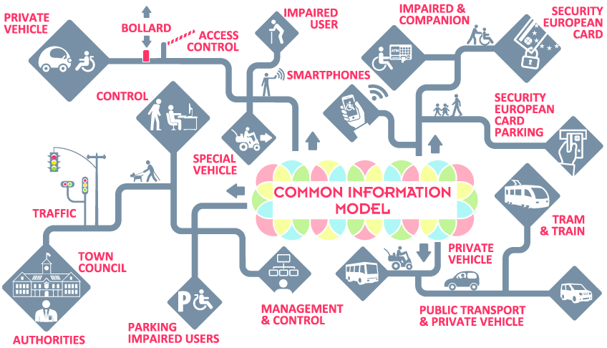
SIMON Project (1/2)
http://simon-project.eu/
Time frame: Jan 2014 – Dec 2016
Description: demonstration-oriented project with 3 large scale pilots in Lisbon, Parma, and Madrid aiming to use ICT services to promote the independent living and societal participation of mobility impaired people in the context of public parking areas and multiple transport modes.

Slide 14

SIMON Project (2/2)
Goals
To reduce fraud in the use of the European Disable Badge for public parking areas.
To improve navigation solutions for elderly and people with disabilities.
Partners: ETRA I+D (Spain), Madrid City Council, Institute of Biomechanics of Valencia, Consorcio Regional de Transportes de Madrid, Locoslab GmbH (Germany), EMEL (Portugal), and Infomobility SpA (Italy).
OEG role
To support CRTM in data preparation tasks through the use of open data protocols and formats (focus on public transport).
To provide updated information through real-time processing on CRTM data streams.
To link existing datasets with new sources related to accessibility.
To collaborate in the writing of the ICT interoperability guidelines.

Slide 15
Thanks!
The presented research has been supported by an AWS in Education Research Grant award.
Alejandro Llaves
allaves@fi.upm.es

