Slide 1


A Method for Re-engineering Non-Ontological Resources for Building Ontologies
Boris Villazón-Terrazas, Asunción Gómez-Pérez
{bvillazon,asun}@fi.upm.es
Ontology Engineering Group. Laboratorio de Inteligencia Artificial
Departamento de Inteligencia Artificial
Facultad de Informática
Universidad Politécnica de Madrid
Date: 19/11/2009

Slide 2
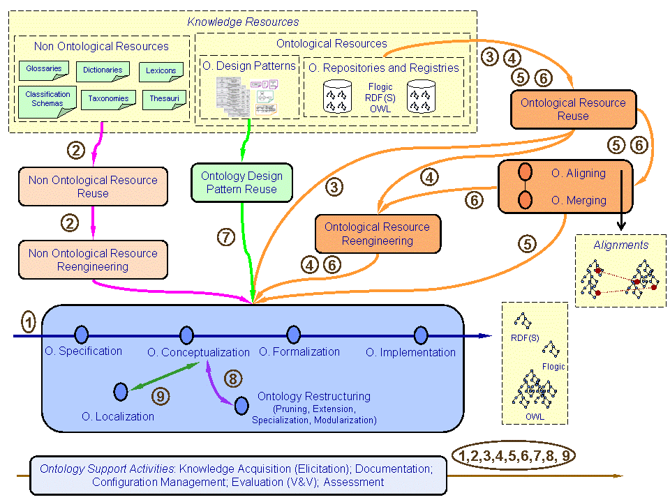
Introduction (II)
Non-Ontological Resource (NOR) is an existing knowledge-aware resource whose semantics has not been formalized yet by an ontology.
Non-Ontological Resource Re-engineering refers to the process of taking an existing non-ontological resource and transforming it into an ontology.
© A Method for Re-engineering Non-Ontological Resources for Building Ontologies
Boris Villazón-Terrazas, Mari Carmen Suárez Figueroa
Notes:
Within the context of the NeOn project, we are proposing a novel scenariobased
methodology for builing ontology networks3. One of the scenarios in the
NeOn methodology is Building Ontology Networks by Reusing and Re-engineering
Non-Ontological Resources. For such scenario we propose methodological guidelines
for reusing and re-engineering NORs.

Slide 3
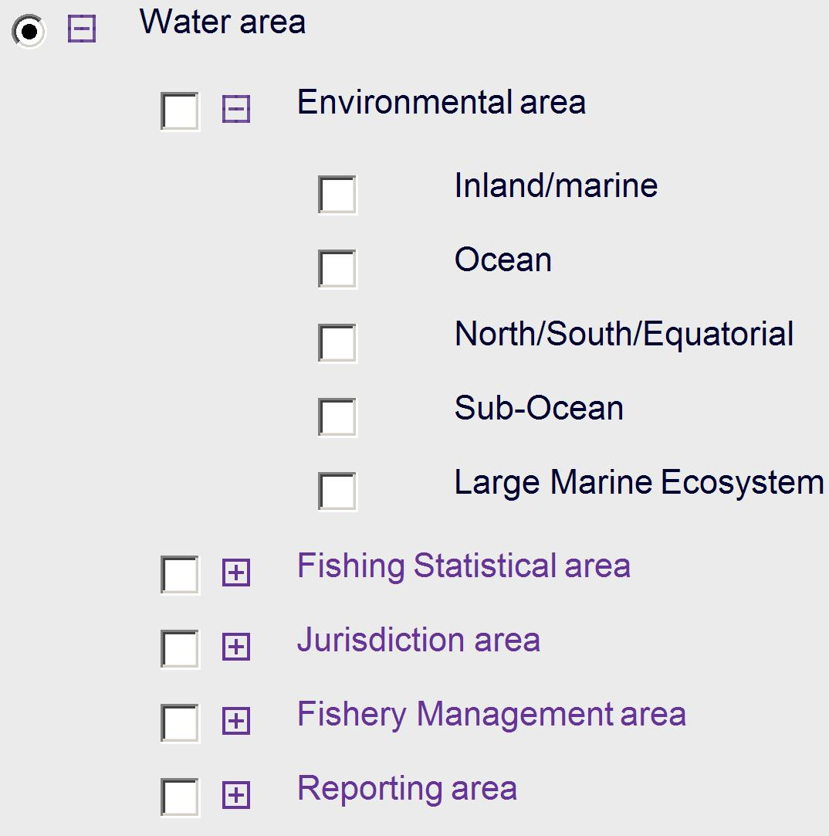
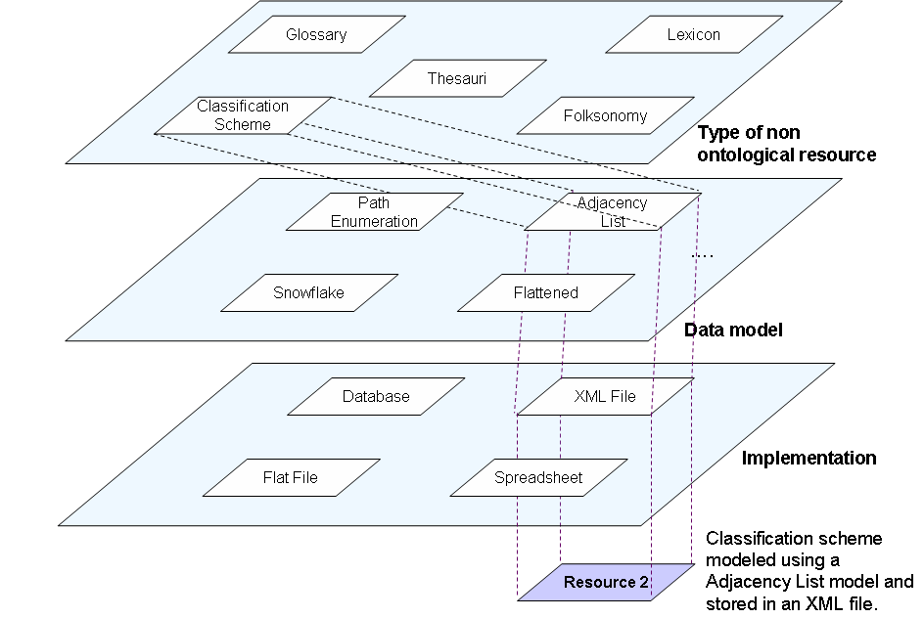
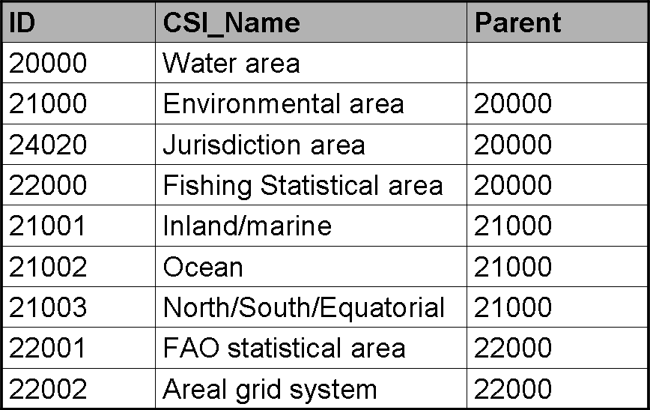
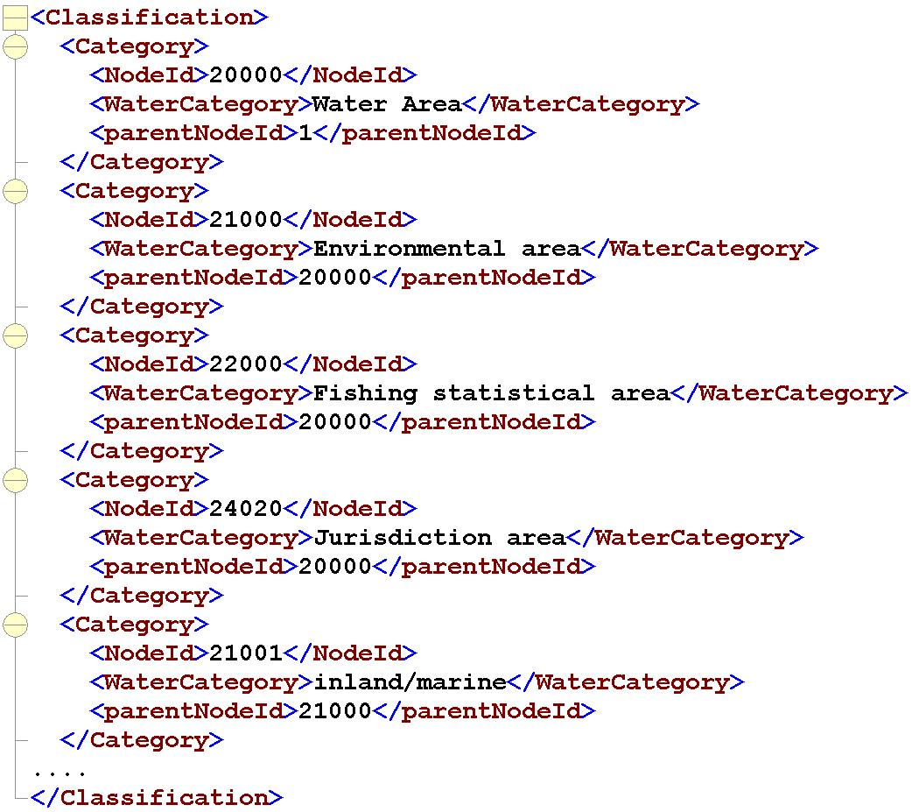

Classification Scheme - Example: FAO Water Areas
A classification scheme¹ is the descriptive information for an arrangement or division of objects into groups based on characteristics, which the objects have in common. E.g. water area classification scheme².
Classification Scheme
Adjacency List
XML
1. International Standard Organization (ISO). Information technology - Metadata registries –
Part 1: Framework, 2004. Report ISO/IEC FDIS 11179-1.
2. http://www.fao.org/figis/servlet/RefServlet
Notes:
Cambiar modeled por modelled,

Slide 4
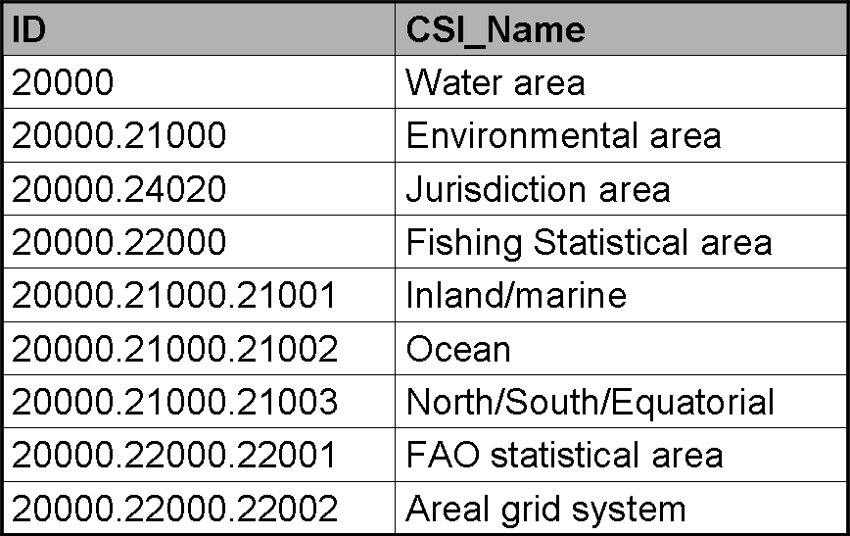
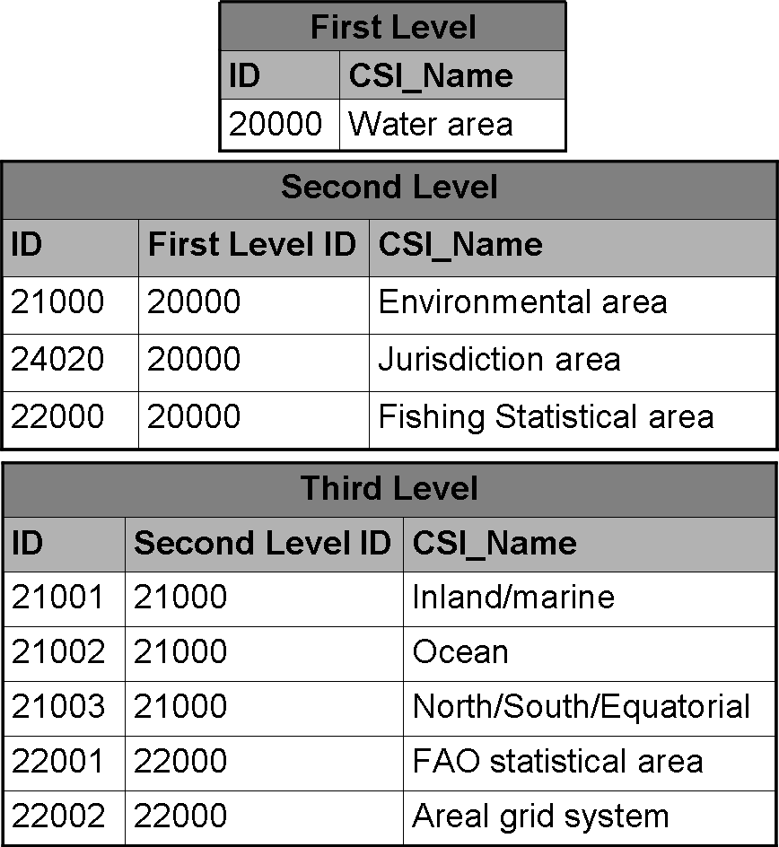
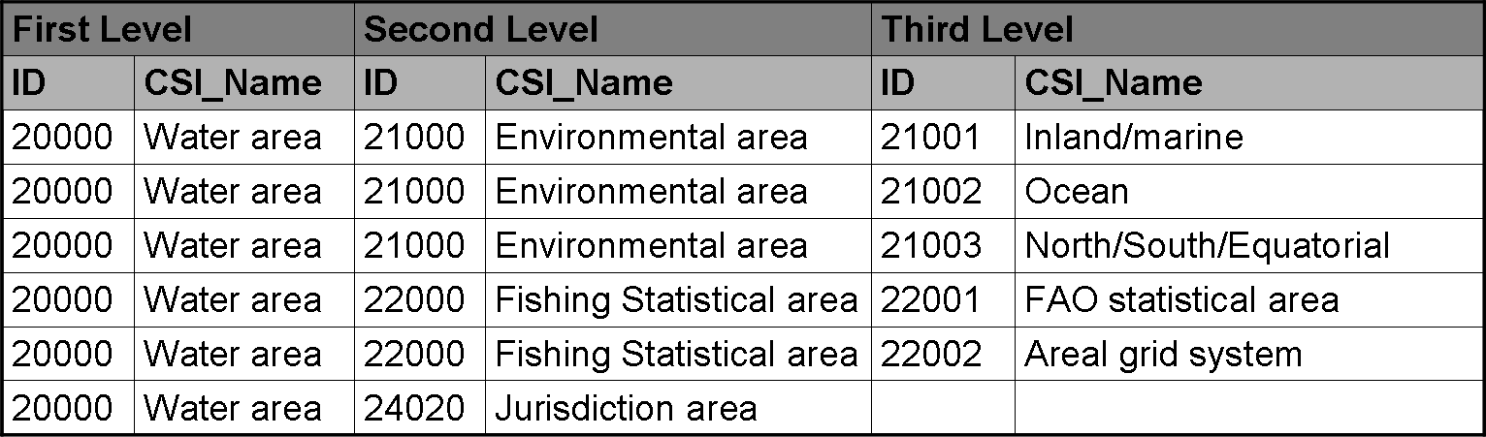
Classification Scheme Data Models
Path Enumeration Data Model is defined as a model that stores for each node the path (as a string) from the root to the node.
Adjacency List is a recursive structure for hierarchy representations that comprises a list of nodes with a linking column to their parent nodes.
1
Snowflake Data Model is a normalized structure for hierarchy representations. For each hierarchy level a entity is created. In this model each hierarchy node has a column linked to its parent node.
Flattened Data Model, is a denormalized structure. The hierarchy is represented with an entity where each hierarchy level is stored on a different column.
2
3
Notes:
Path Enumeration [2]: A path enumeration model is a recursive structure
for hierarchy representations defined as a model which stores for each
node the path (as a string) from the root to the node. This string is the
concatenation of the nodes code in the path from the root to the node.
Fig. 1-a) shows this model.
Adjacency List [2]: An adjacency list model is a recursive structure for
hierarchy representations comprising a list of nodes with a linking column
to their parent nodes. Fig. 1-b) shows this model.

Slide 5
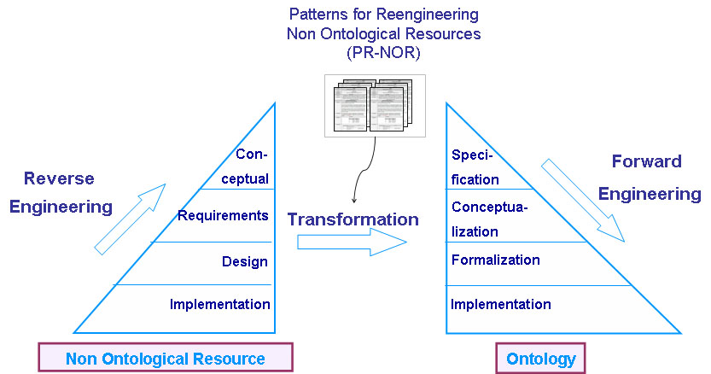
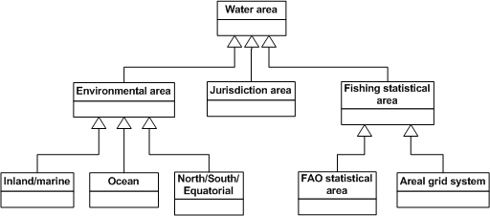
Non-Ontological Resource Re-engineering
Patterns for re-engineering non-ontological Resources (PR-NOR) define a procedure to transform knowledge-aware resources into ontologies
taking into account the resource type (thesaurus, classification scheme, etc.) and their underlying resource data model. For every type of resource
and data model, the NeOn method defines a pattern with a well-defined sequence of activities. Our patterns perform the following transformations:
TBox transformation: for transforming the resource content into an ontology schema.
ABox transformation: for transforming the resource schema into an ontology schema, and the resource content, into ontology instances.
PR-NOR Library at http://ontologydesignpatterns.org
C. Scheme
Path Enumeration, Adjacency List, …
Frame based, Description Logics, …
XML, DB, Flat file, Spreadsheet
RDF(S), OWL
Notes:
Based on the software re-engineering model presented in [3] we propose our
re-engineering model for NOR re-engineering in Fig.3.
The NOR re-engineering process consists of the following activities, which
are defined in a Glossary of Activities in the Ontology Engineering[24]:
Non-Ontological Resource Reverse Engineering, whose goal is to analyze a
NOR to identify its underlying components and create representations of
the resource at the different levels of abstraction (design, requirements and
conceptual). Since NORs can be implemented as XML files, databases or
spreadsheet among others, we can consider them as software resources, and
therefore, we use the software abstraction levels shown in Fig. 3 within this
activity. Here the requirements and the essential design, structure and content
of the NOR must be recaptured.
Non-Ontological Resource Transformation, whose goal is to generate a conceptual
model from the NOR. We propose the use of Patterns for Reengineering
Non-Ontological Resources (PR-NOR) to guide the transformation
process. First, the transformation approach has to be selected: (1)
transforming resource schema into an ontology schema, and then resource
content into instances of the ontology, (2) transforming resource content into
an ontology schema, or (3) transforming the resource content into instances
of an existing ontology. Second, the semantics of the relations between the
NOR entities have to be identified, these semantics can be a)subClassOf,
b)an ad-hoc relation like partOf or c)a mix of subClassOf and ad-hoc relations.
Finally a pattern for re-engineering NORs according to the type of
NOR, as well as the selected transformation approach, and the semantics of
the relations between the NOR entities, has to be searched.
Ontology Forward Engineering, whose goal is to output a new implementation
of the ontology on the basis of the new conceptual model. We use the
ontology levels of abstraction to depict this activity because they are directly
related to the ontology development process.

Slide 6
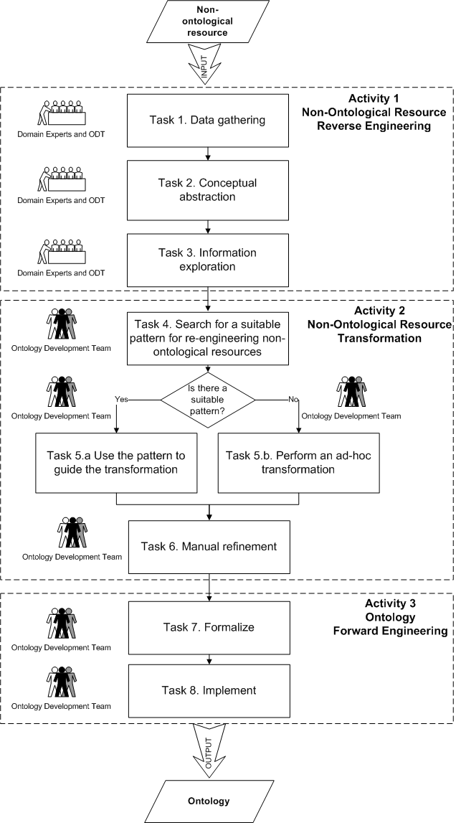
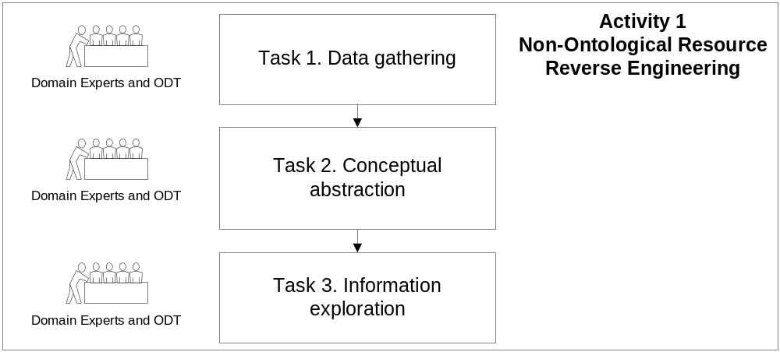
Non-Ontological Resource Re-engineering (II)
Data gathering: to search and compile all the available data and documentation about the non-ontological resource including purpose, components, data model and implementation details.
Conceptual abstraction: to identify the schema of the nonontological
resource including the conceptual components and their relationships.
Information exploration: to find out how the conceptual schema of the non-ontological resource and its content are represented in the data model.

Slide 7
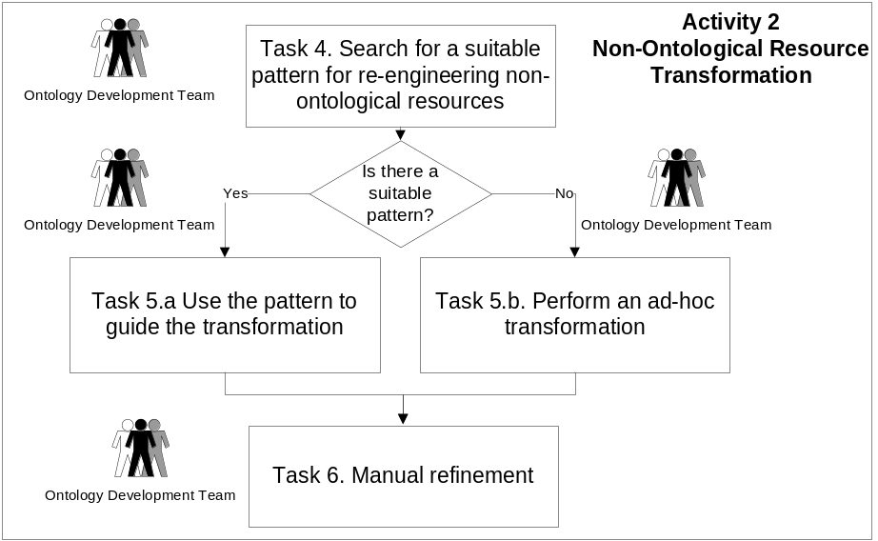
Non-Ontological Resource Re-engineering (III)
The goal is to generate a conceptual model from the NOR
Criteria for searching for a suitable pattern:
NOR Type: classification scheme, thesauri, lexicon, glossary, or folksonomy
Data model: C.Scheme (path enumeration, adjacency list, snowflake, or flattened), Thesaurus (record-based, relation-based)
Transformation approach: TBox, ABox, or population

Slide 8
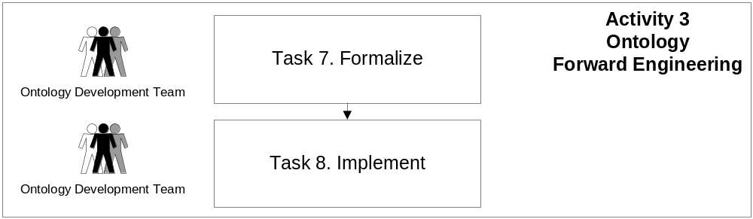
Non-Ontological Resource Re-engineering (IV)
To output a new implementation of the ontology on the basis of the new conceptual model.
Formalize: to transform the conceptual model obtained in task 6 into a formalized model, according to a knowledge representation paradigm as description logics, first order logic, etc.
Implement: to implement in an ontology language.

Slide 9

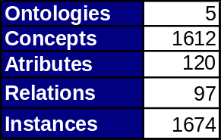

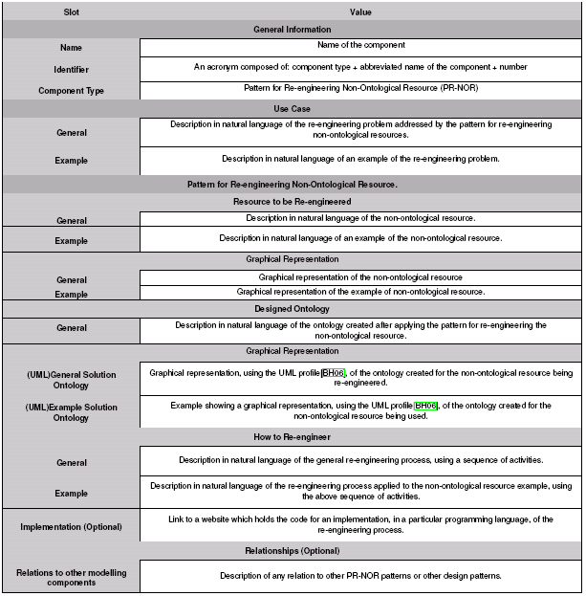


SEEMP Use Case
NORs pertaining to the domain of human resources were transformed into ontologies.
We re-engineered classification schemes using the set of patterns.
Occupation
Ontology
ISCO-88 (COM)
International Standard Classification
of Occupations
(for European Union purposes)
Education
Ontology
FOET
Classification of fields of education and training
Pattern for re-engineering a
classification scheme modelled
with a Path Enumeration Data Model
NACE
Statistical Classification of
Economic Activities in the
European Community
Economic
Activity
Ontology
Geography
Ontology
ISO 3166
English country names
and code elements
Pattern for re-engineering a
classification scheme modelled
with a Snowflake Data Model
ISTAT
Italian Geography
Standard
Italian
Geography
Ontology
Pattern for re-engineering a
classification scheme modelled
with an Adjacency List Data Model
Ontology available at http://droz.dia.fi.upm.es/hrmontology/

Slide 10




SEEMP Use Case - ISTAT
Adjacency list
Criteria for searching a suitable pattern:
NOR Type: classification scheme
Data model: adjacency list
Transformation Approach: TBox
Pattern for re-engineering a
classification scheme modelled
with an Adjacency List Data Model
PR-NOR-CLTX-02
ad-hoc
wrapper
Italian
Geography
Ontology
Notes:
He cambiado the suitable pattern for a pattern.

Slide 11
A Method for Re-engineering Non-Ontological Resources for Building Ontologies
Boris Villazón-Terrazas, Asunción Gómez-Pérez
{bvillazon,asun}@fi.upm.es
Ontology Engineering Group. Laboratorio de Inteligencia Artificial
Departamento de Inteligencia Artificial
Facultad de Informática
Universidad Politécnica de Madrid
Date: 19/11/2009

