Slide 1
Semantic Integration of Streaming Data Sources
Jean-Paul Calbimonte and Oscar Corcho
Ontology Engineering Group. Departamento de Inteligencia Artificial.
Facultad de Informática, Universidad Politécnica de Madrid.
Campus de Montegancedo s/n.
28660 Boadilla del Monte. Madrid. Spain
{jpcalbimonte, ocorcho}@fi.upm.es
Date: 17/12/2009

Slide 2
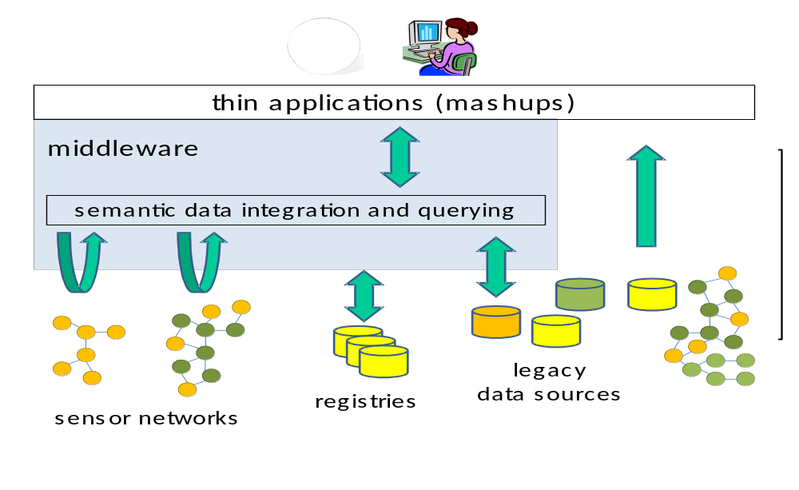
Introduction & Scope
Development of an integrated information space where new sensor networks can be easily discovered and integrated with existing ones and possibly other data sources (e.g., historical databases)
Rapid development of flexible and user-centric decision support systems that use data from multiple autonomous independently deployed sensor networks and other applications.
Semantic Integration Streaming Data Sources

Slide 3
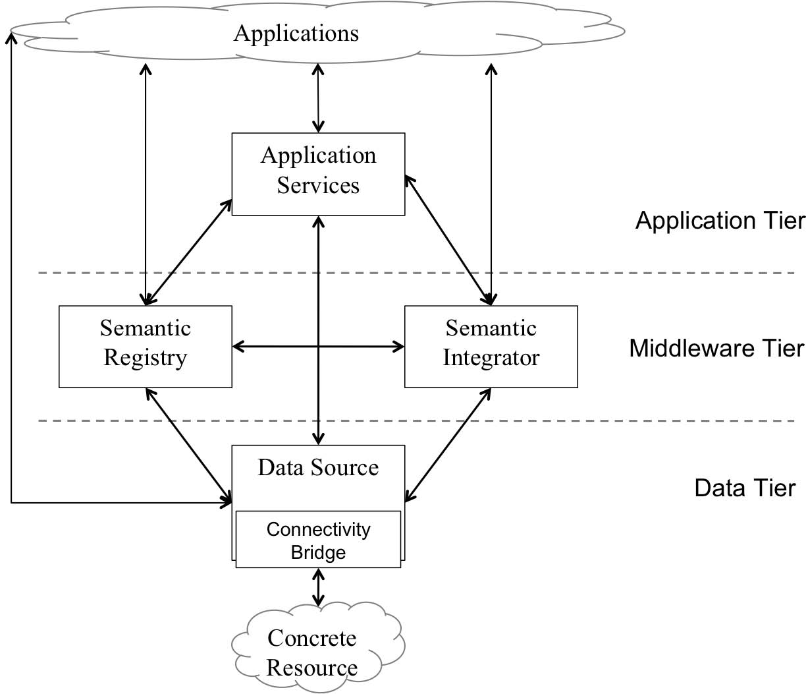
Architecture
Semantic Integrator provides data access to an integrated virtual resource that integrates:
Streaming data sources
Stored data sources
It provides a unified ontological view accessible through declarative queries.
Semantic Integration Streaming Data Sources

Slide 4
Objectives
To design, implement and deploy a Semantic Integration Service for the SemSorGrid4Env software architecture
  To extend existing ontology-based data integration models to take into account sensor networks streaming data, semantic heterogeneity and quality of service
  To implement and deploy the Semantic Integrator
Semantic Integration Streaming Data Sources

Slide 5



Background: Approaches & Technologies
DSMS
DQP
QP
S-RDF
Ontology-based Data Access
Heterogeneous data Integration
Streaming Data Access
Distributed Query Processing
RDF Streams Querying
R₂O + ODEMapster
SNEE/SNEEql
C-SPARQL extensions
q
Semantic Integrator
Semantic Integration Streaming Data Sources

Slide 6



Ontology-based Streaming Data Access
O-O mapping
R2O mappings
q
Query reconciliation
q^{r}
Query canonisation
Q^{c}
SNEEql’ (S₁ S₂ S_{n})
SPARQL_{STR} (O_{g})
SPARQL_{STR} (O₁ O₂ O_{n})
SNEEql (S₁ S₂ S_{n})
Distributed Query Processing
Data reconciliation
Data decanonisation
d
d^{r}
D^{c}
[triple_{Og}]
[triple_{O1 O2 On}]
[tuple_{l1 l2 l3}]
Semantic Integrator
Semantic Integration Streaming Data Sources

Slide 7
S2O: Mapping Streams to Ontologies
conceptmap-def WindSpeedMeasurement
uri-as
concat('ssg4env:WindSpeedMeasurement_',
windsamples.sensorid,windsamples.ts)
described-by
attributemap-def hasSpeed
operation "constant"
has-column windsamples.speed
dbrelationmap-def isProducedBy toConcept Sensor
joins-via
condition "equals"
has-column sensors.sensorid
has-column windsamples.sensorid
conceptmap-def Sensor
uri-as
concat('ssg4env:Sensor_',sensors.sensorid)
described-by
attributemap-def hasName
operation "constant"
has-column sensors.sensorname
S:WindSamples
ts
speed
direction
sensorid
WindSpeedMeasurement
hasSpeed xsd:float
Measurement
isProducedBy
T:Sensors
- sensorid
sensorname
Sensor
hasName xsd:string
Semantic Integration Streaming Data Sources

Slide 8
From SPARQL_{STR} to SNEEql
Semantic Integrator
PREFIX fire: http://www.semsorgrid4env.eu#
PREFIX rdf: http://www.w3.org/1999/02/22-rdf-syntax-ns#
SELECT ?speed ?name
FROM STREAM <http://www.ssg4env.eu/Readings.srdf>
[RANGE 10 MINUTE STEP 1 MINUTE]
WHERE {
?WindSpeed a fire:WindSpeedMeasurement;
fire:hasSpeed ?speed;
fire:isProducedBy ?sensor;
fire:hasTimestamp ?time.
?sensor a fire:Sensor;
fire:hasName ?name.
}
SELECT concat( ‘ssg4env.eu#Sensor' , sensors.sensorid ) as a1 ,
( sensors.sensorname ) as name
FROM sensors
SELECT concat(‘ssg4env.eu#WindSpeedMeasurement' ,
windsensor.id , windsensor.ts ) as a1 ,
( windsensor.speed ) as speed
FROM windsensor[ FROM NOW - 10 TO NOW MIN]
SELECT concat(‘ssg4env.eu#WindSpeedMeasurement' ,
windsensor.id, windsensor.ts ) as a1 ,
concat( ‘ssg4env.eu#Sensor' , sensors.sensorid ) as a2
FROM sensors, windsensor[ FROM NOW - 10 TO NOW MIN]
WHERE ( sensors.sensorid = windsensor.id )
Work in progress: removing redundant queries, basic optimisations, more complex scenarios
Semantic Integration Streaming Data Sources

Slide 9


Semantic Integration Interactions
Semantic Integrator
Streaming Data Resource
Stored Data Resource
Consumer
IntegrateAs (StrRes,StoRes,map)
IntegratedRes
SPARQLExecuteFactory(IntegratedRes, query)
SNEEqlExecuteFactory(StreamingRes, querySNEEql)
access StreamingRes
GetResponseItem(access StreamingRes)
repeat
results
SQLExecuteFactory(StoredRes, querySQL)
results
access IntegratedRes
GetResponseItem(access IntegratedRes)
Semantic Integration Streaming Data Sources

Slide 10
Future Works
Ontology-based streaming data access
  Continue implementation of SPARQL stream extensions
    Multiple graph pattern matching, aggregates, projections
  Continue implementation of SNEEql translation
    Eliminate redundant queries, basic optimizations
    Support for tuple-based windows, slide parameters
  Provision as a Service in the SemSorGrid4Env Architecture
Ontology-based streaming data integration
  Continue implementation of R2O support for streams
    Support for push and pull based streams
    Add mapping of multiple virtual RDF streams
  Support for quality of service parameters
Semantic Integration Streaming Data Sources

