Slide 1

Guidelines for the Specification and Design of Large-Scale Semantic Applications
ASWC 2009
Oscar Muñoz-García - omunoz@fi.upm.es
Raúl García-Castro - rgarcia@fi.upm.es
Speaker: Raúl García Castro
Date: 07/11/26

Slide 2

Motivation
How can I specify the semantic functionalities of my application?
How can I carry out the development process of my semantic application?
Non-expert
Software Engineer
Semantic applications require different software development techniques.
  They manipulate huge quantities of heterogeneous decentralized information.
  They integrate semantic and non-semantic data.
  They explore different sources at run-time.
Need guidelines that can be easily adapted and integrated in the software development process
Óscar Muñoz-García, Raúl García Castro

Slide 3

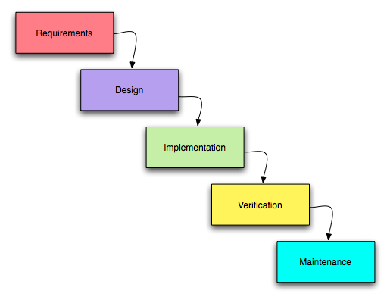
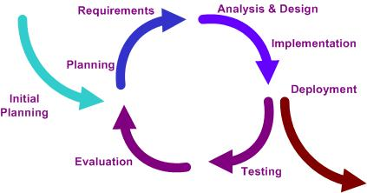
Scope
1st stage: Requirements Engineering of Semantic Applications
2st stage: Design of Semantic Applications
Óscar Muñoz-García, Raúl García Castro

Slide 4
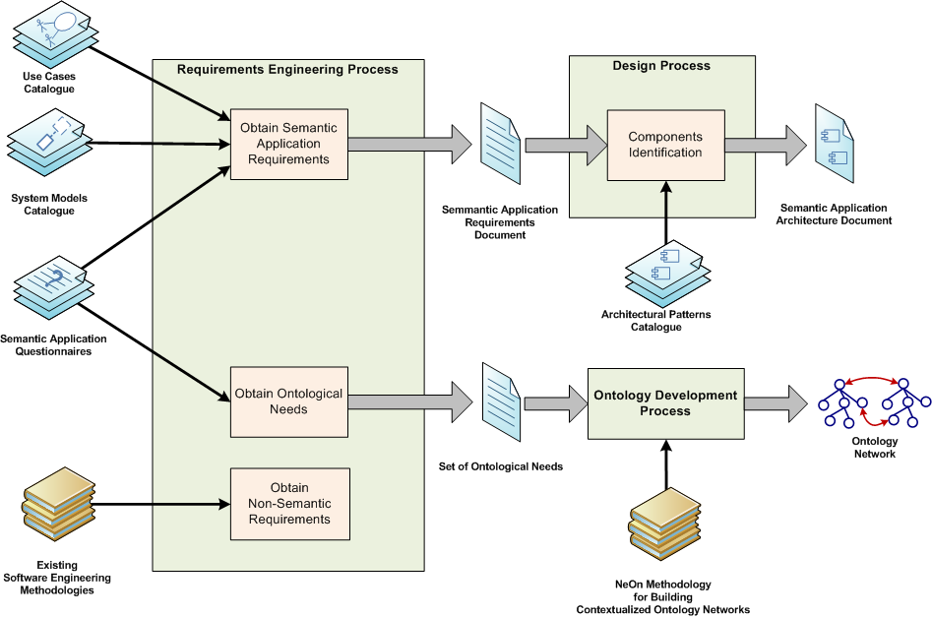
Overview of the Guidelines
Óscar Muñoz-García, Raúl García Castro

Slide 5
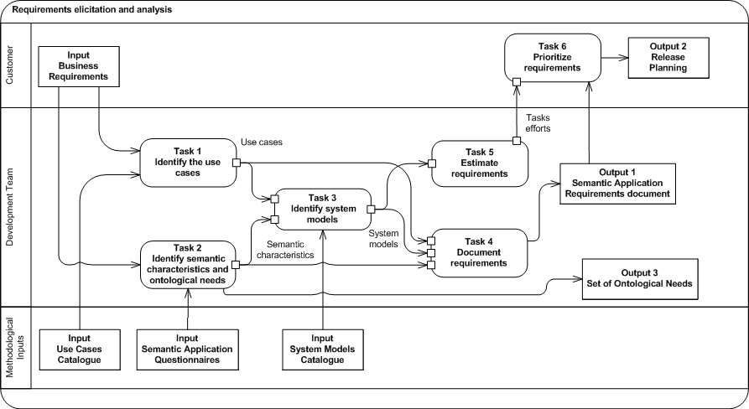
Requirements Elicitation Activity
Óscar Muñoz-García, Raúl García Castro

Slide 6
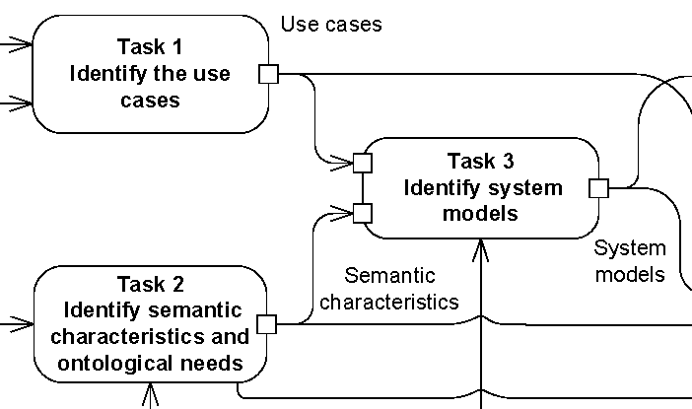
Task 1. Identify the use cases
Objective
  To gather information about the application from the business requirements and to distil scenarios from this information
Technique
  To select and adapt semantic-related scenarios from a catalogue of 5 use cases
Use Cases Catalogue
  Query Information
    To obtain integrated information from several resources given a query
  Search Resources
    To obtain resources (annotated with the corresponding metadata) related to a given query
  Browse Resources
    To navigate through categorised resources utilizing ontologies as indexes
  Extract Information
    To extract meaningful information from a set of resources obtaining after performing a search
  Manage Knowledge
    To collaboratively construct and evolve shared knowledge by
      Managing classes, properties, instances, mappings, annotations...
      Learning or populating an ontology, ...
Slide <number>

Slide 7
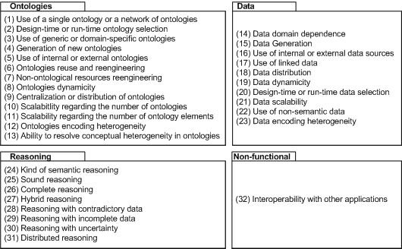
Task 2. Identify Semantic Characteristics and Ontological Needs
Objective
  To collect semantic application requirements and ontological needs
Technique
  To apply 4 questionnaires oriented to obtain the values of 32 characteristics and ontological needs
Characteristics

Slide 8



Task 3. Identify System Models
Objective
  To preliminary specify the application from
    An external perspective
      Systems involved and their limits
    A structural perspective
      By modelling the structure of the information processed
Technique
  To build system model using a set of templates taking into account
    Identified use cases
    Application characteristics
Basic Symbols Relationships
...
System Models Templates Catalogue
  Includes 11 system models templates
Slide <number>

Slide 9
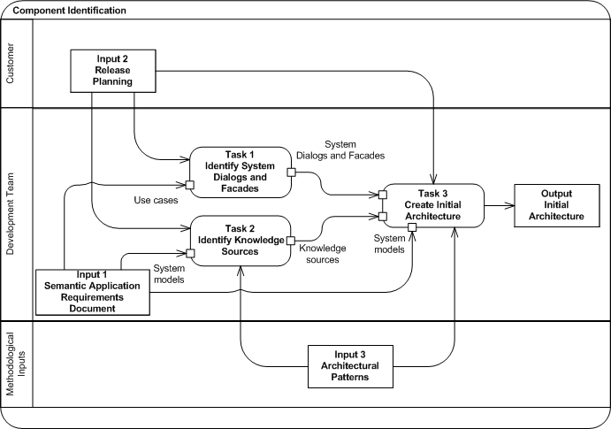
Component Identification Activity
Óscar Muñoz-García

Slide 10
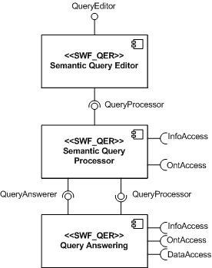


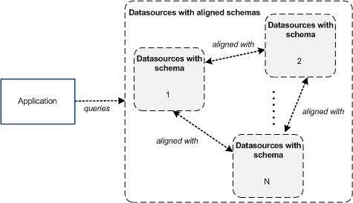

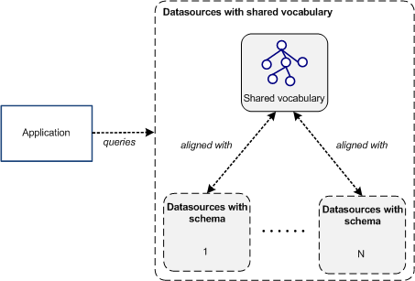

Architectural Patterns Catalogue
Pattern
System Model Templates
Objective
  To draw the application architecture that form an idea of how the components might fit together
Technique
  To draw the architecture by applying 28 architectural patterns associated to the previously identified System Models

Slide 11
Conclusions
Our main goal is to facilitate the development of semantic applications for non-expert software engineers.
  Adapting the Requirements Engineering and Design processes from SE.
  Allowing to design the architecture of SA from scratch and to include semantic components into traditional information systems.
The techniques described are novel and specially oriented to the specification and design of the semantic functionalities of an application.
The semantic characteristics of an application will influence the whole development process.
The use cases are useful to start analysing the application from concrete functional user needs.
The system models are graphical representations of the macro-structure and environment of the application. We have provided architectural patterns that aim to facilitate the Architectural Design of the Semantic Application.
  These architectural patterns are not bound to a particular implementation.
Óscar Muñoz-García, Raúl García Castro

