Slide 1
Querying and optimising access to RDF datasets
PhD Thesis
Progress and future work
Carlos Buil Aranda
Ontology Engineering Group
Facultad de Informática
Universidad Politécnica de Madrid
cbuil@fi.upm.es
27th May 2010

Slide 2
Table of Contents
Introduction
Hypothesis and objectives
PhD Progress
  First Year
  Second Year
  Third Year

Slide 3
Table of Contents
Introduction
Hypothesis and objectives
PhD Progress
  First Year
  Second Year
  Third Year

Slide 4
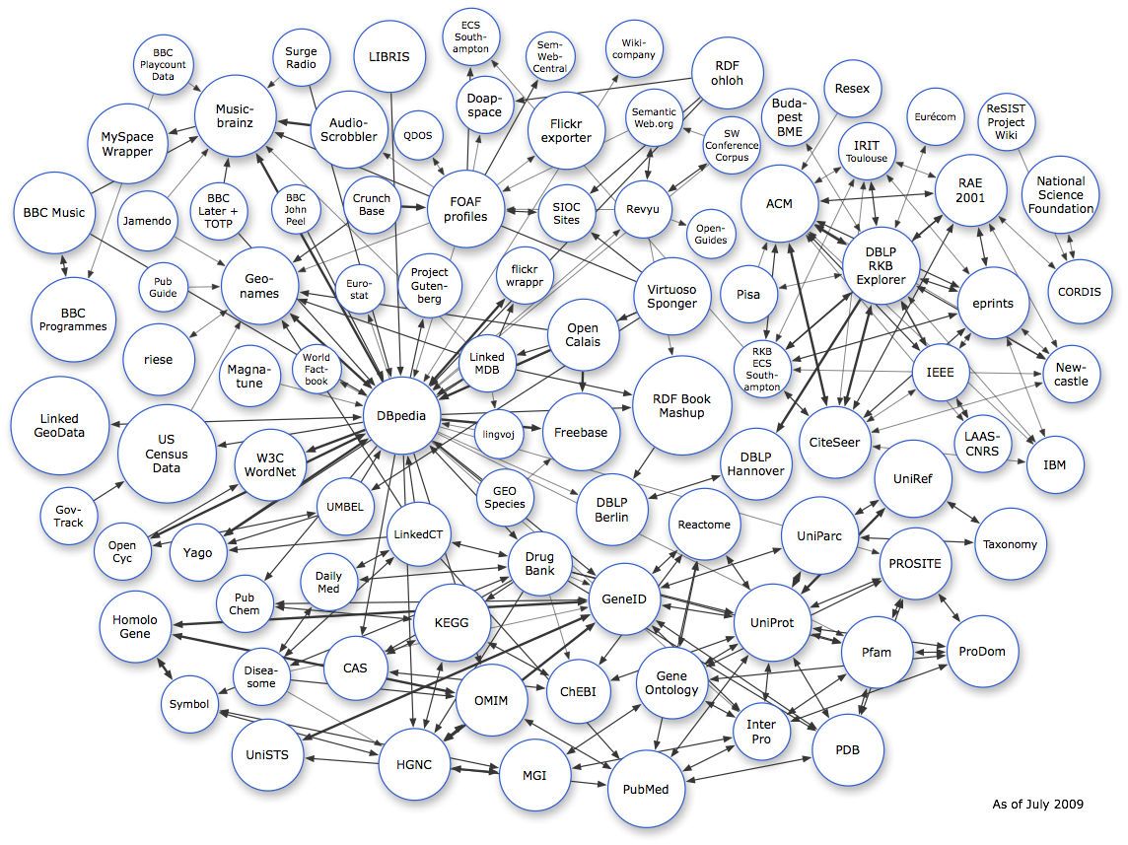
Introduction
Everyday more RDF data is published on the Web
  Mostly via SPARQL endpoints
  Following Linked Data principles
  Currently there are more than13 billion triples in the Web
  http://esw.w3.org/topic/SparqlEndpoints
  http://esw.w3.org/topic/TaskForces/CommunityProjects/LinkingOpenData/DataSets/Statistics
  They are not fully connected, i.e. To mash up the data it is necessary to query each of the RDF datasets

Slide 5
Introduction
Currently there are only a few approaches to federate SPARQL queries
  DARQ (Cyganiak 2006)
  SemWIQ (Langegger, iiWAS2008)
  Networked Graphs (Staab WWW2008)
  Executing SPARQL Queries over the Web of Linked Data (Hartig, Bizer, Freytag, ISWC09)
Problems from the previous approaches
  They implement a basic system for optimising SPARQL queries
  They do not take into account neither blank nodes nor complexity
  They do not implement many optimisation methods

Slide 6
Introduction
Can RDB2RDF Tools Feasibly Expose Large Science Archives for Data Integration?, ESWC 2009
  No, among other reasons there is no research in SPARQL Query Optimisation (authors dixit)
Need of query optimisation
  A Flexible Architecture for Virtual Information Integration based on Semantic Web Concepts, A Langegger, PhD Thesis (beginning 2010)
  Foundations of SPARQL Query Optimization, M Schmidt, M Meier, G Lausen (Tech. Report 2008)

Slide 7
Table of Contents
Introduction
Hypothesis and objectives
PhD Progress
  First Year
  Second Year
  Third Year

Slide 8
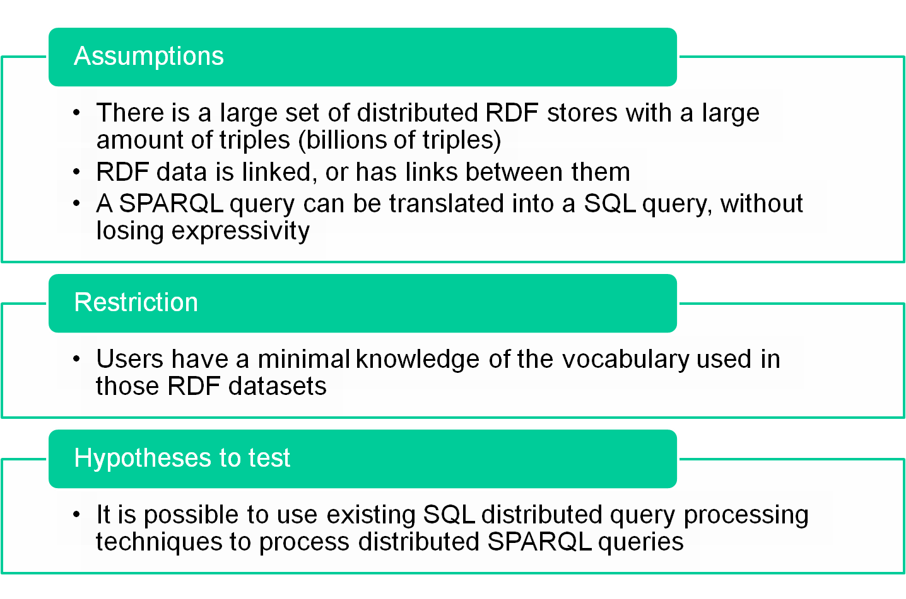
Working Hypotheses

Slide 9
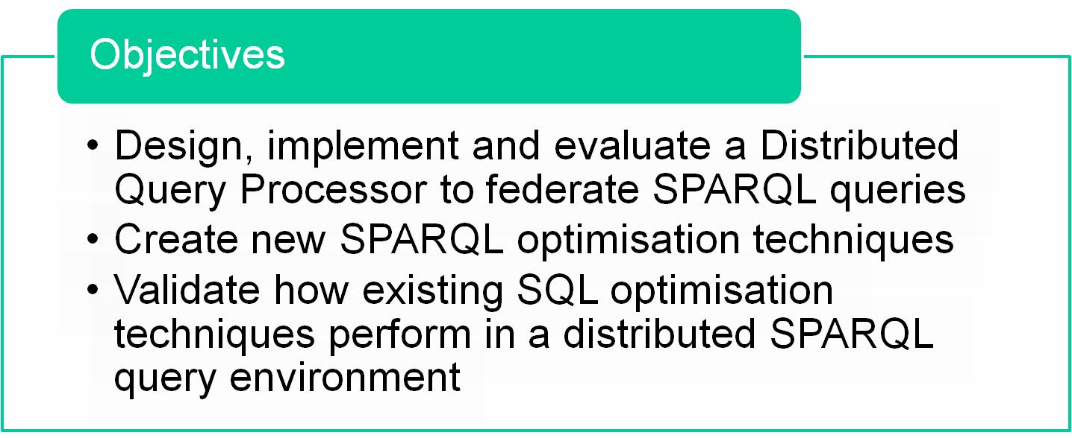

Objectives

Slide 10
Table of Contents
Introduction
Hypothesis and objectives
PhD Progress
  First Year
  Second Year
  Third Year

Slide 11
PhD Progress
First Year
  Read, read, read
    About Grid computing
    About Description Logics
    About Computational Complexity
  Attendance to ISGC 2008 as student
  Attendance to OGF 25
    Which changed a little bit my research topic
  Paper accepted in Web Semantics workshop in conjunction with DEXA2009: Robust service-based semantic querying to distributed heterogeneous databases, Buil-Aranda C, Corcho O, Krause A
  Suficiencia investigadora (beginning of second year)

Slide 12
PhD Progress
Second year
  Extended an existing SQL Distributed Query Processing system
  SPARQL-DQP implementation
    Extends a well know DQP system: OGSA-DQP
  Research visit: EPCC and NeSC in Edinburgh (July to end September)
  Submitted paper to ER2010 conferences, waiting for an answer (an others)
  Many contacts with international institutions, to collaborate in some way
    Carleton Univ. (bio2rdf, Michel Dumontier, thanks to Alex), EPPC & NeSC (Uni Edinburgh), PUC (Chile, M Arenas and C Gutierrez), UCL (London), Uni Vienna, AIST (Japan)
  Collaboration with DAIS-WG

Slide 13
PhD Progress
Third year (since April)
  Improvement of the SPARQL-DQP software
  Research visit to Universidad Católica de Chile (Claudio Gutierrez and Marcelo Arenas)
    Goals: Merge both theoretical and practical approaches to SPARQL query processing
    Treat blank nodes problem?
  Paper to ESWC: outcome from the research visit
  Paper to ISWC? Journal of Web Semantics?
  Write the PhD thesis
  If there is time research visit to?
    Vienna (with A Langegger)?
    U. South California (with JL Ambite)?

Slide 14
Querying and optimising access to RDF datasets
PhD Thesis
Progress and future work
Carlos Buil Aranda
Ontology Engineering Group
Facultad de Informática
Universidad Politécnica de Madrid
cbuil@fi.upm.es
27th May 2010

