Slide 1

Linked Data at the BNE
Biblioteca Nacional de España
Elena Escolano Rodríguez
Universidad Politécnica de Marid
Daniel Vila-Suero
Notes:
We present the process that has been followed for the development
of an application that makes use of several heterogeneous
Spanish public datasets that are related to administrative,
hydrographic, and statistical domains.
Our application
aims at analysing existing relations between the Spanish
coastal area and dierent statistical variables such as
unemployment, population, dwelling, industry, and building
trade. Moreover, we provide an important innovation with
respect to other similar processes followed in other initiatives
by dealing with the geometrical information of features.

Slide 2
Project background
Cooperation project between BNE and national and regional libraries of Spain
GOAL: Create a Unified Authority System (similar to VIAF approach)
MAIN ISSUE: Multilinguality
Various approaches were analysed and tested, but were not succesful

Slide 3
Project background
  Around January 2011 the joint project “Preliminary study of Linked Data” between the BNE and OEG starts

Slide 4
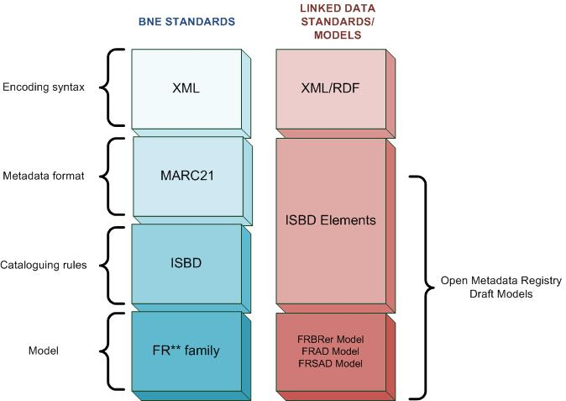
BNE Standards and Ontology selection

Slide 5
Data source set: Cervantes and surrounding data
MARC data selection involved 3 phases:
  Phase 1:
    Authority records: Cervantes + each record that contained Cervantes as author (author-title, author-title-lang, etc.) –> 550 records
    Bibliographic records: Associated to selected set of authoritities → 8552 records
  Phase 2:
    Authority records: Records associated to selected set of bibliographic records in Phase 1 →7351 records
  Phase 3:
    Authority records: Authority records related within any field with selected set in Phase 2. (Mainly themas and works and expressions from authors of phase 2) → 53000 records

Slide 6
RDF Modelling
MARC BIBLIOGRAPHIC
RECORD
frbr:Manifestation
ISBD Elements
Frbr:Expression
FRBR
frbr:Work
MARC AUTHORITY
RECORD
FRAD
frbr:Person
frsad:Thema

Slide 7
URI Design
Followed Cool URIs and Linked Data patterns (Natural keys)
A-Box:
  http://cultura.linkeddata.es/BNE/resource/<Class>/<ID>
T-Box:
  Opaque URIs
  Multilingual labels (EN, ES, HR..)
  Available at metadataregistry.org
  Base URI: http://iflastandards.info/ns/
  Not published, will be published soon → not dereferenceable

Slide 8
Process Overview
OBJECTIVES:
  Find a systematic and repeteable transformation methodology
  Design and implementation of lifecycle supporting tools (mapping, cleaning, transformation, linkage).
  Proove applicability of IFLA RDF/OWL models
Lifecycle Process : Iterative and incremental
Joint effort from two different worlds: Libraries and Semantic Web (Linked Data)

Slide 9
Main activities
Data analysis:
    Understand records’ organization and structure (Authorities and bibliographic)
    Development of analytical tools (fields and subfields combination reports, etc.)
Mapping MARC21 to chosen Models
    Very complex process
    ASSET: Tool for mapping templates generation, with analytical data from input records
Data transformation to RDF:
    Ad-hoc transformation tool

Slide 10
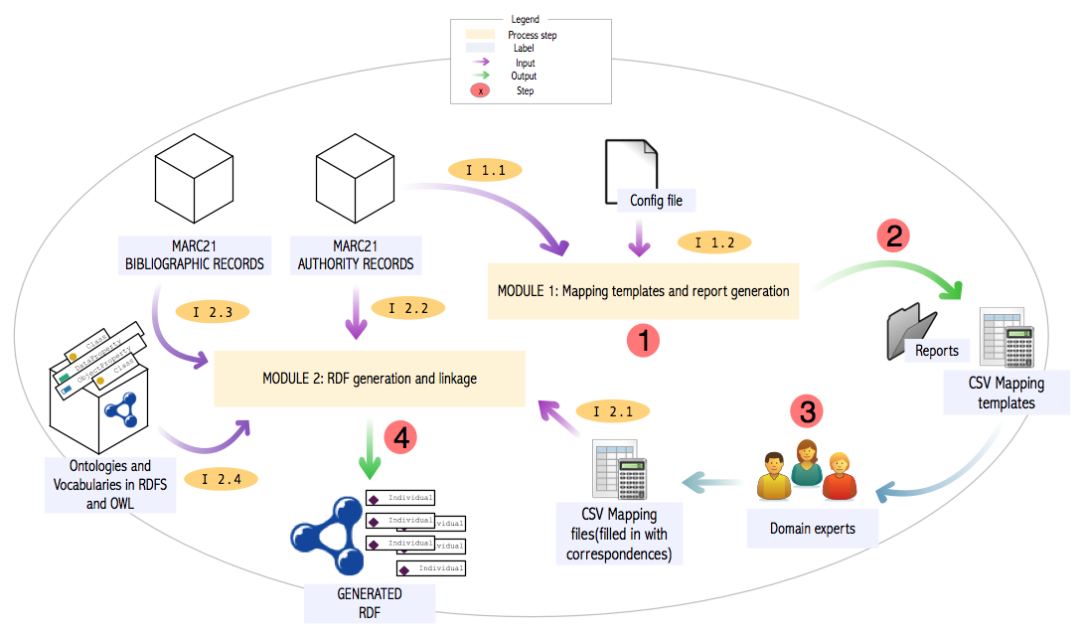
Process overview

Slide 11
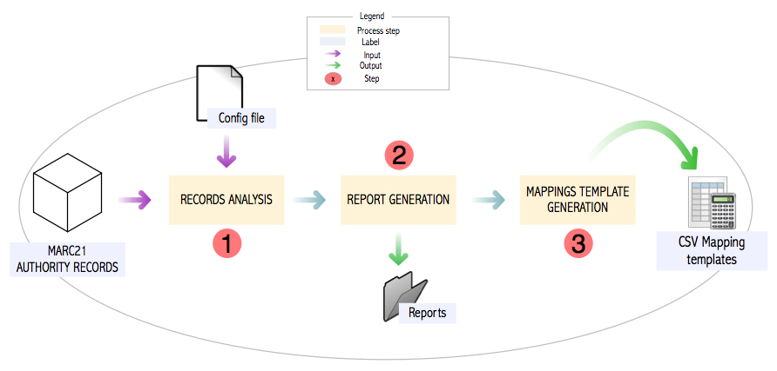
MAPPING TEMPLATES GENERATION
Asunción Gómez Pérez

Slide 12
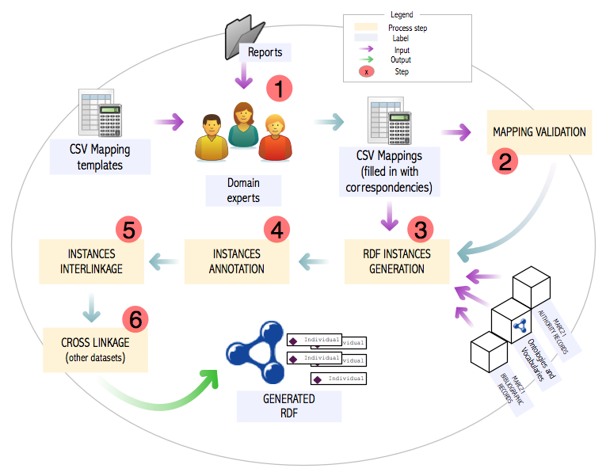
RDF GENERATION AND LINKING
Asunción Gómez Pérez

Slide 13
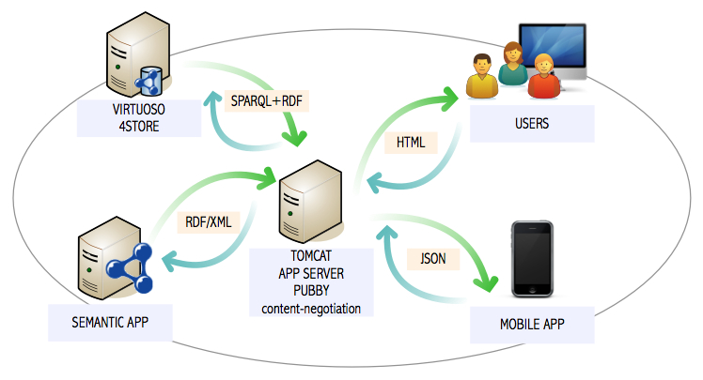
Main activities
Cultura.linkeddata.es domain for CH resources
RDF publishing:
    Virtuoso Server
    Pubby
Linkage to other datasets:
    Phase 1: VIAF y other libraries (BL, DNB, Libris Sweden)
    Phase 2: DBPEDIA, Geo, etc.

Slide 14
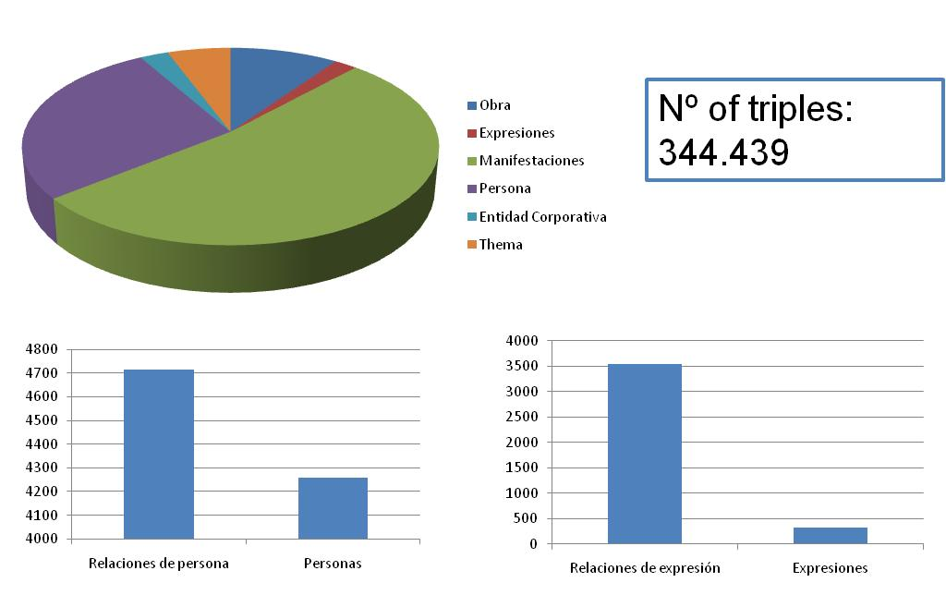

Some results

Slide 15
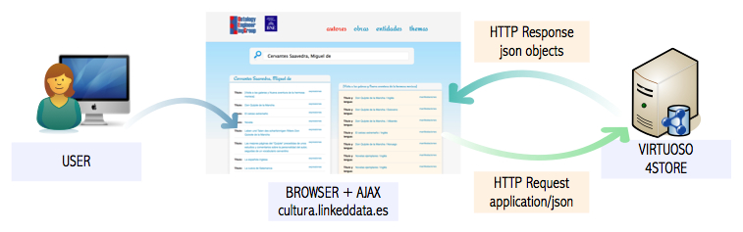
WORK is in Progress
http://cultura.linkeddata.es/visualizer/

Slide 16
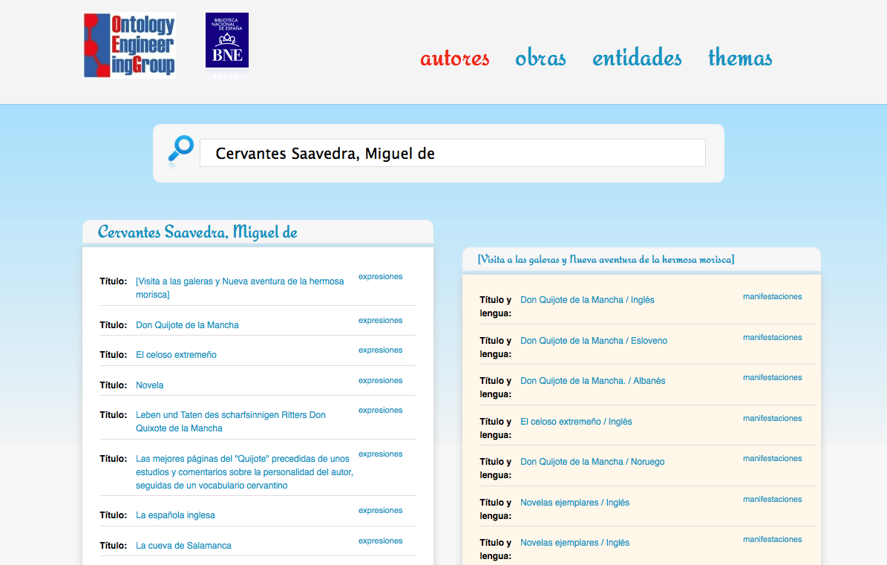

Slide 17
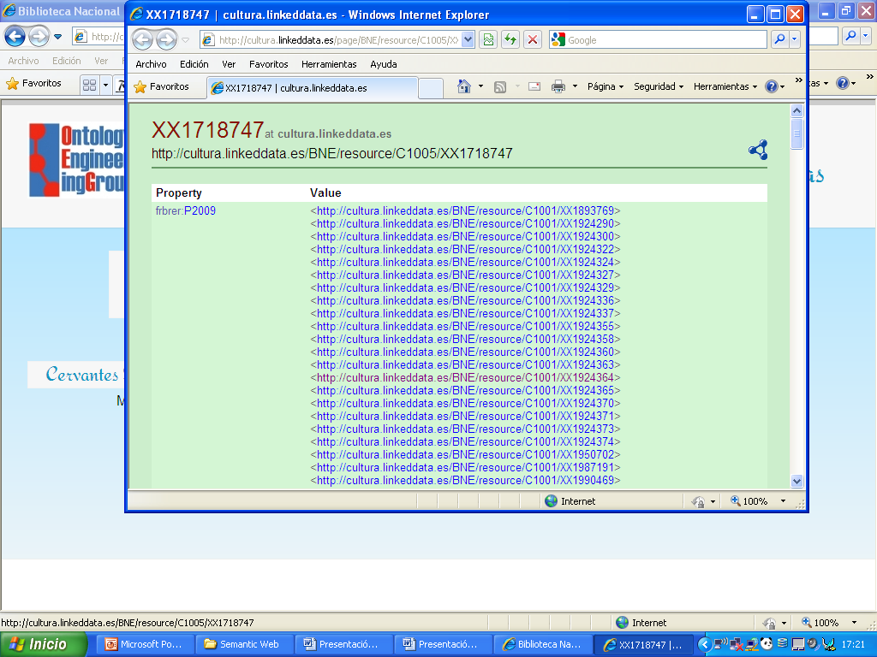

Slide 18
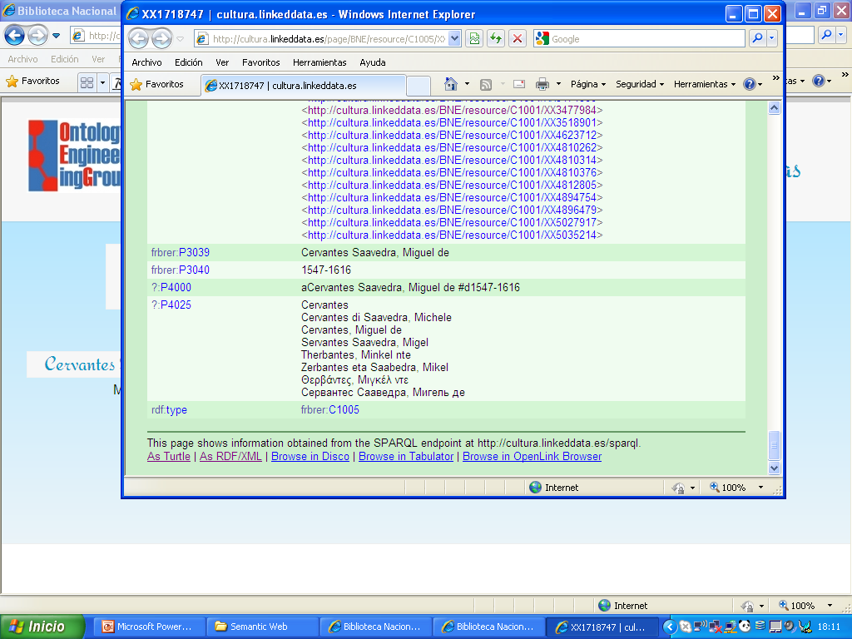

Slide 19
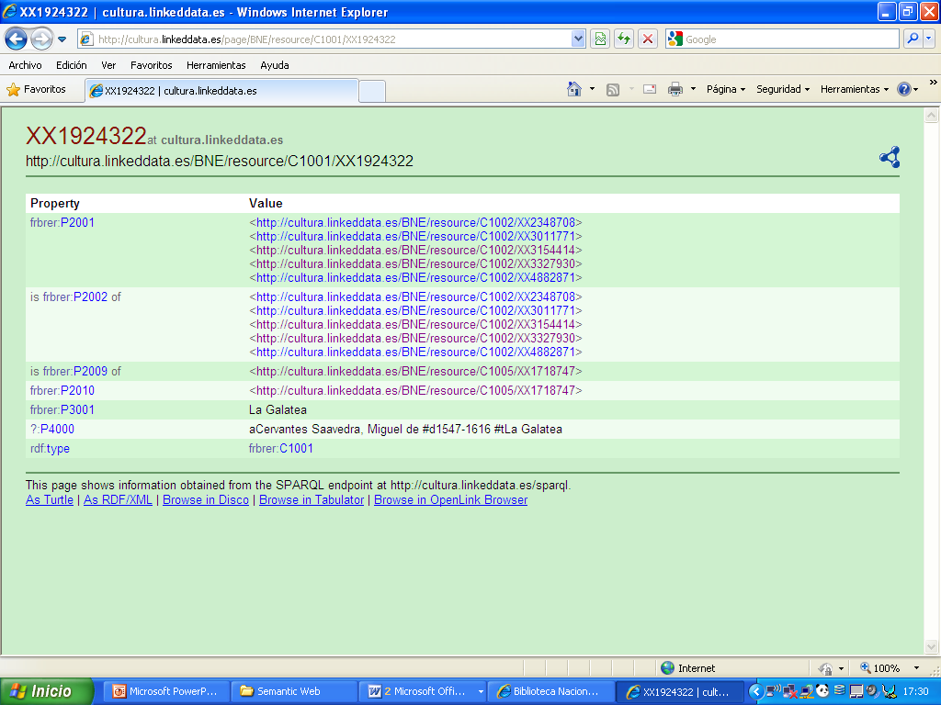

Slide 20
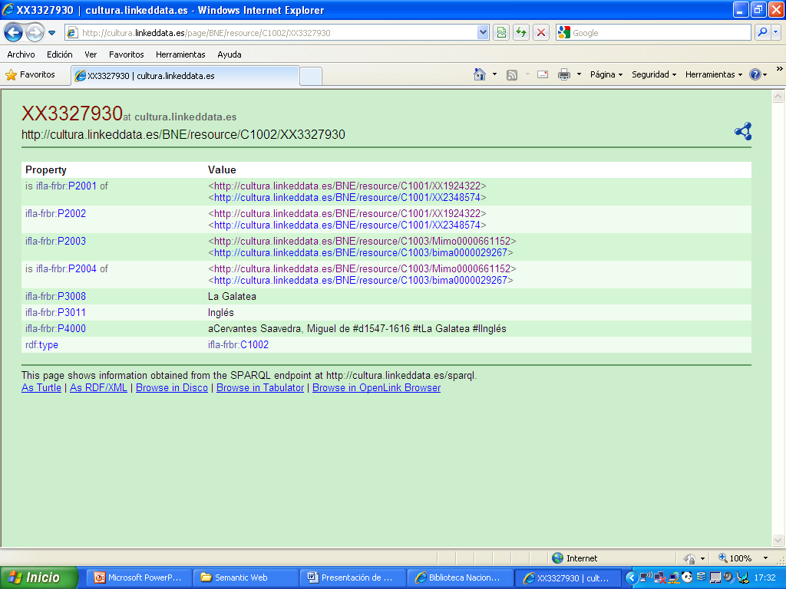

Slide 21
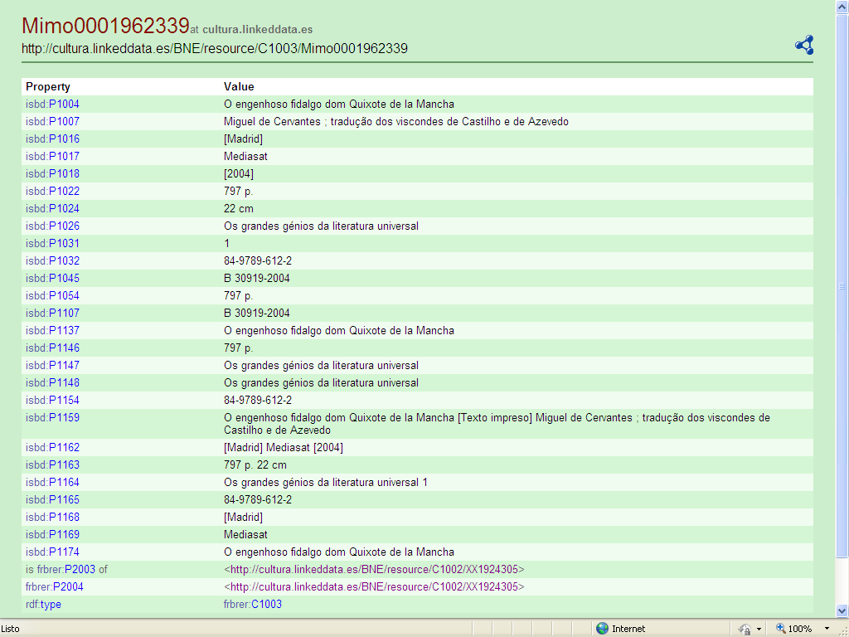

Slide 22
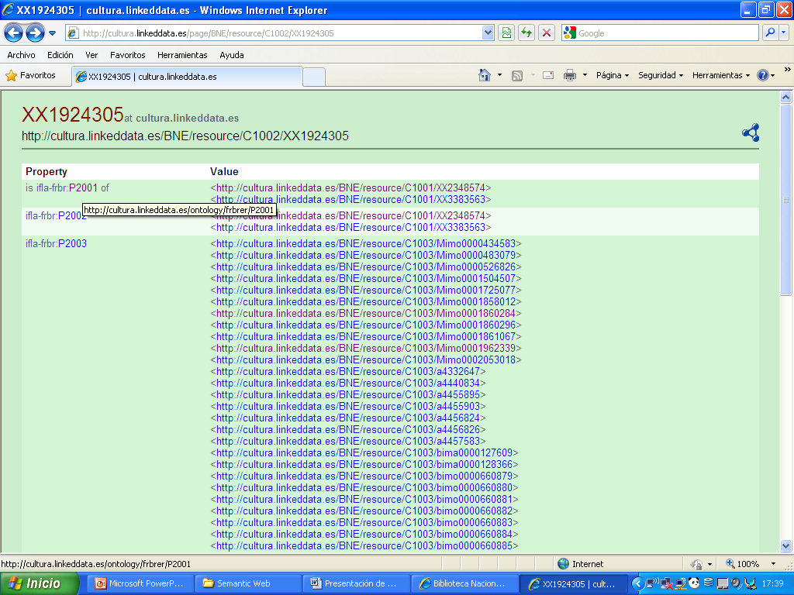

Slide 23
