Slide 1
Government Linked Data Research Projects in Spain
W3C GLD WG F2F1
Boris Villazón-Terrazas, Óscar Corcho, and
Asunción Gómez-Pérez
Facultad de Informática, Universidad Politécnica de Madrid
Campus de Montegancedo sn, 28660 Boadilla del Monte, Madrid
http://www.oeg-upm.net
Phone: 34.91.3366605, Fax: 34.91.3524819
Slides available at: http://www.slideshare.net/boricles/
Credits to the OEG members involved in LD Initiatives
Notes:
We present the process that has been followed for the development
of an application that makes use of several heterogeneous
Spanish public datasets that are related to administrative,
hydrographic, and statistical domains.
Our application
aims at analysing existing relations between the Spanish
coastal area and dierent statistical variables such as
unemployment, population, dwelling, industry, and building
trade. Moreover, we provide an important innovation with
respect to other similar processes followed in other initiatives
by dealing with the geometrical information of features.

Slide 2
ToC
Introduction
GLD Initiatives
  GeoLinkedData – Spanish National Geographic Institute
  BNE – Spanish National Library
  AEMET - Spanish Meteorological Agency
Next steps

Slide 3
ToC
Introduction
GLD Initiatives
  GeoLinkedData – Spanish National Geographic Institute
  BNE – Spanish National Library
  AEMET - Spanish Meteorological Agency
Next steps

Slide 4
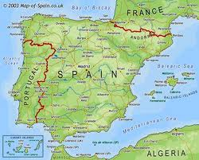

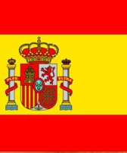
Introduction
The Ontology Engineering Group is promoting the application of Linked Data in Spain within different contexts from several Organizations,

Slide 5
ToC
Introduction
GLD Initiatives
  GeoLinkedData – Spanish National Geographic Institute
  BNE – Spanish National Library
  AEMET - Spanish Meteorological Agency
Next steps

Slide 6

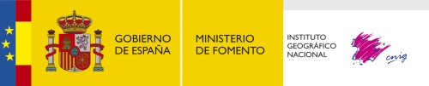
GeoLinkedData
An open initiative whose aim is to enrich the Web of Data with Spanish geospatial data.
It has started off by publishing diverse information sources, such as National Geographic Institute of Spain (IGN).
http://geo.linkeddata.es
Recently, National Statistics Institute (INE)
Notes:
GeoLinked Data1 is an open initiative whose aim is to enrich
the Web of Data with Spanish geospatial data. This
initiative has started o by publishing diverse information
sources belonging to the National Geographic Institute of
Spain2 (IGN-E), and the National Statistic Institute in Spain3
(INE). Such resources are made available as RDF knowledge
bases according to the Linked Data principles.

Slide 7
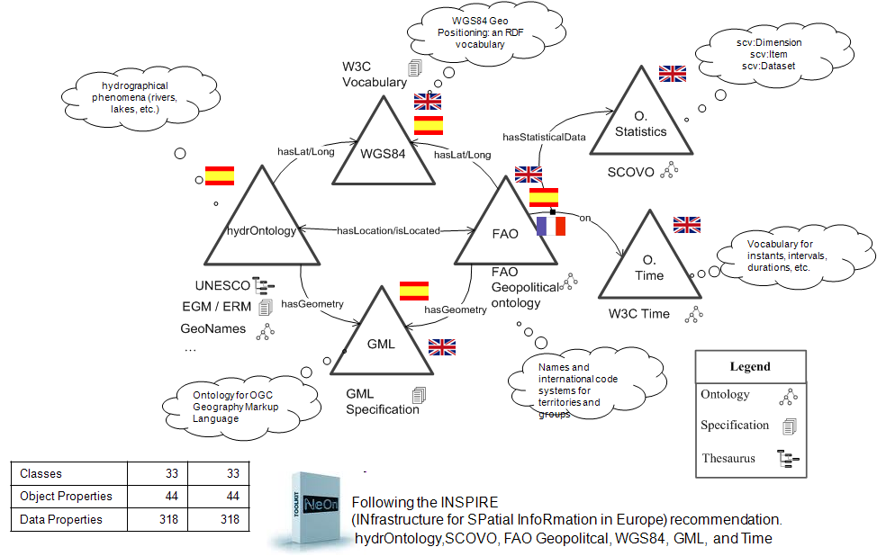
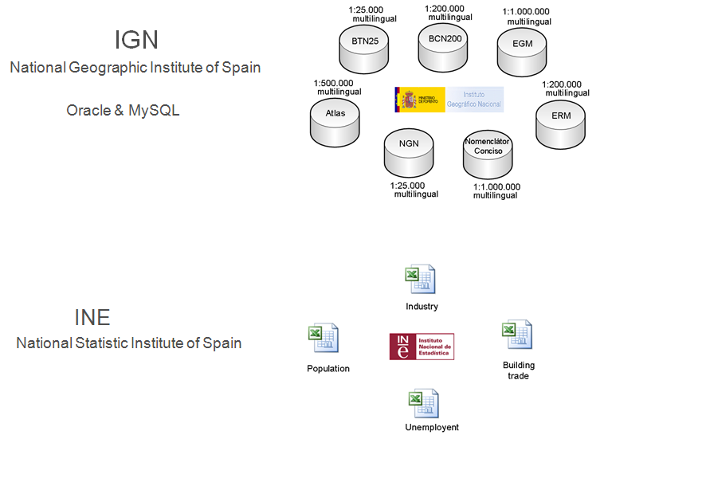
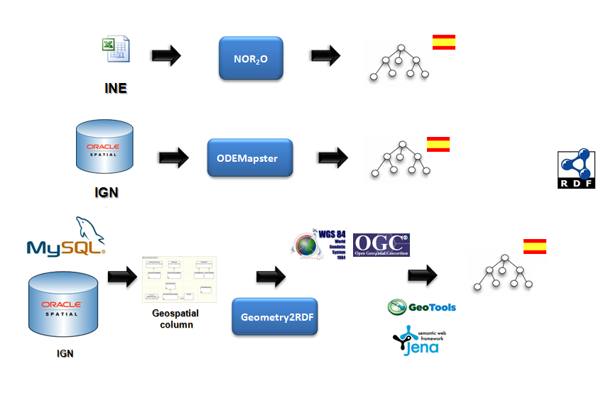
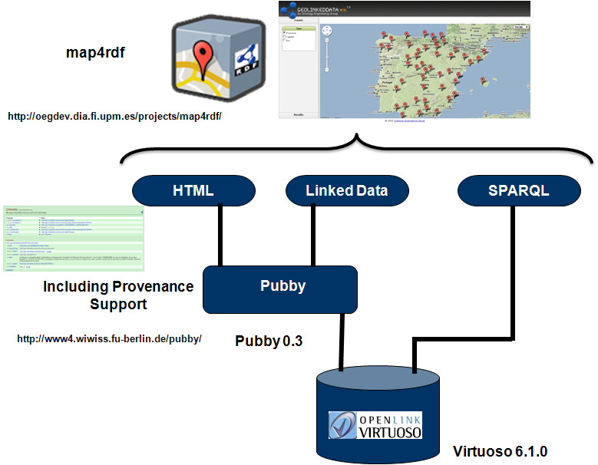
Process
1. Identification
2. Modelling
3. Generation of RDF data
4. Publication & Exploitation

Slide 8
ToC
Introduction
GLD Initiatives
  GeoLinkedData – Spanish National Geographic Institute
  BNE – Spanish National Library
  AEMET - Spanish Meteorological Agency
Next steps

Slide 9

BNE
Collaboration agreement in October 2010. Spanish National Library (Biblioteca Nacional de España – BNE)
Standards and data models
Review other Library Linked Data initiatives, based on IFLA standards
Selection of FRBR, FRAD e ISBD
http://cultura.linkeddata.es/sparql

Slide 10
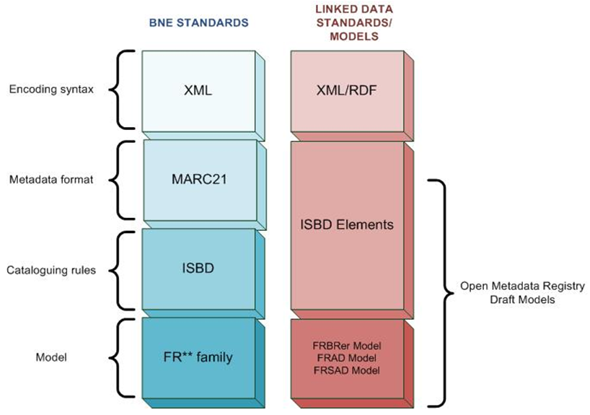

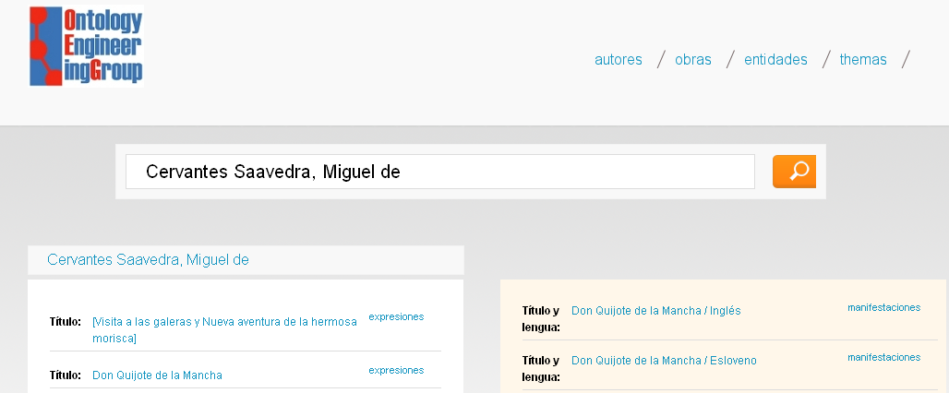
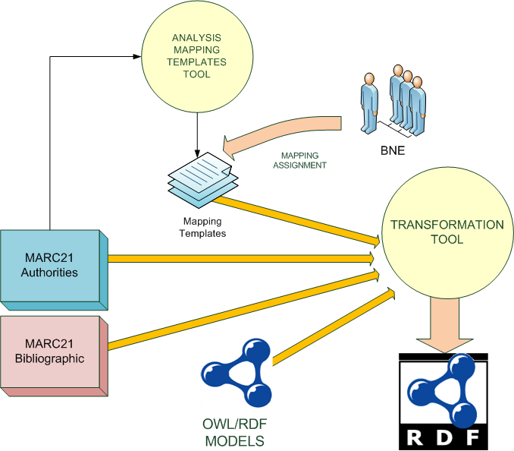
Brief description of the Process
1. Identification
2. Modelling
MARC 21 XML records
3. Generation of the RDF data
4. Publication
&
Exploitation

Slide 11
ToC
Introduction
GLD Initiatives
  GeoLinkedData – Spanish National Geographic Institute
  BNE – Spanish National Library
  AEMET - Spanish Meteorological Agency
Next steps

Slide 12

AEMET
This initiative started off by publishing diverse information sources belonging to the Spanish Meteorological Agency (AEMET).
10 minute data from around 250 weather stations of the Aemet's National Surface Weather Stations Network.
http://aemet.linkeddata.es/

Slide 13
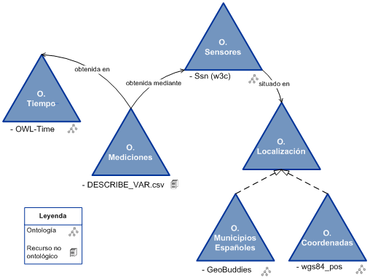
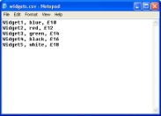
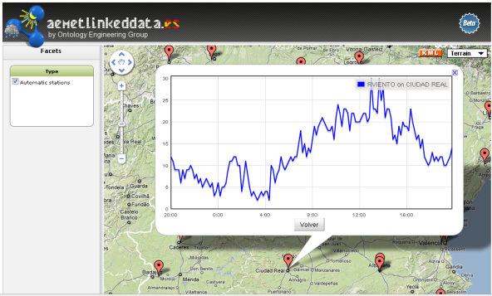
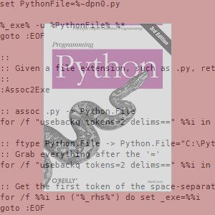



Process
1. Identification
2. Modelling
250 weather stations (pressure, humidity, etc)
Data from the stations in CSV files in a FTP server
3. Generation of RDF data
4. Publication & Exploitation
Python scritps

Slide 14
ToC
Introduction
GLD Initiatives
  GeoLinkedData – Spanish National Geographic Institute
  BNE – Spanish National Library
  AEMET - Spanish Meteorological Agency
Next steps

Slide 15
Next steps
Exchange our experience and promote/learn best practices
Multilingual Government Linked Data
  Not only English, there are other languages
    Spanish, German, French, Italian, etc.
Datasets dynamics
Develop applications that unlock the value of the data to provide benefits to citizens.

Slide 16

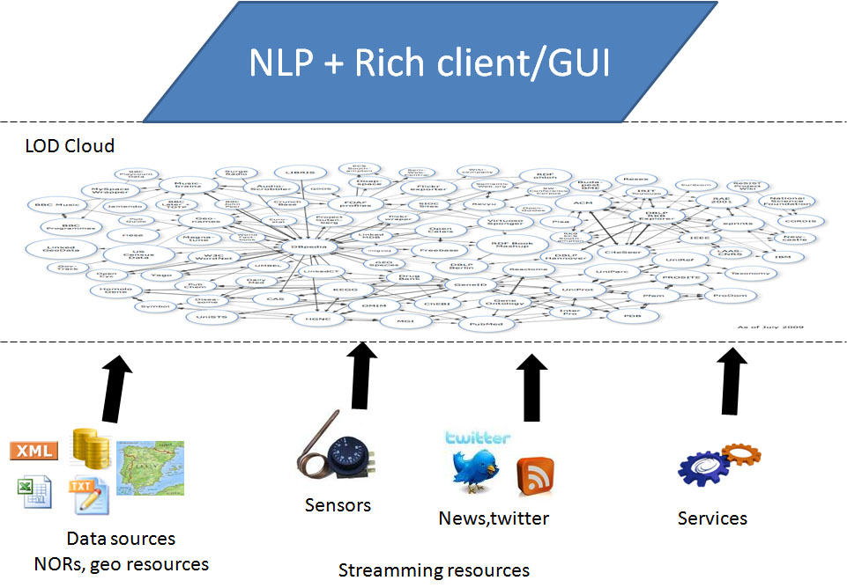
Next steps
Streaming resources

Slide 17


Slide 18
Government Linked Data Research Projects in Spain
W3C GLD WG F2F1
Boris Villazón-Terrazas, Óscar Corcho, and
Asunción Gómez-Pérez
Facultad de Informática, Universidad Politécnica de Madrid
Campus de Montegancedo sn, 28660 Boadilla del Monte, Madrid
http://www.oeg-upm.net
Phone: 34.91.3366605, Fax: 34.91.3524819
Slides available at: http://www.slideshare.net/boricles/
Credits to the OEG members involved in LD Initiatives
Notes:
We present the process that has been followed for the development
of an application that makes use of several heterogeneous
Spanish public datasets that are related to administrative,
hydrographic, and statistical domains.
Our application
aims at analysing existing relations between the Spanish
coastal area and dierent statistical variables such as
unemployment, population, dwelling, industry, and building
trade. Moreover, we provide an important innovation with
respect to other similar processes followed in other initiatives
by dealing with the geometrical information of features.

