Slide 1
Analyzing and predicting social exclusion
Javier Bajo, Asunción Gómez, Jacinto González, Emilio Serrano, and Maria del Carmen Suarez
{jbajo,asun,gpachon,emilioserra,mcsuarez}@fi.upm.es
Ontology Engineering Group
Universidad Politécnica de Madrid
2016

Slide 2
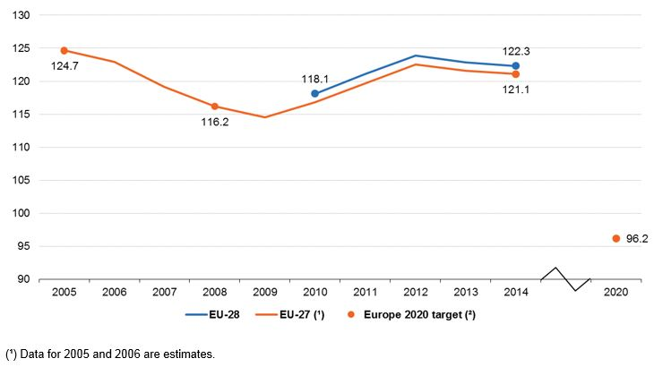
Motivation
The risk of poverty or social exclusion in the EU had been decreasing steadily before the start of the economic crisis, but grew again in the following years.
The objective of the Europe 2020 strategy is reducing the amount of people at risk of poverty or social exclusion by 20 million.
A predictive model of the chronic social exclusion allows social workers to anticipate it.
People at risk of poverty or social exclusion (million people), source: Eurostat (t2020_50)

Slide 3



Predictive model
Batch training
Real time predictions
Historical data:
Gender
Age
Income type
Education level
Accommodation
…
Machine learning methods
Predictive
model
Risk of chronic
social exclusion
Live cases
Social workers input

Slide 4
Projects and outcomes
Project: Services for development of mathematical models for population segmentation. A2016/000271 of “Junta de Castilla y León”.
Outcomes:
Predictive model of chronic social exclusion based on machine learning techniques
Segmentation model of the population and study of the main features in the social exclusions groups
Ontology network which covers the aforementioned models while offers a shareable formalization of the social exclusion main concepts

