Slide 1

Open Science
Idafen Santana, Alexander García, Oscar Corcho,
Olga Giraldo, Carlos Badenes, Esteban González
openscience@delicias.dia.fi.upm.es
Ontology Engineering Group
Universidad Politécnica de Madrid

Slide 2

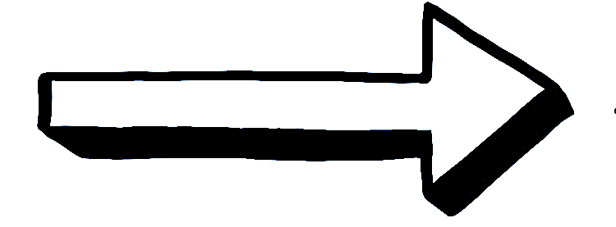
What is Open Science?
F
A
I
R
...
INDABLE
CCESIBLE
NTEROPERABLE
E-USABLE
Opening the scientific process to a
broader audience, promoting collaboration and participation
Students
Citizens
Scientists
Companies
Educators

Slide 3





Open Science Lifecycle
SCIENTIFIC OUTREACH
REPRODUCIBILITY
EXECUTE
CURATION
Scientific Communities
DATA
Citizen Science
PUBLISH
DEFINE
DESIGN
NOT FORGET
METHODS
CONSERVATION
DISCOVER

Slide 4





Projects
2004
Infrastructure
2008
Data & Storage
2008
Process &
Preservation
2010
Knowledge &
Aggregation
2014
http://drinventor.eu/

Slide 5




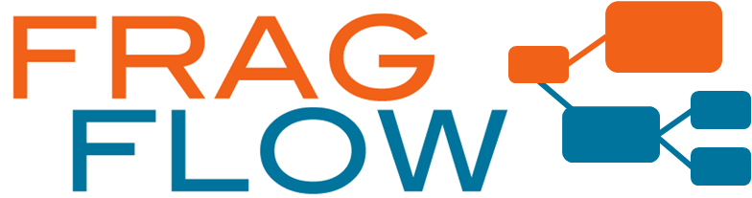

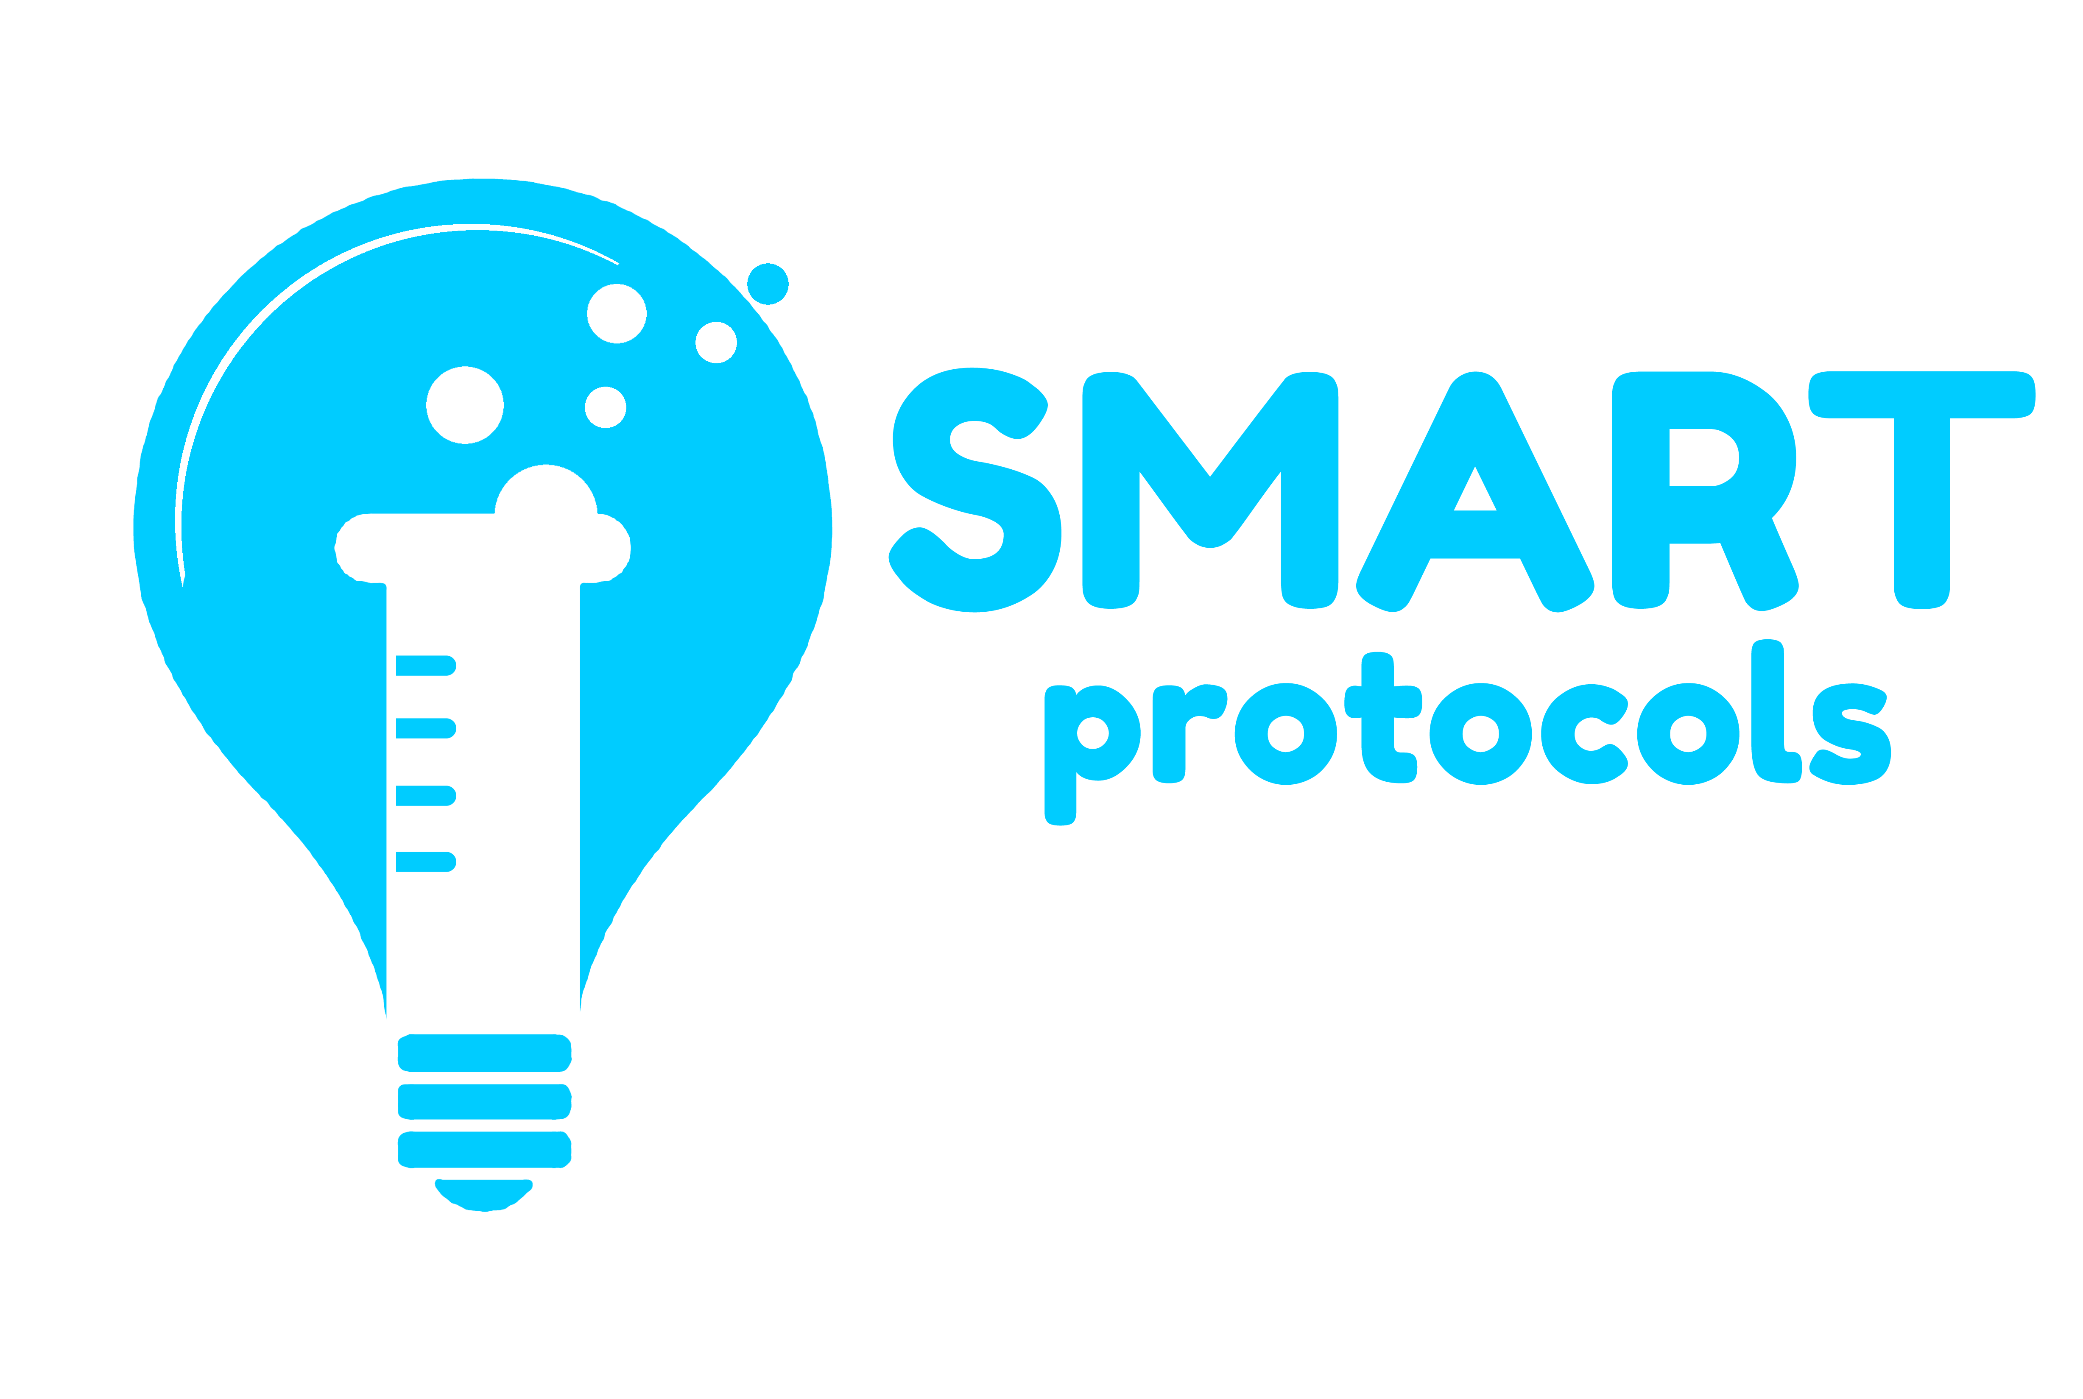

Results
Provenance representation. W3C working group
(https://www.w3.org/TR/prov-o/)
Scientific results publication on the web
(http://www.researchobject.org/)
Detection of common motifs among scientific workflows
(https://github.com/dgarijo/FragFlow)
Reproducibility of scientific execution environments
(http://vocab.linkeddata.es/wicus/wicus/)
Information retrieval from laboratory protocols
(http://vocab.linkeddata.es/SMARTProtocols/)
Analysis of large collections of scientific documents (http://librairy.github.io/)

