Slide 1
Big Data
TIC Sector Analysis
Oscar Corcho <ocorcho@fi.upm.es>
Carlos Badenes <cbadenes@fi.upm.es>
Ontology Engineering Group
Universidad Politécnica de Madrid
2016

Slide 2
Corpus
United States Patent and Trademark Office
780.819 patents

Slide 3
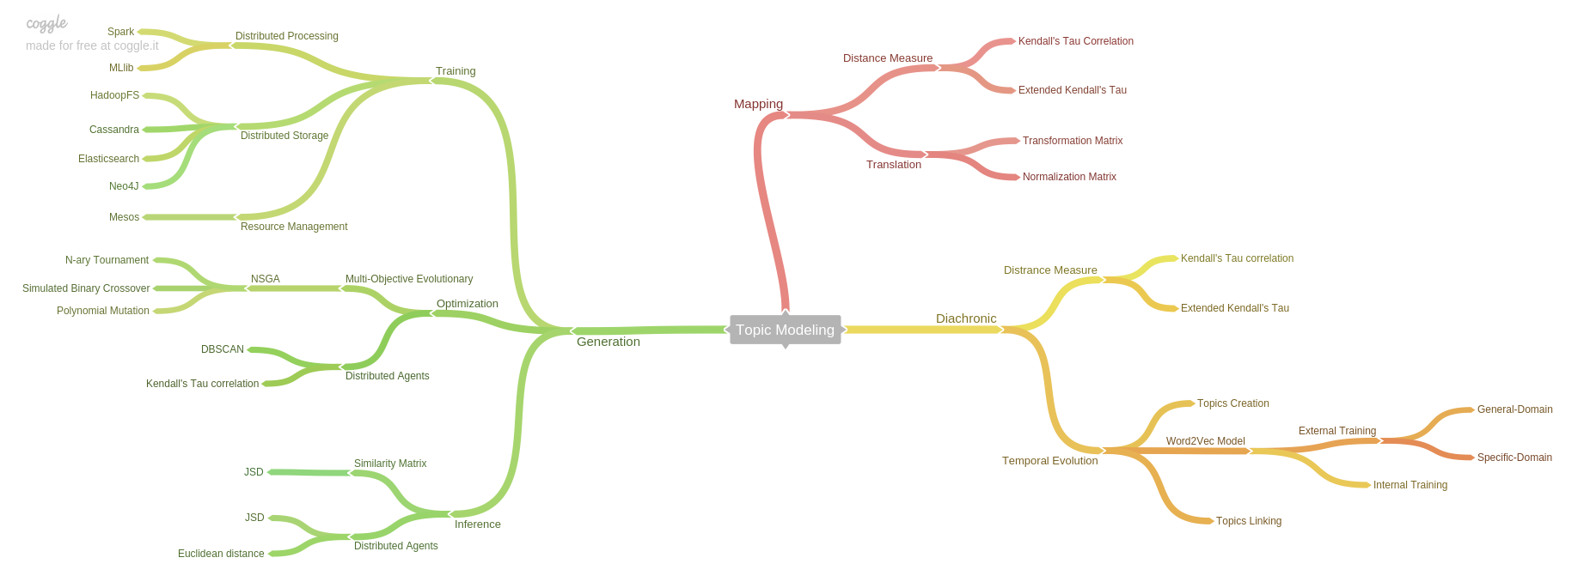
Outcome
Generation of Topic Models and definition of metrics to discover:
similar patents
research areas
temporal evolution of domains
relationships between domains and patents

