Slide 1


Preliminary Results in Tag Disambiguation using DBpedia
Andrés García-Silva†, Martin Szomszor‡, Harith Alani ‡, Oscar Corcho†
† {hgarcia, ocorcho}@fi.upm.es
Facultad de Informática
Universidad Politécnica de Madrid
Campus de Montegancedo s/n
28660 Boadilla del Monte, Madrid, Spain
‡{mns2, h.alani}@ecs.soton.ac.uk
School of Electronics and
Computer Science,
University of Southampton,
SO16 1BJ, UK.

Slide 2





Introduction
Broad folksonomy*
Narrow folksonomy*
Resource creator
Resource
Resource
* www.vanderwal.net

Slide 3
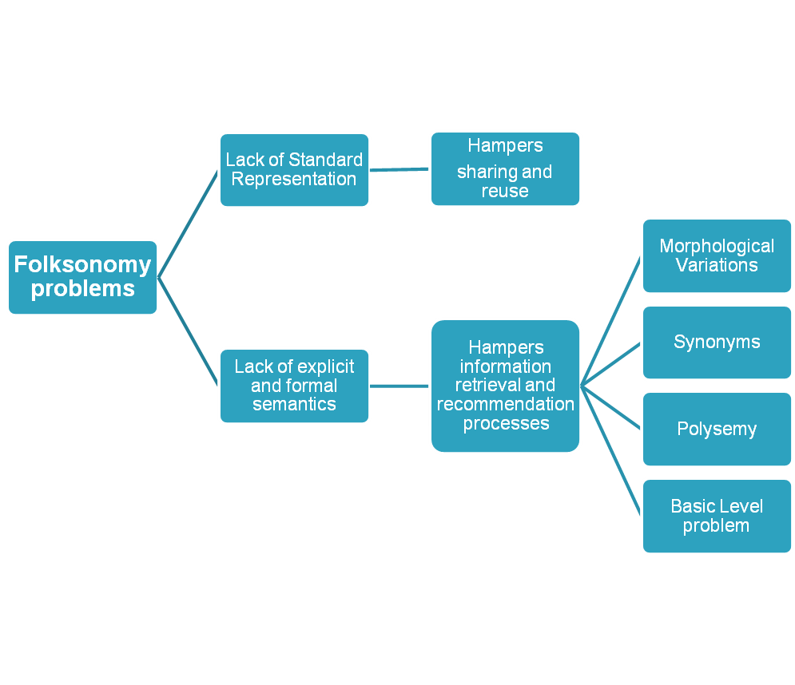
Folksonomy problems
Introduction
Solutions
Ontologies for folksonomies
Semantics association to tags

Slide 4
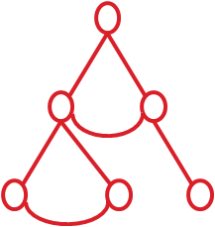
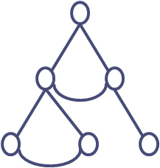
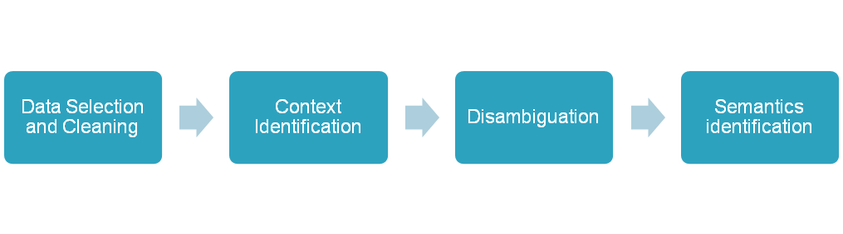


Introduction
Ontology
Ontology
Tag
Semantics association to tags
Folksonomy

Slide 5
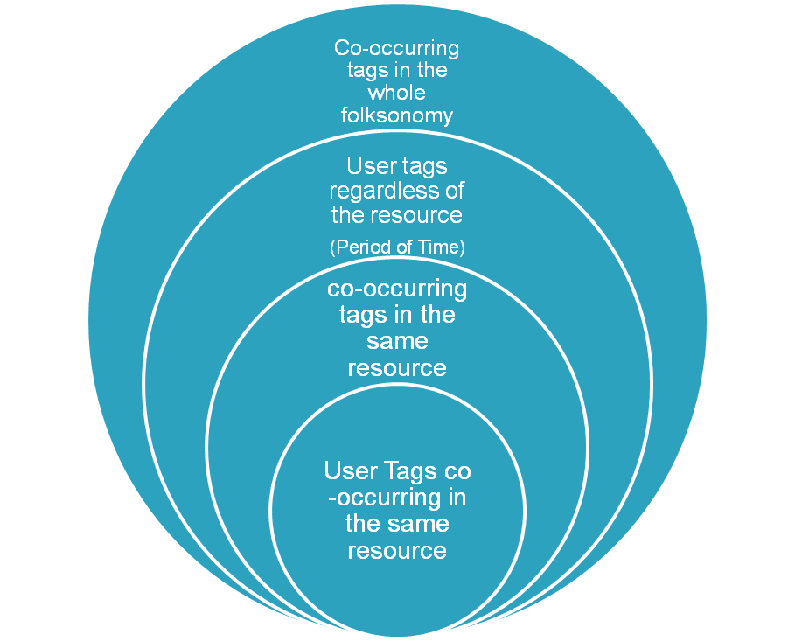
Context & disambiguation
First disambiguation approach relying on a dictionary (Lesk, 1998)
  Definitions of the word to disambiguate & of each word in the context.
    Context: The words appearing in the sentence
  Definitions of the words in the context are compared against the definitions of the word to disambiguate.
Contexts in folksonomies
Problems: When the definitions are short. (Sanderson, 2000)
Lesk, M., “They said true things, but called them by wrong names” – vocabulary problems in retrieval systems. in Proc. 4th Annual Conference of the University of Waterloo Centre for the New OED (1998)
Sanderson, M., Retrieving with Good Sense. In Information Retrieval 2(1): 47-67 (2000)

Slide 6

Tagora Sense Repository
Linked data enabled service endpoint
  Metadata about tags and their possible senses.
    Wikipedia pages -> Disambiguation or Redirection links
    Terms and frequencies
    DBpedia entries related to each Wikipedia page.
  Query using:
    REST -> http://tagora.ecs.soton.ac.uk/tag/apple
    SPARQL end-point.
  Result: RDF document
DBpedia coverage:
  2.6 million things, 213,000 people, 328,000 places, 57,000 music albums, 36,000 films, 20,000 companies.
    Wordnet as of 2006 contains about 150,000 words
  Named entity recognition
  Classes, Instances, and semantic relations

Slide 7
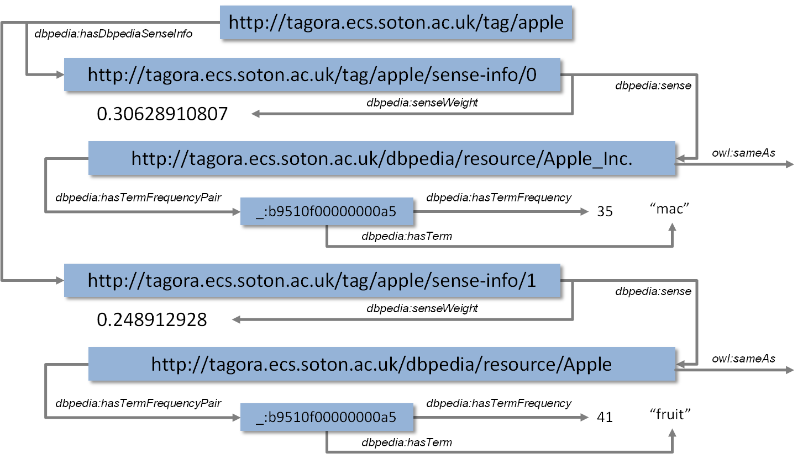
Tagora sense repository
Linked data representation of tag senses

Slide 8

Disambiguation Approach
The algorithm selects among a set of candidate DBpedia entries, the one that describe better the meaning of an ambiguous tag according to its context.
The candidate DBpedia entries and the tag context are represented as vectors.
The tag context vector is compared against each DBpedia entry vector using the cosine of the angle as similarity measure.
The most similar DBpedia entry is selected as the one representing the meaning of the analyzed tag

Slide 9
Disambiguation Approach
Tagging activity:
  User u has tagged the resource r = http://www.nature.com with the tags nature, news, science.
Context(u, nature, r) = {nature, news, science}
Senses(Nature) = {dbpedia:Nature, dbpedia: Nature_(journal)}
  Terms(dbpedia:Nature) = {(life,62), (nature,46), (earth,32)}
  Terms(dbpedia:Nature_(journal)) = {(nature,77), (science,29), (scientific,25)}
Voc(nature) = { life, nature, earth, science, scientific }
V_{context}= (0,1,0,1,0)
V_{nature}= (62,46,32,0,0)
V_{nature(journal)}= (0,77,0,29,25)
Sim(V_{context}, V_{nature}) = 0,389 Sim(V_{context}, V_{nature(journal)}) = 0,872

Slide 10
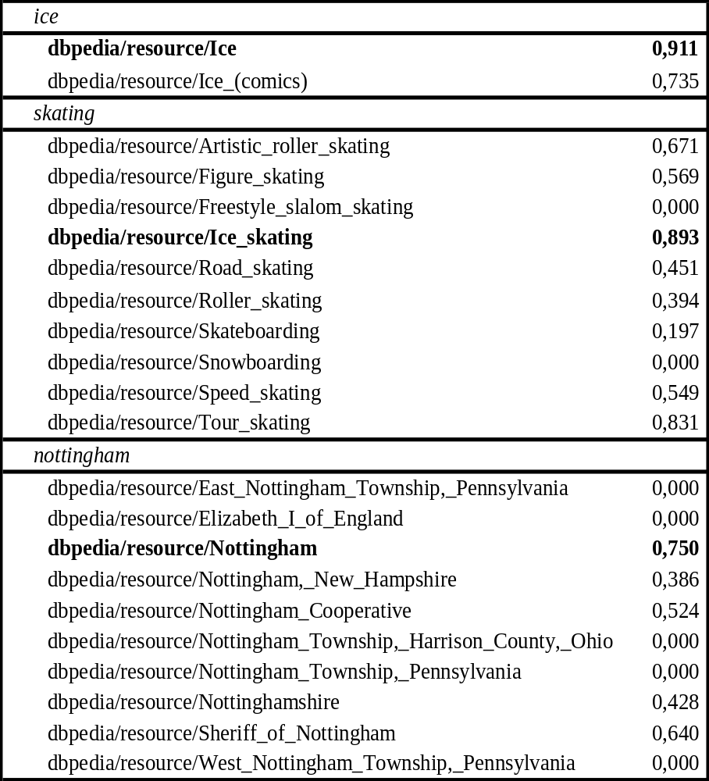
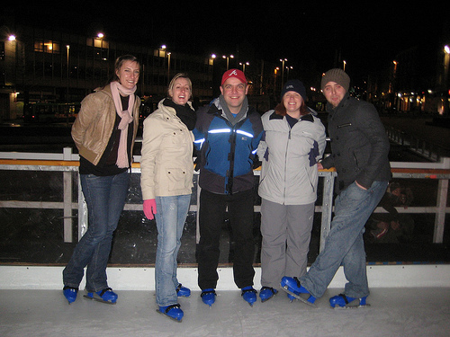
Preliminary Results
Some user x has tagged a picture r with the tags ice, iceskating, nottingham, and skating.

Slide 11
Conclusions & Future Work
Conclusions:
  Inspired by IR techniques we have presented a tag disambiguation algorithm relying on DBpedia & Wikipedia information.
  We have present different definitions of contexts for tagging activities as a way to ameliorate tagging data scarceness.
  Future Work
  Test the approach in a large tag set with the different contexts.
  Sophisticated similarity measures
  Evaluation of the approach and contexts using Precision and Recall
  Extract more context information from the tagged resource (text documents)
  Test bed and Standard evaluation metrics
  Use DBpedia semantic information to evolve domain ontologies
  Use DBpedia semantic information to improve searching and recommendation processes.

