Slide 1

ICIJ-OEG Panama Papers Entity extractor
Pablo Calleja. Oscar Corcho
ocorcho@fi.upm.es
pcalleja@fi.upm.es
Facultad de Informática
Universidad Politécnica de Madrid
Campus de Montegancedo s/n
28660 Boadilla del Monte, Madrid, Spain
Date: 19-9-2016

Slide 2
Table of contents
Project overview
Implementation
Results
Evaluation

Slide 3


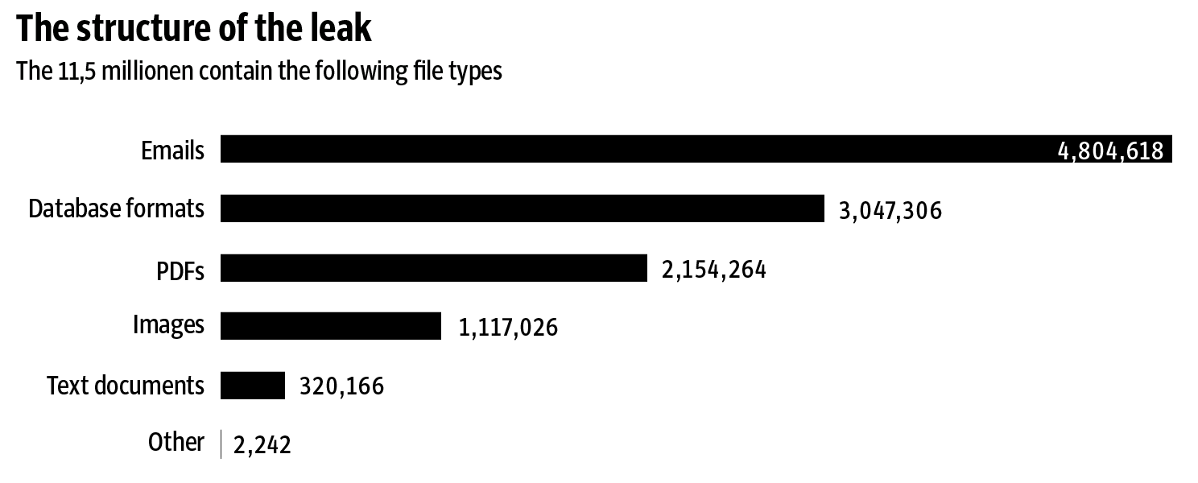
1. Project overview
The Panama Papers
11.5 million leaked documents of 214,488 offshore entities from the corporate Mossack Fonseca. The biggest ever data leaks.
Massive information
Documents in different format
Multilingualism
Project
An Information Extraction system for entity recognition processes over leaked documents to help journalist in the search process

Slide 4



1. Project overview
Natural Language Processing
Named entity recognition based on lexical-syntactic patterns and dictionaries.
The target entities are:
Companies
Person names
Countries
Addresses
Emails
Telephones
Document 1
Document 2
Document 3
Input documents
Named Entity
Recognition system
Output entities
Company 1
Person 1
Country 1
Address 1
Company 2
Person 2
Country 1
Address 2
Company 2
Person 1
Country 2
Address 3
Journalist focused on Person 1
Document 1
Document 2
Document 3

Slide 5


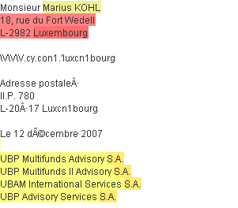
2. Implementation
Corpus
Annotated entities on corpus
Entity extractor library
Identify entities in a corpus:
- Companies
- Person names
- Countries
- Addresses
- Emails
- Telephones

Slide 6
2. Implementation
Implemented as an API
Annotated entities on corpus
Entity extractor library
Corpus
OpenNLP
CoreNLP

Slide 7

2. Implementation
Entity extractor processes
Gate application
Tokeniser
Sentence Splitter
Gazetteer
JAPE
rules
Document
Rules are trained with Luxembourg Leaks documents
External resources could be improved
Company Designators
Places
Countries
Internet domains
Telephone prefixes
…
Company
Person name
Email
Street
…

Slide 8
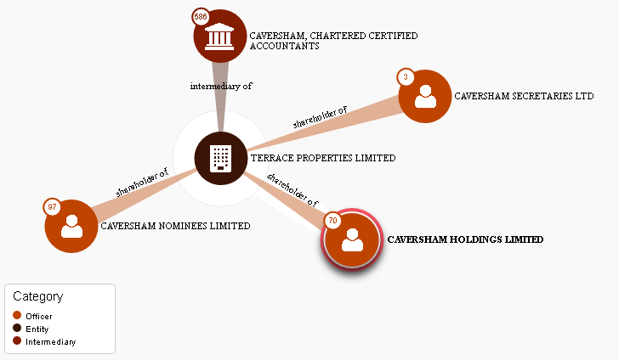


3. Results
Result entities are stored in a solr database
Entities are linked by journalists
company
person
country
email
Solr database
https://offshoreleaks.icij.org/

Slide 9
4. Evaluation
Luxembourg Leaks Gold Standard: 577 documents
Set of countries where the offshore works
Set of companies involved with the offshore
Too much expert knowledge
Entity | All references | Subset of references | None
Countries | 52.4% | 37.84% | 9.76%
Companies | 78.6% | 11.3% | 10,1%

Slide 10
4. Evaluation
Luxembourg Leaks: 577 documents
Comparative between other APIs for companies entities
Tool | All references | Subset of references | None
EntityExtractor | 78.6% | 11.3% | 9,76%
CoreNLP | 73% | 14% | 13%
OpenNLP | 47% | 23% | 30%

Slide 11
4. Evaluation
Panama Papers Gold Standard: Subset of 282 documents
Gold standard oriented for companies
One company per document
Tool | Reference extracted | Reference not extracted
EntityExtractor | 78.6% | 9,76%
CoreNLP | 57% | 37%
OpenNLP | 43% | 63%

Slide 12
ICIJ-OEG Panama Papers Entity extractor
Pablo Calleja. Oscar Corcho
ocorcho@fi.upm.es
pcalleja@fi.upm.es
Facultad de Informática
Universidad Politécnica de Madrid
Campus de Montegancedo s/n
28660 Boadilla del Monte, Madrid, Spain
Date: 19-9-2016

