Slide 1
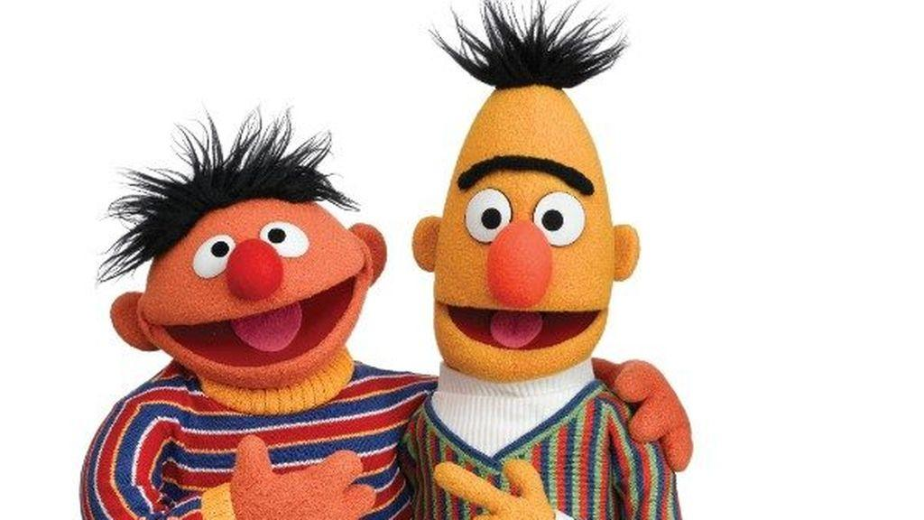
Muppets session 2: Language Models
Ontology Engineering Group
Universidad Politécnica de Madrid, Spain
Pablo Calleja
Notes:
Bert and ernie

Slide 2
RECAP
ON THE PREVIOUS TALK

Slide 3
Why Transformers apperared?
Neural machine translation architecture is divided in two main modules: an encoder and a decoder
Encoder
Decoder
I am a student
Je suis étudiant

Slide 4
Why Transformers apperared?
Traditionally based on Recurrent Neural Networks (LSTMs)
NMT
Encoder
Decoder
Je
suis
étudiant
<end>
I
am
a
student
Context Vector
<Start>
Je
suis
étudiant
I am a student
Je suis étudiant

Slide 5
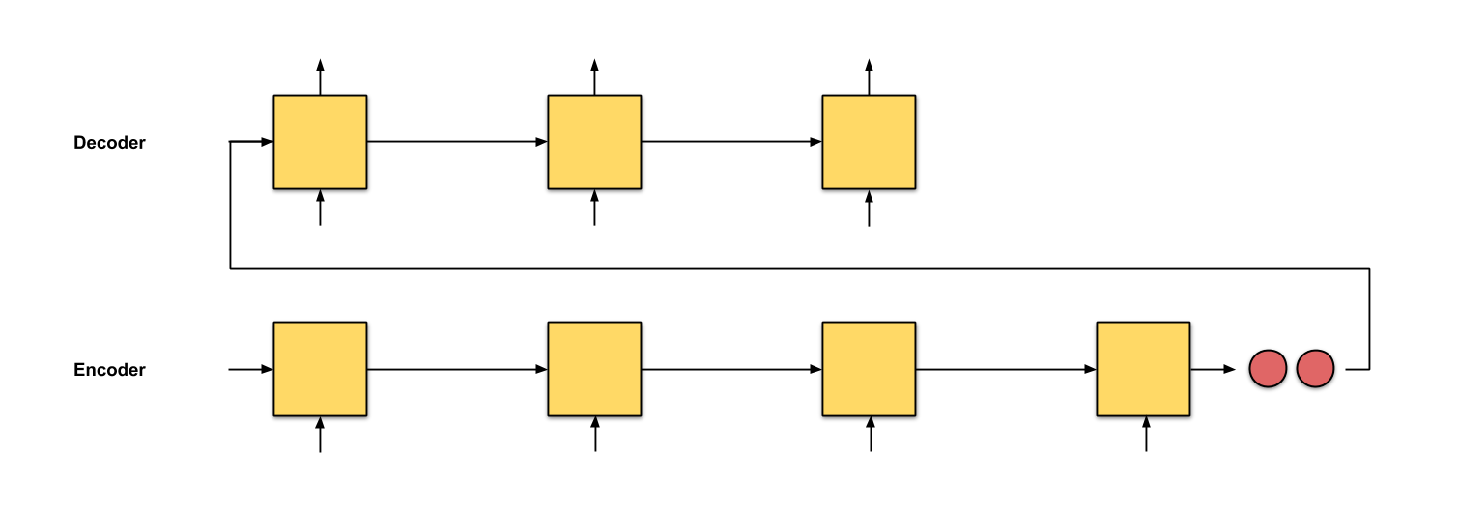
Why Transformers apperared?
Problem with RNN
Incapability of remembering long sentences
The previous word is not the most important to generate the next one
Context Vector

Slide 6
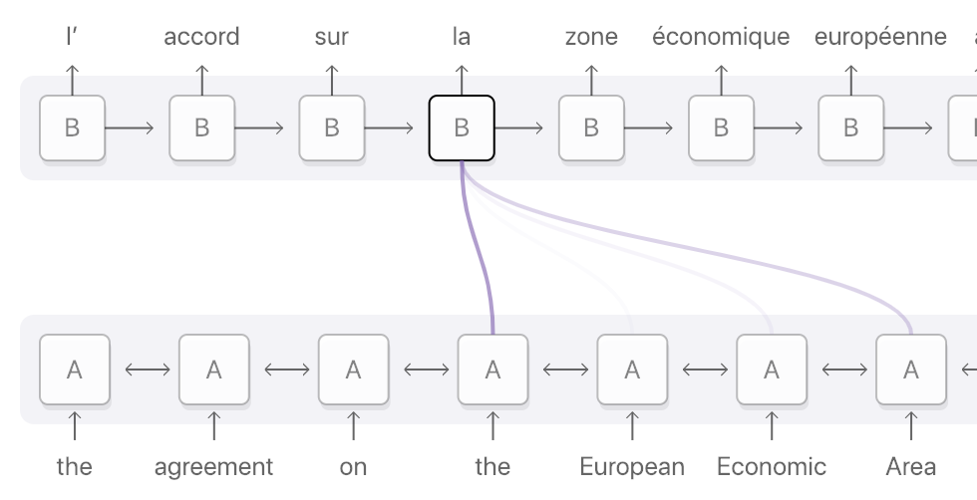
Why Transformers apperared?
Attention
Be able to focus on specific words on the sentence

Slide 7
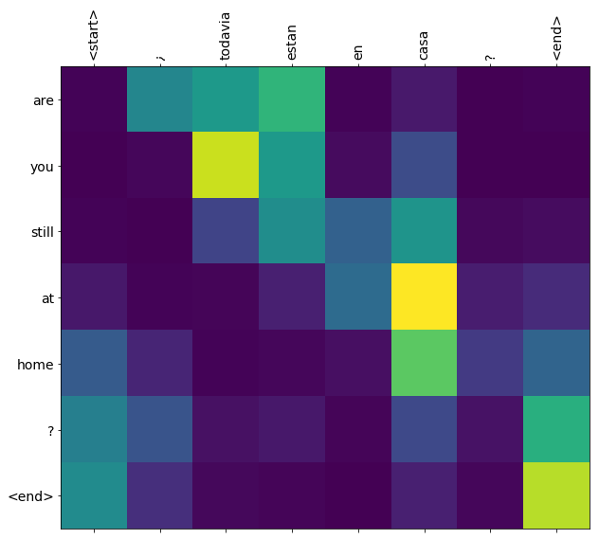
Why Transformers apperared?
Attention representation

Slide 8

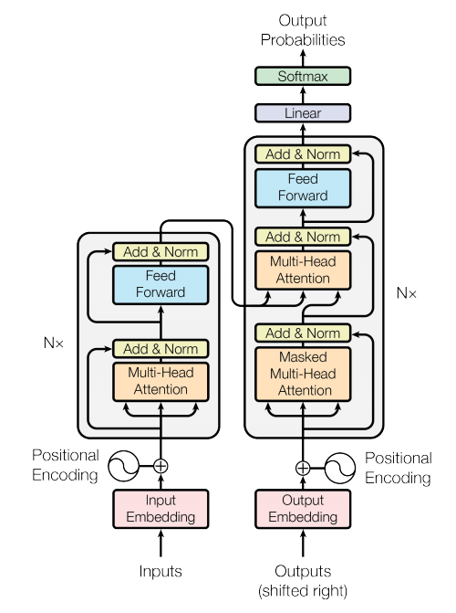
Why Transformers apperared?
Attention is all you need
The transformer is presented
Main ideas:
No need of RNNs, all the sentence are computed at once
Everything can be done with attention: self-attention

Slide 9
Why Transformers apperared?
Not only 1 encoder and 1 decoder: a stack of them
N
Encoder
N
Decoder
Encoder
Decoder
1
1

Slide 10
Why Transformers apperared?
Idea of multi-head attention
I am a student
I
am
a
student
0.8
0.7
0.5
0.6
0.1
0.6
0.1
0.4
0.1
0.1
0.8
0.6
0.1
0.4
0.3
0.6
Idea of masked multi-head attention
<start>
Je
étudiant
suis
<start>
0.8
0.7
0.5
0.6
Je
0.1
0.6
0.1
0.4
suis
0.1
0.1
0.8
0.6
0.1
0.4
0.3
0.6
étudiant

Slide 11
Why Transformers apperared?
Je
suis
étudiant
<end>
Transformer Encoder
I
Transformer Decoder
am
a
student
I
am
a
student
<start>
Je
suis
étudiant

Slide 12
Now that we have all ideas refreshed
Let’s start

Slide 13
A definition
What is Language Model?
A language model is basically a probability distribution over words or word sequences.
A language model gives the probability of a certain word sequence being “valid”.
Validity in this context does not refer to grammatical validity at all.
It means that it shows similar to the data used to train - which is what the language model learns.

Slide 14
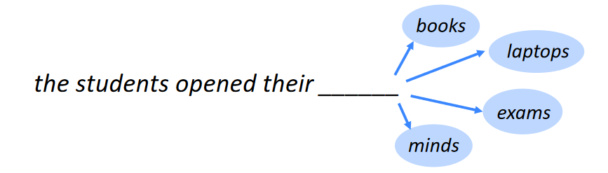
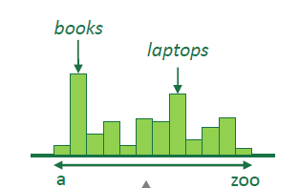
A definition

Slide 15
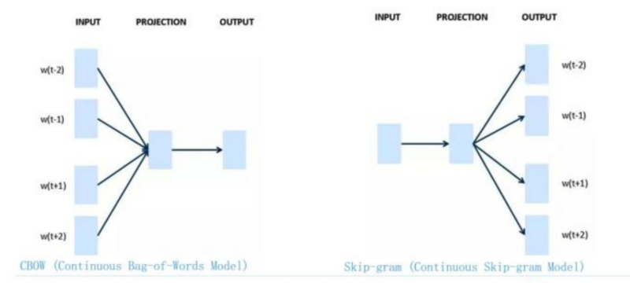
Word embeddings
Word2Vec showed that we can use a vector to represent words in a way that captures semantic or meaning-related relationships

Slide 16
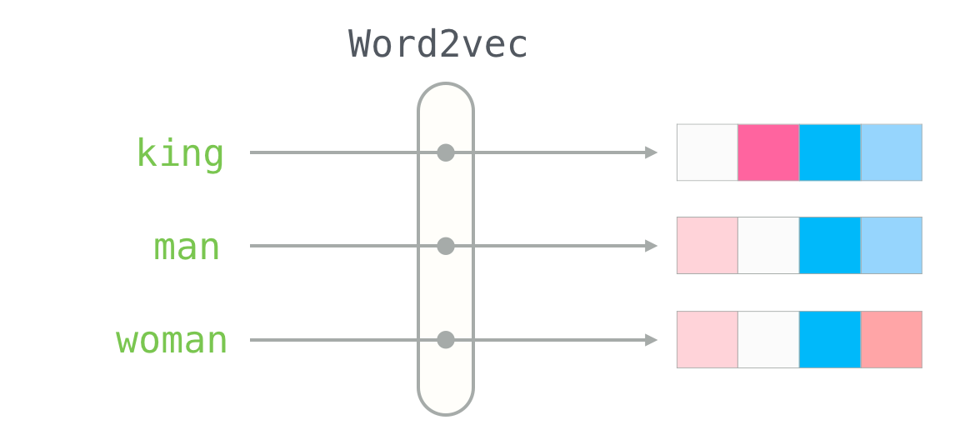
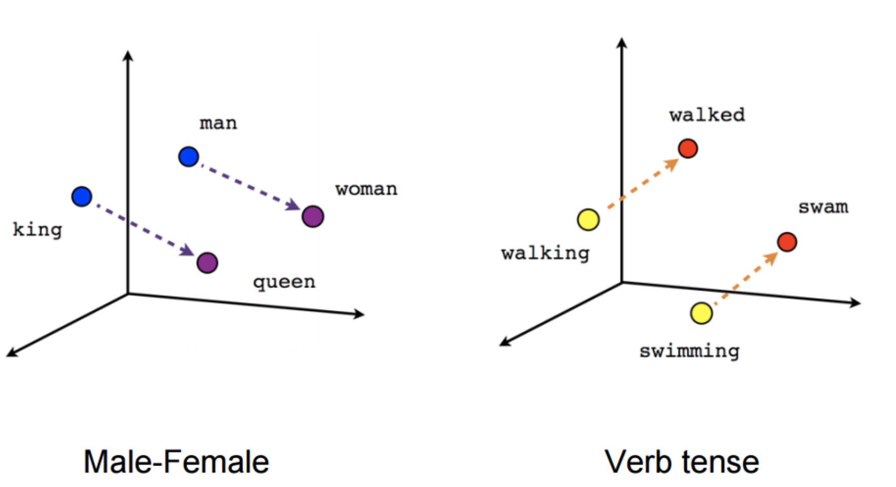
Word embeddings
This relationships can be represented

Slide 17
Word embeddings
Some problems:
Same vector for a word regardless the context, and context matters
Word embeddings learn about words and relations but not about ‘language’

Slide 18

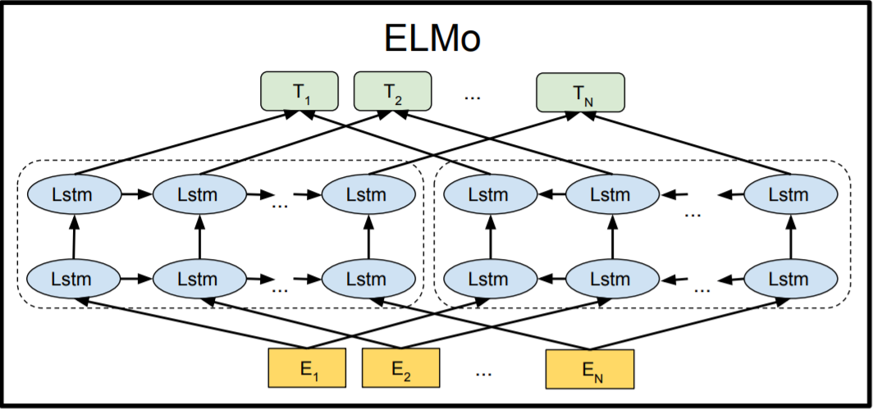
ELMo
ELMo -Embeddings from Language Models
Introduced the concept of Deep contextualized Word representations
Based on Bi-LSTMs. Learns about the context of the word
Notes:
Can perform the Language Modeling task better

Slide 19
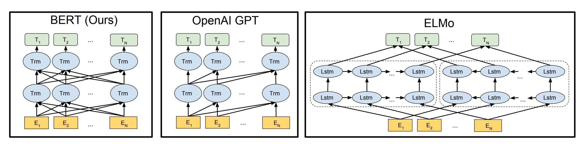

OpenAI Transformer. GPT
Transformers appeared. Attention is a substitute of LSTMs
OpenAI transformer is based on decoders
Predict next Word
Masked Self attention (to not look at future tokens during training)
0.8
0.7
0.5
0.6
0.1
0.6
0.1
0.4
Masked self attention
0.1
0.1
0.8
0.6
0.1
0.4
0.3
0.6
books
Transformer Decoder (s)
the
students
opened
their

Slide 20
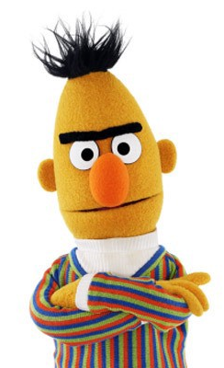
BERT
BERT - Bidirectional Encoder Representations from Transformers
Encoder: The model uses the encoder part of the transformer
Bidirectional:
Looks both forward and backwards
With a novel technique named Masked LM (MLM)
Notes:
BERT (Bidirectional Encoder Representations from Transformers). a novel technique named Masked LM (MLM)

Slide 21
BERT
How BERT is trained?
Two strategies:
Masked Language Model
Next Sentence Prediction

Slide 22
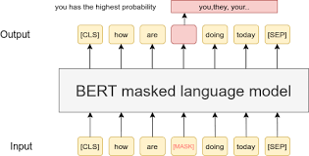
BERT
What is Masked Language Modeling?
15% of tokens in the input are Masked
80% replaced with [MASK]
10% with a random Word
10% with the original Word
Why?
100% of Mask tokens -> the model is only optimized for masked words
90% of mask and 10% of random -> the observation is never correct
90% of mask and 10% of original -> the model copy the original embedding
Notes:
BERT (Bidirectional Encoder Representations from Transformers). a novel technique named Masked LM (MLM)

Slide 23
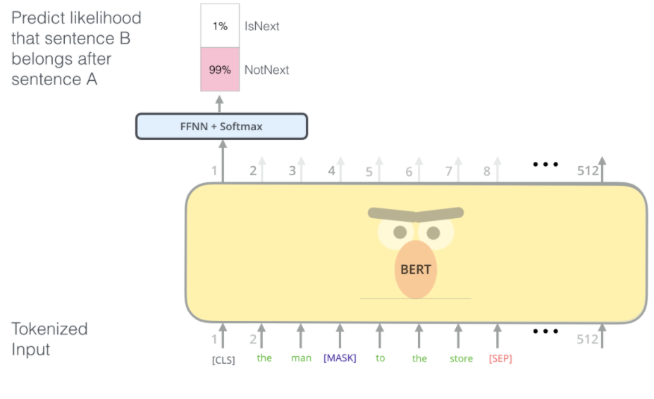
BERT
What is Next Sentence Prediciton?
BERT is trained with pair of sentences and predict if the second is the subsequent
50% are subsequent pairs and 50% are random
Uses special tokens for the classification. CLS at the beginning, and SEP at the end of each sentence
CLS token is used to predict IsNext/NotNext

Slide 24
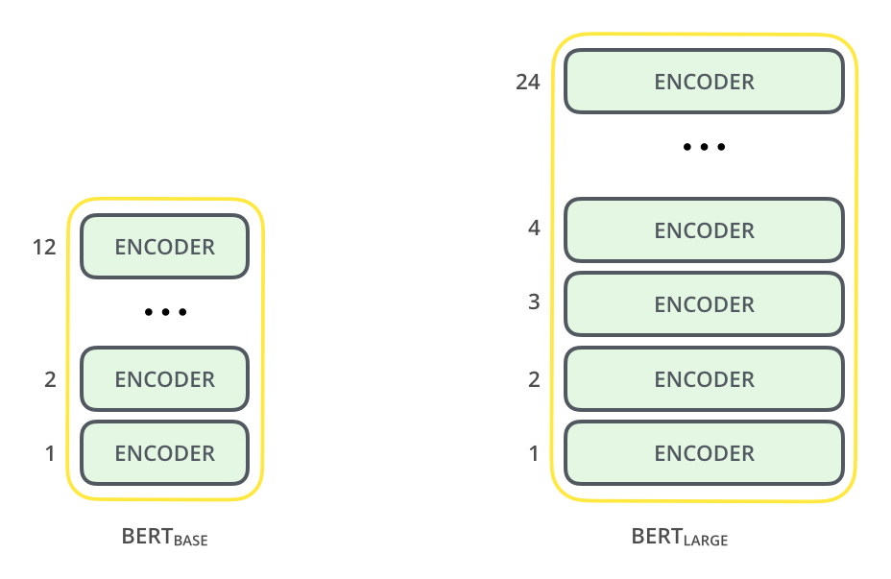
Other specifications of BERT
BERT is distributed in two versions: Base and Large
Base was only prepared to compare results with GPT
Larger feed-forward networks (768 (b) and 1024 (L))
More attention heads (12(b) and 16 (L))
Notes:
Both BERT model sizes have a large number of encoder layers (which the paper calls Transformer Blocks) – twelve for the Base version, and twenty four for the Large version. These also have larger feedforward-networks (768 and 1024 hidden units respectively), and more attention heads (12 and 16 respectively) than the default configuration in the reference implementation of the Transformer in the initial paper (6 encoder layers, 512 hidden units, and 8 attention heads).

Slide 25
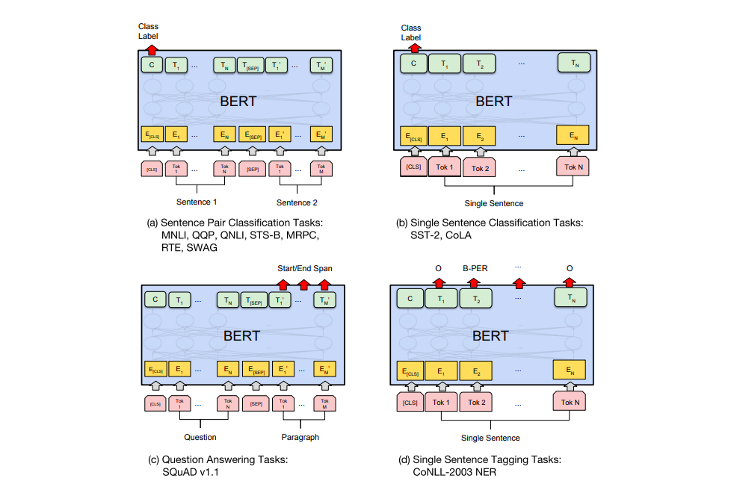
Fine-Tuning BERT
BERT can be adapted for different tasks

Slide 26
Fine-Tuning BERT

Slide 27
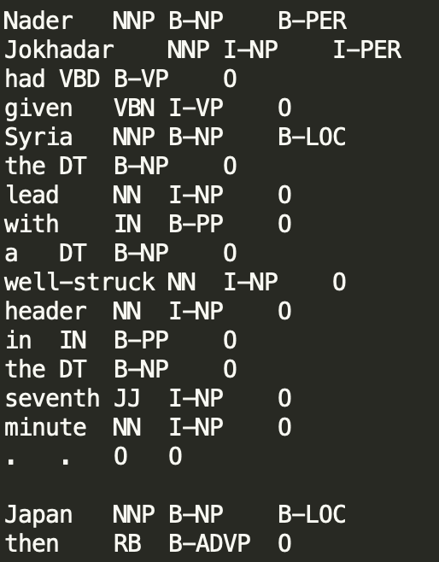
The importance of LMs in NLP
Has changed most NLP tasks and even the used datasets
Example: NER dataset
Excerpt of CoNLL datatset
Columns in the middle are no longer needed
Neither other features

Slide 28
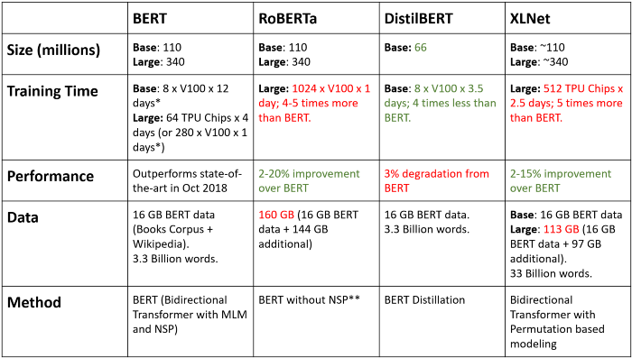


Different BERT-based models

Slide 29
Let’s see some of them
https://huggingface.co/bert-base-uncased
https://huggingface.co/PlanTL-GOB-ES/roberta-base-bne
https://huggingface.co/Recognai/distilbert-base-es-multilingual-cased

Slide 30
References
https://lilianweng.github.io/lil-log/2018/06/24/attention-attention.html
https://towardsdatascience.com/evolution-of-language-models-n-grams-word-embeddings-attention-transformers-a688151825d2
https://www.topbots.com/leading-nlp-language-models-2020/
https://towardsdatascience.com/bert-roberta-distilbert-xlnet-which-one-to-use-3d5ab82ba5f8
https://towardsdatascience.com/bert-explained-state-of-the-art-language-model-for-nlp-f8b21a9b6270
https://jalammar.github.io/illustrated-bert/
https://www.analyticsvidhya.com/blog/2019/09/demystifying-bert-groundbreaking-nlp-framework/
https://towardsdatascience.com/bert-explained-state-of-the-art-language-model-for-nlp-f8b21a9b6270
https://jalammar.github.io/illustrated-gpt2/

Slide 31
Muppets session 2: Language Models
Ontology Engineering Group
Universidad Politécnica de Madrid, Spain
Pablo Calleja
Notes:
Bert and ernie

Slide 32

Call for Demo day
GPU experiments analysis session
AKA Why the hell this code does not run in this GPU and works in others?

Slide 33
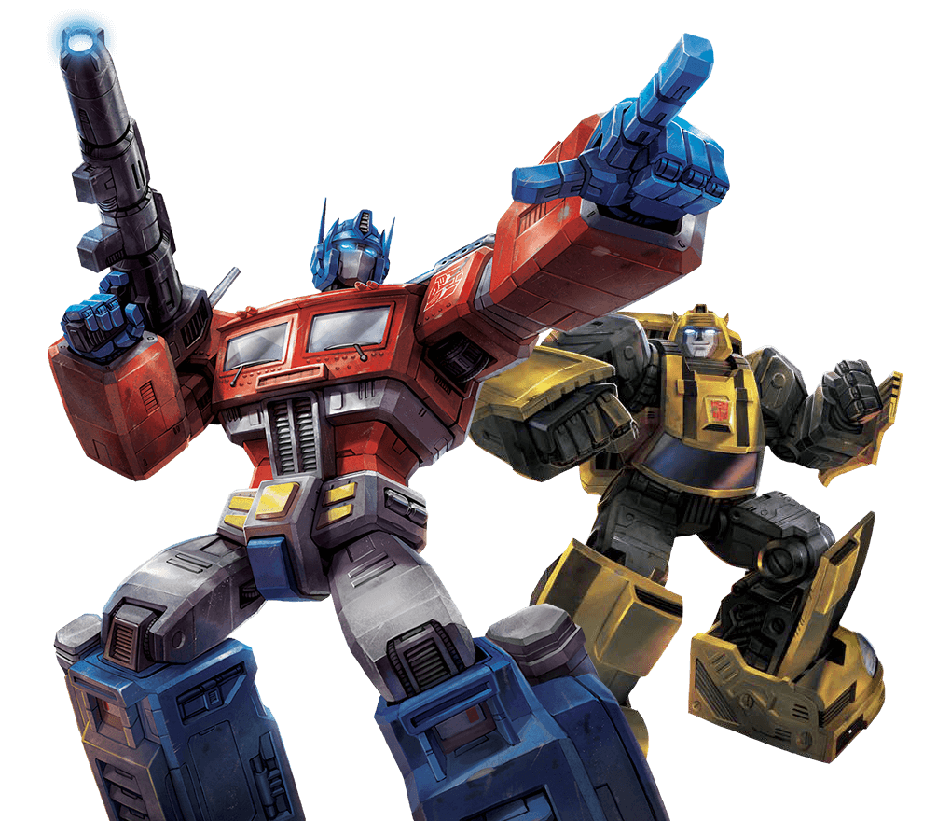
The era of transformers
Ontology Engineering Group
Universidad Politécnica de Madrid, Spain
Pablo Calleja

Slide 34
Neural Machine Translation. Antecesors
Recurrent Neural Netwoks - LSTM
Output
Output of I
Output of am
Output of a
Output of student
Part of the output
Context Vector
Input
I
am
a
student

Slide 35
Neural Machine Translation. Recap
Representation example
MT
Encoder
Decoder
Context Vector
Je
suis
Scores / attention weightt
Attention vector
I
am
a
student
<Start>
Je
I am a student
Je suis étudiant

Slide 36

The overview o the transformer
Decoder
Encoder
Lets go step by step

Slide 37
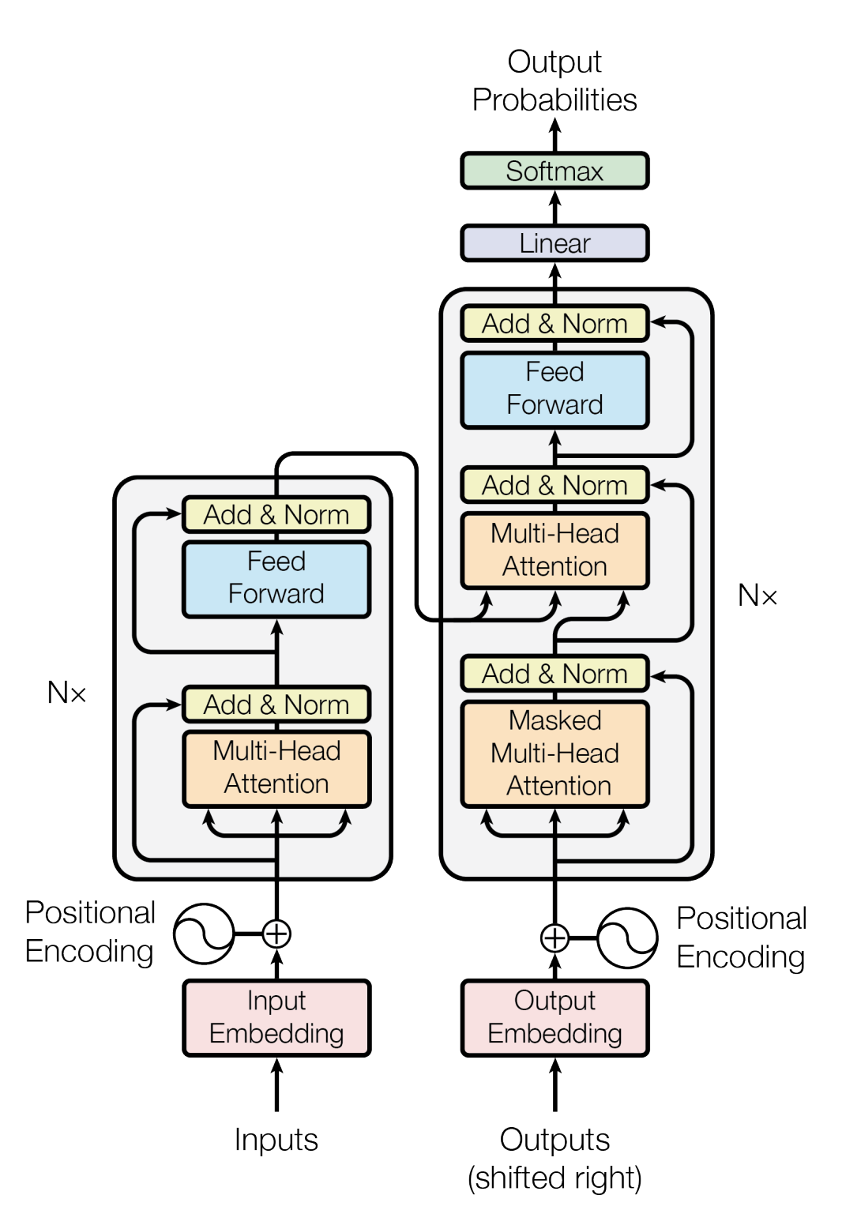
The Transformer. Inputs in the model
INPUT EMBEDDING
I am a student
0.1
student =
0.54
0.29

Slide 38
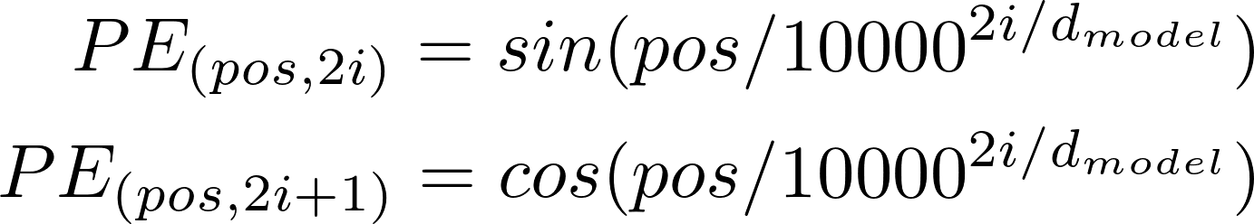
The Transformer. Inputs in the model
Positional Input embeddings
Positional encoding
+
+
+
+
Time Step
1
2
3
4
Notes:
give the model some information about the relative position of the words in the sentence

Slide 39
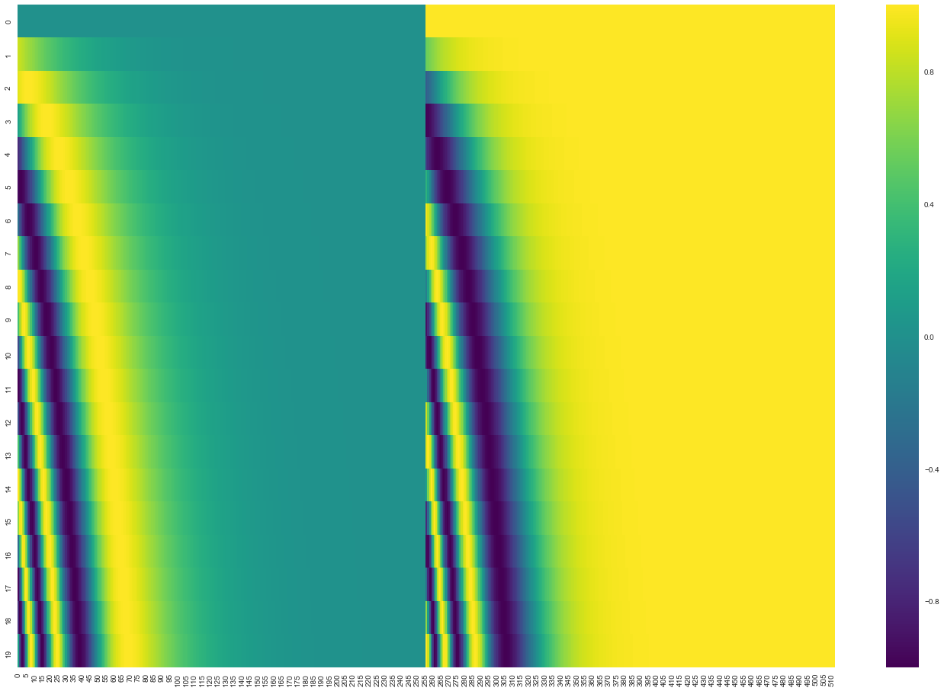
The Transformer. Inputs in the model
Sine
Cosine
Notes:
give the model some information about the relative position of the words in the sentence

Slide 40
The Transformer. Encoder Layer
Encoder Input Representation
Encoder Layer
Positional Input embeddings

Slide 41
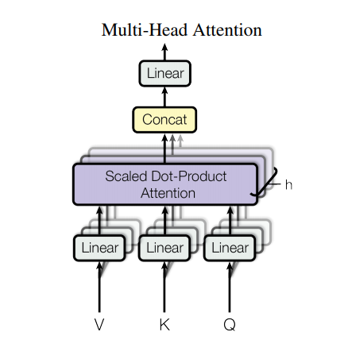
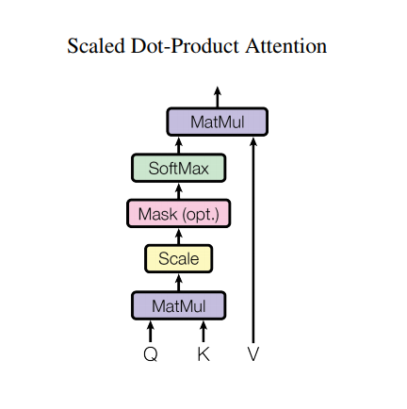
The Transformer. Multihead attention
Positional Input embeddings

Slide 42
The Transformer. Multihead attention
Linear
Concat
query
key
value
MatMul
SoftMax
Linear
Linear
Linear
Scale
MatMul
Linear
Linear
Linear
Positional Input embeddings
Q
K
V

Slide 43
The Transformer. Multihead attention
Linear
Concat
query
key
scores
MatMul
X
=
SoftMax
I am a student
I
am
a
student
10
98
27
65
Scale
27
89
31
67
MatMul
10
31
91
54
12
67
54
92
Linear
Linear
Linear
Q
K
V

Slide 44
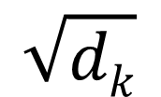
The Transformer. Multihead attention
Linear
Concat
MatMul
scores
SoftMax
Scaled Scores
=
$$\sqrt{dk}$$
Scale
MatMul
To allow more stable gradients
Linear
Linear
Linear
Q
K
V

Slide 45
The Transformer. Multihead attention
Linear
Concat
attention weights
value
output
X
=
MatMul
SoftMax
Scale
MatMul
Linear
Linear
Linear
Linear
Q
K
V

Slide 46
The Transformer. Multihead attention
Linear
Concat
Head
Hx
MatMul
Concat
SoftMax
Scale
Self Attention Head 1
Self Attention Head 2
MatMul
q
k
v
q
k
v
Linear
Linear
Linear
Split
Q
K
V
Notes:
Multi-head attention allows the model to jointly attend to information from different representation subspaces at different positions. With a single attention head, averaging inhibits this.

Slide 47
The Transformer. Encoder
LayerNorm:
+
Linear
Relu
Linear
LayerNorm:
+
Multi-head attention output
Positional Input embeddings

Slide 48
The Transformer. Multihead attention
Transformer Encoder N
N times
Transformer Encoder 1

Slide 49
The overview o the transformer
Decoder

Slide 50
The Transformer. Decoder
Je
suis
étudiant
<end>
I
Transformer Decoder
am
a
student
<start>
Je
suis
étudiant

Slide 51
The Transformer. Decoder
Linear
Concat
MatMul
SoftMax
Mask
Scale
MatMul
Linear
Linear
Linear
Q
K
V

Slide 52
The Transformer. Decoder
Linear
Concat
Look-Ahead Mask
MatMul
0
-inf
-inf
-inf
SoftMax
0
0
-inf
-inf
Mask
0
0
0
-inf
Scale
0
0
0
0
MatMul
Linear
Linear
Linear
Q
K
V

Slide 53
The Transformer. Decoder
Linear
Concat
<start>
Je
suis
étudiant
MatMul
0.8
0
0
0
<start>
SoftMax
0.1
0.6
0
0
Je
Mask
0.1
0.1
0.8
0
suis
Scale
0.1
0.4
0.3
0.6
étudiant
MatMul
Linear
Linear
Linear
Q
K
V

Slide 54
The Transformer. Decoder
Multi-head Attention 2
Q
K
V
Decoder
Encoder
Encoder

Slide 55
The Transformer. Decoder
Je
N Class (vocab size)
Softmax
N Class (vocab size)
Linear (Classifier)

Slide 56
The Transformer. Interesting resouces
Text Generation Example:
https://transformer.huggingface.co/doc/distil-gpt2
Attention visualization
https://colab.research.google.com/github/tensorflow/tensor2tensor/blob/master/tensor2tensor/notebooks/hello_t2t.ipynb#scrollTo=OJKU36QAfqOC

Slide 57
Bibliography
https://lilianweng.github.io/lil-log/2018/06/24/attention-attention.html#:~:text=Self%2Dattention%2C%20also%20known%20as,summarization%2C%20or%20image%20description%20generation
https://towardsdatascience.com/illustrated-self-attention-2d627e33b20a
https://towardsdatascience.com/attn-illustrated-attention-5ec4ad276ee3
https://www.youtube.com/watch?v=4Bdc55j80l8
https://www.youtube.com/watch?v=S27pHKBEp30
https://www.tensorflow.org/tutorials/text/nmt_with_attention?hl=en
https://www.tensorflow.org/tutorials/text/transformer?hl=en
https://towardsdatascience.com/illustrated-guide-to-transformers-step-by-step-explanation-f74876522bc0

